Slide 1
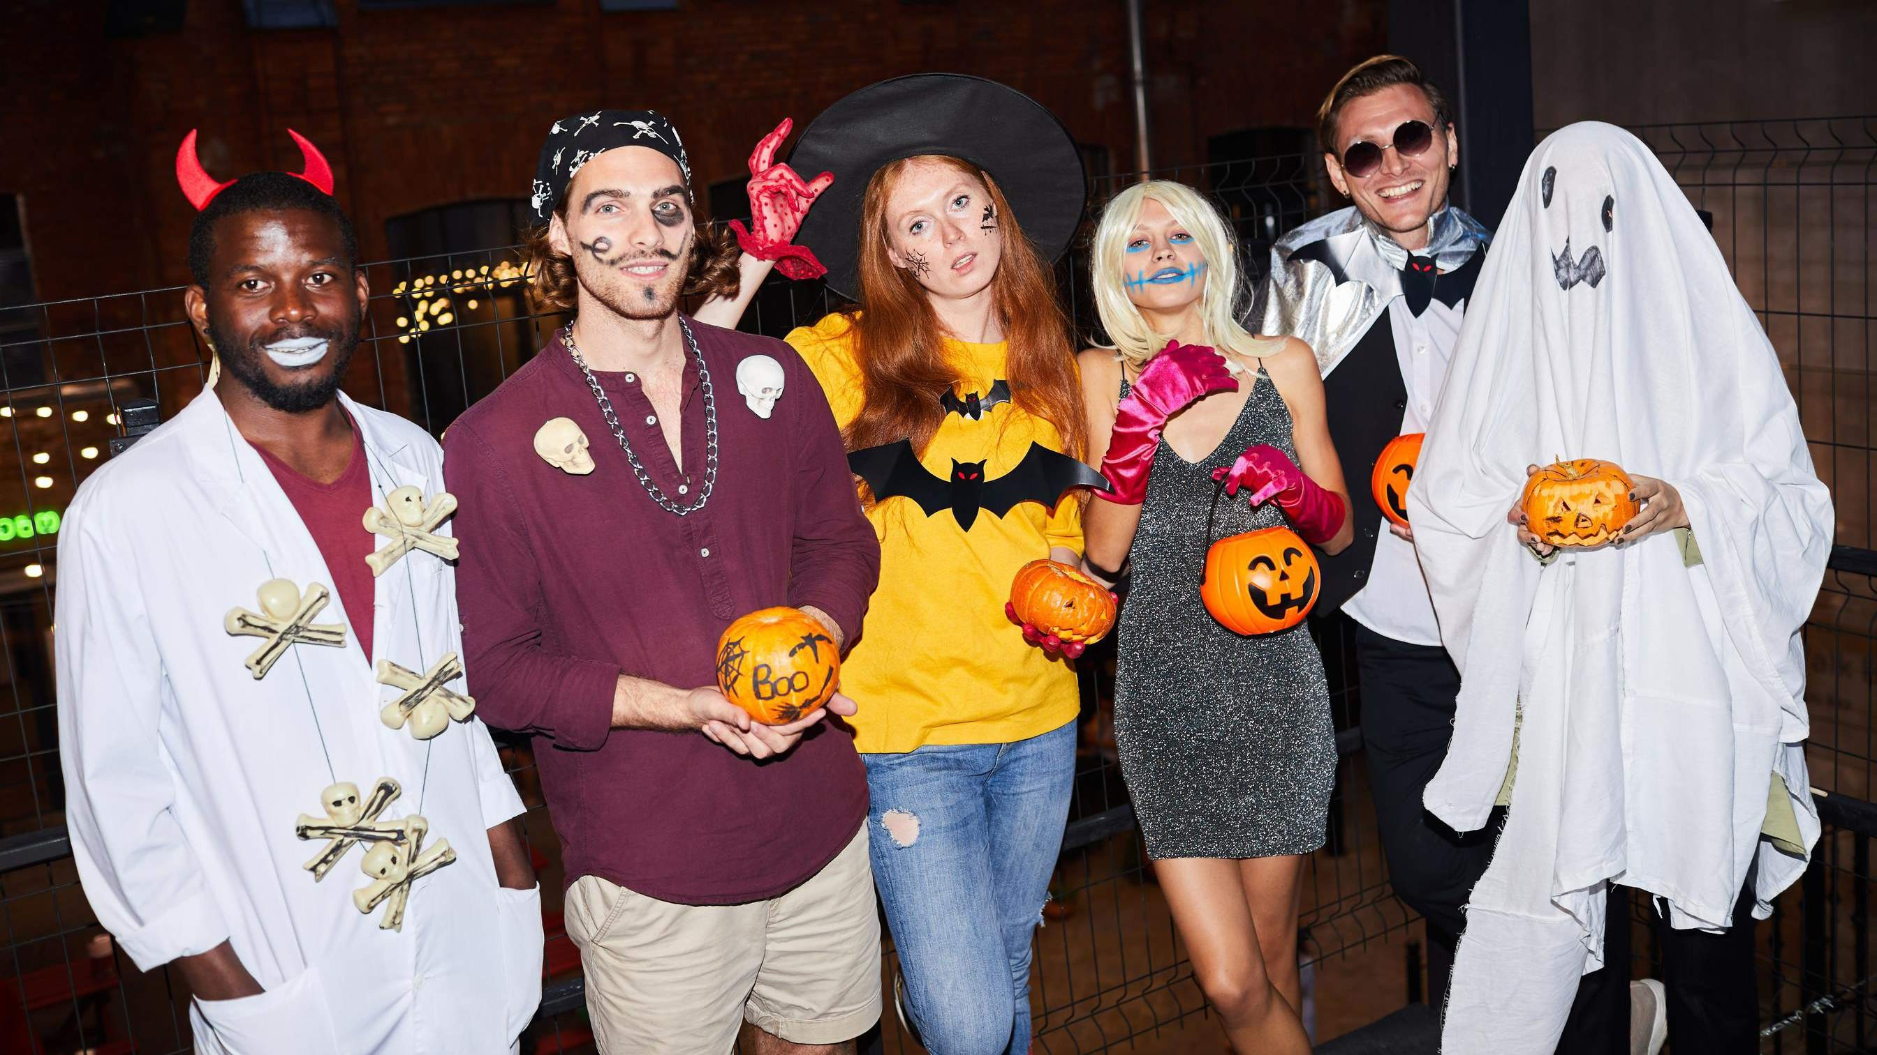




Global,Regional,CountryAnalysis

Slide 2
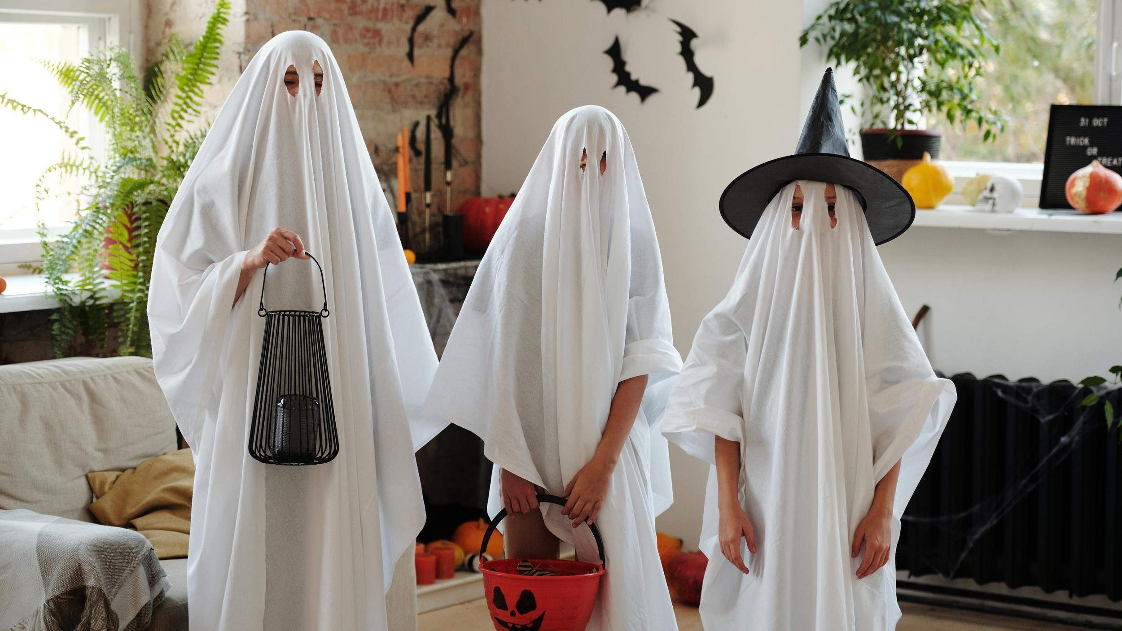
INTRODUCTION
The Halloween costumes market is a vibrant and booming industry centered on celebrating Halloween, a celebratory occasion where people of all ages dress up in various costumes to represent characters, creatures, or themes. Traditional eerie clothes such as witches, vampires, and zombies can be worn, as well as pop culture celebrities, superheroes, and innovative DIY options. The industry caters to a diverse population, including children, adults, and even pets, and includes a wide range of themes and designs, ranging from terrifying to charming and hilarious. Retailers, both physical and online, stock a wide variety of costumes and accessories, making it a seasonal industry that sees a spike in demand in the weeks leading up to Halloween, with a growing trend toward innovative and customizable costume alternatives.

Slide 3
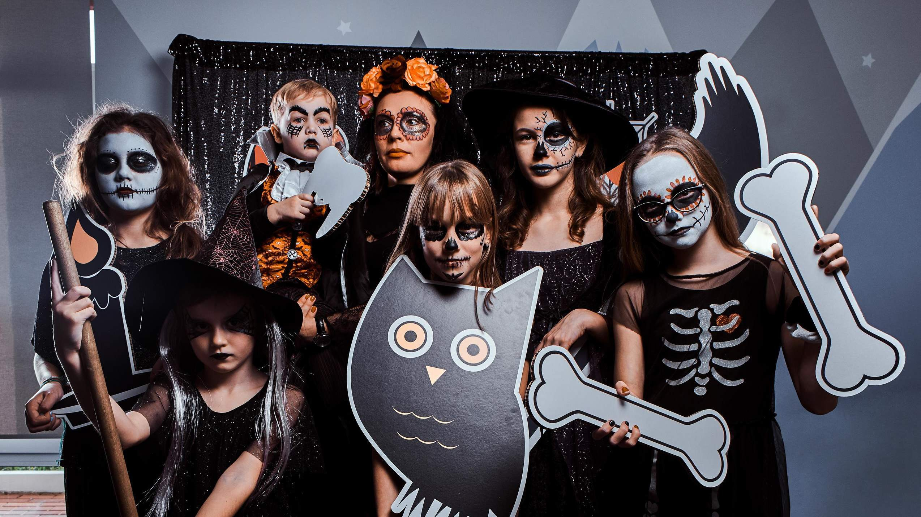

KEY INSIGHTS
20₋23
CAGR 5.0%
2030

Slide 4
REVENUE MARKET SHARE BY SEGMENTS 2022
Costumes
Costume Shoes
Masks & Accessories
Type Segment
Men's Costumes
Women's Costumes
Girls' Costumes
Boys' Costumes
Baby Costumes
End-User Segment

Slide 5
Global Halloween Costumes Market Revenue share for 2022
North America 40 %

Slide 6
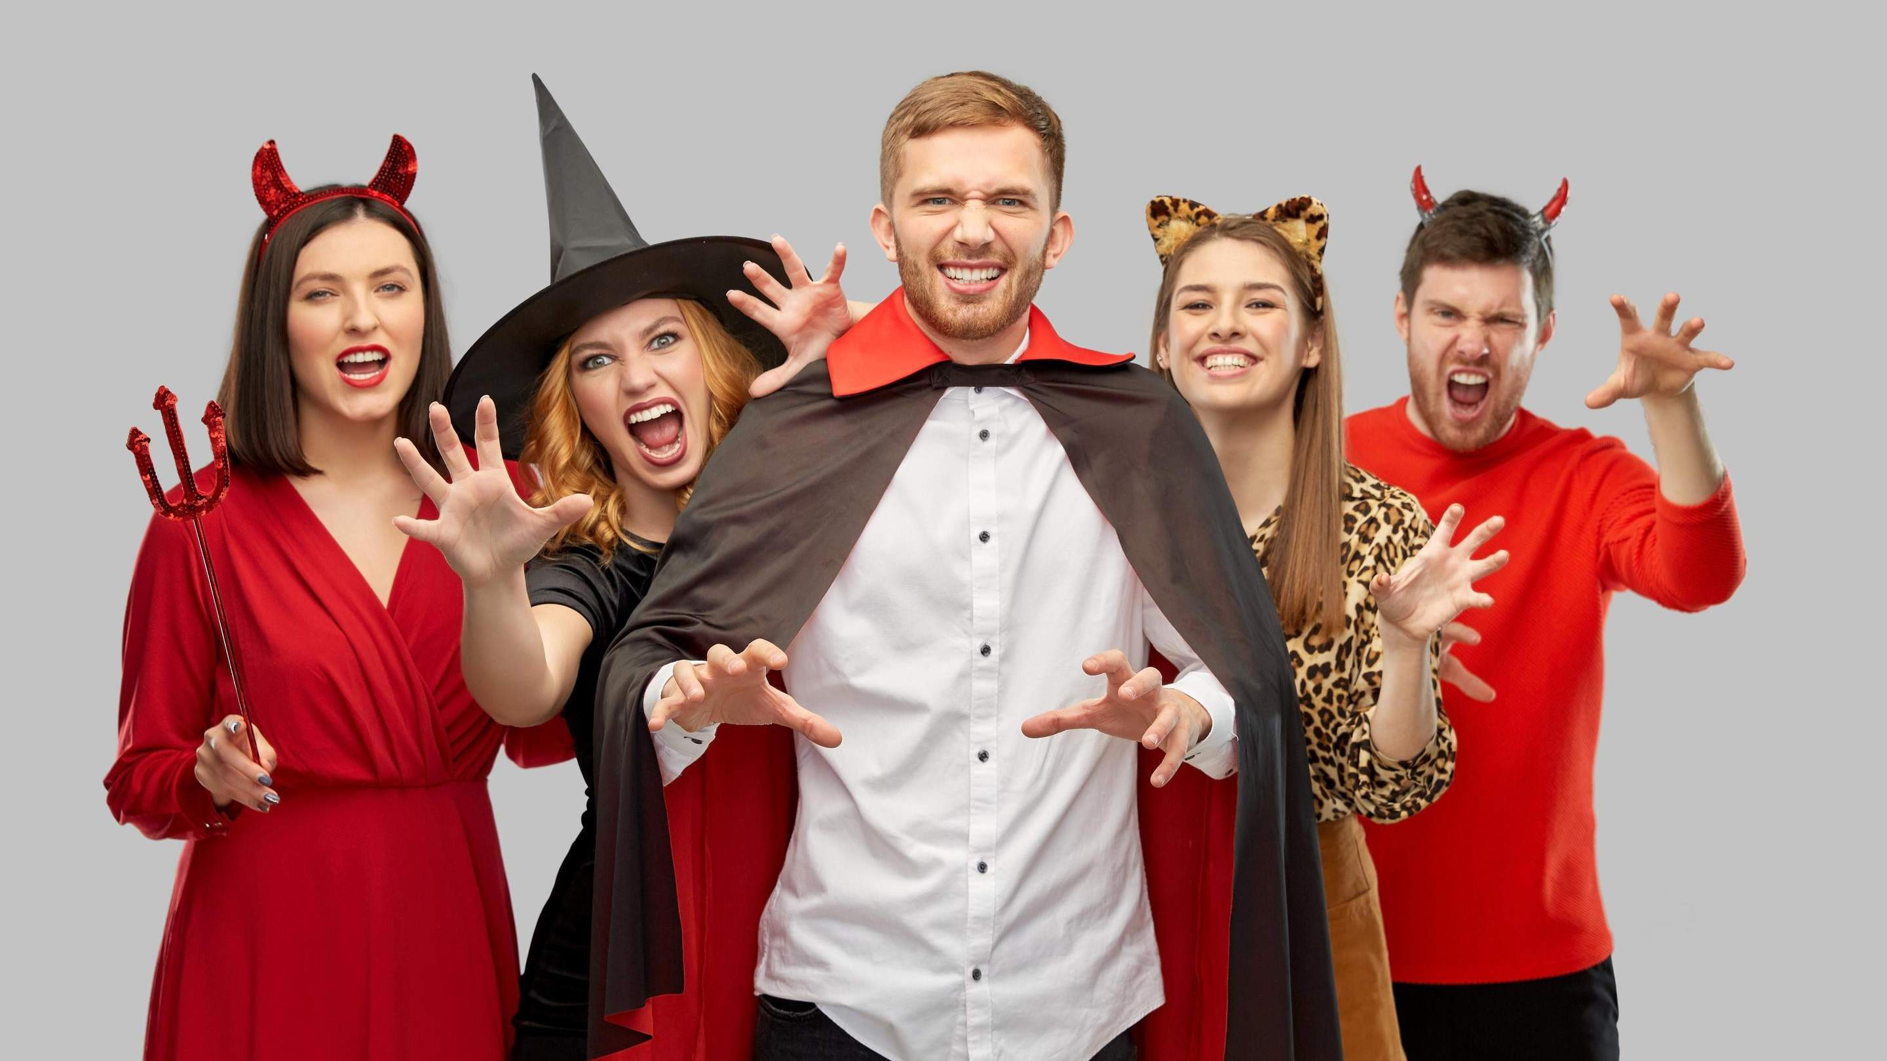



Slide 7
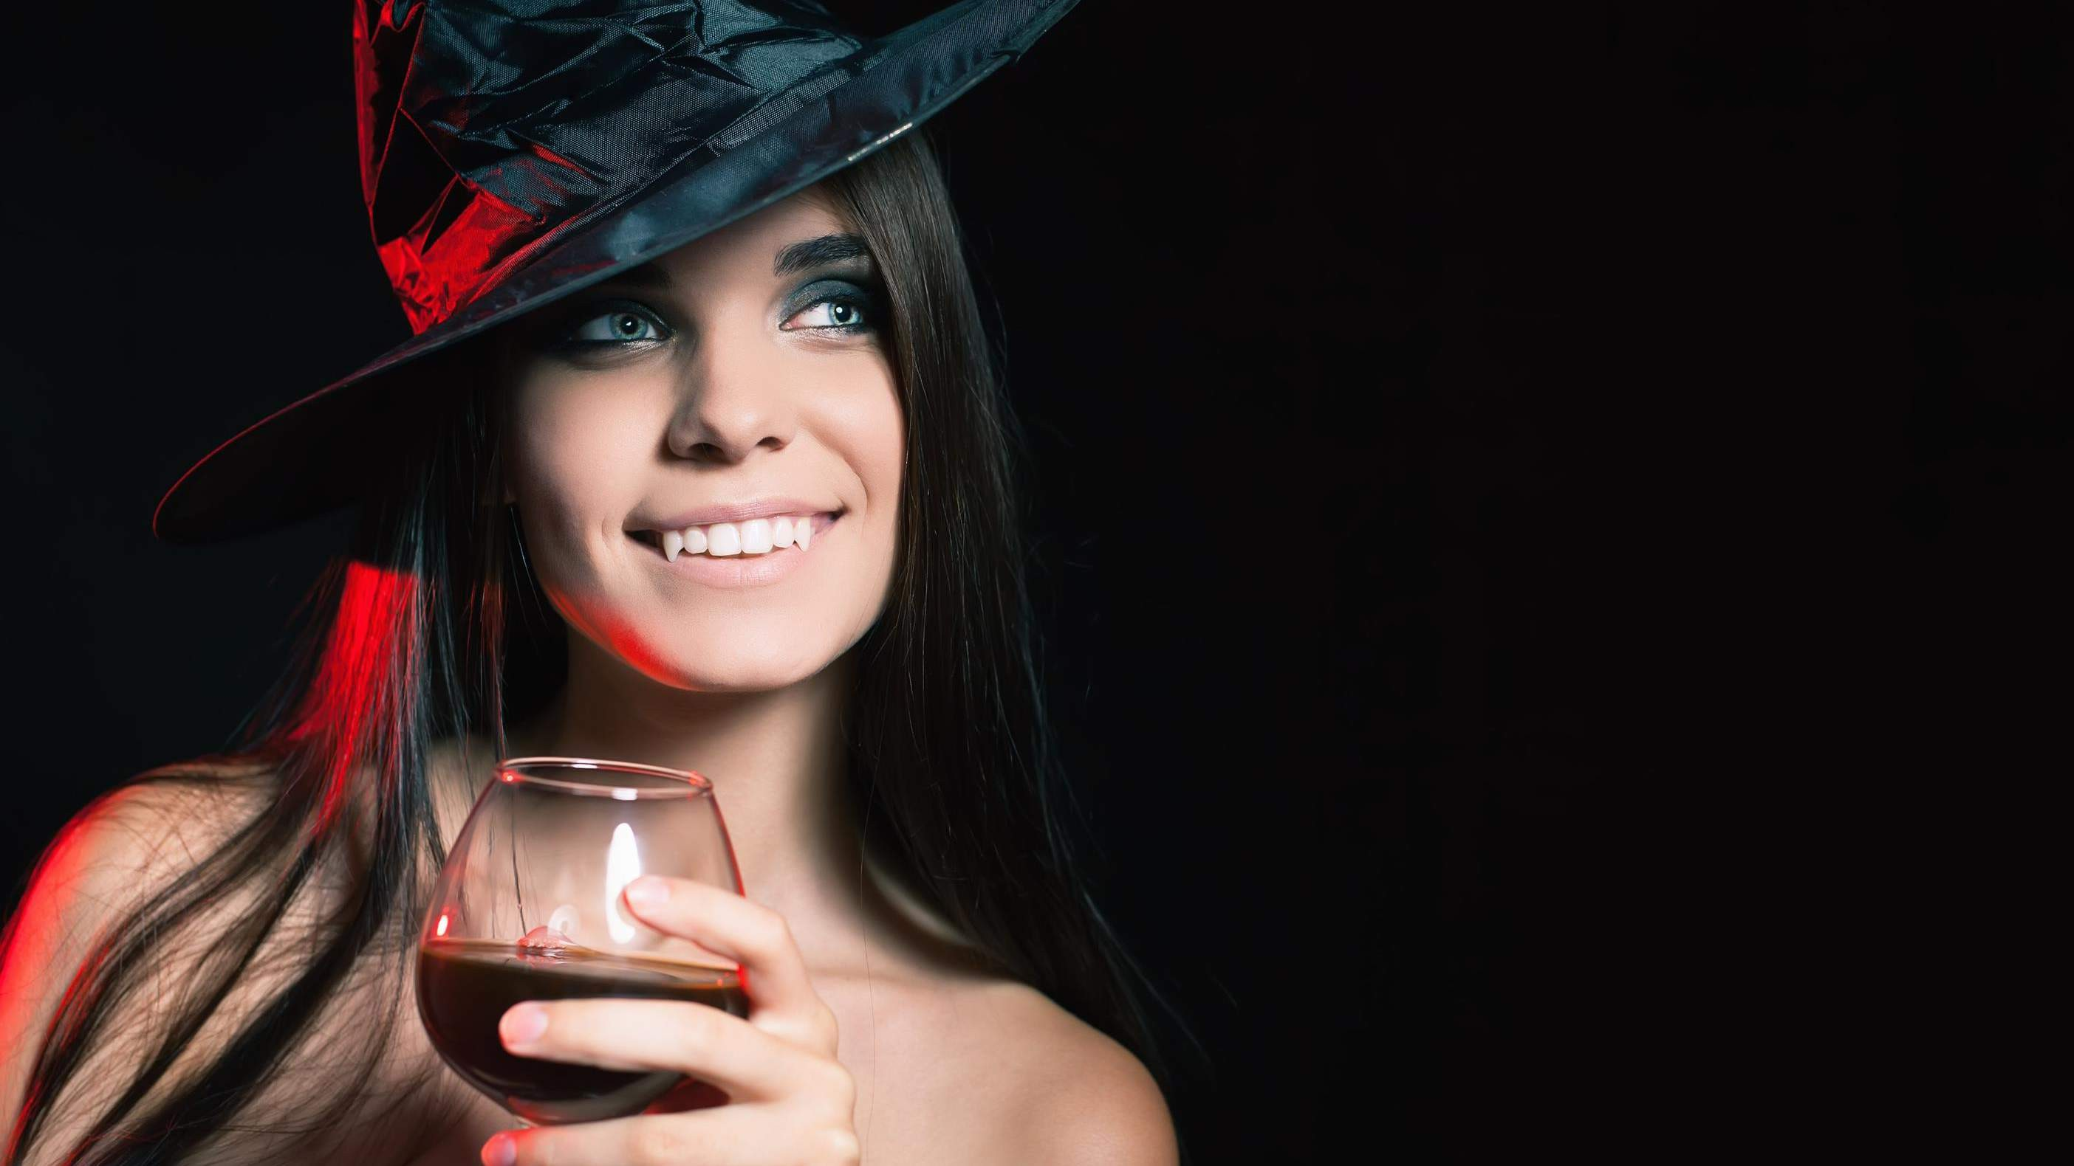
AUTHOR'S PERSPECTIVE
The Global Halloween Costumes Market is witnessing significant growth in the near future.
The Masks and accessories sector is a major growth driver in the Halloween
Costumes Product market. Masks, makeup, and costume accessories are necessary for completing and enhancing Halloween costumes.
Men's costumes range in topic from classic to current, terrifying to comical, character-based to unique DIY
ensembles.

Slide 8
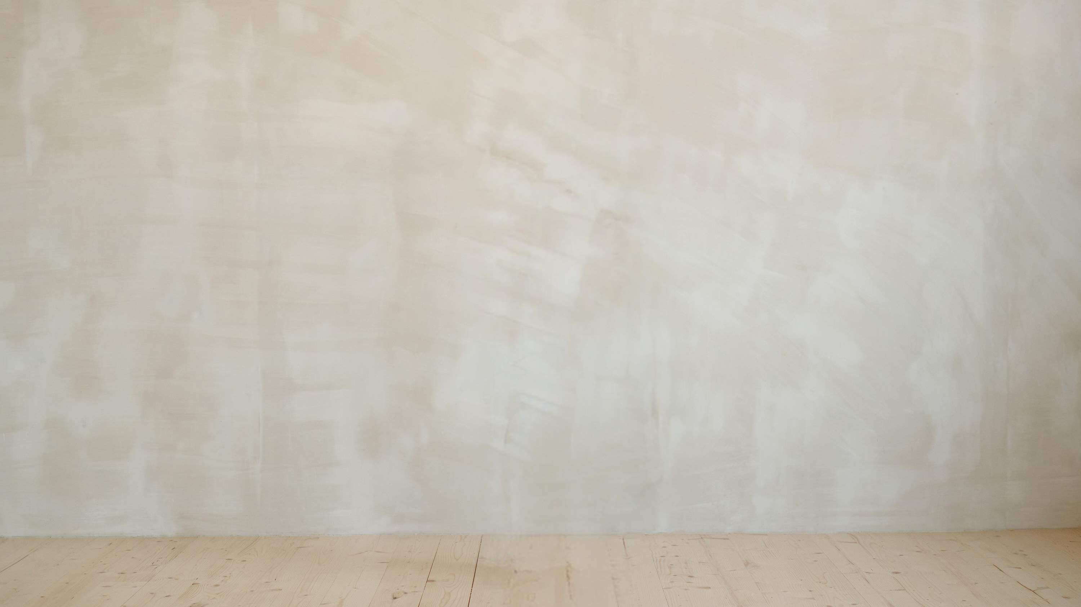
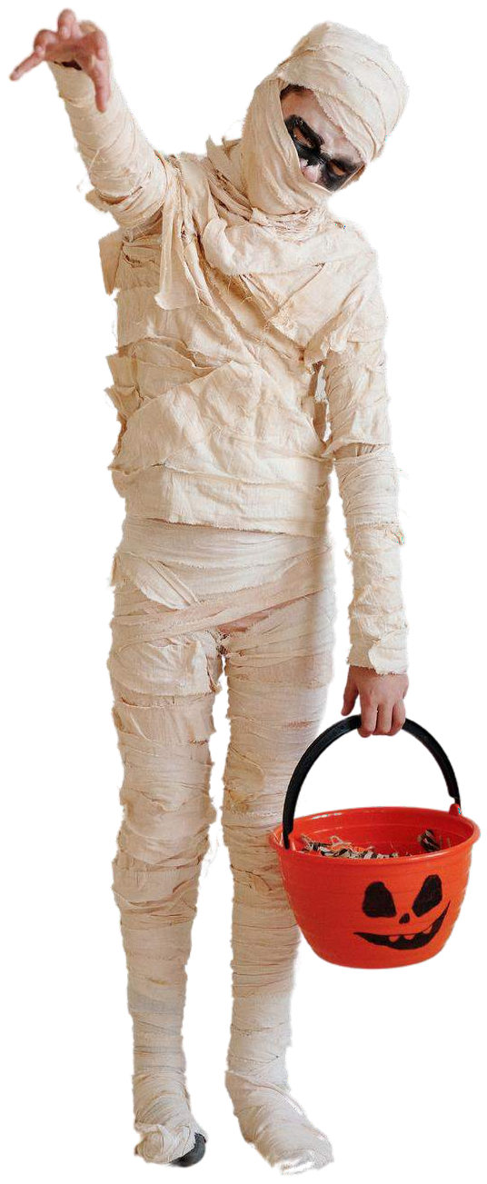
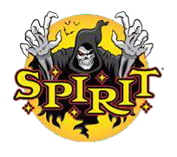

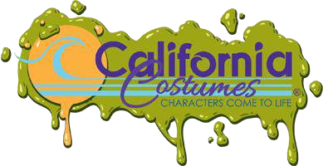
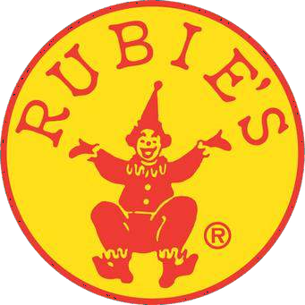


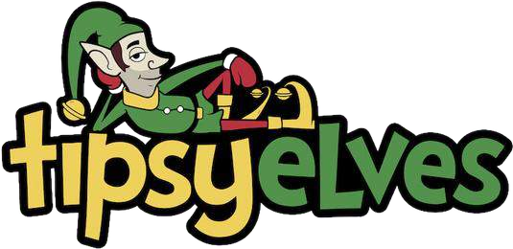

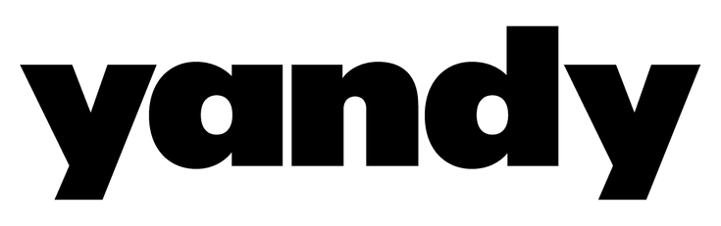
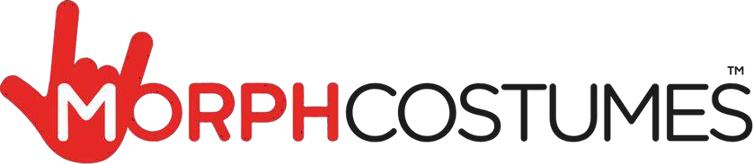
KEY PLAYERS

Slide 9


Contact us
For Full Report
COGNITIVE MARKET RESEARCH
Tel: + 1 312 - 376 - 8303 | + 44 020 - 8123 - 0732
India: ( + 91 ) 983 - 496 - 8611
sales@ cognitivemarketresearch. com
Access the Full Report : http://tinyurl.com/4fwxpes2
Please visit our website:
https://www.cognitivemarketresearch.com

