Slide 1

GLOBAL
HAIR SHAMPOO
MARKET REPORT
2024
Global,Regional,CountryAnalysis

Slide 2

INTRODUCTION
Hair care product shampoo is a thick liquid used for cleaning hair, aiming to remove unwanted build-up without stripping too much sebum, making hair more manageable. Typically, shampoo consists of a surfactant like sodium lauryl sulfate or sodium laureth sulfate mixed with a co-surfactant such as Cocamidopropyl betaine in water. The market is driven by the growing popularity of herbal shampoo and the high demand for this product.

Slide 3


KEY INSIGHTS
MARKET SIZE
USD 30.6 billion
2023
CAGR
4.80%
2023- 2030

Slide 4

REVENUE MARKET SHARE BY SEGMENTS 2022
  Health
  Anti-Dandruff
  Herbal
Product Type Segment
  Hypermarkets and Supermarkets
  Department Stores
  Specialty Retailers
Application Segment

Slide 5
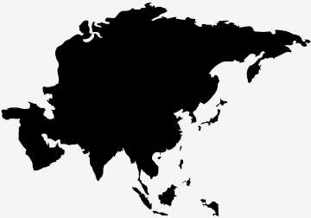
Global Hair Shampoo Market Revenue share for 2024
Asia-Pacific
USD 11.32 billion

Slide 6
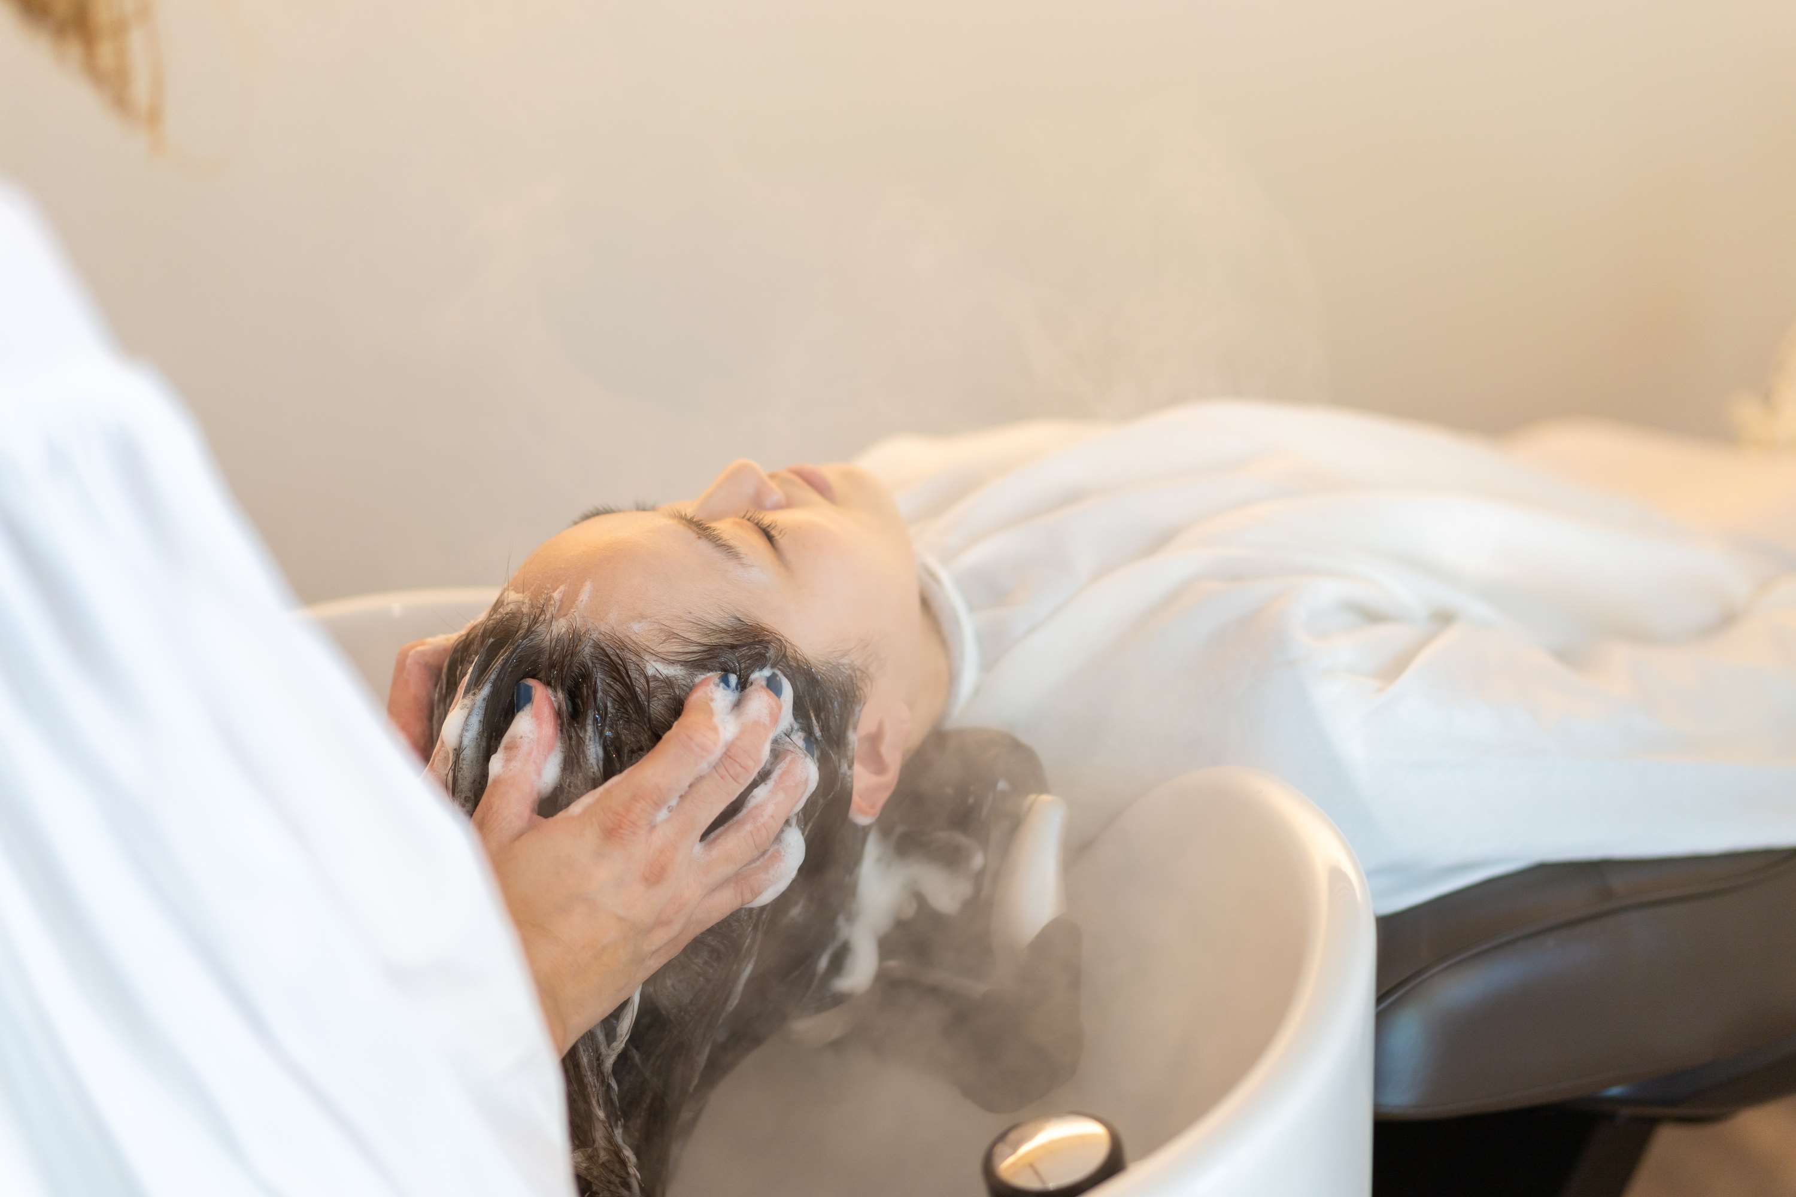
Shifting Consumer Preferences towards Sustainable and Natural Products to Propel Market Growth
Drivers
Saturation and Intense Competition to Restrict Market Growth
Restraints

Slide 7
AUTHOR'S PERSPECTIVE
  The Global Hair Shampoo Market is witnessing significant growth in the near future.
  Fueled by the global shift towards natural and plant-based beauty products, herbal shampoos experience rapid growth.
  Consumers are increasingly drawn to formulations featuring botanical extracts, herbs, and natural ingredients known for their hair-nourishing properties.
  Herbal shampoos cater to the rising demand for clean beauty, free from harsh chemicals, sulfates, and synthetic fragrances.
  Hypermarkets and supermarkets provide consumers with a convenient one-stop shopping experience, enabling them to compare and choose from a diverse range of shampoos based on brand, type, and price.
  Specialty retailers often stock premium and specialized shampoos, including those targeting specific hair concerns or featuring natural and organic formulations.

Slide 8









KEY PLAYERS

Slide 9


For Full Report
Contact us
COGNITIVE MARKET RESEARCH
Tel: +1 312-376-8303 | +44 020-8123-0732
India: (+91) 983-496-8611
sales@cognitivemarketresearch.com
Access the Full Report : https://tinyurl.com/yfdjz2mw
Please visit our website:
https://www.cognitivemarketresearch.com

