Slide 1

GLOBAL
GUITAR BAG
MARKET REPORT
2024
Global,Regional,CountryAnalysis

Slide 2

INTRODUCTION
A guitar bag is a specially designed bag with padding that shields a guitar from dirt, dust, and other harm caused by the environment. It usually includes compartments for spare strings, picks, and other accessories. Additionally, it is equipped with a shoulder strap for convenient transportation, and certain models even offer extra pockets for carrying miscellaneous items. It is a necessary accessory for any individual who plays the guitar. The rise in demand for lightweight and long-lasting guitar bags, as well as the increasing desire for personalized options, has contributed to the growth of this market.

Slide 3


KEY INSIGHTS
CAGR
5.36%
2024- 2031

Slide 4

REVENUE MARKET SHARE BY SEGMENTS 2022
  Acoustic & Classical Guitar Bags
  Bass Guitar Bags
  Electric Guitar Bags
Type Segment
  Personal
  Commercial
Application Segment

Slide 5

Global Guitar Bag Market Revenue share for 2024
North America
42%

Slide 6

Innovations in Design and Material Technology to Propel Market Growth
Drivers
Price Sensitivity and Economic Fluctuations to Hinder Market Growth
Restraints

Slide 7
AUTHOR'S PERSPECTIVE
  The Global Guitar Bag Market is witnessing significant growth in the near future.
  Electric guitar bags are designed with reinforced padding, multiple compartments for accessories, and ergonomic carrying options, catering to the needs of both amateur and professional guitarists.
  Commercial users include professional musicians, touring bands, recording studios, and music schools.

Slide 8
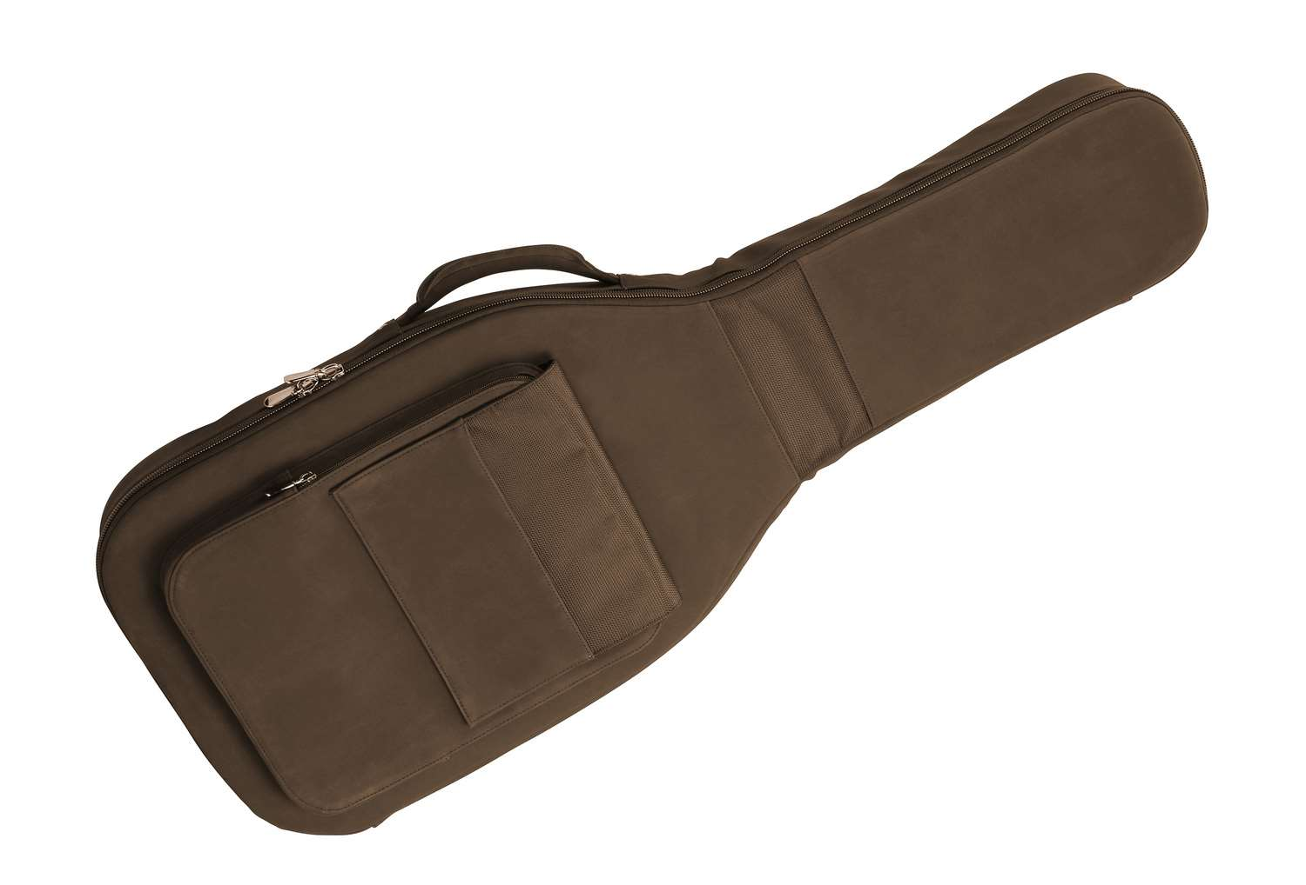









KEY PLAYERS

Slide 9


For Full Report
Contact us
COGNITIVE MARKET RESEARCH
Tel: +1 312-376-8303 | +44 020-8123-0732
India: (+91) 983-496-8611
sales@cognitivemarketresearch.com
Access the Full Report : https://tinyurl.com/4xvdyt3h
Please visit our website:
https://www.cognitivemarketresearch.com

