Slide 1
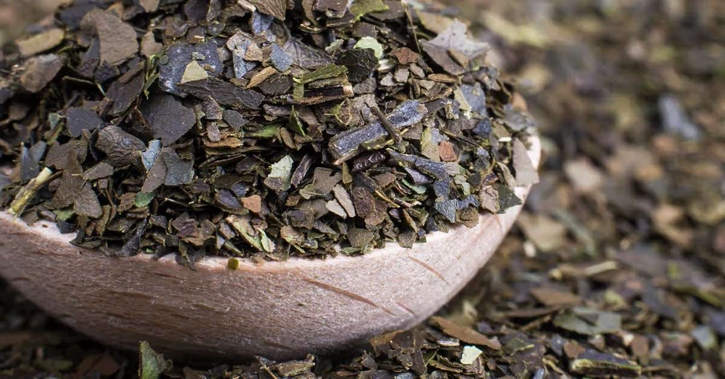
GLOBAL
GUAYUSA
MARKET REPORT
2024
Global,Regional,CountryAnalysis

Slide 2
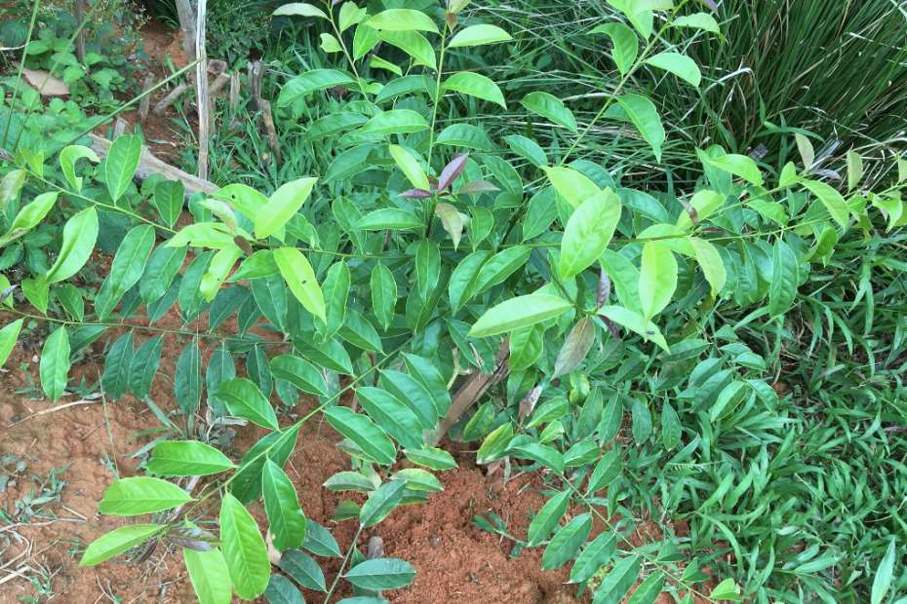
INTRODUCTION
Guayusa also contains antioxidants, vitamins, minerals, and amino acids that make it a healthy beverage choice. The flavor of Guayusa is earthy and slightly sweet, with notes of citrus and herbs. The rising realization of the health benefits of Guayusa is also contributing to the growth of this market. With the increase in the recognition of the benefits offered by the Guayusa plant, the manufacturers are engaged in developing ways to diversify their product portfolio. With the rising health concerns, consumers are inclined towards a healthier alternative, which, in turn, is expected to shift their preference to Guayusa tea.

Slide 3
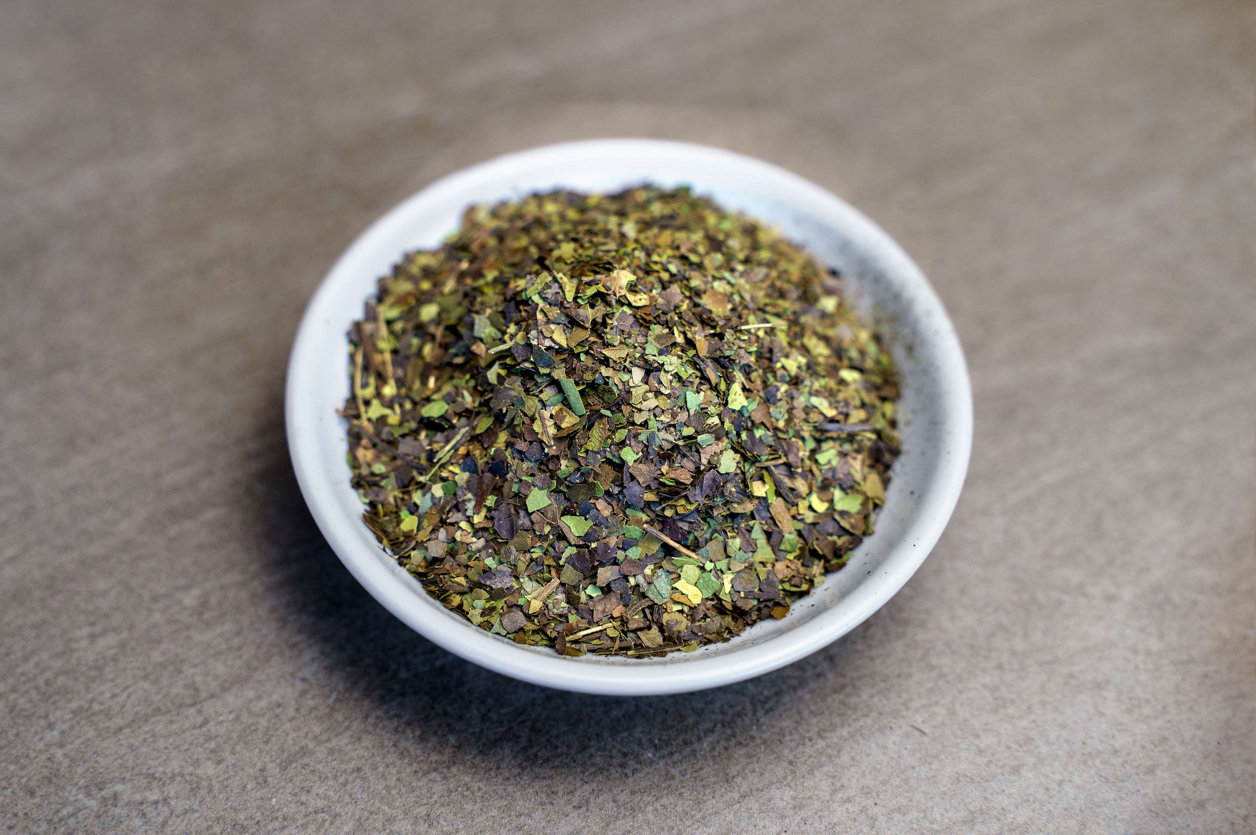

KEY INSIGHTS
MARKET SIZE
USD 0.08 billion
2023
CAGR
5.00%
2023- 2030

Slide 4
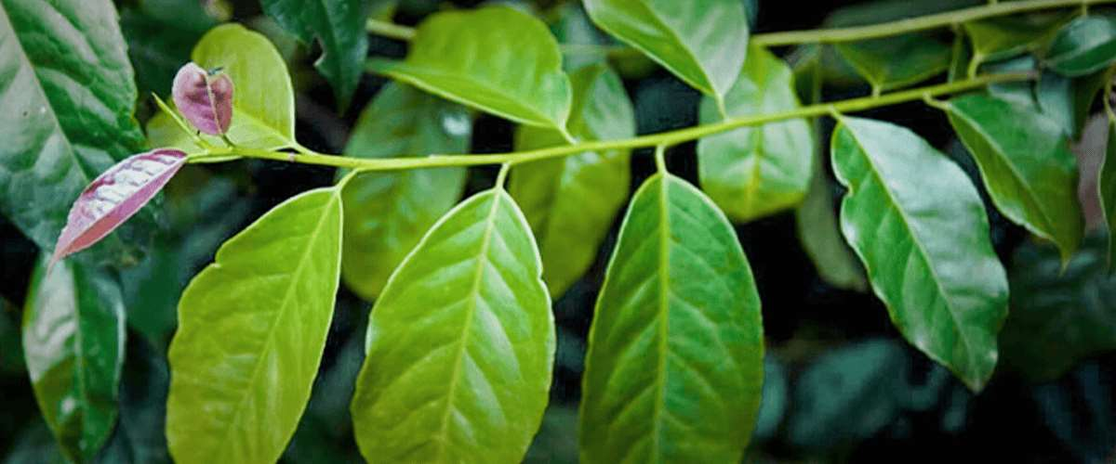
REVENUE MARKET SHARE BY SEGMENTS 2022
  Guayusa Extract
  Guayusa Leaf Extract
Type Segment
  Tea
  Energy Drinks
Application Segment

Slide 5

Global Guayusa Market Revenue share for 2024
North America
55%

Slide 6
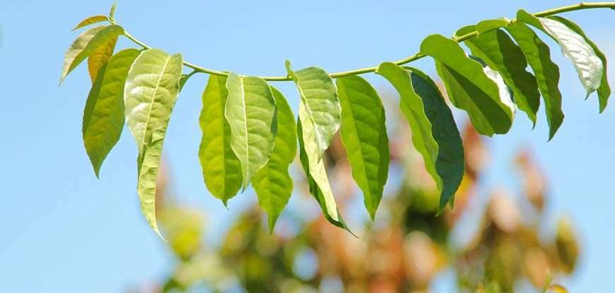
Ease of Distribution to Remain a Robust Growth to Propel Market Growth
Drivers
Excessive Consumption to Hinder Market Growth
Restraints

Slide 7
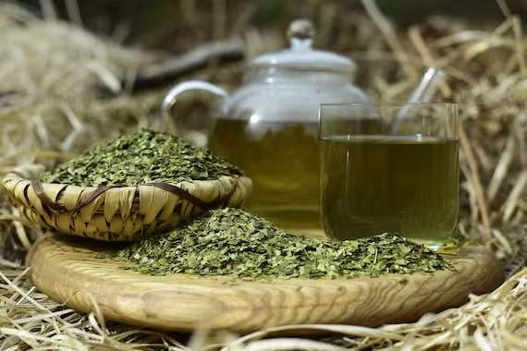
AUTHOR'S PERSPECTIVE
  The Global Guayusa Market is witnessing significant growth in the near future.
  Guayusa leaf, on the other hand, represents the whole, dried leaves of the Guayusa plant.
  Guayusa leaf is associated with traditional and functional beverage markets, appealing to those interested in sustained energy and mental clarity.
  Guayusa tea has gained popularity due to its rich, earthy flavor and its high caffeine content, which gives a natural and sustained energy boost.
  Guayusa is also a crucial ingredient in the production of energy drinks. Its high caffeine and antioxidant content make it an attractive choice for formulating natural energy-boosting beverages.

Slide 8
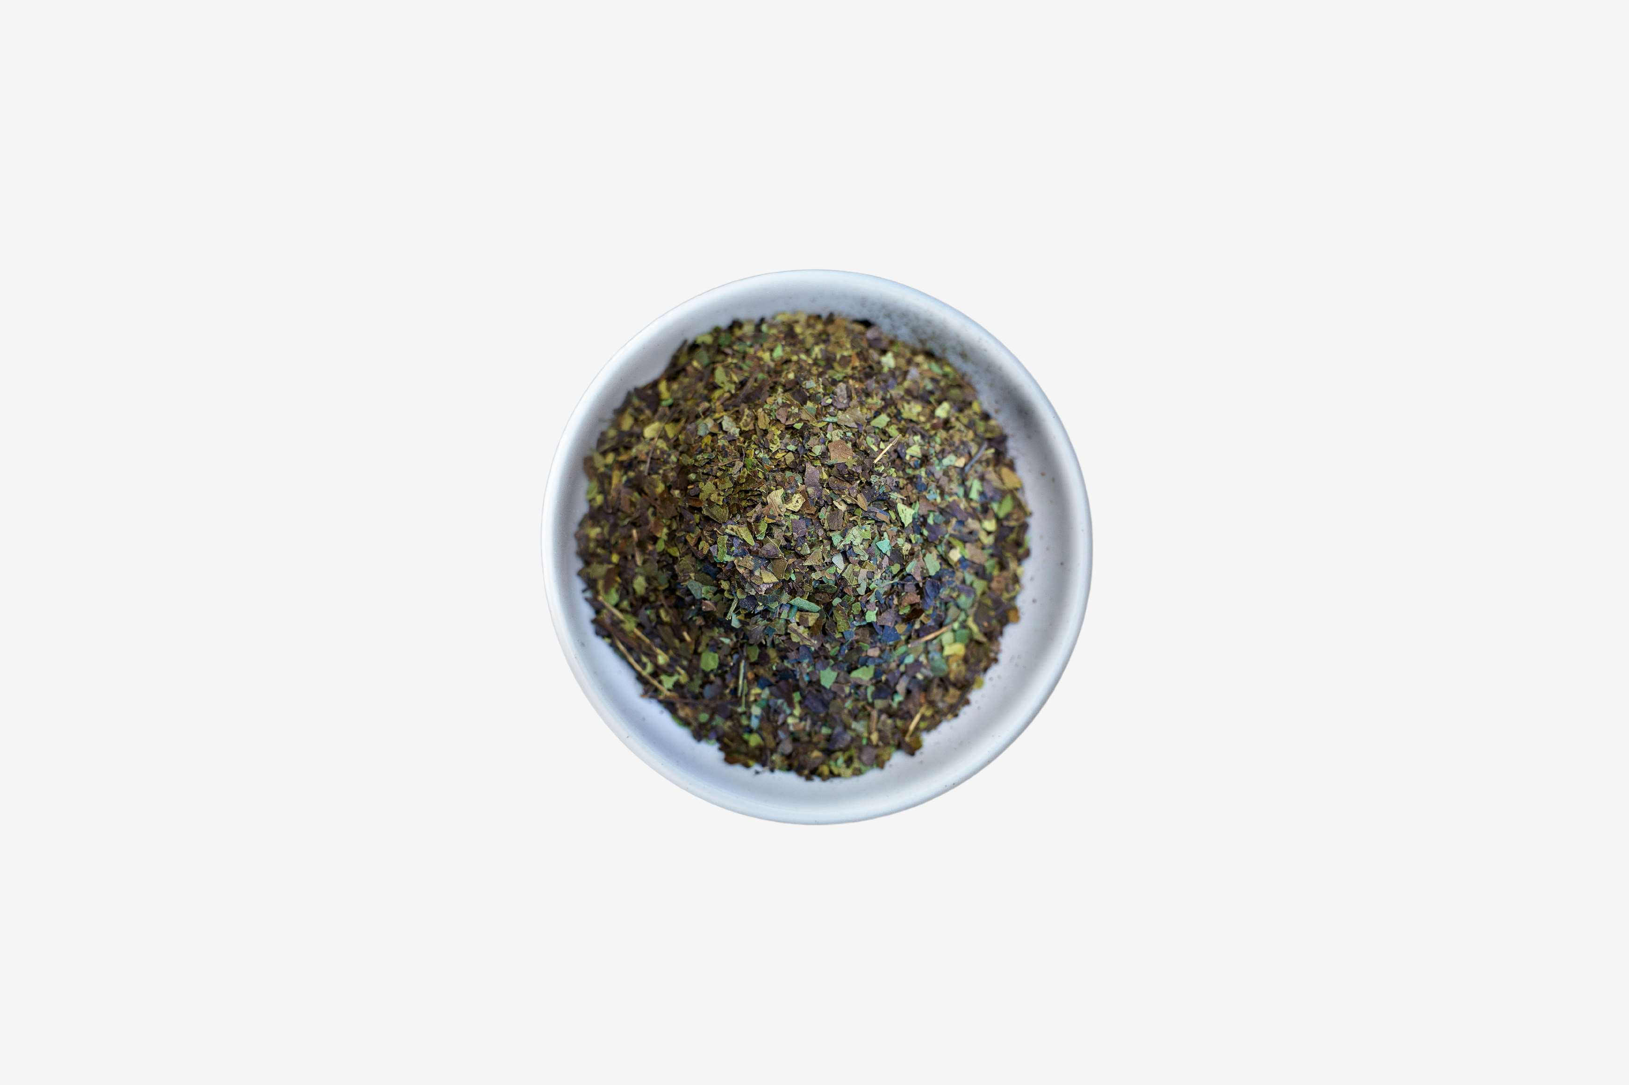







KEY PLAYERS

Slide 9


For Full Report
Contact us
COGNITIVE MARKET RESEARCH
Tel: +1 312-376-8303 | +44 020-8123-0732
India: (+91) 983-496-8611
sales@cognitivemarketresearch.com
Access the Full Report : https://tinyurl.com/f9wudfjv
Please visit our website:
https://www.cognitivemarketresearch.com

