Slide 1
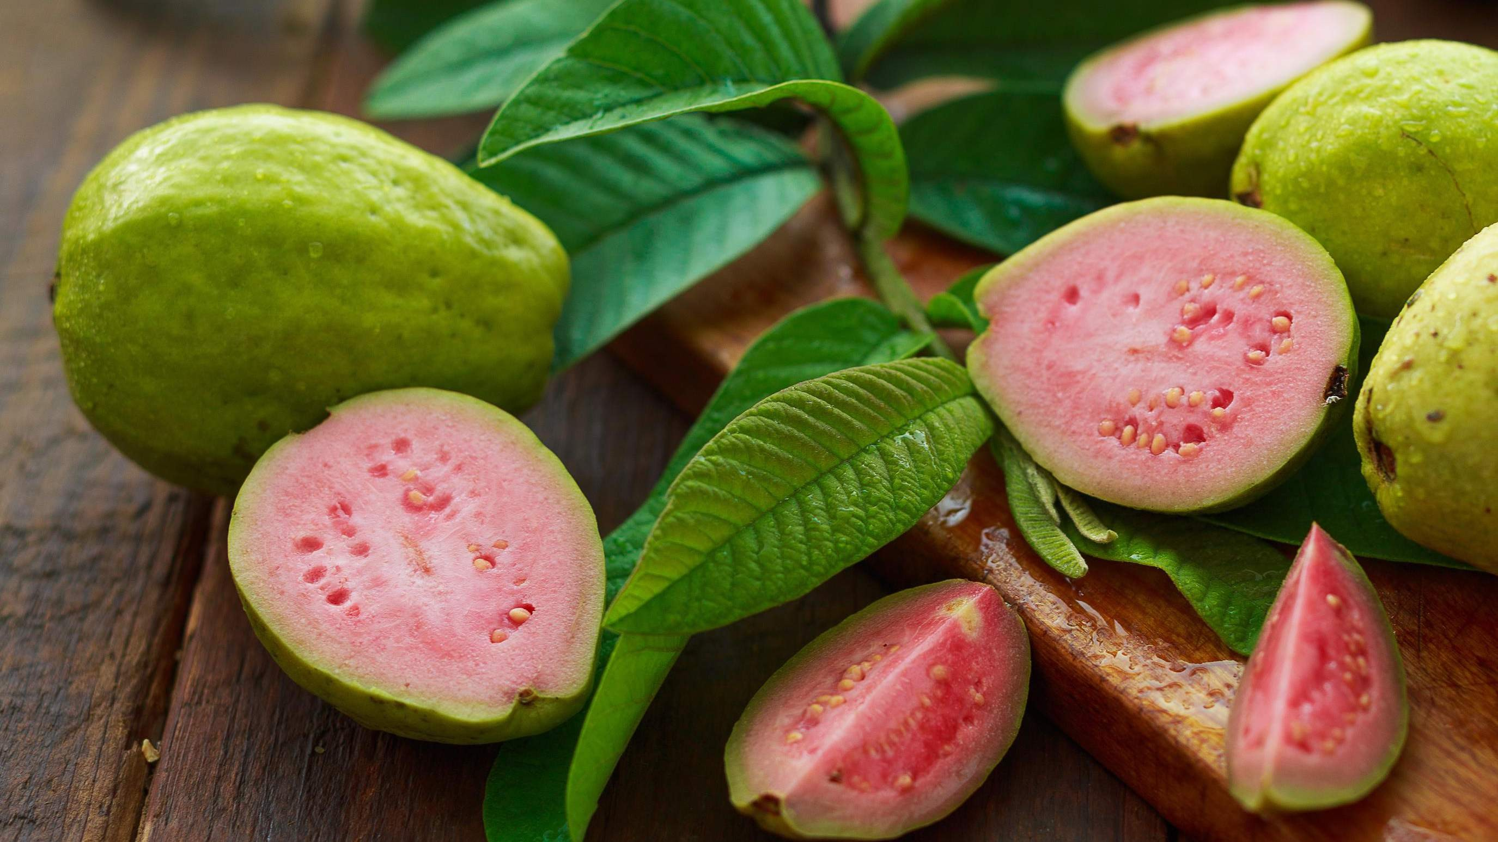
GLOBAL GUAVA
MARKET REPORT 2024
Global,Regional,CountryAnalysis

Slide 2
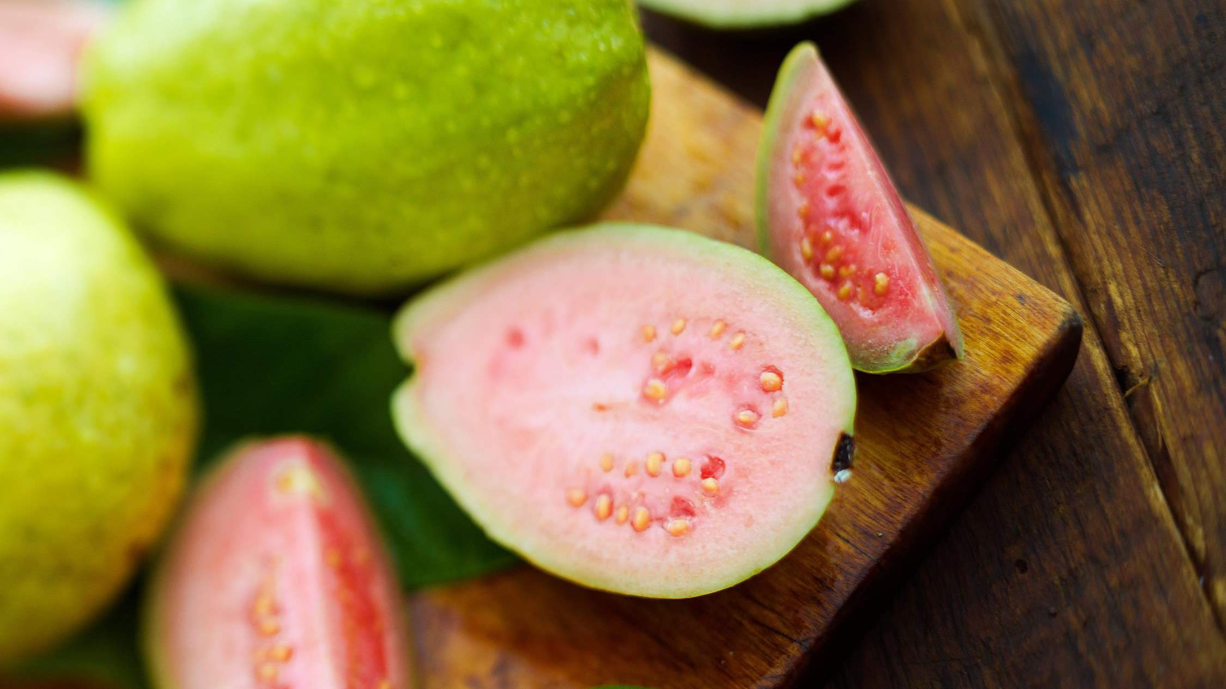
INTRODUCTION
Guava, a tropical fruit prized for its sweet-tangy flavour and nutritional richness, is characterized by its round or oval shape, typically with green or yellow skin and pink or white flesh filled with small seeds. Renowned for its high vitamin C content and antioxidants, guava finds versatile use in fresh consumption, juices, jams, and desserts. Native to Central America and the Caribbean, guava thrives in warm climates globally. With its refreshing taste and health benefits, guava stands as a symbol of tropical indulgence, offering a delightful sensory experience to consumers worldwide.

Slide 3
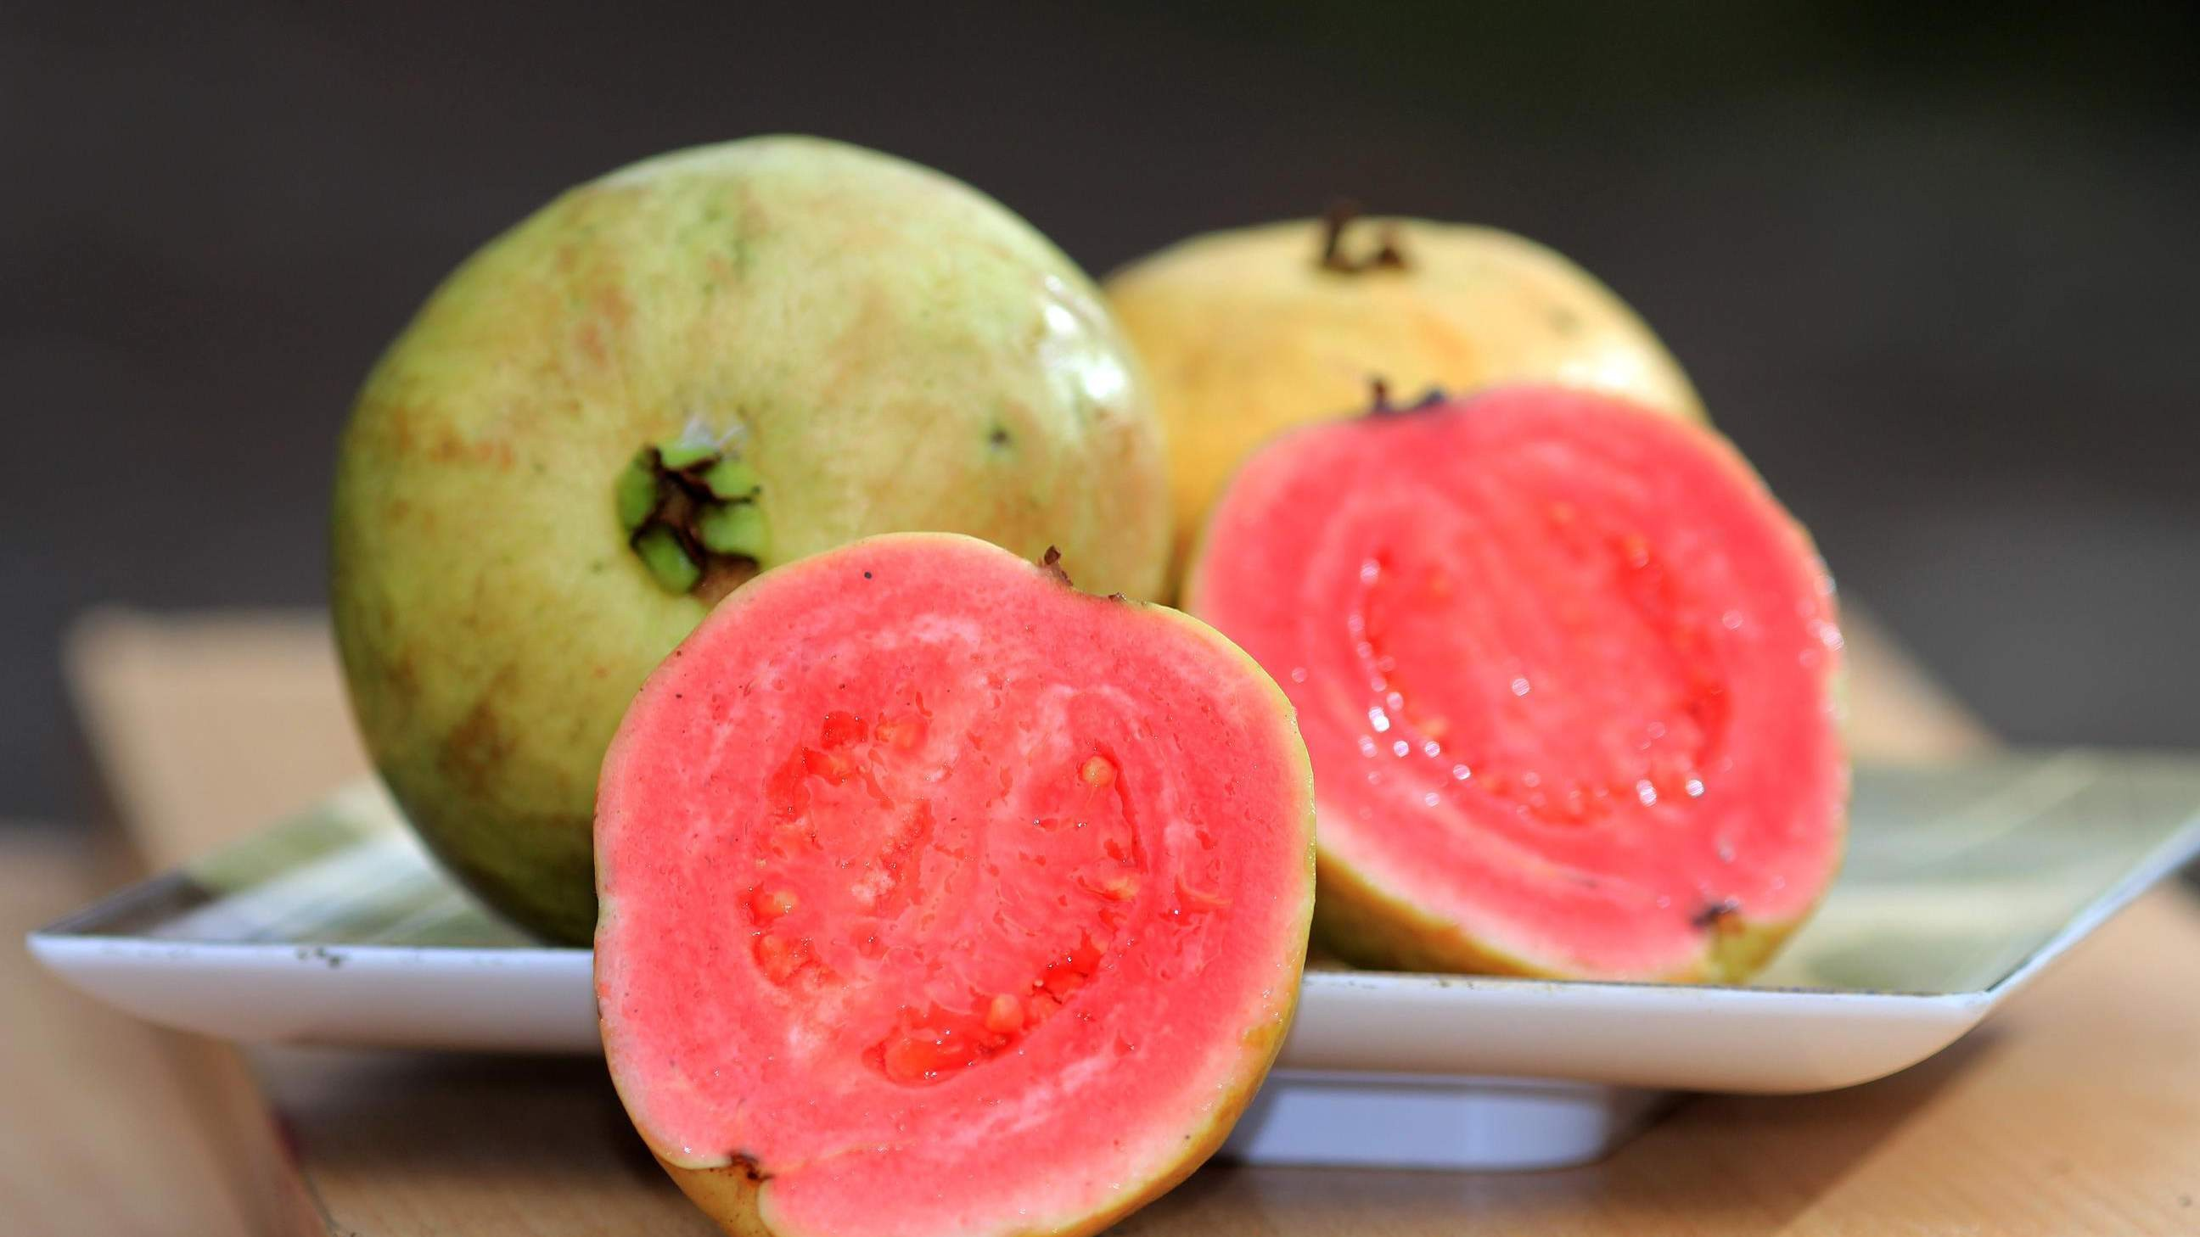

KEY INSIGHTS
MARKET SIZE
USD 968.2 million
2024
CAGR 4.70%
2024
-
2031

Slide 4
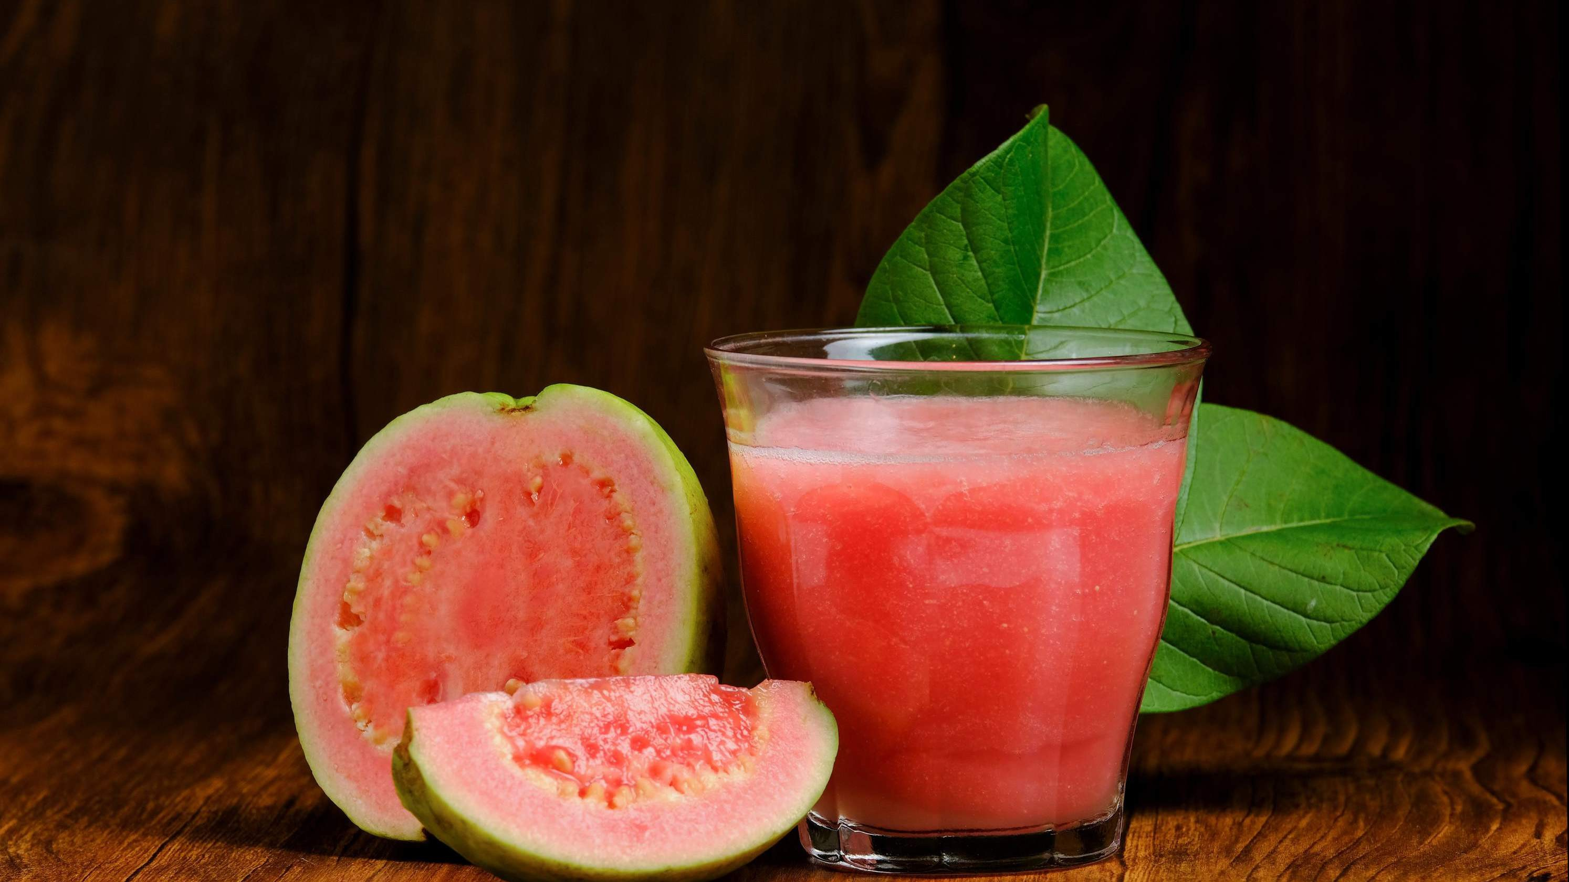
REVENUE MARKET SHARE BY SEGMENTS 2022
Food Industry
Beverage Industry
Pharmaceutical Industry
White Guava Pulp
Pink Guava Pulp
Product Segment
Application Segment
Online Retail
Supermarkets/Hyper markets
Convenience Stores
Fresh Fruit
Jam
Juice
Type Segment
Distribution channel

Slide 5
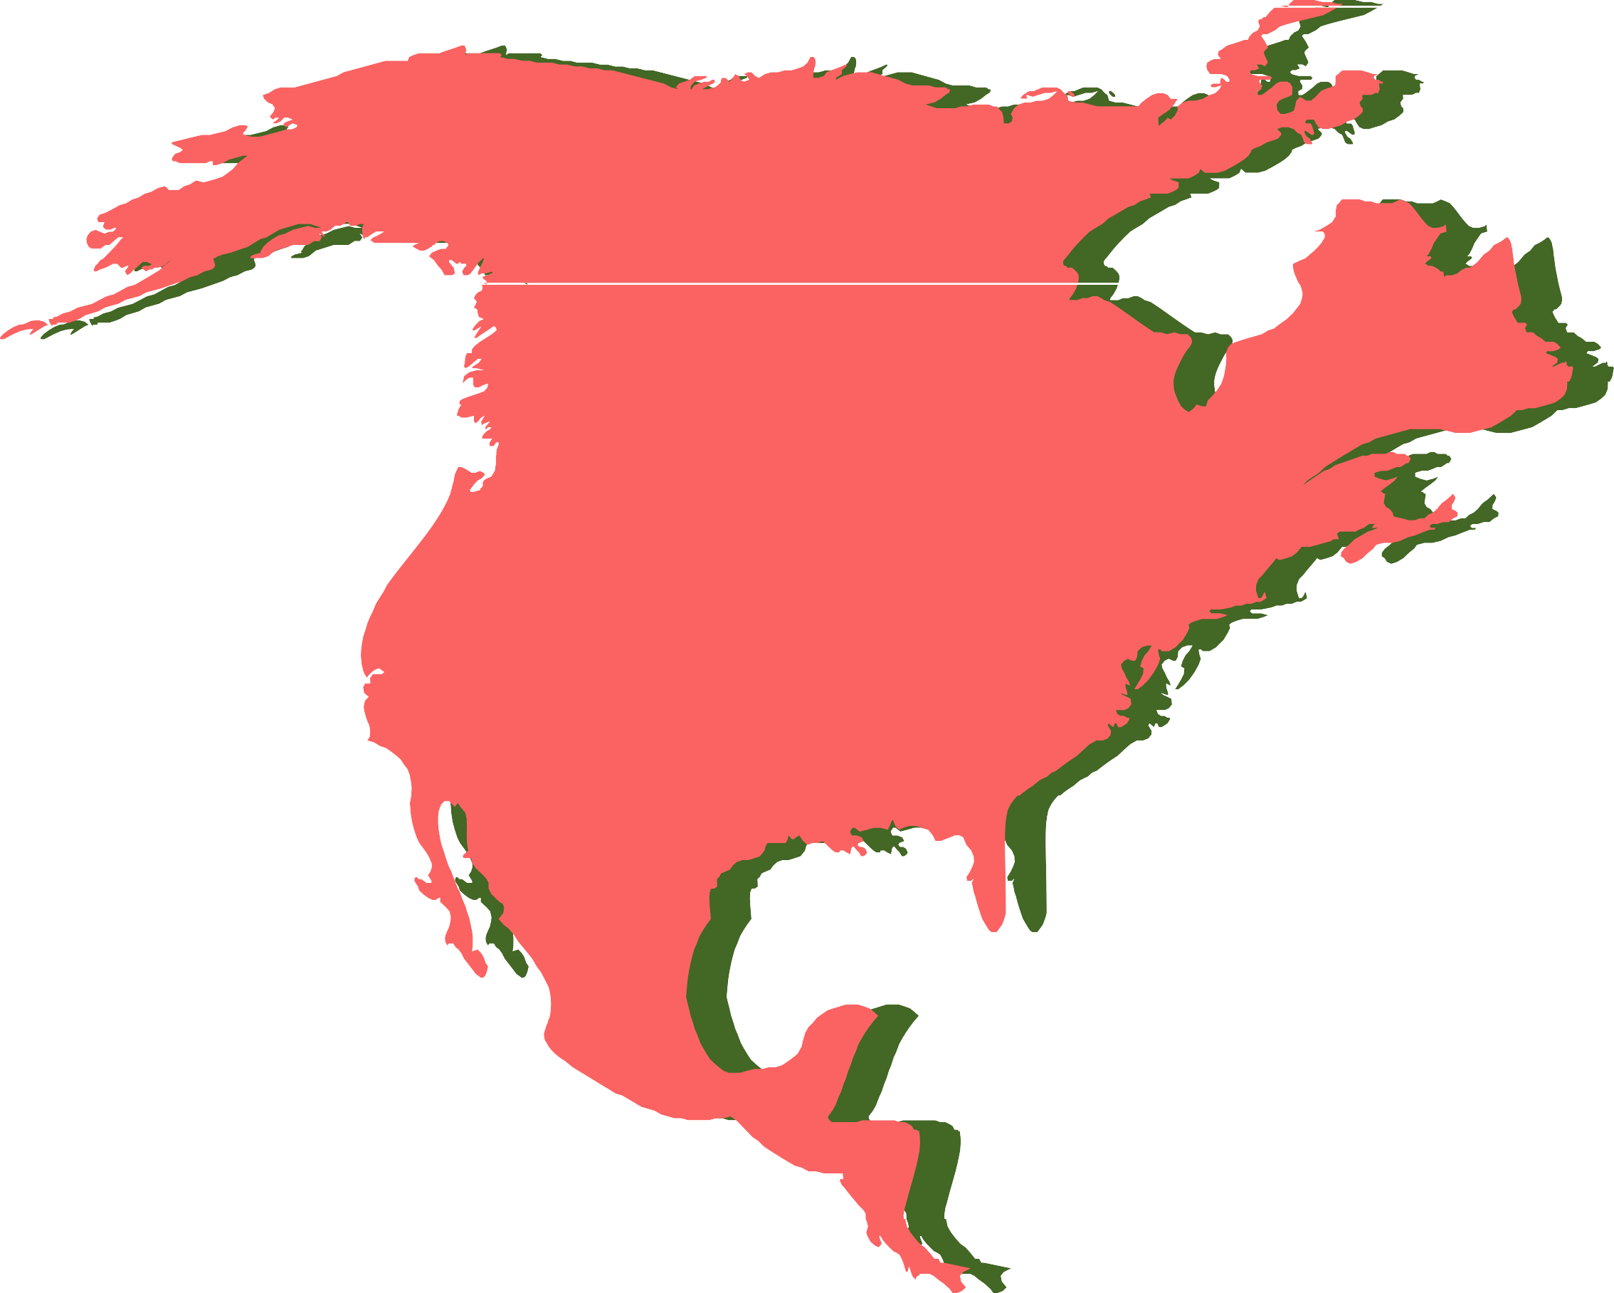
Global Guava Market Revenue share for 2024
North America 40%

Slide 6
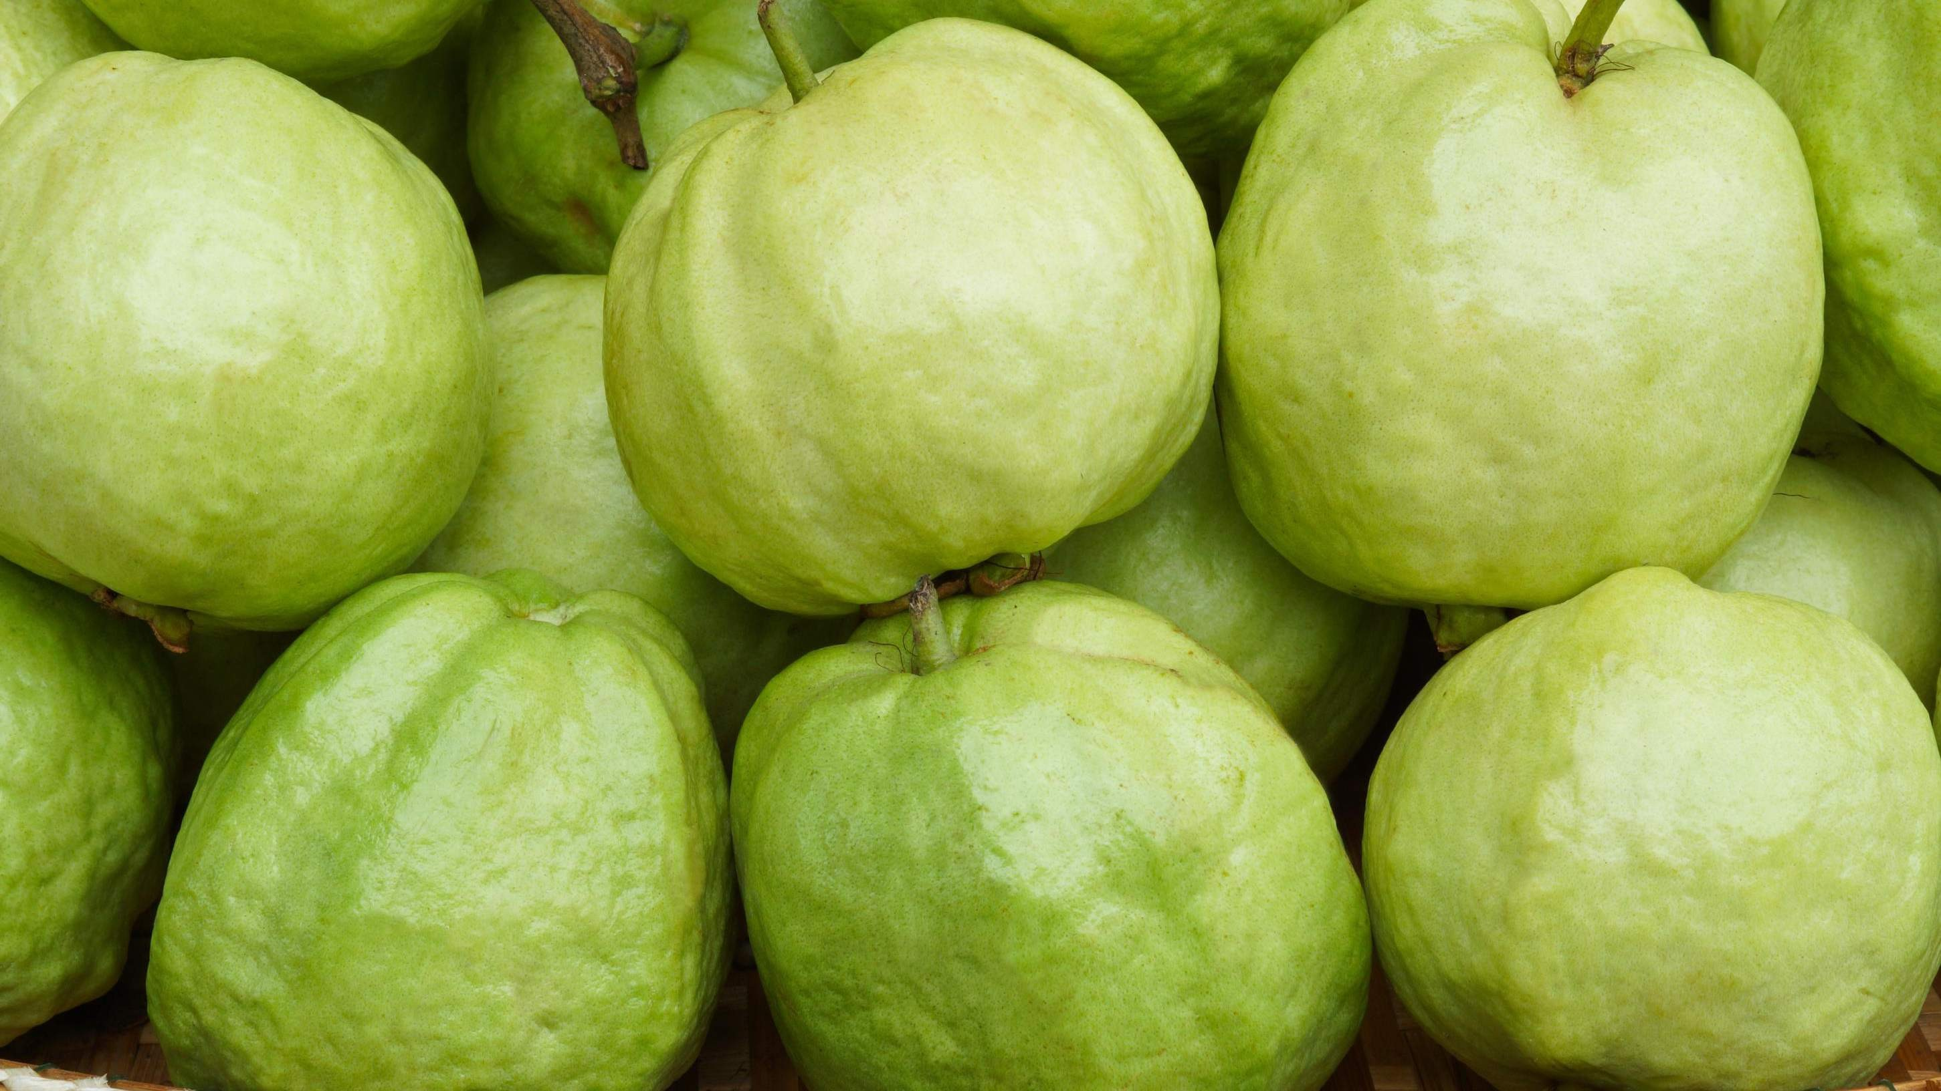


Growing Awareness about the Nutritional Benefits of Guava to Increase the Sales Globally
Inconsistent Supply due to Seasonal Fluctuations can Lead to Limit the Sales

Slide 7
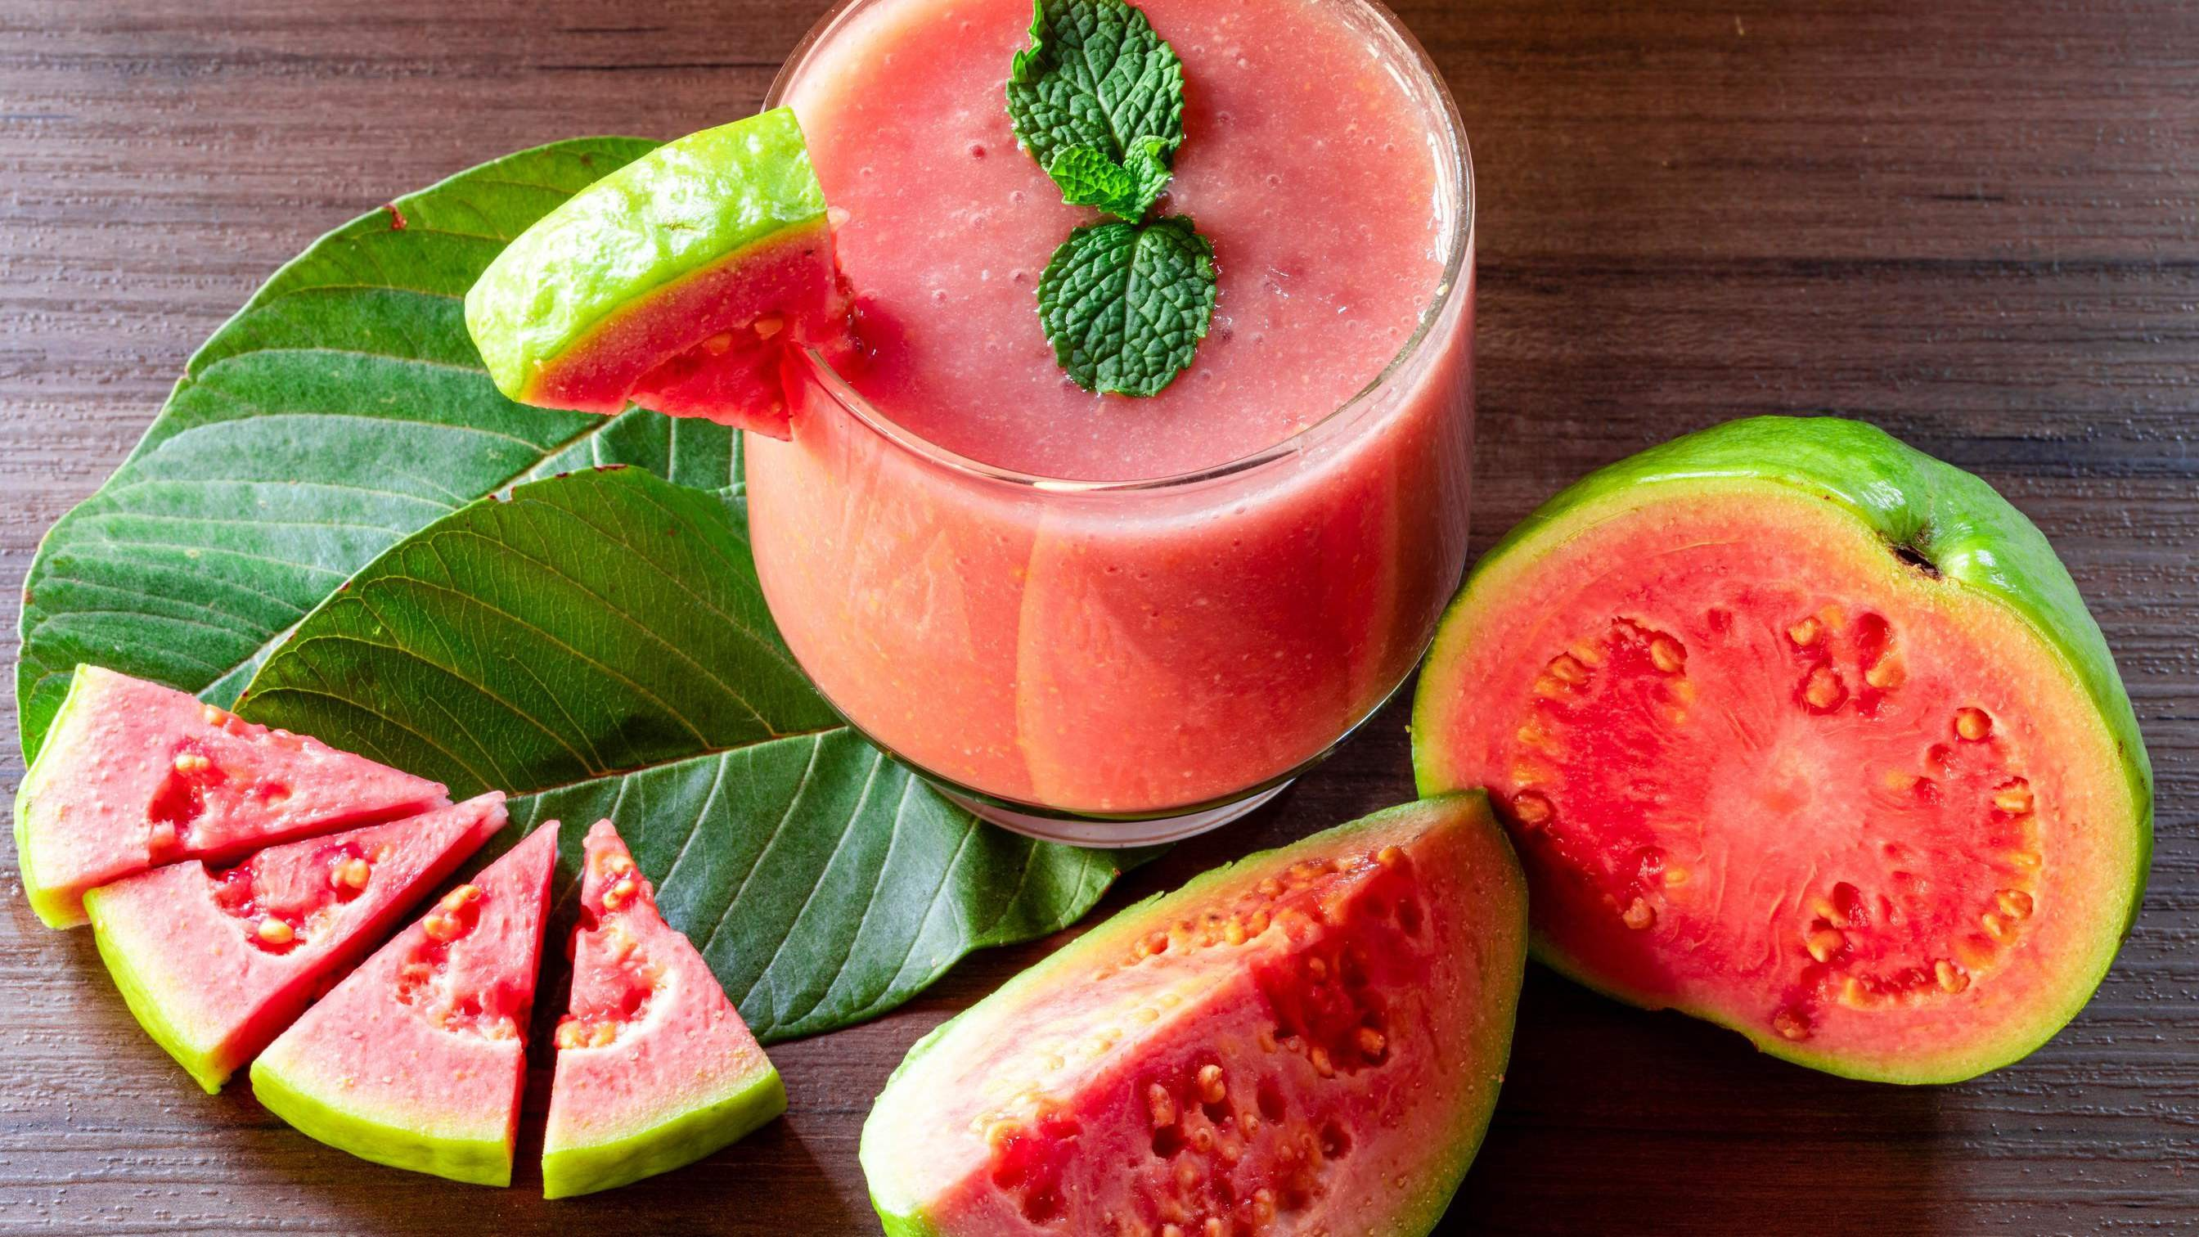
AUTHOR'S PERSPECTIVE
The global guava market will expand significantly by 4.70% CAGR between 2024 to 2031.
White guava pulp is the fastest-growing category over the forecast period. Its appeal stems from its subtle yet refreshing taste, gaining recognition across diverse food applications.
The sales of pink guava pulp are poised to rise due to its exotic flavour, higher nutritional content, growing consumer preference for unique fruits, and increasing demand for natural ingredients in various food and beverage products.
The sales of fresh guava fruit are anticipated to rise owing to increasing health consciousness among consumers, growing awareness of the fruit's nutritional benefits, and rising demand for natural, whole fruits.

Slide 8



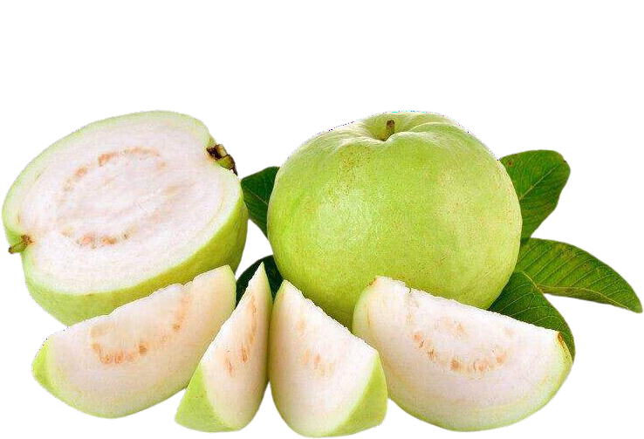





KEY PLAYERS

Slide 9


Contact us
For Full Report
COGNITIVE MARKET RESEARCH
Tel: + 1 312 - 376 - 8303 | + 44 020 - 8123 - 0732
India: ( + 91 ) 983 - 496 - 8611
sales@ cognitivemarketresearch. com
Access the Full Report : http://tinyurl.com/4krzyu6c
Please visit our website:
https://www.cognitivemarketresearch.com

