Slide 1
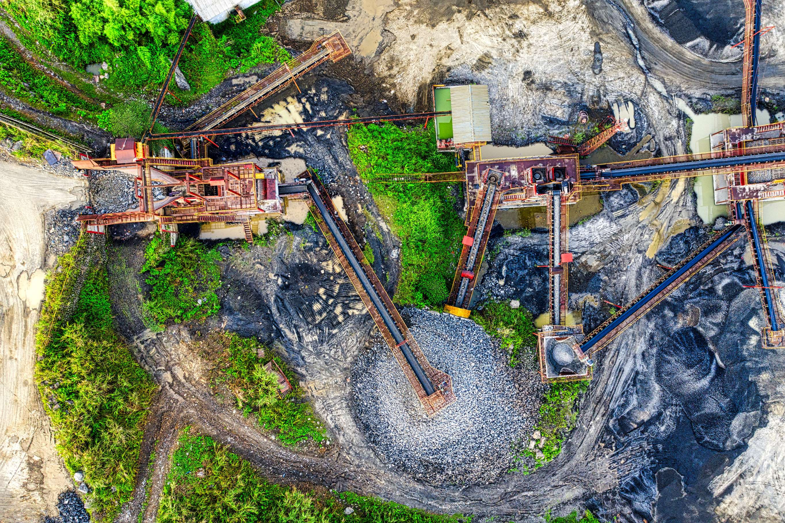
GLOBAL
GREEN MINING
MARKET REPORT
2024
Global,Regional,CountryAnalysis

Slide 2
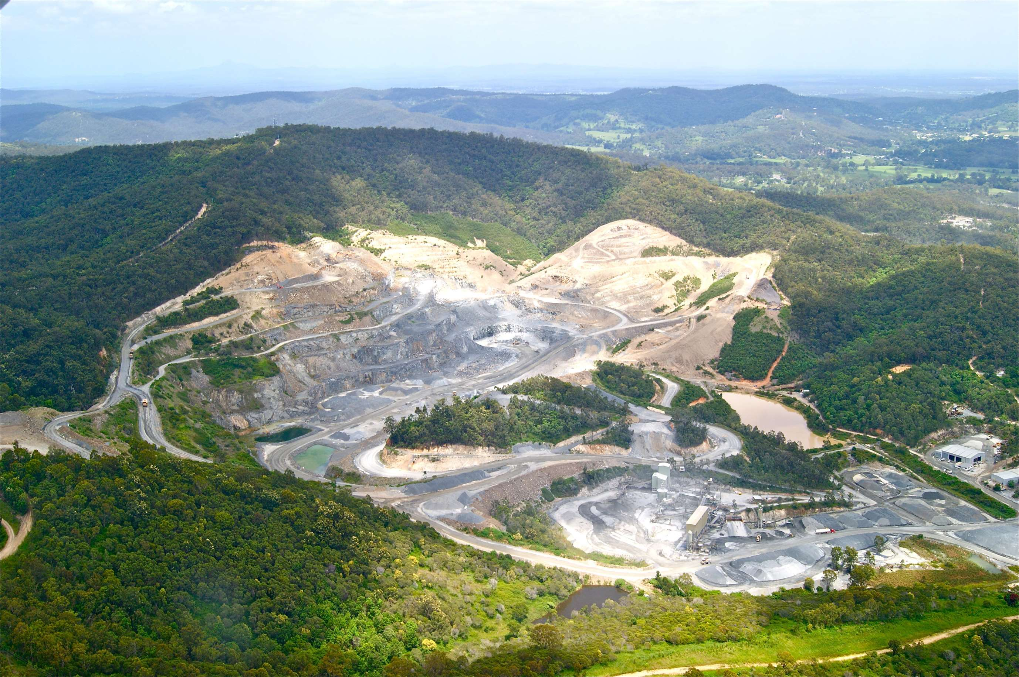
INTRODUCTION
Green mining refers to environmentally sustainable practices and technologies employed in the mining industry to minimize its ecological footprint and mitigate environmental impacts. The concept encompasses a range of strategies aimed at reducing the negative consequences traditionally associated with mining activities, such as habitat disruption, water pollution, and the emission of greenhouse gases.The rising stringency of environmental regulations and the increasing focus on sustainable practices are crucial for the expansion of the green mining market. These approaches enable leading companies to secure a substantial market share and stay competitive in the dynamic green mining industry.

Slide 3
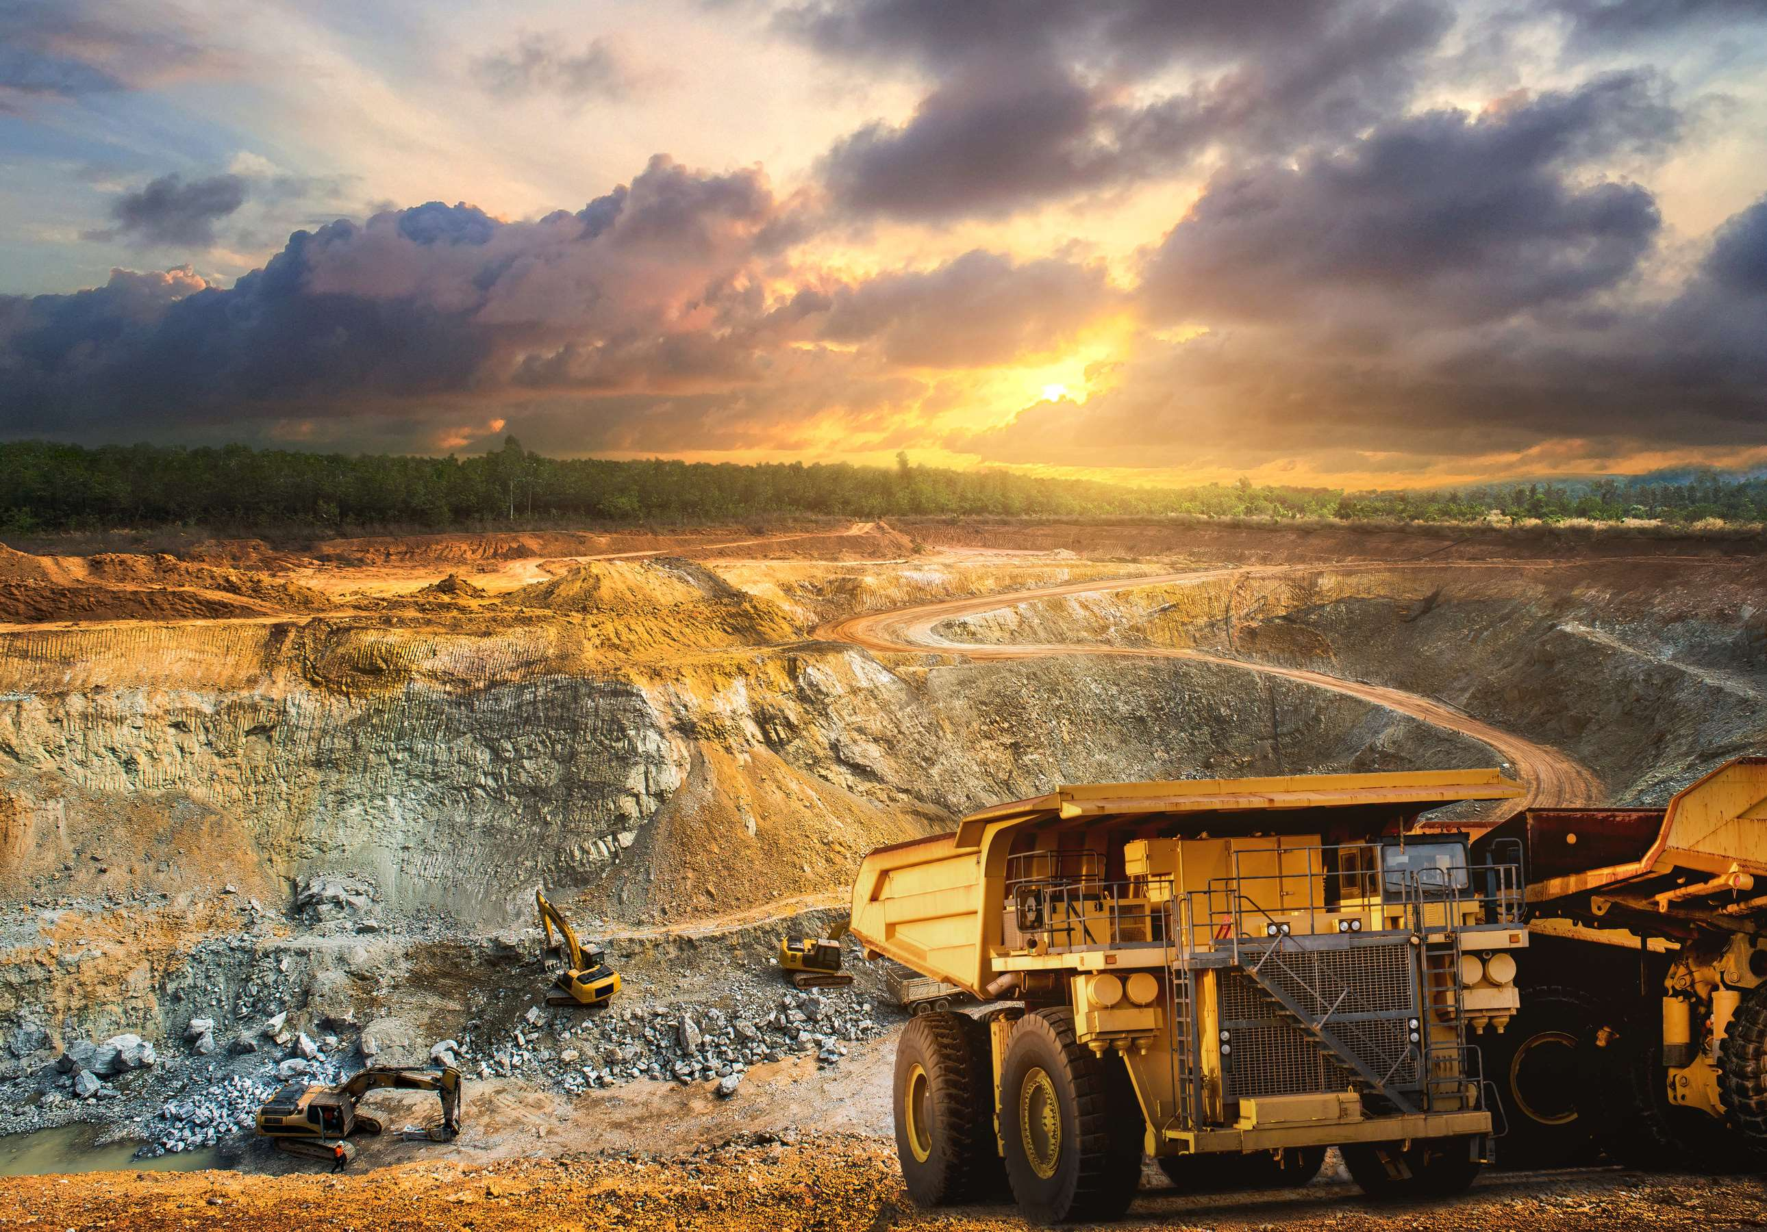

KEY INSIGHTS
MARKET SIZE
USD 12512.2 million
2023
CAGR
10.50%
2023- 2030

Slide 4
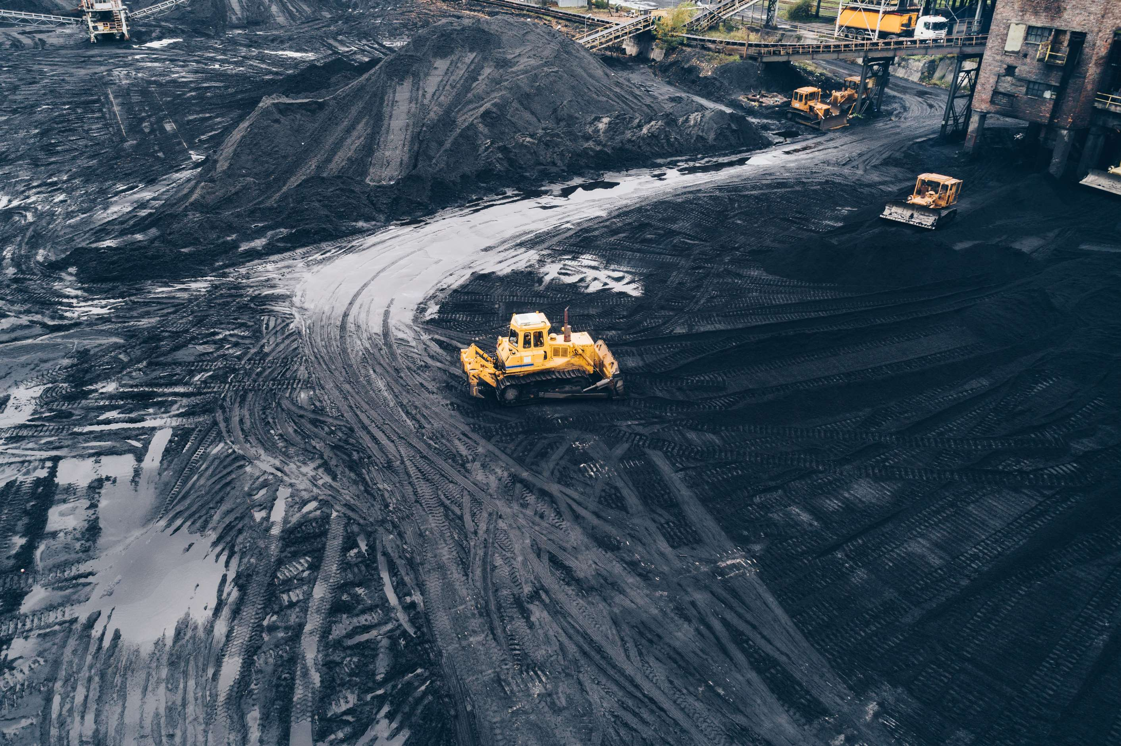
REVENUE MARKET SHARE BY SEGMENTS 2022
  Mine Filling
  Water Preservation
  Simultaneous Extraction of Coal and Gas
  Oxidizing Utilization of Ventilation Air Methane (VAM)
  Gangue Discharge Reduction
  Mining From Tailings
  Dust Suppression Techniques
  Liquid Membrane Emulsion Technology
Type Segment

Slide 5
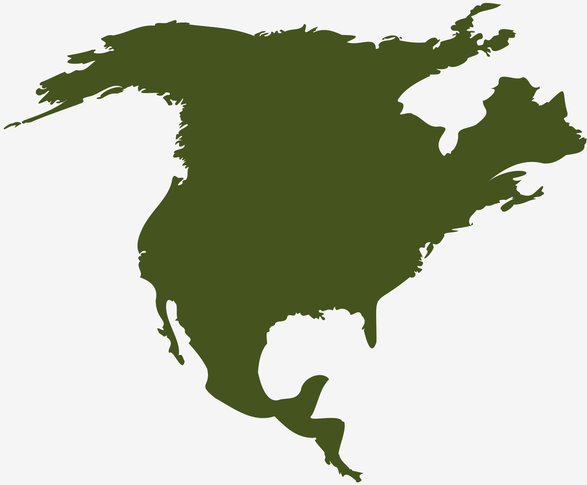
Global Green Mining Market Revenue share for 2024
North America
40%

Slide 6
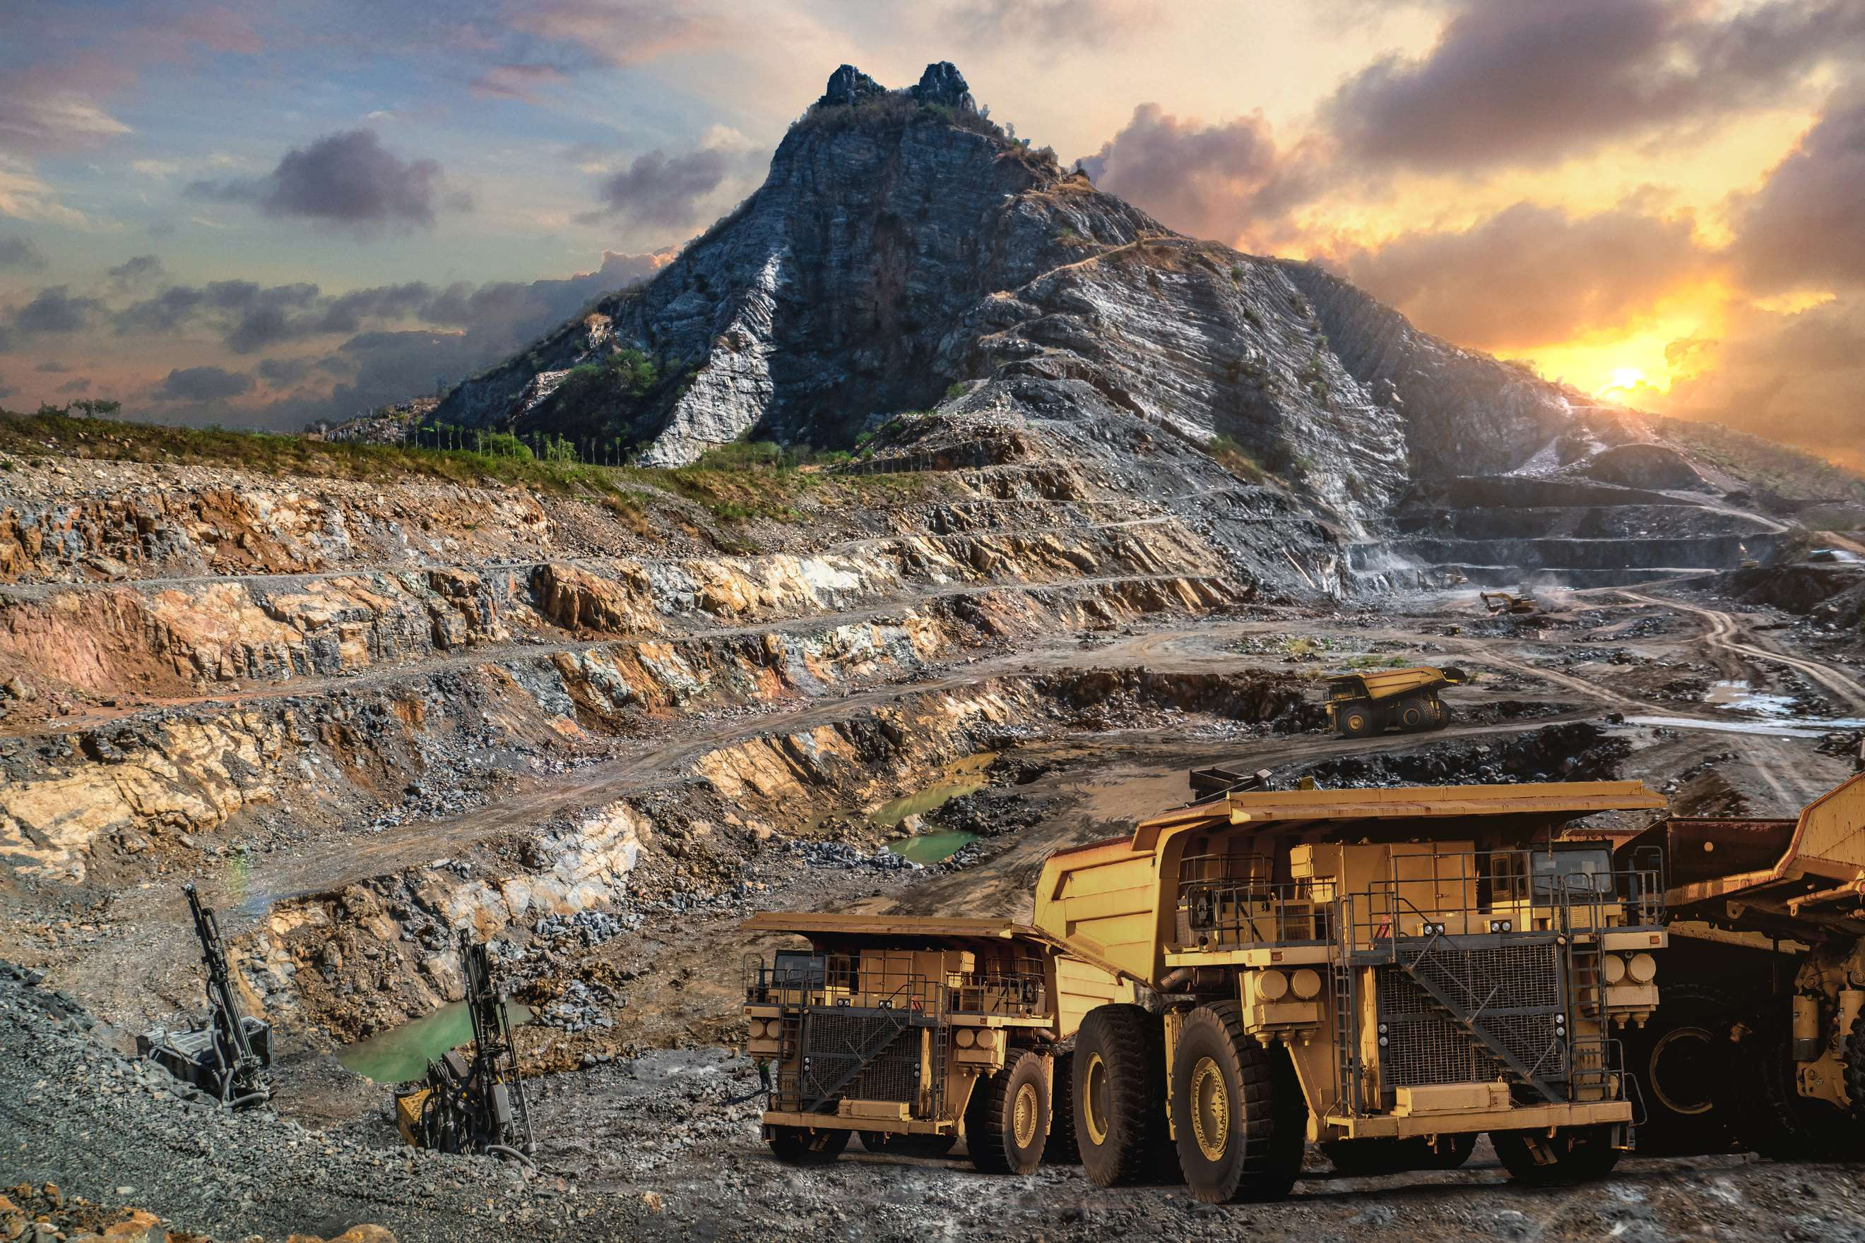
Advancements in Sustainable Technologies to Propel Market Growth
Drivers
Challenges in Initial Capital Investment to Restrict Market Growth
Restraints

Slide 7
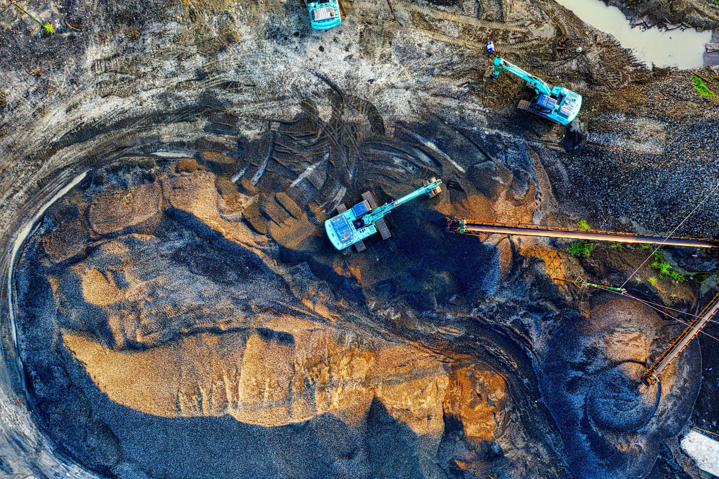
AUTHOR'S PERSPECTIVE
  The Global Green Mining Market is witnessing significant growth in the near future.
  Placer Mining's simplicity, reduced environmental impact, and adaptability to green practices make it the fastest-growing category.
  Green Mining initiatives prioritize responsible extraction methods for these valuable resources, ensuring minimal environmental impact.
  Liquid Membrane Emulsion Technology emerges as the fastest-growing category in the Green Mining market, propelled by its innovative approach to environmental conservation.

Slide 8
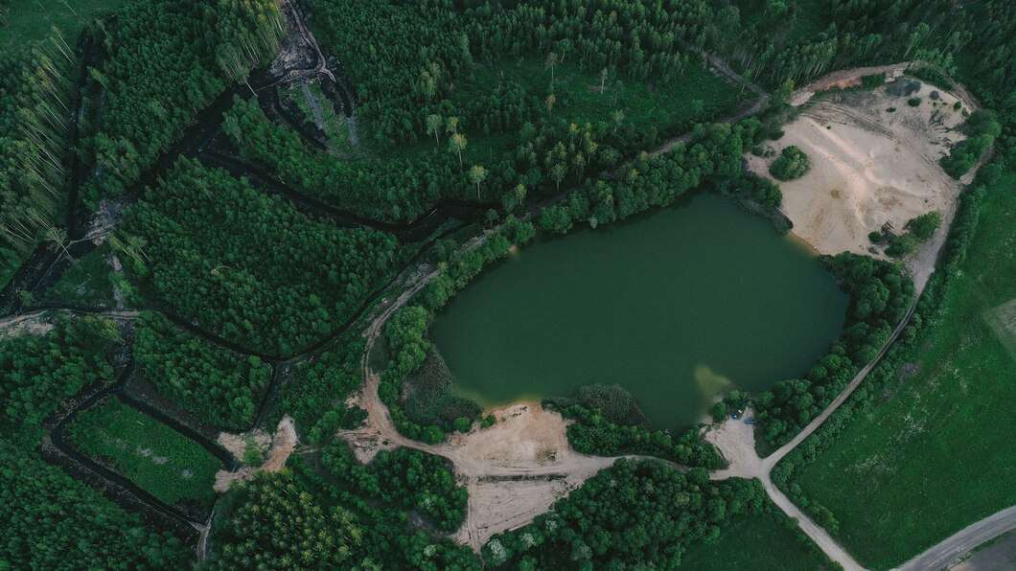


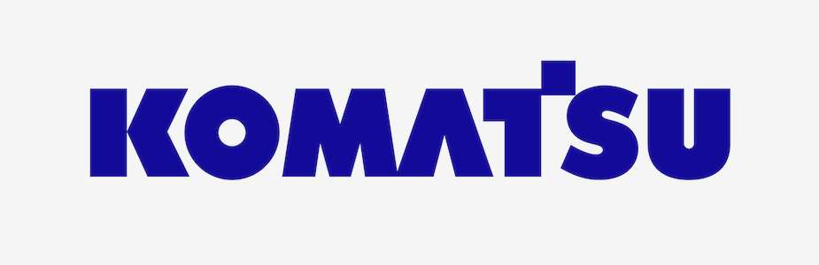

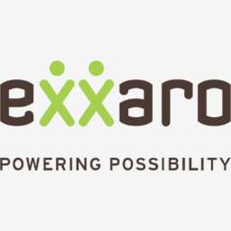


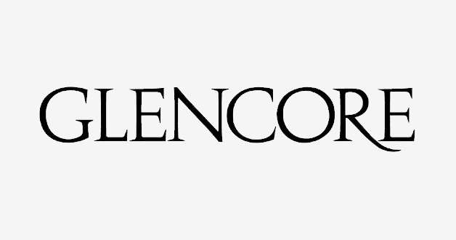

KEY PLAYERS

Slide 9


For Full Report
Contact us
COGNITIVE MARKET RESEARCH
Tel: +1 312-376-8303 | +44 020-8123-0732
India: (+91) 983-496-8611
sales@cognitivemarketresearch.com
Access the Full Report : https://tinyurl.com/23m7a96s
Please visit our website:
https://www.cognitivemarketresearch.com

