Slide 1
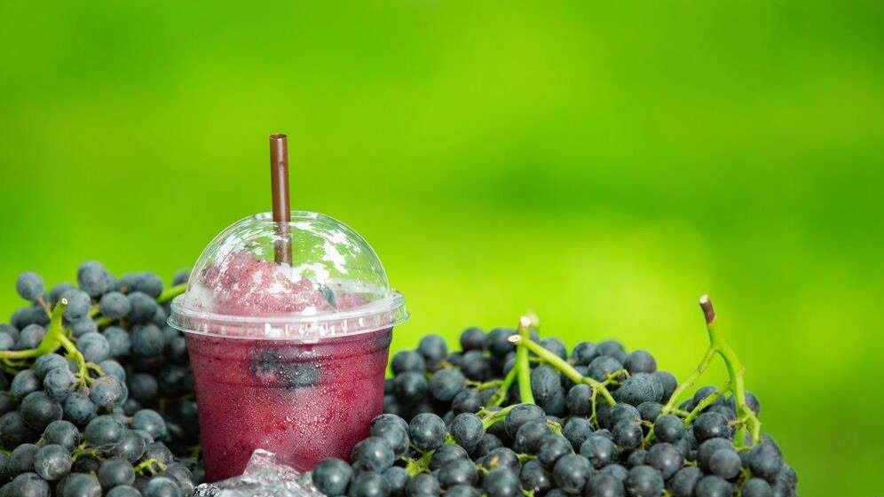
GLOBAL GRAPE SODA
MARKET REPORT 2024
Global,Regional,CountryAnalysis

Slide 2

INTRODUCTION
The grape soda market's substantial growth is a direct response to the increasing consumer desire for unique and distinctive flavors, prompting beverage companies to innovate and expand their grape soda offerings to cater to this demand. The grape soda market has responded to the growing demand for healthier options driven by consumer health- consciousness by introducing lower-calorie or sugar-free variants, leading to market evolution and encouraging companies to align their products with changing consumer preferences.

Slide 3
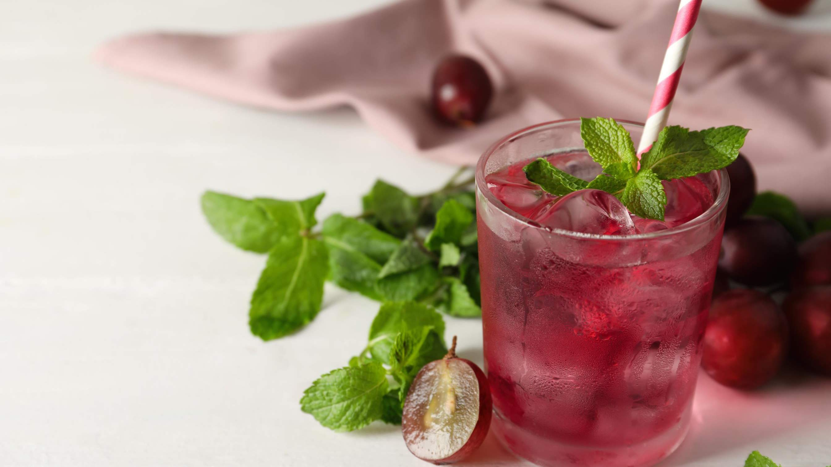

KEY INSIGHTS
MARKET SIZE
USD 5.9 billion
2022
20₋23
CAGR 5%
2030

Slide 4
REVENUE MARKET SHARE BY SEGMENTS 2022
Green Grape Soda
Purple Grape Soda
Red Grape Soda
Sparkling Grape Soda
Diet Grape Soda
Product Segment
Supermarkets/Hypermarkets
Convenience Stores
Independent Retailers
Online Sales
Restaurants/Cafes
Vending Machines
Application Segment

Slide 5
Global Grape Soda Market Revenue share for 2022
North America

Slide 6
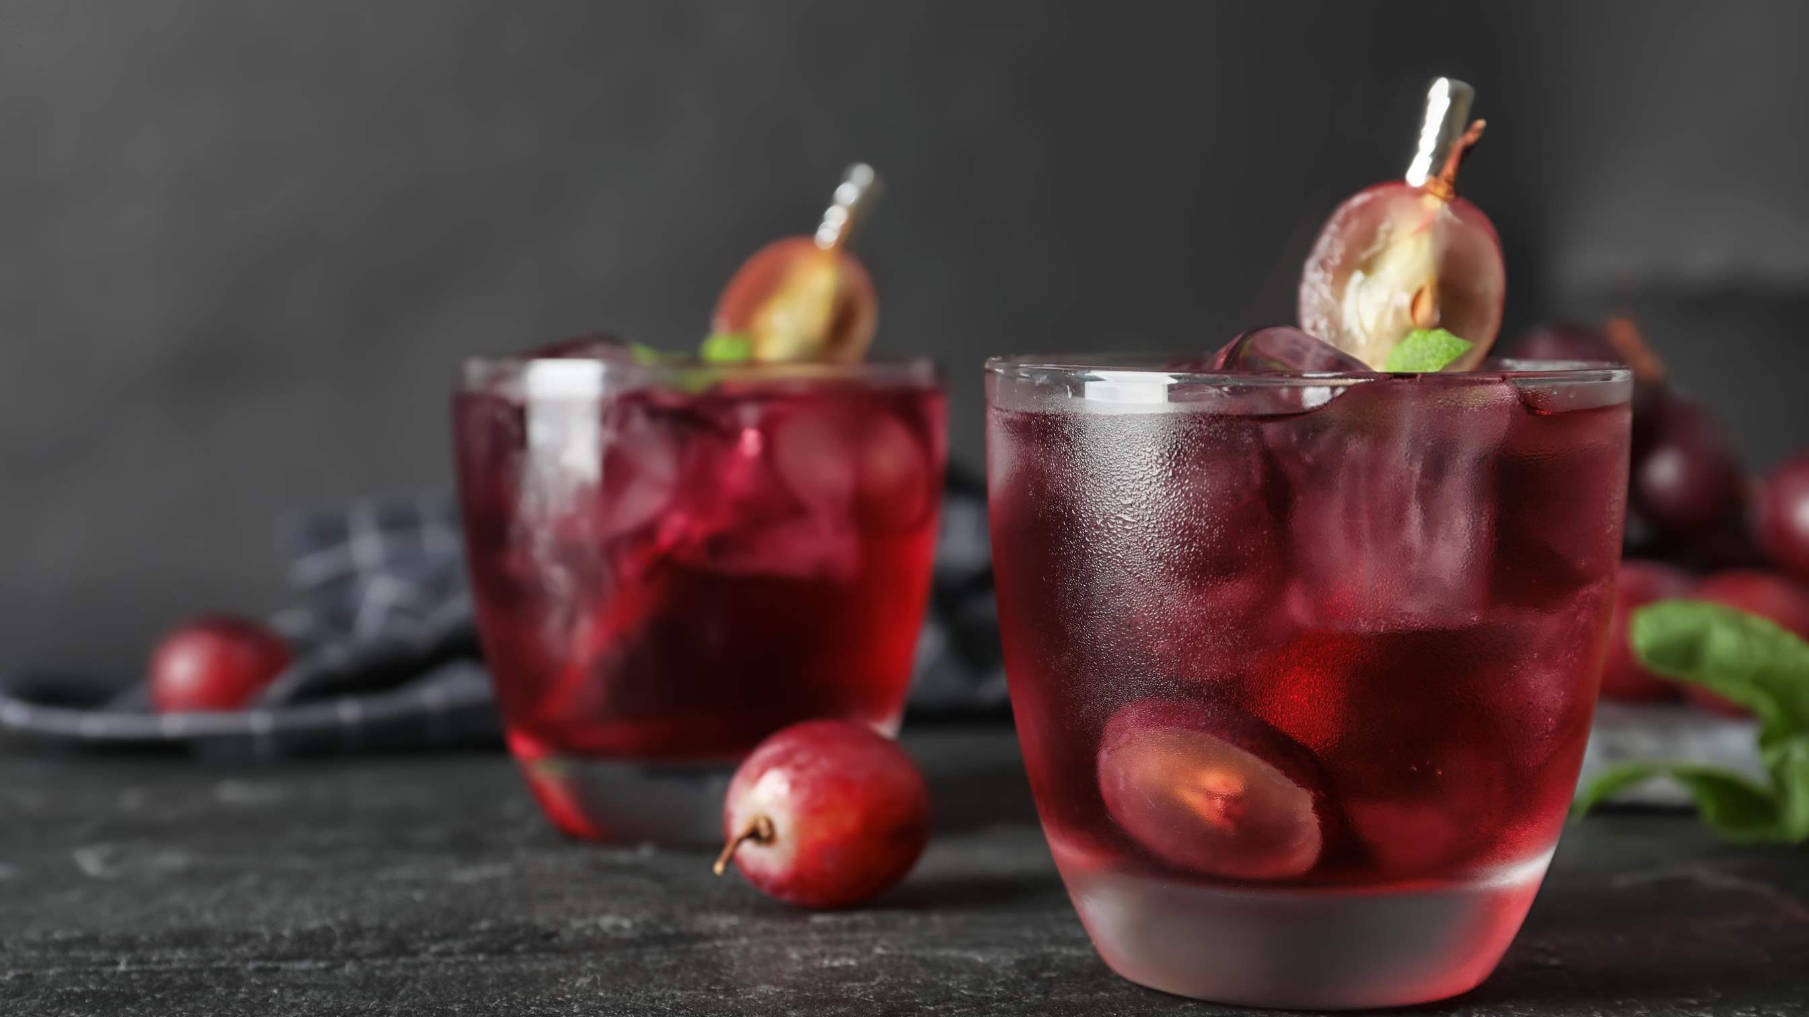




Slide 7

AUTHOR'S PERSPECTIVE
The Global Grape Soda Market is witnessing significant growth in the near future.
"Diet Grape Soda" represents the fastest-growing segment, capitalizing on the rising health-consciousness among consumers who seek low-calorie and sugar-free alternatives.
In contrast, the fastest-growing segment is Online Sales, fueled by evolving consumer preferences and the
convenience of e-commerce, allowing consumers to shop for grape soda easily and have it delivered to their
doorstep.
The Supermarkets/Hypermarkets segment is expected to expand at the significant CAGR retaining position throughout the forecast period.

Slide 8
KEY PLAYERS

Slide 9


Contact us
For Full Report
COGNITIVE MARKET RESEARCH
Tel: + 1 312 - 376 - 8303 | + 44 020 - 8123 - 0732
India: ( + 91 ) 983 - 496 - 8611
sales@ cognitivemarketresearch. com
Access the Full Report : http://tinyurl.com/3p84m52c
Please visit our website:
https://www.cognitivemarketresearch.com

