Slide 1

GLOBAL GRANOLA BAR
MARKET REPORT 2024
Global,Regional,CountryAnalysis

Slide 2
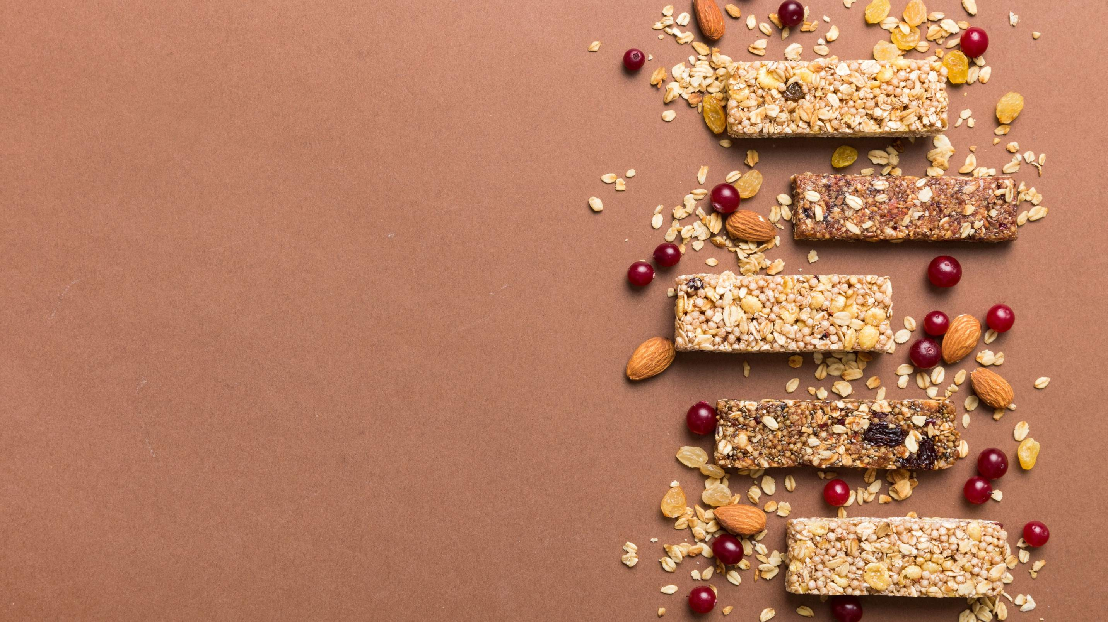
INTRODUCTION
The granola bars market is experiencing growth due to growing consumer awareness of health and wellness, driving demand for convenient, nutritious snacks. Granola bars are perceived as a wholesome and on-the-go option, often containing oats, nuts, seeds, and dried fruits. Additionally, the trend towards snacking between meals and the desire for energy-boosting, satiating snacks contribute to market expansion.
Manufacturers are responding with diverse
flavors, organic options, and innovative ingredients, appealing to a broader consumer base. The convenience, nutritional value, and evolving product offerings collectively propel the growth of the Granola Bars Market.

Slide 3
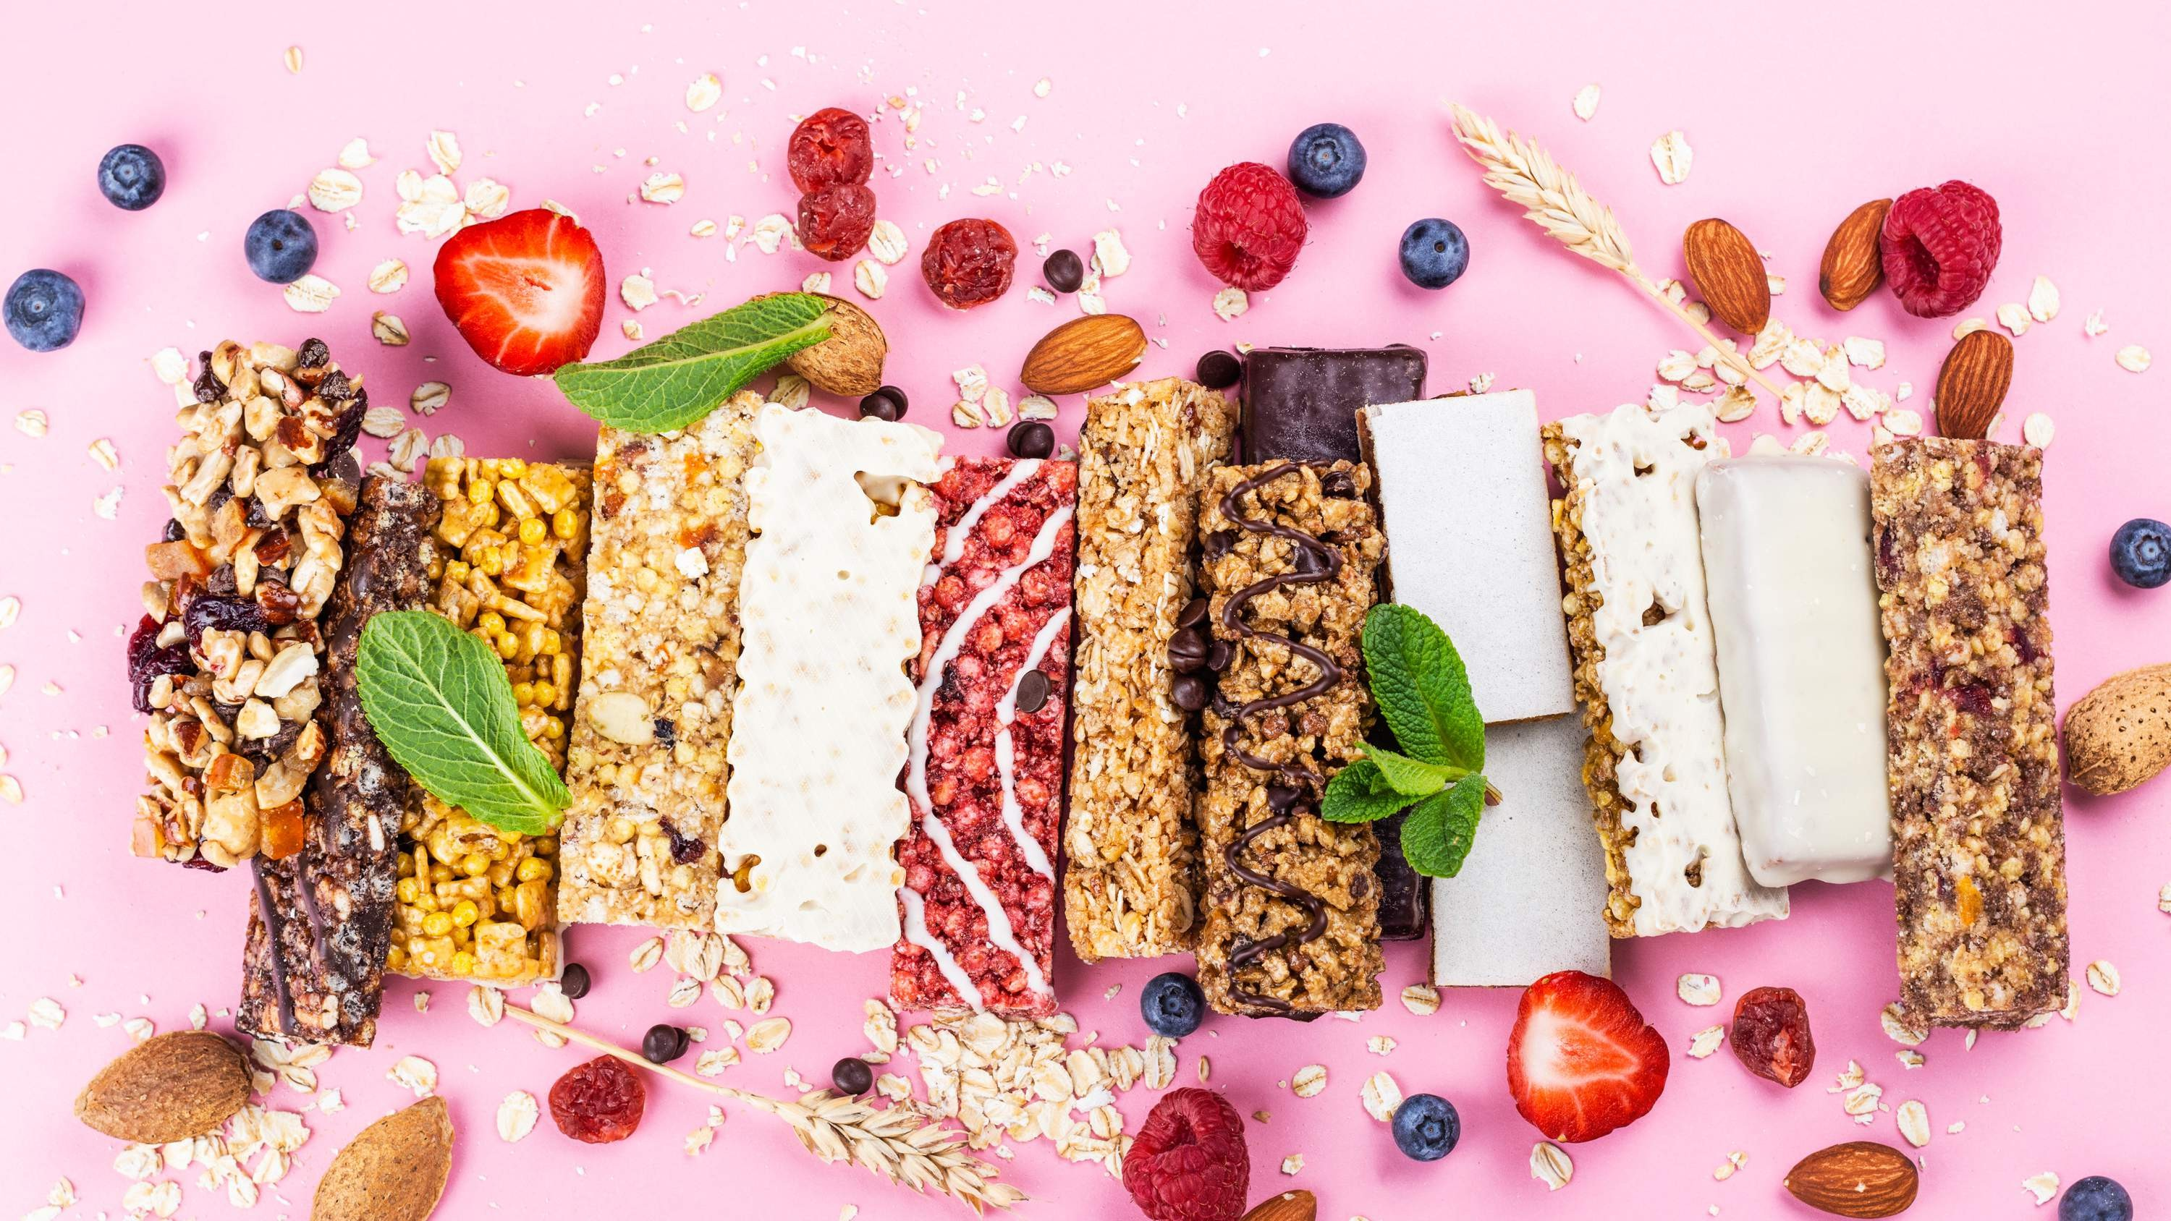
KEY INSIGHTS
MARKET SIZE
USD 4.8 billion
2023
2023-
2030
CAGR 5.5%

Slide 4
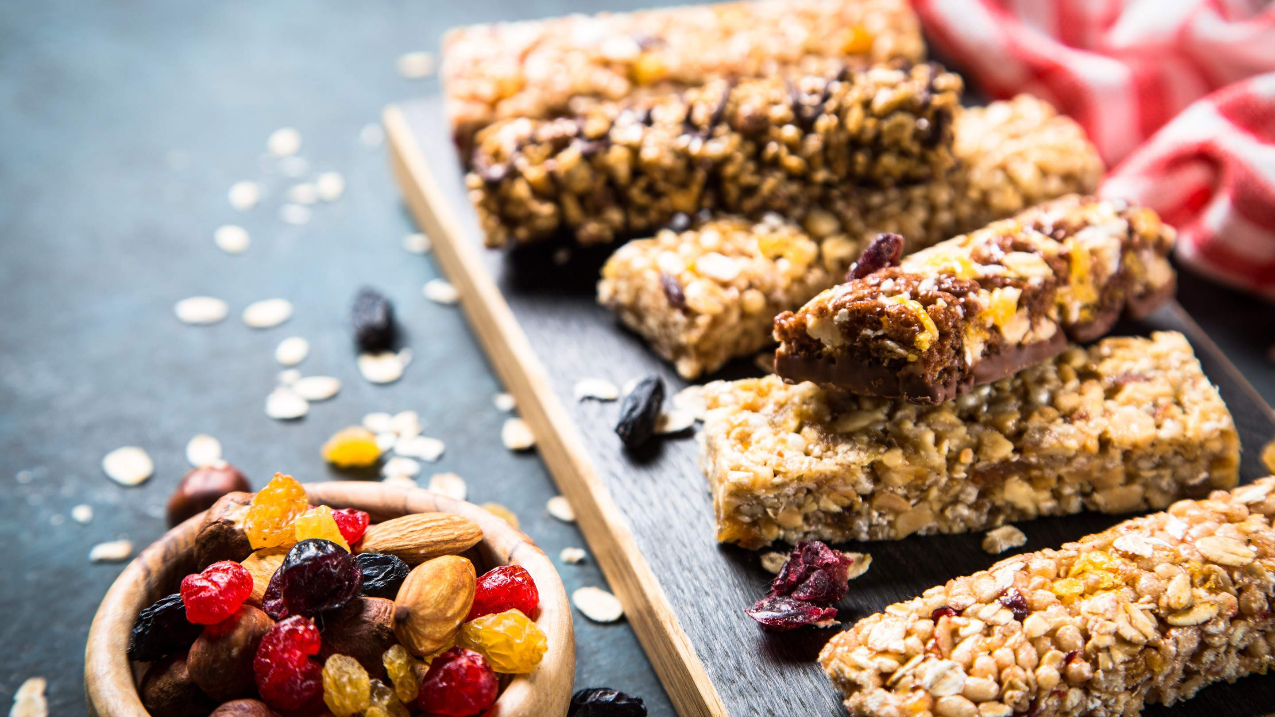
REVENUE MARKET SHARE BY SEGMENTS 2022
Supermarkets Hypermarkets Online stores Convenience Stores Specialty Stores Others
Distribution Channel

Slide 5

Global Granola Bar Market Revenue share for 2022
NORTH AMERICA 38%

Slide 6
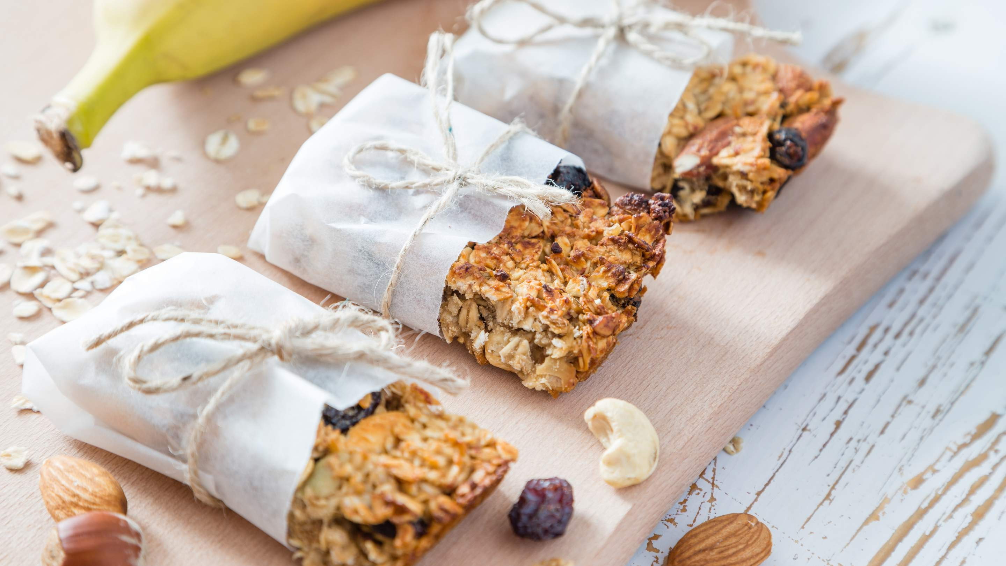
Increasing Health and Wellness Trends to Provide Viable Market Output
Growing Innovative Ingredients to Propel Market Growth
Drivers
Restraints
Increasing Allergen Concerns Restrict Market Growth

Slide 7
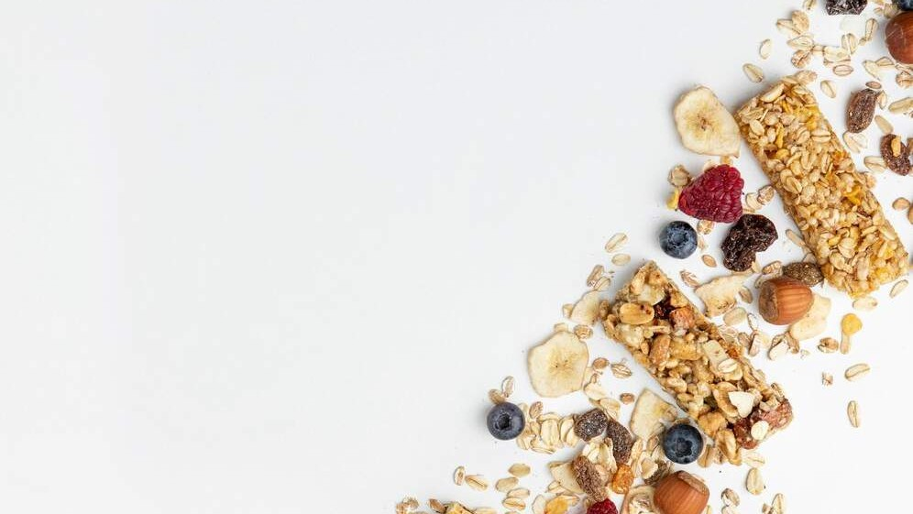
AUTHOR'S PERSPECTIVE
The Global Granola Bar Market is witnessing significant growth in the near future.
Fruit flavors have captured the largest market share in the Granola Bars market due to their widespread consumer appeal.
Nuts, such as almonds, walnuts, or peanuts, are rich in protein, healthy fats, and essential nutrients.
Conventional granola bars typically incorporate traditional ingredients and production methods, appealing to a broad consumer base.
The wide variety of brands, flavors, and specialty options available online, coupled with the ease of doorstep delivery, appeals to a tech-savvy and time-conscious consumer base

Slide 8
KEY PLAYERS

Slide 9


Contact us
For Full Report
COGNITIVE MARKET RESEARCH
Tel: + 1 312 - 376 - 8303 | + 44 020 - 8123 - 0732
India: ( + 91 ) 983 - 496 - 8611
sales@ cognitivemarketresearch. com
Access the Full Report : http://tinyurl.com/36585vty
Please visit our website:
https://www.cognitivemarketresearch.com

