Slide 1
GLOBAL
GOLF TROLLEY MARKET REPORT 2024
Global,Regional,CountryAnalysis

Slide 2

INTRODUCTION
The substantial growth in the golf trolley market is primarily fueled by the increasing popularity of golf as a recreational activity, driven by its transition from a competitive sport to a widely embraced leisure pursuit, leading to heightened demand for efficient means of traversing golf courses. Innovations in golf trolley technology are a significant driving force behind the golf trolley market's growth, as advancements such as electric models with lithium-ion batteries, remote-controlled operation, lightweight materials, collapsible frames, and ergonomic handle designs have transformed the golfing experience, offering enhanced convenience and appeal to a broader range of golfers.

Slide 3


KEY INSIGHTS
MARKET SIZE
USD 518.2 million
2022
20₋23
CAGR 4.2%
2030

Slide 4

REVENUE MARKET SHARE BY SEGMENTS 2022
Men Women Kids
Manual Electric
Type Segment
End User Segment
Specialty Stores Sporting Goods Chain On-course Shops Online Stores
Application segment
Leisure Professional
Distribution Channel

Slide 5

Global Golf Trolley Market Revenue share for 2022
North America

Slide 6

Technological Advancements Transforming Golf Trolleys to Boost Market Growth
Drivers
Economic Volatility's Limits the Golf Trolley Market
Restraints

Slide 7
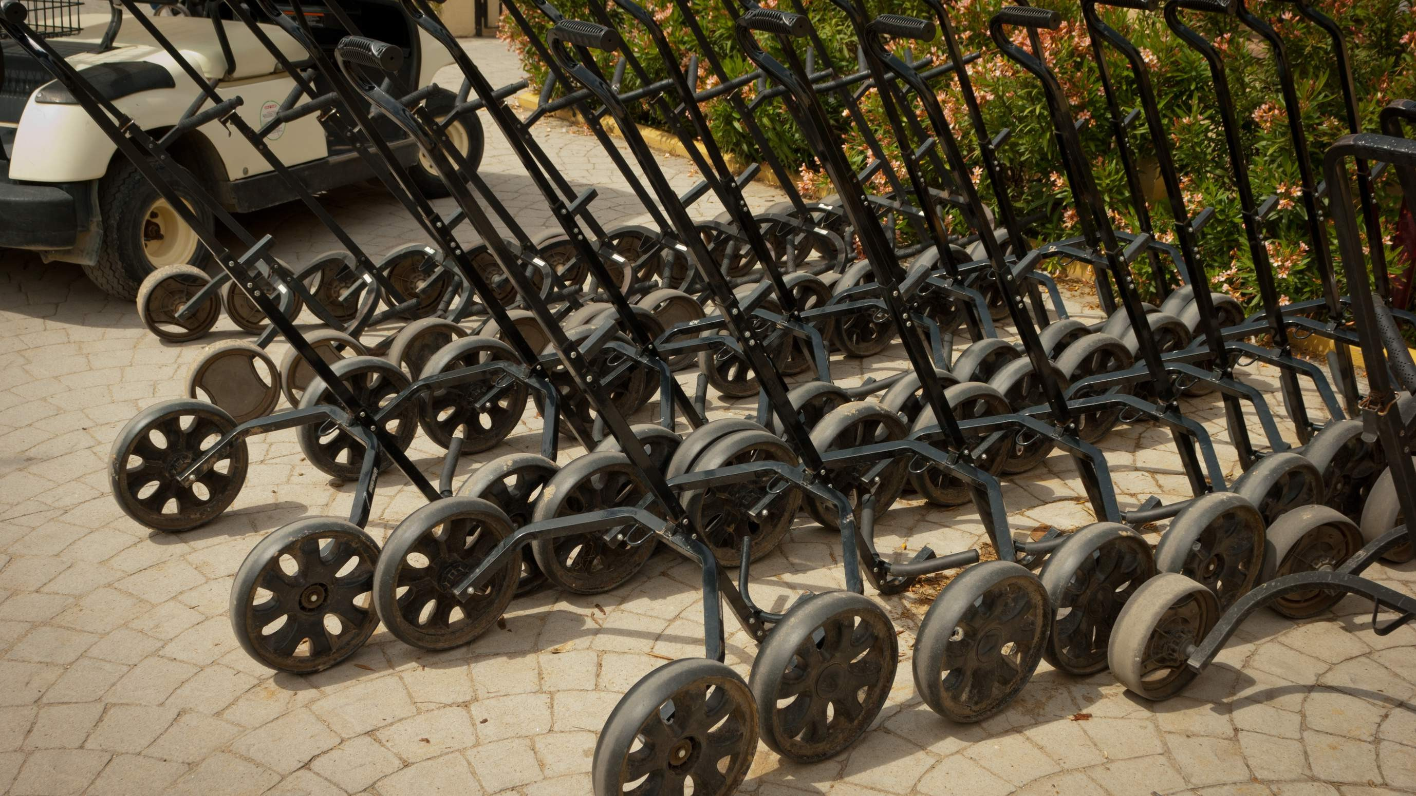
AUTHOR'S PERSPECTIVE
The Global Golf Trolley Market is witnessing significant growth in the near future.
Manual golf trolleys, characterized by their simplicity and affordability, rely on the golfer's physical effort for propulsion.
Electric golf trolleys, powered by batteries or electric motors, have surged in popularity.
Professional trolleys, on the other hand, cater to competitive players, featuring advanced electric or remote-controlled models, sophisticated braking systems, and ergonomic designs.
Women golfers, on the other hand, are an emerging and rapidly growing segment, with preferences leaning toward lighter, more compact, and aesthetically appealing trolley designs.

Slide 8
KEY PLAYERS

Slide 9


Contact us
For Full Report
COGNITIVE MARKET RESEARCH
Tel: + 1 312 - 376 - 8303 | + 44 020 - 8123 - 0732
India: ( + 91 ) 983 - 496 - 8611
sales@ cognitivemarketresearch. com
Access the Full Report : http://tinyurl.com/mt428hkk
Please visit our website:
https://www.cognitivemarketresearch.com

