Slide 1

GOLF SHOE
MARKET REPORT

Slide 2

INTRODUCTION
Golf shoes are sports shoes that are designed to keep golfers of all ability levels safe and comfortable. It is specifically required on golf courses to ensure that the turf, particularly the greens, is not damaged. Currently, the market offers a diverse selection of trendy and comfortable golf shoes, ranging from full leather snakeskin to modern athletic models.

Slide 3
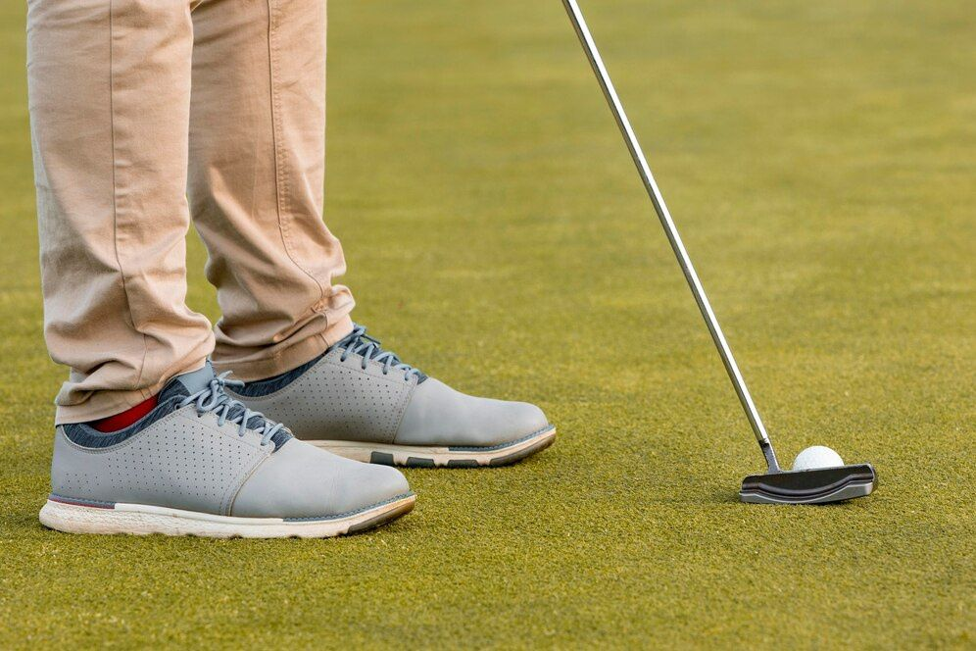
KEY INSIGHTS
2028
MARKET SIZE
$3,353.30 Million
2023-
2030
CAGR
3.06%

Slide 4

REVENUE MARKET SHARE BY SEGMENTS 2022
TYPE SEGMENT
APPLICATION SEGMENT
Spiked or Cleated Golf Shoes
USD 1,324.63 Million
Men
USD 1,837.49 Million

Slide 5

GLOBAL GOLF SHOE MARKET REVENUE SHARE FOR 2022
NORTH AMERICA
USD 1,253.69 MILLION

Slide 6

Rise in instances of crime, terrorism, and natural disasters
Drivers
Increasing errors and bandwidth limitations
Restraints

Slide 7

AUTHOR'S PERSPECTIVE
  The Global Golf Shoe Market revenue in 2016: USD 2,809.65 Million
  Spiked or Cleated Golf Shoes held for largest share of total revenue generated in 2019
  Men held maximum share of Golf Shoe market in 2019
  High popularity for playing golf stimulates the growth of golf shoes market
  Rise in disposable income boost the growth of golf shoes market
  Intense competition may hinder the growth of golf shoes market
  Technological advancements will propel the growth of golf shoes market in the following years.

Slide 8







KEY PLAYERS

Slide 9


For Full Report
Contact us
COGNITIVE MARKET RESEARCH
Tel: +1 312-376-8303 | +44 020-8123-0732
India: (+91) 983-496-8611
sales@cognitivemarketresearch.com
Access the Full Report : https://tinyurl.com/3486xcwz
Please visit our website:
https://www.cognitivemarketresearch.com

