Slide 1

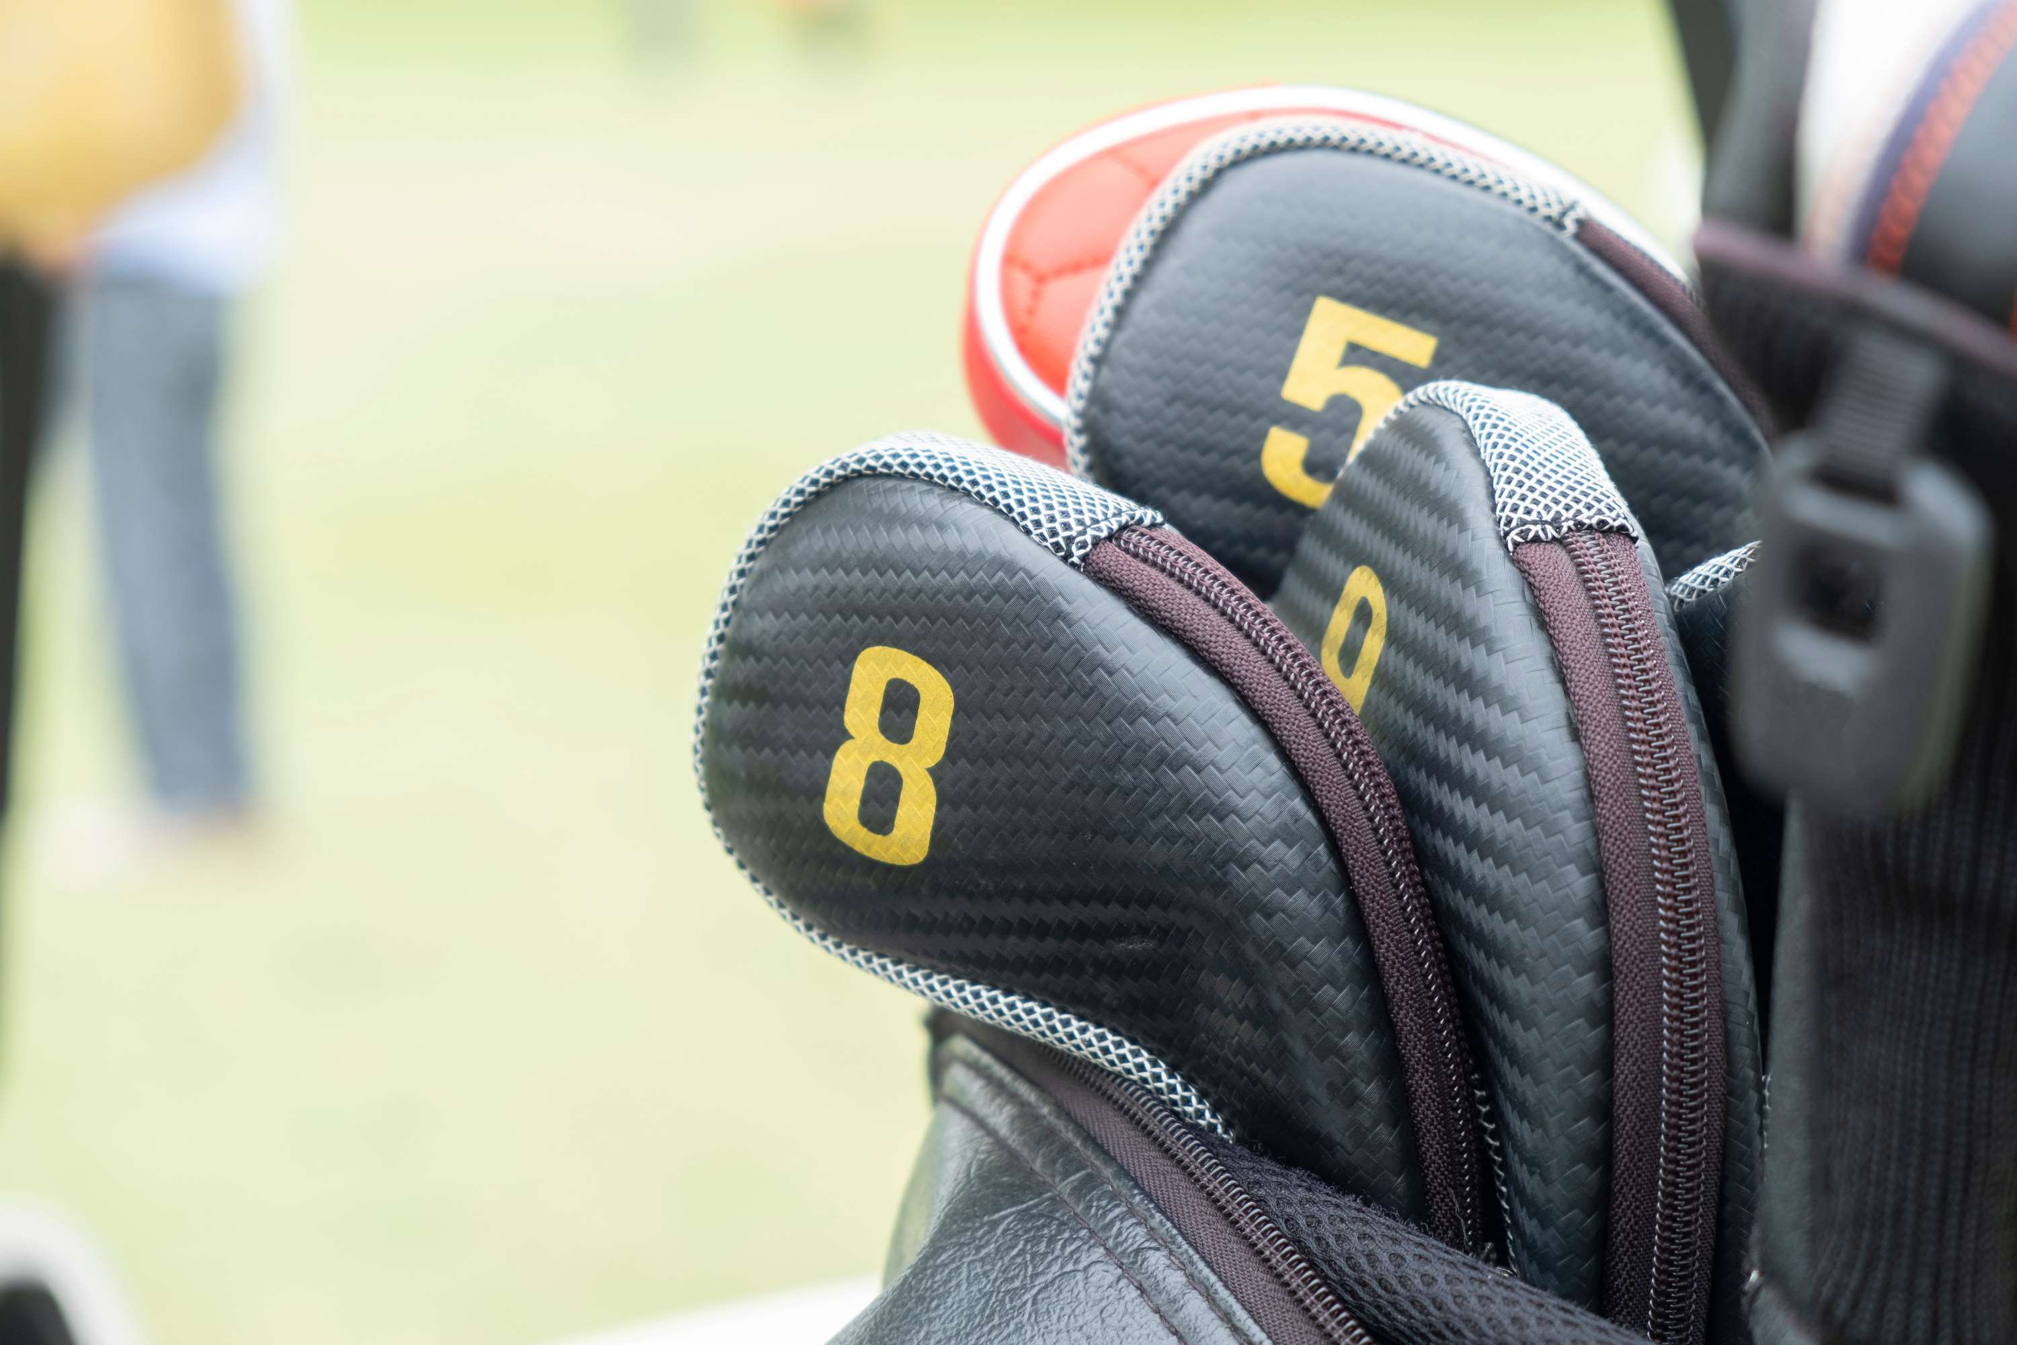
GLOBAL
GOLF CLUB HEADS MARKET REPORT
2024
Global,Regional,CountryAnalysis

Slide 2

INTRODUCTION
The golf club heads market focuses on manufacturing and selling critical components of golf clubs designed for striking golf balls. Major players like Callaway, TaylorMade, and Titleist compete in this global industry, constantly innovating materials and design to improve golfers' performance. Key trends include lightweight materials, adjustability features, and the integration of technology for swing analysis. Regulatory standards from organizations like the USGA ensure compliance with size and weight specifications. Overall, this market caters to golf enthusiasts worldwide, offering advanced club heads to enhance the golfing experience.

Slide 3
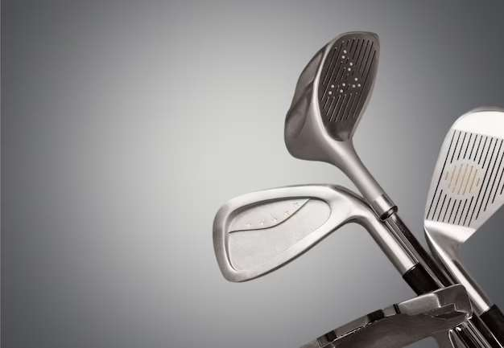

KEY INSIGHTS
MARKET SIZE
USD 3.71 billion
2023
CAGR
4.5%
2023- 2030

Slide 4

REVENUE MARKET SHARE BY SEGMENTS 2022
  Wood
  Iron
  Hybrid
  Putter
Type Segment
  Professional Golf Club
  Amateur Golf Club
  Golf Retail Store
Application Segment
  Steel
  Titanium
  Carbon Fibre
Material Segment

Slide 5

Global Golf Club Heads Market Revenue share for 2022
North America

Slide 6

Rising Popularity of Golf Fueling the Demand for Club Heads
Drivers
High Cost of Entry for New Manufacturers Limits Golf Club Heads Market
Restraints

Slide 7

AUTHOR'S PERSPECTIVE
  The Global Golf Club Heads Market is witnessing significant growth in the near future.
  The fastest-growing segment is hybrid club heads, as they combine the strengths of both wood and iron club heads, making them highly sought after by golfers of all skill levels.
  Professional clubs are engineered for tournament-level players, emphasizing high-performance club heads with precision and accuracy, often featuring tailored advanced technology.
  Titanium club heads have gained prominence for their lightweight composition and exceptional strength-to-weight ratio, contributing to increased distance and power for golfers.

Slide 8


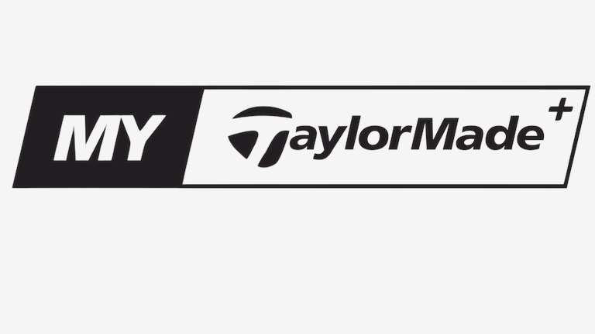
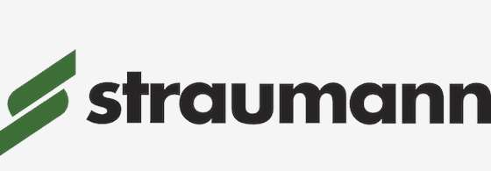










KEY PLAYERS

Slide 9


For Full Report
Contact us
COGNITIVE MARKET RESEARCH
Tel: +1 312-376-8303 | +44 020-8123-0732
India: (+91) 983-496-8611
sales@cognitivemarketresearch.com
Access the Full Report : http://tinyurl.com/3e4vuxw8
Please visit our website:
https://www.cognitivemarketresearch.com

