Slide 1
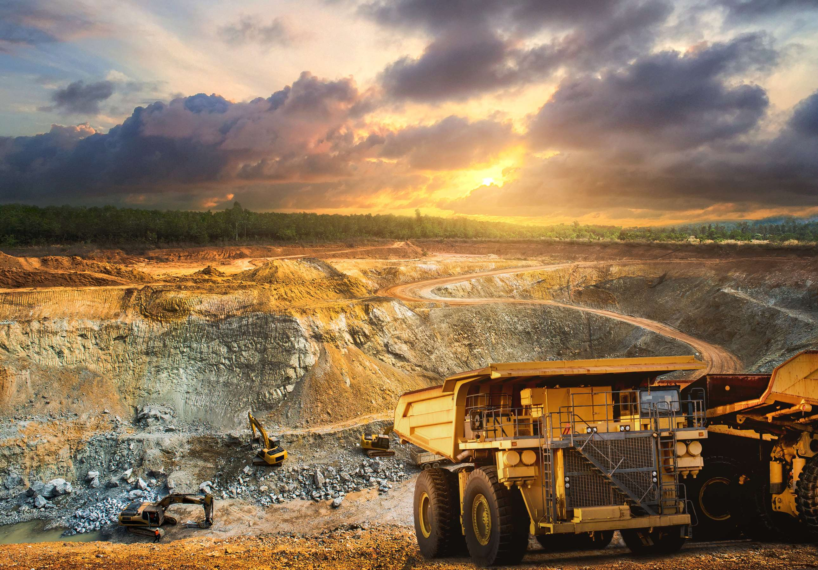
GLOBAL
GOLD MINING
MARKET REPORT
2024
Global,Regional,CountryAnalysis

Slide 2
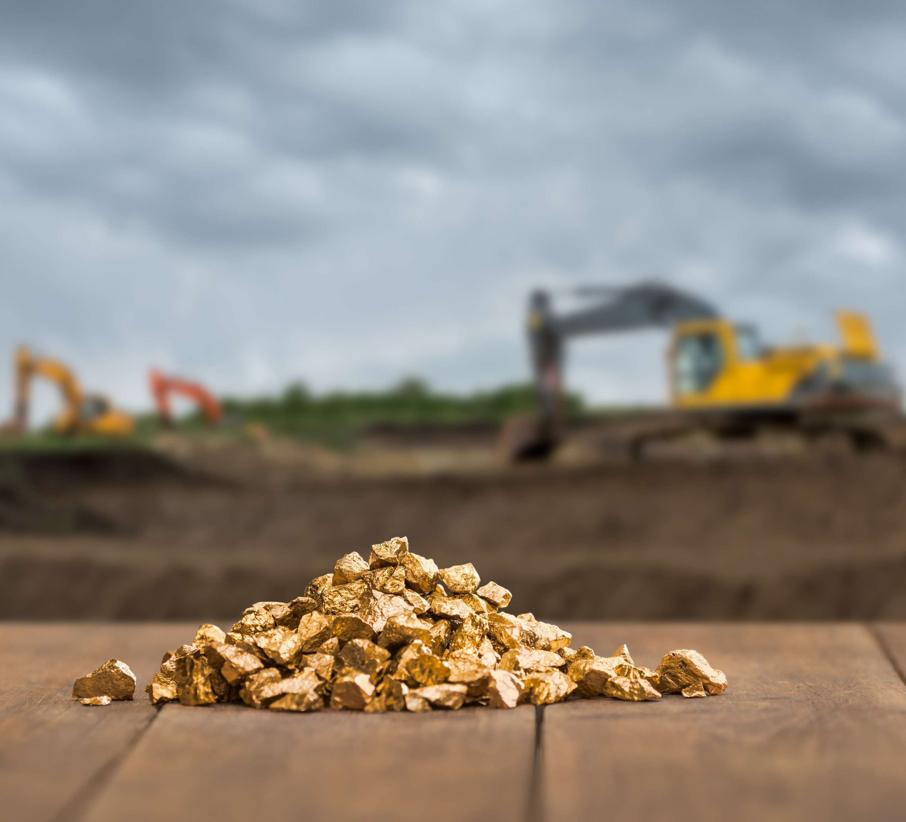
INTRODUCTION
The Gold Mining market refers to the sector of the mining industry dedicated to the exploration, extraction, refining, and commercialization of gold. Gold mining involves various processes, from prospecting and geological assessments to the extraction of gold-bearing ores and the subsequent processing of extracted materials to obtain refined gold. Market is fuled by technological advancements in exploration and extraction and rising demand for gold in various industries. These strategies help key players capture a significant market share and remain competitive in the dynamic gold mining market.

Slide 3
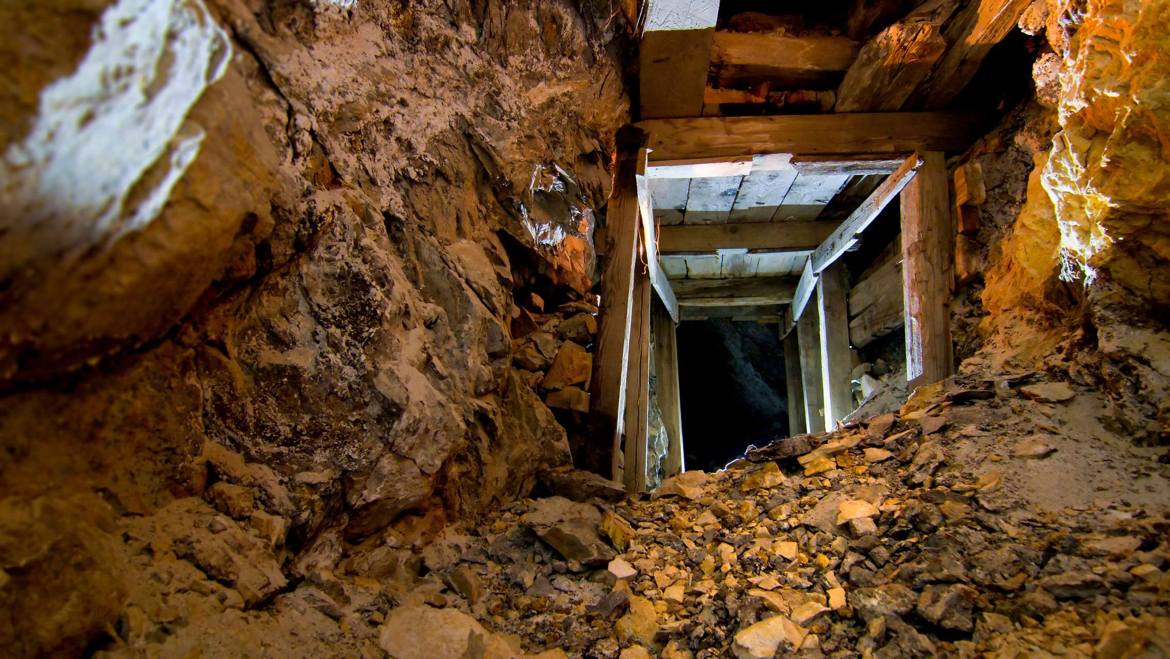

KEY INSIGHTS
MARKET SIZE
USD 202515.2 million
2023
CAGR
3.80%
2023- 2030

Slide 4
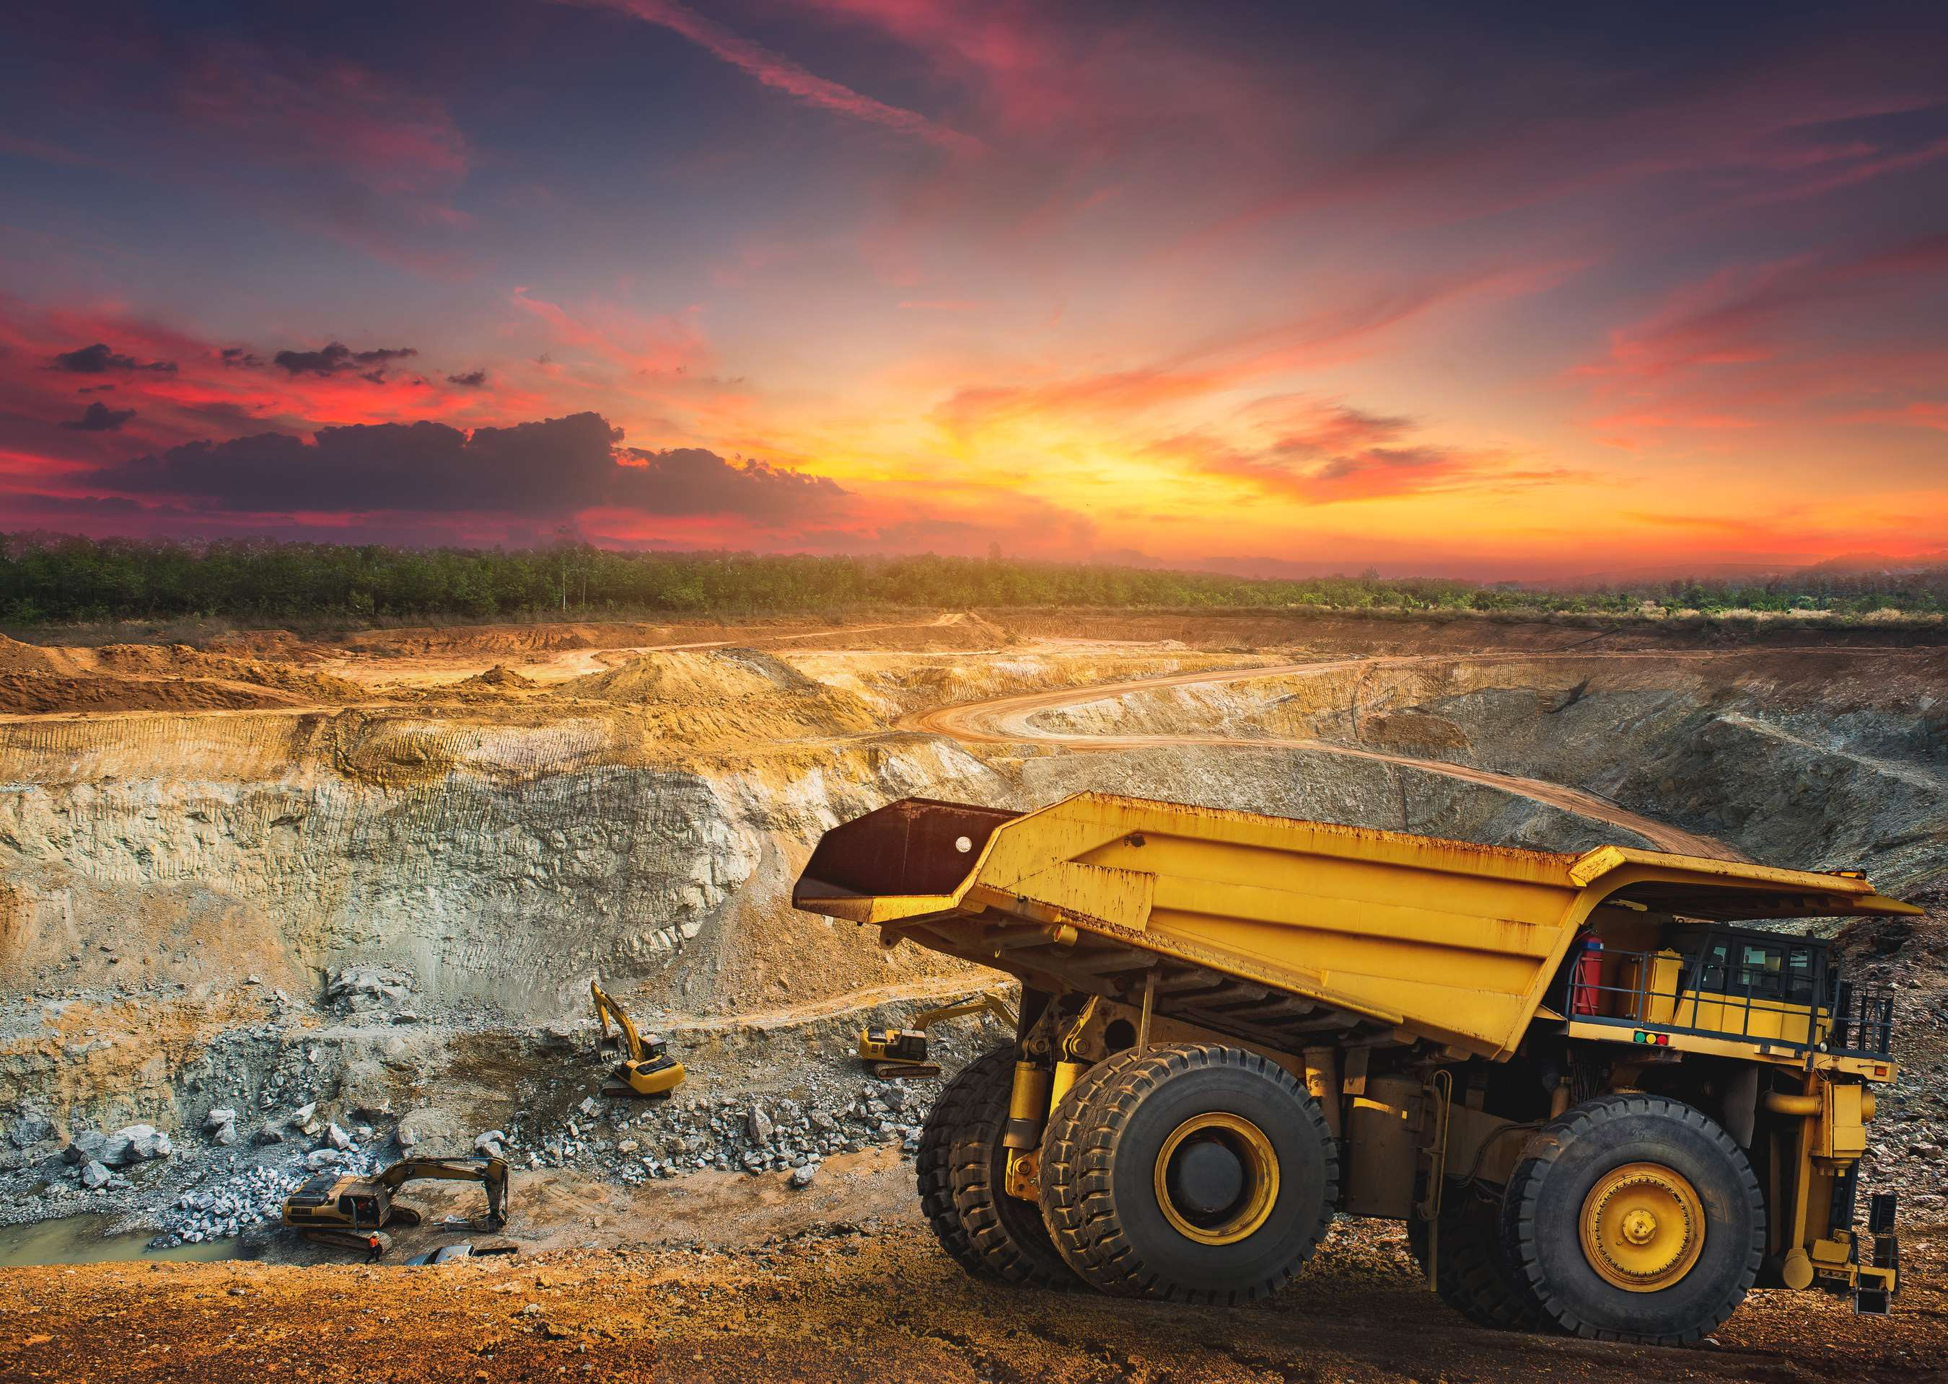
REVENUE MARKET SHARE BY SEGMENTS 2022
Hardrock mining is prevalent in regions with significant gold deposits contained within quartz veins or other solid structure
Mining Method Segment

Slide 5

Global Gold Mining Market Revenue share for 2024
North America
28%

Slide 6
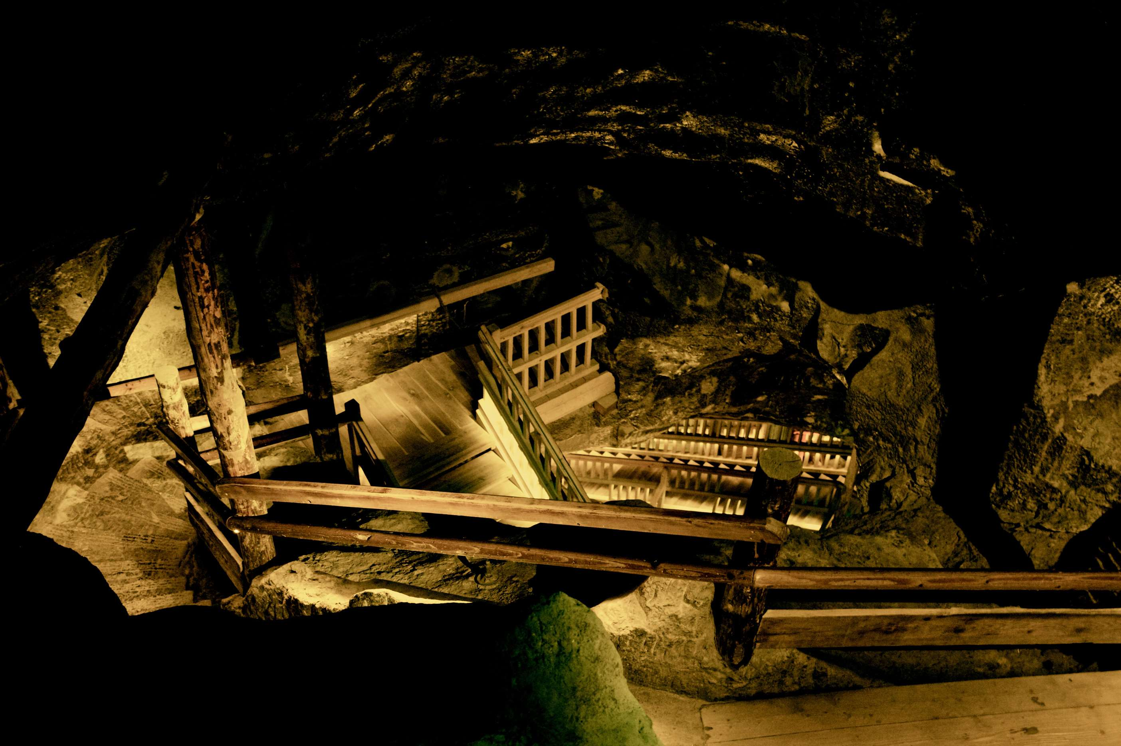
Global Economic Conditions and Gold Prices to Provide Viable Market Output
Drivers
Technological Advancements in Exploration to Propel Market Growth
Restraints

Slide 7
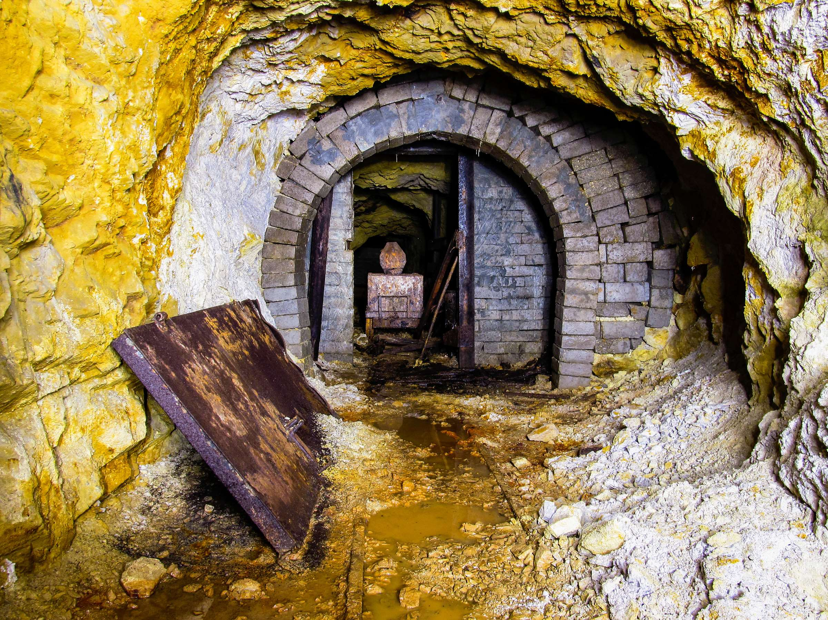
AUTHOR'S PERSPECTIVE
  The Global Gold Mining Market is witnessing significant growth in the near future.
  Hardrock mining is prevalent in regions with significant gold deposits contained within quartz veins or other solid structures.
  Placer Mining emerges as the fastest-growing category in the Gold Mining market.
  Gold has long been considered a safe-haven asset and a store of value, especially during times of economic uncertainty. Investors often turn to gold as a hedge against inflation, currency fluctuations, and geopolitical risks.

Slide 8
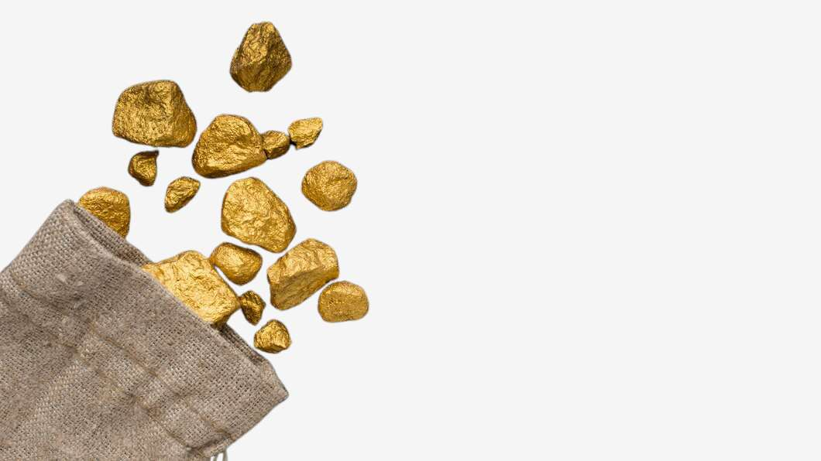



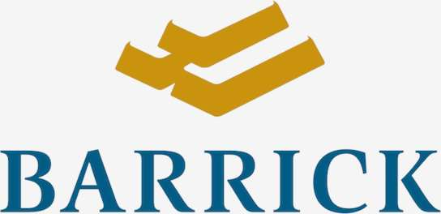
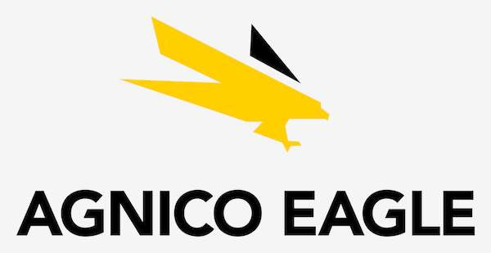


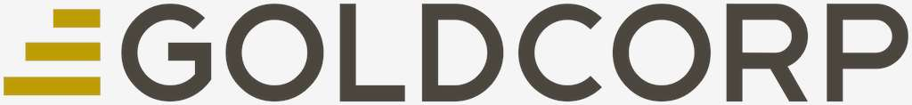
KEY PLAYERS

Slide 9


For Full Report
Contact us
COGNITIVE MARKET RESEARCH
Tel: +1 312-376-8303 | +44 020-8123-0732
India: (+91) 983-496-8611
sales@cognitivemarketresearch.com
Access the Full Report : https://tinyurl.com/mvufvcww
Please visit our website:
https://www.cognitivemarketresearch.com

