Slide 1
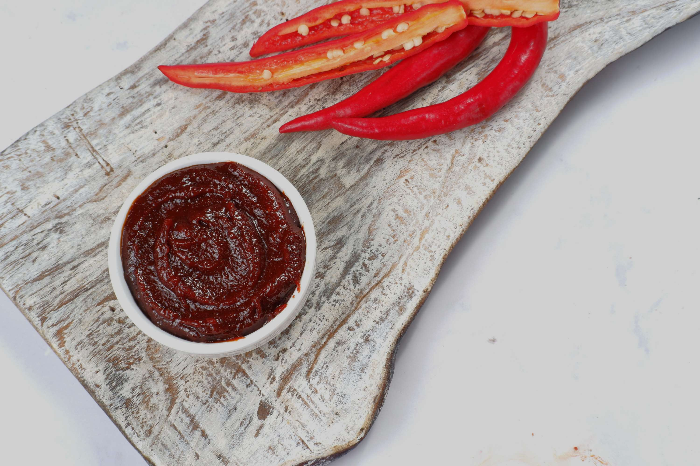

GOCHUJANG
MARKET REPORT
2024
Qualitative Analysis + Quantitative Analysis

Slide 2
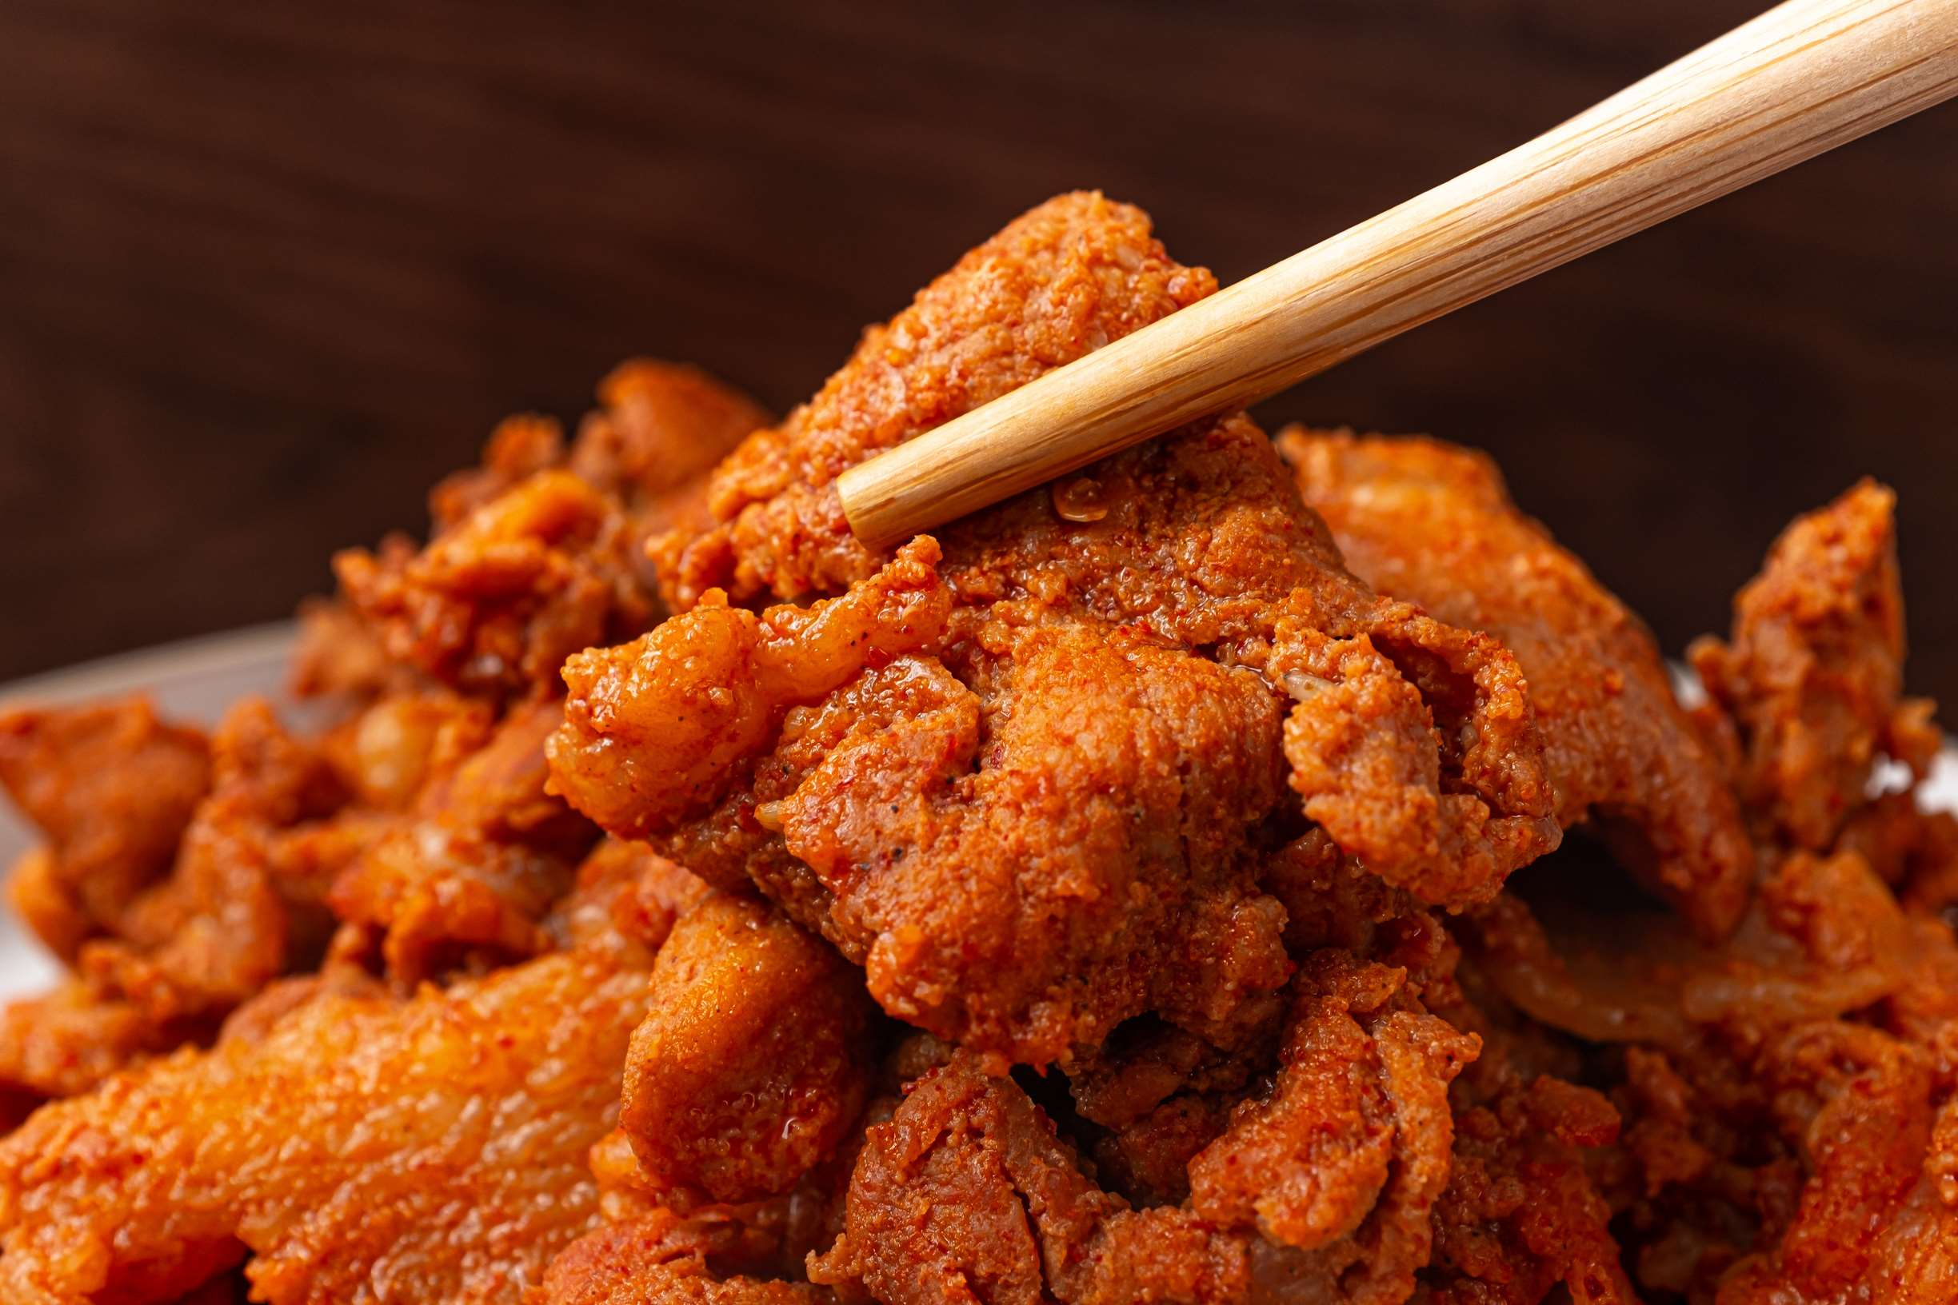
INTRODUCTION
The global commerce and consumption of Gochujang, a fermented Korean chili paste known for its unique flavor profile of spice, sweetness, and savoryness, is referred to as the "Gochujang market." A common ingredient in Korean cooking, gochujang is used in bibimbap, bulgogi, and tteokbokki, among other meals. Because of its widespread appeal, there is a booming global market. The market includes channels for manufacturing, distribution, and consumption, such as conventional brick-and-mortar stores, internet merchants, and eateries. The global demand for bold and spicy tastes has led to a notable expansion and diversification of the Gochujang market, which now offers a wide range of product formulas and package sizes to suit different consumer tastes and culinary uses.

Slide 3
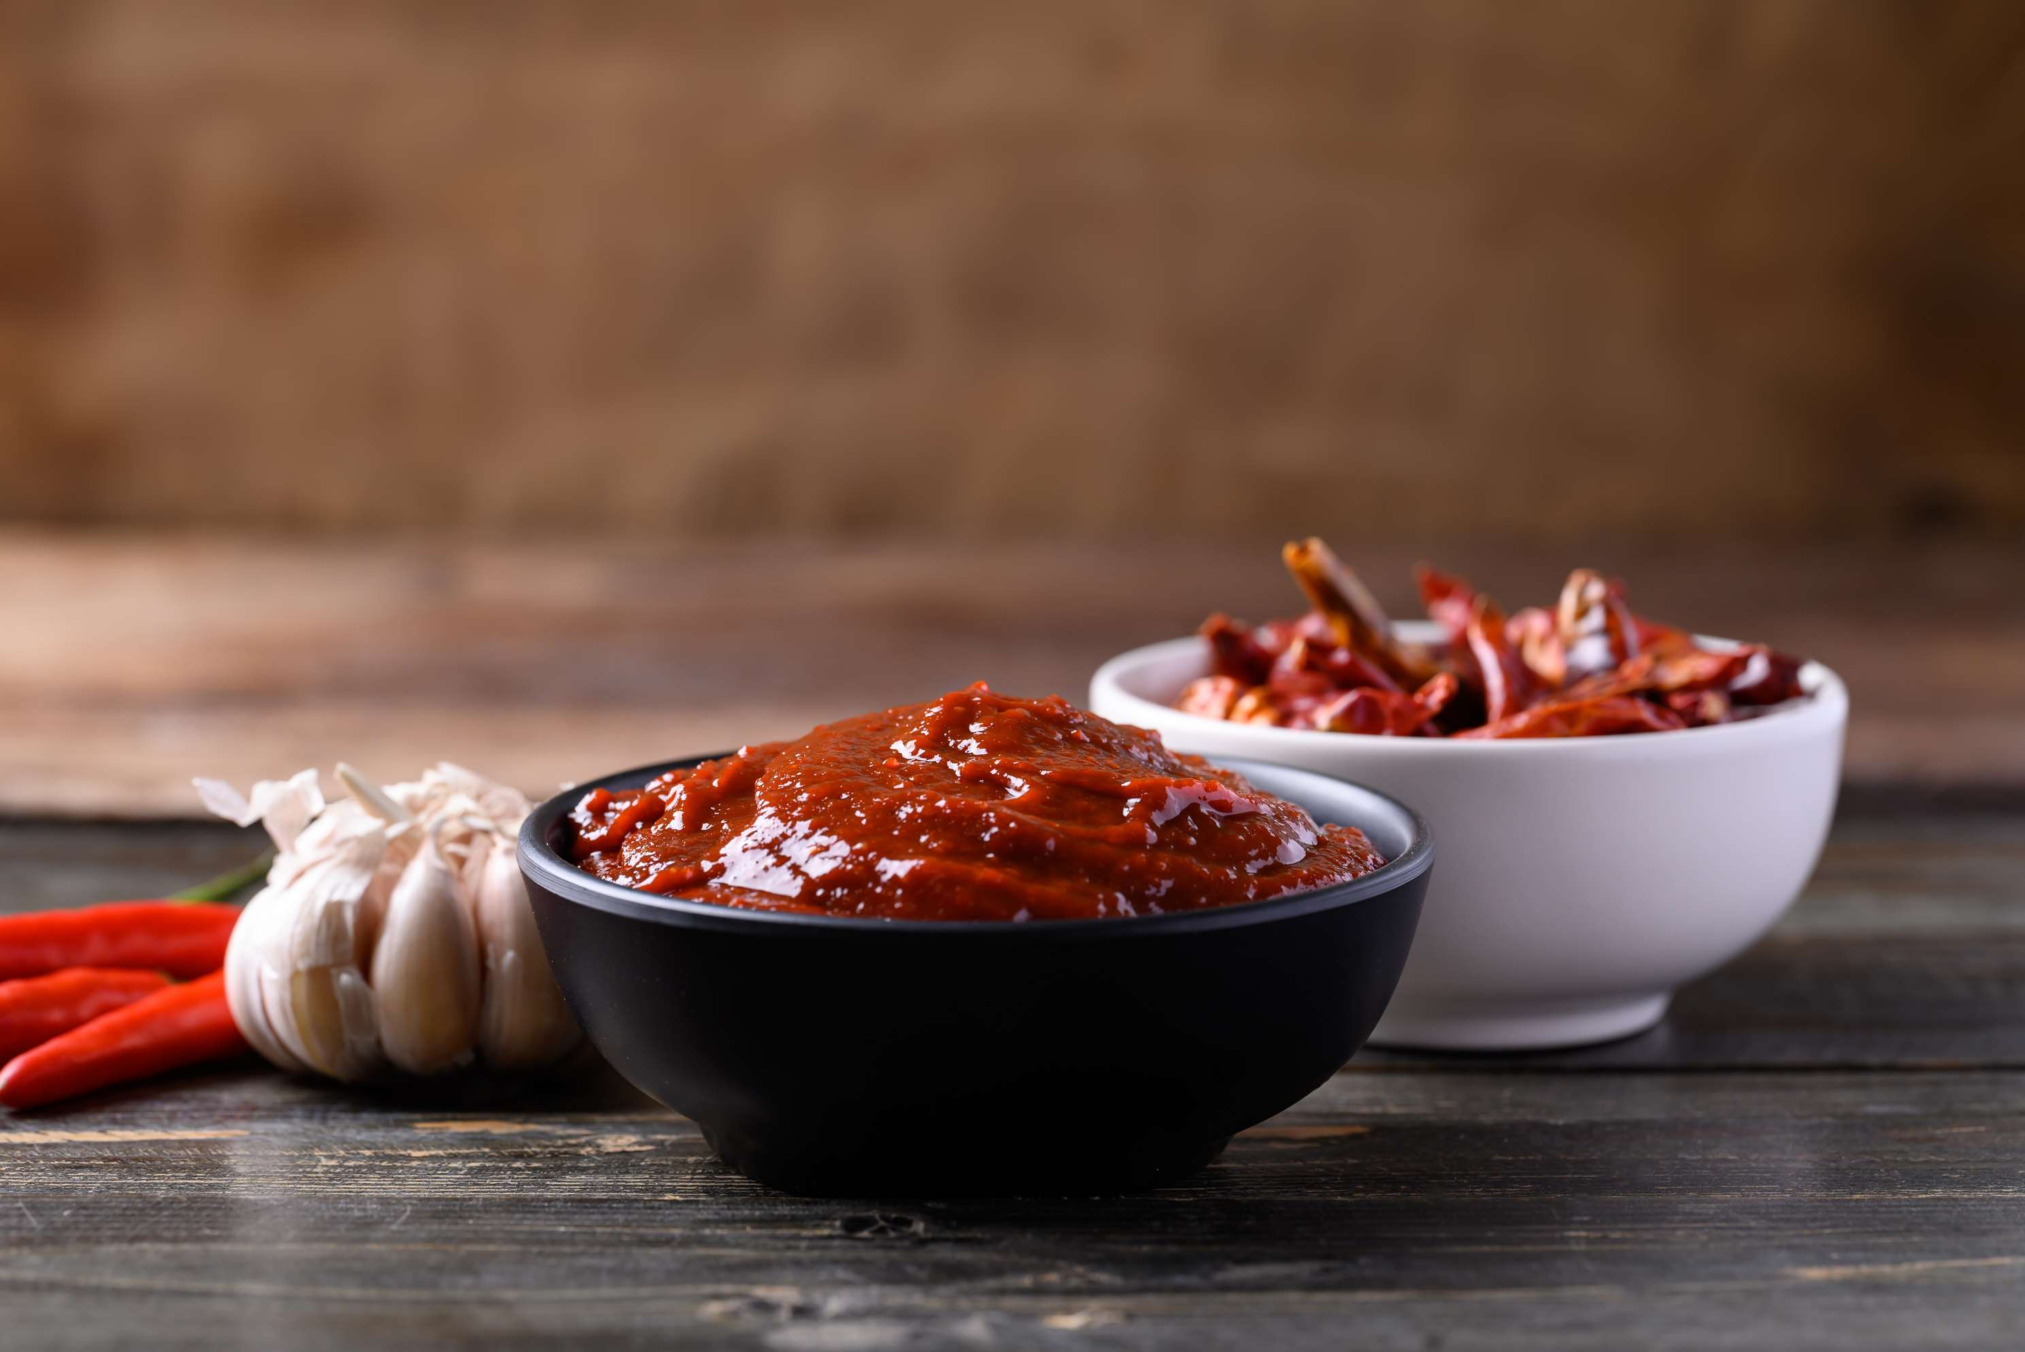

KEY INSIGHTS
CAGR
3.60%
2024- 2031

Slide 4
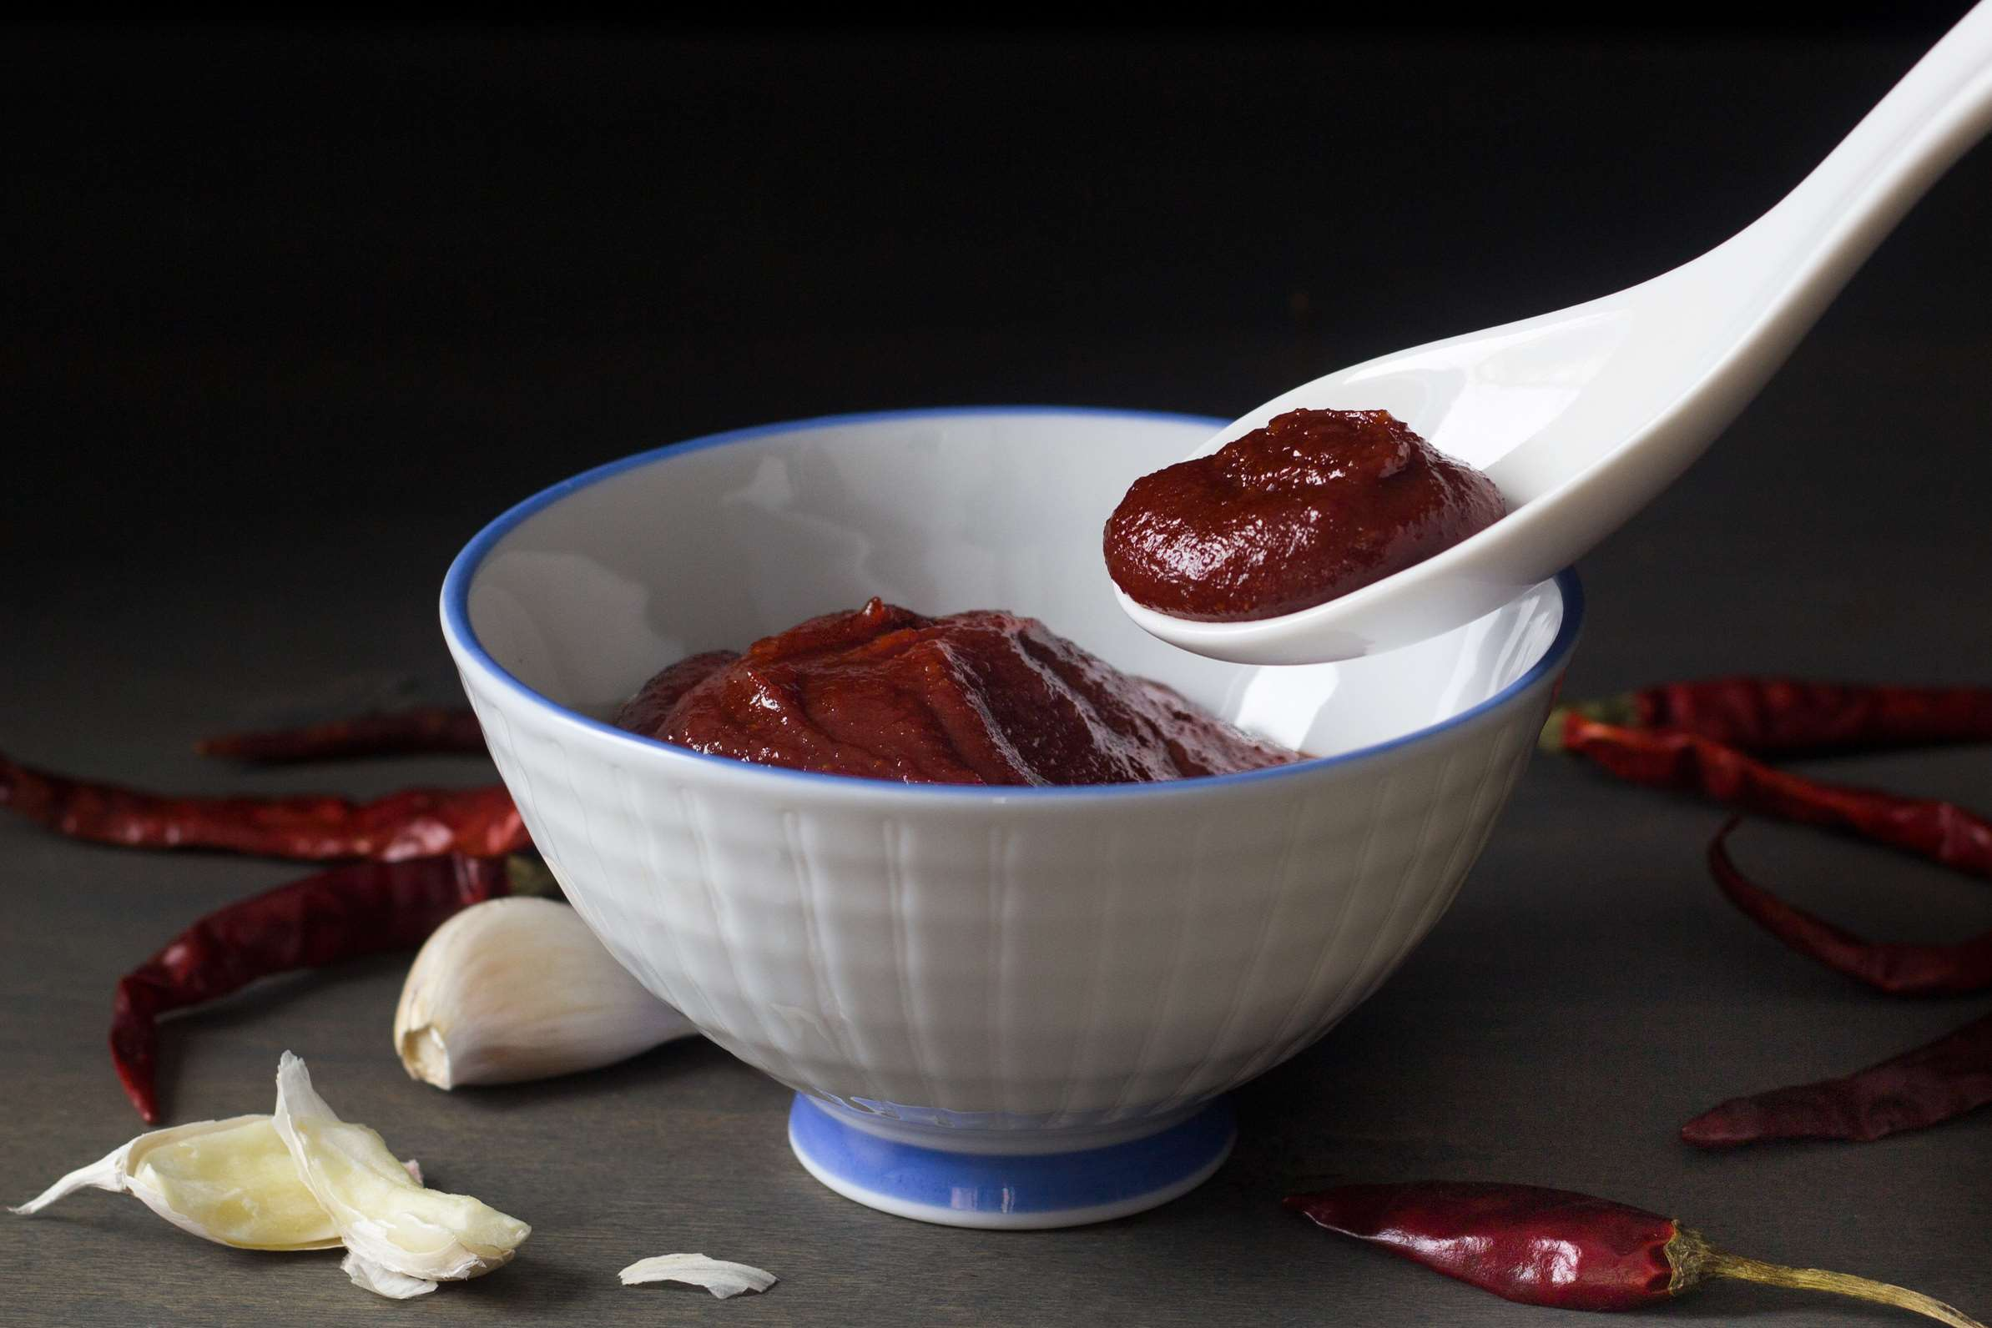
REVENUE MARKET SHARE BY SEGMENTS 2024
  Bagged Gochujang
  Box Packed Gochujang
  Bottled Gochujang
Type Segment
  Online Stores
  Supermarkets
  Independent Retailers
  Specialty Stores
Distribution Segment
  Restaurants
  Home
  Others
Application Segment

Slide 5

REGION ANALYSIS
NORTH AMERICA
Europe
Asia Pacific
Latin America
MIDDLE EAST AFRICA
40%
30%
23%
5%
2%
North America Gochujang Market Revenue share for 2024 is 40%

Slide 6
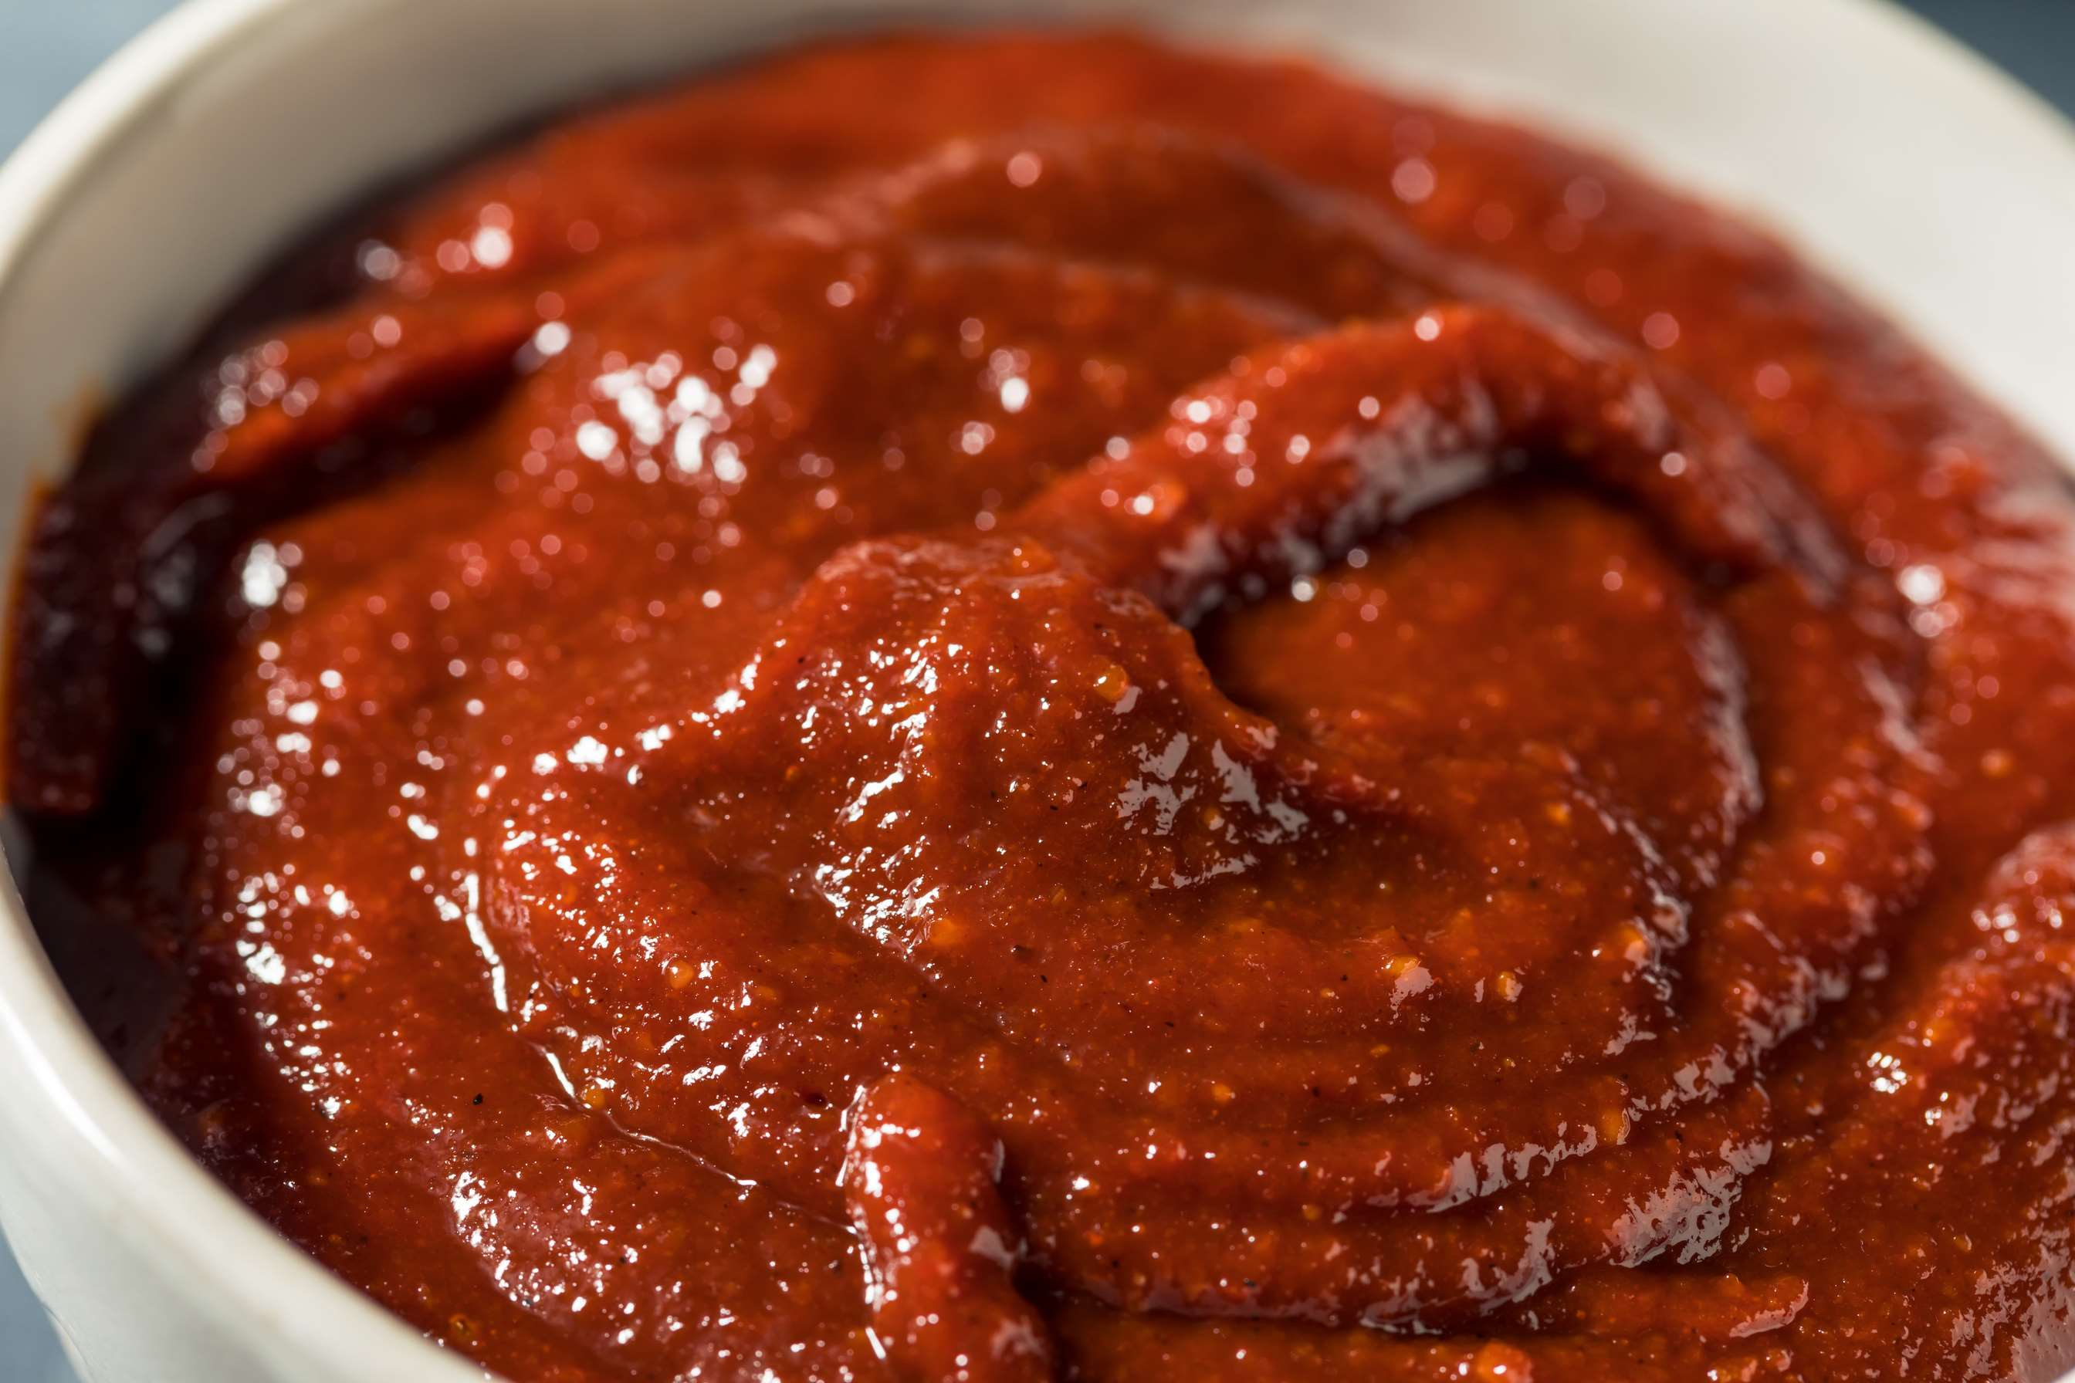
  Rise of Korean Cuisine to Increase the Demand Globally
  Adventurous Eaters and Spicy Food Trend to Propel Market Growth
Drivers
Spice Tolerance and Cultural Preferences to Limit the Sales
Restraints

Slide 7
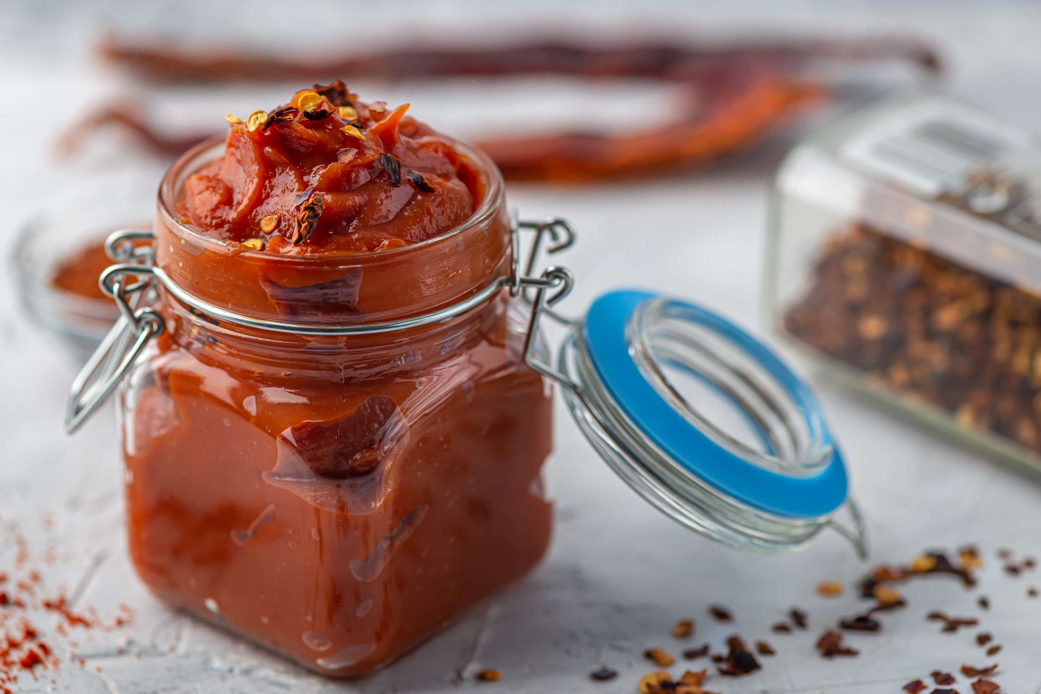
AUTHOR'S PERSPECTIVE
  The global Gochujang market will expand significantly by 3.60% CAGR between 2024 to 2031.
  The market for gochujang is seeing innovation as a result of new product variations, such as sauces infused with gochujang, flavored pastes, and low-sodium choices. This makes it more appealing and opens up more gastronomic possibilities than just traditional Korean cuisine.
  Gochujang is becoming more widely available to customers worldwide as major supermarkets and specialty shops carry it. Its simple availability is further facilitated by online sellers.

Slide 8


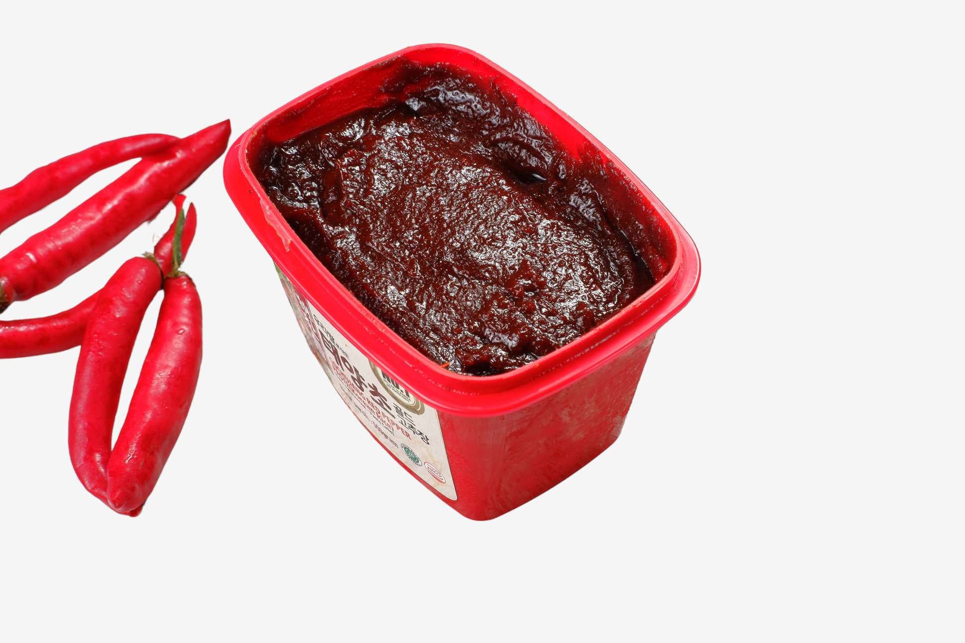


KEY PLAYERS

Slide 9


For Full Report
Contact us
COGNITIVE MARKET RESEARCH
Tel: +1 312-376-8303 | +44 020-8123-0732
India: (+91) 983-496-8611
sales@cognitivemarketresearch.com
Access the Full Report : https://tinyurl.com/39cwcbp4
Please visit our website:
https://www.cognitivemarketresearch.com

