Slide 1


GLUTEN FREE BISCUITS
MARKET REPORT
2024
Qualitative Analysis + Quantitative Analysis

Slide 2
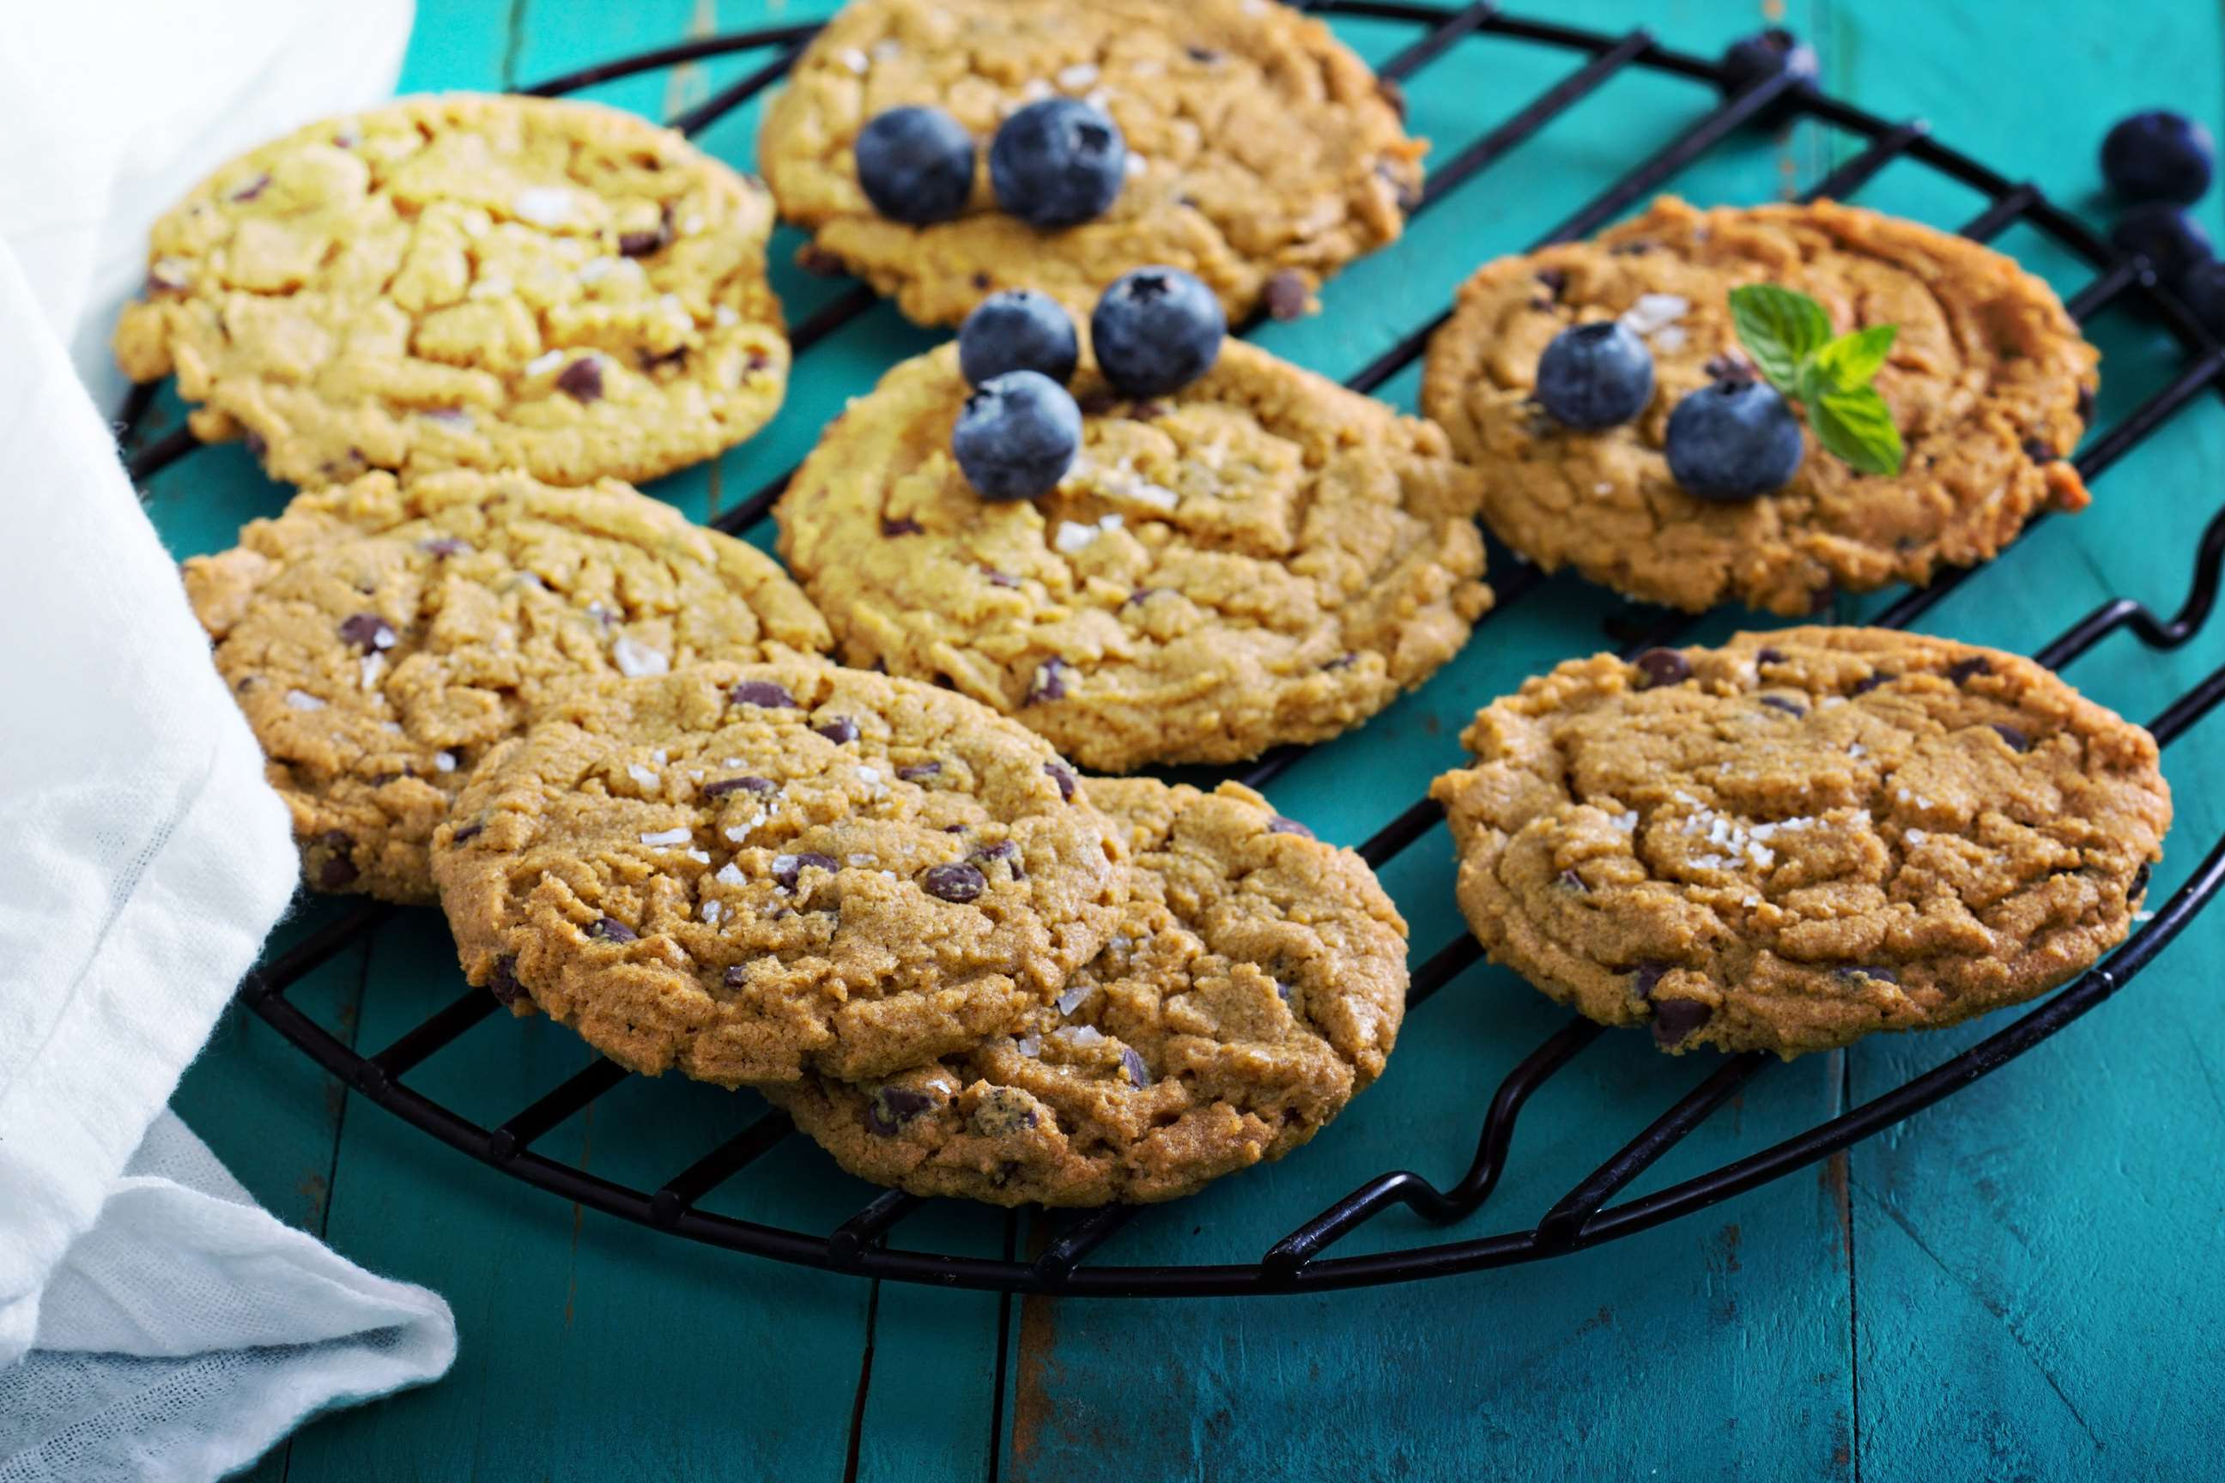
INTRODUCTION
Gluten-free biscuits are baked goods typically made without wheat or other gluten-containing ingredients. Instead, alternative flours such as rice, almond, or tapioca flour are used to achieve a similar texture. These biscuits cater to individuals with gluten intolerance or celiac disease, providing a safe option for enjoying baked treats. The growing awareness about celiac disease and gluten sensitivity among consumers, rising trend towards healthier eating habits and lifestyles, rising demand for convenience foods, expansion of retail channels, product innovation and diversification, rising disposable income, increasing demand for clean label and natural ingredients, influence of social media and digital platforms, increasing globalization and cultural exchange and regulatory support and standards are the major factors influencing the growth of the Gluten Free Biscuits Market.

Slide 3
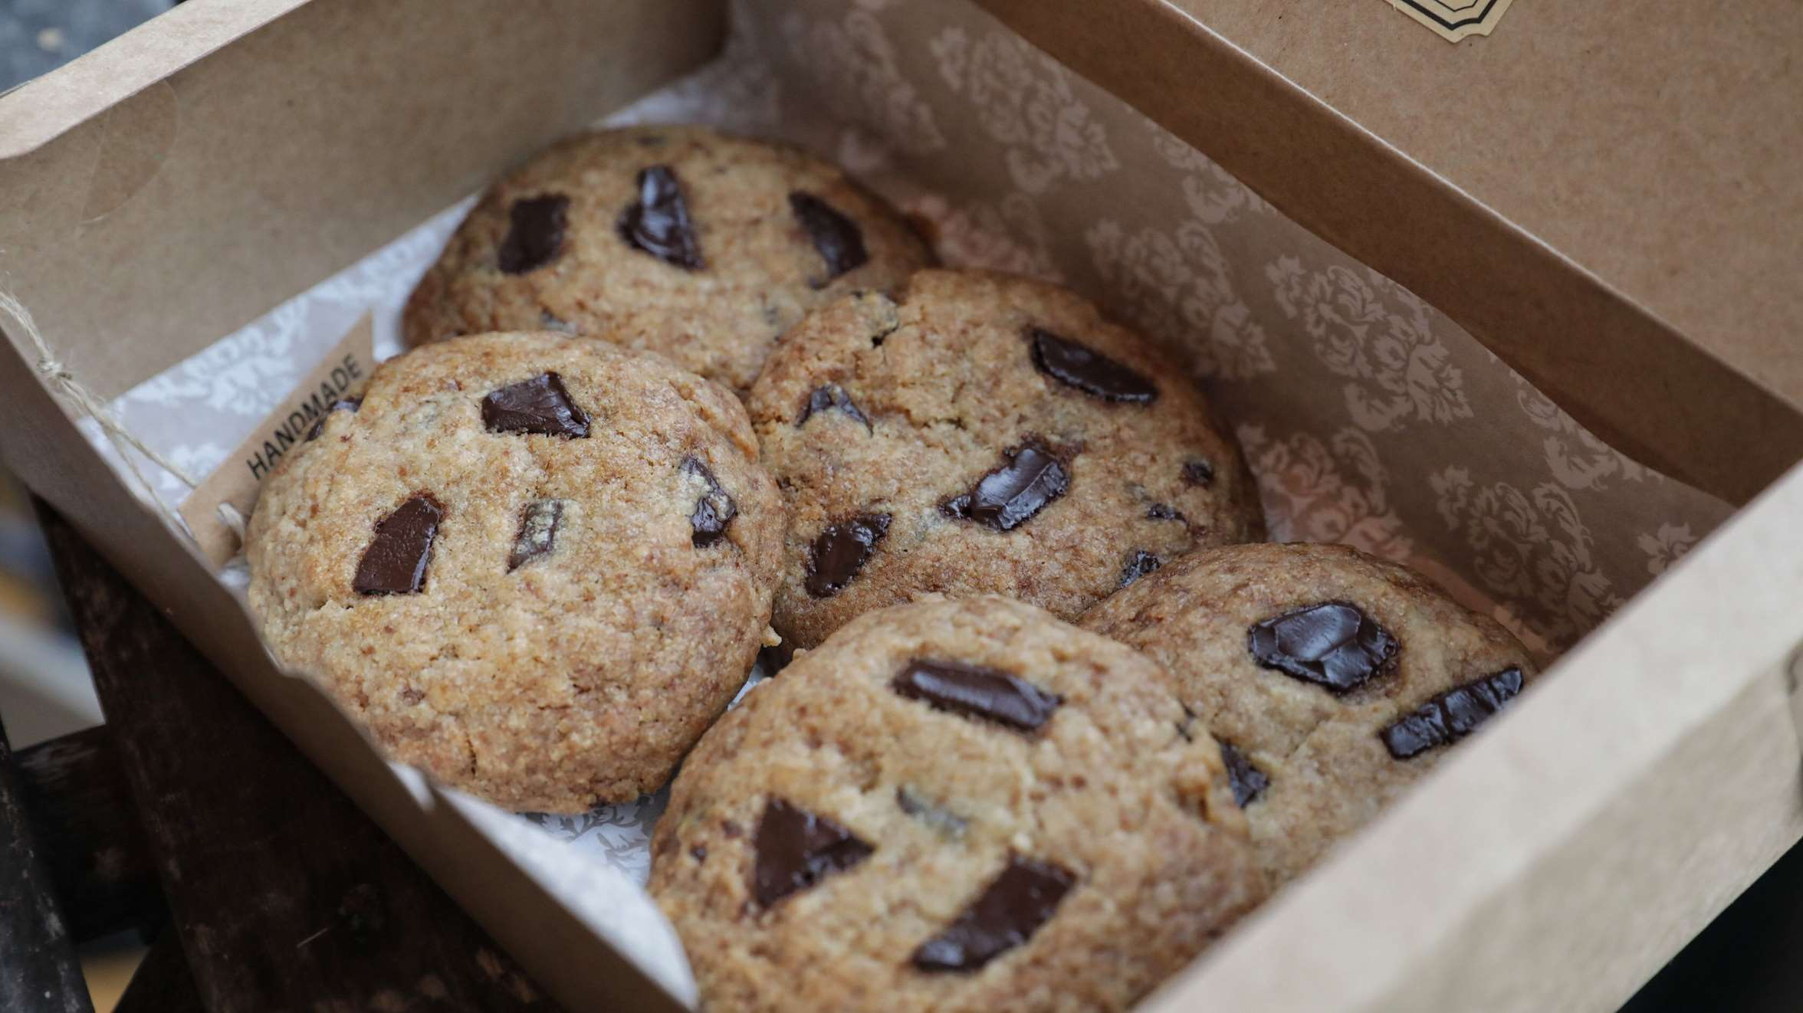

KEY INSIGHTS
MARKET SIZE
USD 512.2 million
2024
CAGR
9.00%
2024- 2031

Slide 4
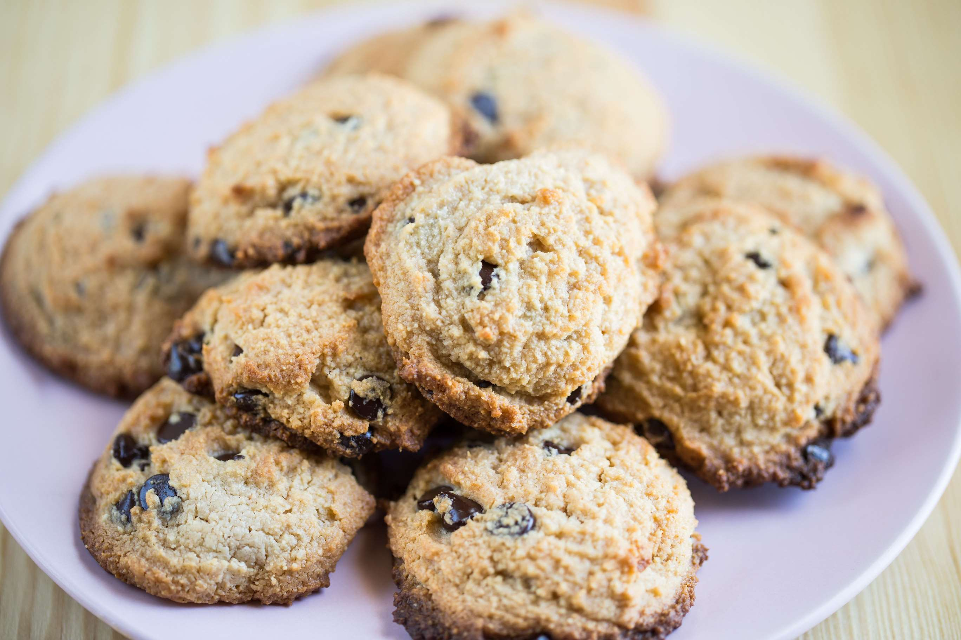
REVENUE MARKET SHARE BY SEGMENTS 2024
  Plain
  Milk
  Chocolate
Type Segment
  Supermarkets and Hypermarkets
  Convenience Stores
  Specialty Stores
  E-Commerce
Distribution Channel
  Baby
  Kids
  Pregnant Woman
  Patients
End-user Segment

Slide 5


North America
40%
North America Gluten Free Biscuits Market Revenue share for 2024 is 40%

Slide 6

  Rise in health-conscious consumer to Provide Viable Market Output
  Rising demand for clean label and organic products to Propel Market Growth.
Drivers
High costs of biscuits to Restrict Market Growth
Restraints

Slide 7
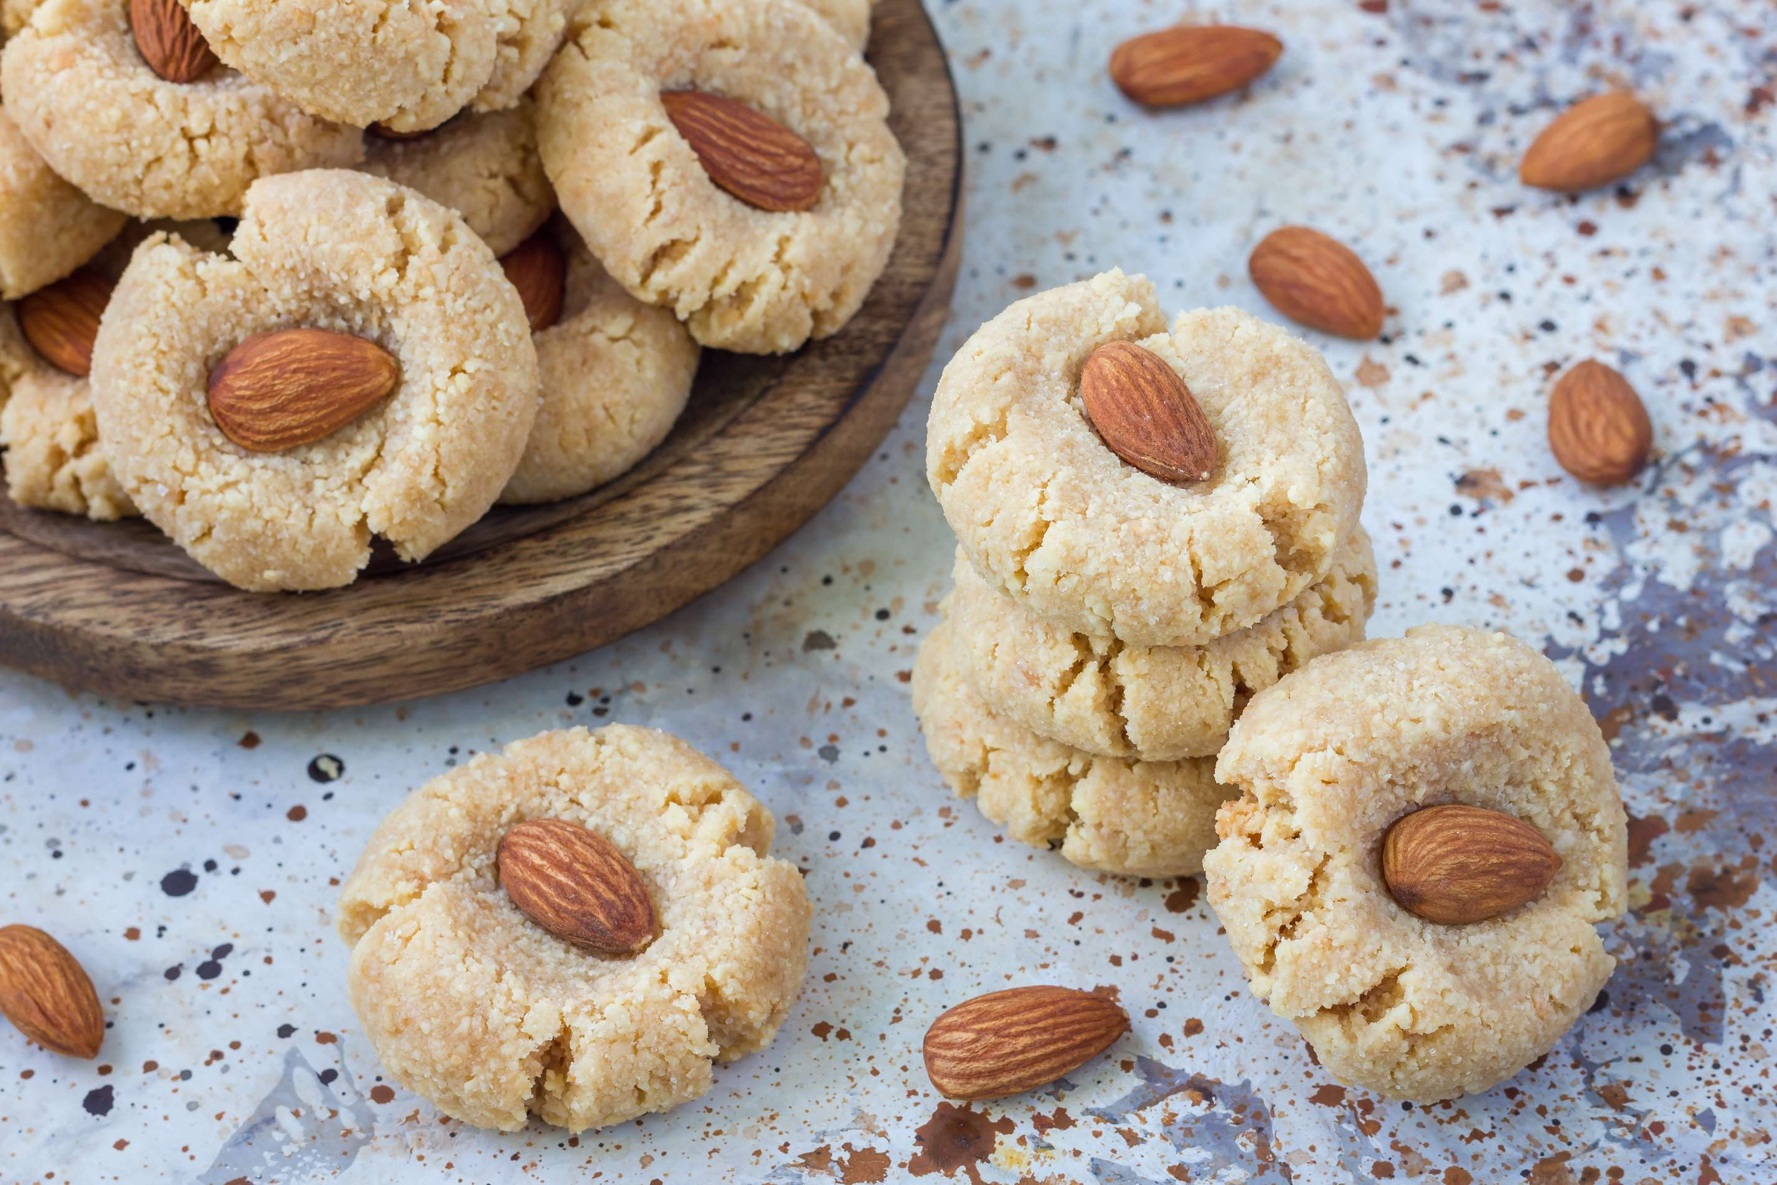
AUTHOR'S PERSPECTIVE
  The global gluten-free biscuits market will expand significantly by 9.00% CAGR between 2024 and 2031.
  Sales of the plain segment are set to rise as they cater to consumers seeking a simple, natural option without compromising taste or texture for those with gluten sensitivities or preferences.
  There is an expansion of retail channels, product innovation and diversification, and rising disposable income.

Slide 8









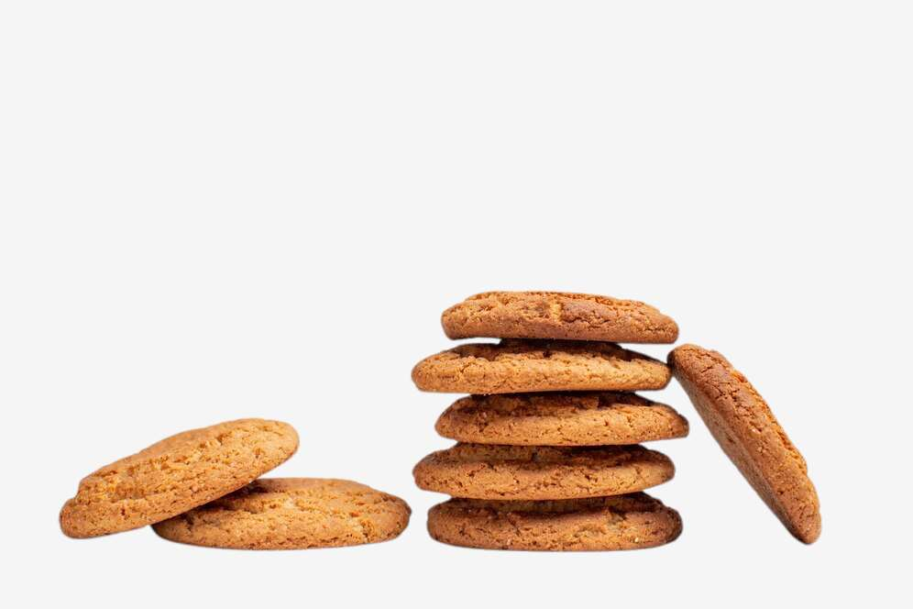



KEY PLAYERS

Slide 9


For Full Report
Contact us
COGNITIVE MARKET RESEARCH
Tel: +1 312-376-8303 | +44 020-8123-0732
India: (+91) 983-496-8611
sales@cognitivemarketresearch.com
Access the Full Report : https://tinyurl.com/mtf4swcd
Please visit our website:
https://www.cognitivemarketresearch.com

