Slide 1

GLOBAL
GLASSES CASE
MARKET REPORT
2024
Global,Regional,CountryAnalysis

Slide 2
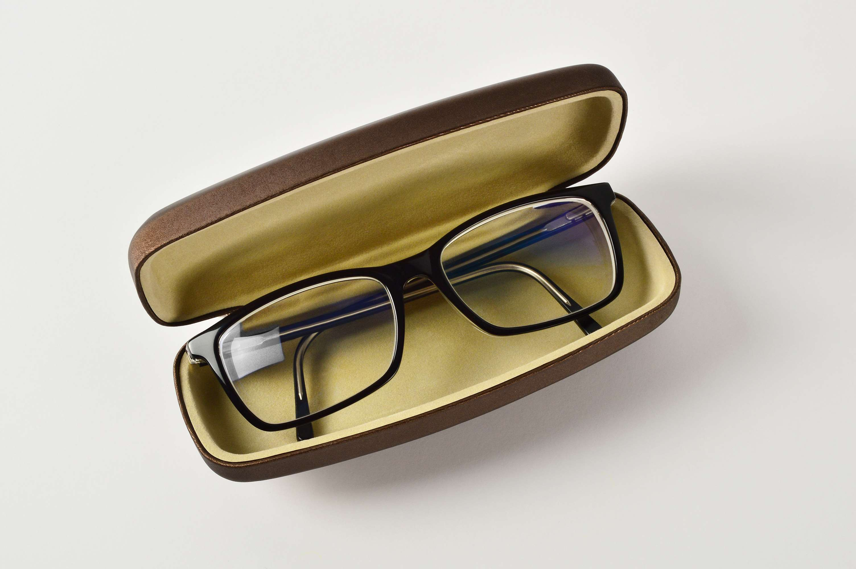
INTRODUCTION
A glasses case is a compact box typically covered in fabric, which is specifically designed to house eyeglasses. It also serves as a means of safeguarding sunglasses. The significance of a glasses case lies in its capacity to maintain the cleanliness and scratch-free condition of eyeglasses when they are not in use. The expansion in the industry is driven by the escalating demand for sunglasses and eyeglasses, the heightened consciousness regarding eye health, and the increased disposable income. Additionally, there is a growing awareness of the significance of eye health and safety, coupled with the rising disposable income of consumers in developing nations.

Slide 3
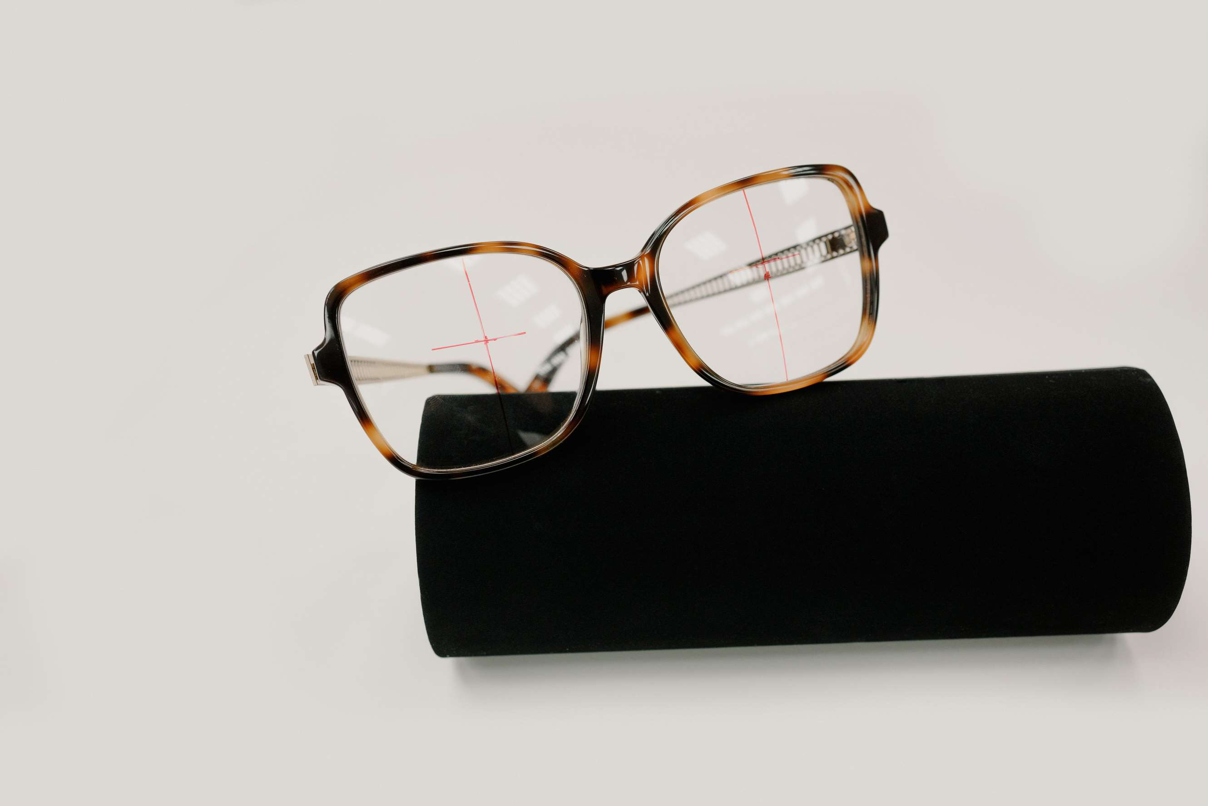

KEY INSIGHTS
CAGR
5.90%
2023- 2030

Slide 4

REVENUE MARKET SHARE BY SEGMENTS 2022
  Plastic
  Metal
  EVA
Type Segment
  Online
  Offline
Application Segment

Slide 5

Global Glasses Case Market Revenue share for 2024
North America

Slide 6

E-commerce Boom to Propel Market Growth
Drivers
Changing Consumer Behavior and Preferences to Hinder Market Growth
Restraints

Slide 7
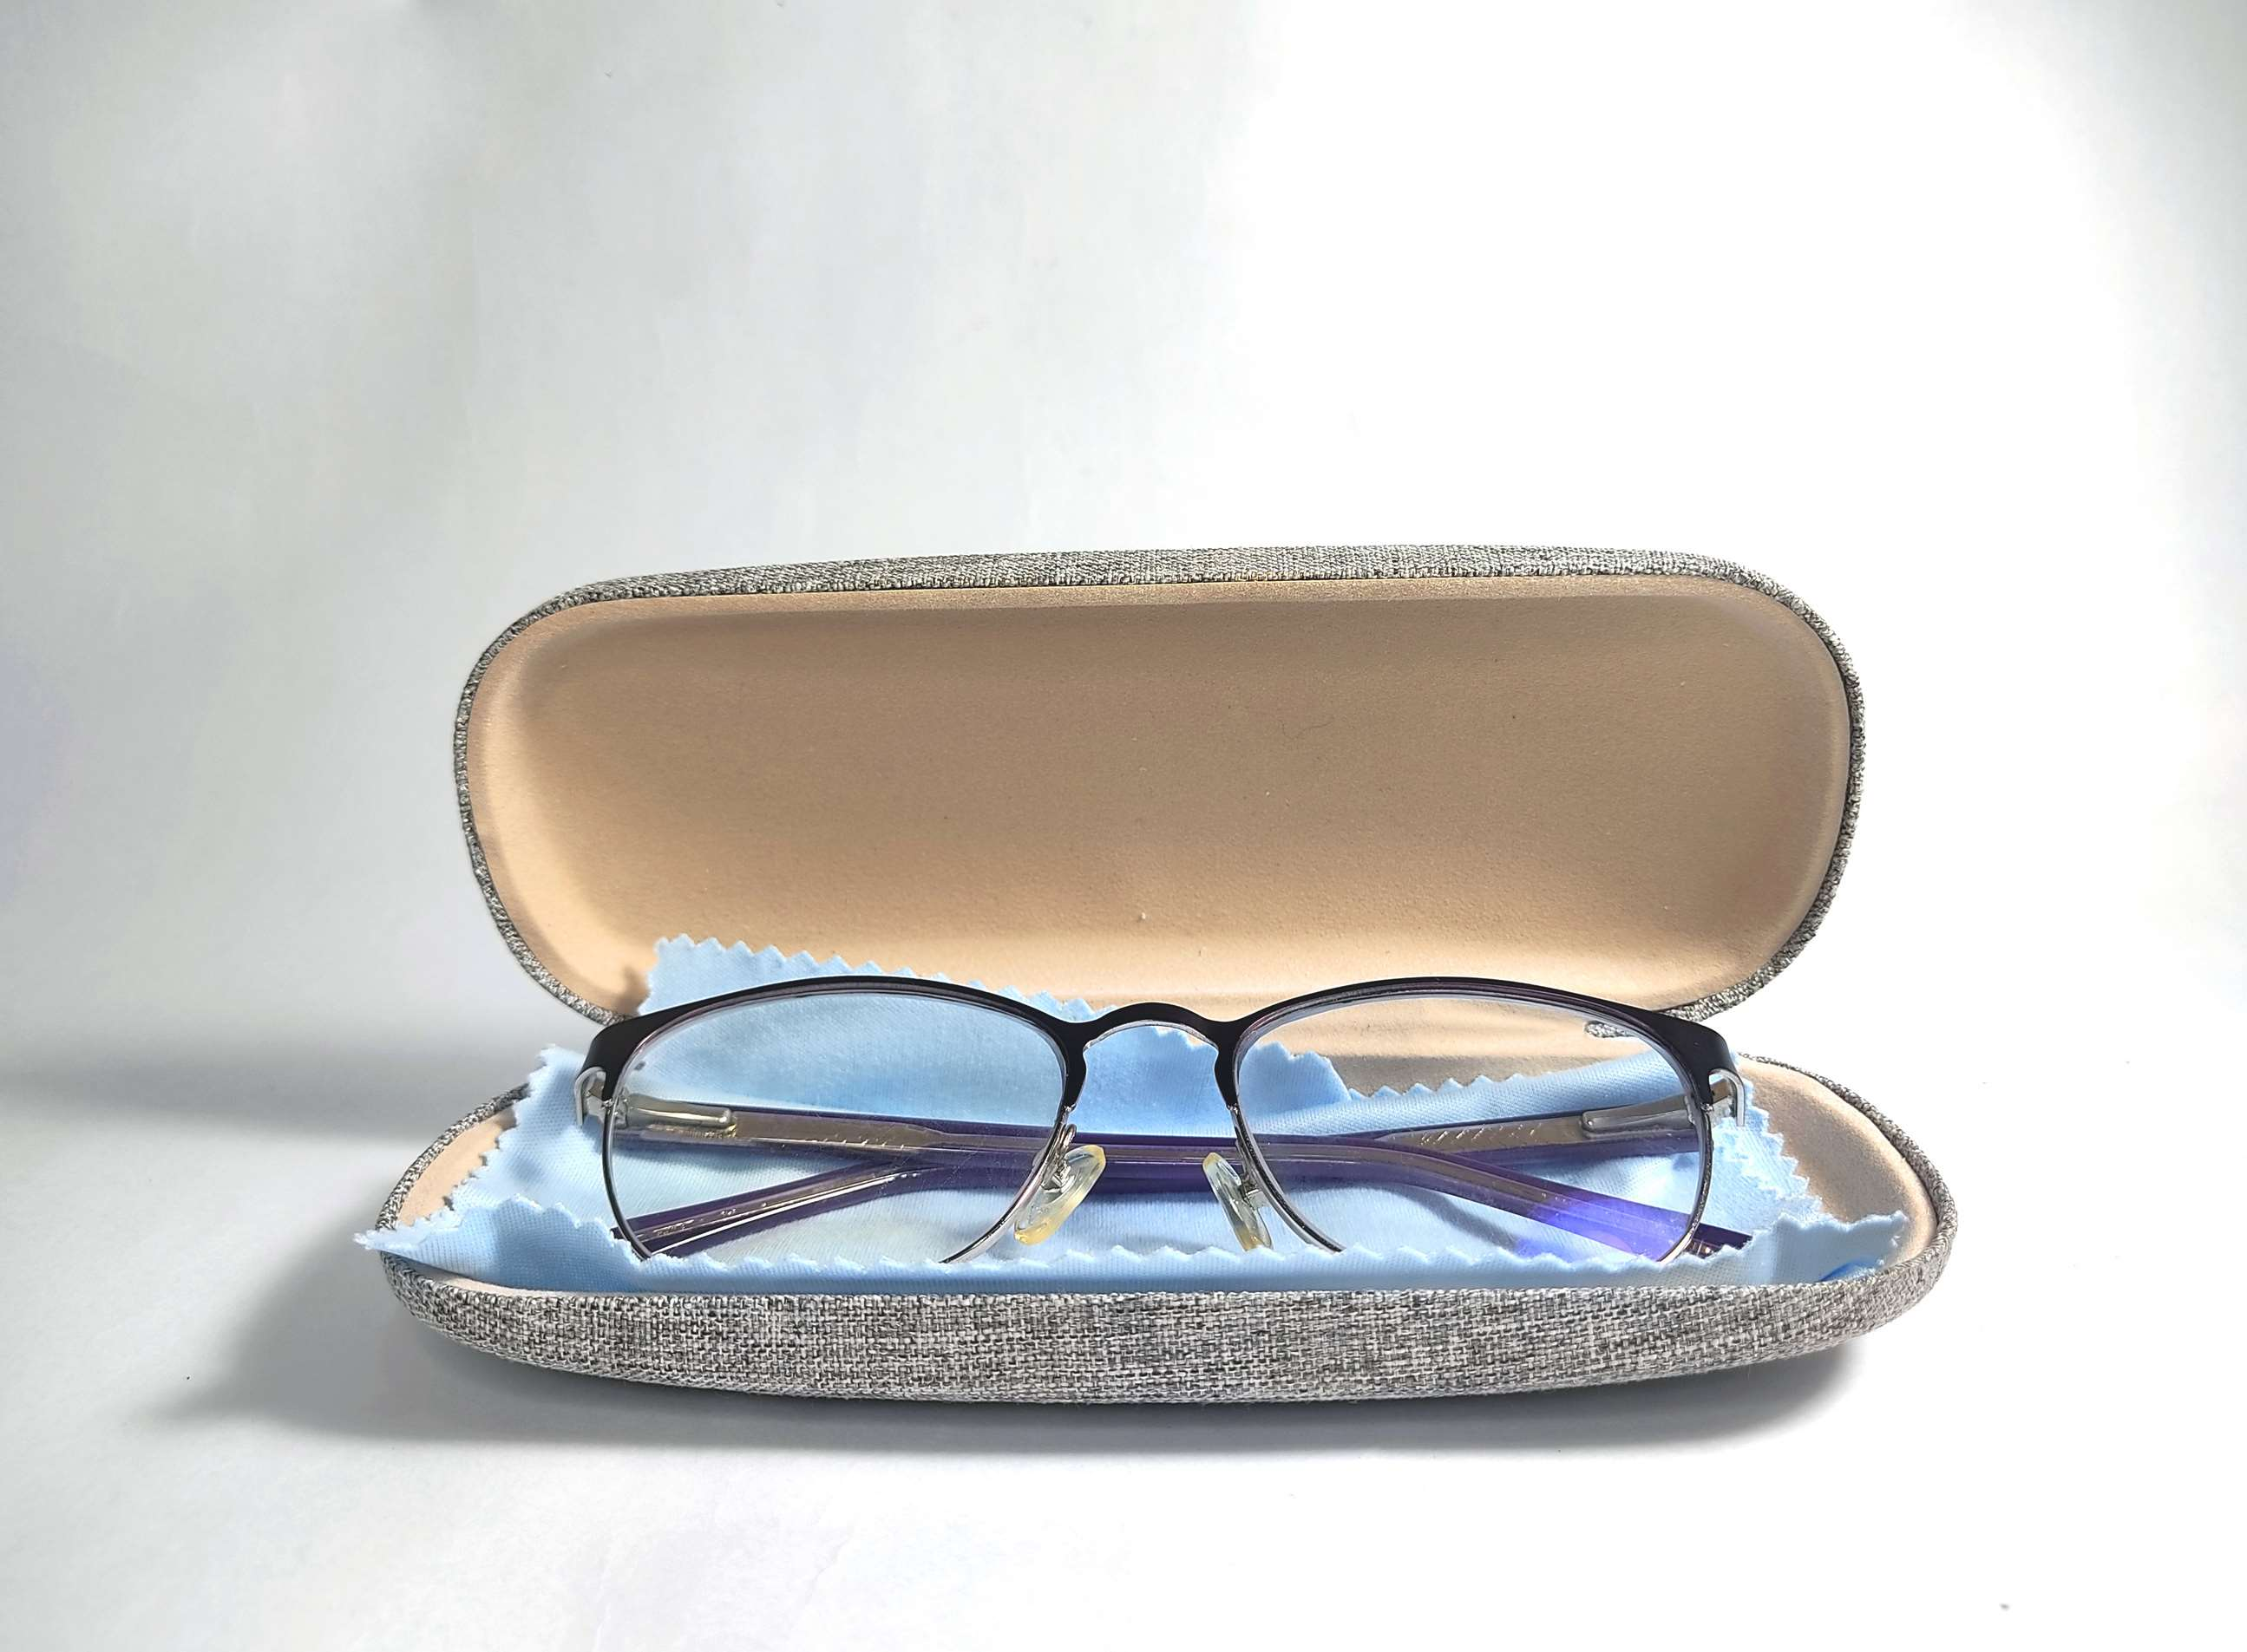
AUTHOR'S PERSPECTIVE
  The Global Glasses Case Market is witnessing significant growth in the near future.
  EVA cases are known for their durability and high-impact resistance, providing superior protection for eyewear, including sunglasses.
  Traditional distribution channels such as brick-and-mortar eyewear stores, optical shops, and department stores have always been the primary means of distributing glasses cases.

Slide 8









KEY PLAYERS

Slide 9


For Full Report
Contact us
COGNITIVE MARKET RESEARCH
Tel: +1 312-376-8303 | +44 020-8123-0732
India: (+91) 983-496-8611
sales@cognitivemarketresearch.com
Access the Full Report : https://tinyurl.com/2nc78y5k
Please visit our website:
https://www.cognitivemarketresearch.com

