Slide 1

GLOBAL
GIFT BOXES
MARKET REPORT 2024
Global,Regional,CountryAnalysis

Slide 2

INTRODUCTION
One of the key elements that is projected to fuel demand for gift packaging is the booming e- commerce in the gifting sector. Large e-commerce enterprises like Snapdeal and Amazon crucially fuel the need for gift packaging. Additionally, rising per capita income and increased exposure to worldwide trends are providing incentives for the expansion of the global gift sector, which is in turn driving up the market for gift packaging. The market is comprehensively evaluated in the study of the global gift packaging industry. The research provides a thorough analysis of the market's major segments, trends, drivers, constraints, competitive environment, and other important elements.

Slide 3


KEY INSIGHTS
MARKET SIZE
USD 2.1 billion
2023
20₋23
CAGR 6.98%
2030

Slide 4

REVENUE MARKET SHARE BY SEGMENTS 2022
Slide Sleeve Telescopic
Type Segment
Consumer Goods Food & Beverages Electronic Devices
Cosmetics and Personal Care Products
Application Segment
Paper Plastic Others
Raw Material

Slide 5
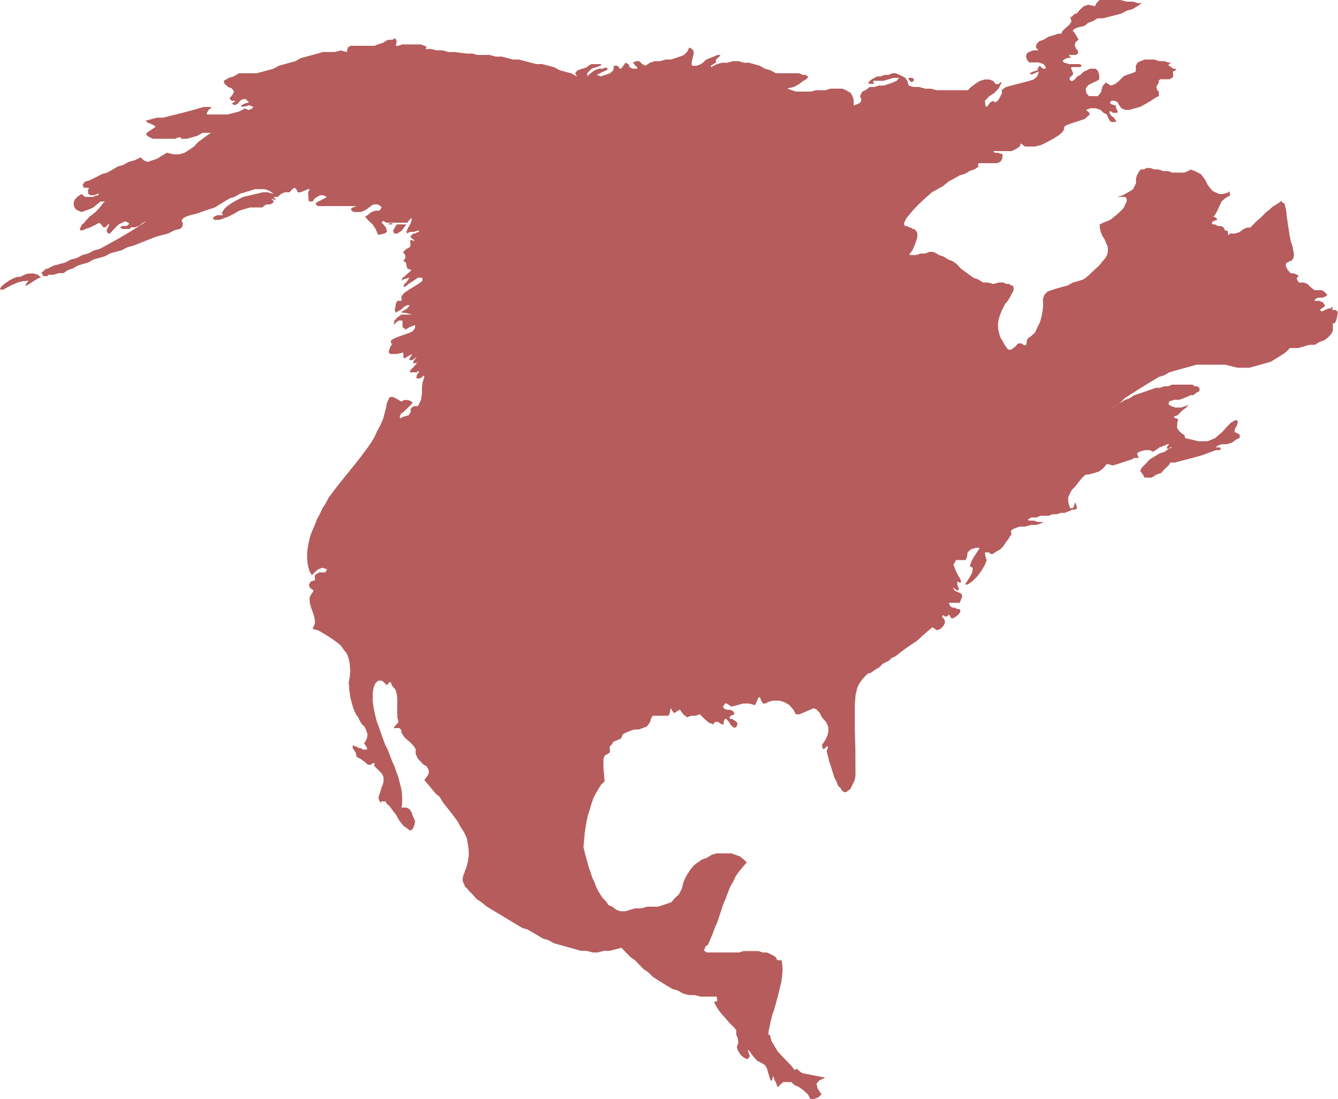
Global Gift Boxes Market Revenue share for 2022
North America 37%

Slide 6

Online Shopping and E- commerce Growth Present a Substantial Prospect to Propel Market Growth
Drivers
Sustainability And Environmental Laws Can Be Impeding to Hinder Market Growth
Restraints

Slide 7

AUTHOR'S PERSPECTIVE
The Global Gift Boxes Market is witnessing significant growth in the near future.
A sheet of paper that wraps around an item (such as a jar, a box, or a t-shirt) and helps to brand it without necessarily placing the goods in a custom-printed box, which is more expensive, is known as packaging sleeves or belly band packaging.
The packaging is made to reflect the brand's personality, appeal to the target market, and raise the perceived worth of the goods as a whole.
The transparency, toughness, flexibility, and printability of many plastics, including polyethylene terephthalate (PET), polypropylene (PP), and polystyrene (PS), are only a few of their special qualities.
Flexography Printed is a flexible, economical option for straightforward designs and big orders.

Slide 8
KEY PLAYERS

Slide 9


Contact us
For Full Report
COGNITIVE MARKET RESEARCH
Tel: + 1 312 - 376 - 8303 | + 44 020 - 8123 - 0732
India: ( + 91 ) 983 - 496 - 8611
sales@ cognitivemarketresearch. com
Access the Full Report : http://tinyurl.com/285jbwbh
Please visit our website:
https://www.cognitivemarketresearch.com

