Slide 1


GARDENING POTS
MARKET REPORT
2024
Qualitative Analysis + Quantitative Analysis

Slide 2
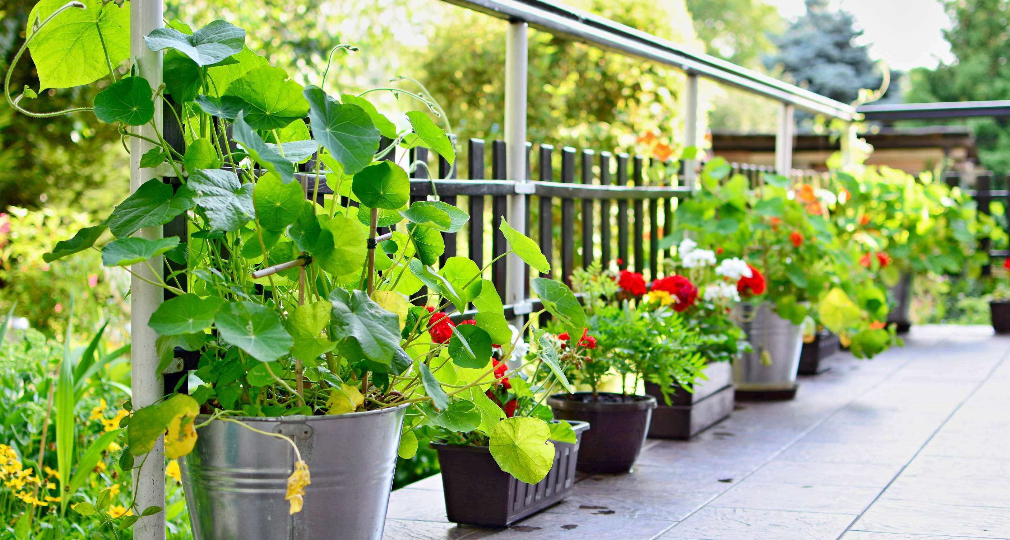
INTRODUCTION
Modern gardening pots are getting more and more sophisticated as more individuals choose to cultivate their plants. The product's numerous positive attributes are its portability, ideality for growing plants in a nursery, and ease of maintenance. The product's use is expanding as more and more individuals use flowers to decorate their rooms to create a calming and friendly atmosphere. Growing global spending on gardening-related activities is also believed to be a major factor in the rise in consumption. For instance, the National Garden Association reported in April 2022 that US gardening and yard maintenance spending is over $52.3 billion.

Slide 3
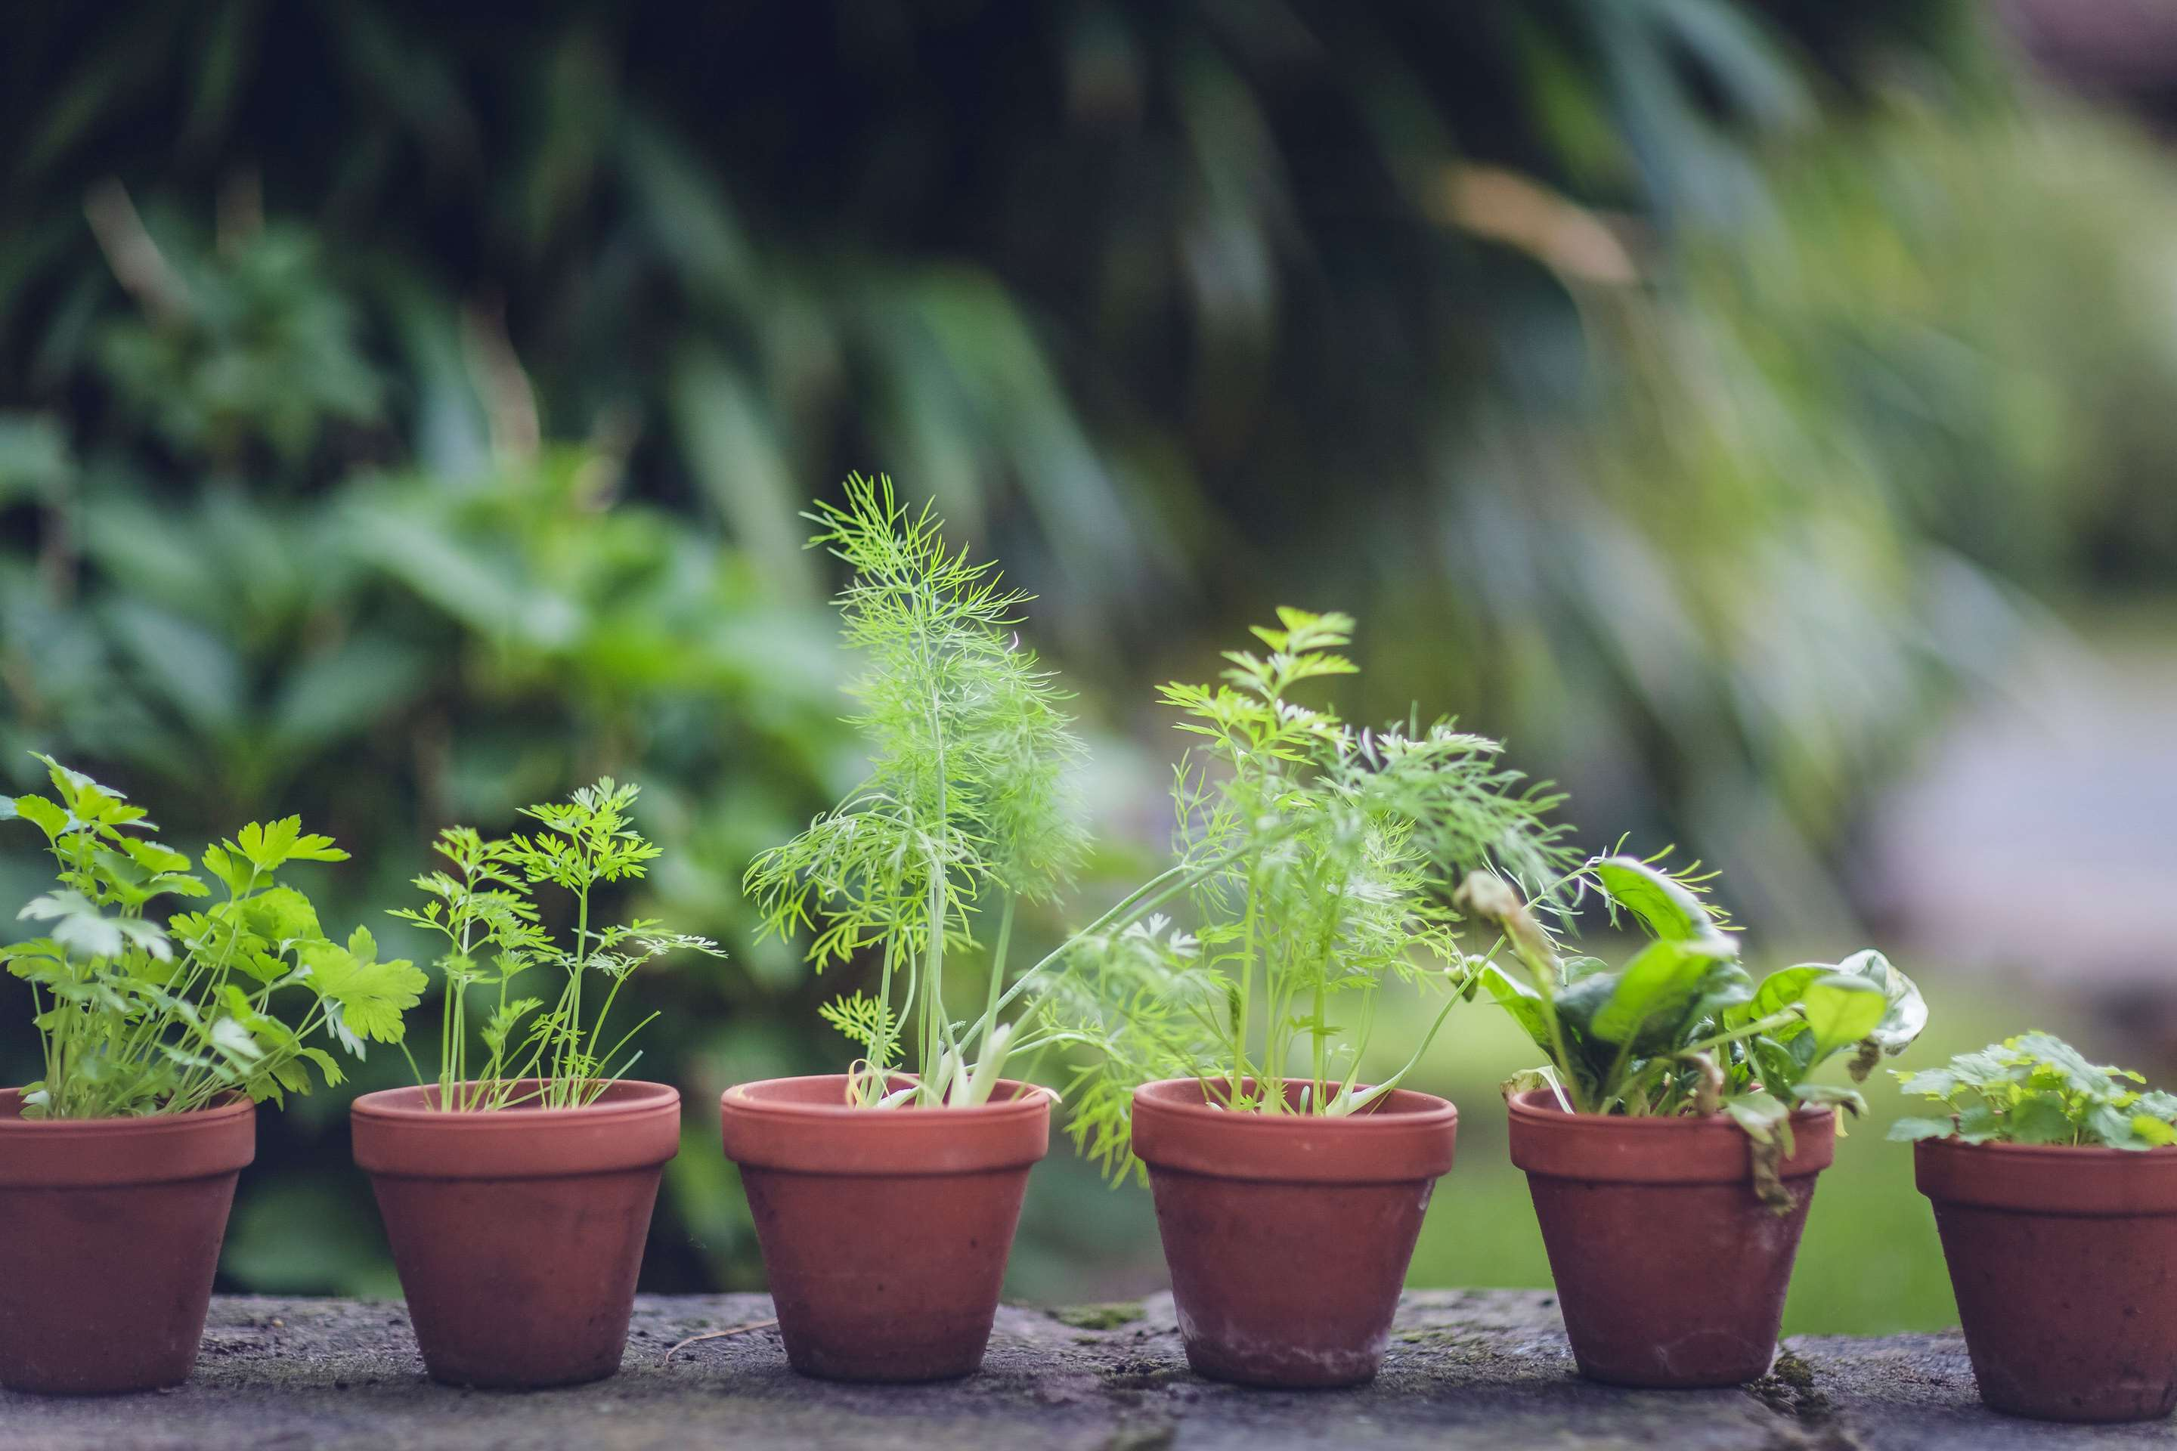

KEY INSIGHTS
MARKET SIZE
USD 18512.2 million
2024
CAGR
19.60%
2024- 2031

Slide 4
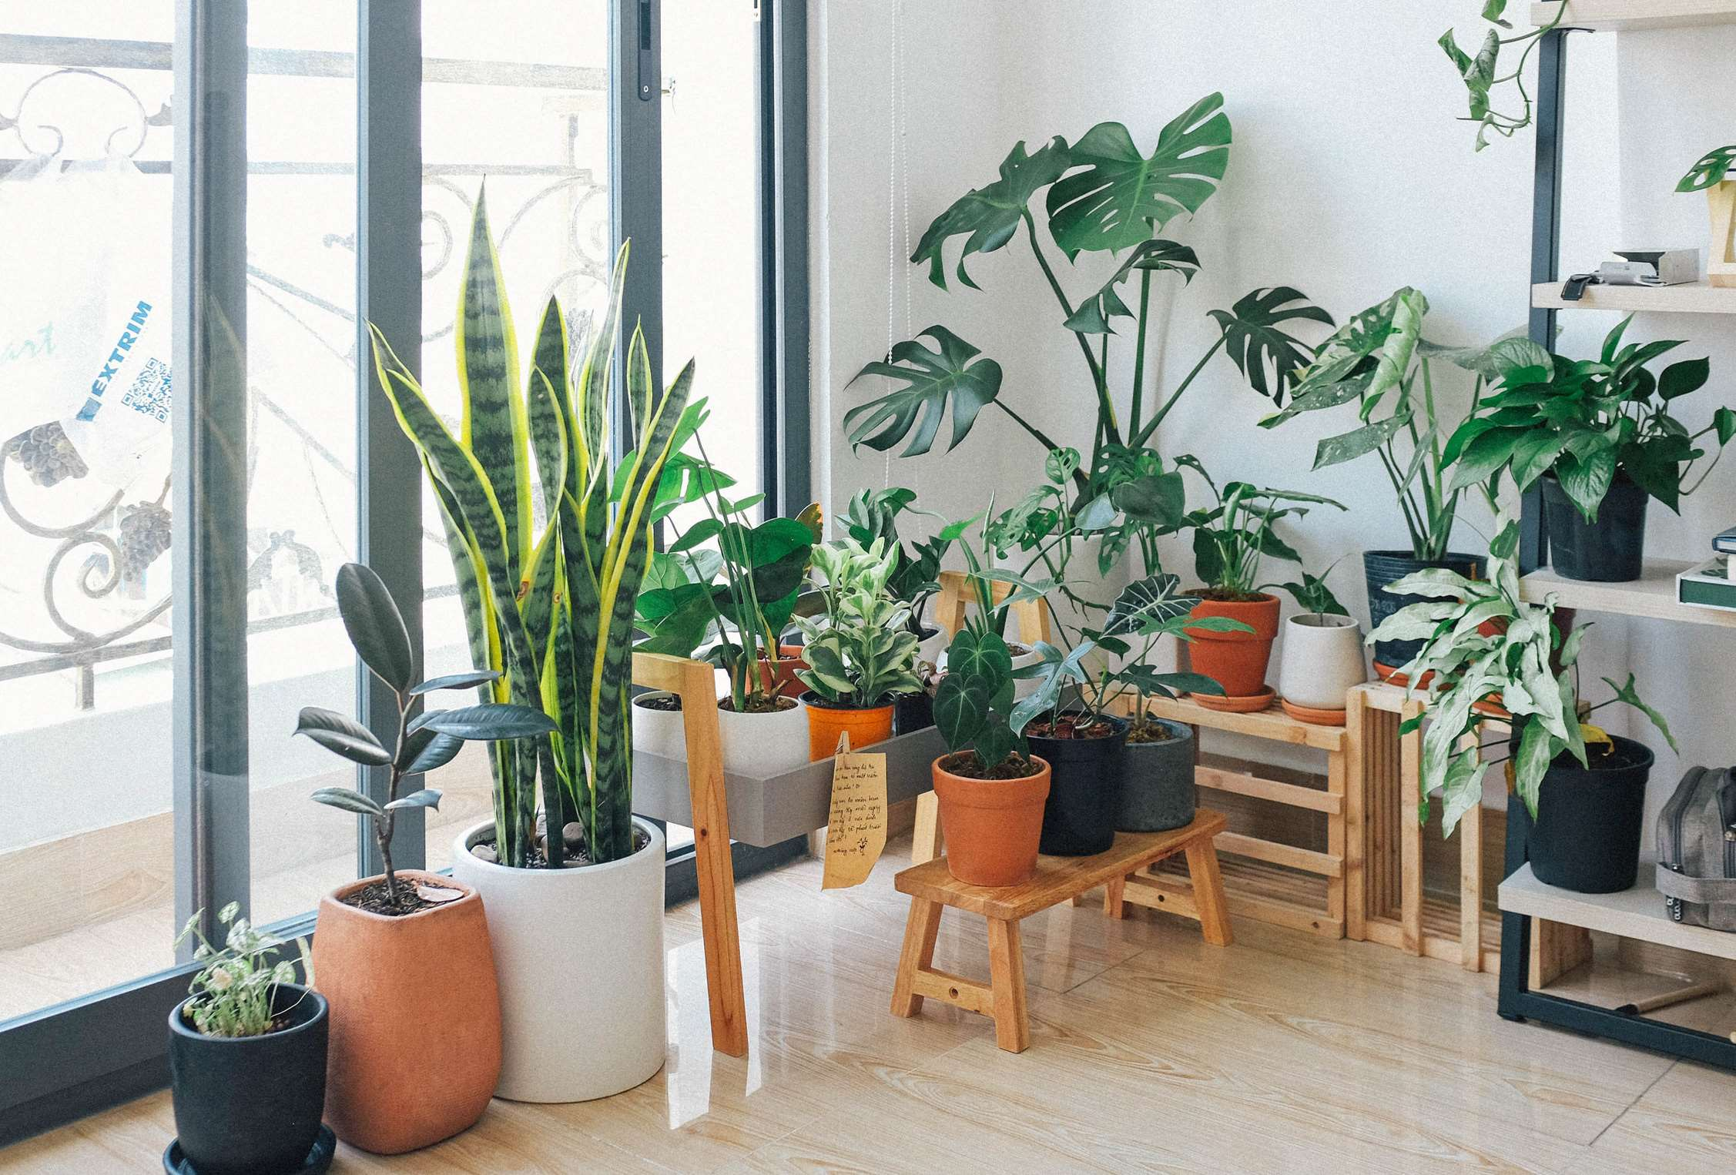
REVENUE MARKET SHARE BY SEGMENTS 2024
  Plastic
  Metal
  Ceramic
  Stone
  Wood
Type Segment
  E-Commerce
  Retail Stores
Distribution Channel
Application Segment
  Residential
  Commercial

Slide 5

REGION ANALYSIS
NORTH AMERICA
Europe
Asia Pacific
Latin America
MIDDLE EAST AFRICA
USD 7404.88 million
USD 5553.66 million
USD 4257.81 million
USD 925.61 million
USD 370.24 million

Slide 6
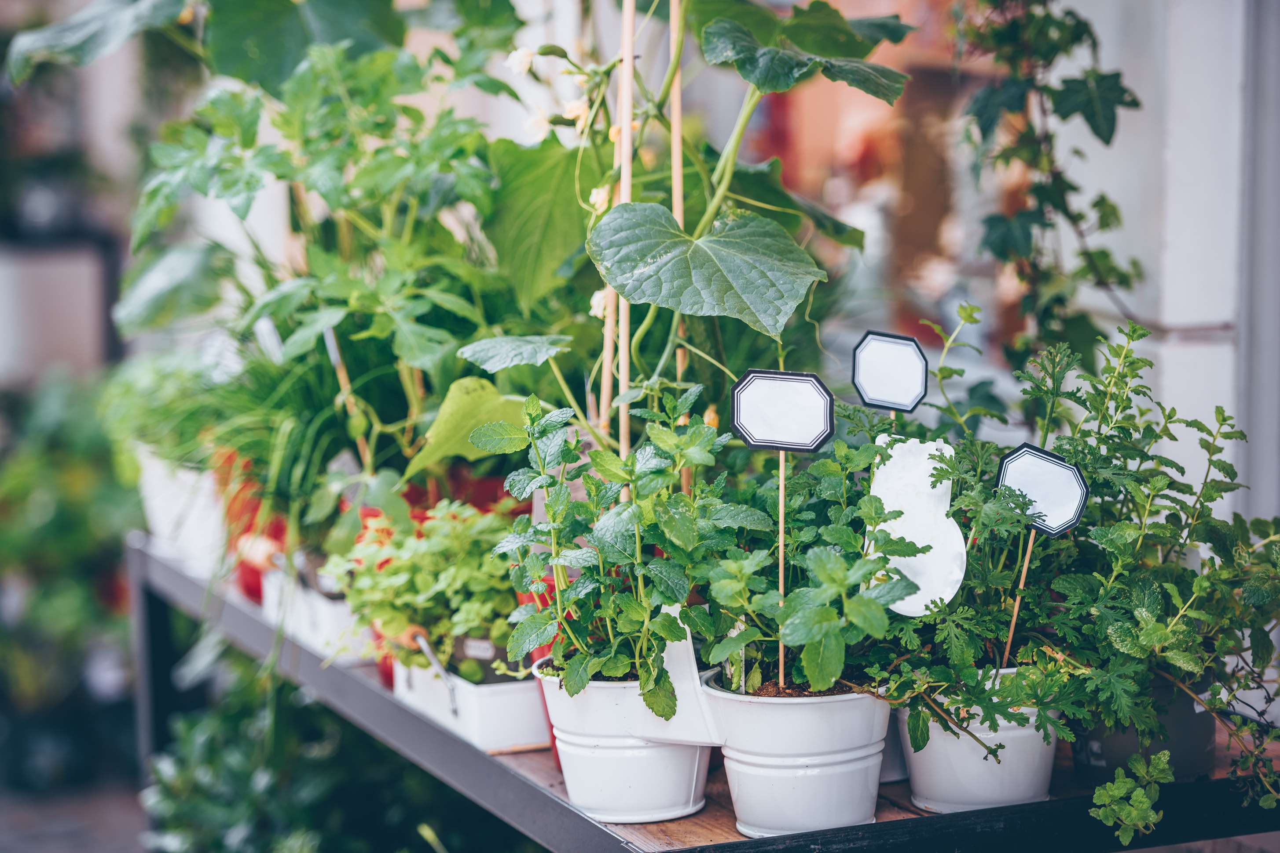
  Increasing Use of Vertical Gardens to Increase the Demand Globally
  Growing Activity in Commercial Construction to Propel Market Growth
Drivers
Restraints
Price Variability for Raw Materials to Limit the Sales

Slide 7
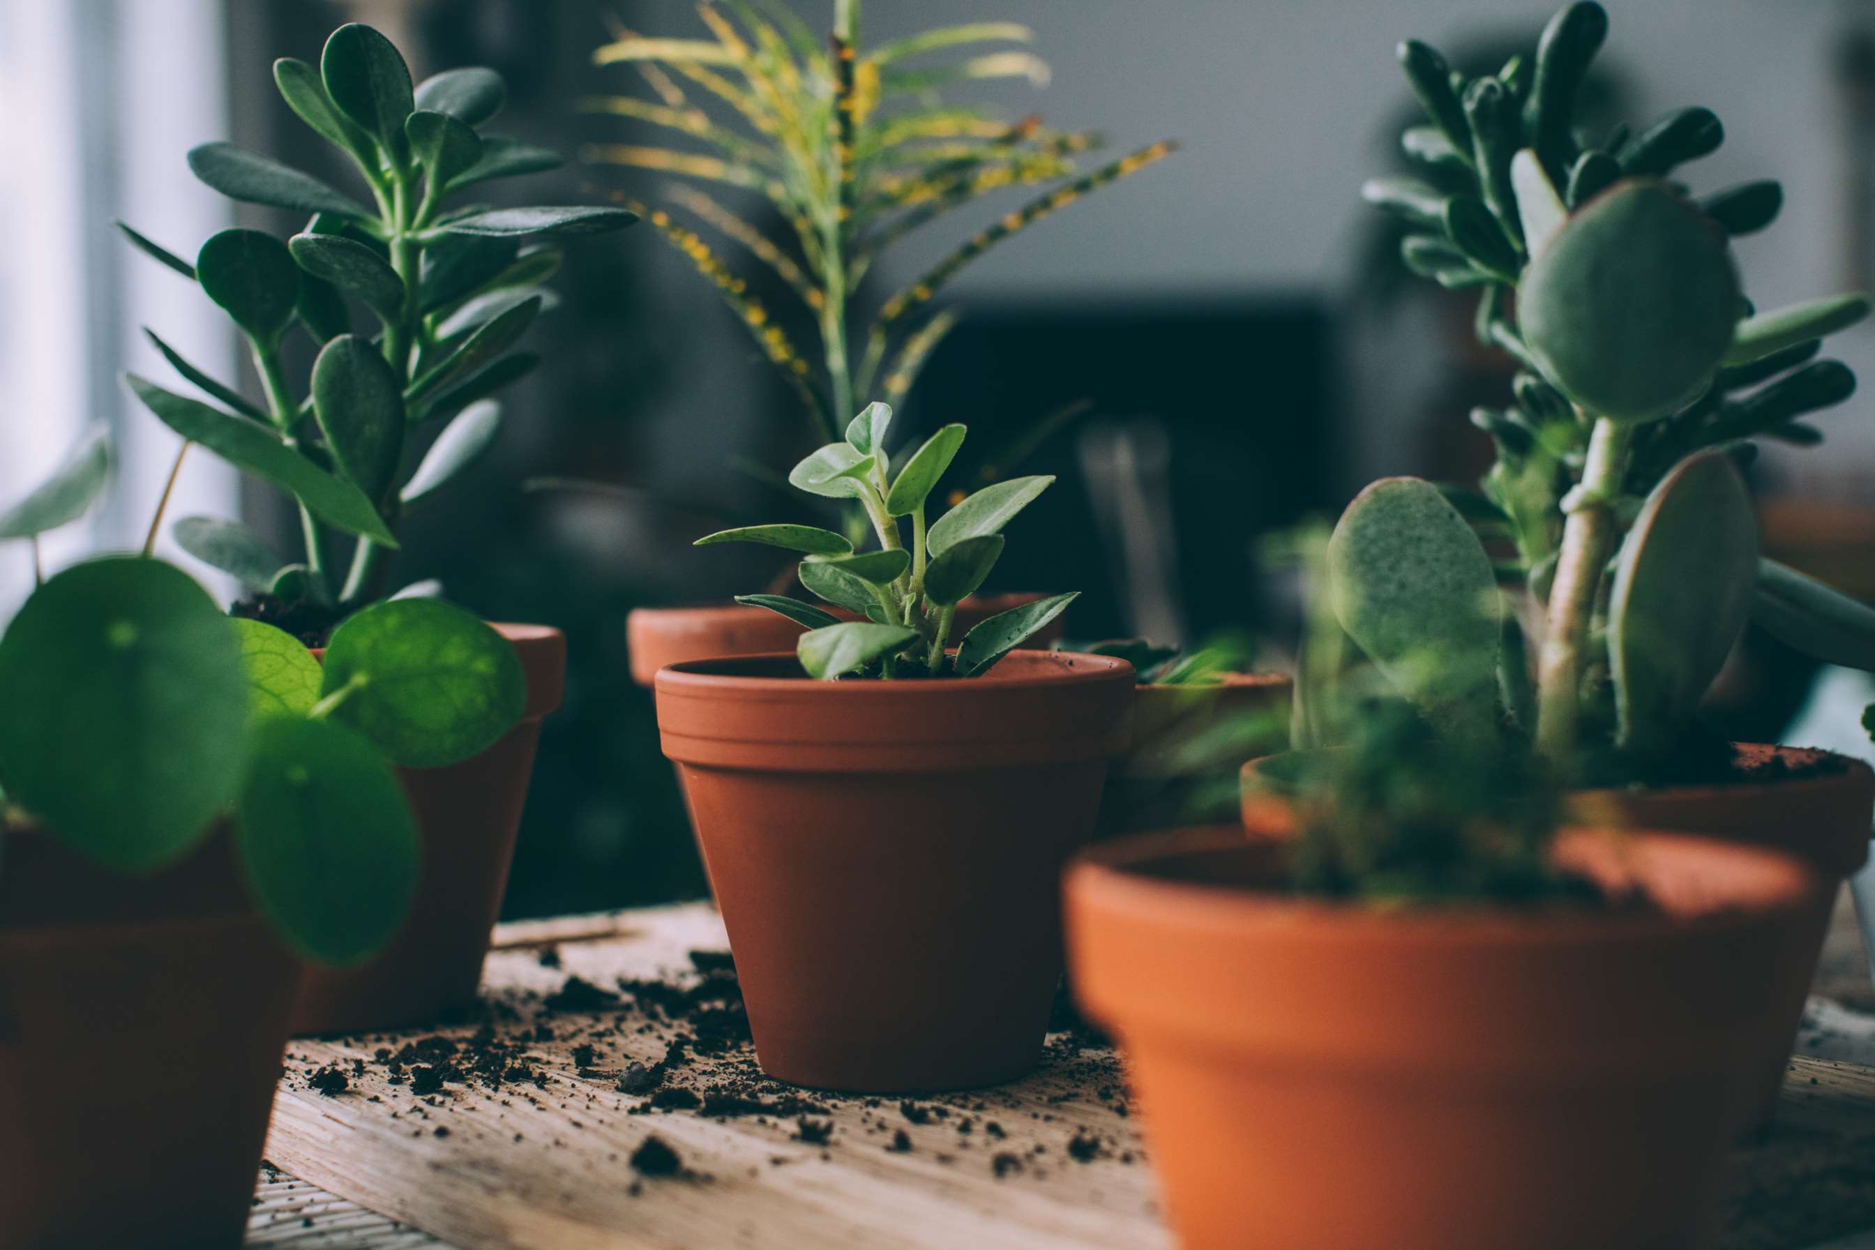
AUTHOR'S PERSPECTIVE
  The global gardening pot market will expand significantly by 19.60% CAGR between 2024 to 2031.
  The sales in the plastic segment are set to rise.
  Because plastic products are readily available at low prices and are lightweight, making them easy to move, plastic is expected to lead the market.
  Due to the vast number of enterprises that regularly grow flowers and other plants, the commercial segment is anticipated to be larger than the other.
  The product is also in high demand since it allows growers and florists to showcase their plants and flowers at venues like hotels, resorts, and other establishments.

Slide 8





KEY PLAYERS

Slide 9


For Full Report
Contact us
COGNITIVE MARKET RESEARCH
Tel: +1 312-376-8303 | +44 020-8123-0732
India: (+91) 983-496-8611
sales@cognitivemarketresearch.com
Access the Full Report : https://tinyurl.com/2277jtas
Please visit our website:
https://www.cognitivemarketresearch.com

