Slide 1


FURNITURE
MARKET REPORT
2024
Qualitative Analysis + Quantitative Analysis

Slide 2
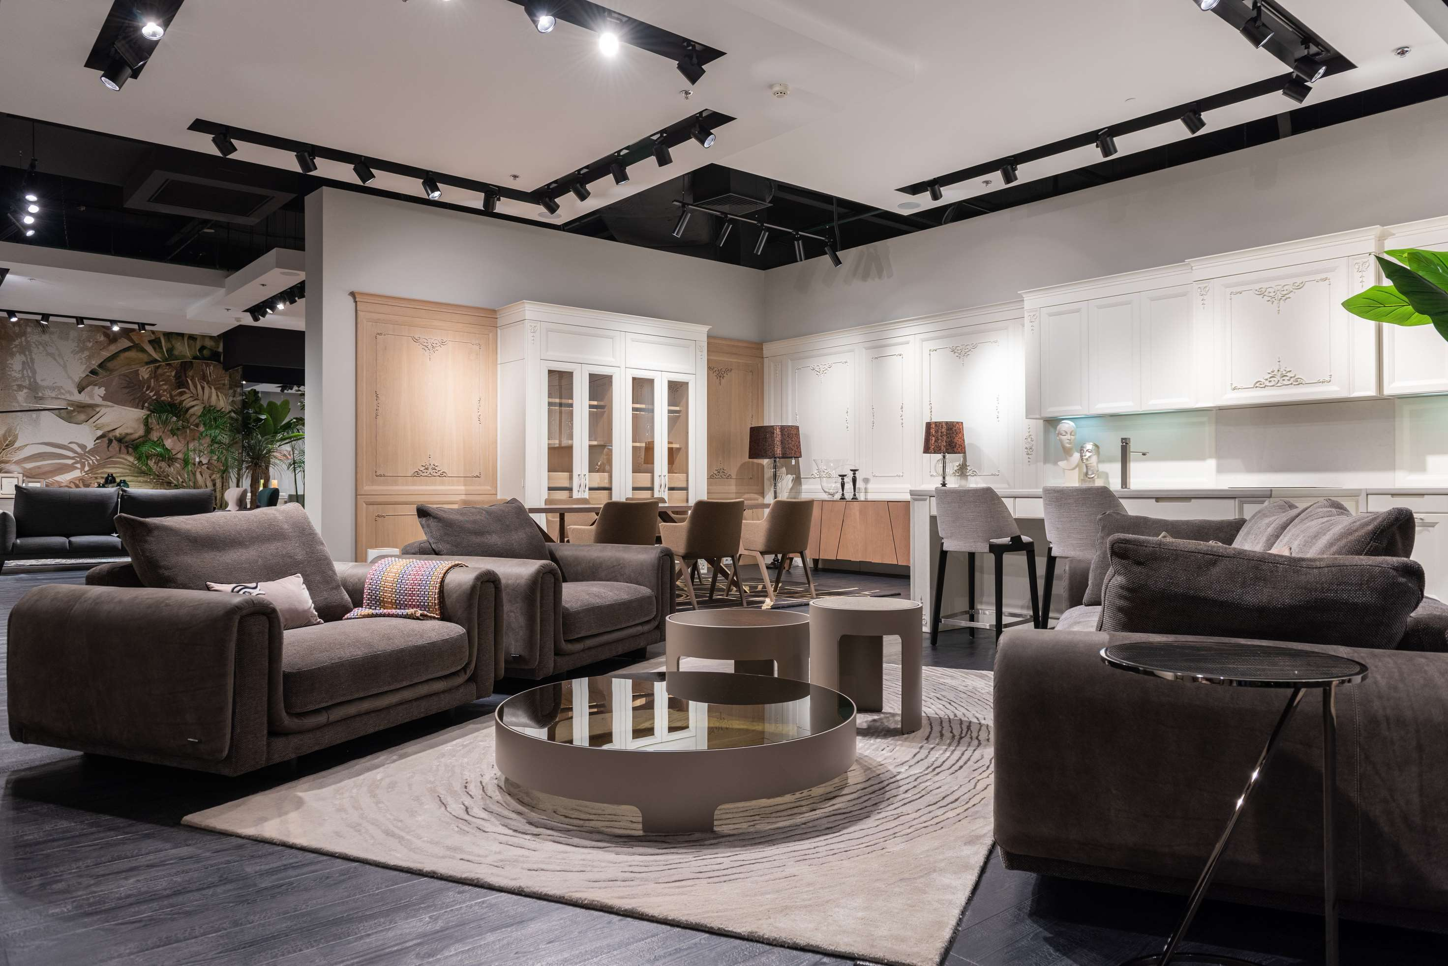
INTRODUCTION
Furniture refers to movable objects intended to support various human activities such as seating, eating, and sleeping. It also serves to hold objects at a convenient height for work or to store items. Furniture is a vital component of living spaces in homes, offices, and virtually all types of buildings, including schools, hotels, and commercial establishments. Typically made from materials like wood, metal, or plastic, furniture pieces are often considered a form of decorative art and can range from simple and functional to complex and ornate. The design and arrangement of furniture can significantly influence the functionality and aesthetic appeal of an interior space.

Slide 3


KEY INSIGHTS
MARKET SIZE
USD 548954.2 million
2024
CAGR
5.60%
2024- 2031

Slide 4

REVENUE MARKET SHARE BY SEGMENTS 2024
  Solid Wood
  Metal
  Jade
  Glass
Type Segment
  Indoor
  Outdoor
Category Segment
  Household
  Office
  Hospital
  Outdoor
Application Segment

Slide 5

REGION ANALYSIS
NORTH AMERICA
Europe
Asia Pacific
Latin America
MIDDLE EAST AFRICA
40%
30%
23%
5%
2%
North America Furniture Market Revenue share for 2024 is 40%

Slide 6

  Rising Urbanization and Real Estate Development to Increase the Demand Globally
  Trends in Home Decor and Customization to Propel Market Growth
Drivers
Intense Market Competition to Limit the Sales
Restraints

Slide 7

AUTHOR'S PERSPECTIVE
  The global furniture market will expand significantly by 5.60% CAGR between 2024 to 2031.
  Solid wood furniture sales will increase due to its durability, timeless appeal, and growing consumer preference for sustainable, high-quality materials that offer both aesthetic and functional benefits.
  Household furniture sales will rise due to increased home ownership, the popularity of home renovations, and the ongoing trend toward personalized, functional living spaces driven by lifestyle enhancements.

Slide 8










KEY PLAYERS

Slide 9


For Full Report
Contact us
COGNITIVE MARKET RESEARCH
Tel: +1 312-376-8303 | +44 020-8123-0732
India: (+91) 983-496-8611
sales@cognitivemarketresearch.com
Access the Full Report : https://shorturl.at/vGJNW
Please visit our website:
https://www.cognitivemarketresearch.com

