Slide 1
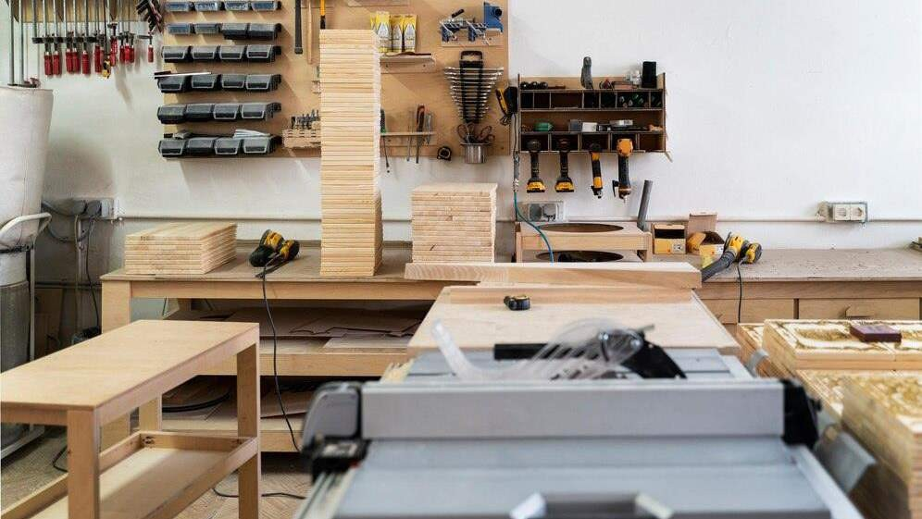
FURNITURE HARDWARE MARKET REPORT

Slide 2

INTRODUCTION
Furniture hardware refers to the fasteners, fittings, and component pieces required to construct a functional, long-lasting piece of furniture. Furniture hardware support the appearance, style, and longevity of a piece of furniture.

Slide 3


KEY INSIGHTS
MARKET SIZE
s21,700.81 Million
2028
2023-
2030
CAGR 4.20%

Slide 4
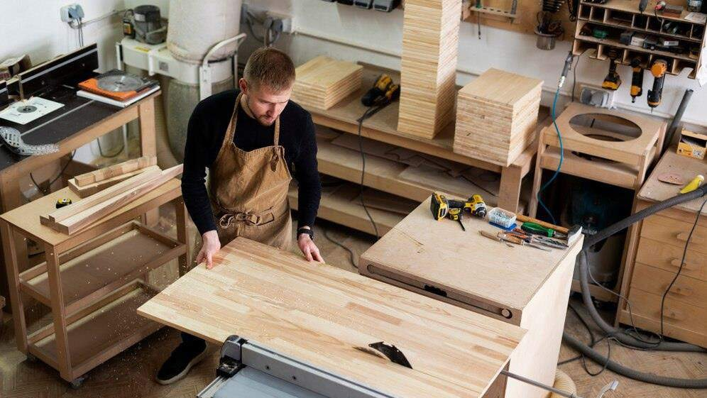
REVENUE MARKET SHARE BY SEGMENTS 2022
BY TYPE
Drawer Slides USD 2,692.24 Million
BY APPLICATION
Commercial Furniture
USD 7,709.99 Million

Slide 5
GLOBAL FURNITURE HARDWARE MARKET REVENUE SHARE FOR 2022
North America USD 4,750.31 Million

Slide 6



Rising residential construction activities
Inconsistent, high raw material prices and insufficient supply chain

Slide 7
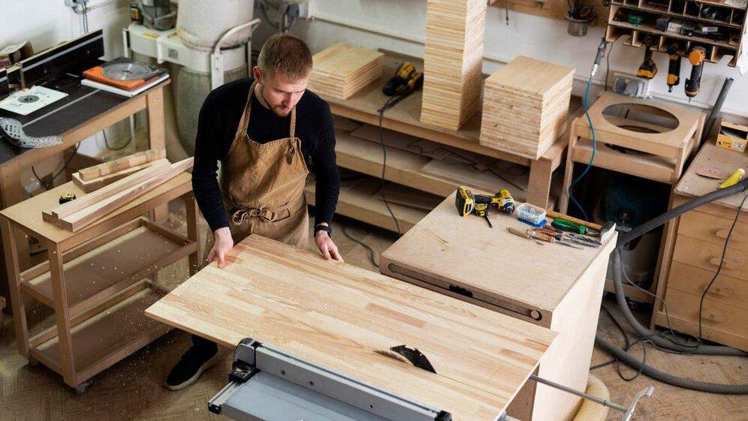
AUTHOR'S PERSPECTIVE
The Global Furniture Hardware Market revenue in 2016: USD 12,574.22 Million
Kitchen Pull Out Basket held for largest share of total revenue generated in 2019
Residential Furniture held maximum share of Furniture Hardware market in 2019
As residential construction activities is growing, it drives the market for furniture hardware
Rising building and construction industry stimulates more and more activities associated with commercial buildings, enhancing the growth of furniture hardware market
Continuously growing inconsistency and high raw material prices along with insufficient
supply of raw materials creates negative impact on the overall growth of the furniture hardware market
Surge in renovation activities of buildings as well as rising number of skyscrapers will
further enhance the demand of furniture, propelling the growth of furniture hardware market

Slide 8









KEY PLAYERS

Slide 9


Contact us
For Full Report
COGNITIVE MARKET RESEARCH
Tel: + 1 312 - 376 - 8303 | + 44 020 - 8123 - 0732
India: ( + 91 ) 983 - 496 - 8611
sales@ cognitivemarketresearch. com
Access the Full Report : https://rb.gy/1iasi
Please visit our website:
https://www.cognitivemarketresearch.com

