Slide 1

GLOBAL
FRYING PAN
MARKET REPORT
2024
Global,Regional,CountryAnalysis

Slide 2
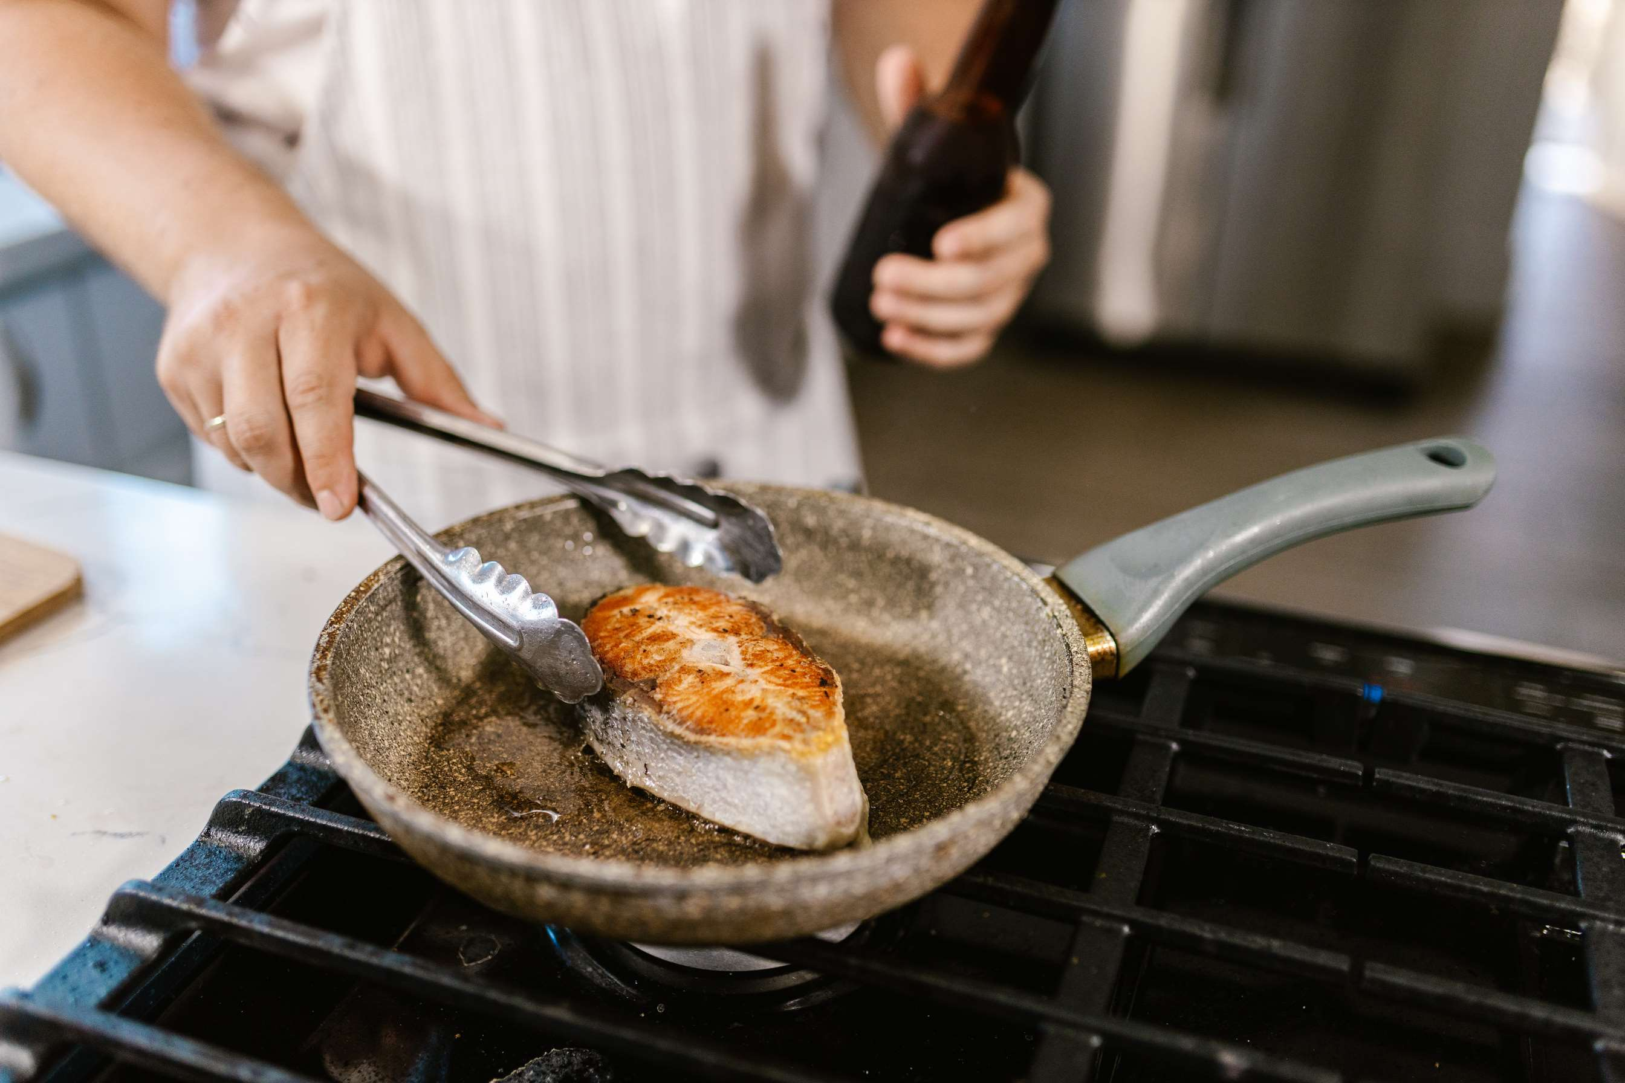
INTRODUCTION
The manufacturing, distribution, and consumption of kitchenware made expressly for frying food are all included in the frying pan market. These pans usually have slanted sides and a flat bottom, which make it easier to cook a variety of foods quickly and with little oil. A wide variety of frying pans, suitable for various cooking requirements and tastes, are available in the market. These include non-stick, stainless steel, cast iron, and ceramic alternatives. Growing disposable incomes, shifting lifestyles that prioritize quick meal preparation, and the appeal of home cooking are major drivers of industry expansion. Additionally, the emergence of high-end frying pans with cutting-edge features results from technological breakthroughs. But problems like price differences and supply chain interruptions can change the dynamics of the market, forcing producers to adjust to changing customer needs and market circumstances.

Slide 3


KEY INSIGHTS
MARKET SIZE
USD 1851.2 million
2024- 2031
CAGR
3.40%
2024- 2031

Slide 4
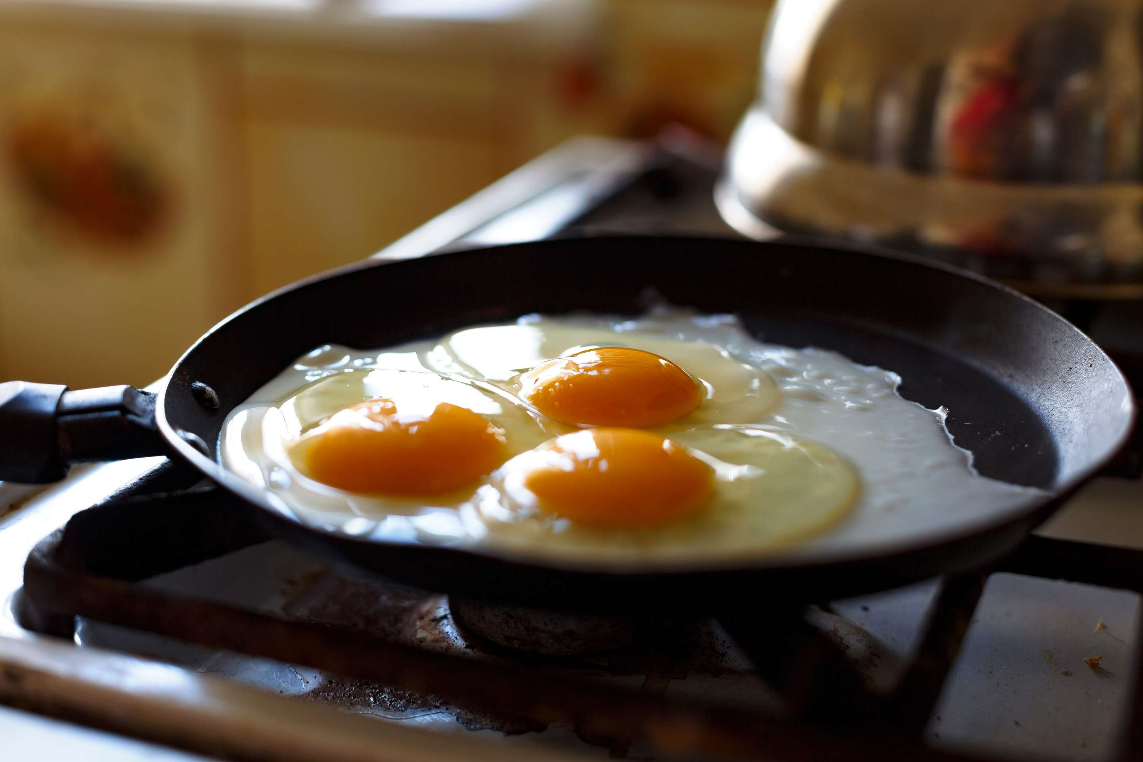
REVENUE MARKET SHARE BY SEGMENTS 2022
  Stainless Steel
  Carbon Steel
  Cast Iron
  Polytera Flourethylene
  Residential
  Commercial
Type Segment
End-User Segment
  Fry
  Steam
  Others
  Pressed
  Forged
  Others
Application Segment
Production Technique
  Supermarket & Hypermarket
  Retail Store
  Online
  Fixed
  Detachable
Handle Type Segment
Distribution Channel

Slide 5

Global Frying Pan Market Revenue share for 2024
North America
40%

Slide 6

  Growing Population and Increased Consumption to Increase the Demand Globally
  Rising Disposable Income and Changing Lifestyles to Propel Market Growth
Drivers
High Cost of Premium Frying Pans to Limit the Sales
Restraints

Slide 7
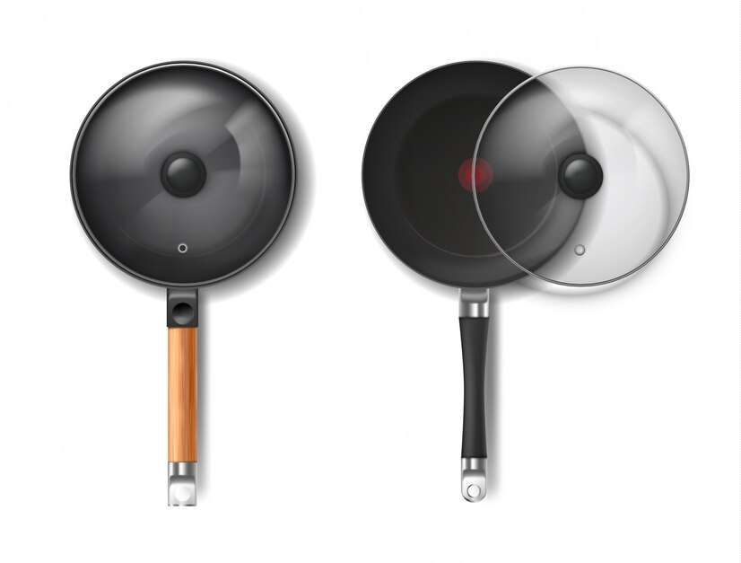
AUTHOR'S PERSPECTIVE
  The global Frying Pan market will expand significantly by 3.40% CAGR between 2024 to 2031.
  Fry pans are becoming more widely available due to growing trends in online buying, which increases customer convenience and market reach.
  Sustainability issues and environmentally friendly solutions: Growing consumer awareness of environmental issues drives demand for frying pans manufactured using sustainable production methods or recycled materials.

Slide 8









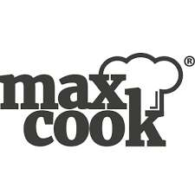
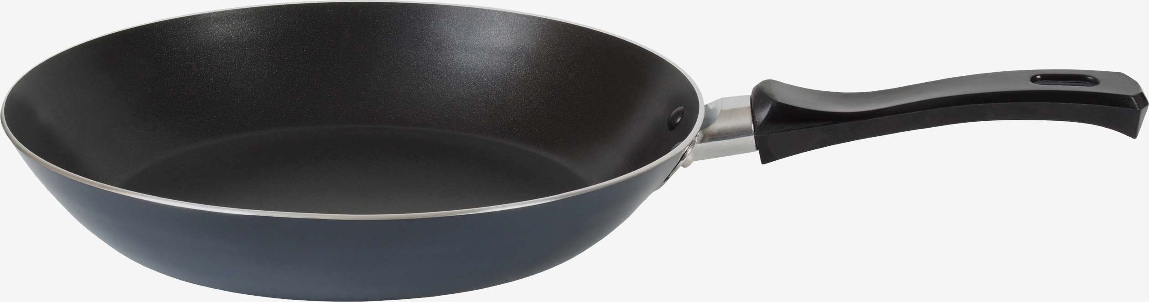
KEY PLAYERS

Slide 9


For Full Report
Contact us
COGNITIVE MARKET RESEARCH
Tel: +1 312-376-8303 | +44 020-8123-0732
India: (+91) 983-496-8611
sales@cognitivemarketresearch.com
Access the Full Report : https://tinyurl.com/367xmu74
Please visit our website:
https://www.cognitivemarketresearch.com

