Slide 1
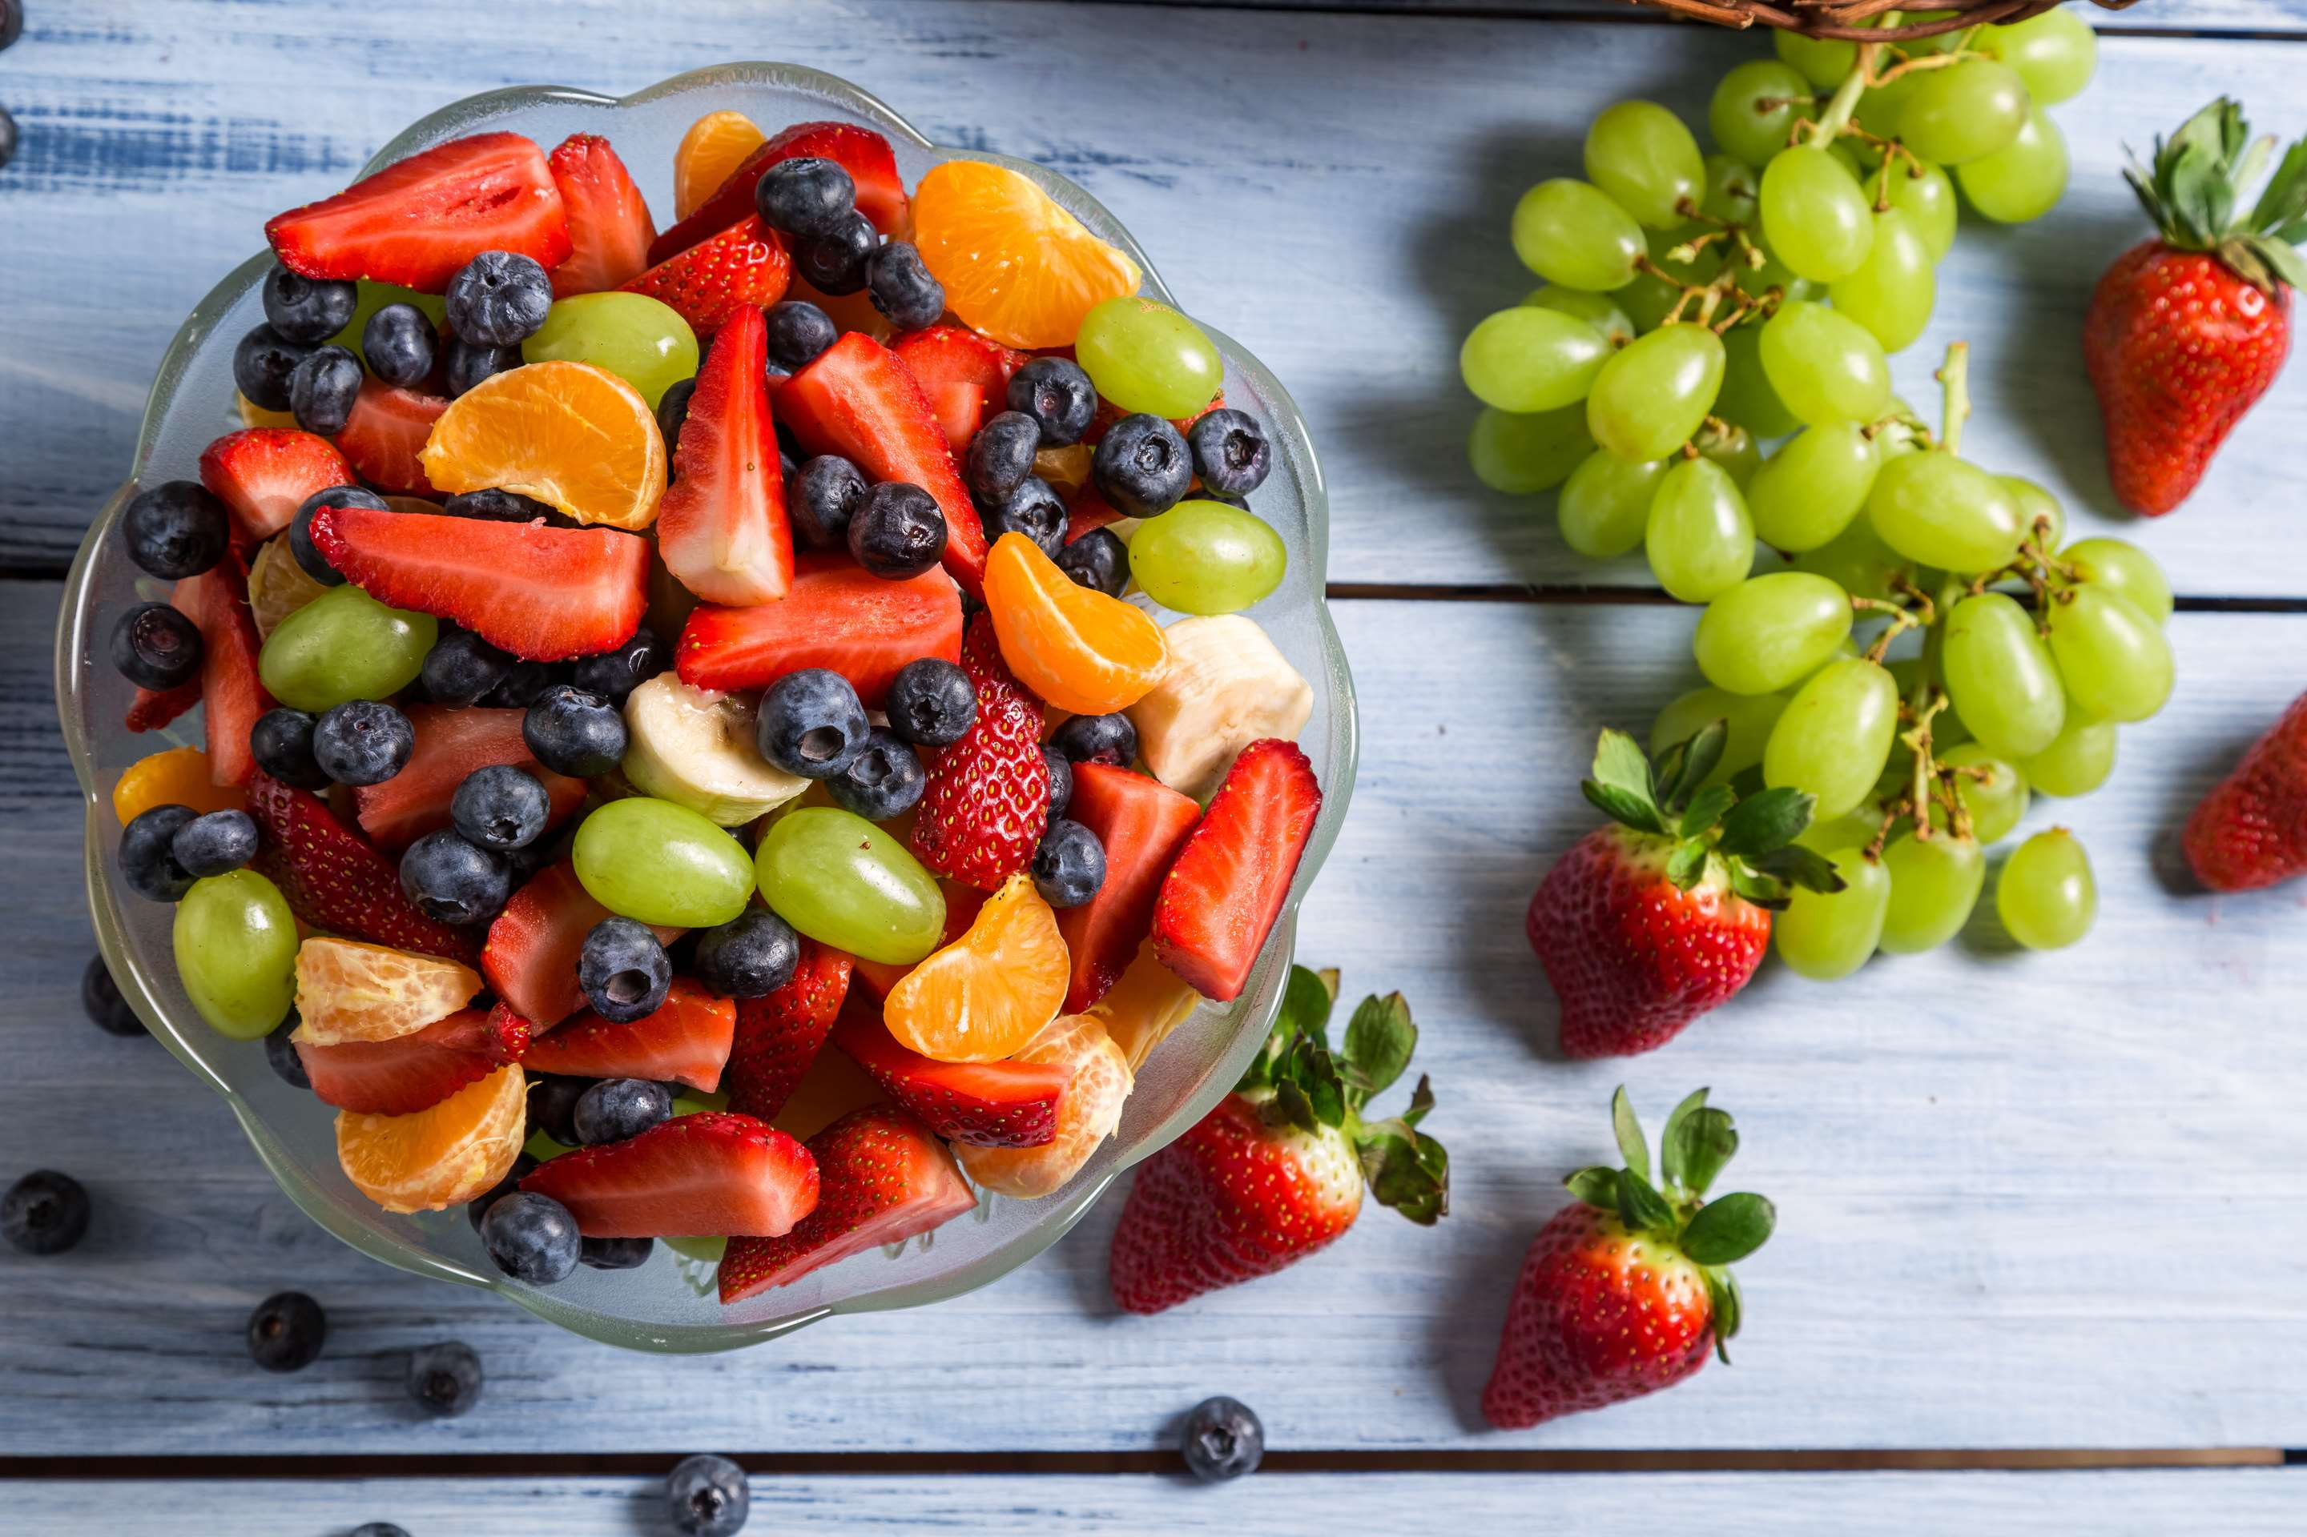
GLOBAL
FRUIT PREPARATIONS
MARKET REPORT
2024
Global,Regional,CountryAnalysis

Slide 2
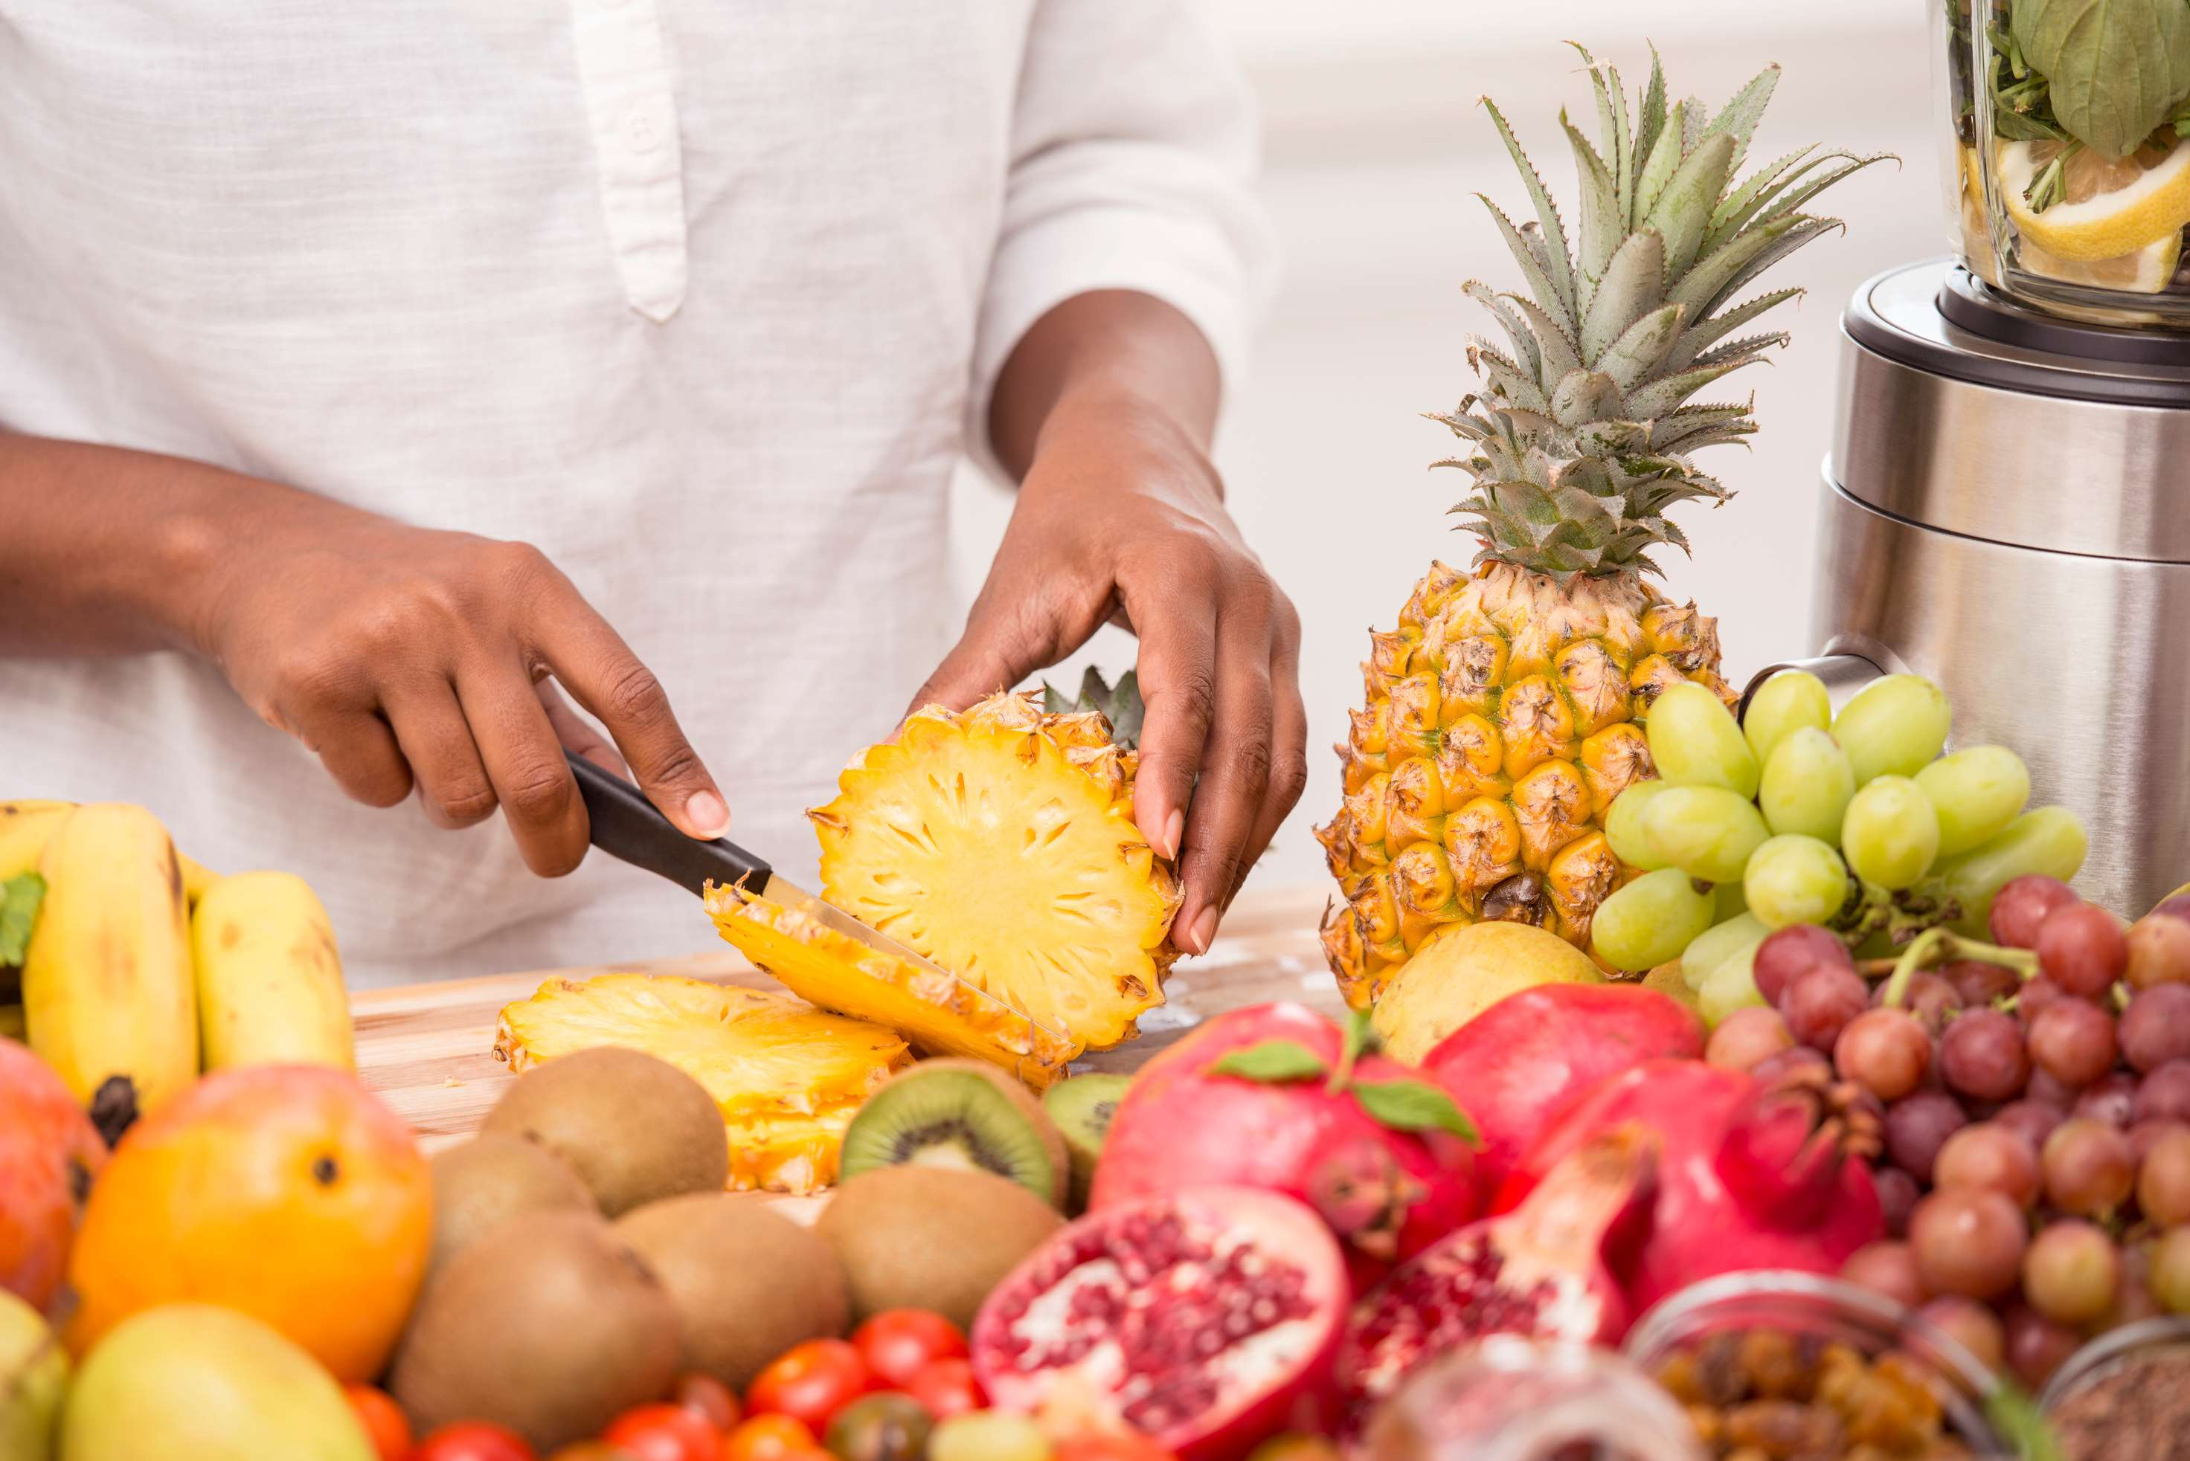
INTRODUCTION
Fruit preparations are processed fruit products that are utilized in different culinary uses, including baking, confectionery, desserts, and beverages. These preparations are commonly created by cooking, pureeing, or blending fresh fruits and incorporating sweeteners like sugar or syrup to enhance the taste. The growth of this industry is driven by the growing demand for top-notch natural spreads and fruit snacks, as well as the increased consumption of natural-flavored dairy products like yogurts, ice creams, and desserts.

Slide 3
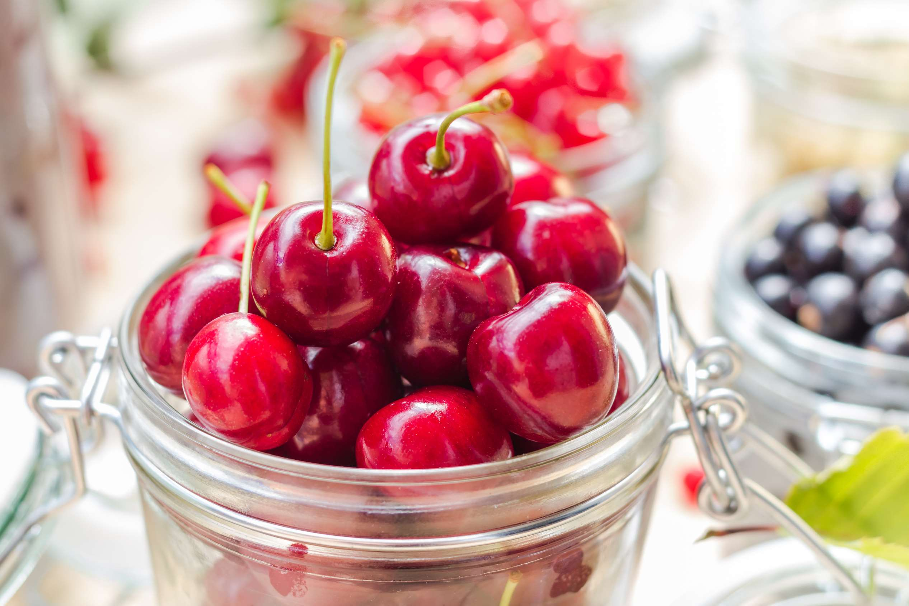

KEY INSIGHTS
MARKET SIZE
USD 45.2 billion
2023
CAGR
6.60%
2023- 2030

Slide 4
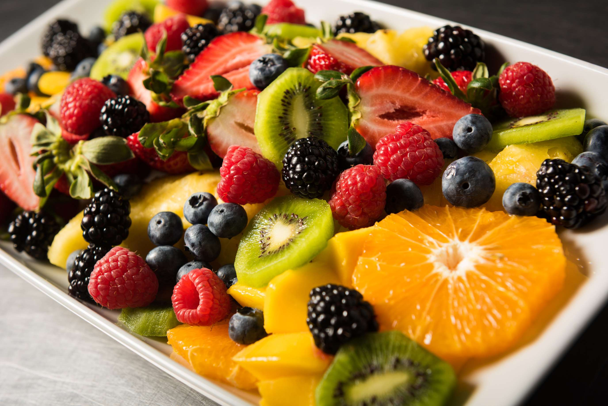
REVENUE MARKET SHARE BY SEGMENTS 2022
  Jams
  Filling
  Others
Type Segment
  Beverages
  Dairy & Frozen Desserts
  Bakery and Confectionary
  Infant Food
Application Segment
  Supermarkets
  Independent Retailers
  Convenience Stores
  Specialty Stores
Distribution Channel

Slide 5

Global Fruit Preparations Market Revenue share for 2024
North America
30%

Slide 6
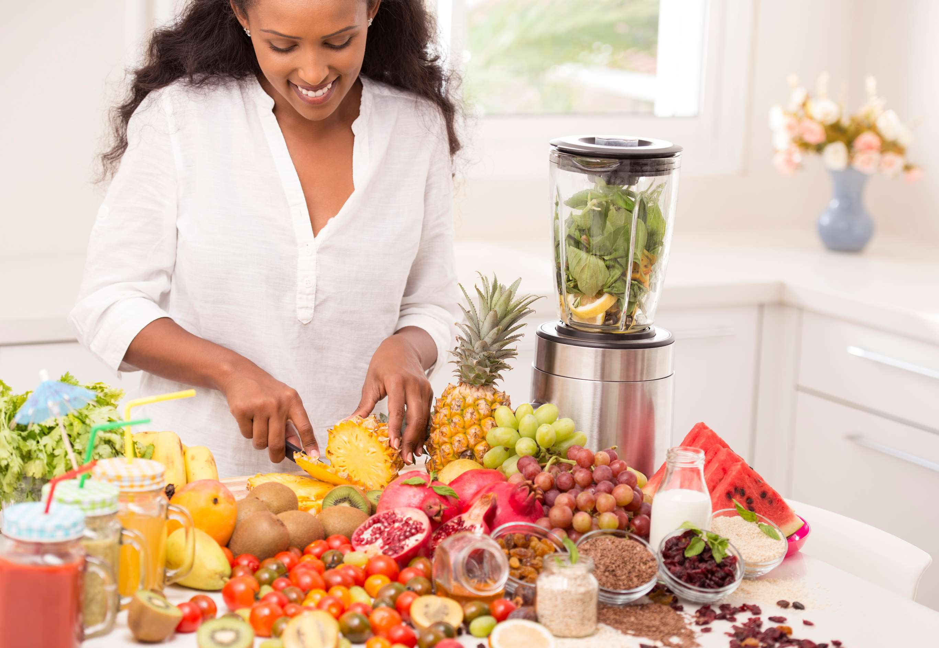
Health and Wellness Trends to Propel Market Growth
Drivers
Supply Chain Challenges to Hinder Market Growth
Restraints

Slide 7
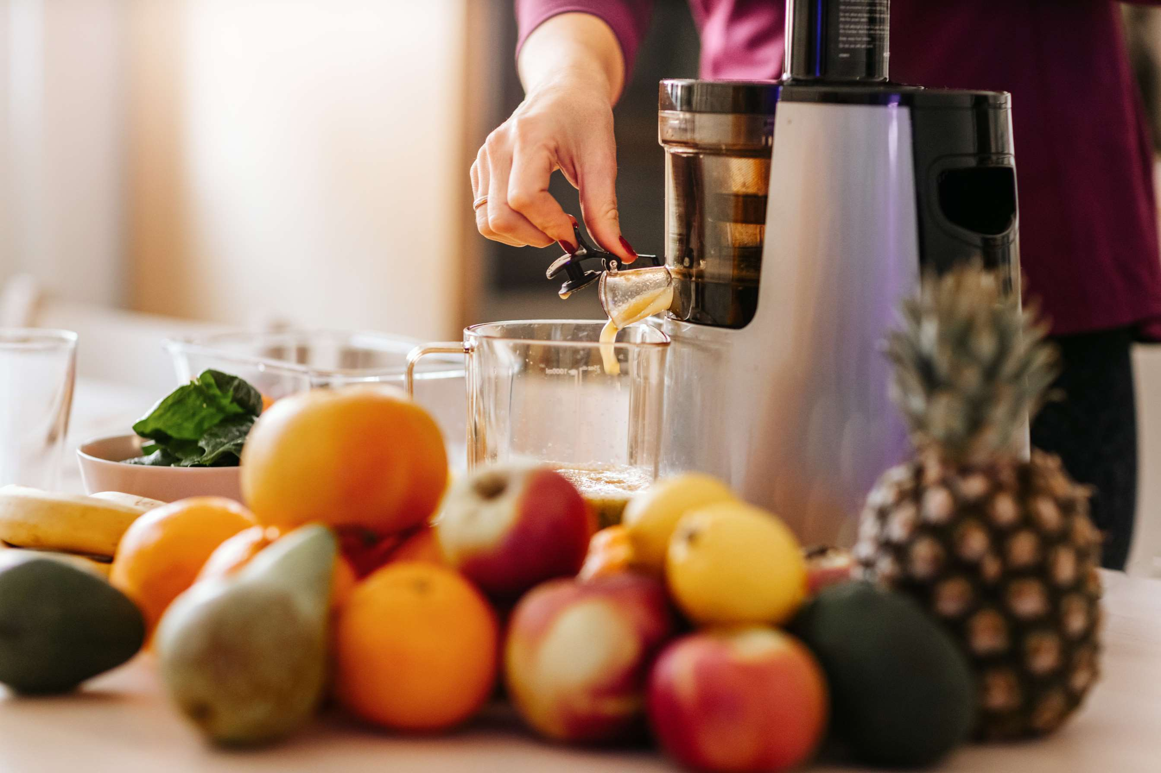
AUTHOR'S PERSPECTIVE
  The Global Fruit Preparations Market is witnessing significant growth in the near future. affordable costs because they frequently offer discounts and promotions.
  Consumers appreciate the natural, fruity flavors preserved in jams, making them a household favorite.
  Fruit fillings are highly sought after in the baking and pastry industry, used in pies, pastries, cakes, and other desserts.
  Supermarkets also benefit from consumers' tendency to do bulk shopping, making them the go-to destination for families and individuals looking for a variety of fruit preparations for their diverse needs.

Slide 8
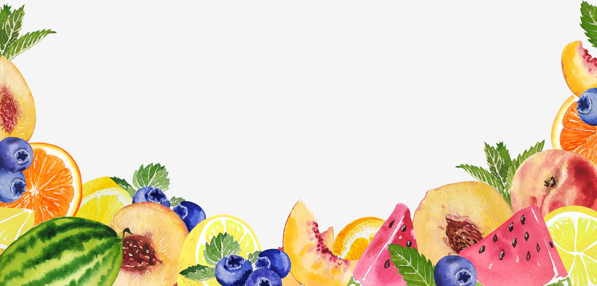





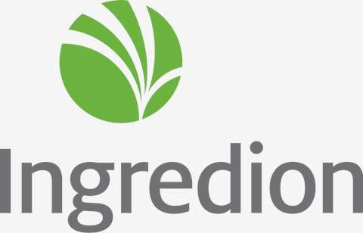




KEY PLAYERS

Slide 9


For Full Report
Contact us
COGNITIVE MARKET RESEARCH
Tel: +1 312-376-8303 | +44 020-8123-0732
India: (+91) 983-496-8611
sales@cognitivemarketresearch.com
Access the Full Report : https://shorturl.at/fxBTY
Please visit our website:
https://www.cognitivemarketresearch.com

