Slide 1


FRUIT PREP
MARKET REPORT
2024
Qualitative Analysis + Quantitative Analysis

Slide 2
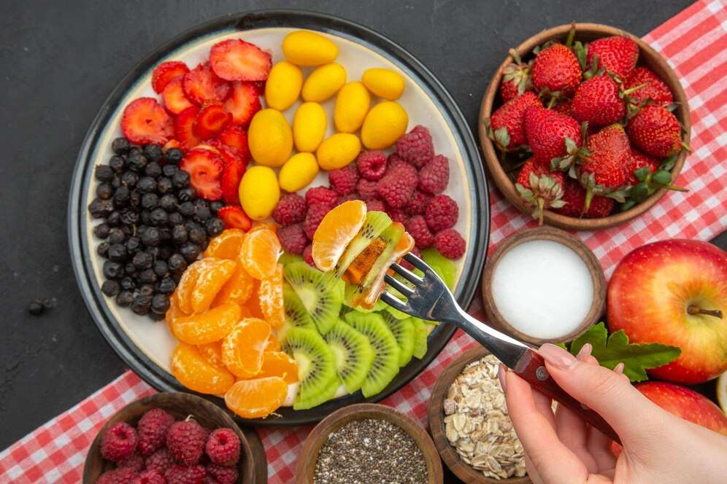
INTRODUCTION
Fruit prep, short for fruit preparation, refers to the series of actions taken to make fruits ready for consumption or use in cooking and baking. This process includes selecting, washing, peeling, cutting, and sometimes preserving fruits. In commercial contexts, fruit prep can also involve more specialized processes like slicing fruits to uniform sizes, combining them with preservatives or flavor enhancers, and packaging them for retail sale. Fruit prep is essential not only for aesthetic and taste purposes but also for health reasons, as proper cleaning and handling help remove harmful bacteria and chemicals. In the culinary world, fruit prep ensures that fruits contribute effectively to the desired final presentation and taste of dishes.

Slide 3
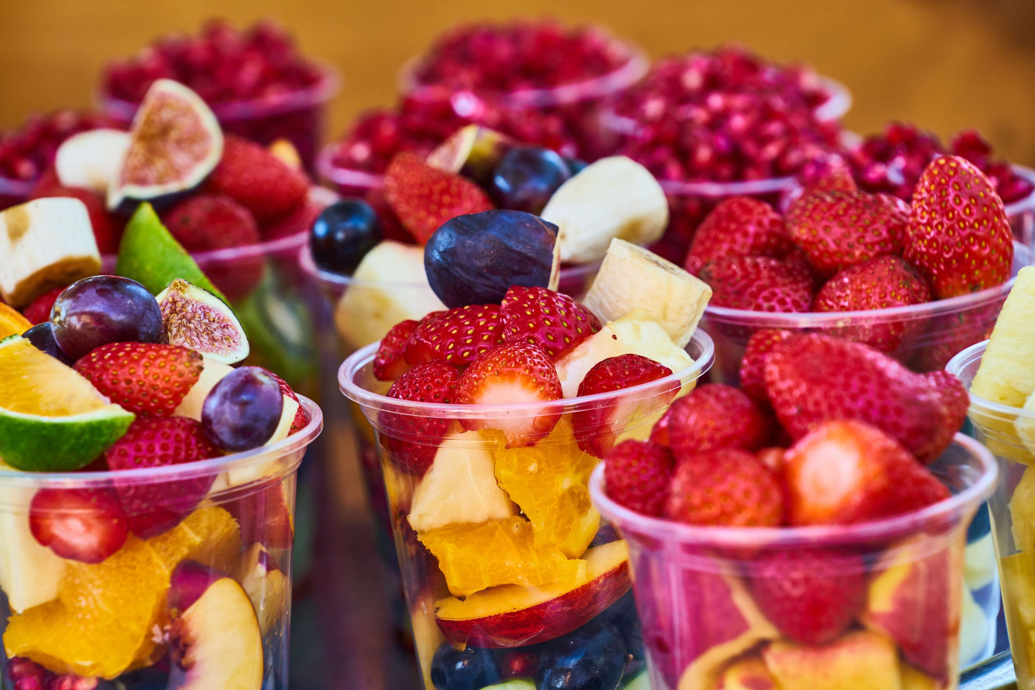

KEY INSIGHTS
MARKET SIZE
USD 5581.2 million
2024
CAGR
6.00%
2024- 2031

Slide 4

REVENUE MARKET SHARE BY SEGMENTS 2024
  Jams
  Filling
  Others
Product Segment
  Supermarkets
  Independent Retailers
  Convenience Stores
  Specialty Stores
Product Type Segment

Slide 5

North America
40%
North America Fruit Prep Market Revenue share for 2024 is 40%

Slide 6

  Health and Wellness Trends to Increase the Demand Globally
  Innovation in Food & Beverage Industry to Propel Market Growth
Drivers
Innovation in Food & Beverage Industry to Propel Market Growth
Restraints

Slide 7

AUTHOR'S PERSPECTIVE
  The global fruit prep market will expand significantly by 6.00% CAGR between 2024 to 2031.
  Sales of pulp and purees will increase due to their versatility in food production, ability to maintain fruit’s natural flavors and nutrients, and rising demand for convenient, healthy options.
  Sales of beverages will rise driven by consumer preference for natural, healthier drink options and the growing popularity of functional beverages that incorporate fruit preparations for added health benefits.

Slide 8











KEY PLAYERS

Slide 9


For Full Report
Contact us
COGNITIVE MARKET RESEARCH
Tel: +1 312-376-8303 | +44 020-8123-0732
India: (+91) 983-496-8611
sales@cognitivemarketresearch.com
Access the Full Report : https://tinyurl.com/zwxeedr4
Please visit our website:
https://www.cognitivemarketresearch.com

