Slide 1
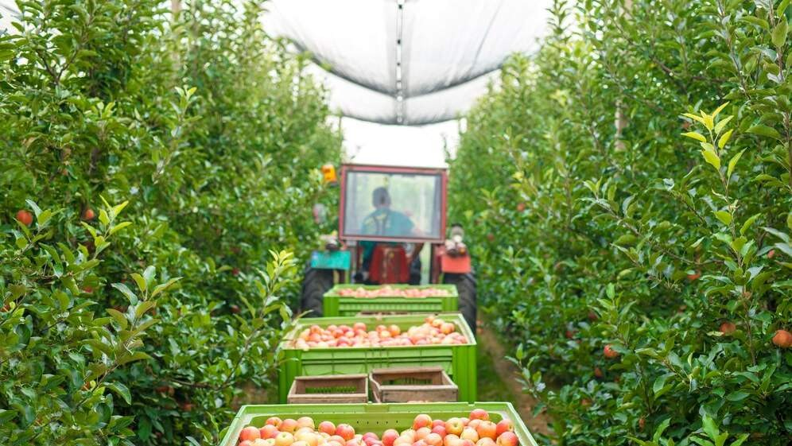
GLOBAL
FRUIT HARVESTING MACHINES MARKET REPORT
2024
Global,Regional,CountryAnalysis

Slide 2
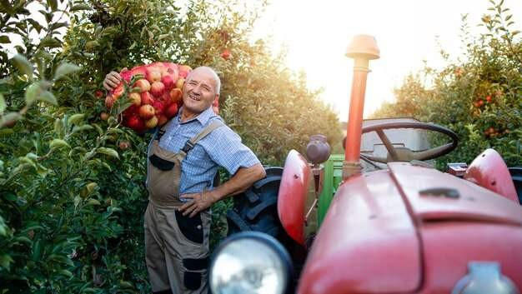
INTRODUCTION
Technological advancements have also had a hand in the growing adoption of electronically operated fruit harvesting. With the integration of artificial intelligence and computer software, harvesting can be automated. Advanced detection software will allow farmers to harvest fruits at their full potential and prevent early harvests. This automated fruit harvesting machine can reduce human error when using manual labor. The harvesting can also be done at a faster rate with the help of such fruit harvesting. With the help of AI, farmers can track fruits at various stages and create customized plans to ensure that the harvesting is carried out efficiently.

Slide 3
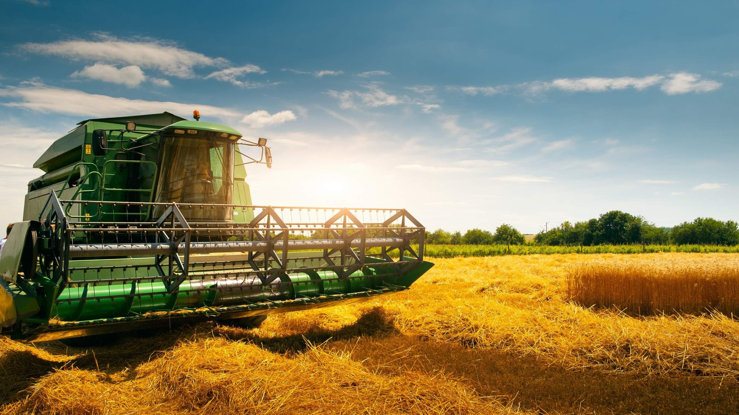

KEY INSIGHTS
CAGR 5.80%
20₋23
2030

Slide 4
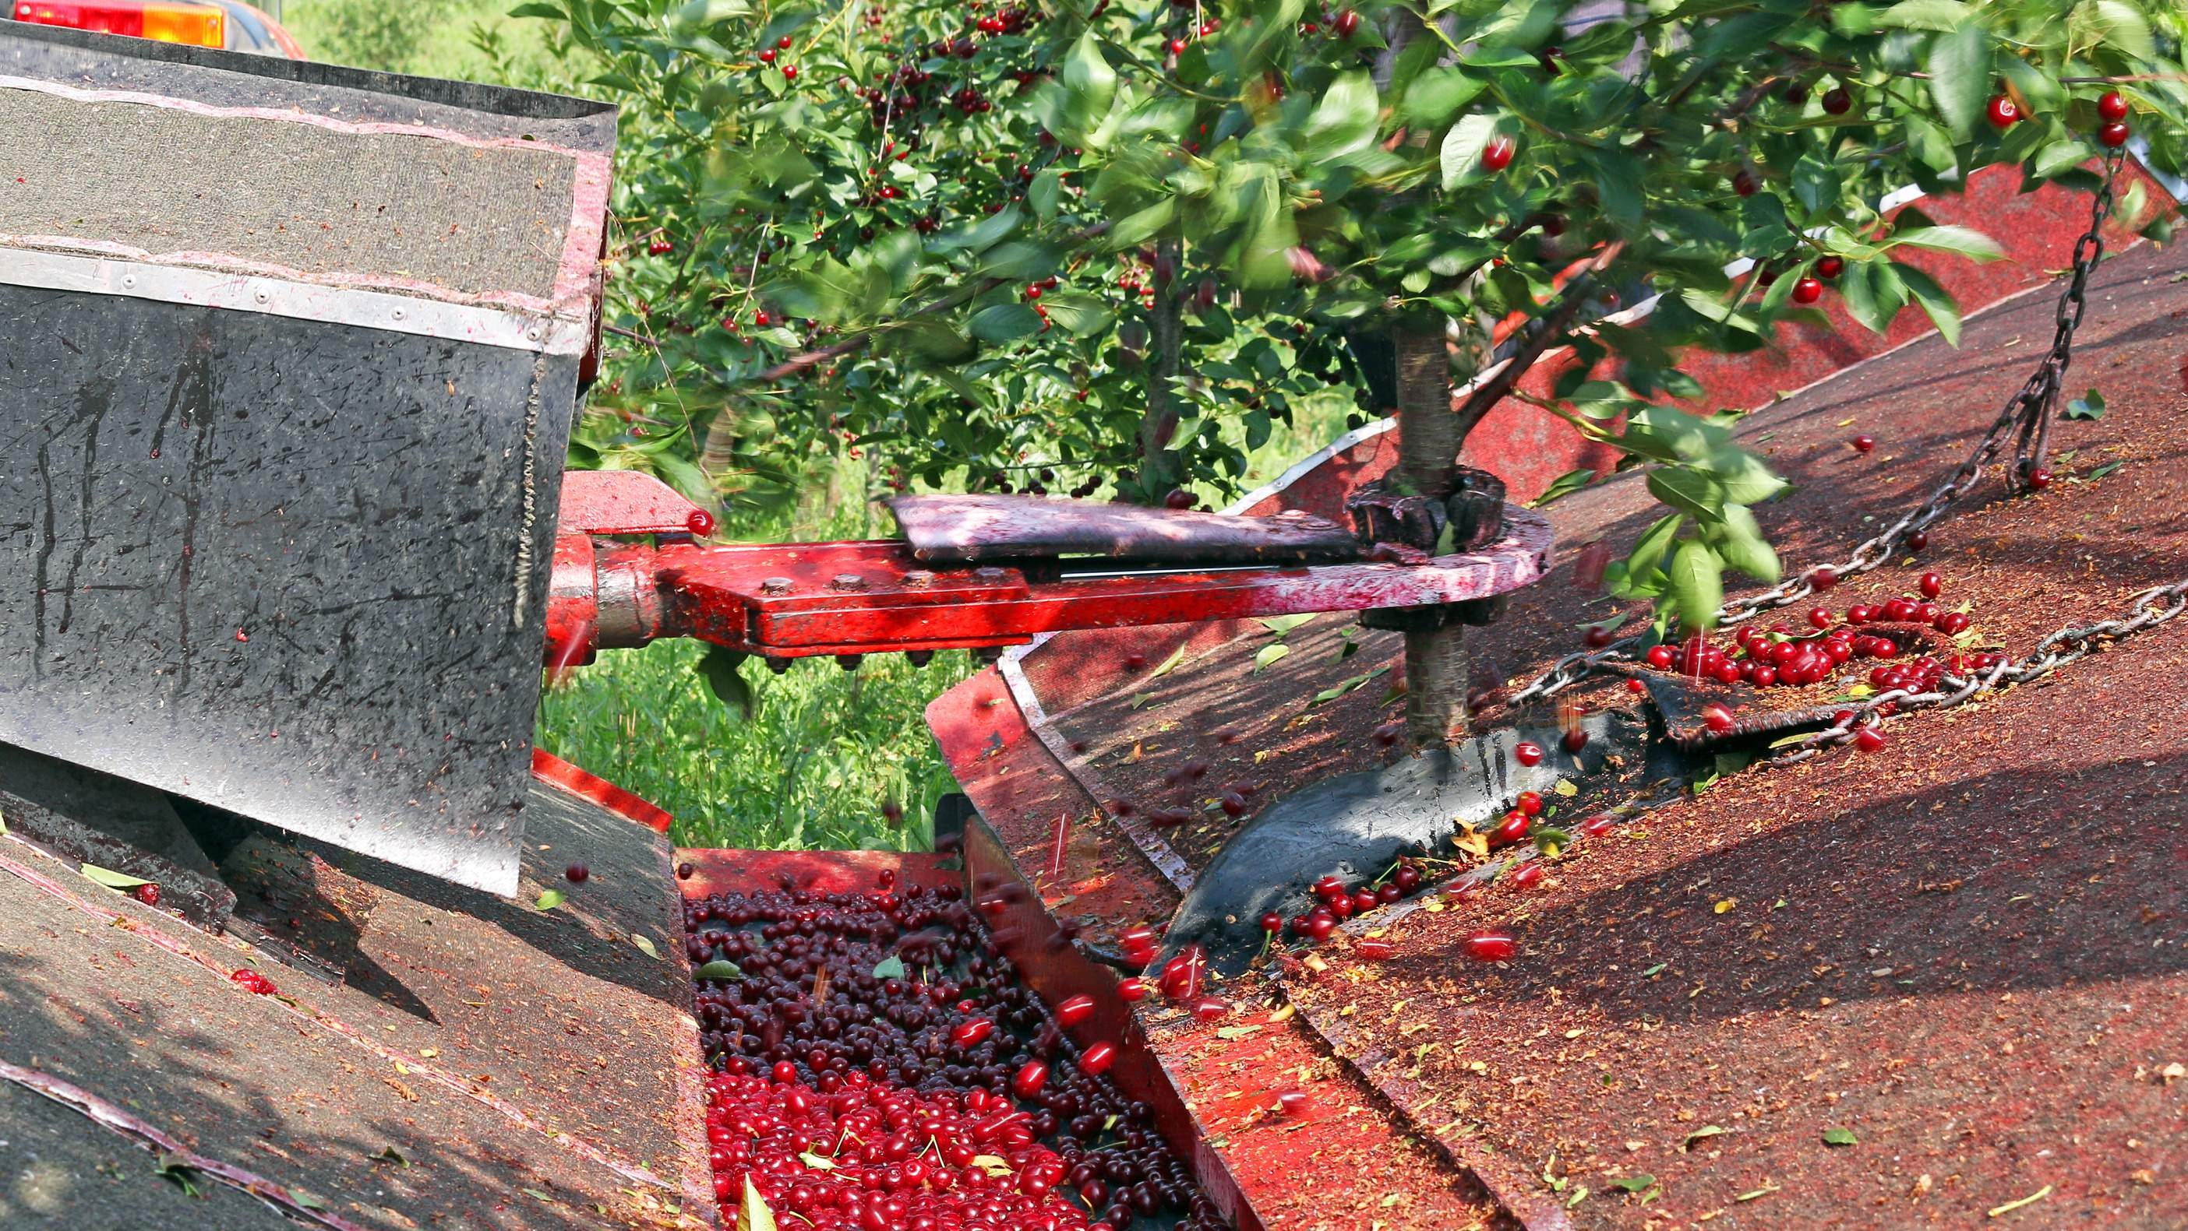
REVENUE MARKET SHARE BY SEGMENTS 2022
Apple Harvesting Machines Raspberry Harvesting Machines Grape Harvesting Machines Pineapple Harvesting Machines
Type Segment
Application Segment
Commercial Personal

Slide 5

Global Fruit Harvesting Machines Market Revenue share for 2022
North America
35%

Slide 6
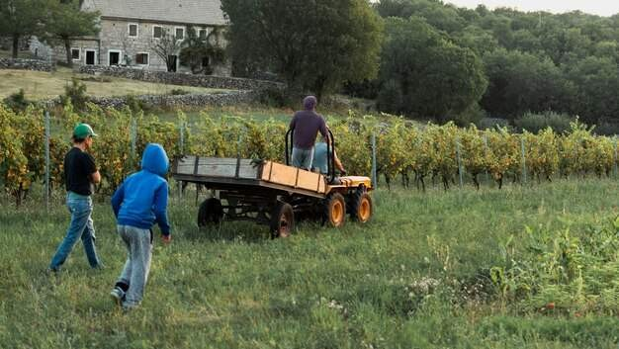
Growing Government Initiatives to Propel Market Growth
Drivers
Growing Government Initiatives to Propel Market Growth
Restraints

Slide 7
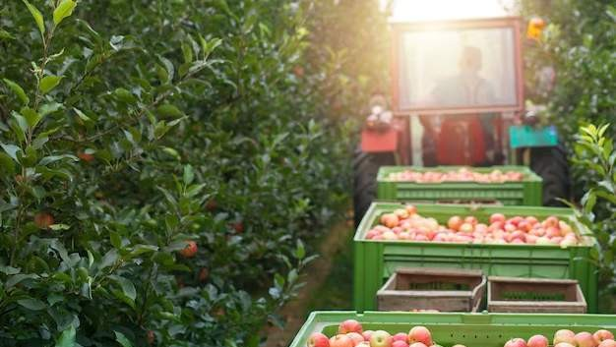
AUTHOR'S PERSPECTIVE
The Global Fruit Harvesting Machines Market is witnessing significant growth in the near future.
Apple harvesting machines are the fastest-growing category as the apple industry faces extraordinary challenges due to the perishable nature of the fruit and the requirement for careful harvesting to support quality.
Traditional manual grape harvesting can be labor-intensive and time-consuming, often leading to labor deficiencies and improved prices for vineyard owners.
Commercial fruit production often affects the cultivation of vast stretches of fruit-bearing trees or plants, making manual harvesting labor-intensive and time-consuming.
Fruit harvesting machines cater to the requirements of the commercial sector by delivering high-speed, mechanical harvesting capabilities.

Slide 8
KEY PLAYERS

Slide 9


Contact us
For Full Report
COGNITIVE MARKET RESEARCH
Tel: + 1 312 - 376 - 8303 | + 44 020 - 8123 - 0732
India: ( + 91 ) 983 - 496 - 8611
sales@ cognitivemarketresearch. com
Access the Full Report : http://tinyurl.com/hu6ttr8a
Please visit our website:
https://www.cognitivemarketresearch.com

