Slide 1
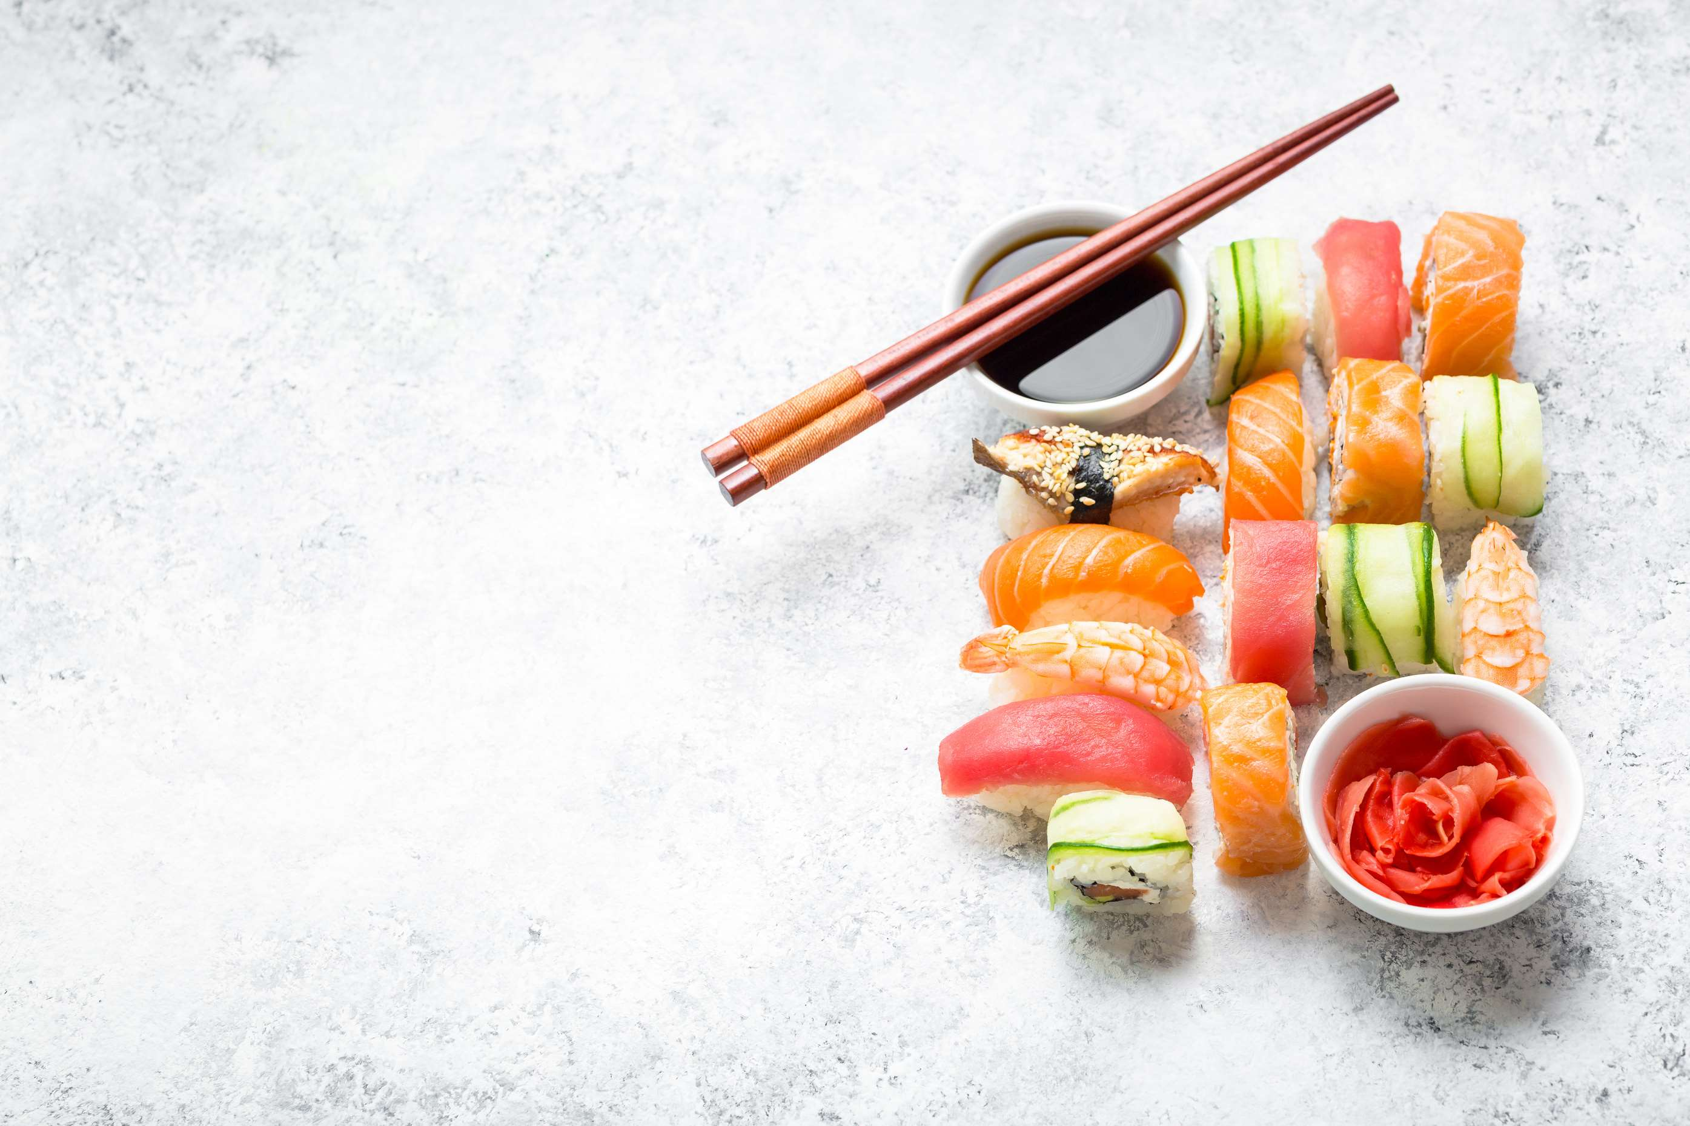

FROZEN SUSHI
MARKET REPORT
2024
Qualitative Analysis + Quantitative Analysis

Slide 2
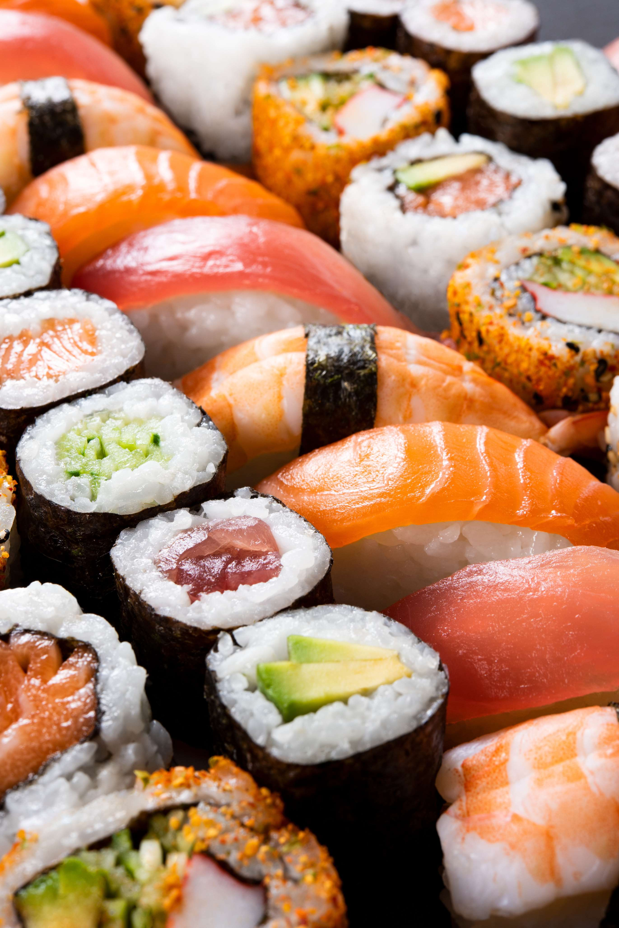
INTRODUCTION
The frozen sushi market has witnessed significant growth in recent years, fueled by evolving consumer preferences, technological advancements in food preservation, and the globalization of culinary tastes. Frozen sushi offers convenience, longer shelf life, and accessibility, catering to busy lifestyles and expanding consumer demographics.

Slide 3
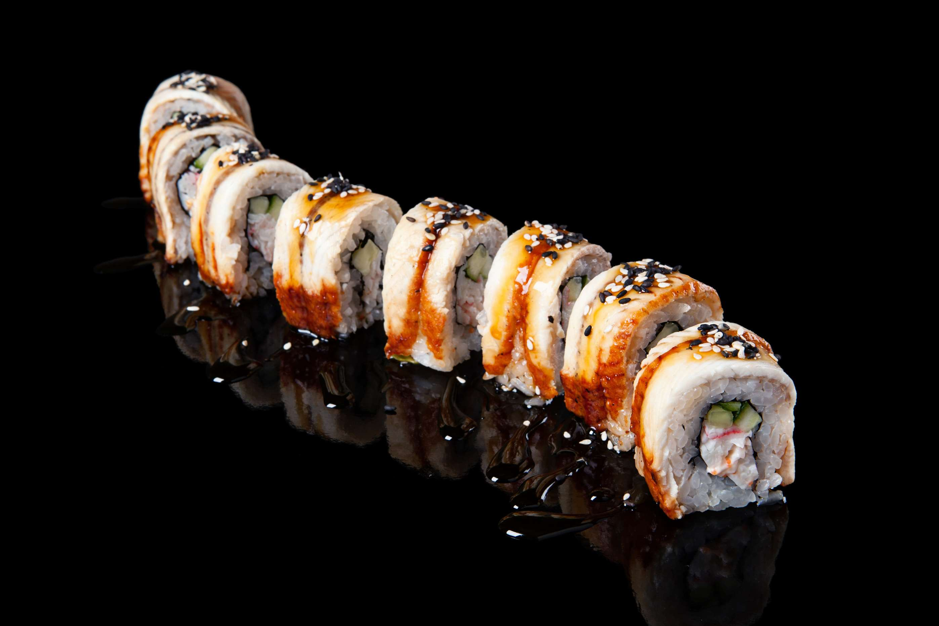

KEY INSIGHTS
MARKET SIZE
USD 815.2 million
2024
CAGR
6.00%
2024- 2031

Slide 4
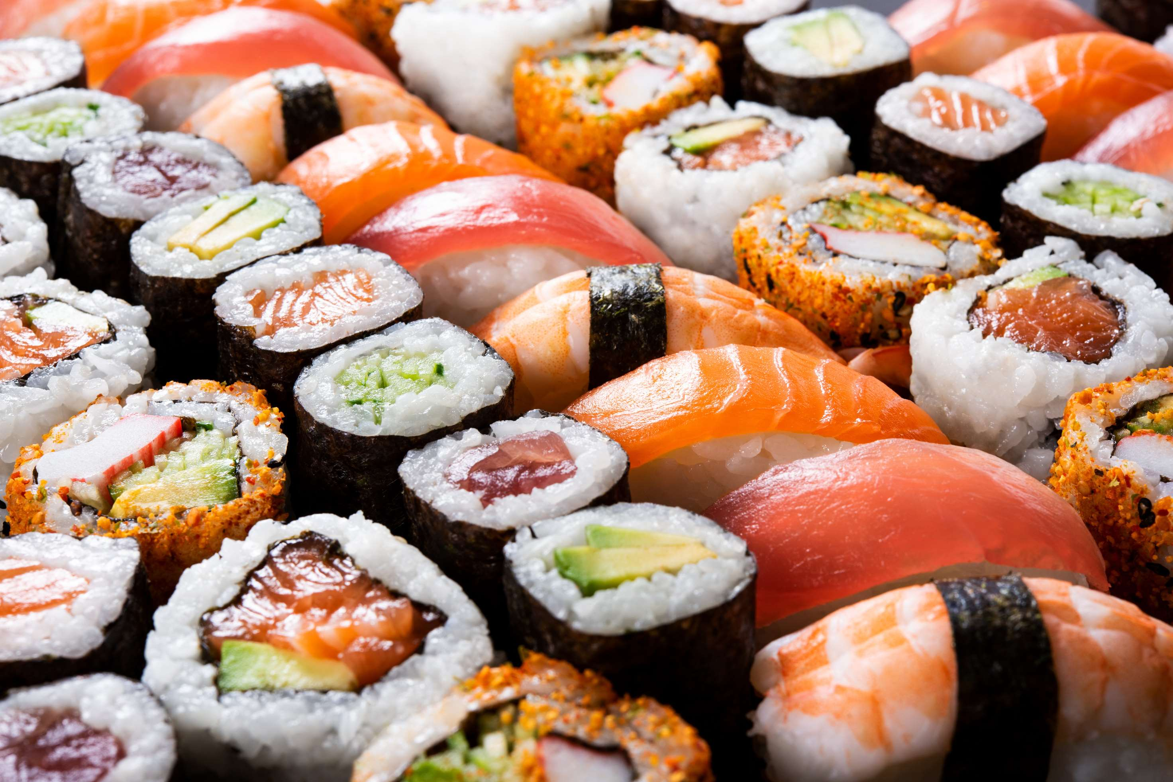
REVENUE MARKET SHARE BY SEGMENTS 2024
  Nigiri
  Maki Rolls
  Uramaki
Type Segment
  Supermarket/Hypermarket
  Retail Stores
  Convenience Stores
  Online Platforms
Distribution Channel
  Households
  Restaurants
  Hotels
  Food Processing Industry
End User Segment

Slide 5

REGION ANALYSIS
NORTH AMERICA
Europe
Asia Pacific
Latin America
MIDDLE EAST AFRICA
40%
30%
23%
5%
2%
North America Frozen Sushi Market Revenue share for 2024 is 40%

Slide 6
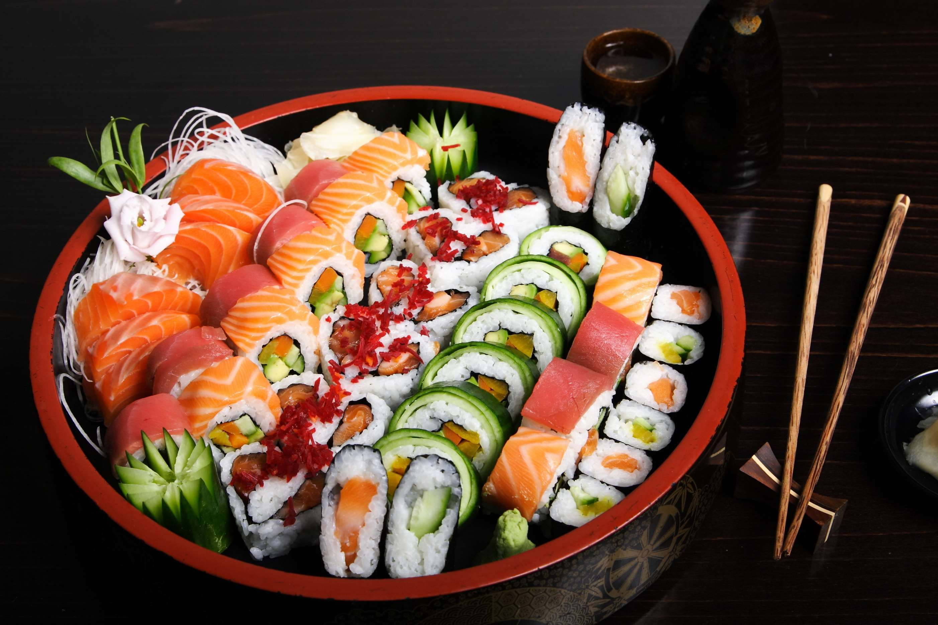
  Rising Demand for Shelf-Stable & Preservative-free Fish to Increase the Demand Globally
  Technological innovation and advancement to Propel Market Growth
Drivers
Restraints
Loss of Quality during Storage of Frozen Fish to Limit the Sales

Slide 7
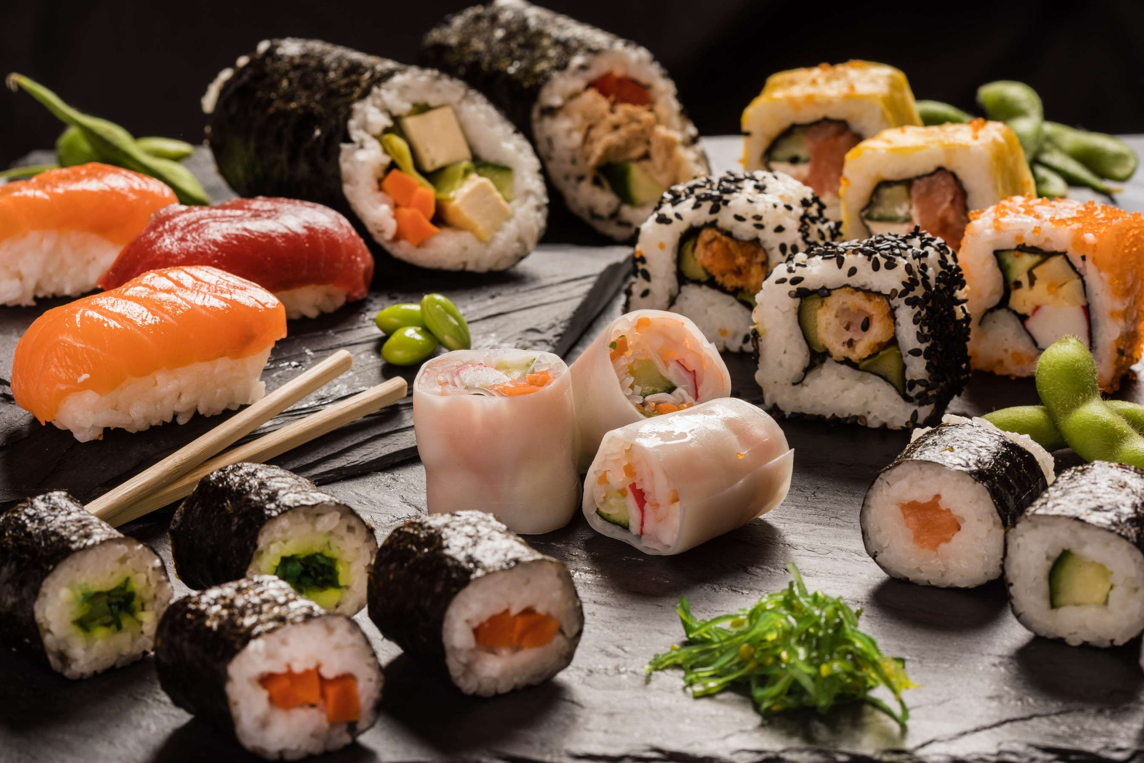
AUTHOR'S PERSPECTIVE
  The global Frozen Sushi market will expand significantly by 6.00% CAGR between 2024 to 2031.
  The Nigirisegment is set to its convenience and longer shelf life. Consumers seek authentic taste and quality despite being frozen.
  Increasing demand for ready-to-eat options and expanding distribution channels contribute to the segment's promising outlook, driving innovation and diversity in product offerings.
  Growing demand for healthy, ready-to-eat options, technological advancements in freezing techniques, and global sushi consumption trends also contribute to market growth.
  Rising awareness of sustainability practices further influences purchasing decisions.

Slide 8






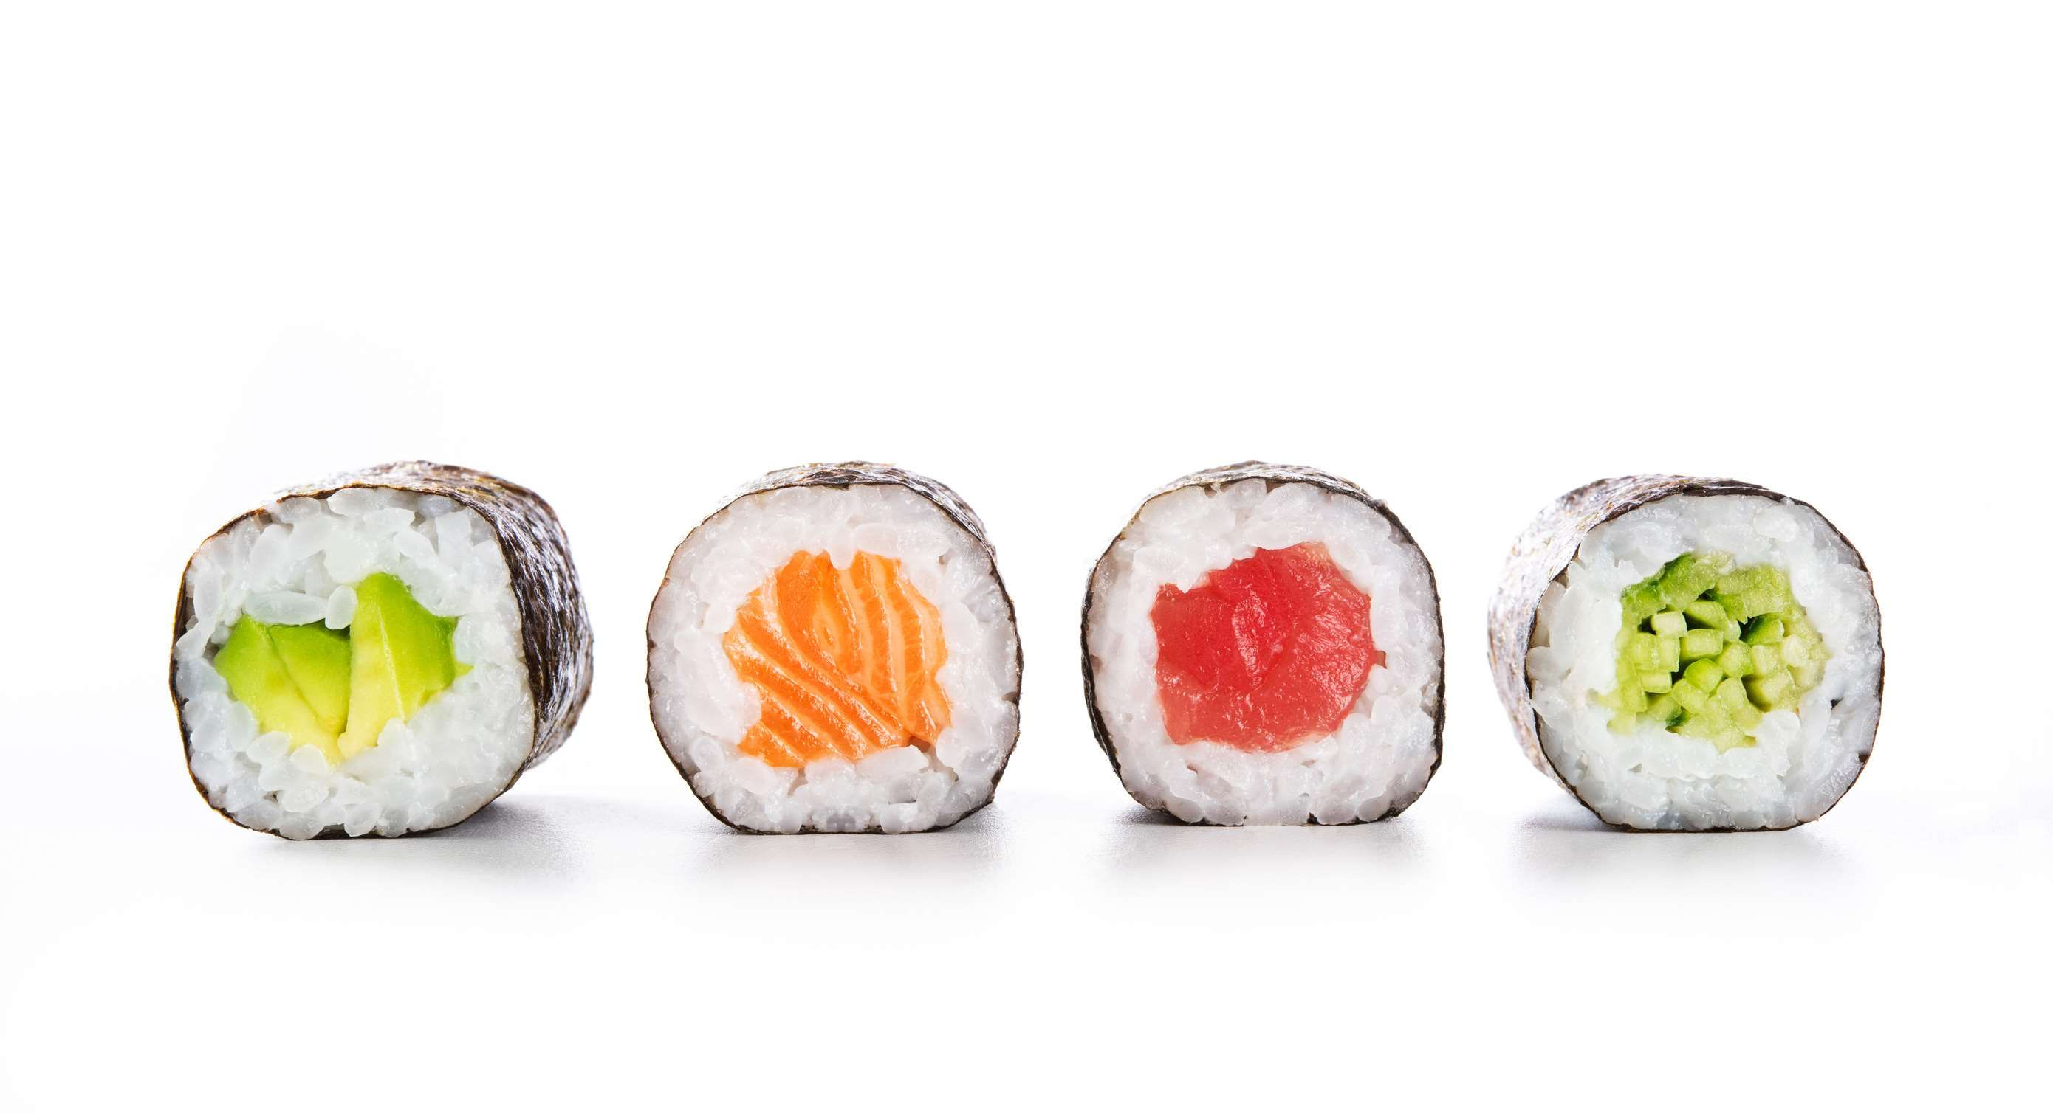
KEY PLAYERS

Slide 9


For Full Report
Contact us
COGNITIVE MARKET RESEARCH
Tel: +1 312-376-8303 | +44 020-8123-0732
India: (+91) 983-496-8611
sales@cognitivemarketresearch.com
Access the Full Report : https://tinyurl.com/2n8c23fy
Please visit our website:
https://www.cognitivemarketresearch.com

