Slide 1



GLOBAL
FROZEN FISH
MARKET REPORT
2024
Global,Regional,CountryAnalysis

Slide 2

INTRODUCTION
Frozen fish refers to seafood that has been subjected to low temperatures to preserve its freshness, quality, and nutritional value. Typically caught from oceans, rivers, or aquaculture farms, fish are rapidly frozen soon after harvest to prevent bacterial growth and enzymatic degradation. This process involves lowering the temperature of the fish to below -18°C (0°F) to halt biological processes, preserving its texture, flavor, and nutrients. Frozen fish offers consumers a convenient, year-round source of seafood, retaining much of its taste and nutritional benefits. It is a vital component of the global food industry, providing access to diverse fish species regardless of season or location.

Slide 3


KEY INSIGHTS
MARKET SIZE
USD 27518.2 million
2024
CAGR
8.00%
2024- 2031

Slide 4

REVENUE MARKET SHARE BY SEGMENTS 2022
  Raw
  Processed
Form Segment
  Supermarkets/ Hypermarkets
  Convenience Stores
  Specialty Stores
Distribution Channel

Slide 5
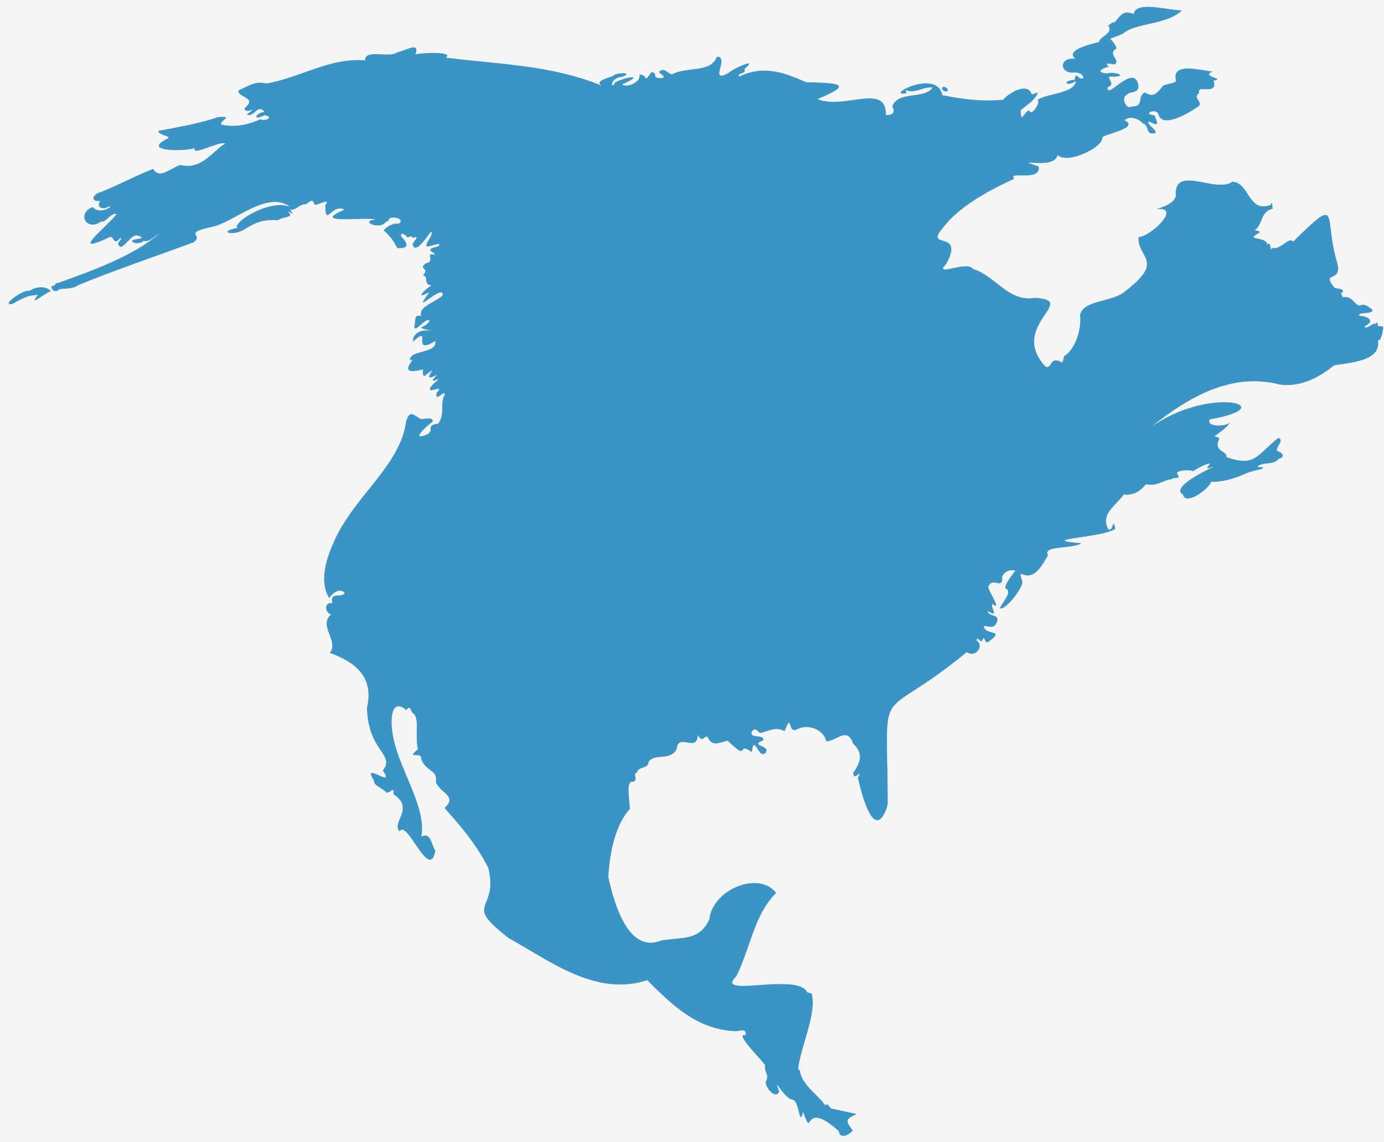
Global Frozen Fish Market Revenue share for 2024
North America
40%

Slide 6

  Health Conscious Consumer Trends to Increase the Demand Globally
  Convenience and Accessibility to Propel Market Growth
Drivers
Perceived Quality Concerns to Limit the Sales
Restraints

Slide 7
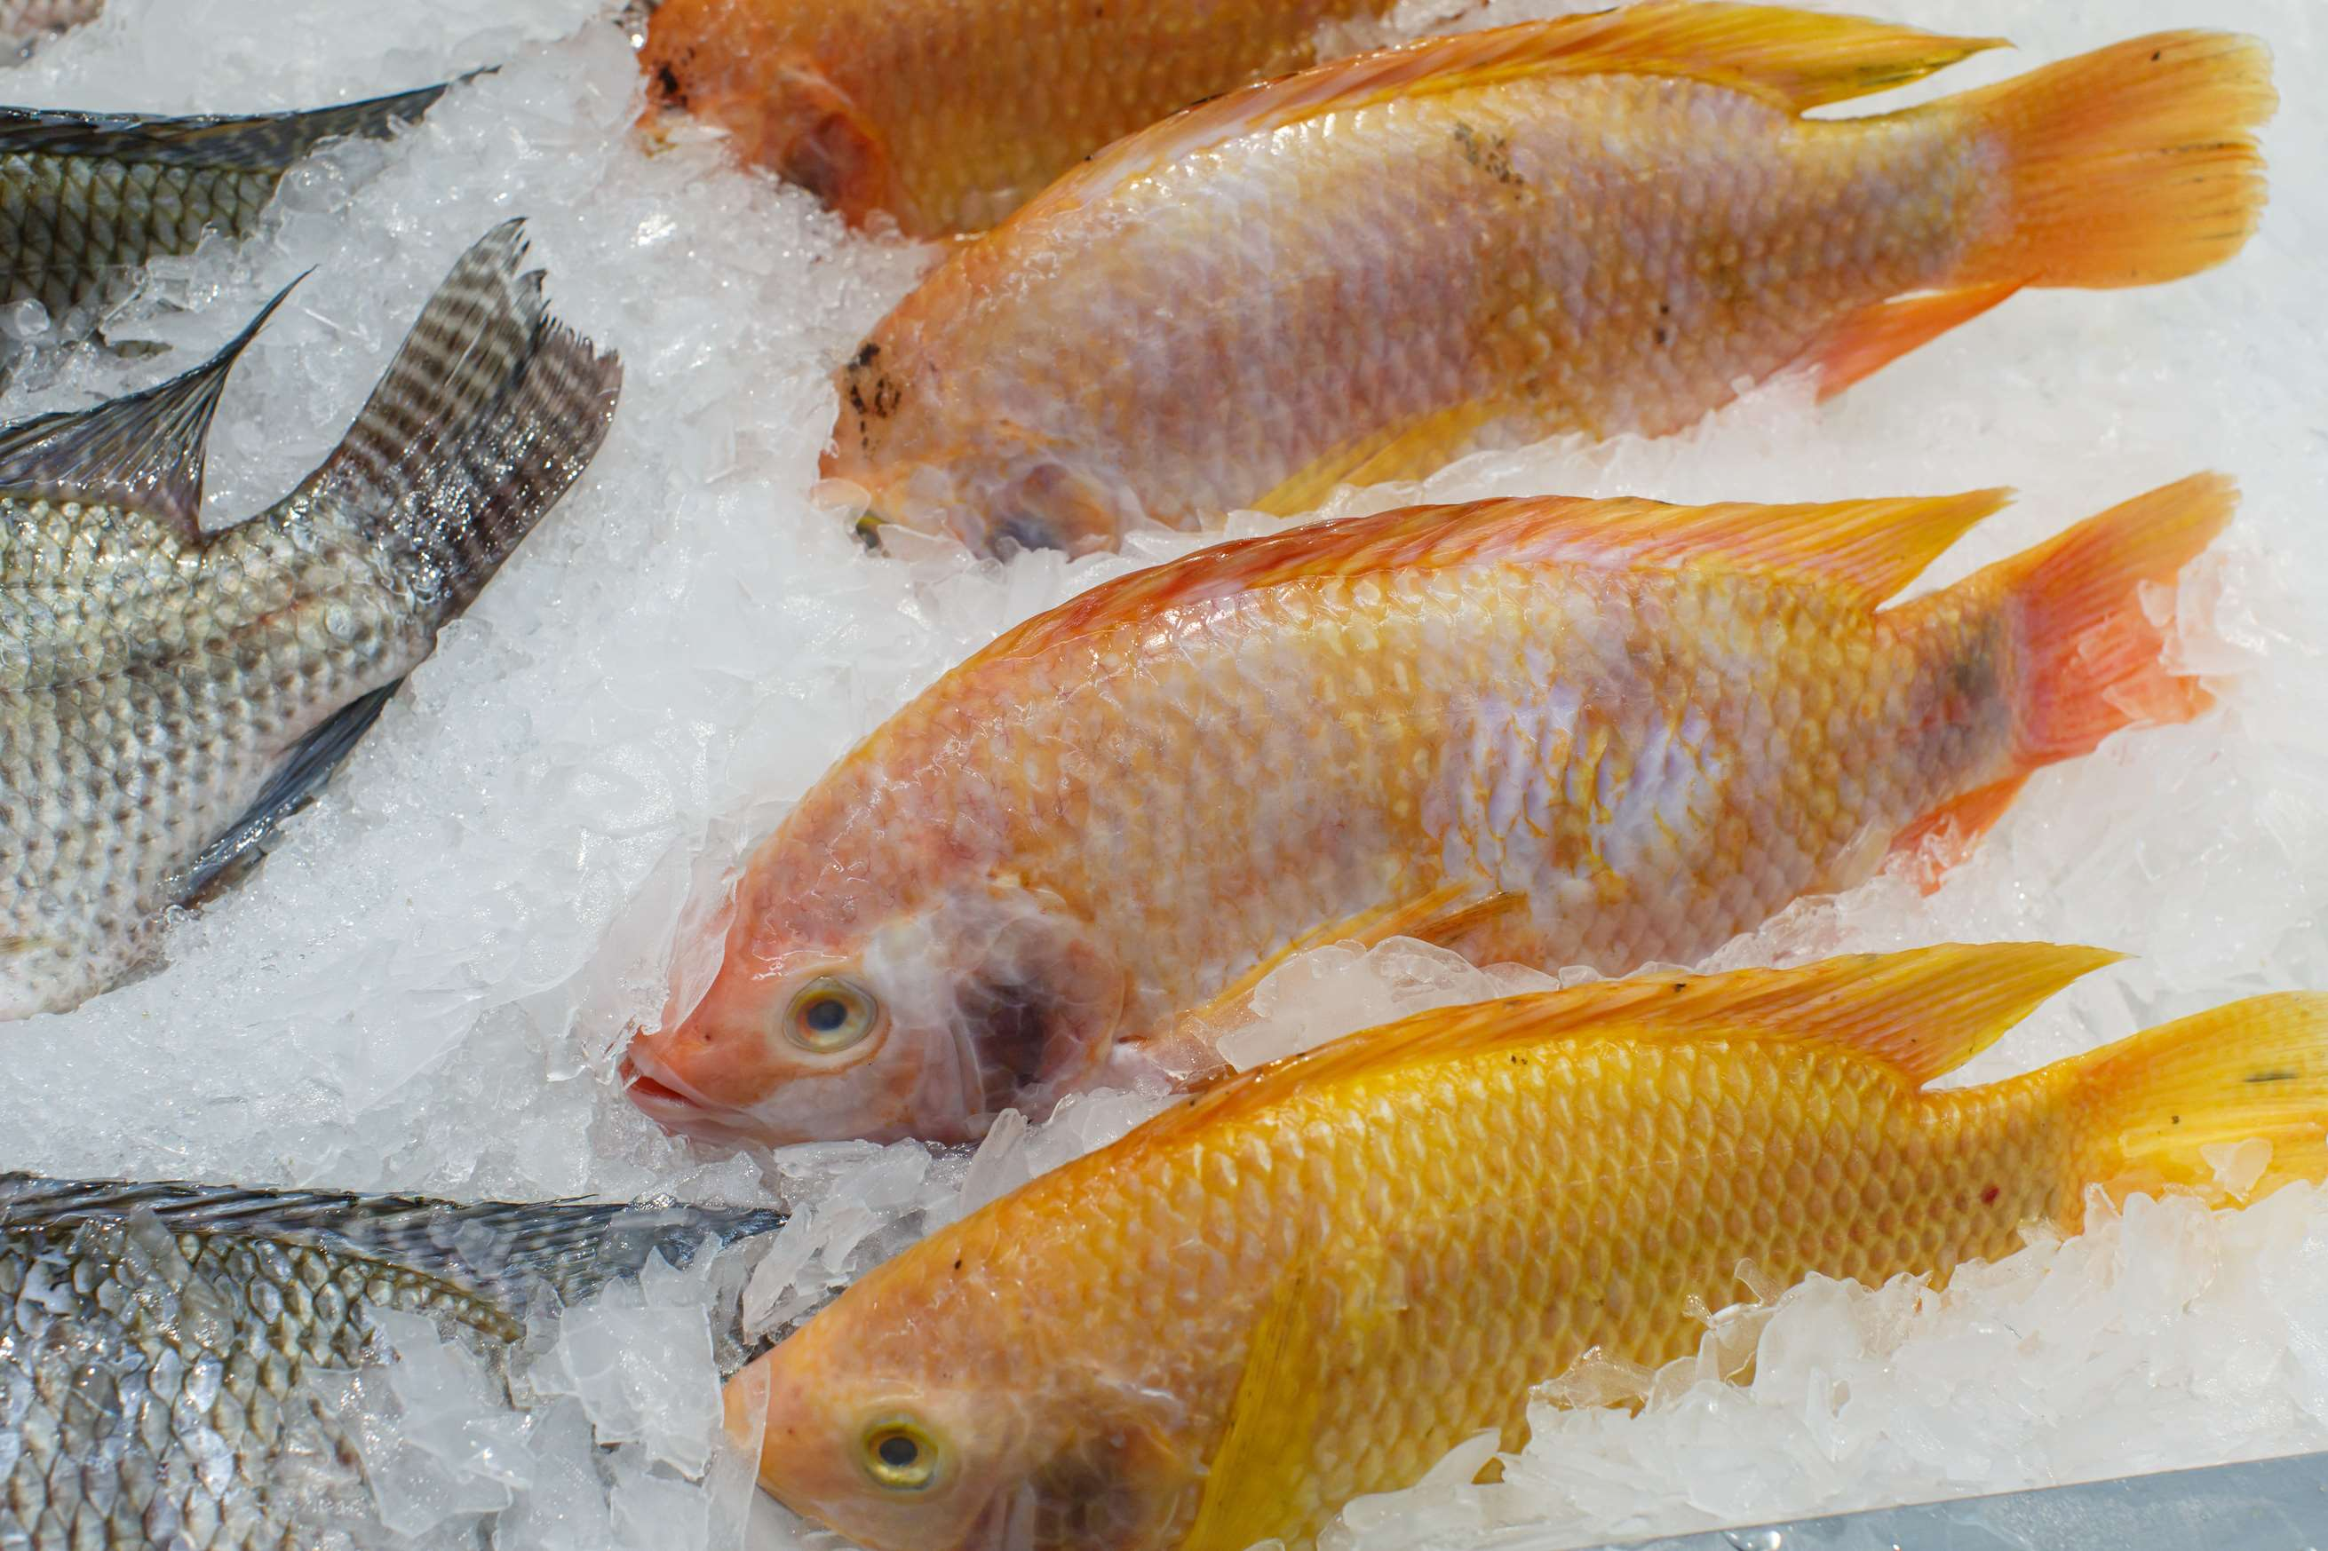
AUTHOR'S PERSPECTIVE
  The global frozen fish market will expand significantly by 8.00% CAGR between 2024 to 2031.
  Sales of salmon are expected to increase due to its popularity as a versatile and nutritious seafood option, coupled with growing consumer awareness of its health benefits and culinary appeal.
  Sales of conventional frozen fish are likely to increase due to their widespread availability, affordability, established supply chains, and stringent quality control measures, ensuring consistency and reliability.

Slide 8











KEY PLAYERS

Slide 9


For Full Report
Contact us
COGNITIVE MARKET RESEARCH
Tel: +1 312-376-8303 | +44 020-8123-0732
India: (+91) 983-496-8611
sales@cognitivemarketresearch.com
Access the Full Report : https://tinyurl.com/ycysfxpc
Please visit our website:
https://www.cognitivemarketresearch.com

