Slide 1
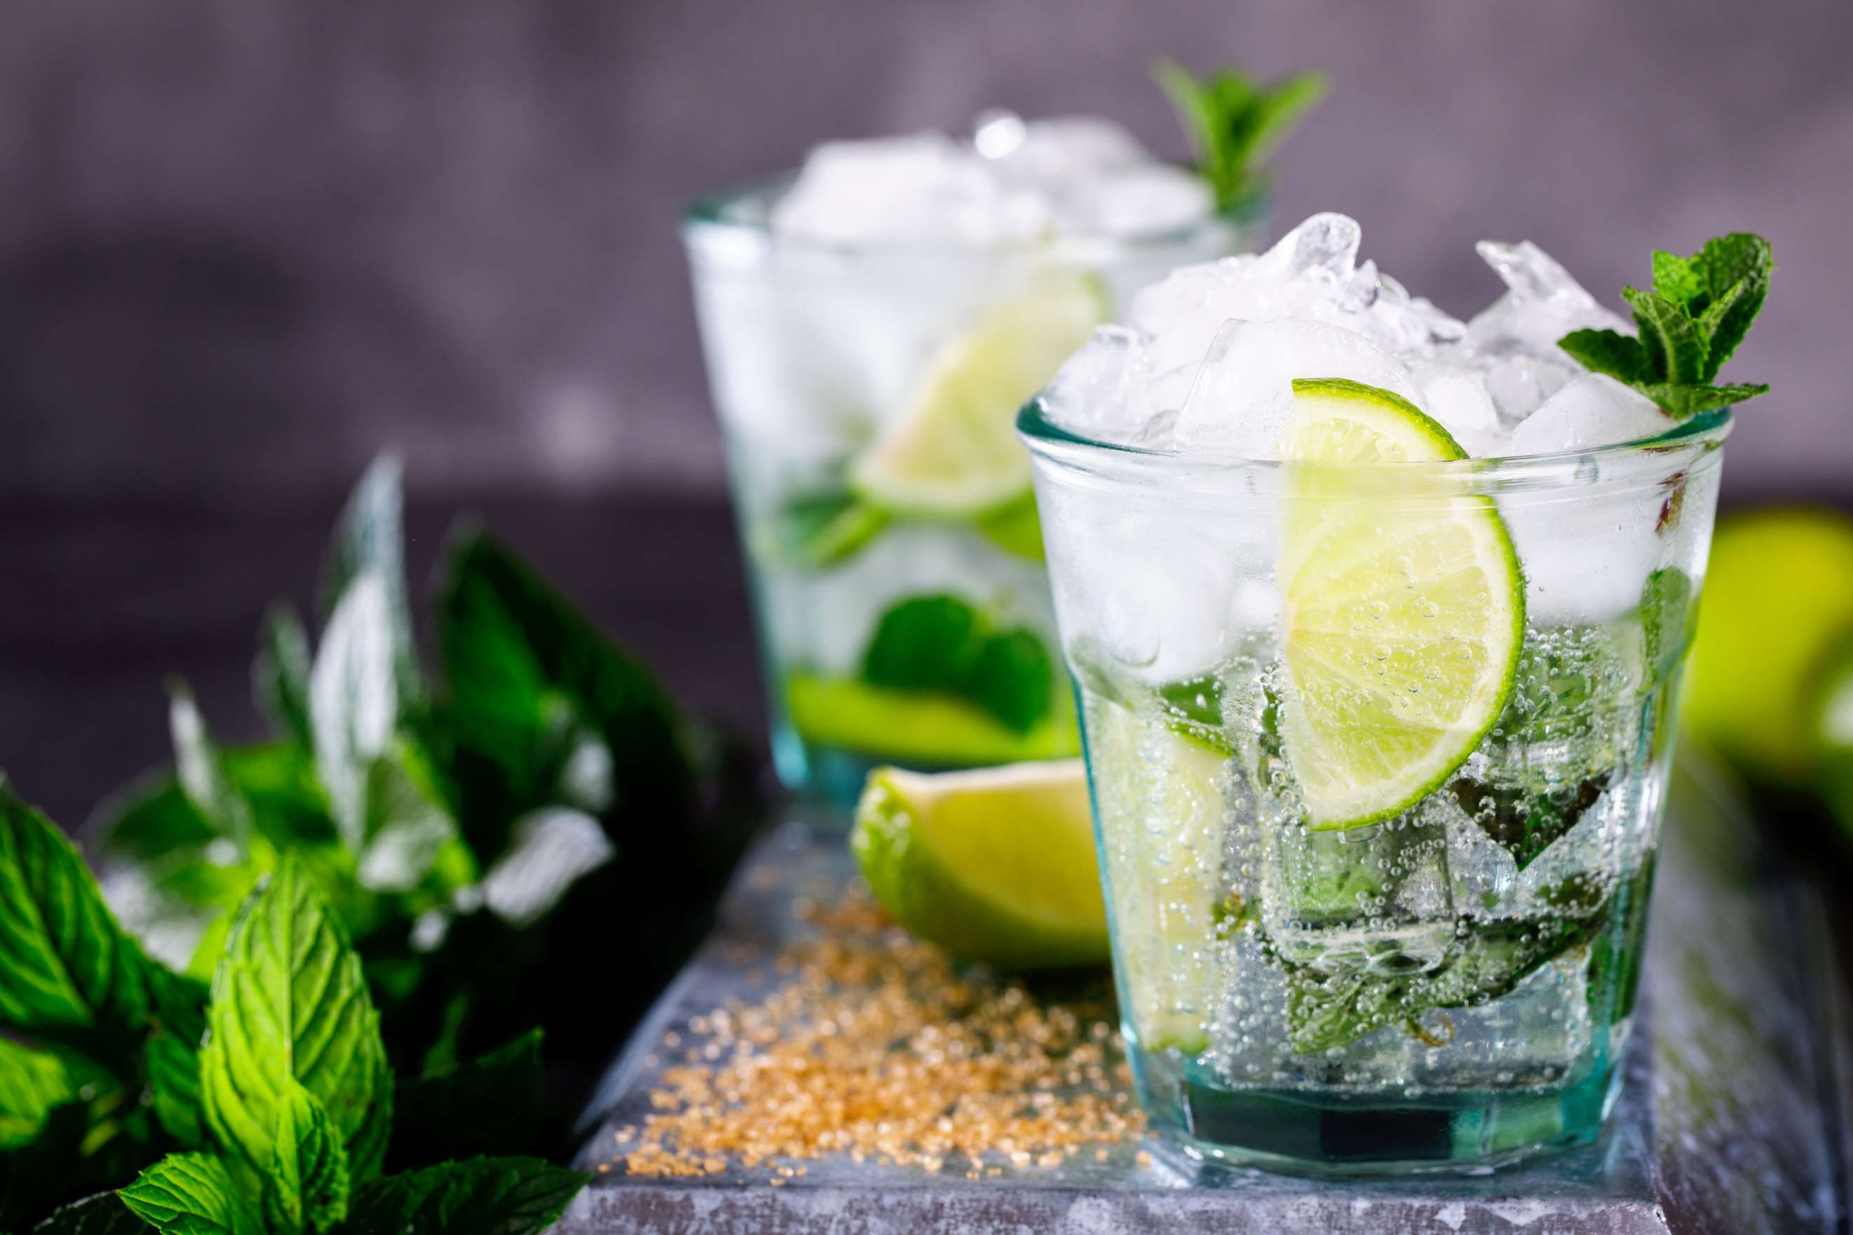
GLOBAL
FROZEN COCKTAILS
MARKET REPORT
2024
Global,Regional,CountryAnalysis

Slide 2
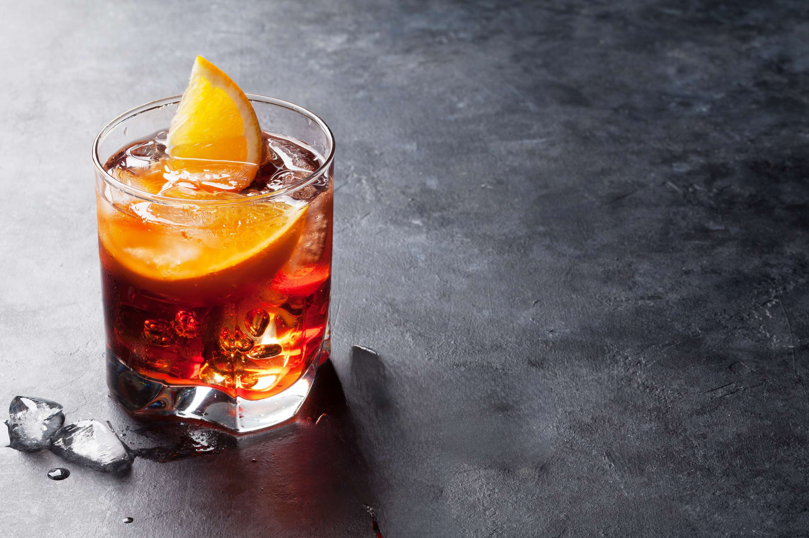
INTRODUCTION
Frozen cocktails are intoxicated beverages that include a mixture of non-fruity flavors, fruit juices, and alcohol. The rising popularity of frozen cocktails among the millennials and the significant expansion in the purchase of frozen beverages has contributed to expanding its market growth. The frozen cocktail is a steadily increasing source of profitability as a stimulating and tasty drink. Additionally, the frozen cocktail dispenser machine needs minimal ingredients and has the possibility to make a highly profitable product delivery, thereby boosting its market expansion.

Slide 3
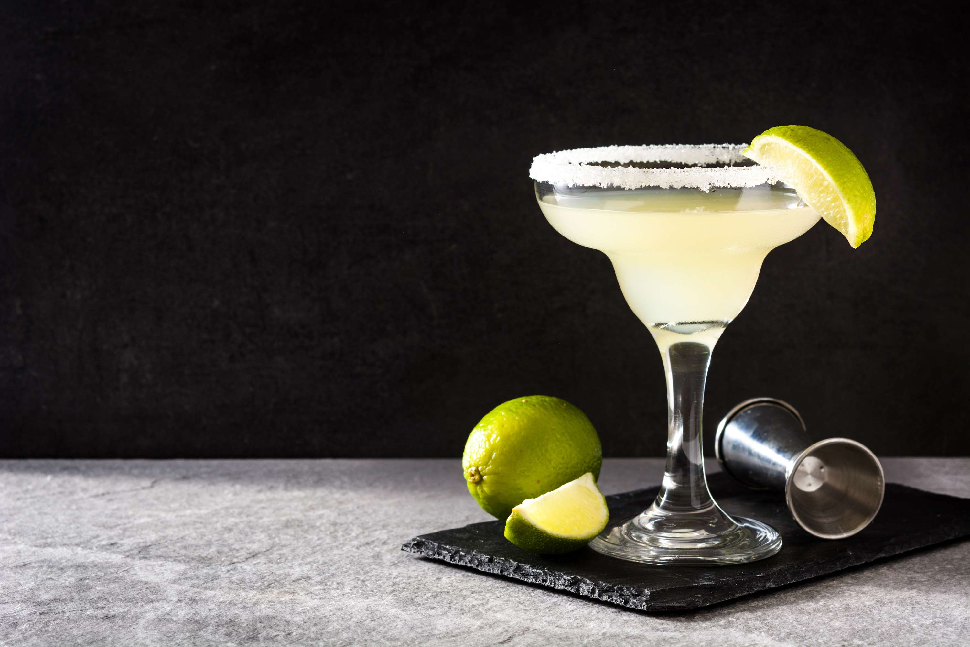

KEY INSIGHTS
MARKET SIZE
USD 1.3 billion
2023
CAGR
5.80%
2023- 2030

Slide 4
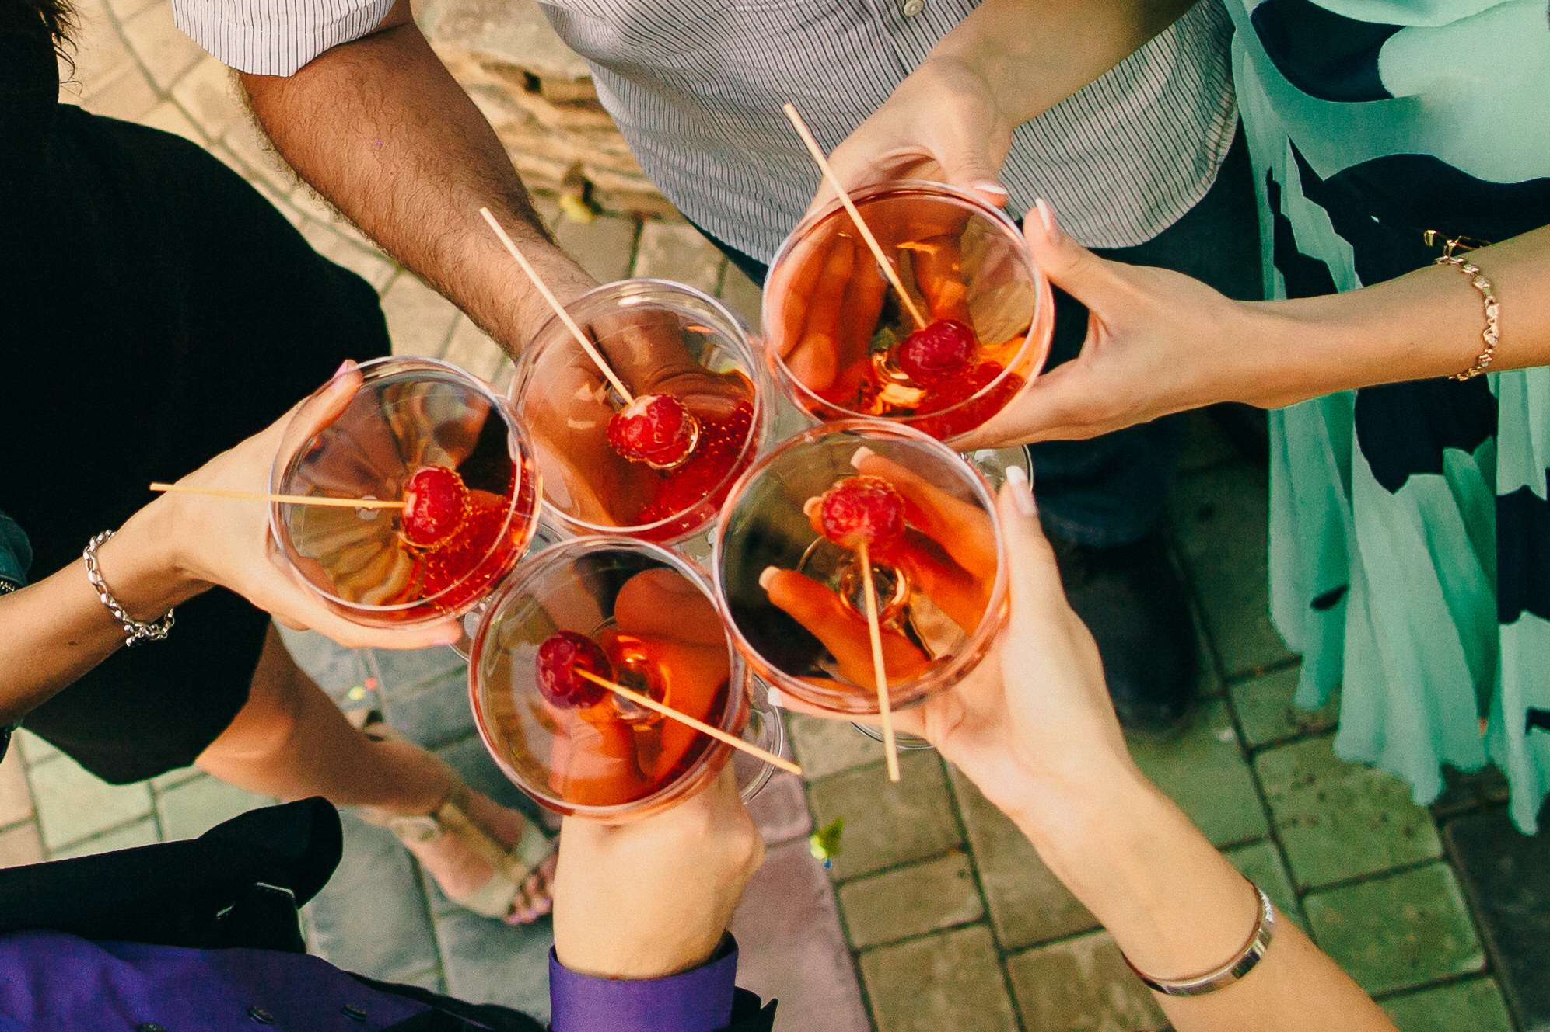
REVENUE MARKET SHARE BY SEGMENTS 2022
  Cosmopolitan
  Martini
  Mojito
  Margarita
  Strawberry Daiquiri
  Sangria
  Ice Popsicles
  Freezer Pouch Drinks
By Type
Form Segment
  Specialty Stores
  Horeca
  Liquor Stores
  Retailers
  Online Retailers
Flavour Segment
  Fruit Flavour
  Spices Flavour
  Herbs Flavour
Application

Slide 5
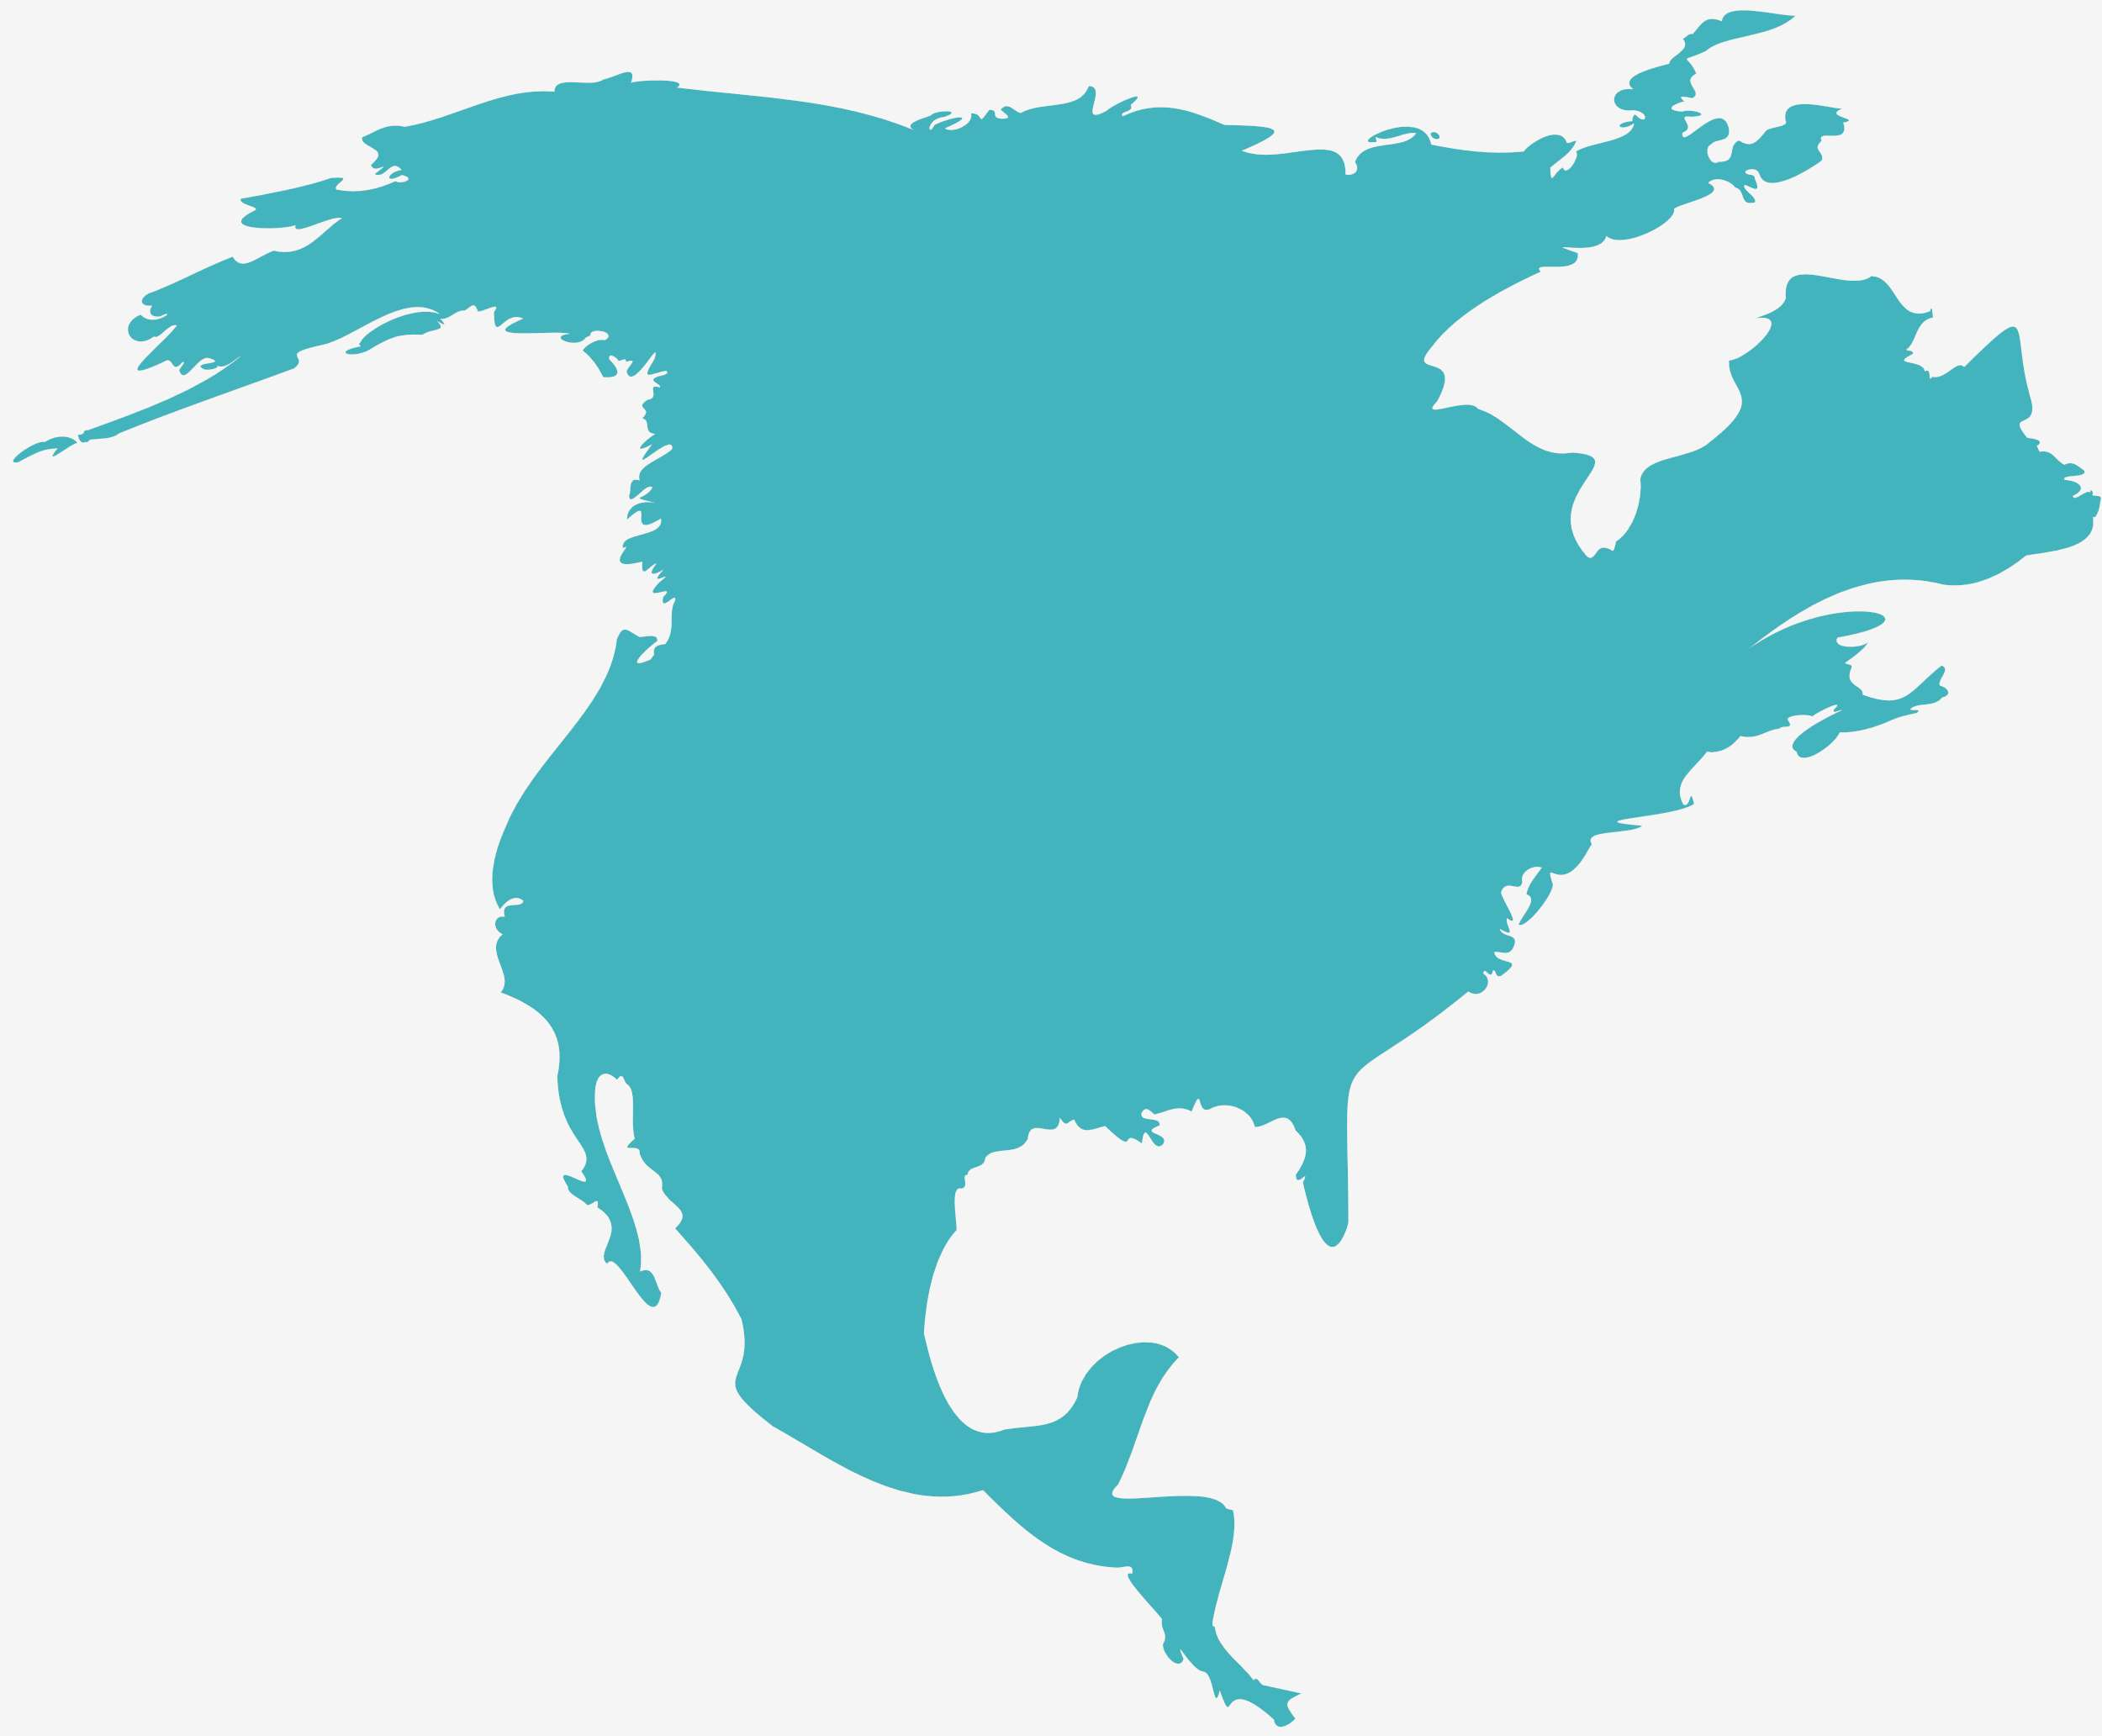
Global Frozen Cocktails Market Revenue share for 2022
North America
35%

Slide 6
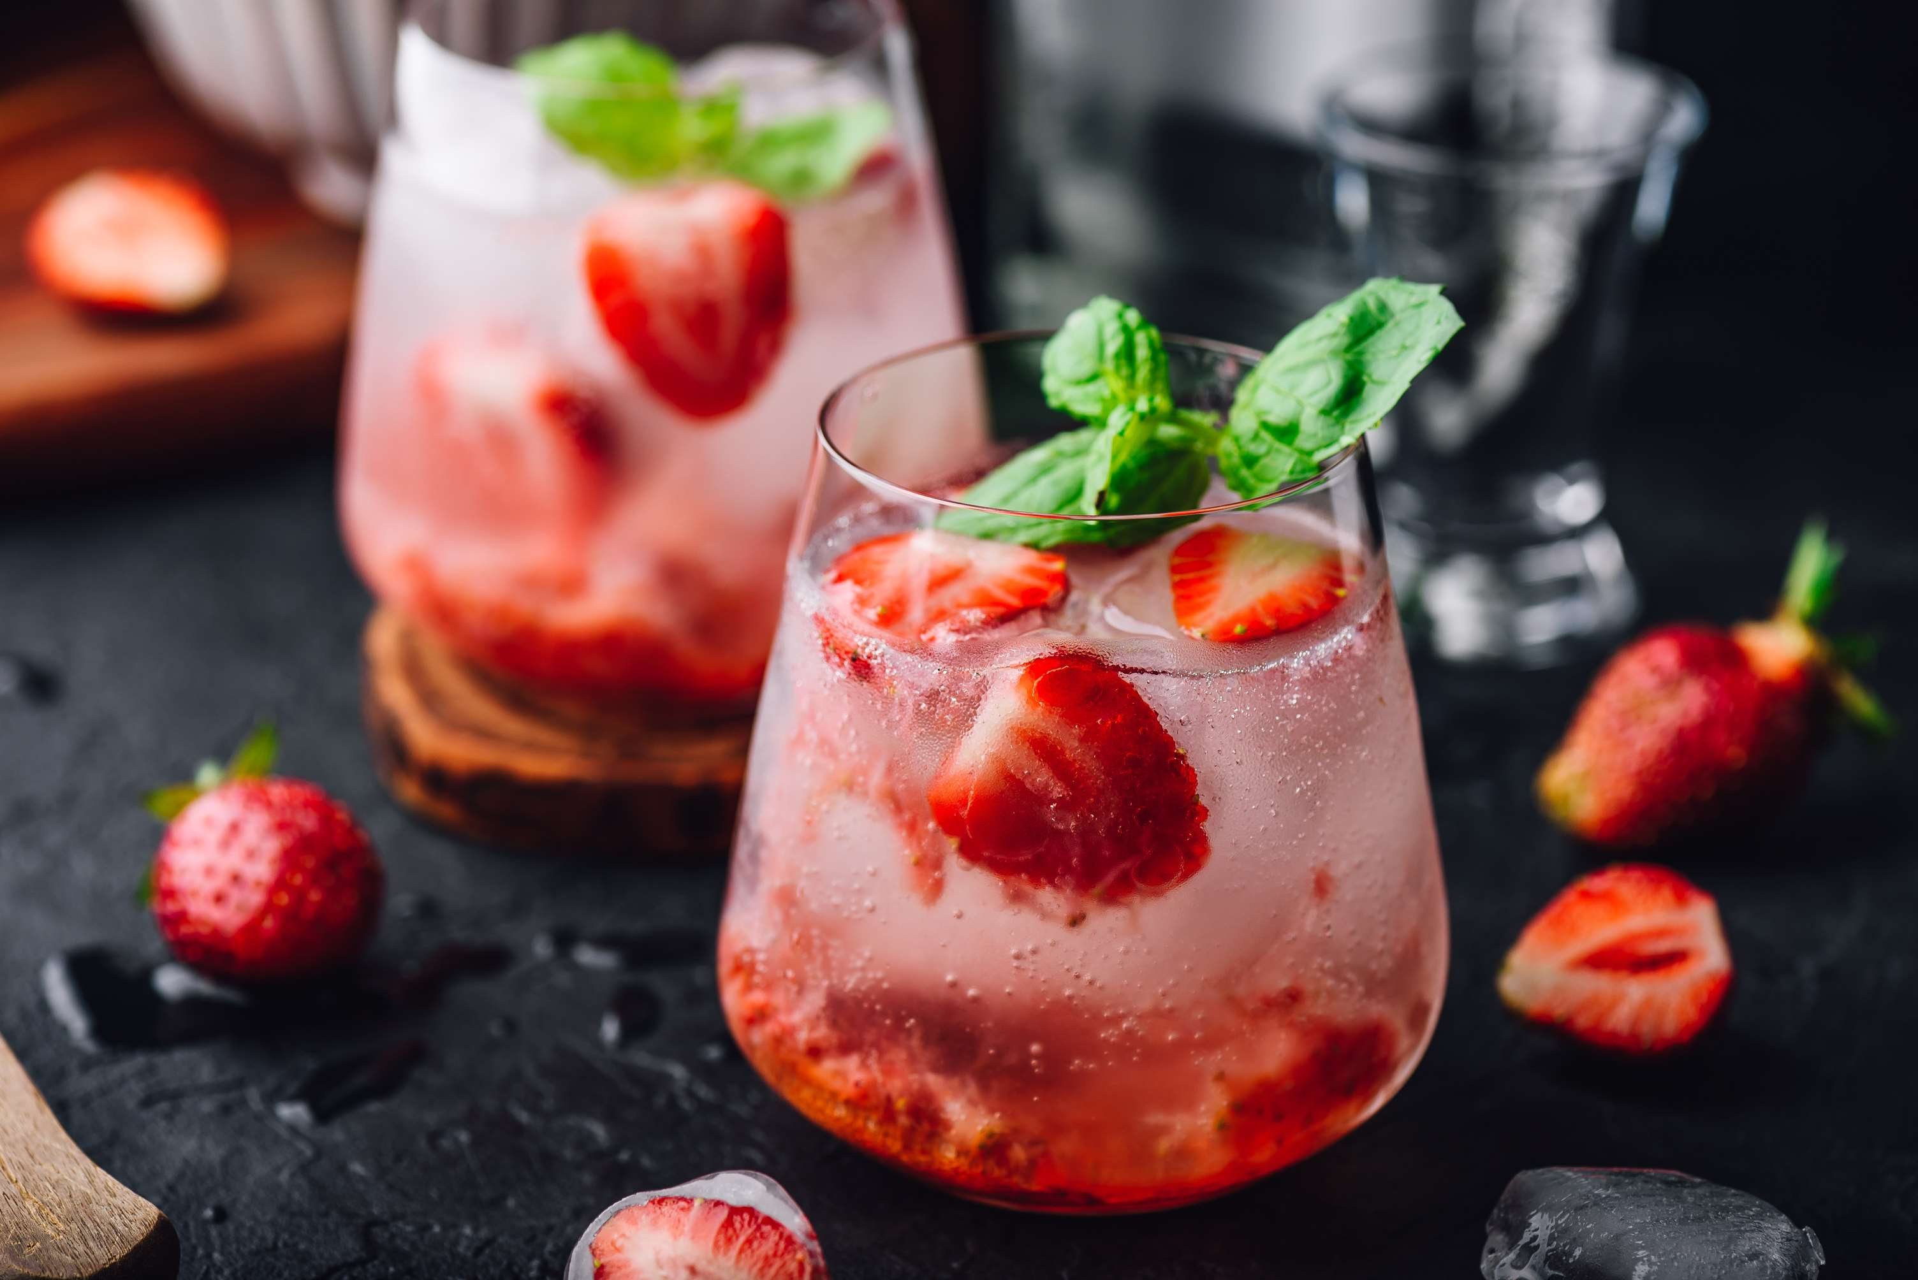
Various Strategies by Key Players to Provide Viable Market Output
Drivers
Limitations of Cocktail Consumption to Hinder Market Growth
Restraints

Slide 7
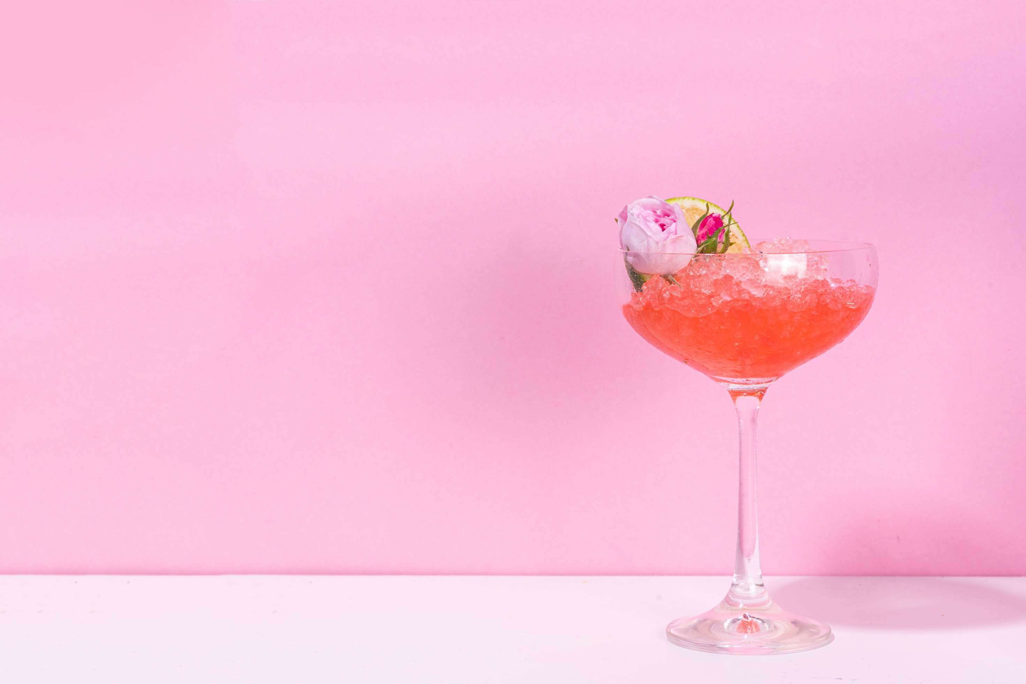
AUTHOR'S PERSPECTIVE
  The Global Frozen Cocktails Market is witnessing significant growth in the near future
  Frozen cocktails, like daiquiris and piña coladas, offer a tropical escape with their slushy consistency and fruity flavors.
  In contrast, frozen cocktails ignite a playful spirit, blending vibrant fruit flavors with crushed ice to create a slushy delight synonymous with fun and relaxation.
  To promote safety, offline retailers can provide educational materials on responsible drinking, encourage designated drivers, and even collaborate with ride-sharing services to ensure customers have safe transportation options.
  In 2023, the Cosmopolitan segment accounted for noticeable share of global Frozen Cocktails Market and is projected to experience significant growth in the near future.

Slide 8

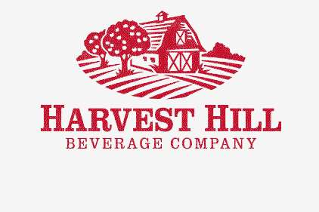

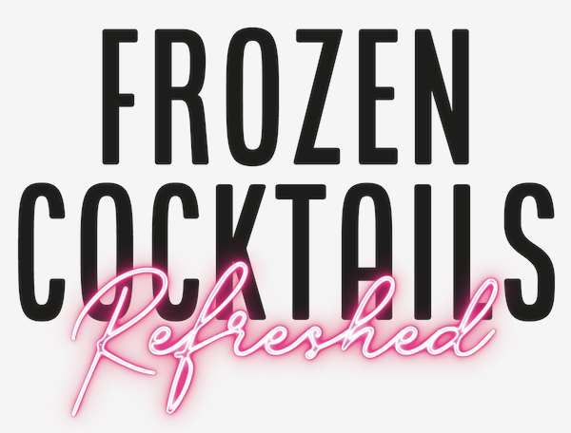


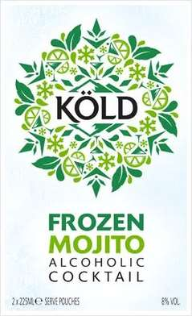

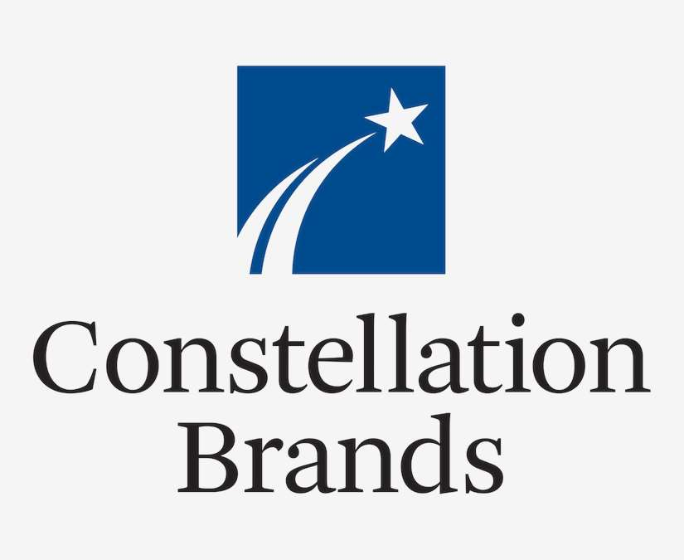
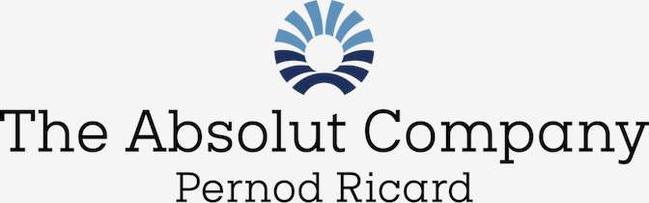
KEY PLAYERS

Slide 9


For Full Report
Contact us
COGNITIVE MARKET RESEARCH
Tel: +1 312-376-8303 | +44 020-8123-0732
India: (+91) 983-496-8611
sales@cognitivemarketresearch.com
Access the Full Report : http://tinyurl.com/ed7xpy2r
Please visit our website:
https://www.cognitivemarketresearch.com

