Slide 1
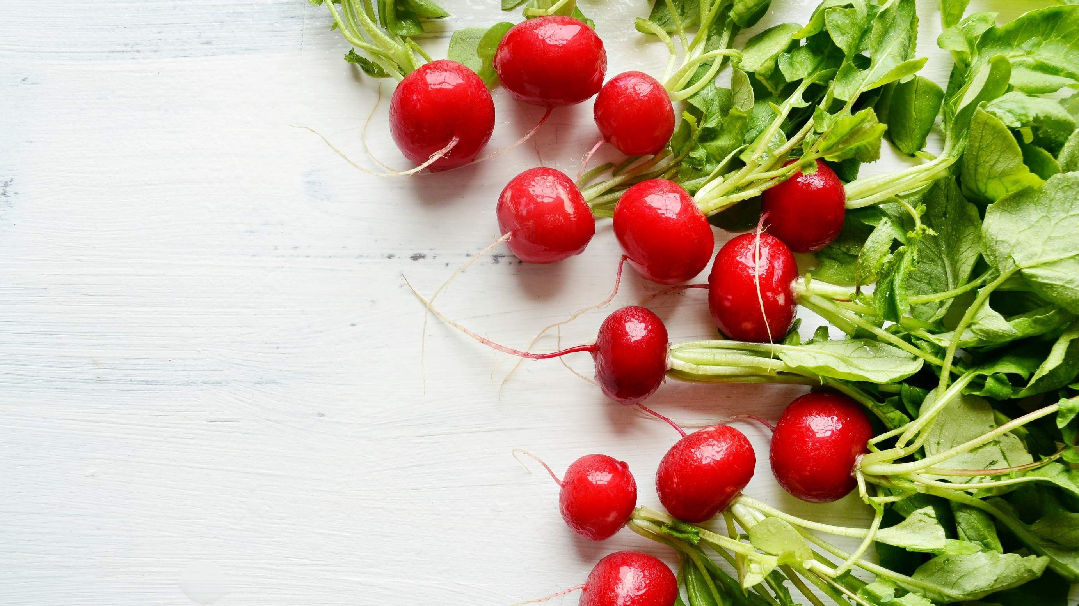
GLOBAL
FRESH RADISH
MARKET REPORT 2024
Global,Regional,CountryAnalysis

Slide 2
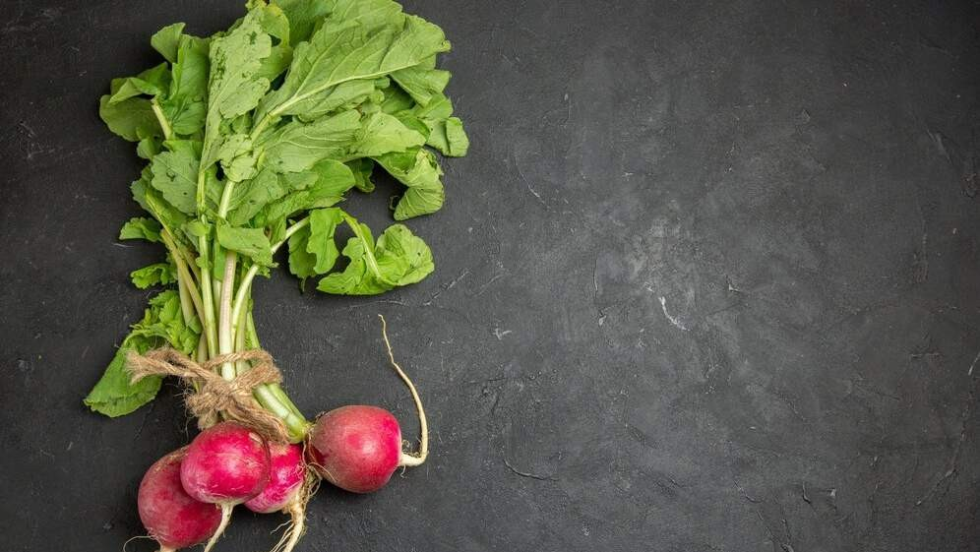
INTRODUCTION
A freshly harvested radish is a root
vegetable with a crisp texture and comes in red or white color. I t is commonly
used in salads, soups, and various dishes due to i ts high content of Vitamin C and other nutrients, making i t a vital
component of a nutritious diet. The
market is experiencing growth driven by the growing demand for healthy and
organic food products and the increasing disposable income of consumers in
developing nation.

Slide 3
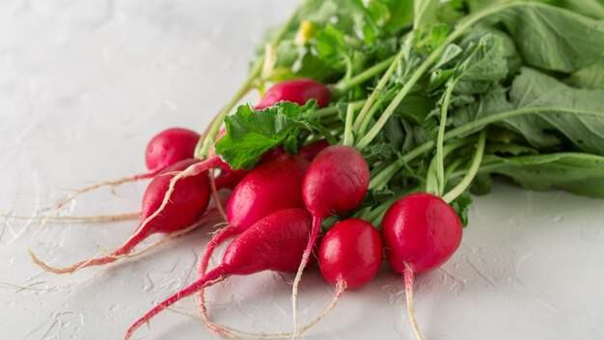

KEY INSIGHTS
MARKET SIZE
USD 1.3 billion
2023
20₋23
CAGR 4.00%
2030

Slide 4
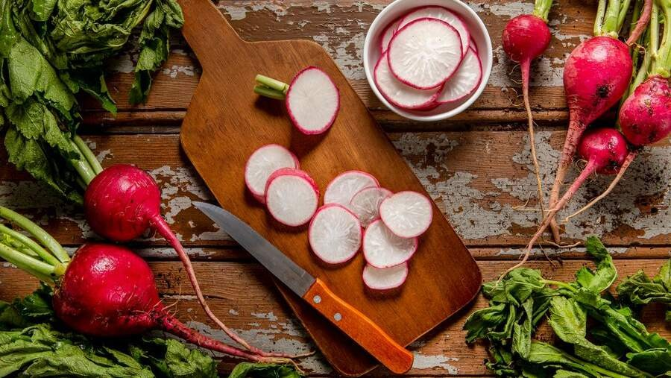


REVENUE MARKET SHARE BY SEGMENTS 2022
Round Root Radish Elongated Root Radish
Type Segment
Supermarkets/Hypermarkets Convenience Stores Independent Retailers Online Sales
Application Segment

Slide 5

Global Fresh Radish Market Revenue share for 2022
Asia Pacific USD 0.47 Billion

Slide 6
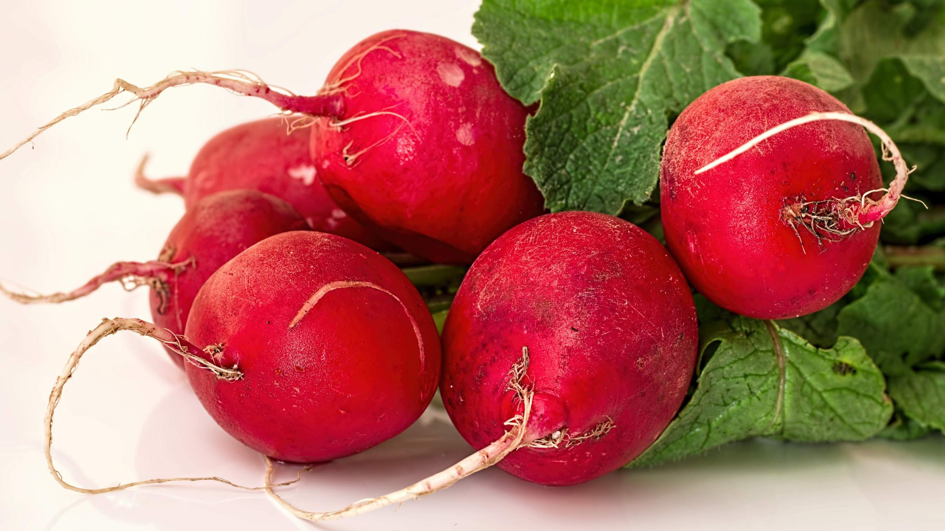
Culinary Diversity and Growing Food Trends to Propel Market Growth
Drivers
Seasonal Availability and Limited Shelf Life to Restrict Market Growth
Restraints

Slide 7
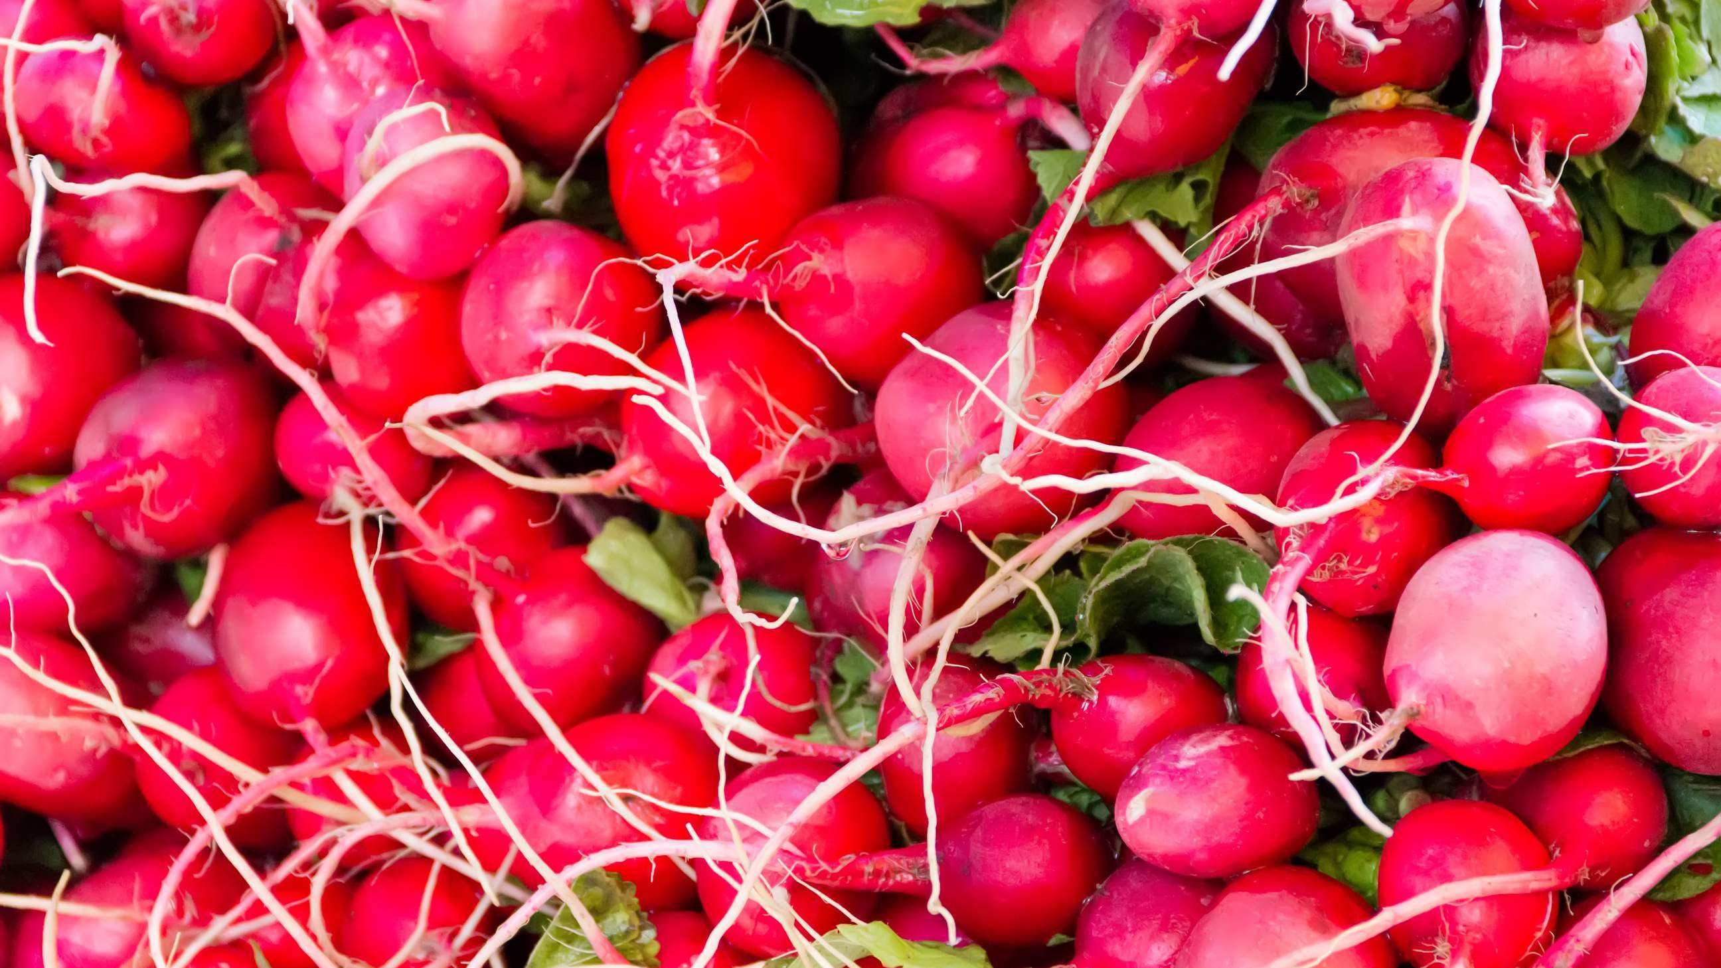
AUTHOR'S PERSPECTIVE
The Global Fresh Radish Market is witnessing significant growth in the near future. Elongated root radish takes the lead as the fastest-growing category in the fresh radish market.
Consumers often prefer the convenience of purchasing fresh radishes alongside other grocery items in these well-established retail spaces, driving significant market share for supermarkets/hypermarkets.
Consumers appreciate the option to order fresh radishes from the comfort of their homes, and the ability of online platforms to deliver quality produce has contributed to the rapid growth of this category
As food trends evolve, the demand for elongated root radishes continues to surge, positioning it as the fastest-growing category in the market.

Slide 8
KEY PLAYERS

Slide 9


Contact us
For Full Report
COGNITIVE MARKET RESEARCH
Tel: + 1 312 - 376 - 8303 | + 44 020 - 8123 - 0732
India: ( + 91 ) 983 - 496 - 8611
sales@ cognitivemarketresearch. com
Access the Full Report : http://tinyurl.com/8ez7bpr4
Please visit our website:
https://www.cognitivemarketresearch.com

