Slide 1

GLOBAL
Freediving
MARKET REPORT 2024
Freediving
Global,Regional,CountryAnalysis

Slide 2

INTRODUCTION
Freediving, also called breath-hold diving or apnea diving, is an underwater diving method in which divers depend on their ability to hold their breath to explore the depths of the ocean or other bodies of water. Unlike scuba diving, freedivers do not utilize breathing equipment and instead rely on training methods to hold their breath for extended periods. The popularity of freediving is rising due to the growing interest in adventure sports and outdoor activities and the increasing awareness of the health and wellness advantages associated with breath-control techniques, including stress reduction.

Slide 3


KEY INSIGHTS
CAGR 6.00%
20₋23
2030

Slide 4

REVENUE MARKET SHARE BY SEGMENTS 2022
Open Respiratory System
Enclosed Respiratory System
Type Segment
Application Segment
Entertainment
Competition
Traning Center
Travel Service Provider
Product Segment

Slide 5
Global Freediving Market Revenue share for 2022
North America 38%

Slide 6
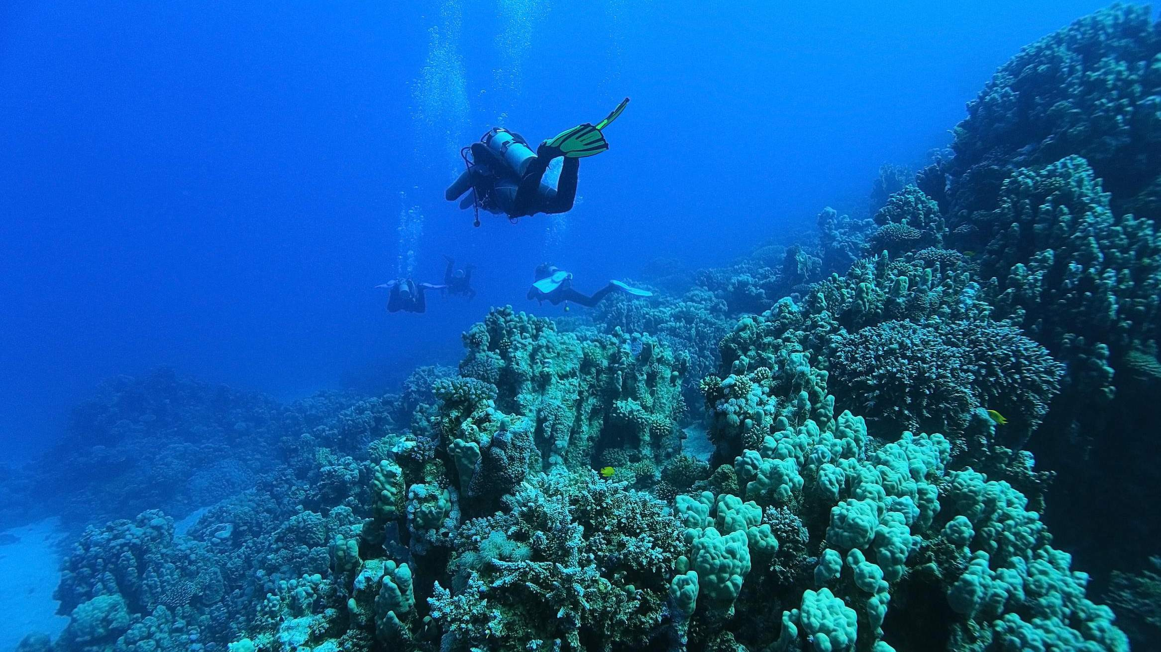









Slide 7

AUTHOR'S PERSPECTIVE
The Global Freediving Market is witnessing significant growth in the near future.
Professional freedivers and enthusiasts seeking to explore greater depths and extend their underwater experiences increasingly turn to enclosed respiratory systems.
Freediving competitions, governed by organizations like AIDA International, have gained significant momentum globally.

Slide 8
KEY PLAYERS

Slide 9


Contact us
For Full Report
COGNITIVE MARKET RESEARCH
Tel: + 1 312 - 376 - 8303 | + 44 020 - 8123 - 0732
India: ( + 91 ) 983 - 496 - 8611
sales@ cognitivemarketresearch. com
Access the Full Report : http://tinyurl.com/3fakma99
Please visit our website:
https://www.cognitivemarketresearch.com

