Slide 1
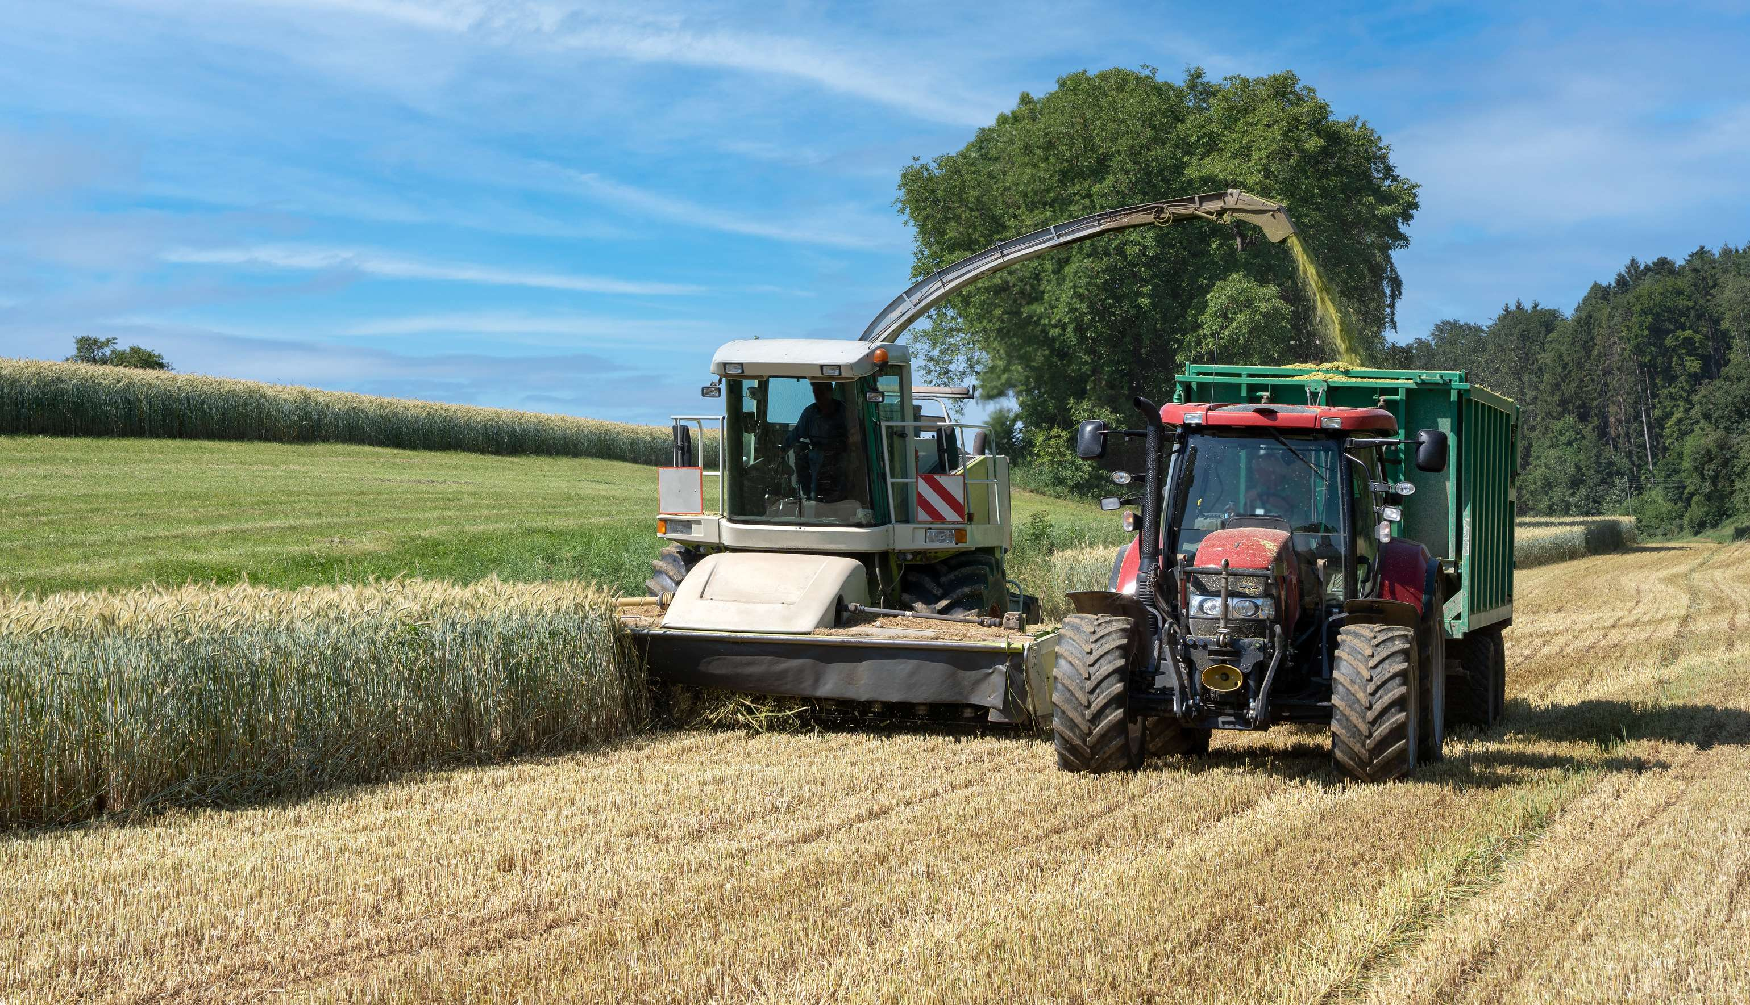
GLOBAL
FORAGE HARVESTER
MARKET REPORT
2024
Global,Regional,CountryAnalysis

Slide 2
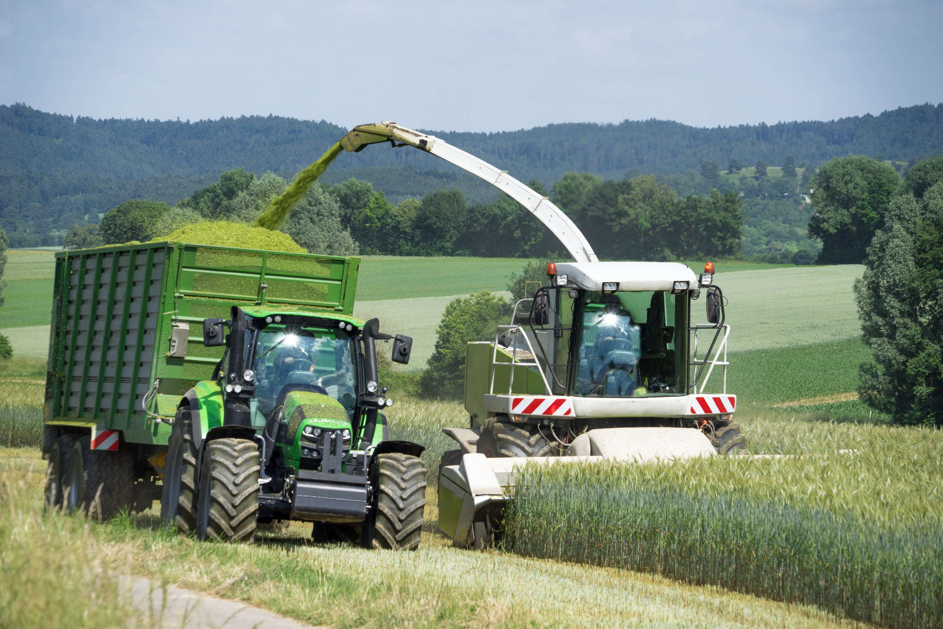
INTRODUCTION
A variety of factors influence forage harvesters, which are essential in contemporary agriculture. Technological breakthroughs first drive efficiency. Improved cutting and chopping systems streamline the process of harvesting fodder. Furthermore, environmental issues spur innovation. A top priority is lowering fuel and emission usage in accordance with environmental objectives. The role of economic considerations is crucial. Fluctuations in commodity prices impact the adoption of forage harvesters. Excessive costs for animal feed stimulate investment. Government rules, subsidies, and incentives also have an impact on the market. Forage harvesters are used more often when sustainable agriculture policies are supported.

Slide 3
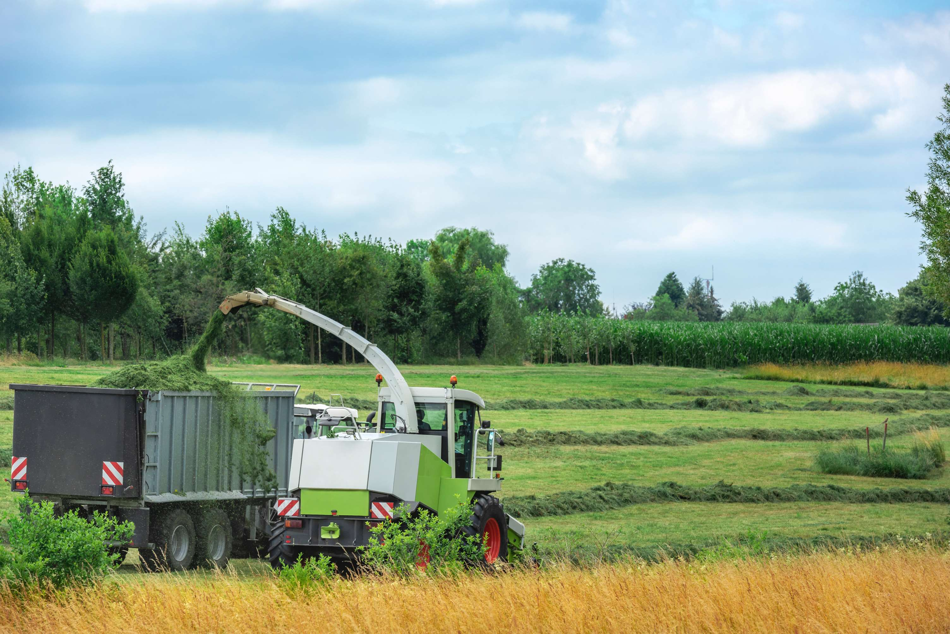

KEY INSIGHTS
CAGR
9.6%
2023- 2030

Slide 4
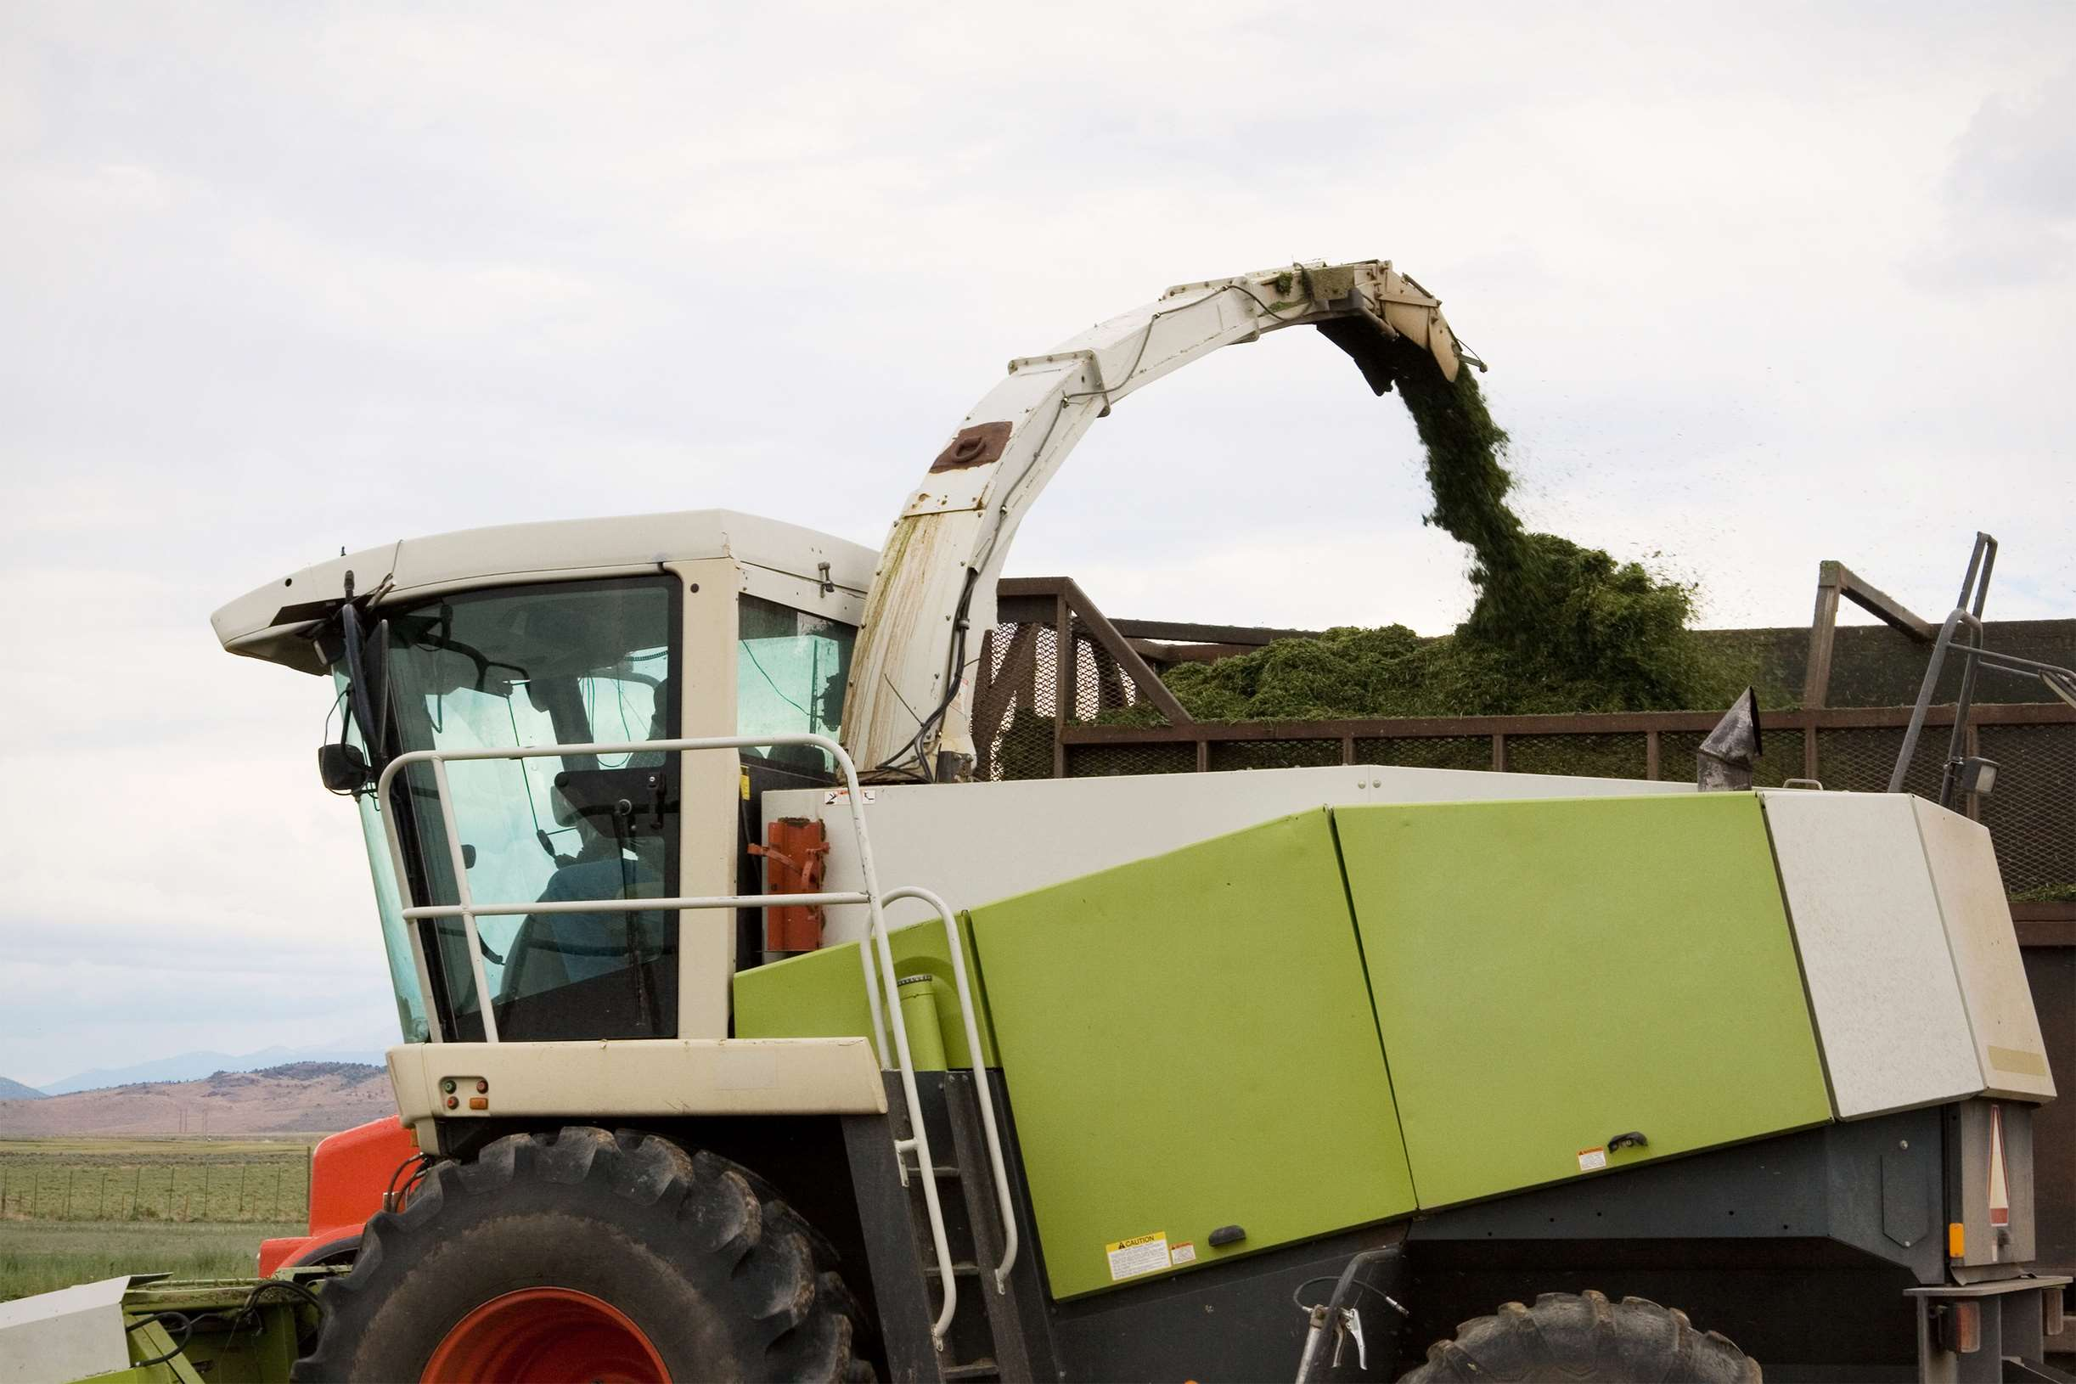
REVENUE MARKET SHARE BY SEGMENTS 2022
  Conventional
  Advanced
  Residential
  Commercial
Technology Segment
End User Segment
  Low
  Medium
  High
  Household Use
  Farms Use
Application Segment
Capacity Industry

Slide 5

Global Forage Harvester Market Revenue share for 2024
Asia Pacific
37%

Slide 6
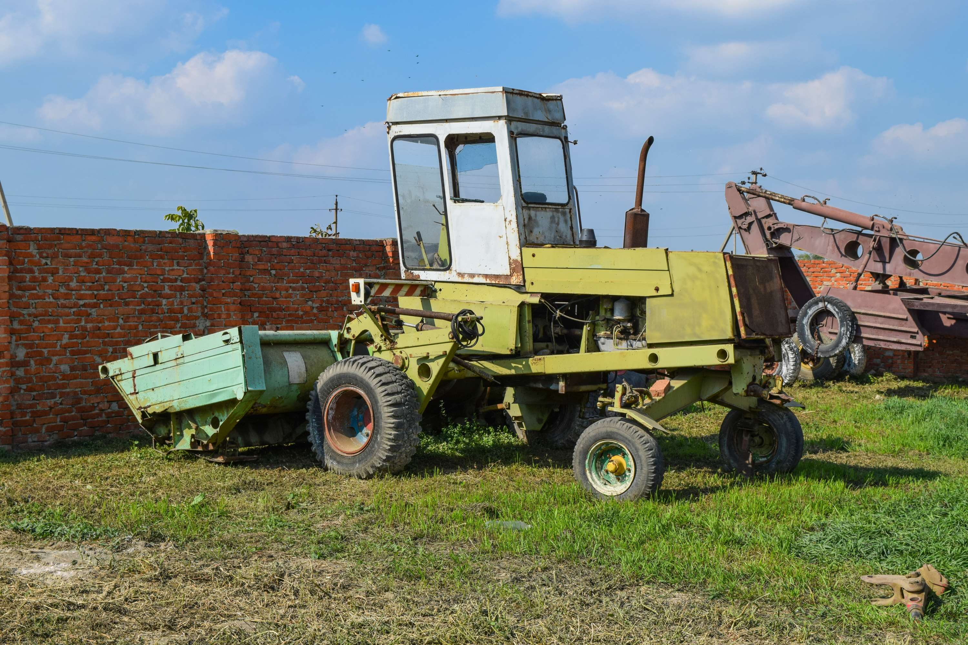
Focus on Cutting Operating Expenses and Their Carbon Impact to Increase the Provide Market Precedence
Drivers
Higher Investment Expenses to Lower Market Growth
Restraints

Slide 7
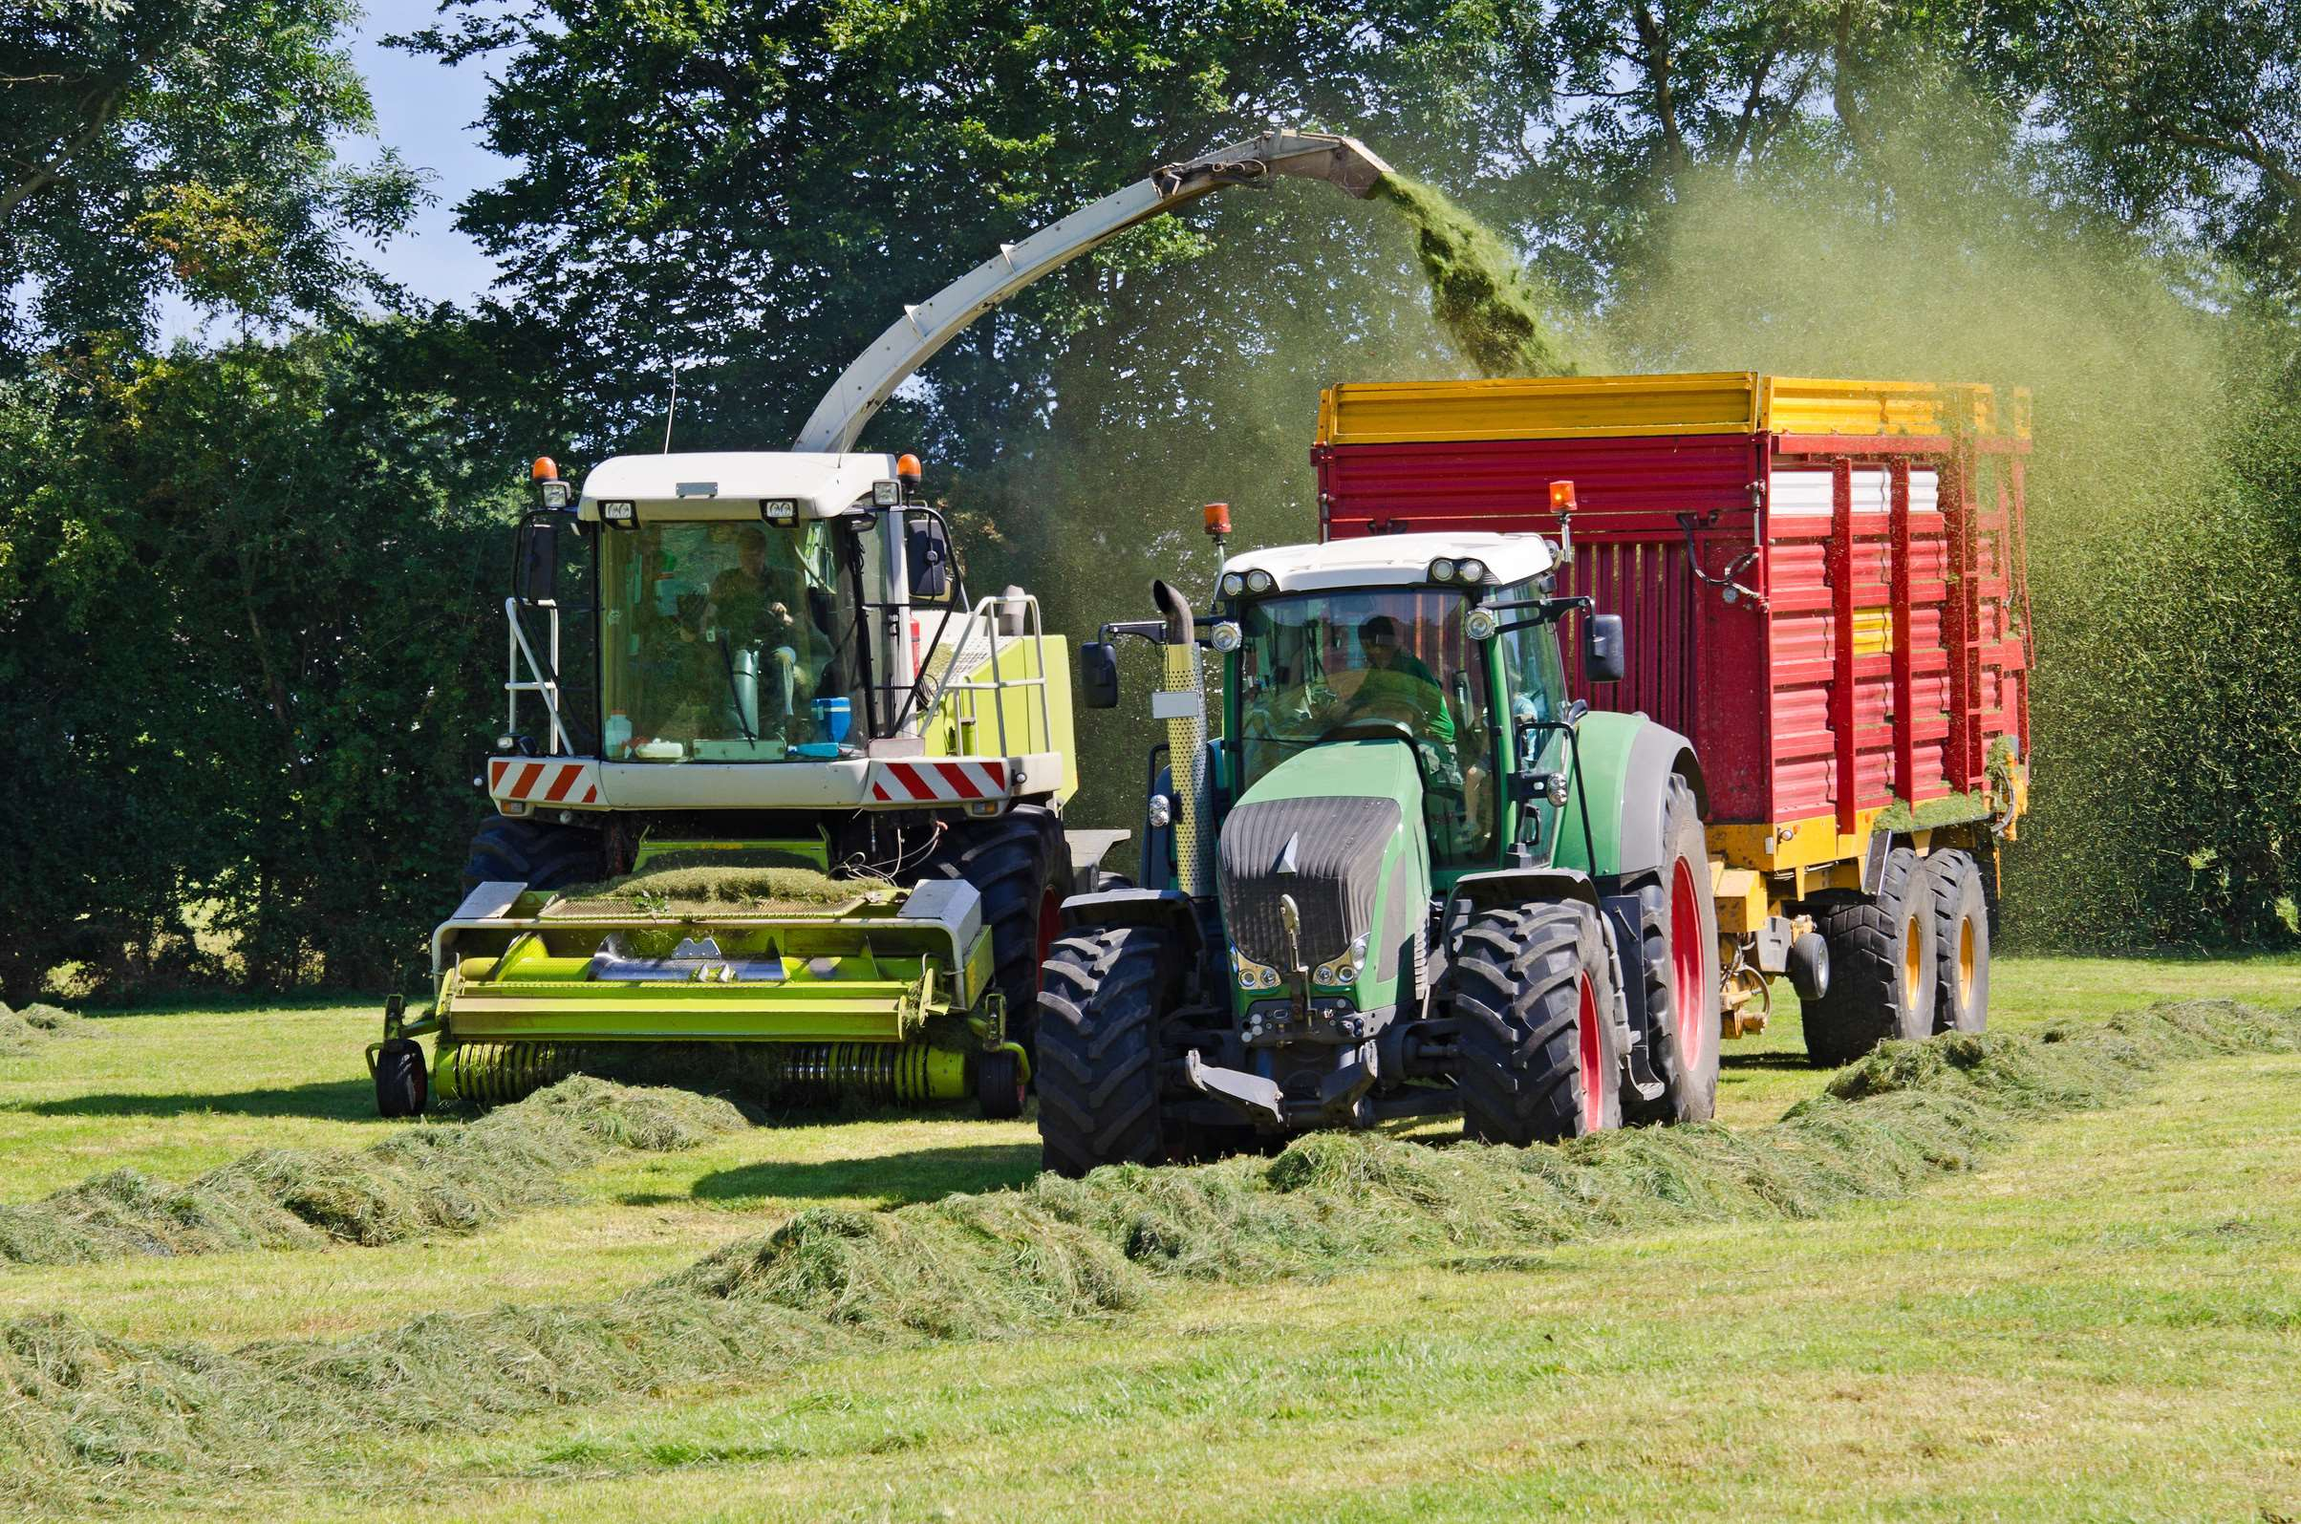
AUTHOR'S PERSPECTIVE
  The Global Forage Harvester Market is witnessing significant growth in the near future.
  Farmers are accustomed to using these machines, especially in areas where technological development may be slower.
  Conventional forage harvesters are characterized by their dependability and simplicity. Farmers that value affordability and ease of upkeep tend to favor them.
  Residential forage harvesters are renowned for being simple to operate and maintain, and they are made for comparatively lighter daily workloads.
  Forage harvesters used for commercial purposes are the second most popular product on the market. Because of their superior capabilities and robustness, larger farming enterprises, agribusinesses, and commercial livestock farms prefer them.

Slide 8





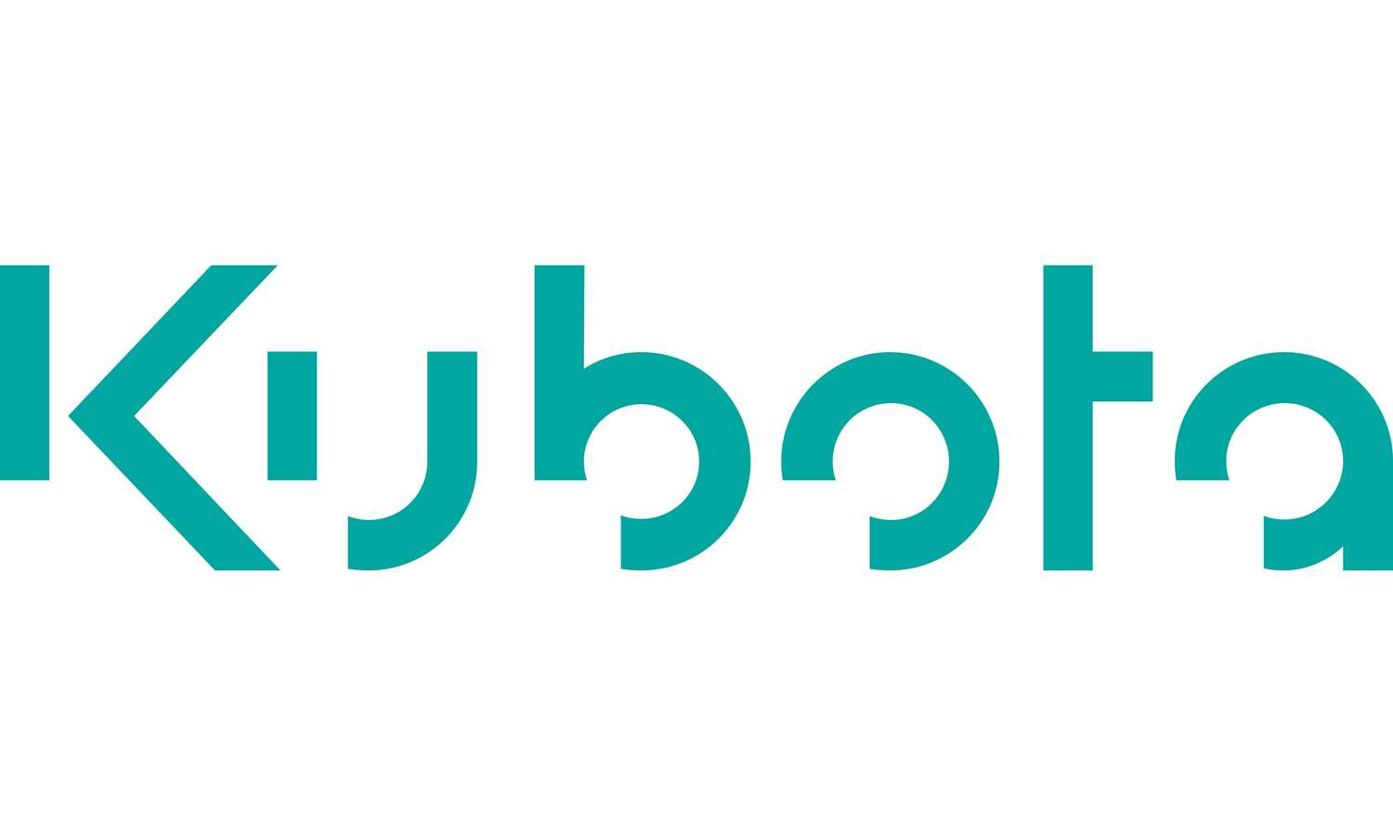



KEY PLAYERS

Slide 9


For Full Report
Contact us
COGNITIVE MARKET RESEARCH
Tel: +1 312-376-8303 | +44 020-8123-0732
India: (+91) 983-496-8611
sales@cognitivemarketresearch.com
Access the Full Report : https://tinyurl.com/vzdnz8as
Please visit our website:
https://www.cognitivemarketresearch.com

