Slide 1

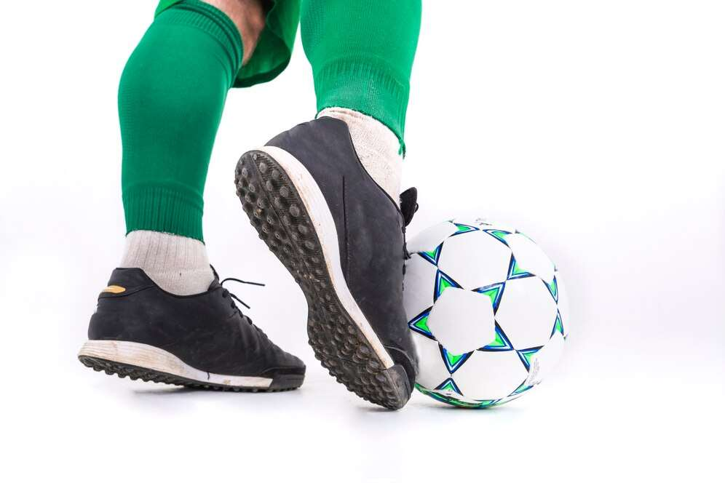
FOOTBALL BOOTS
MARKET REPORT
2024
Qualitative Analysis + Quantitative Analysis

Slide 2

INTRODUCTION
Football shoes have studs on the bottom for increased traction and are designed for grass fields. From their humble and unassuming beginnings, football shoes have come a long way. Today, they are the subject of intensive research, development, sponsorship, and marketing at the core of a global, multinational industry. Modern shoes have long since absorbed the basic design and aesthetics of sneakers, so much so that they are no longer really shoes in the sense that they do not cover the ankle. In addition to association football, players in specific positions commonly wear them instead of specialized rugby shoes for rugby union and rugby league. Football boots are commonly used for other team sports played on grass fields, like tug of war, hurling, Lacrosse, shinty, and quidditch.

Slide 3


KEY INSIGHTS
MARKET SIZE
USD 19542.2 million
2024
CAGR
5.50%
2024- 2031

Slide 4
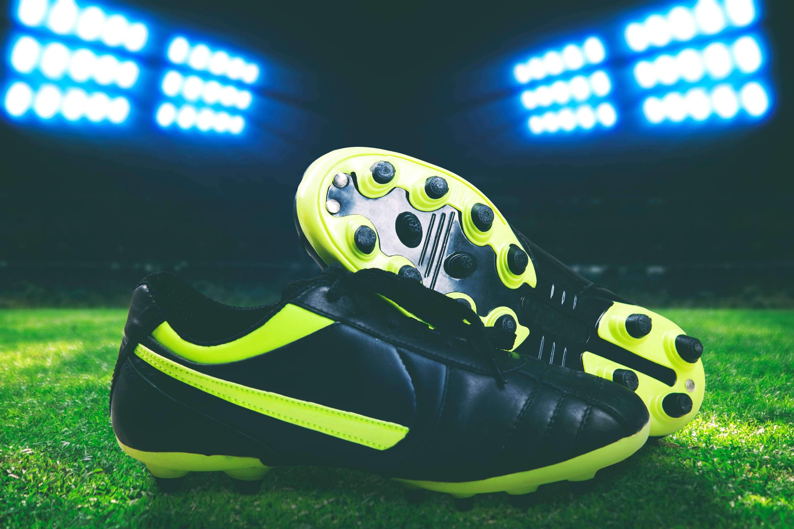
REVENUE MARKET SHARE BY SEGMENTS 2024
  Soft Ground Football Boots
  Firm Ground Football Boots
  Artificial Ground Football Boots
  Hard Ground Football Boots
Type Segment
  K-Leather
  Natural Leather
  Synthetic Leather
  Synthetic
  Mesh
Material Segment
  SIndividual Football Boots
  Institutional Football Boots
  Promotional Football Boots
Buyer Type Segment

Slide 5

North America
40%
North America Football Boots Market Revenue share for 2024 is 40%

Slide 6
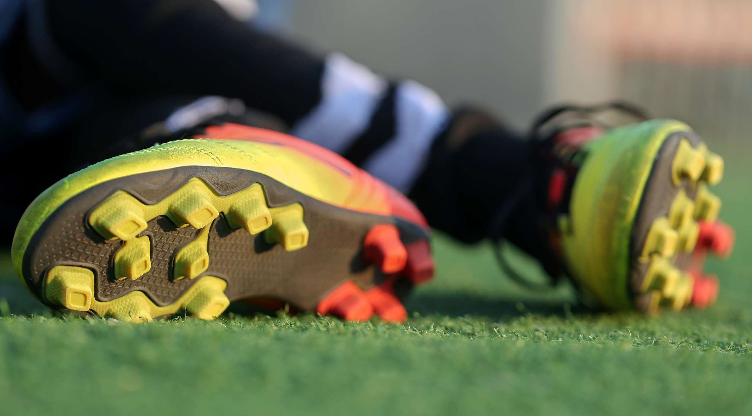
  Fresh Approaches and Marketing Campaigns to Increase the Demand Globally
  Global Football Play is Increasingly Popular to Propel Market Growth
Drivers
Possibility of Damage to Limit the Sales
Restraints

Slide 7
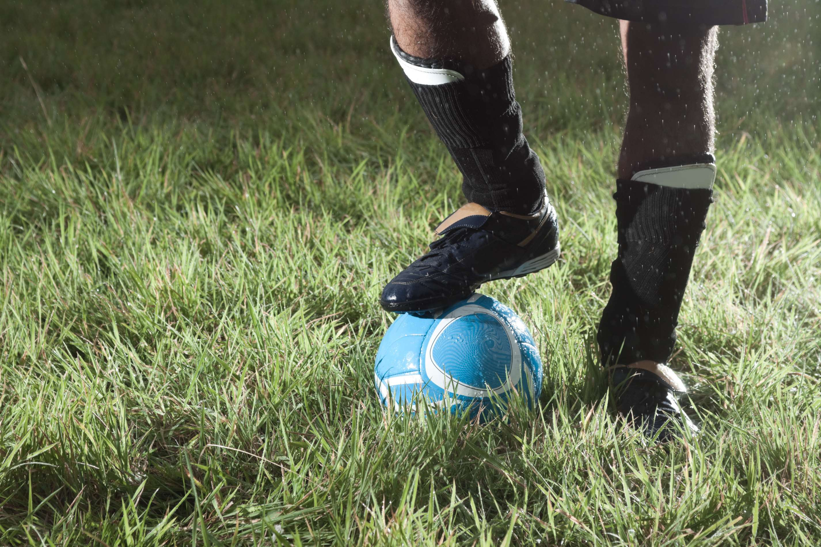
AUTHOR'S PERSPECTIVE
  The global football boots market will expand significantly by 5.50% CAGR between 2024 to 2031.
  Synthetic Leather stands out as the dominating category. Synthetic leather is generally cheaper than natural leather, making it an attractive option for budget-minded consumers. The dominating category is individual football boots.
  This is due to the fact that most football players need to purchase their boots, and there is a wide range of boots available to choose from, at different price points, to suit the needs of different players.

Slide 8


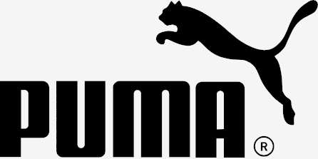
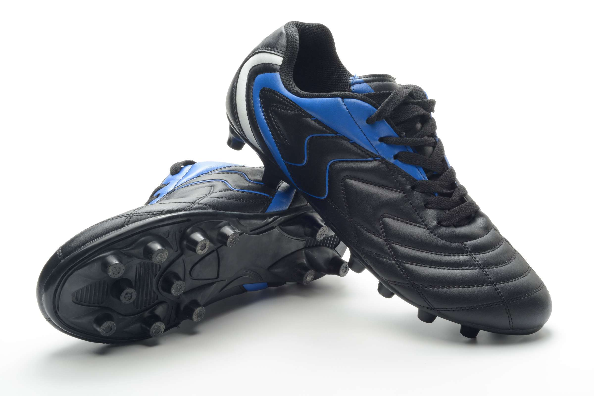

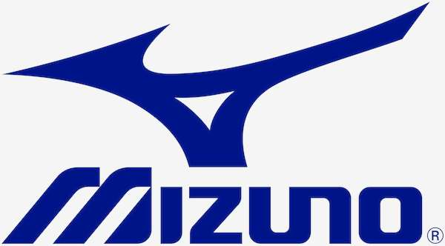
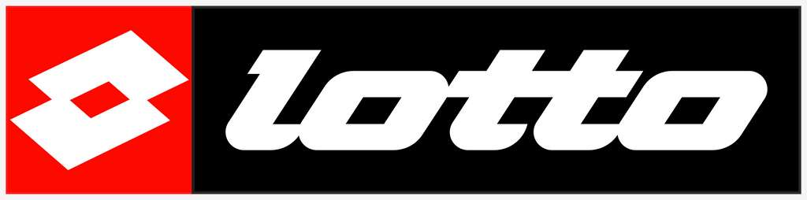
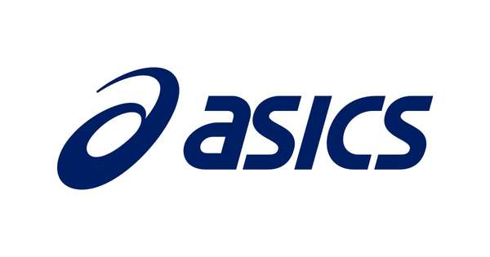
KEY PLAYERS

Slide 9


For Full Report
Contact us
COGNITIVE MARKET RESEARCH
Tel: +1 312-376-8303 | +44 020-8123-0732
India: (+91) 983-496-8611
sales@cognitivemarketresearch.com
Access the Full Report : https://tinyurl.com/mvp8ne3y
Please visit our website:
https://www.cognitivemarketresearch.com

