Slide 1

GLOBAL
FOOD SERVICE
MARKET REPORT
2024
Global,Regional,CountryAnalysis

Slide 2

INTRODUCTION
The food service industry is a dynamic and expansive market that includes both commercial and non-commercial sectors. It has been experiencing steady global growth driven by factors like urbanization and changing consumer preferences. The sector is diverse, with various system types such as conventional, centralized, ready-prepared, and assembly-serve food service systems. Restaurants, ranging from cafes and bars to quick-service and full-service establishments, cater to different consumer demands. The market structure includes both chained and independent outlets, each offering unique advantages. Regional variations are significant, influenced by cultural differences and local economic conditions. Ongoing trends encompass technological innovations, sustainability, and health-conscious offerings. However, the industry faces challenges such as competition, fluctuating commodity prices, and evolving consumer preferences.

Slide 3


KEY INSIGHTS
MARKET SIZE
USD 2601.5 billion
2023
CAGR
11.00%
2023- 2030

Slide 4

REVENUE MARKET SHARE BY SEGMENTS 2022
  Cafés and bars
  Street food
  Quick service restaurants
  Full-service restaurants
  Compressor
  Absorption
  Thermoelectric
Sector Segment
Types of Restaurants Segment
  Conventional Foodservice System
  Centralized Foodservice System
  Ready Prepared Foodservice System
  Assembly-Serve Foodservice System
Structure Segment
  Chained Outlets
  Independent Outlets
System Segment

Slide 5

Global Food Service Market Revenue share for 2024
Asia Pacific
37%

Slide 6

Changing Consumer Lifestyles to Propel Market Growth
Drivers
Energy Consumption Concerns to Restrict Market Growth
Restraints

Slide 7

AUTHOR'S PERSPECTIVE
  The Global Food Service Market is witnessing significant growth in the near future.
  Non-commercial sectors, including institutional food service providers in settings like schools, hospitals, and workplaces, are experiencing accelerated growth.
  Consumers, with busy schedules, are seeking quick and easily accessible food options, and the ready-prepared system caters to this need effectively.
  Quick-service restaurants are characterized by their efficient service model, streamlined menus, and often affordable pricing, making them particularly appealing to busy lifestyles and diverse consumer demographics.

Slide 8



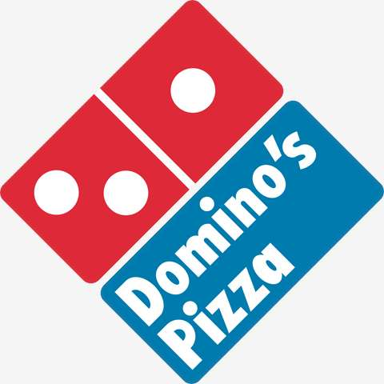






KEY PLAYERS

Slide 9


For Full Report
Contact us
COGNITIVE MARKET RESEARCH
Tel: +1 312-376-8303 | +44 020-8123-0732
India: (+91) 983-496-8611
sales@cognitivemarketresearch.com
Access the Full Report : http://tinyurl.com/2fj4jzef
Please visit our website:
https://www.cognitivemarketresearch.com

