Slide 1


FLOUR
MARKET REPORT
2024
Qualitative Analysis + Quantitative Analysis

Slide 2
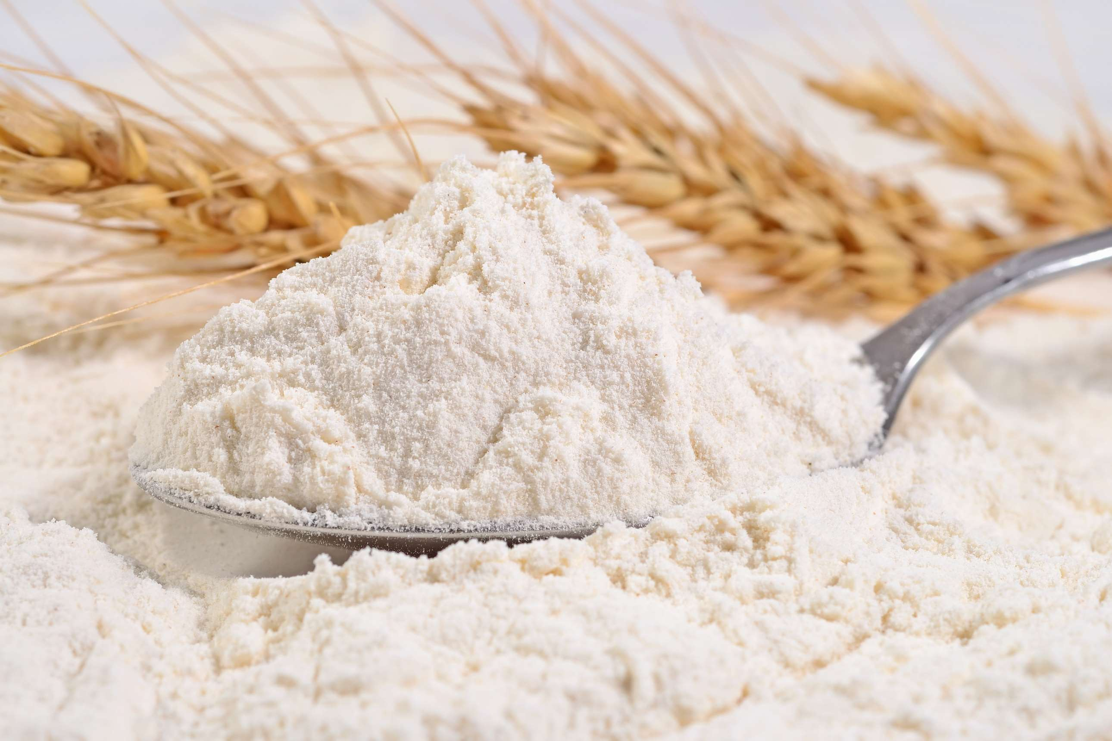
INTRODUCTION
The production, transport, and consumption of flour—a basic ingredient obtained from grinding cereal grains, including wheat, maize, and rice—are all included in the flour market. Flour is a staple ingredient in many foods, such as bread, pastries, noodles, and biscuits. It serves both commercial and domestic consumption, which is vital in the global food systems. The market dynamics are impacted by several variables, including agriculture production, milling techniques, technical developments, shifting dietary choices, and prevailing economic situations. To meet the numerous culinary needs of consumers, flour production entails milling grains into different grades and varieties of flour. Large-scale industrial producers, smaller artisanal mills, and regional differences in consuming habits and tastes define the market's landscape

Slide 3


KEY INSIGHTS
MARKET SIZE
USD 8309.06 million
2024
CAGR
4.0%
2024- 2031

Slide 4

REVENUE MARKET SHARE BY SEGMENTS 2024
  Wheat
  Rice
  Maize
  Oats
Source Segment
  Direct
  Indirect
  Bread and Bakery Products
  pasta and Noodles
  Snacks
channel Segment
Application Segment
End User Segment
  HoReCa
  Residential
  Dry Technology
  Wet Technology
Technology Segment

Slide 5

REGION ANALYSIS
NORTH AMERICA
Europe
Asia Pacific
Latin America
MIDDLE EAST AFRICA
40%
30%
23%
5%
2%
North America Flour Market Revenue share for 2024 is 40%

Slide 6

  Rising Population to Increase the Demand Globally
  Urbanization and Changing Dietary Habits to Propel Market Growth
Drivers
Fluctuations in Wheat Prices to Limit the Sales
Restraints

Slide 7
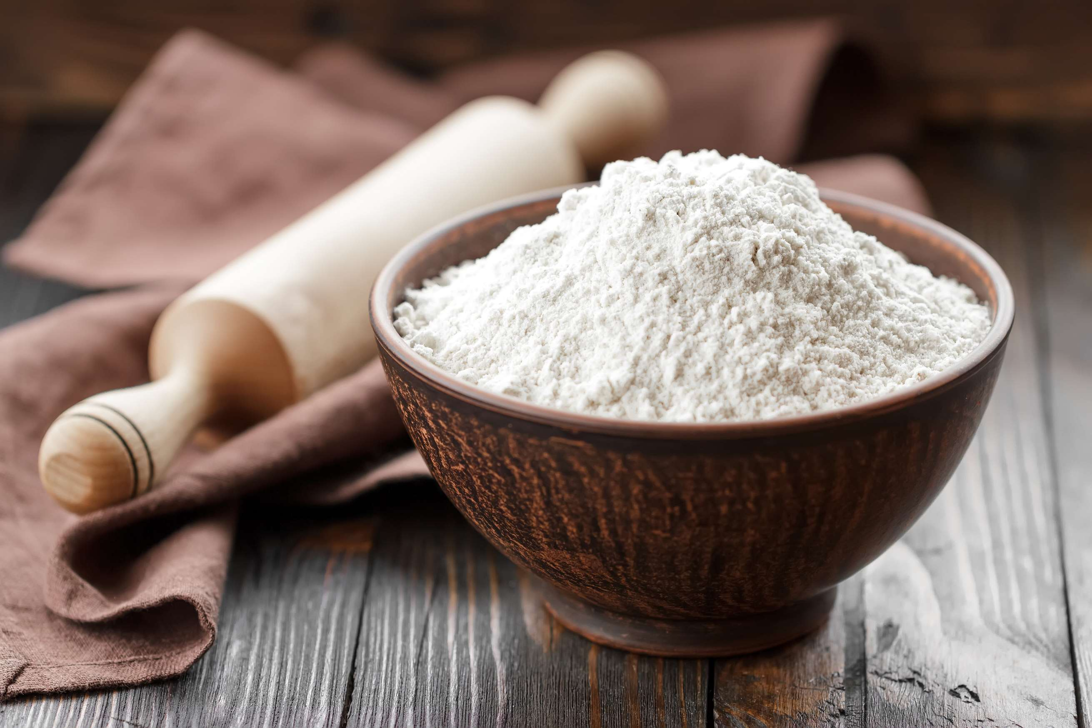
AUTHOR'S PERSPECTIVE
  The global Flour market will expand significantly by 4.0% CAGR between 2024 to 2031.
  Growing awareness of celiac illness and gluten intolerance is fueling the market for gluten-free flours such as chickpea flour, almond flour, and coconut flour.
  In addition, there is a developing market for substitute flours derived from beans and lentils due to the growing popularity of plant-based and vegan diets.

Slide 8









KEY PLAYERS

Slide 9


For Full Report
Contact us
COGNITIVE MARKET RESEARCH
Tel: +1 312-376-8303 | +44 020-8123-0732
India: (+91) 983-496-8611
sales@cognitivemarketresearch.com
Access the Full Report : https://tinyurl.com/2ezc7wku
Please visit our website:
https://www.cognitivemarketresearch.com

