Slide 1


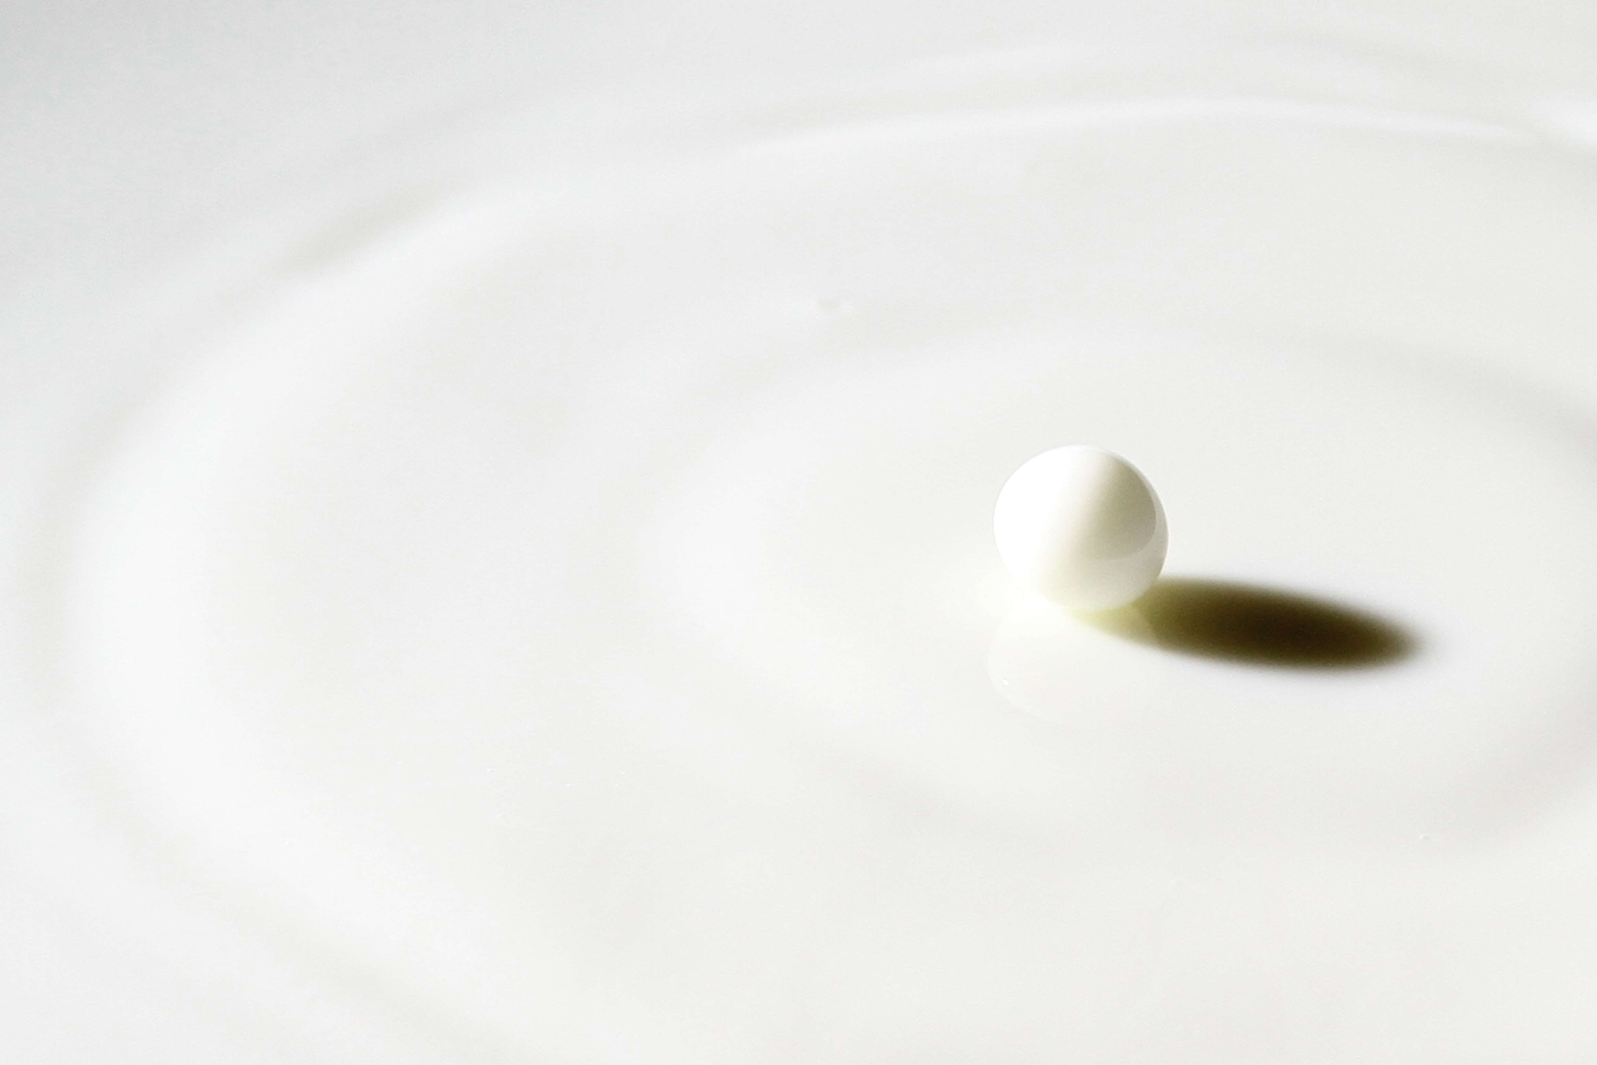




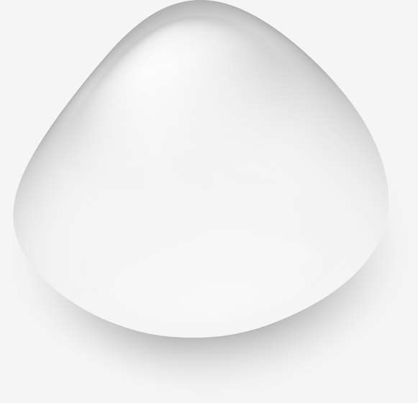
FLAVORED MILK
MARKET REPORT
2024
Qualitative Analysis + Quantitative Analysis

Slide 2
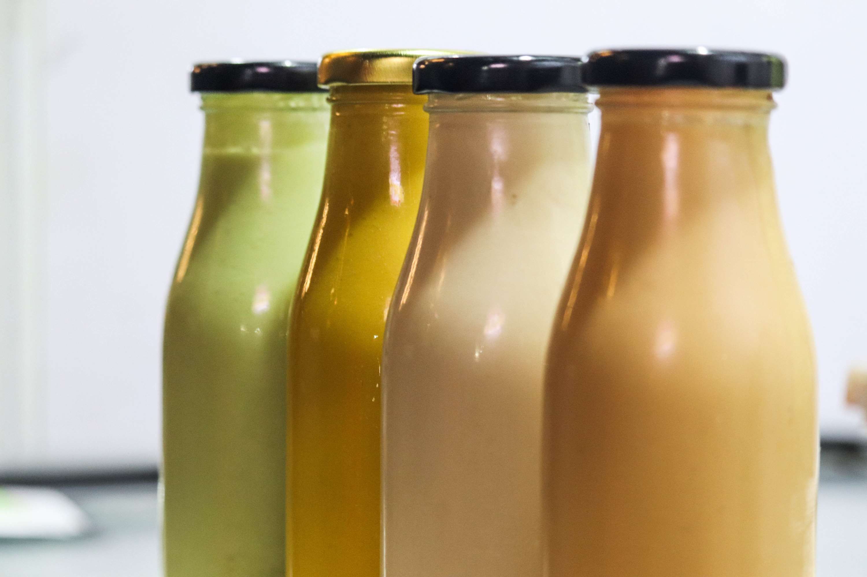
INTRODUCTION
The flavored milk market encompasses a dynamic segment of the dairy industry, offering a wide array of milk products infused with various flavors such as chocolate, strawberry, vanilla, and more. Positioned at the intersection of taste and nutrition, flavored milk has gained popularity among consumers of all ages, presenting a convenient and enjoyable way to incorporate dairy into their diets. With its appealing taste profiles and nutritional benefits, flavored milk has become a staple in households, schools, and foodservice establishments worldwide. The market is characterized by continuous innovation, with manufacturers developing new flavors, formulations, and packaging formats to cater to evolving consumer preferences and lifestyle trends.

Slide 3
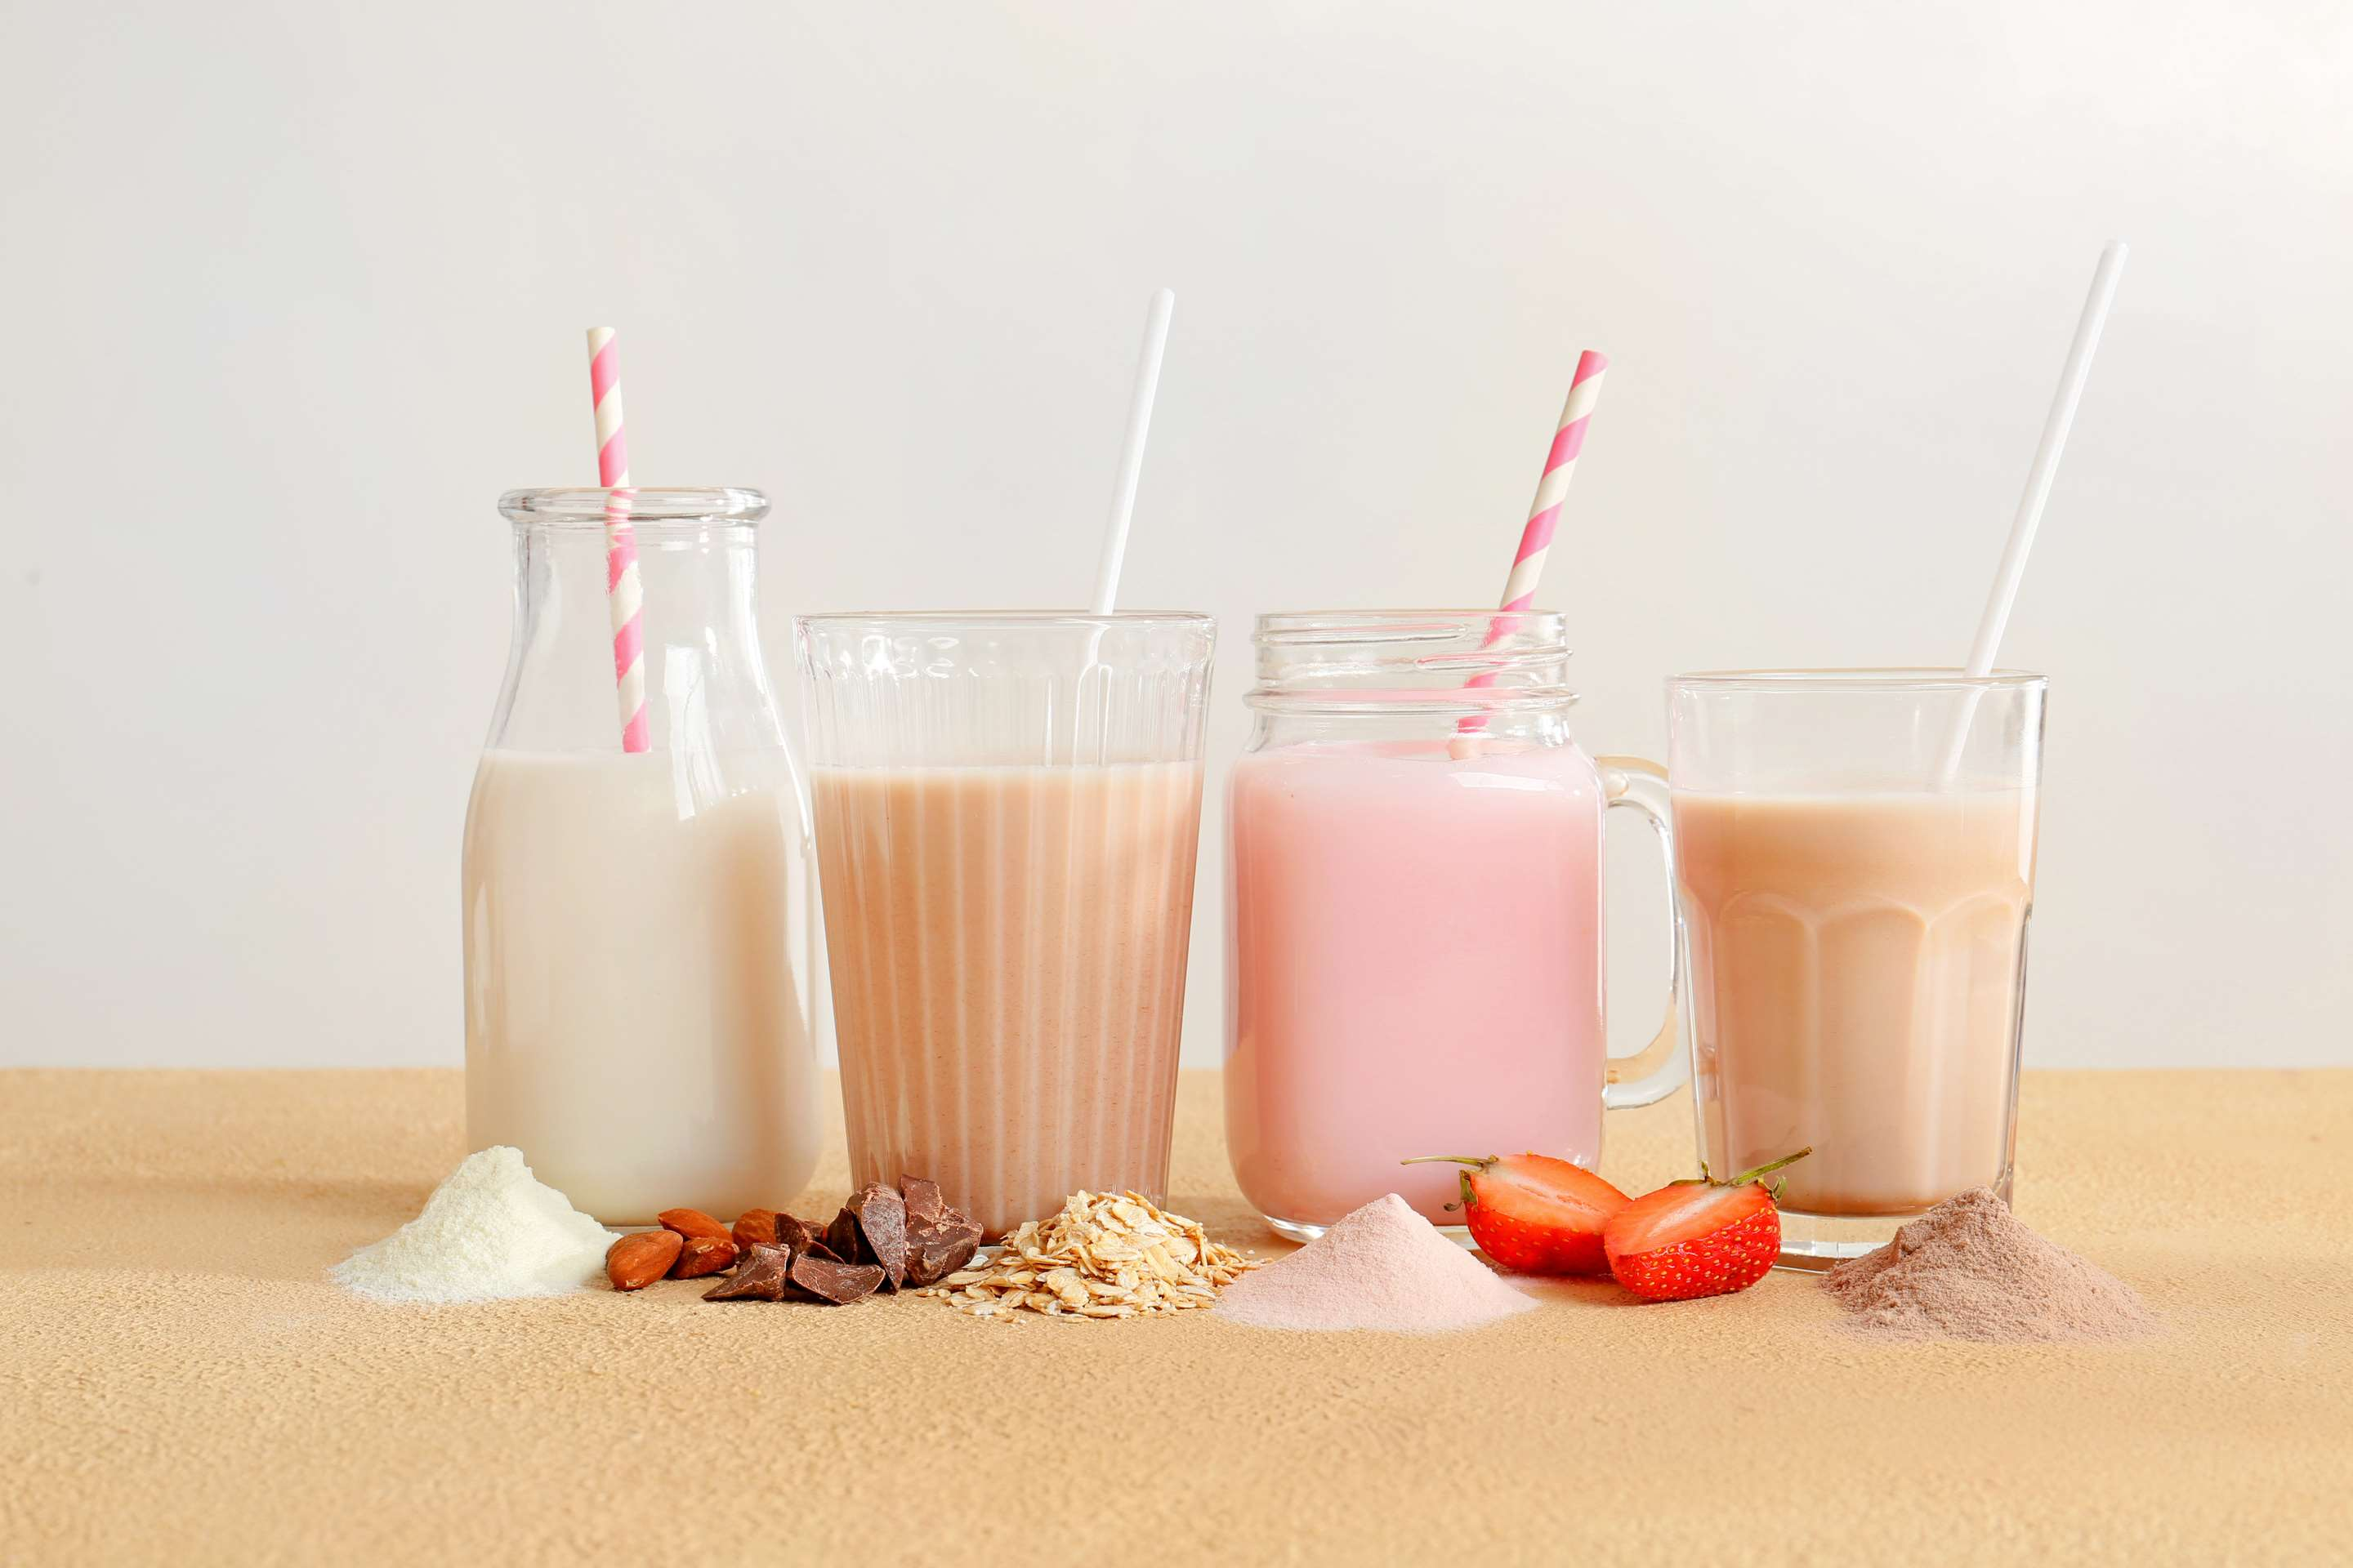

KEY INSIGHTS
MARKET SIZE
USD 57581.2 million
2024
CAGR
6.20%
2024- 2031

Slide 4
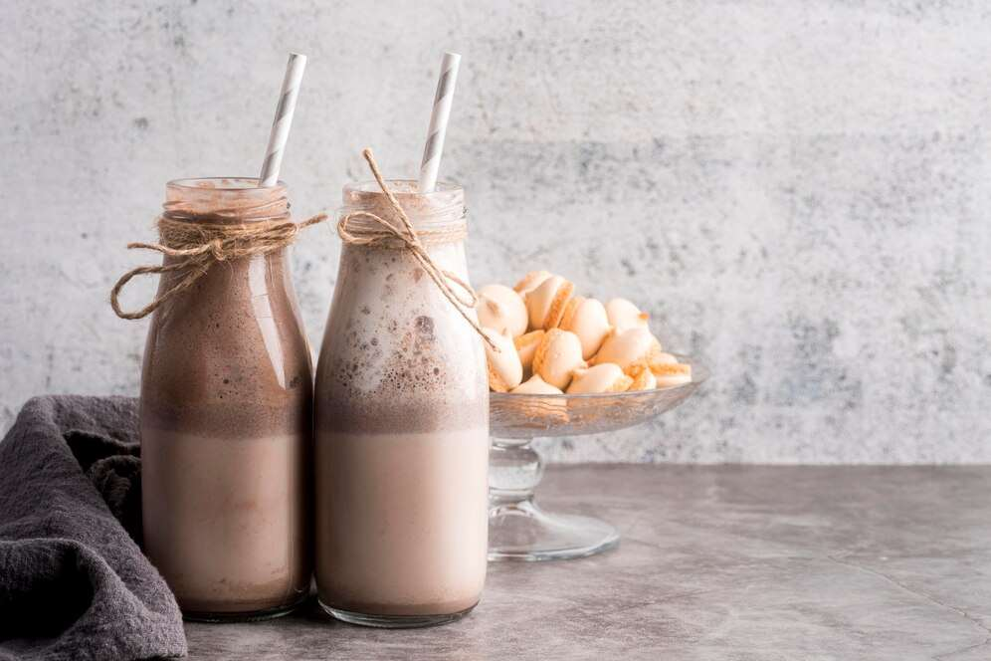
REVENUE MARKET SHARE BY SEGMENTS 2024
  Chocolate stands out as the dominating category
  Butterscotch emerges as the fastest-growing category in the Flavored Milk Market
Flavours Outlook Segment
  Paper-Based Packaging is the dominating category
  The fastest-growing category in the Flavored Milk Market is Plastic Packaging.
Packaging Segment
  Store-Based is the dominating category
  The fastest-growing category in the Flavored Milk Market is Non Store-Based
Distribution Channel

Slide 5

REGION ANALYSIS
NORTH AMERICA
Europe
Asia Pacific
Latin America
MIDDLE EAST AFRICA
40%
30%
23%
Latin America
5%
2%
North America Flavored Milk Market Revenue share for 2024 is 40%

Slide 6
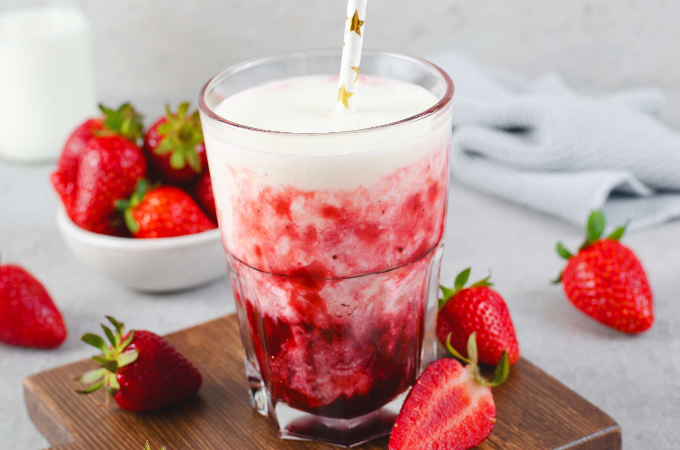
  Changing Consumer Preferences to Increase the Demand Globally
  Convenience and On-the-go Consumption to Propel Market Growth
Drivers
Perception and Consumer Preferences to Limit the Sales
Restraints

Slide 7
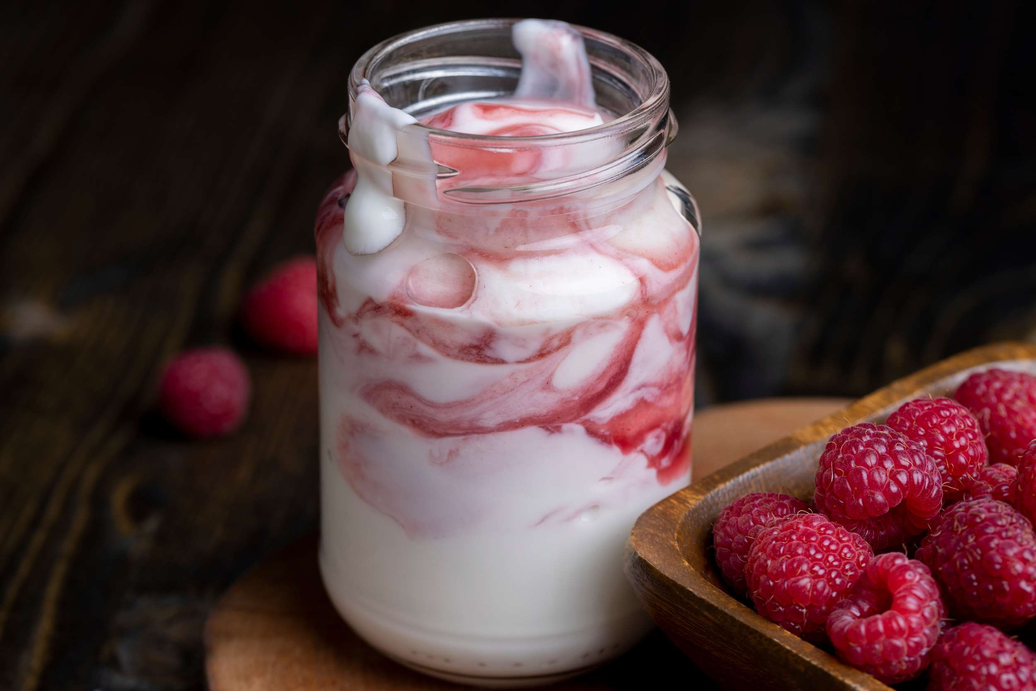
AUTHOR'S PERSPECTIVE
  The global Flavored Milk Market will expand significantly by 6.20% CAGR between 2024 to 2031.
  Chocolate stands out as the dominating category.
  Chocolate-flavored milk offers a satisfying blend of sweetness and creaminess, making it a beloved choice for both occasional treats and everyday consumption.
  The dominating category is Paper-Based Packaging.
  With increasing awareness of environmental concerns and a shift towards more sustainable consumption practices, paper-based packaging has gained significant traction among consumers and manufacturers alike.

Slide 8
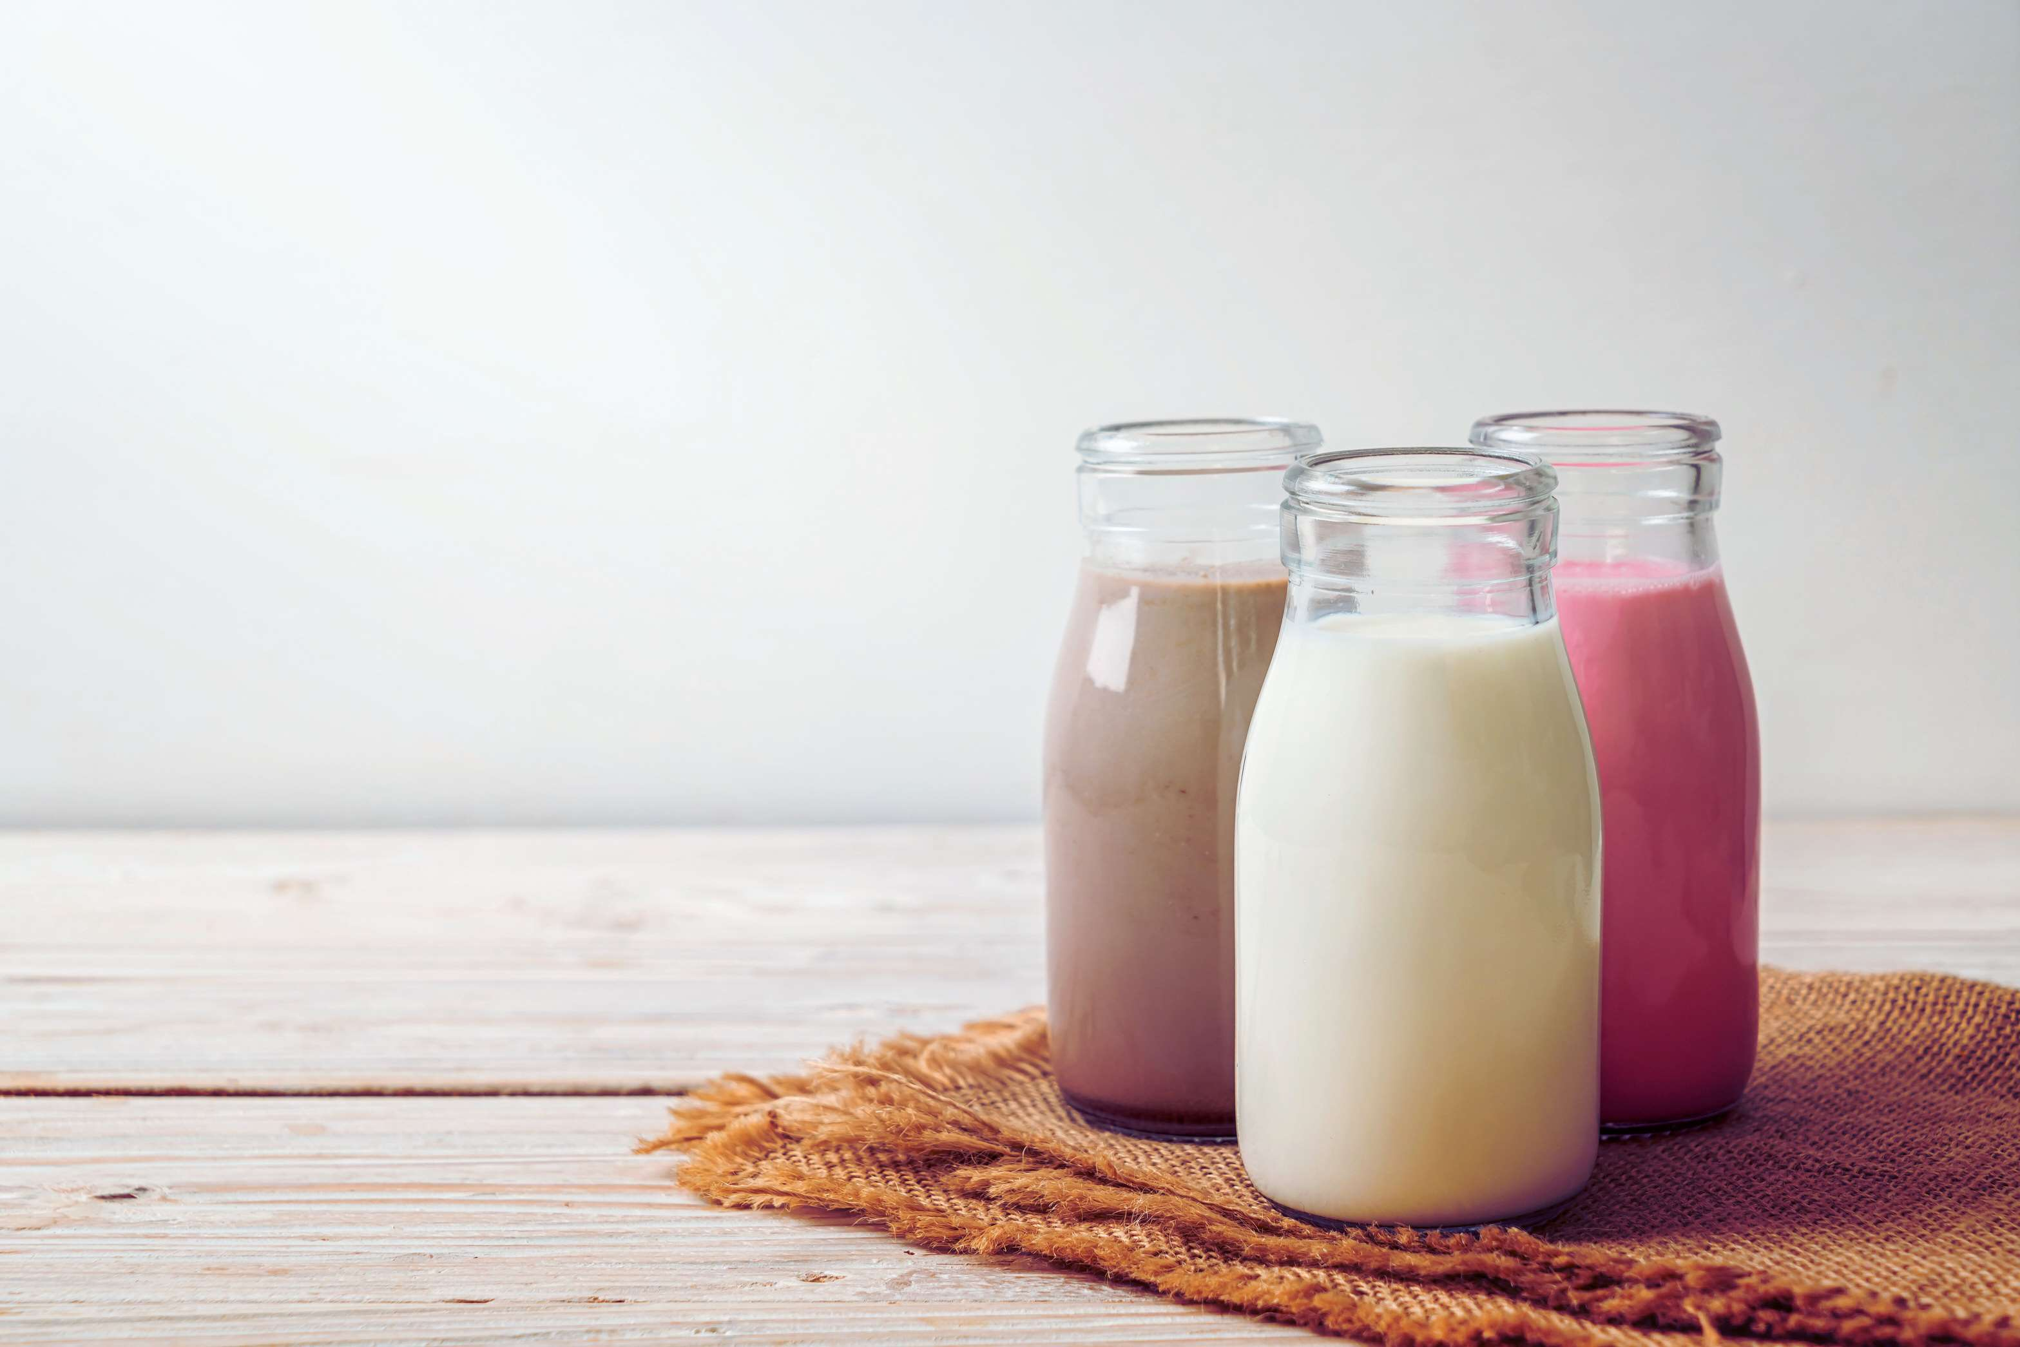
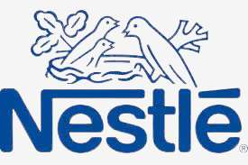

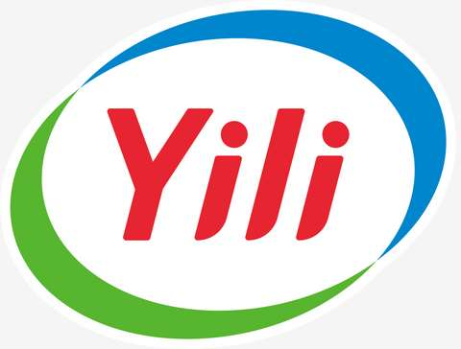
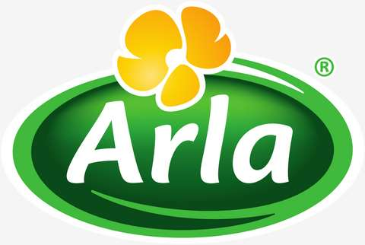

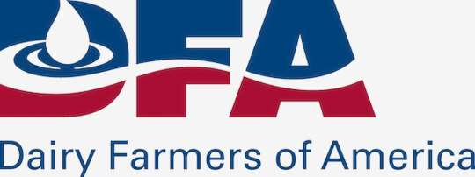
KEY PLAYERS

Slide 9


For Full Report
Contact us
COGNITIVE MARKET RESEARCH
Tel: +1 312-376-8303 | +44 020-8123-0732
India: (+91) 983-496-8611
sales@cognitivemarketresearch.com
Access the Full Report : https://tinyurl.com/uahz7936
Please visit our website:
https://www.cognitivemarketresearch.com

