Slide 1
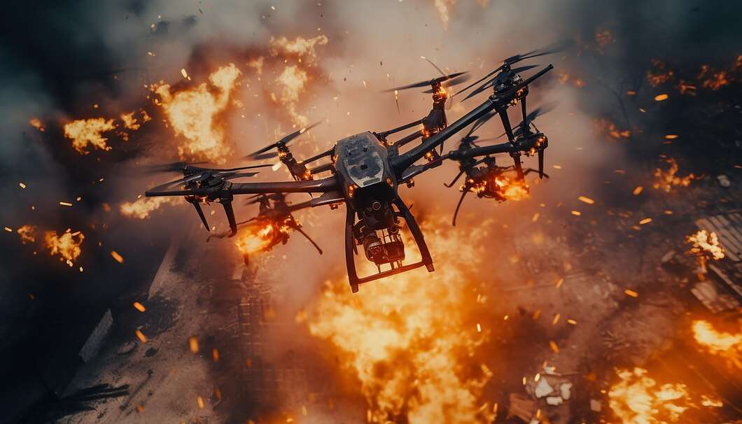
GLOBAL FIREFIGHTING DRONE MARKET REPORT 2024
Global,Regional,CountryAnalysis

Slide 2
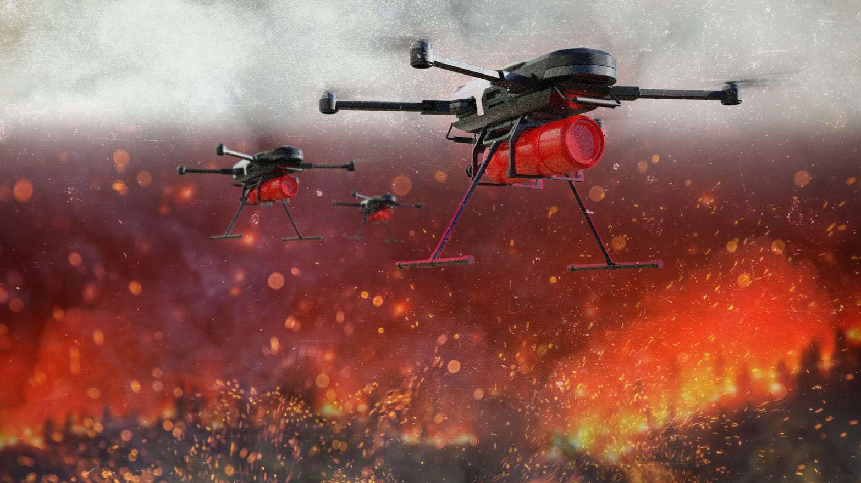
INTRODUCTION
Firefighting drones can be remotely controlled and can carry firefighting equipment such as foam dispensers or water cannons. The major purpose of designing firefighting drones was to control fires in areas that are inaccessible to firefighters or fire trucks like dense forests and high-rise buildings.

Slide 3
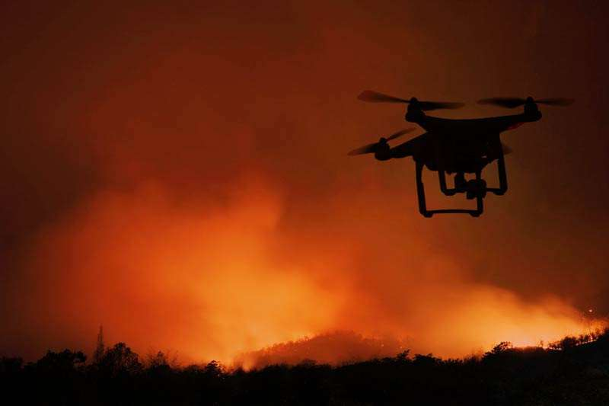

KEY INSIGHTS
MARKET SIZE
$1.31 Bn
2022
FORECAST
$2.76 Bn
2030
2023-
2030
CAGR
9.8%%

Slide 4
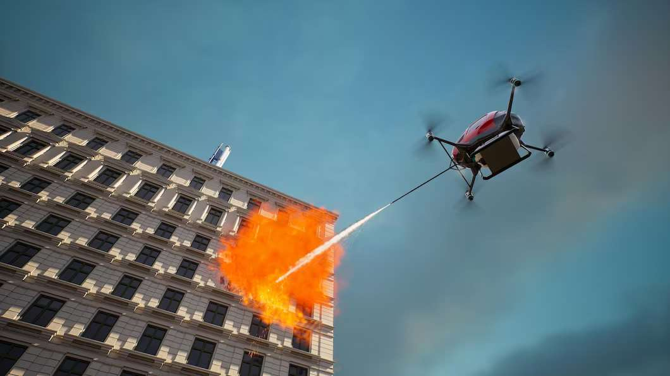
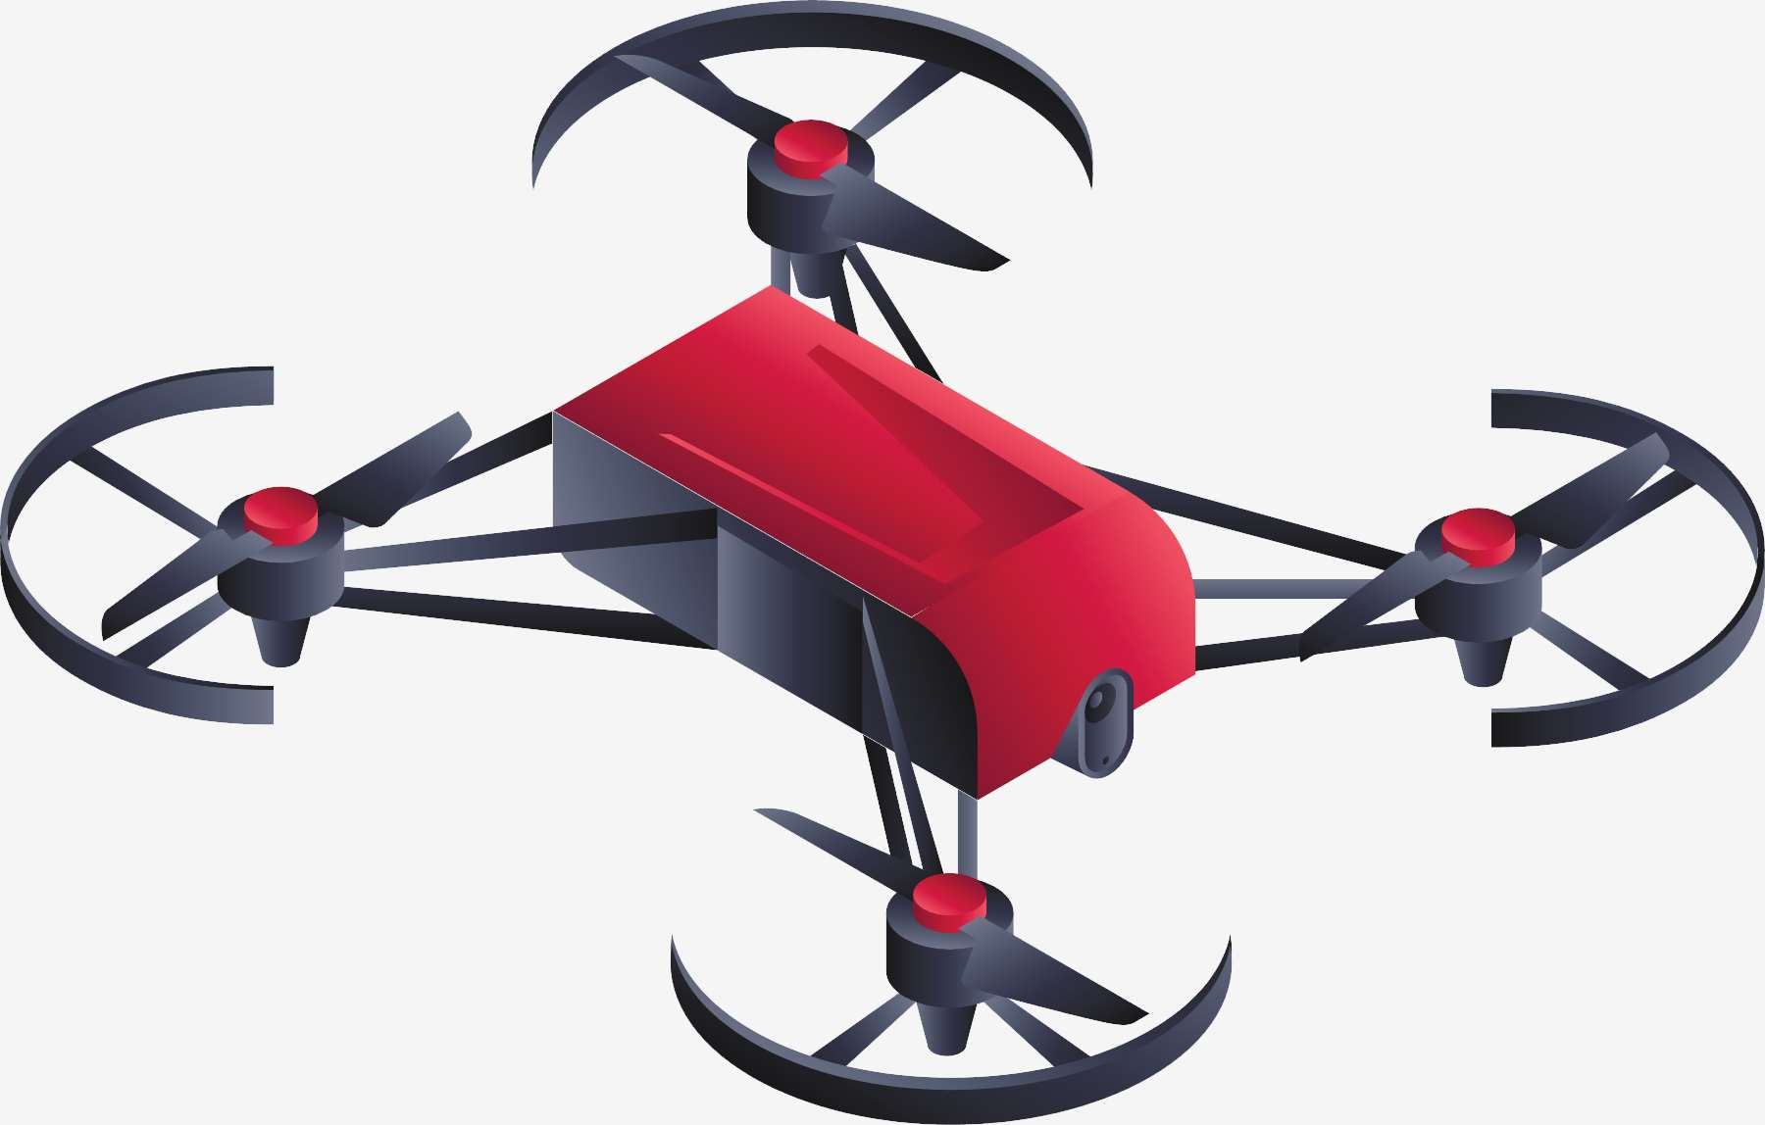


REVENUE MARKET SHARE BY SEGMENTS 2022
Multirotor type
71.5%
Microdrones
74.2%
Firefighting application
40.5%

Slide 5
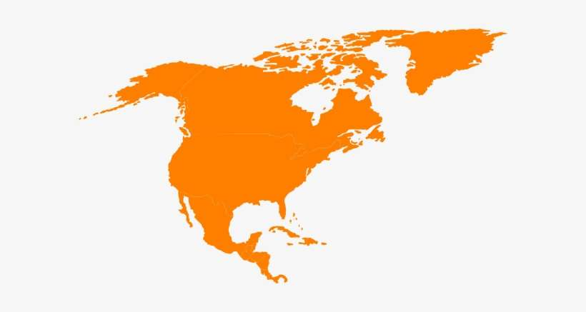
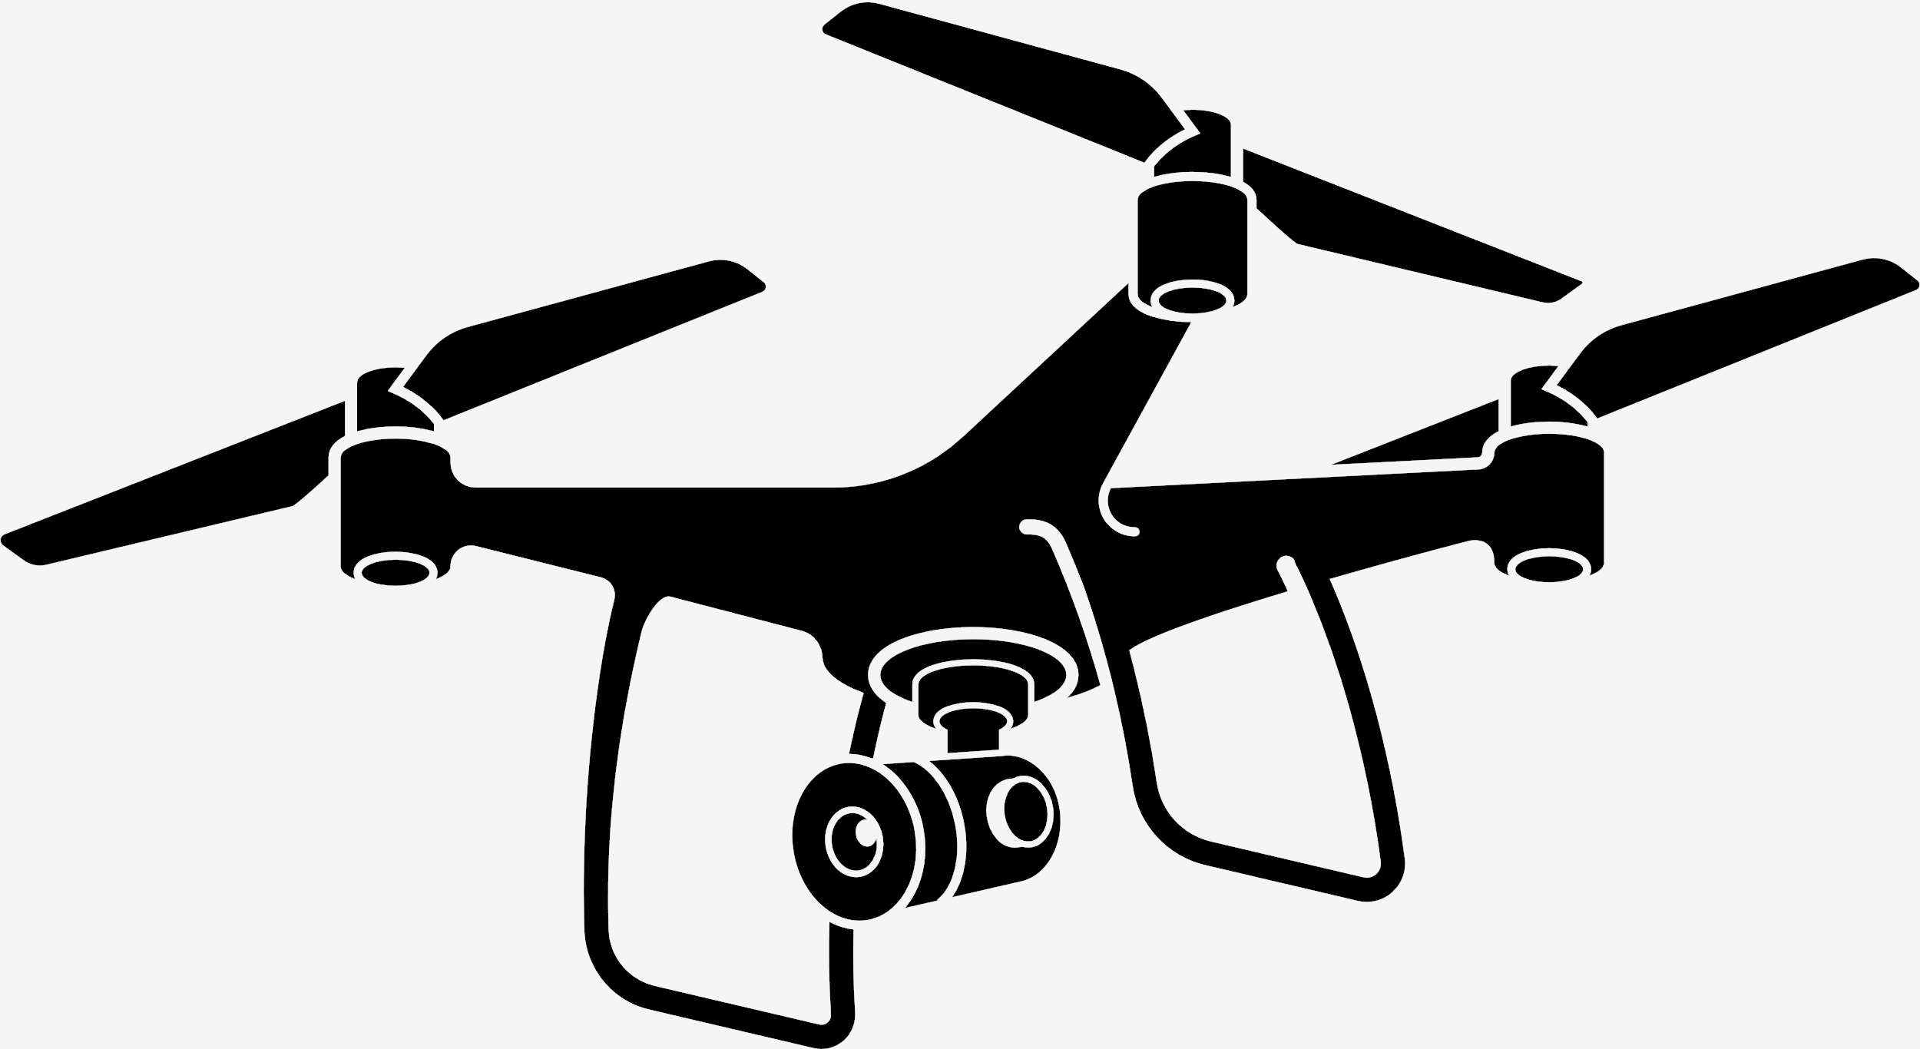
GLOBAL FIREFIGHTING DRONE MARKET REVENUE SHARE FOR 2022
North America
40.5%

Slide 6
RESTRAINTS
DRIVERS
  Increasing usage of drones to extinguish wildfire
  The growing forest & industrial fire incidents frequently have provided lucrative opportunities to market participantsfor the growth of the firefighting drones market

Slide 7
AUTHOR'S PERSPECTIVE
  The Global Firefighting Drone Market is witnessing significant growth in the near future.
  In 2023, the Fixed Wing segment accounted for noticeable share of global Firefighting Drone Market and is projected to experience significant growth in the near future
  The Scene Monitoring segment is expected to expand at the significant CAGR retaining position throughout the forecast period.

Slide 8
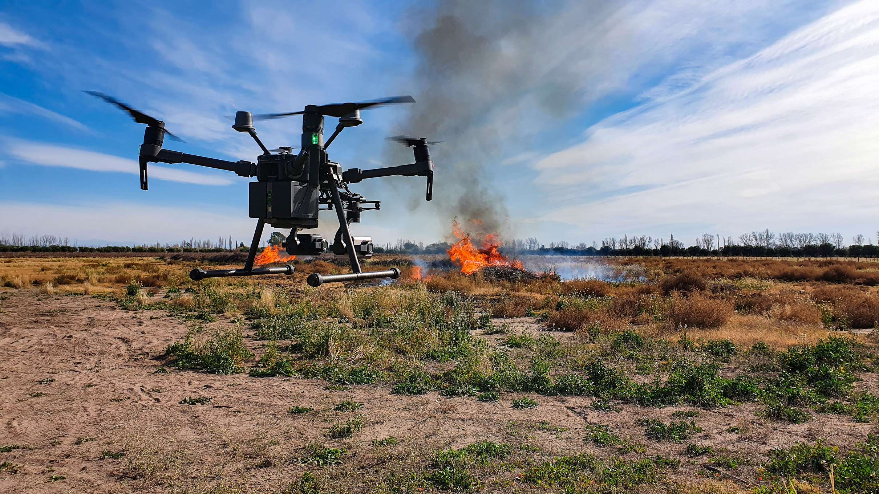






KEY PLAYERS

Slide 9
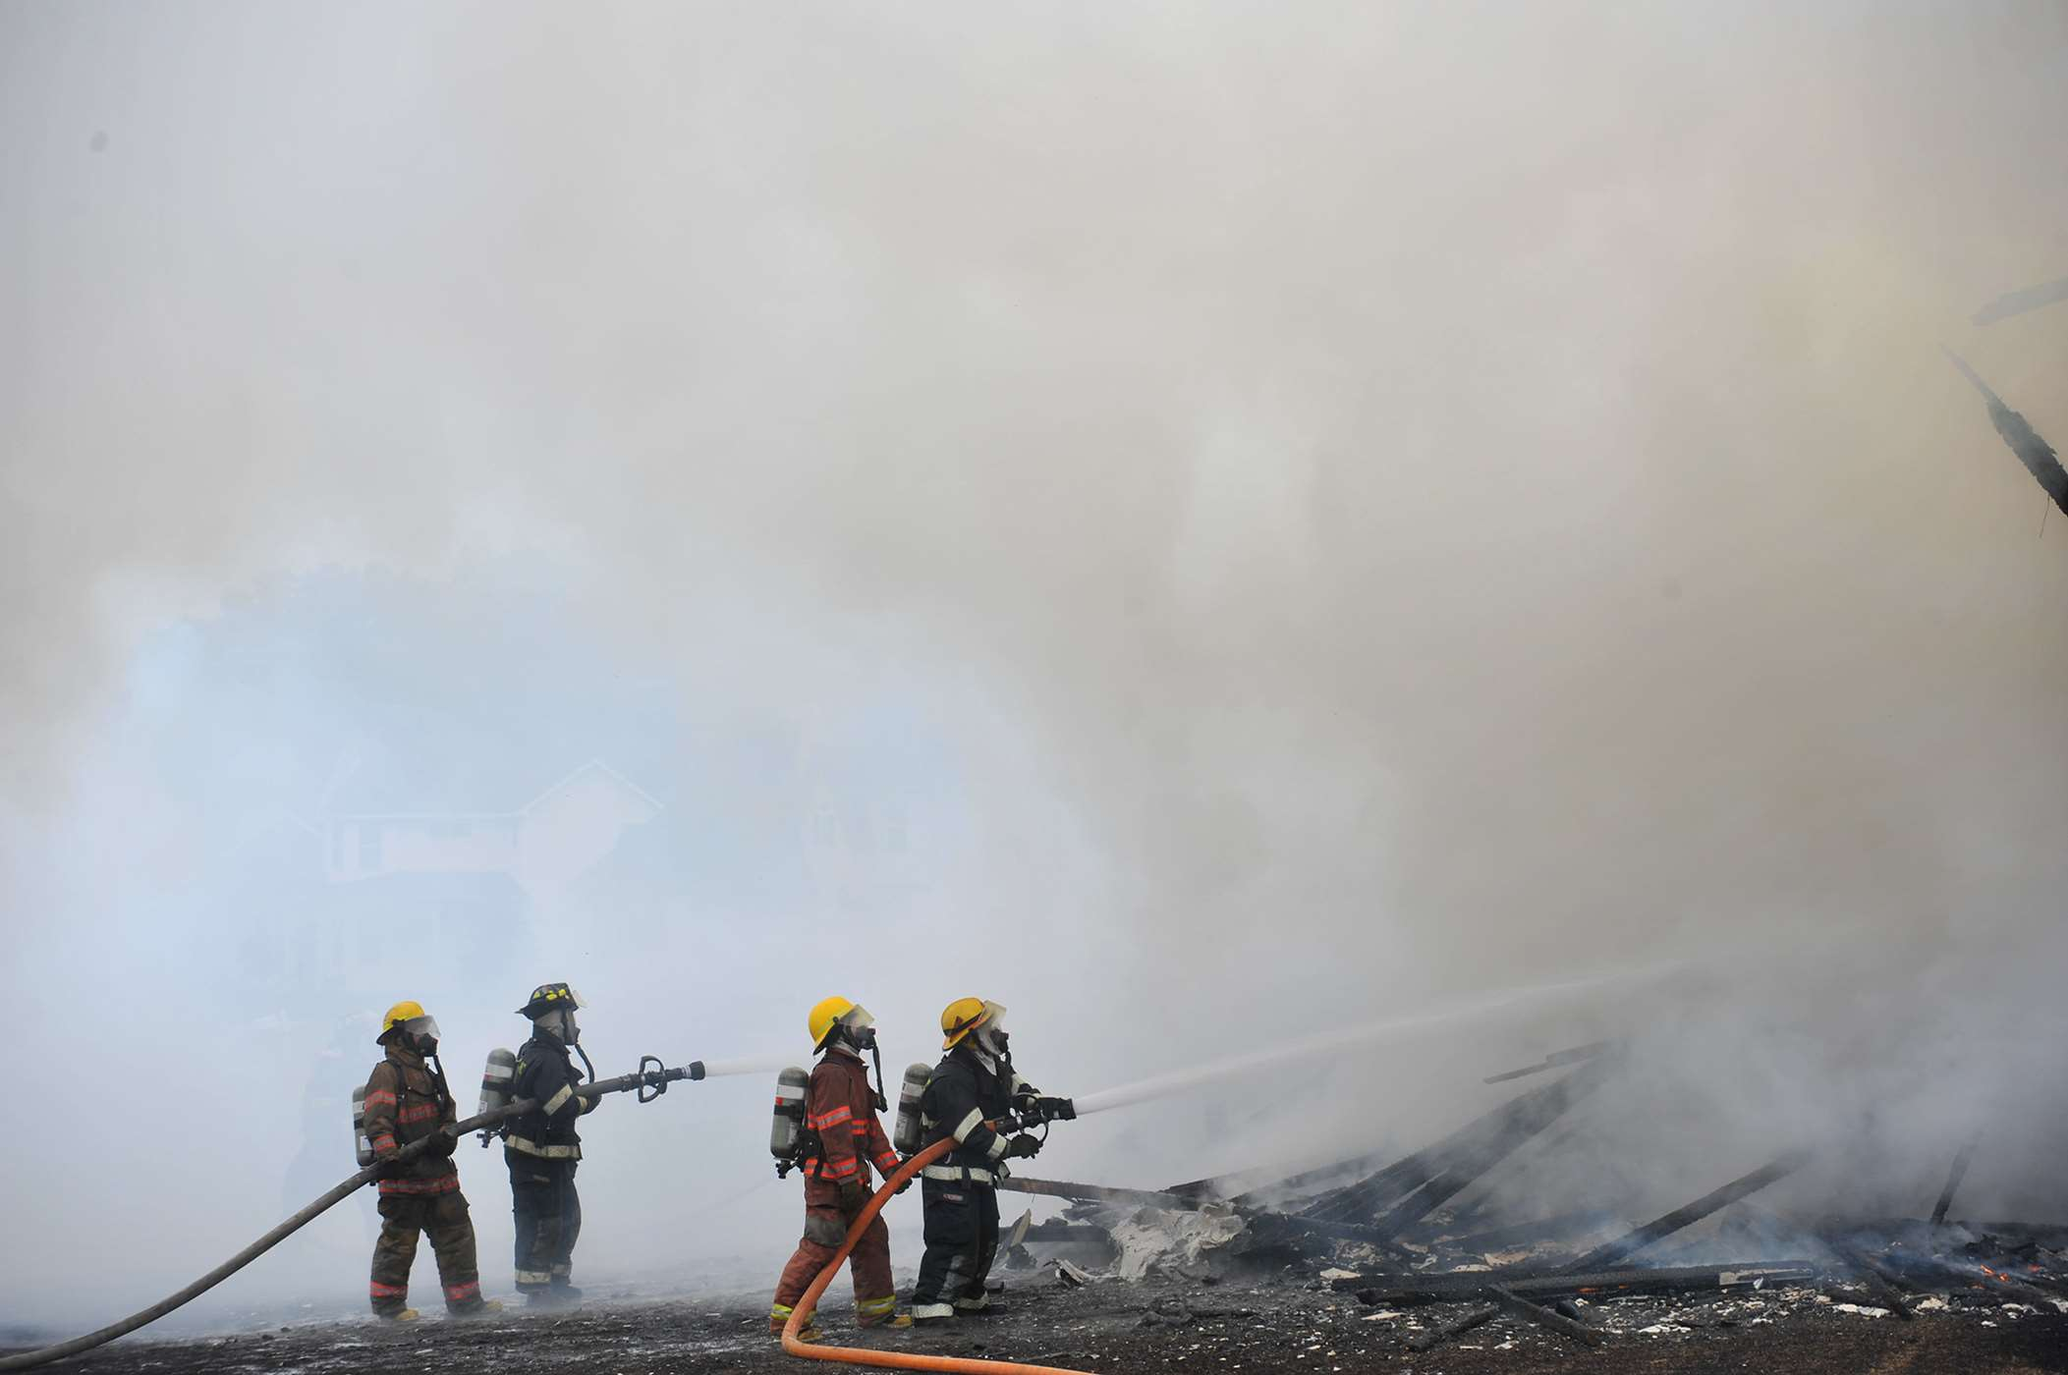

For Full Report
Contact us
COGNITIVE MARKET RESEARCH
Tel: +1 312-376-8303 | +44 020-8123-0732
India: (+91) 983-496-8611
sales@cognitivemarketresearch.com
Access the Full Report : https://shorturl.at/lnvzN
Please visit our website:
https://www.cognitivemarketresearch.com

