Slide 1

GLOBAL
FILM CAMERA
MARKET REPORT 2024
Global,Regional,CountryAnalysis

Slide 2

INTRODUCTION
Film cameras employ photographic film, which is normally plastic covered with a light-sensitive emulsion and generates a latent picture when exposed to light. It is a totally light-tight plastic or metal housing that protects the light-sensitive film. The film is then exposed to a chemical process called film development, which produces visible pictures. Most film cameras contain a viewfinder so users can see how the shot will turn out, a xenon flash bulb that adds enough extra light energy to activate the film even in low light, and a self-timer function so users could shoot selfies without the assistance of others.

Slide 3


KEY INSIGHTS
MARKET SIZE
$277.91 USD Million
2023
FORECAST
USD 387.27 Million
2028
CAGR
5.2 %
2023- 2030

Slide 4

REVENUE MARKET SHARE BY SEGMENTS 2022
35mm
USD 89.67 Million
FILM CAMERA MARKET
SEGMENT ANALYSIS
Medium Format
USD 61.33 Million
Large Format
USD 30.76 Million
Instant Film
USD 59.98 Million

Slide 5

Global Film Camera Market Revenue share for 2022
North America
USD 97.91 Million

Slide 6

Rising Disposable Income is contributing to the sales revenue increase of Cameras
Drivers
Availability of several substitutes
of Film Cameras
Restraints

Slide 7
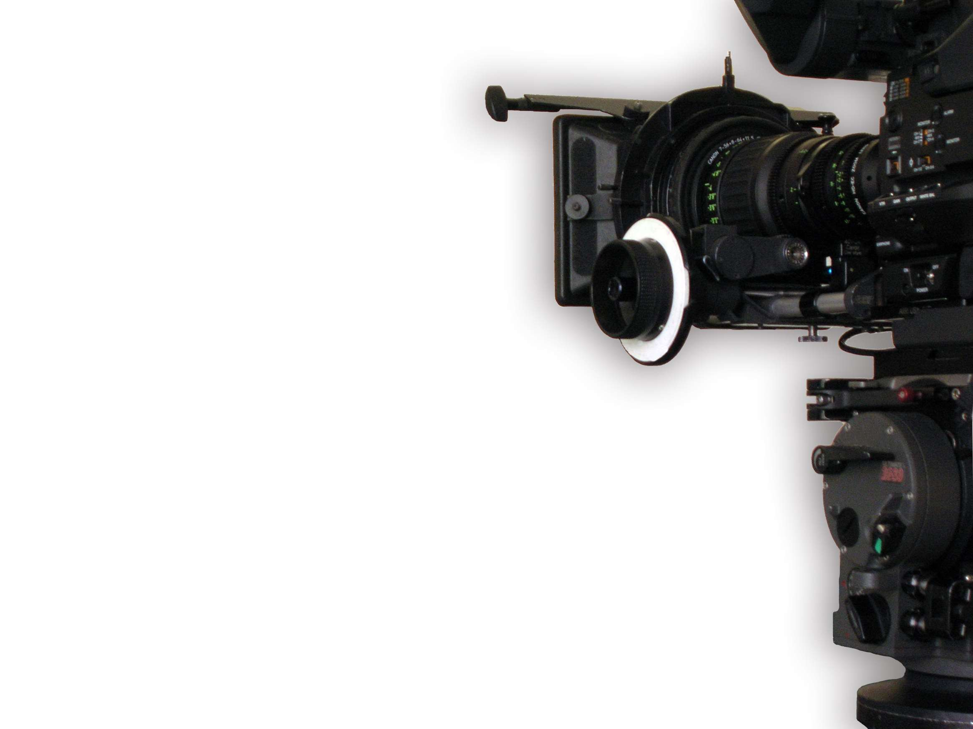
AUTHOR'S PERSPECTIVE
  The Global Film Camera Market revenue in 2017 was USD 248.70 Million.
  By 2029, total revenue is expected to grow up to $312.55 Million.
  CAGR from 2022-2029 is expected to be: 3.74%.
  35mm Film Cameras held for the largest share of total revenue generated in 2020.
  In terms of revenue, the Commercial Use segment held the maximum share of the Film Camera market in 2020.
  In terms of revenue, Direct Channel held the maximum share of the Film Camera market in 2020.
  The rising disposable income, growing tourism industry, and mounting photography trend is propelling the growth of the market, in the estimated forecast period
  Availability of several substitutes restricting the growth of the film camera market
  The availability of film cameras on various e-commerce platforms is expected to provide significant opportunities for the players in the market

Slide 8

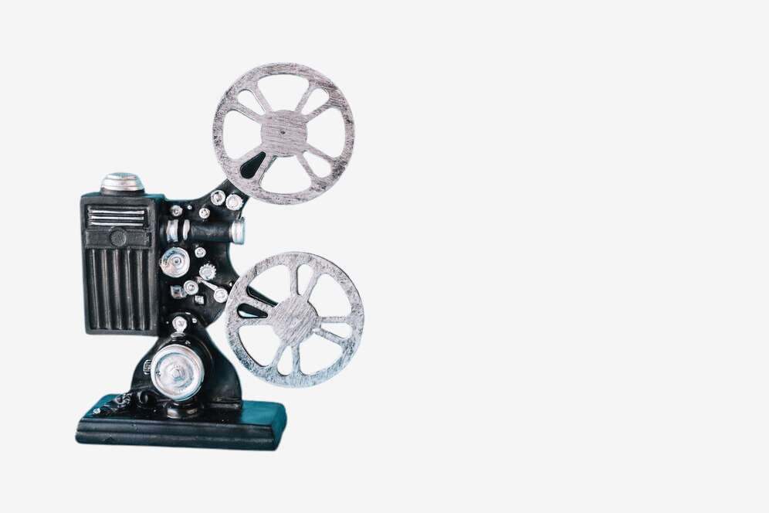









KEY PLAYERS

Slide 9


For Full Report
Contact us
COGNITIVE MARKET RESEARCH
Tel: +1 312-376-8303 | +44 020-8123-0732
India: (+91) 983-496-8611
sales@cognitivemarketresearch.com
Access the Full Report : https://tinyurl.com/mwekxcby
Please visit our website:
https://www.cognitivemarketresearch.com

