Slide 1

GLOBAL
FETA CHEESE
MARKET REPORT 2024
Global,Regional,CountryAnalysis

Slide 2

INTRODUCTION
The cheese feta originates in Greece and is prepared from either pure milk of sheep or a mixture of goat and sheep milk. Feta cheese is a great nutritional source of nutrients and health-improving ingredients that support healthy body function. It offers a greater variety of nutritious elements in concentrated form together with the mouthwatering cheese flavors. The demand for protein-rich foods is rising, quick-service restaurants are becoming more popular, and there is a developing trend for international cuisine, all of which have contributed to the expansion of the worldwide feta cheese market.

Slide 3
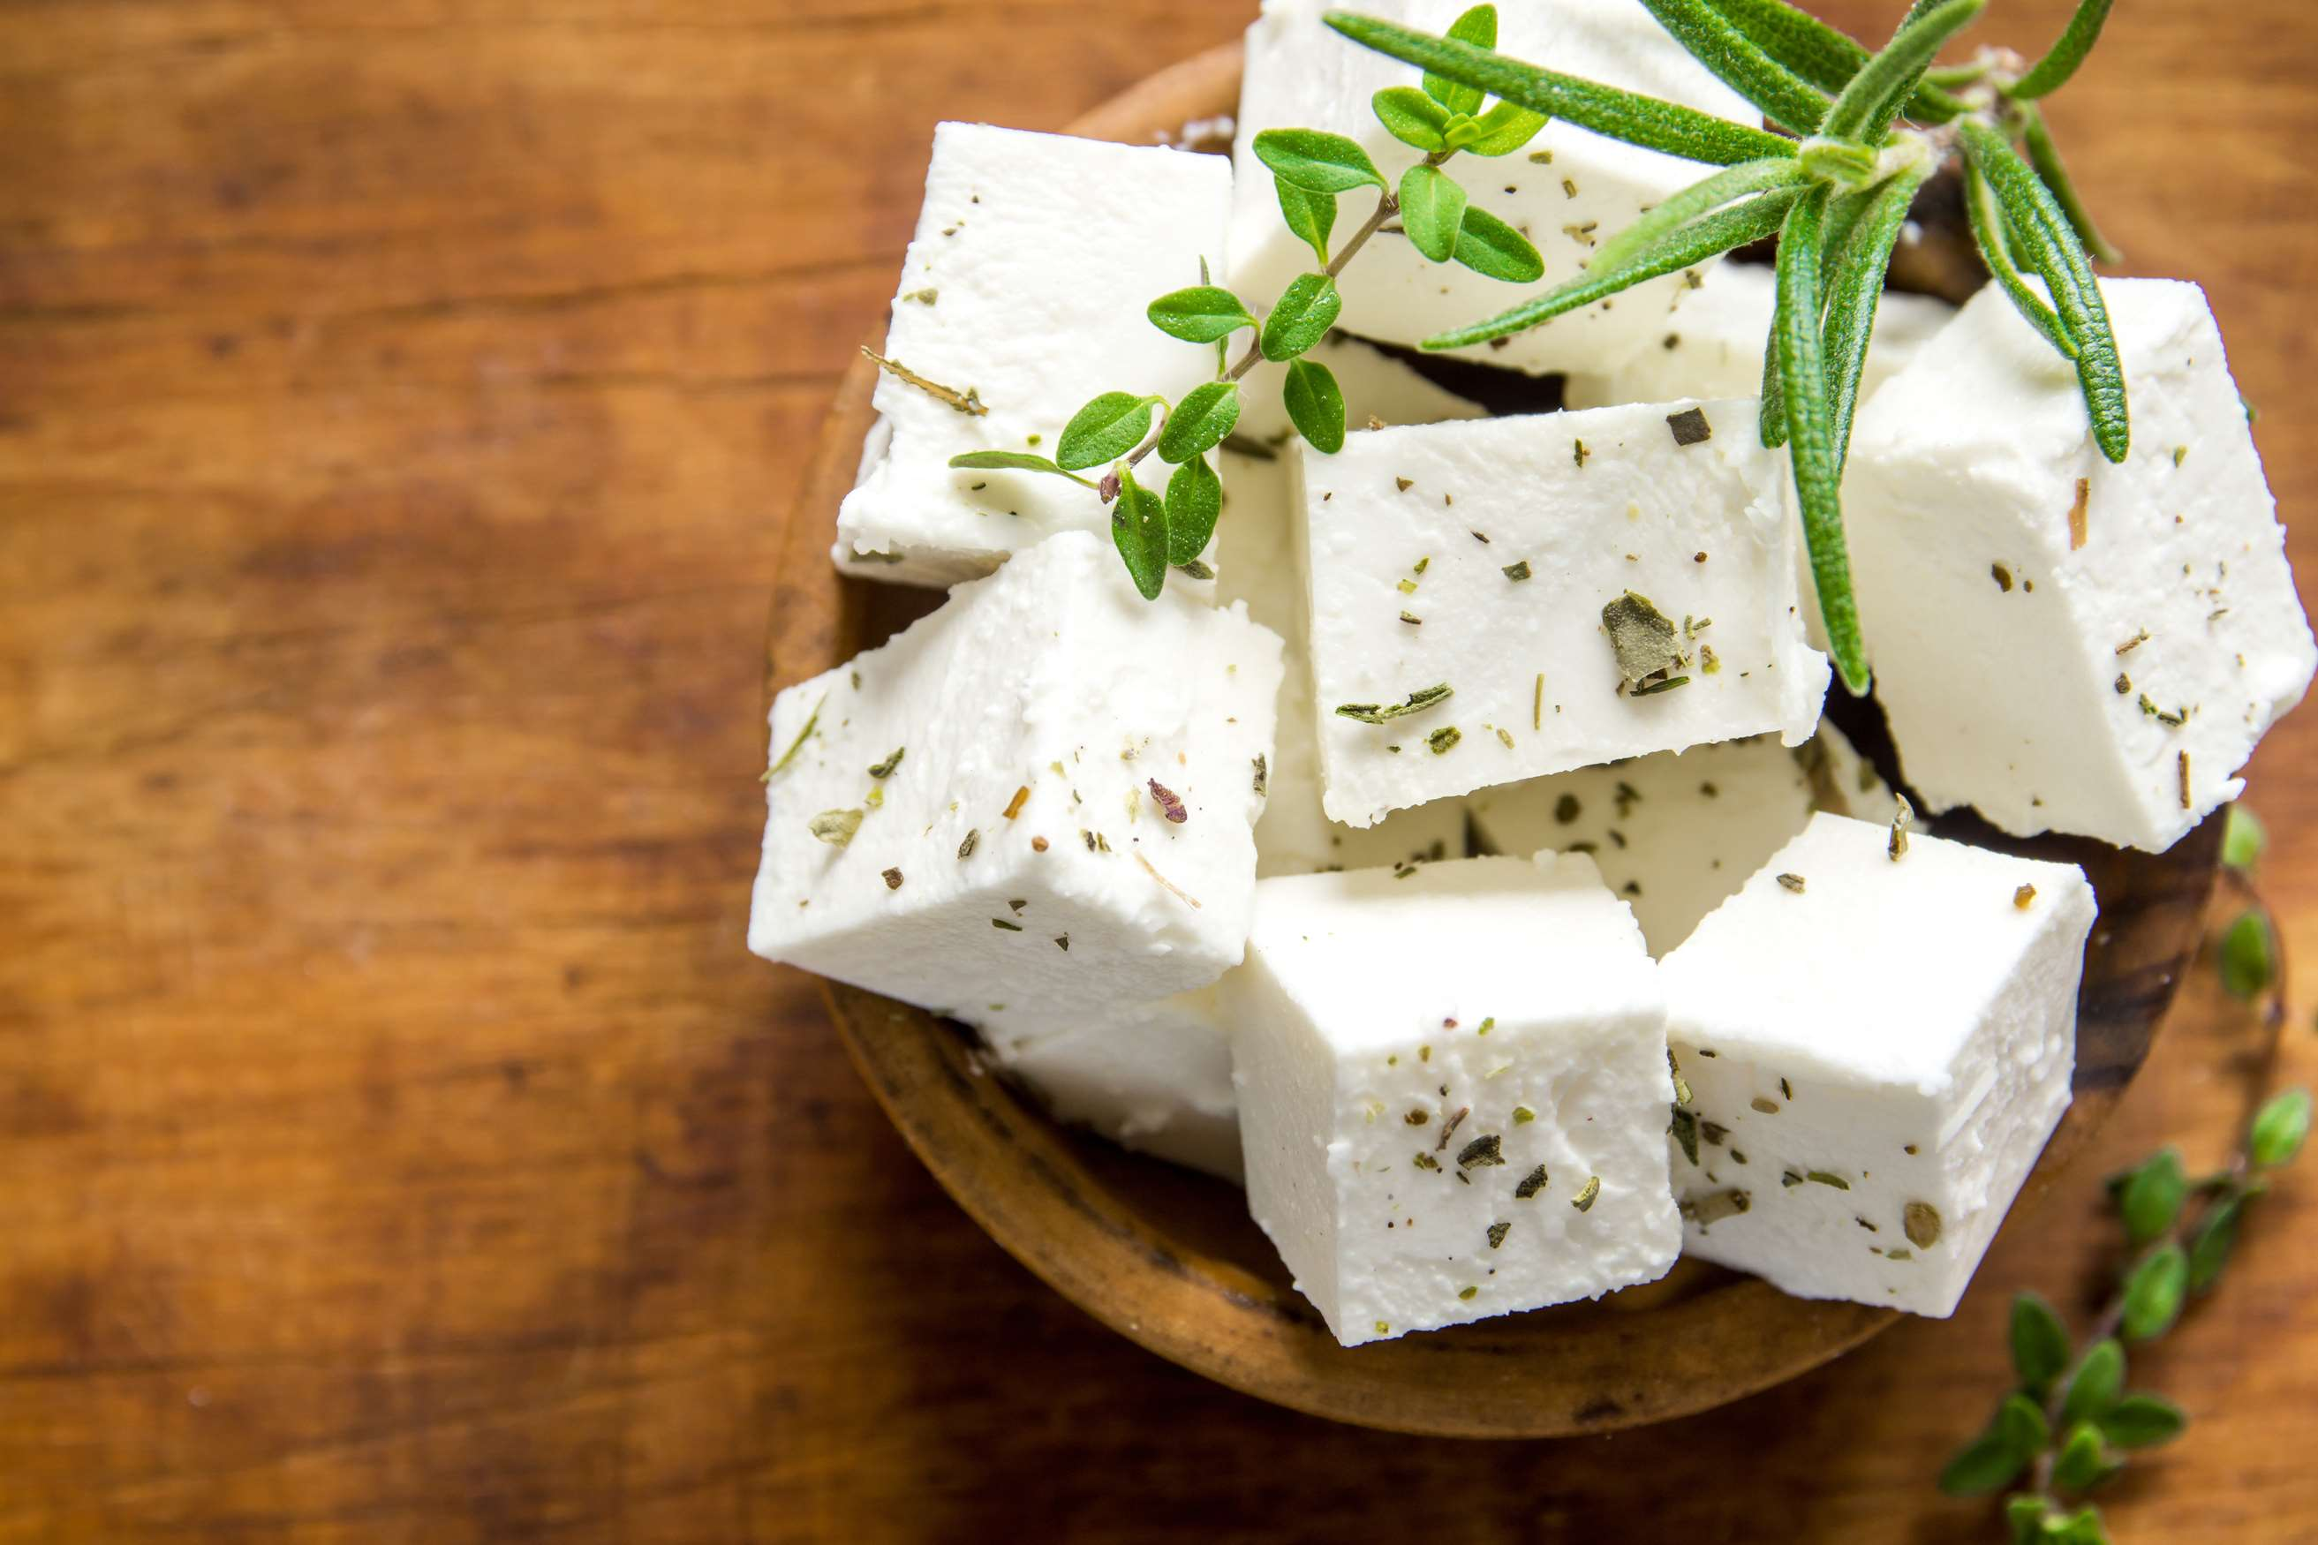

KEY INSIGHTS
MARKET SIZE
USD 11.5 billion
2023
CAGR
5.90%
2023- 2030

Slide 4

REVENUE MARKET SHARE BY SEGMENTS 2022
  Bulgarian Feta
  French Feta
  German Feta
By Type
Distribution Channel
  B2B
  B2C
  Cow Milk
  Sheep Milk
  Goat Milk
Source Segment

Slide 5

Global Feta Cheese Market Revenue share for 2022
Europe

Slide 6

Increase in Milk Supply from Animals like Sheep and Goats will Drive Market Growth
Drivers
Lack of Storage Space and Efficient Transportation Could Restrain Market Growth
Restraints

Slide 7

AUTHOR'S PERSPECTIVE
  The Global Feta Cheese Market is witnessing significant growth in the near future.
  In 2023, the Bulgarian Feta segment accounted for noticeable share of global Feta Cheese Market and is projected to experience significant growth in the near future.
  The B2B segment is expected to expand at the significant CAGR retaining position throughout the forecast period.

Slide 8





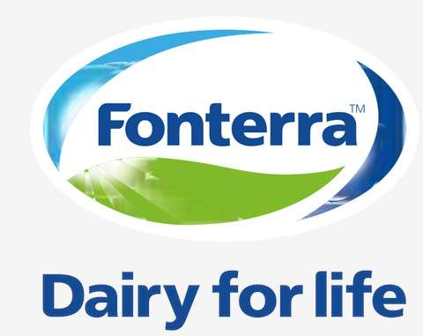


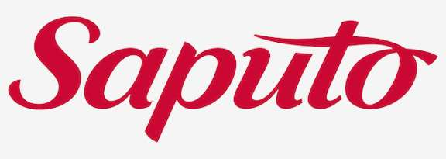


KEY PLAYERS

Slide 9


For Full Report
Contact us
COGNITIVE MARKET RESEARCH
Tel: +1 312-376-8303 | +44 020-8123-0732
India: (+91) 983-496-8611
sales@cognitivemarketresearch.com
Access the Full Report : https://shorturl.at/lwEQY
Please visit our website:
https://www.cognitivemarketresearch.com

