Slide 1
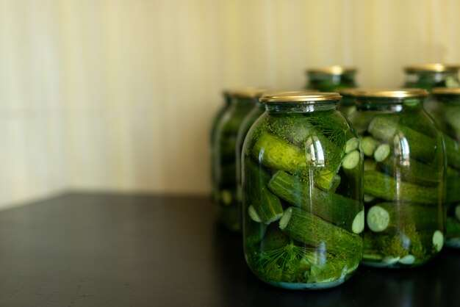
GLOBAL
FERMENTED CUCUMBER
MARKET REPORT
2024
Global,Regional,CountryAnalysis

Slide 2
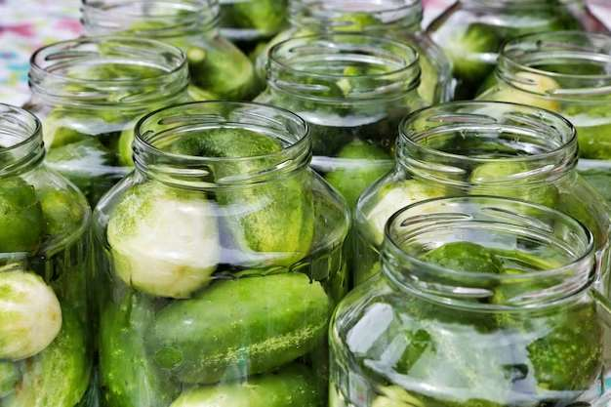
INTRODUCTION
Cucumbers are fermented after being steeped in a brine solution and fermenting into pickles. This technique adds tang, extends shelf life, and introduces helpful microorganisms. The fermented cucumber market is experiencing increased demand as a result of rising consumer interest in probiotic-rich diets and the expanding popularity of fermented goods. Fermented cucumbers' numerous health benefits, includes increased gut health and vitamin absorption, are attracting health-conscious customers. A wide range of product options, including conventional pickles, kimchi, and novel flavor profiles, distinguishes the market. Furthermore, the movement toward natural and organic food options contributes to the market's growth. As customers seek out new and exciting flavors, the fermented cucumber market is likely to grow further, providing possibilities for both established and rising food sector firms.

Slide 3
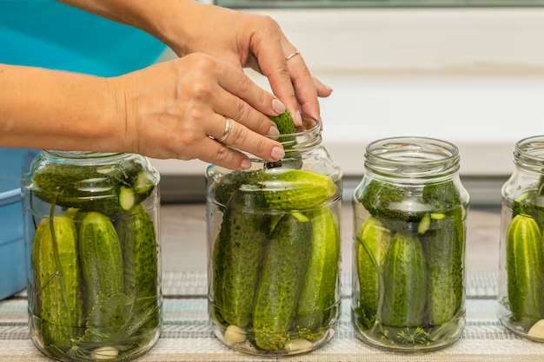

KEY INSIGHTS
MARKET SIZE
USD 1121.5 billion
2023
CAGR
5.80%
2023- 2030

Slide 4
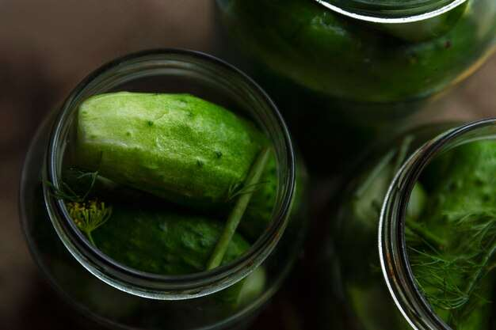
REVENUE MARKET SHARE BY SEGMENTS 2022
  Kosher
  Polish
  Genuine
  Baby
Type Segment
  Whole-Shaped
  Spear-Shaped
  Sliced
Form Segment
  Organic
  Processed
Nature Segment

Slide 5

Global Fermented Cucumber Market Revenue share for 2024
North America
40%

Slide 6

Global Demand for Ethnic Cuisines to Propel Market Growth
Drivers
Food Safety Concerns to Restrict Market Growth
Restraints

Slide 7
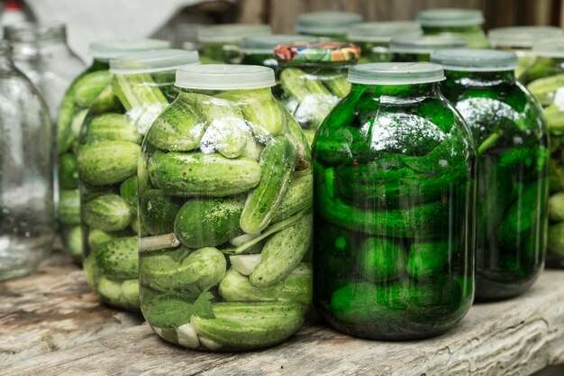
AUTHOR'S PERSPECTIVE
  The Global Fermented Cucumber Market is witnessing significant growth in the near future.
  Consumers looking for quick and healthful snacks will like the practical design, as well as the preserved crunchiness and distinct flavor profile.
  Spear-shaped fermented cucumber is the fastest-growing category over the forecast period; as customers increasingly value convenience and stackability, the spear-shaped fermented cucumber trend is driving market expansion.
  In 2023, the Kosher segment accounted for noticeable share of global Fermented Cucumber Market and is projected to experience significant growth in the near future.
  The Whole-Shaped segment is expected to expand at the significant CAGR retaining position throughout the forecast period.

Slide 8






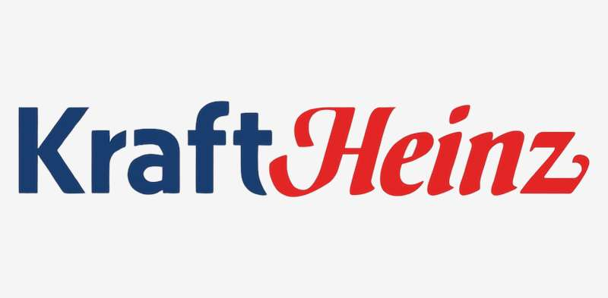

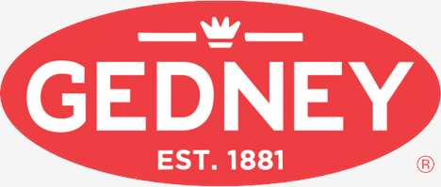
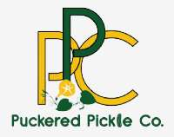
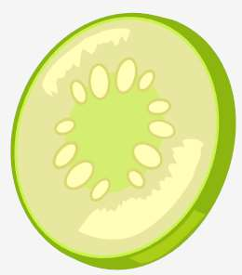
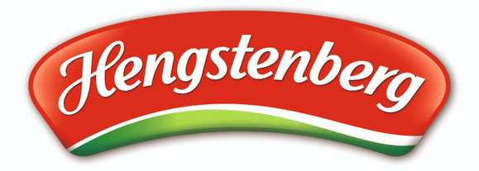
KEY PLAYERS

Slide 9


For Full Report
Contact us
COGNITIVE MARKET RESEARCH
Tel: +1 312-376-8303 | +44 020-8123-0732
India: (+91) 983-496-8611
sales@cognitivemarketresearch.com
Access the Full Report : http://tinyurl.com/4h7ek2nm
Please visit our website:
https://www.cognitivemarketresearch.com

