Slide 1
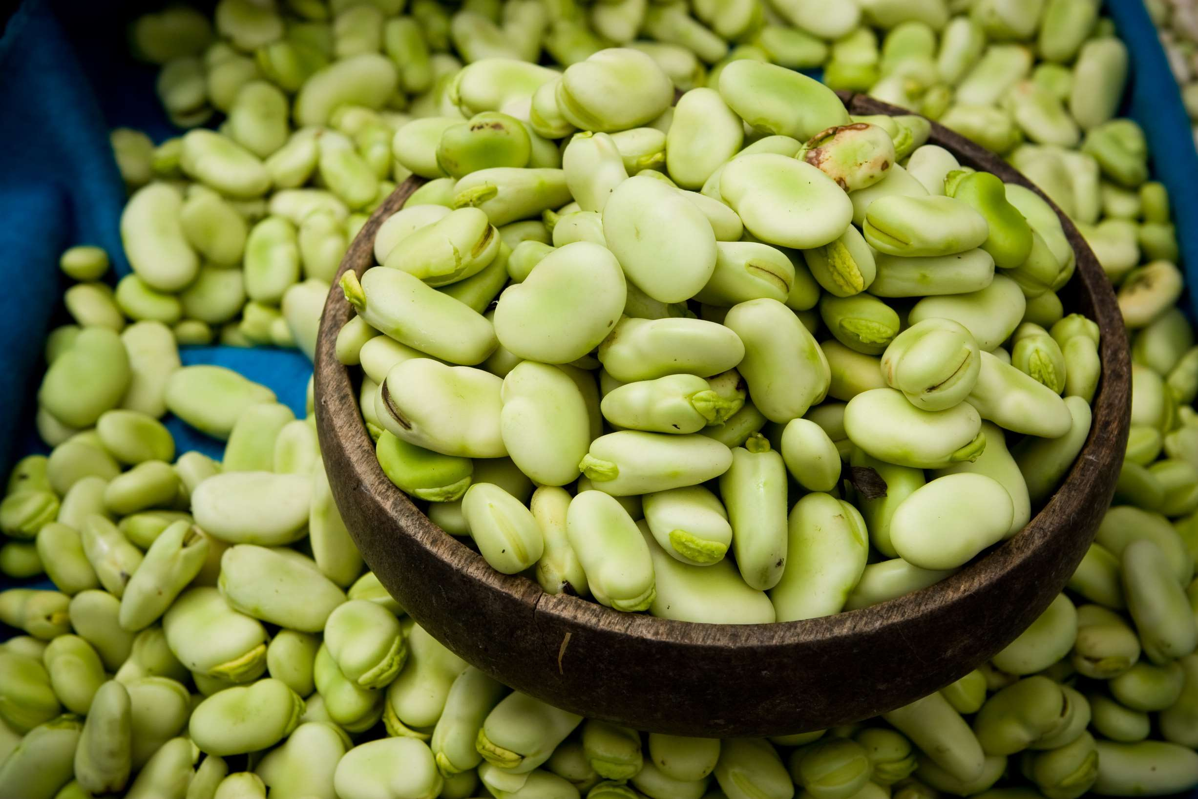
GLOBAL
FAVA BEANS
MARKET REPORT
2024
Global,Regional,CountryAnalysis

Slide 2
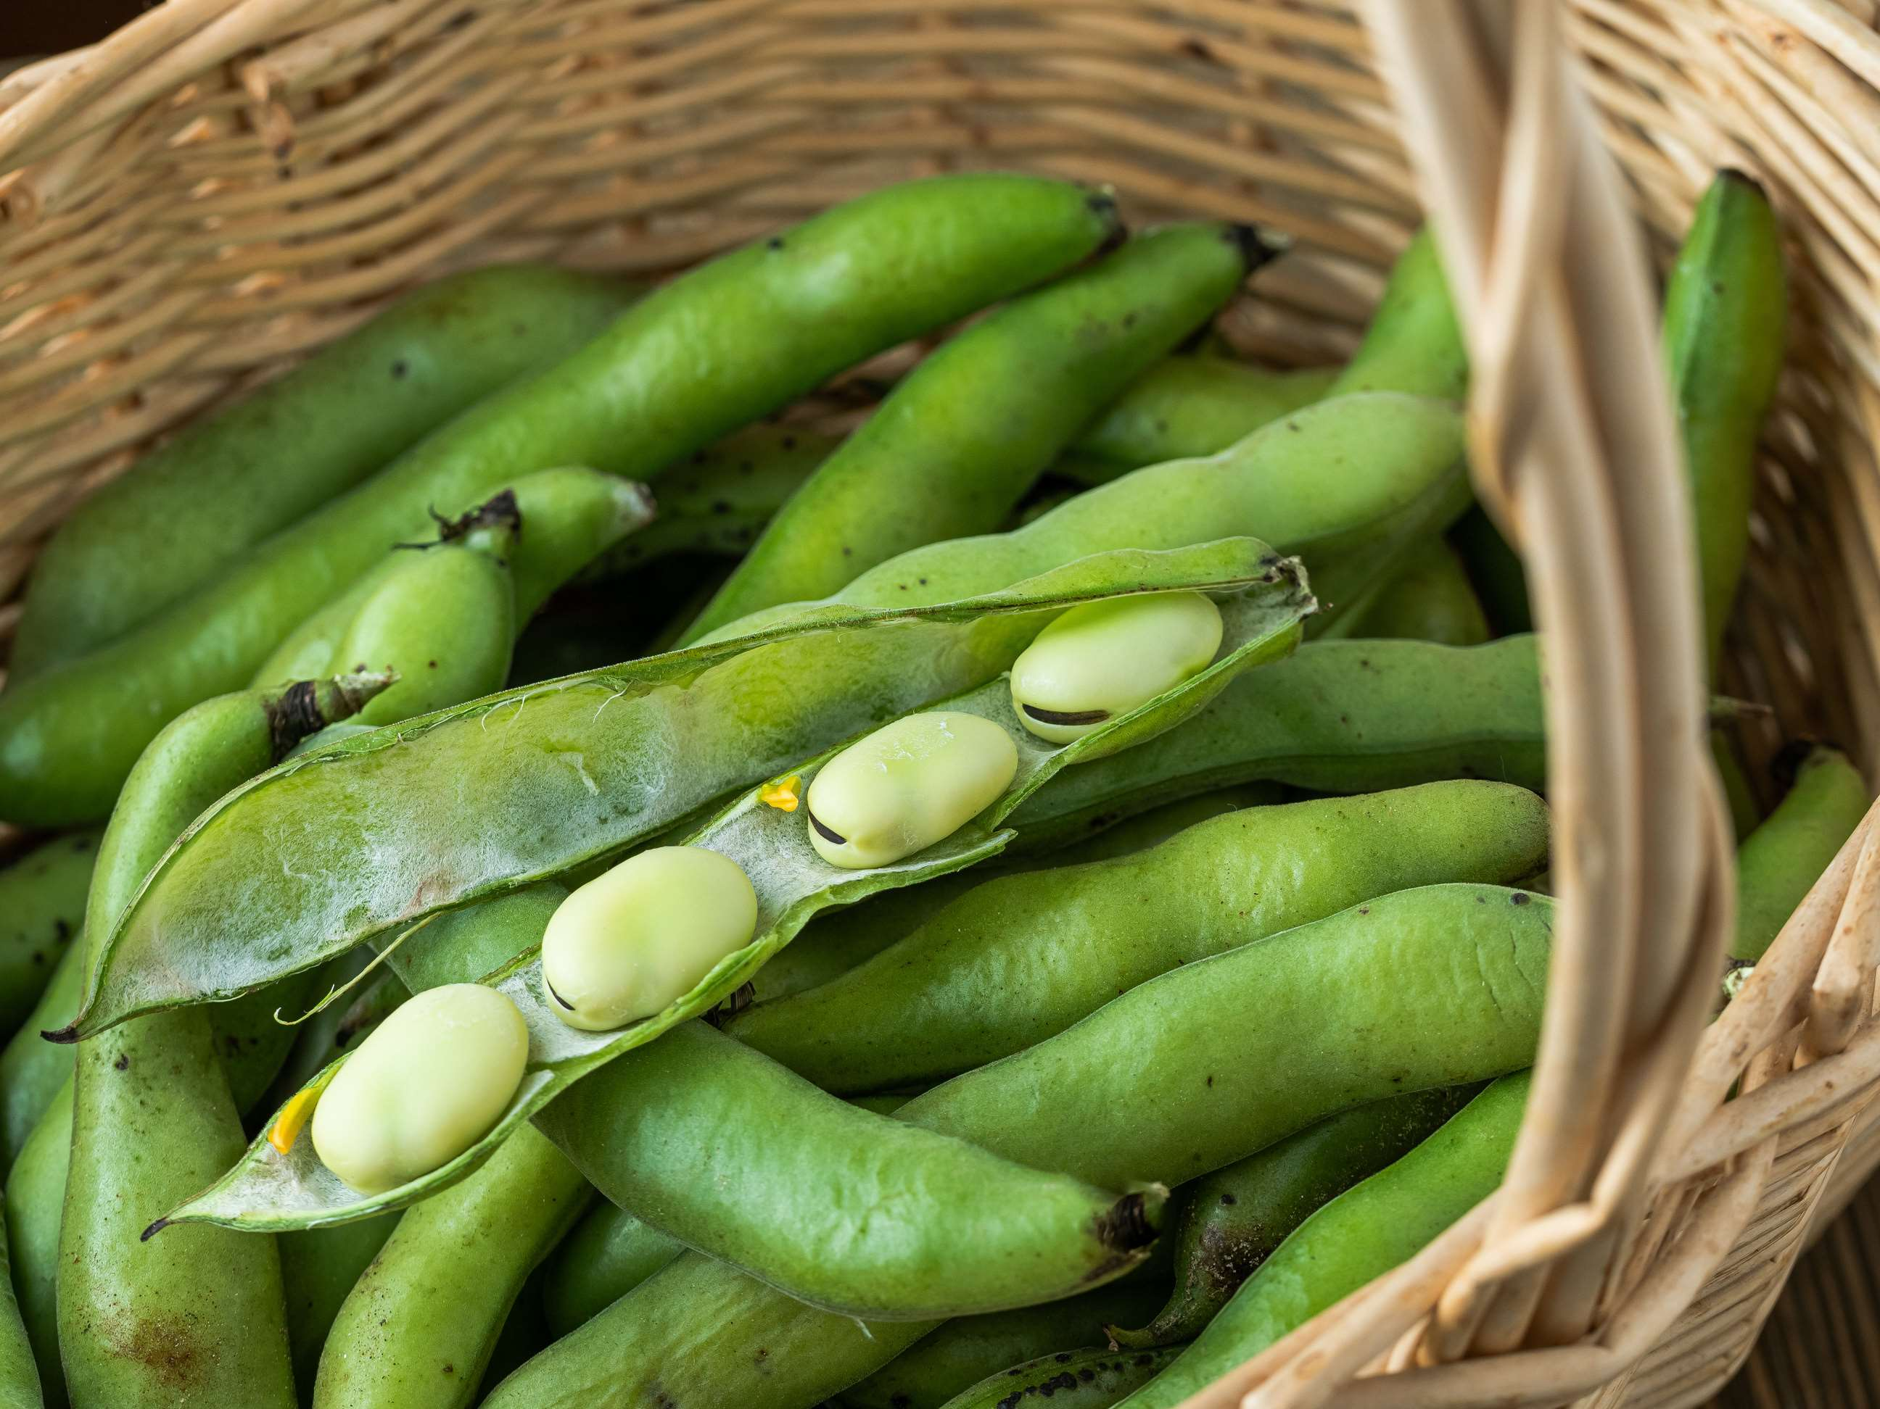
INTRODUCTION
Fava beans, formally known as Vicia faba, are a species of legume distinguished by big, flat, and elongated seeds housed in thick, leathery pods. They are enriched with critical nutrients like protein, dietary fiber, folate, vitamin K, and minerals like iron, potassium, and magnesium. They also include antioxidants such as flavonoids and polyphenols, which fight oxidative stress and lower the risk of chronic diseases. Their fiber content promotes digestive health, regulates blood sugar levels, and improves cardiovascular health by lowering cholesterol and maintaining healthy blood pressure. Their frequent and moderate ingestion promotes red blood cell formation and helps prevent iron deficiency anemia.

Slide 3
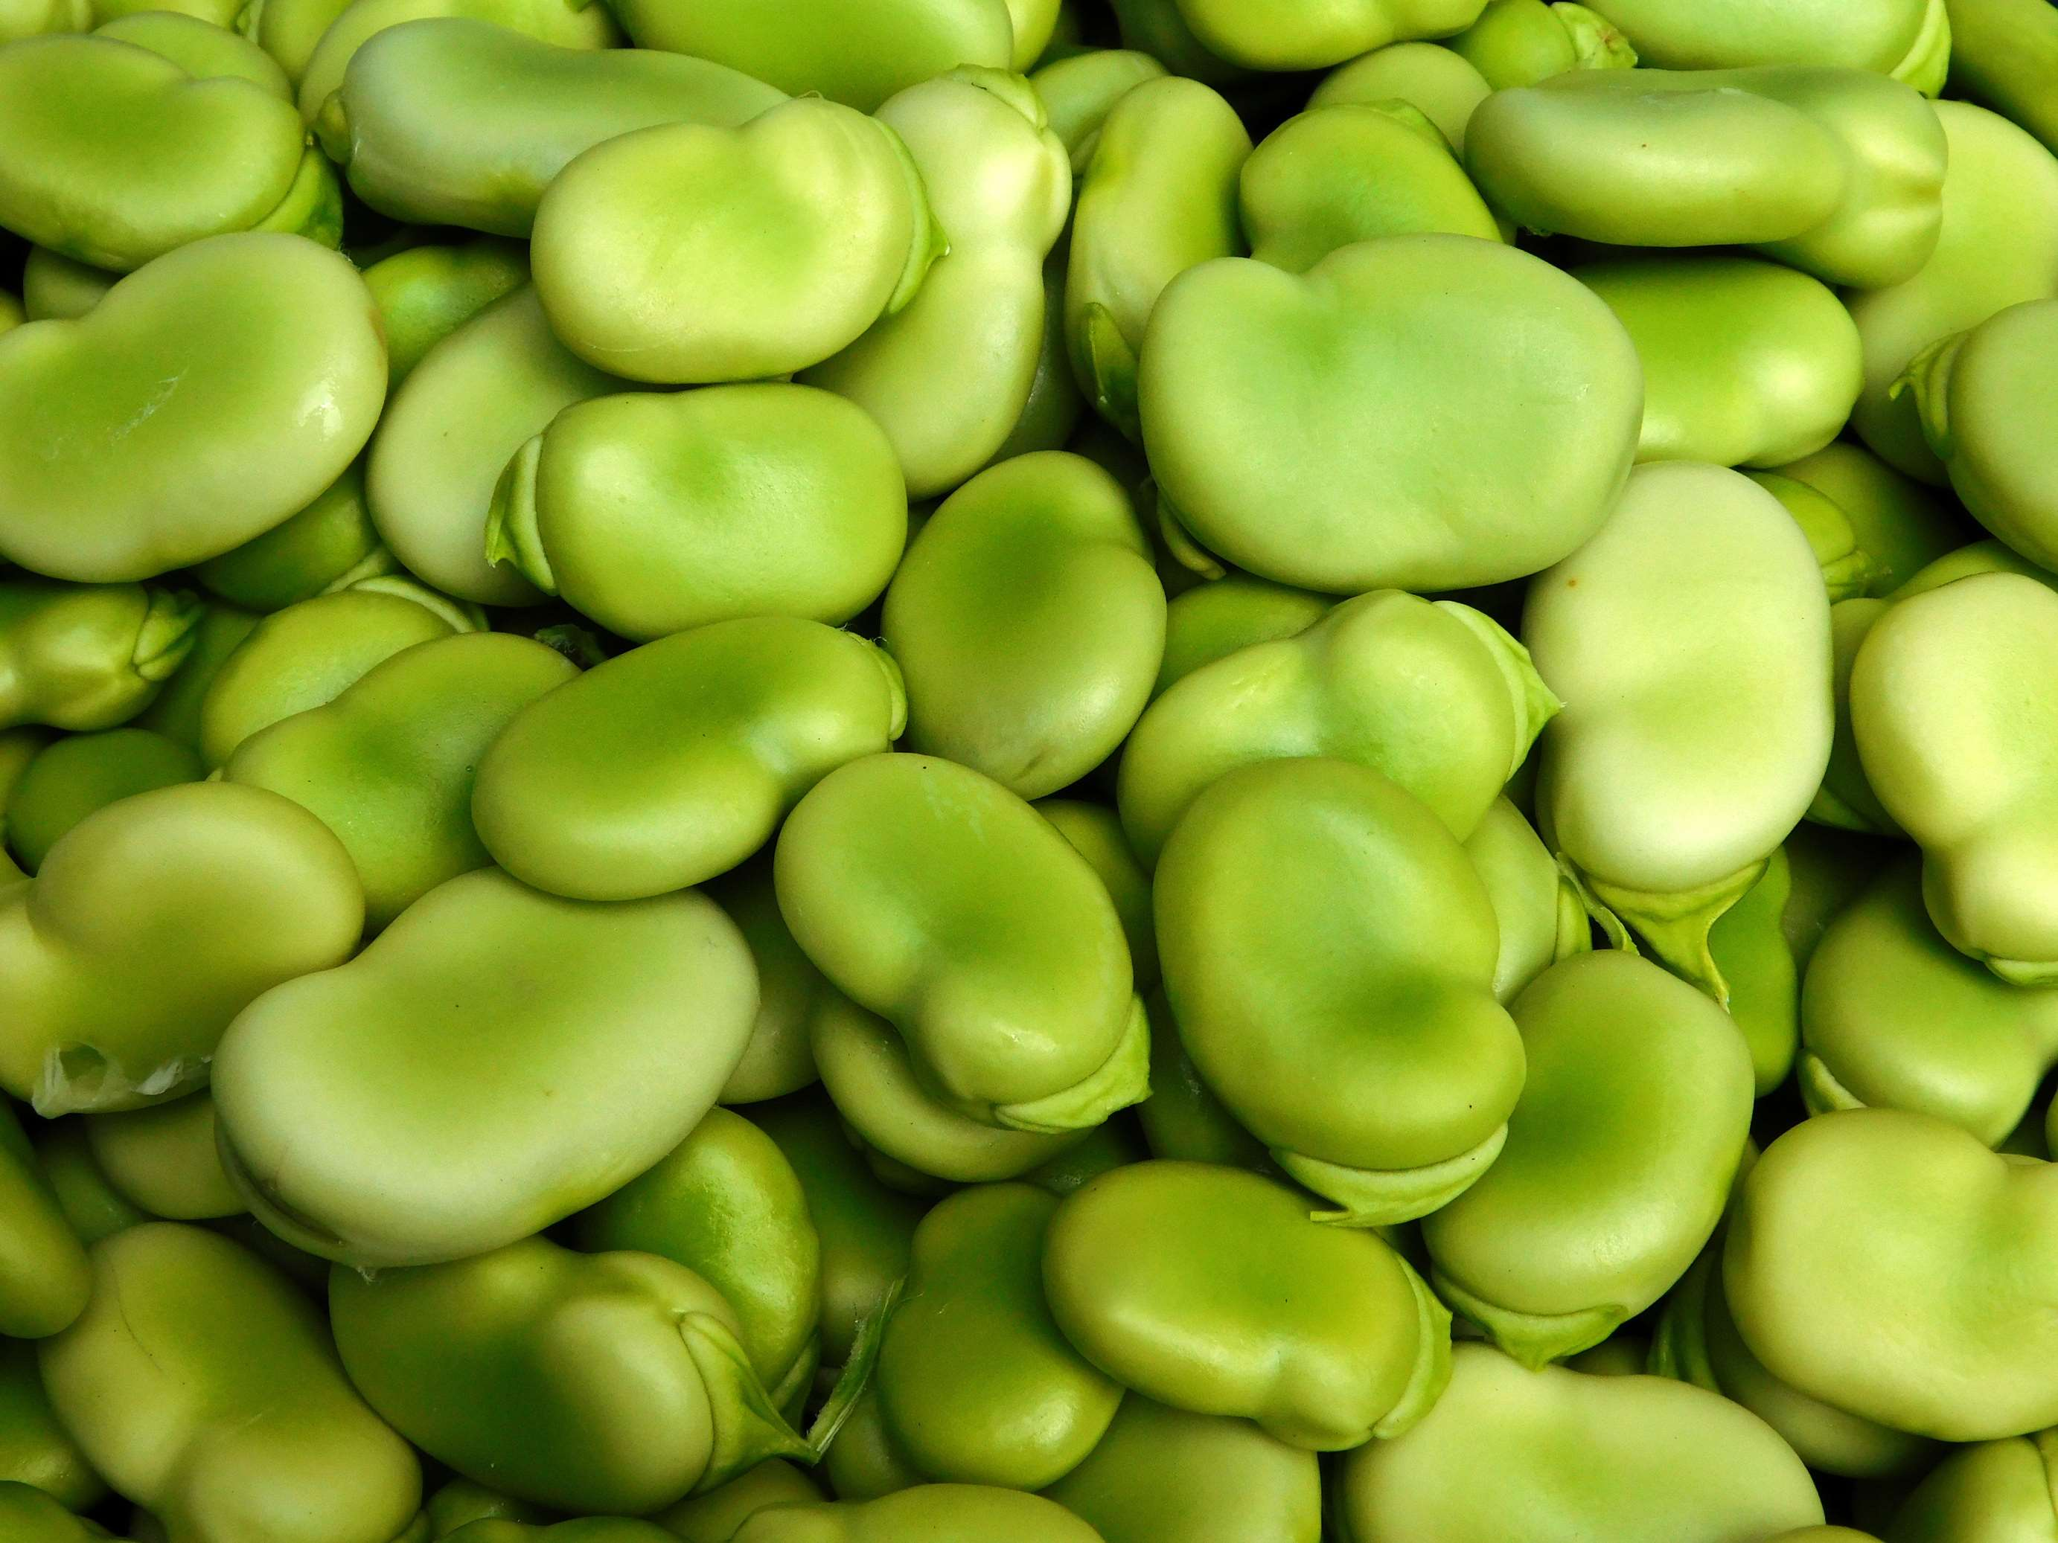

KEY INSIGHTS
MARKET SIZE
USD 2951.2 million
2024
CAGR
2.30%
2024- 2031

Slide 4
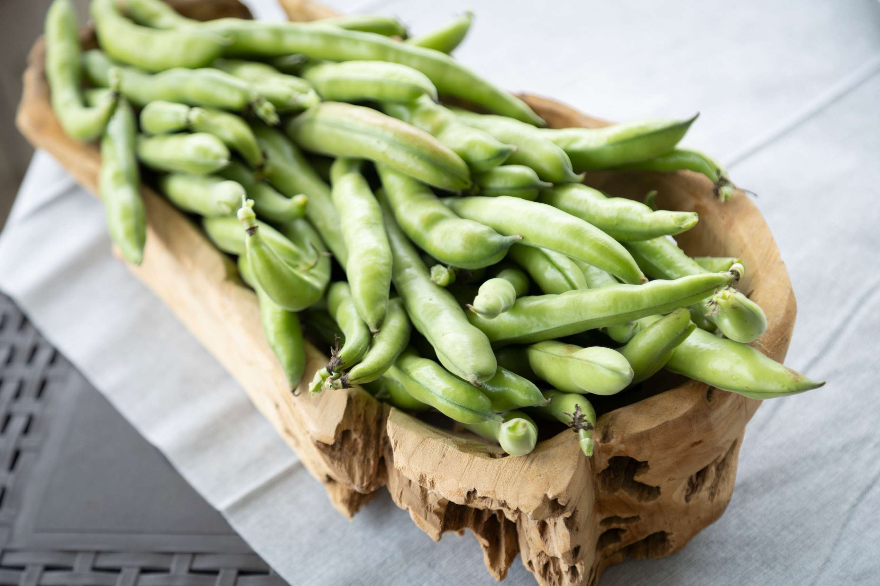
REVENUE MARKET SHARE BY SEGMENTS 2022
  Fresh
  Frozen
  Pod
  Organic
Type Segment
  Animal Feed
  Human Nutrition
Application Segment
  Supermarket/Hypermarket
  Grocery Stores
  E-commerce Platform
Distribution Channel

Slide 5

Global Fava Beans Market Revenue share for 2024
North America
40%

Slide 6
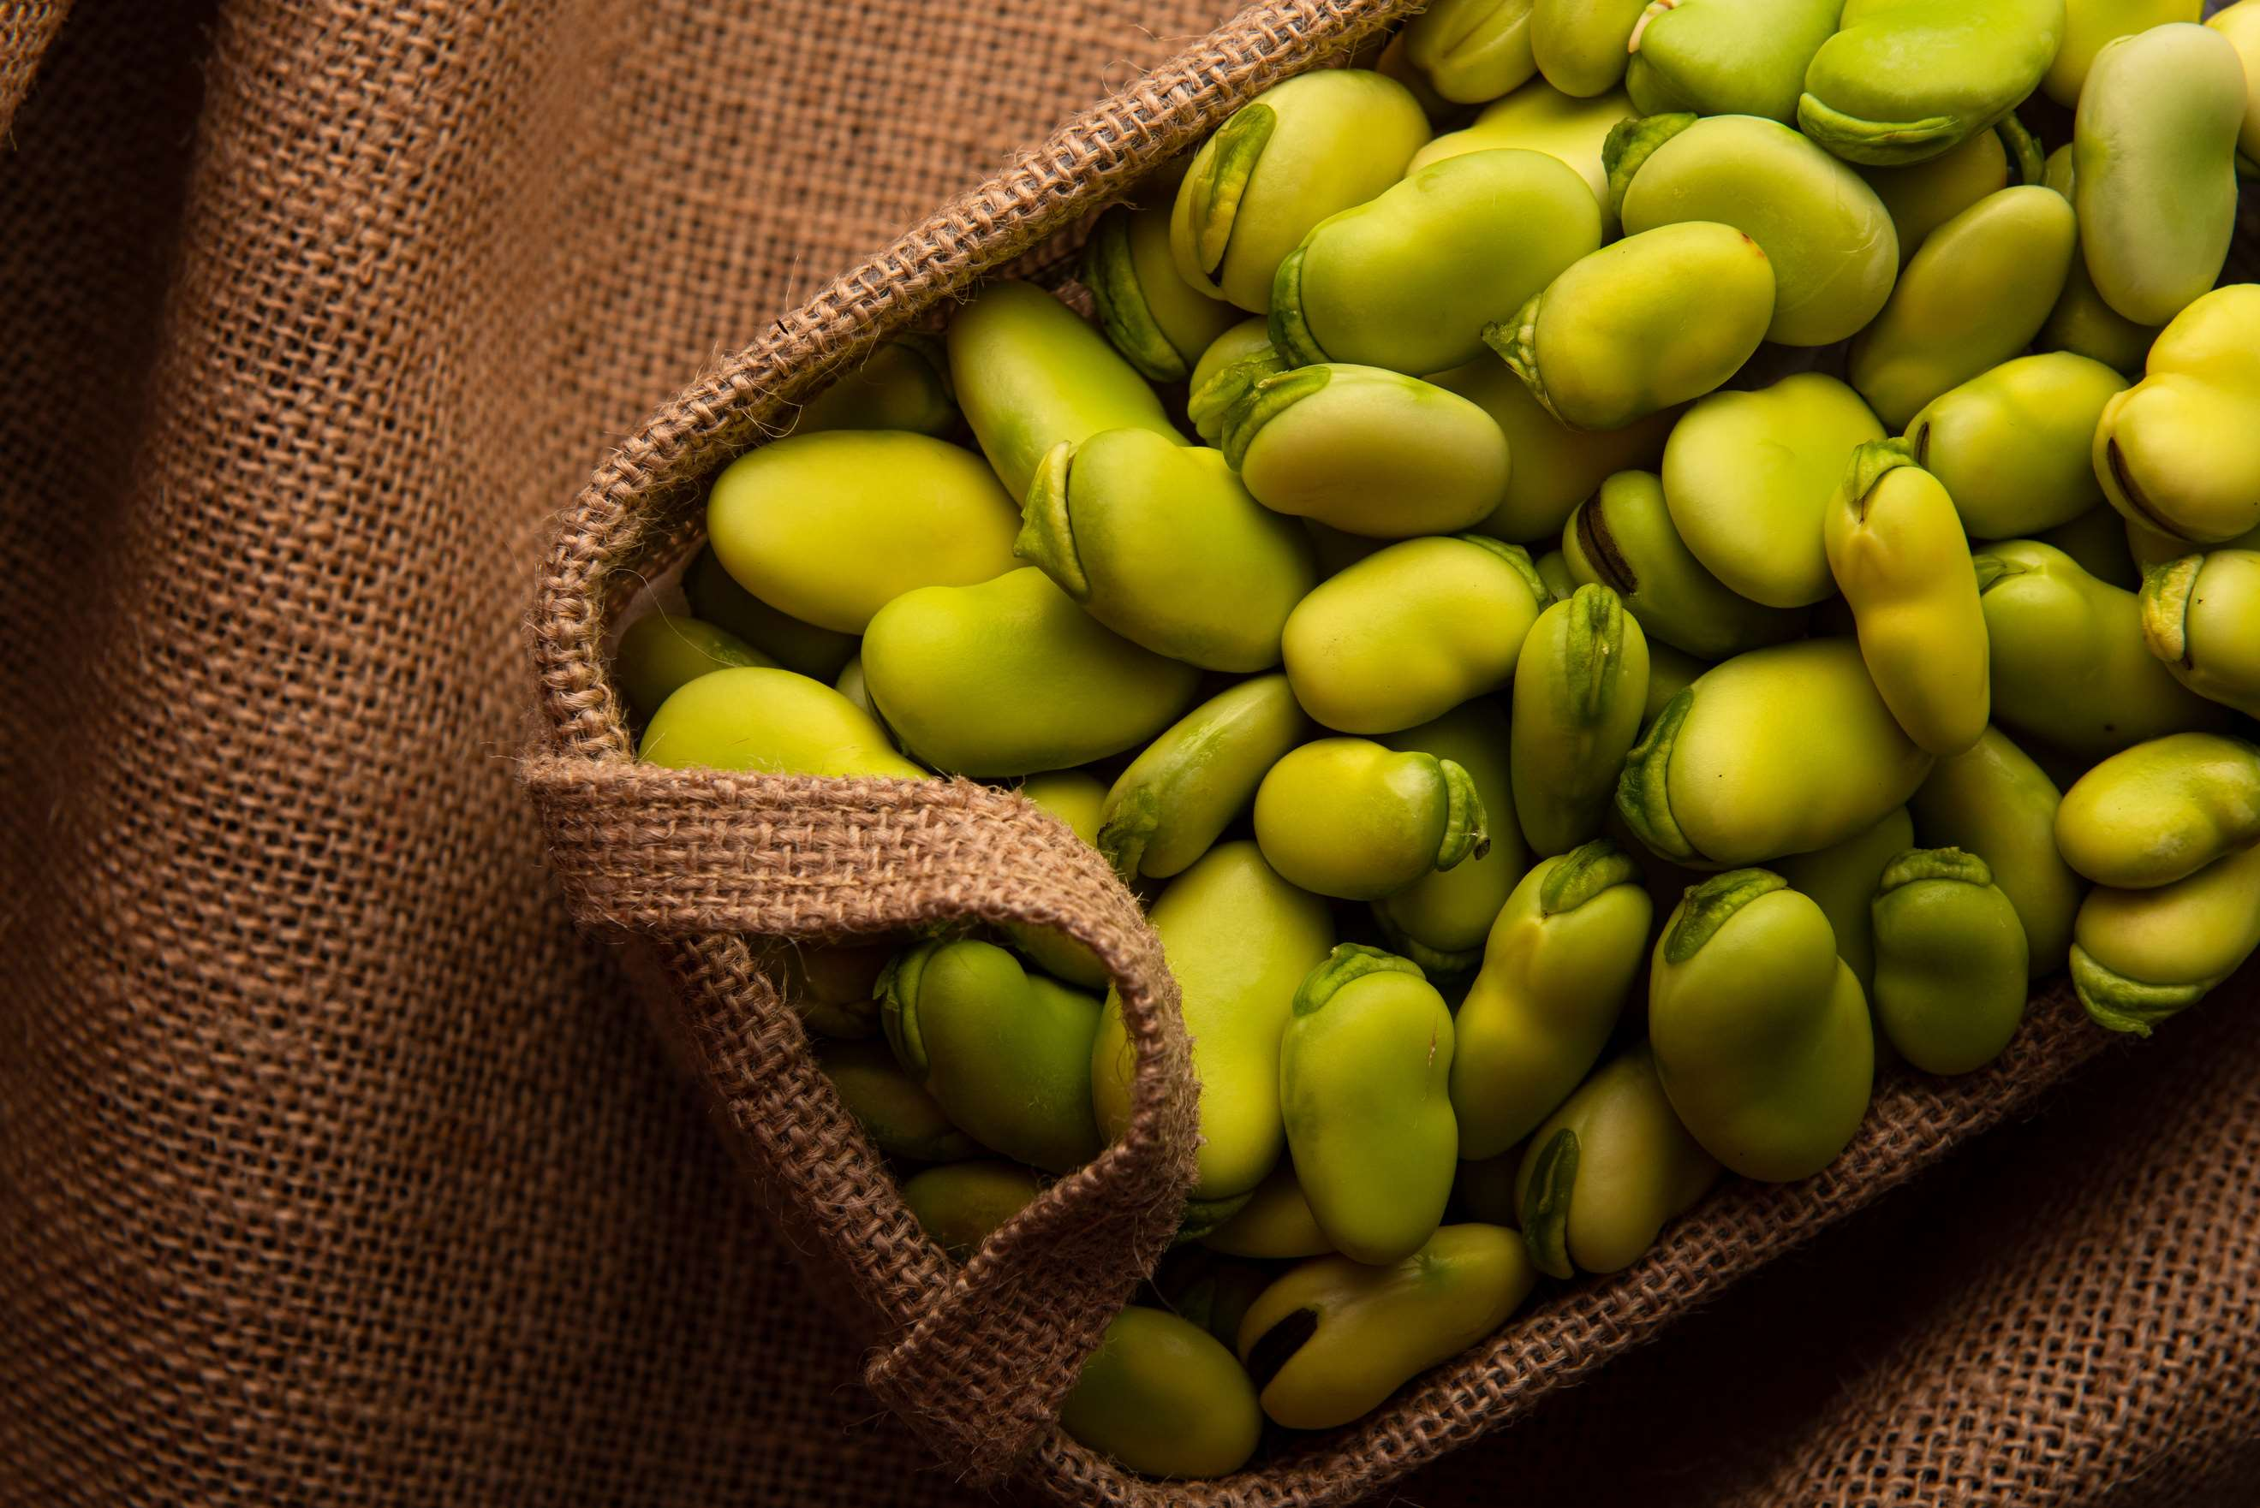
Crop Rotation and Sustainable Farming to Propel Market Growth
Drivers
Cooking Times Increased and Culinary Advancements to Limit the Sales
Restraints

Slide 7
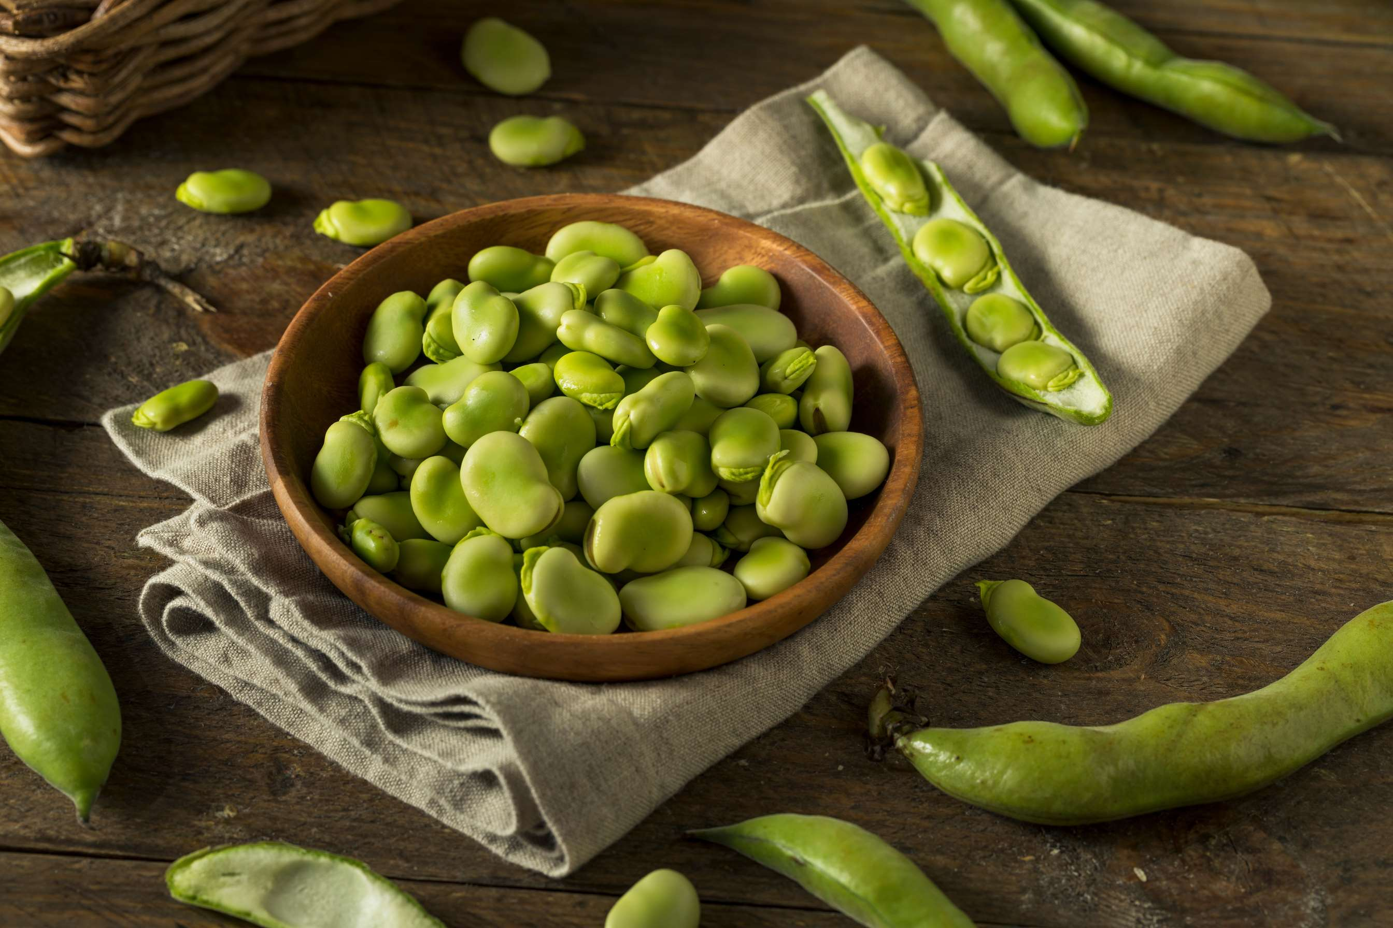
AUTHOR'S PERSPECTIVE
  Fresh bean sales are set to rise, as is the acceptance of ethnic and cultural cuisines and the growing need for plant-based protein.
  Fava beans are a popular option for vegans and vegetarians since they are high in fiber and protein.
  Supermarkets and hypermarkets have the potential to contribute to this increase by providing a greater range of fava bean products, informing customers about the advantages of fava beans, and lowering their prices.
  Increasing demand for healthy eating propels sales in the human nutrition segment. The growing demand for sustainable products, healthier foods, and plant-based proteins is helping the market.

Slide 8





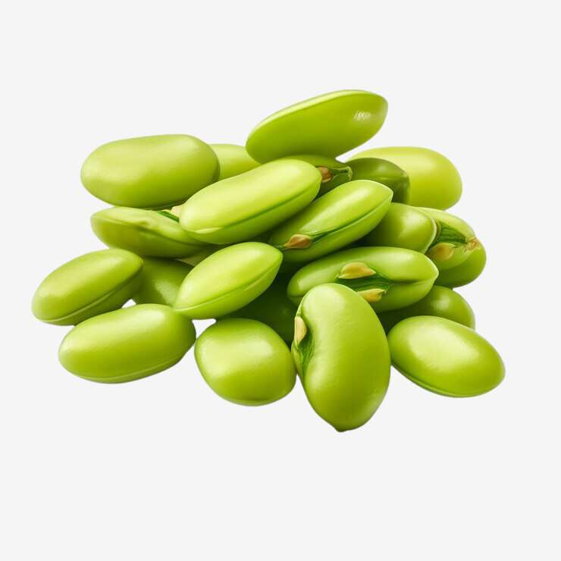







KEY PLAYERS

Slide 9


For Full Report
Contact us
COGNITIVE MARKET RESEARCH
Tel: +1 312-376-8303 | +44 020-8123-0732
India: (+91) 983-496-8611
sales@cognitivemarketresearch.com
Access the Full Report : https://tinyurl.com/yc2bzx5c
Please visit our website:
https://www.cognitivemarketresearch.com

