Slide 1
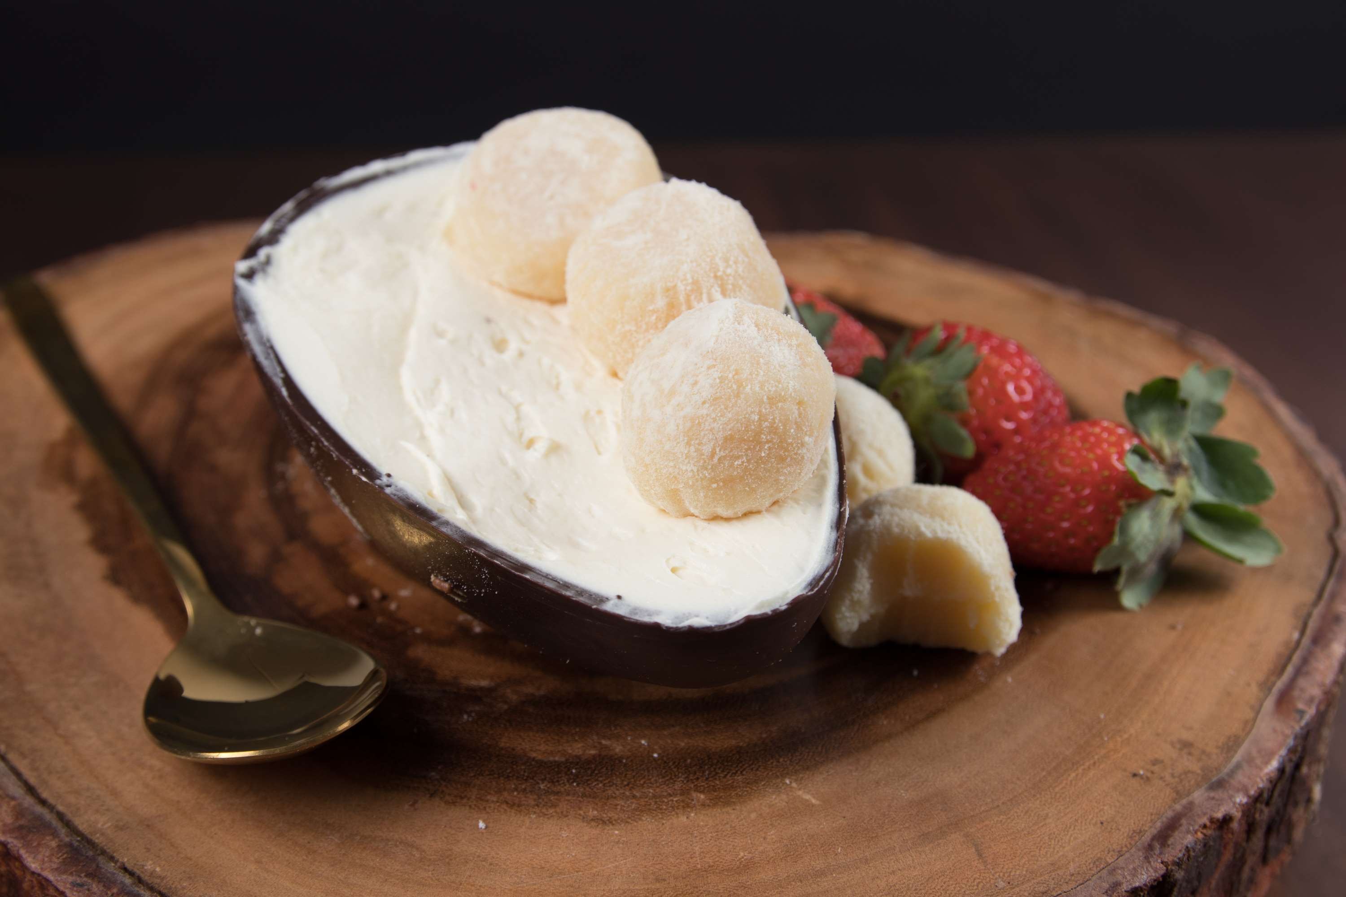
GLOBAL
FAT FILLED MILK POWDERS
MARKET REPORT
2024
Global,Regional,CountryAnalysis

Slide 2
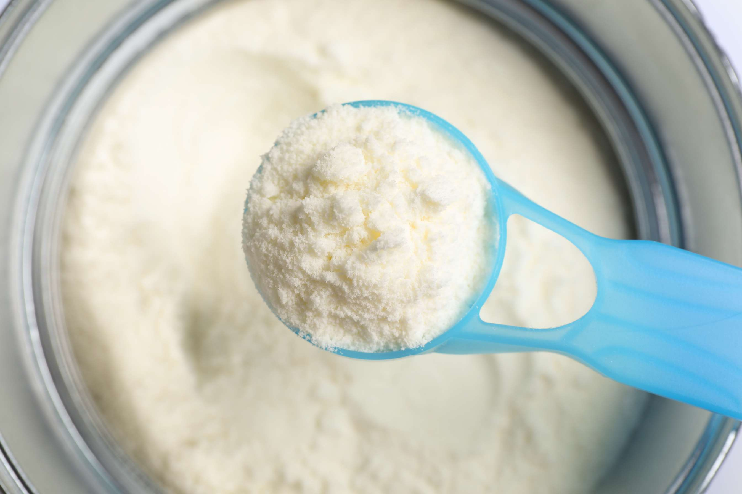
INTRODUCTION
Fat-filled milk powders are dairy products that contain milk solids combined with vegetable fats. These powders are created by blending skimmed milk powder with vegetable oils or fats such as palm oil, coconut oil, or others. The purpose of fat-filled milk powders is to provide an economical alternative to whole milk powder while maintaining similar functional properties. They are widely used in various food applications such as bakery, confectionery, beverage mixes, and dairy products. Fat-filled milk powders offer benefits such as enhanced creaminess, improved solubility, extended shelf life, and cost-effectiveness. They are a versatile ingredient in the food industry, catering to diverse consumer needs.

Slide 3
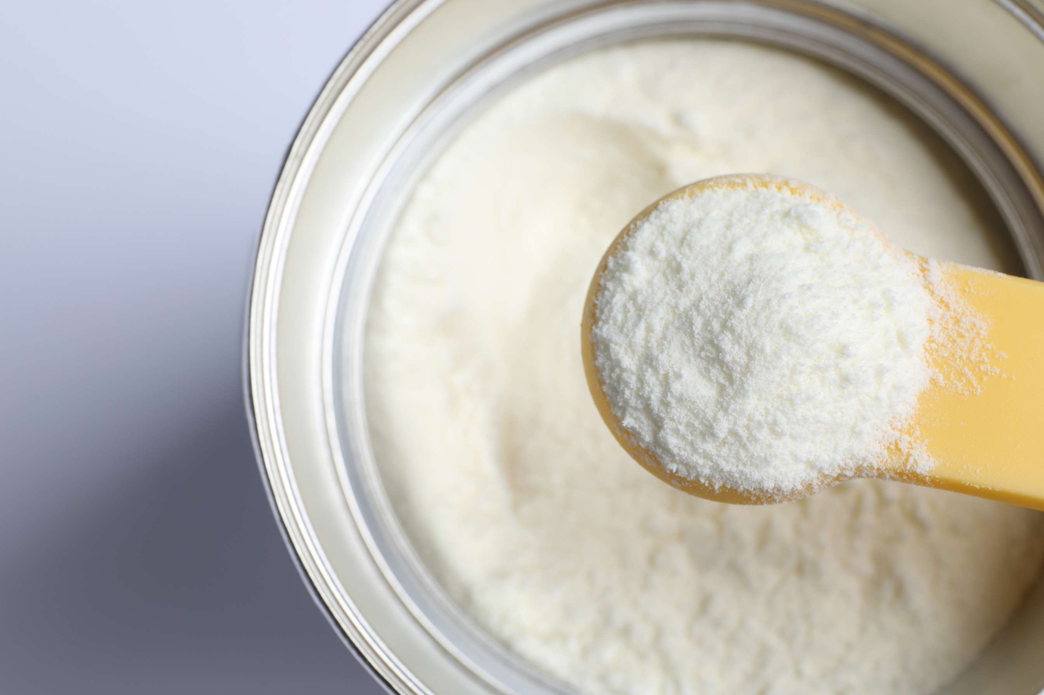

KEY INSIGHTS
MARKET SIZE
USD 5142.2 million
2024
CAGR
6.20%
2024- 2031

Slide 4
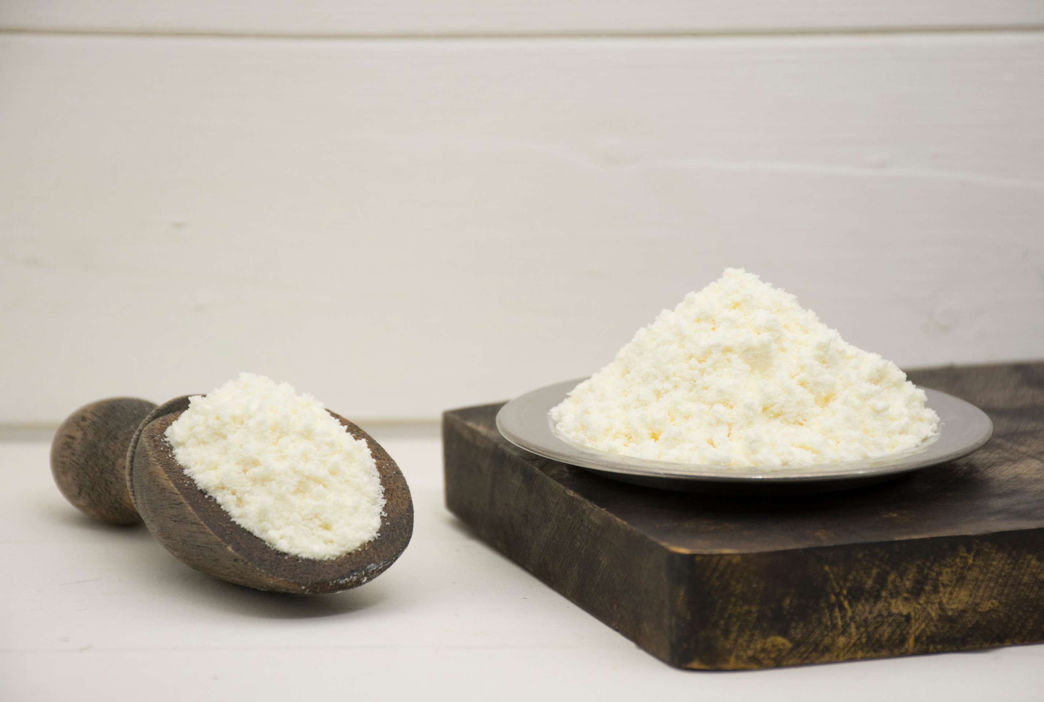
REVENUE MARKET SHARE BY SEGMENTS 2022
  Fat Filled Milk Powder 26%
  Fat Filled Milk Powder 28%
  Online
  Offline
Distribution Channel
Type Segment
  Dairy products
  Bakery products
  Confectionaries
  Chocolates
  Ice Cream
  Pouches
  Sachets
  Tin Cans
Packaging Segment
End-Use Segment

Slide 5
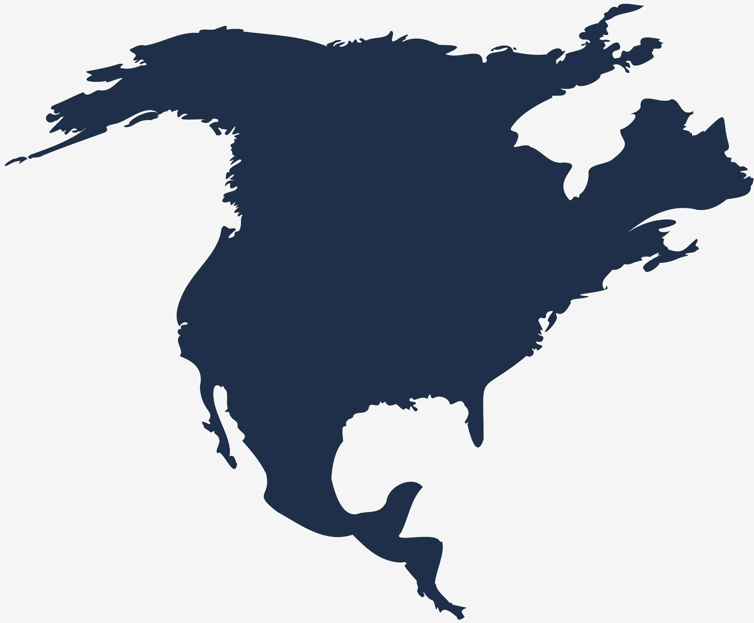
Global Fat filled Milk Powders Market Revenue share for 2024
North America
40%

Slide 6
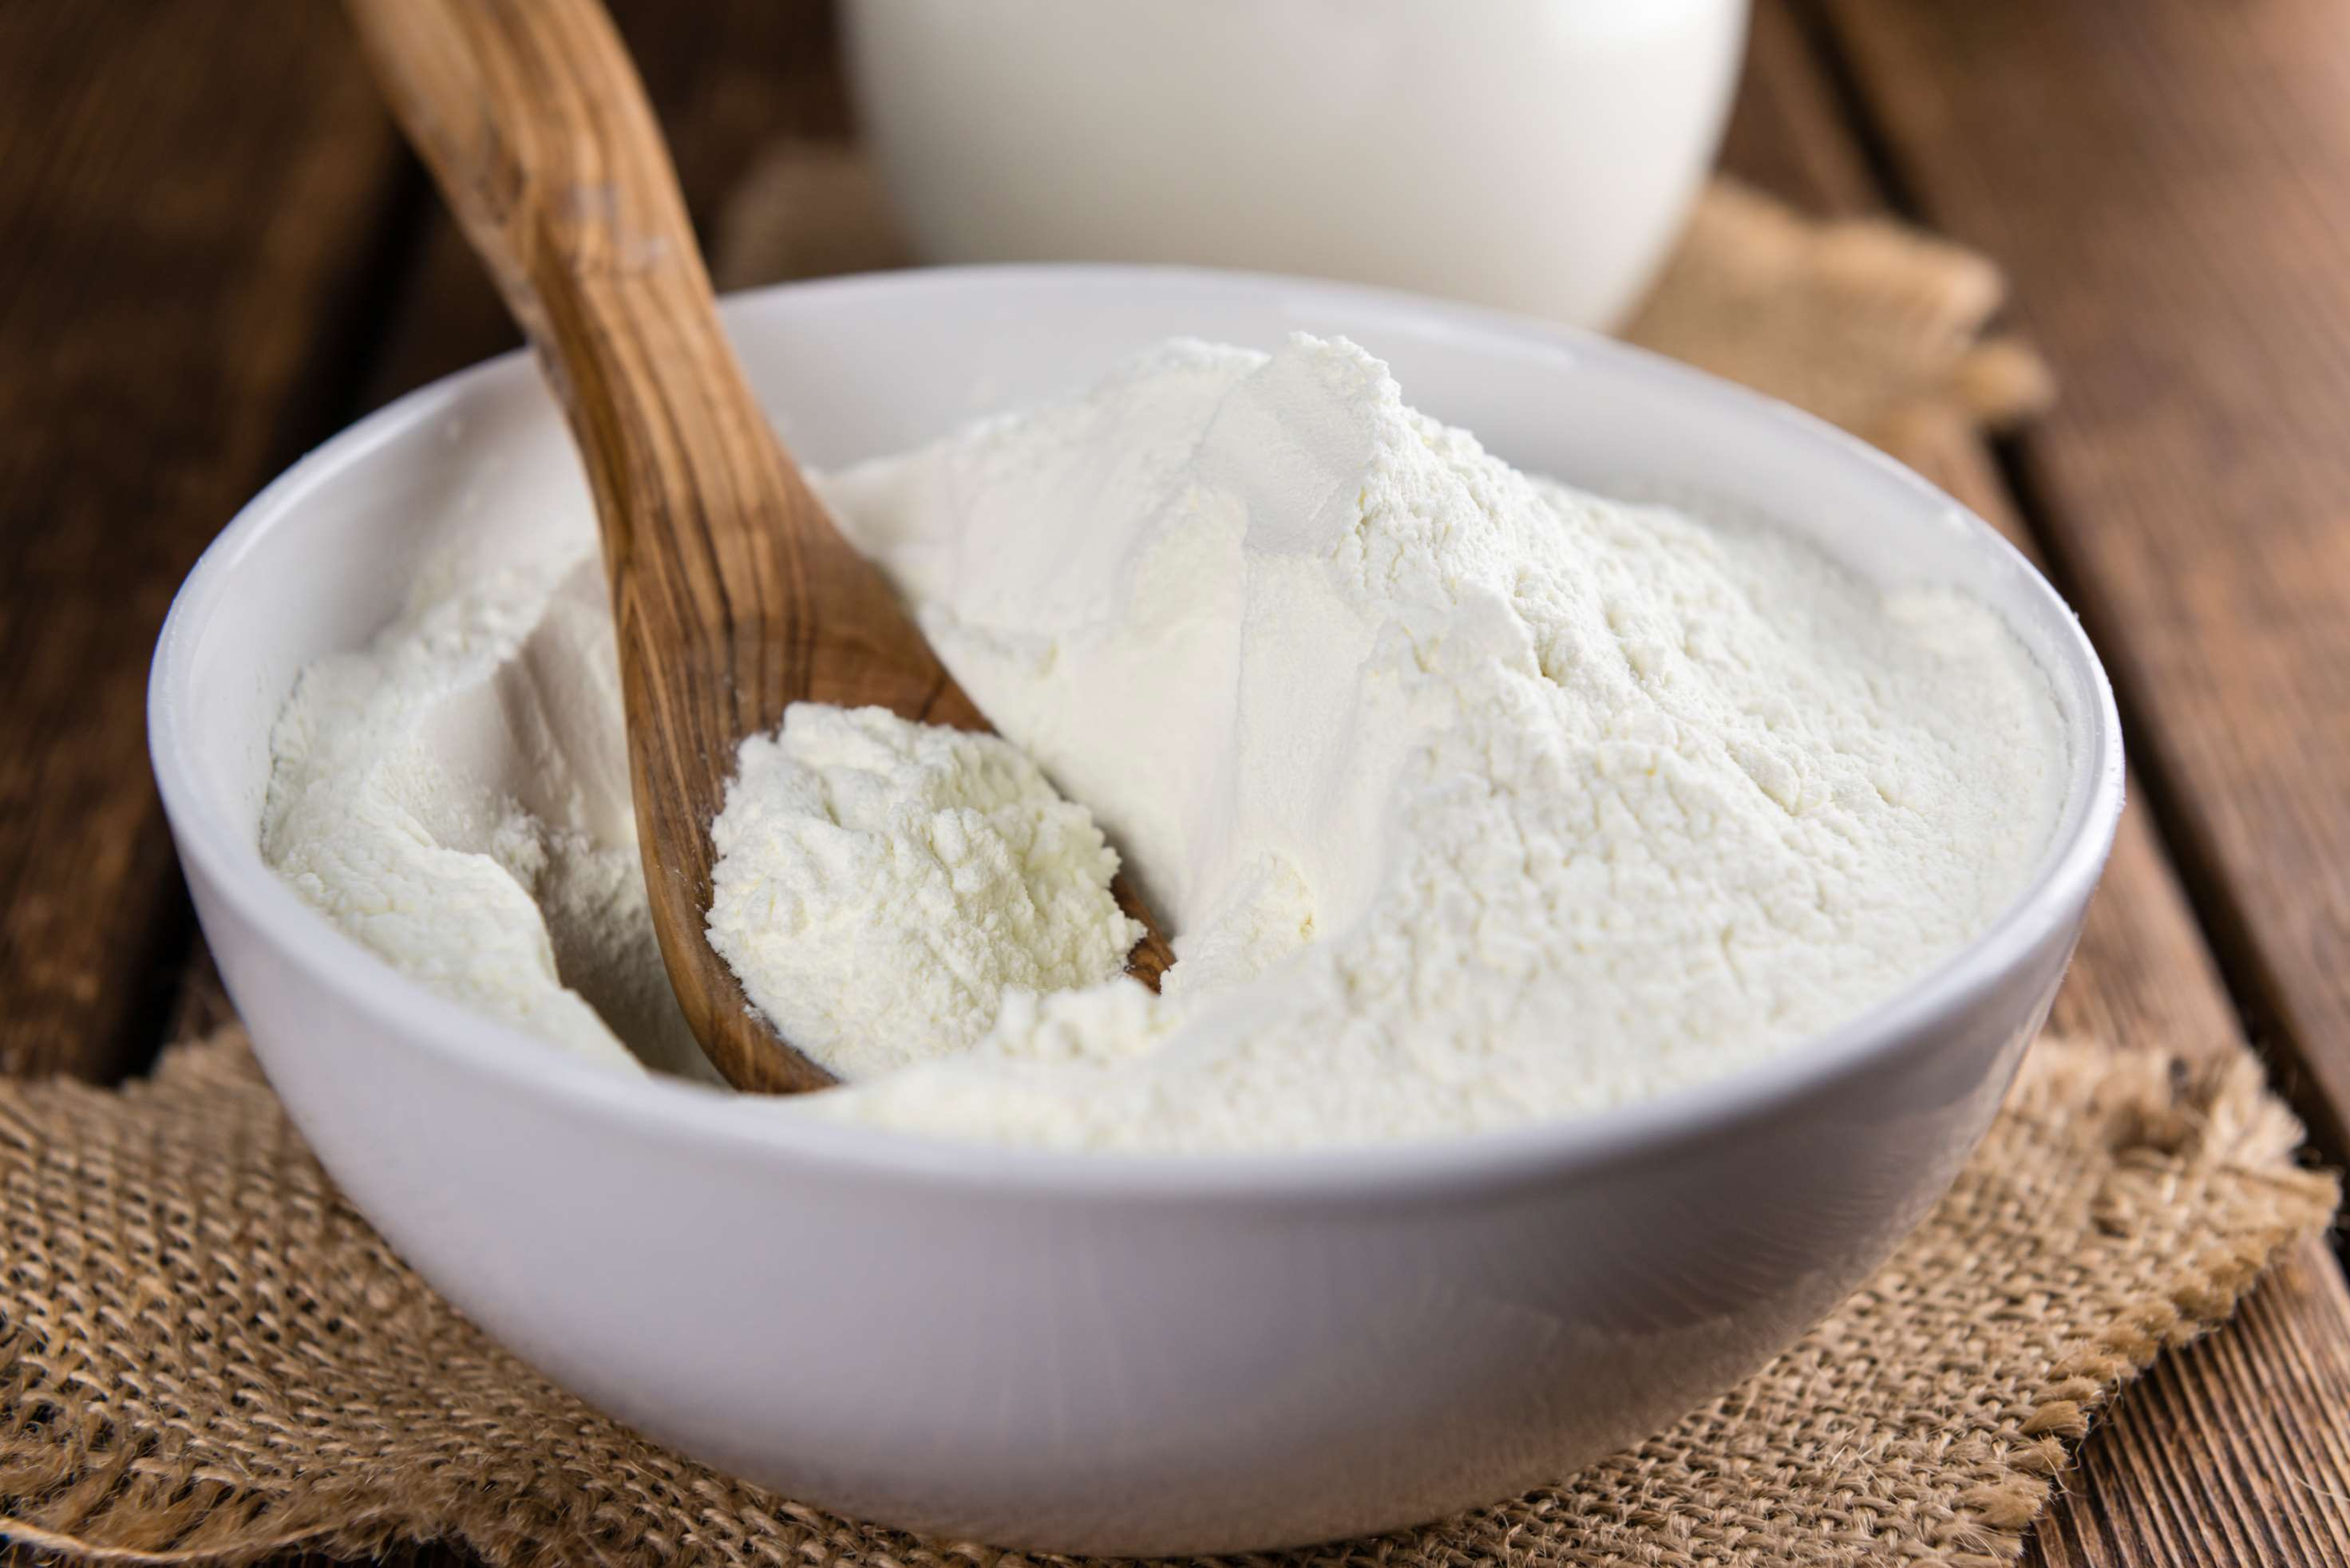
Change in Consumer Preferences to Drive the Global Demand
Drivers
Increasing Awareness of the Potential Health Risks to Impact the Sales
Restraints

Slide 7
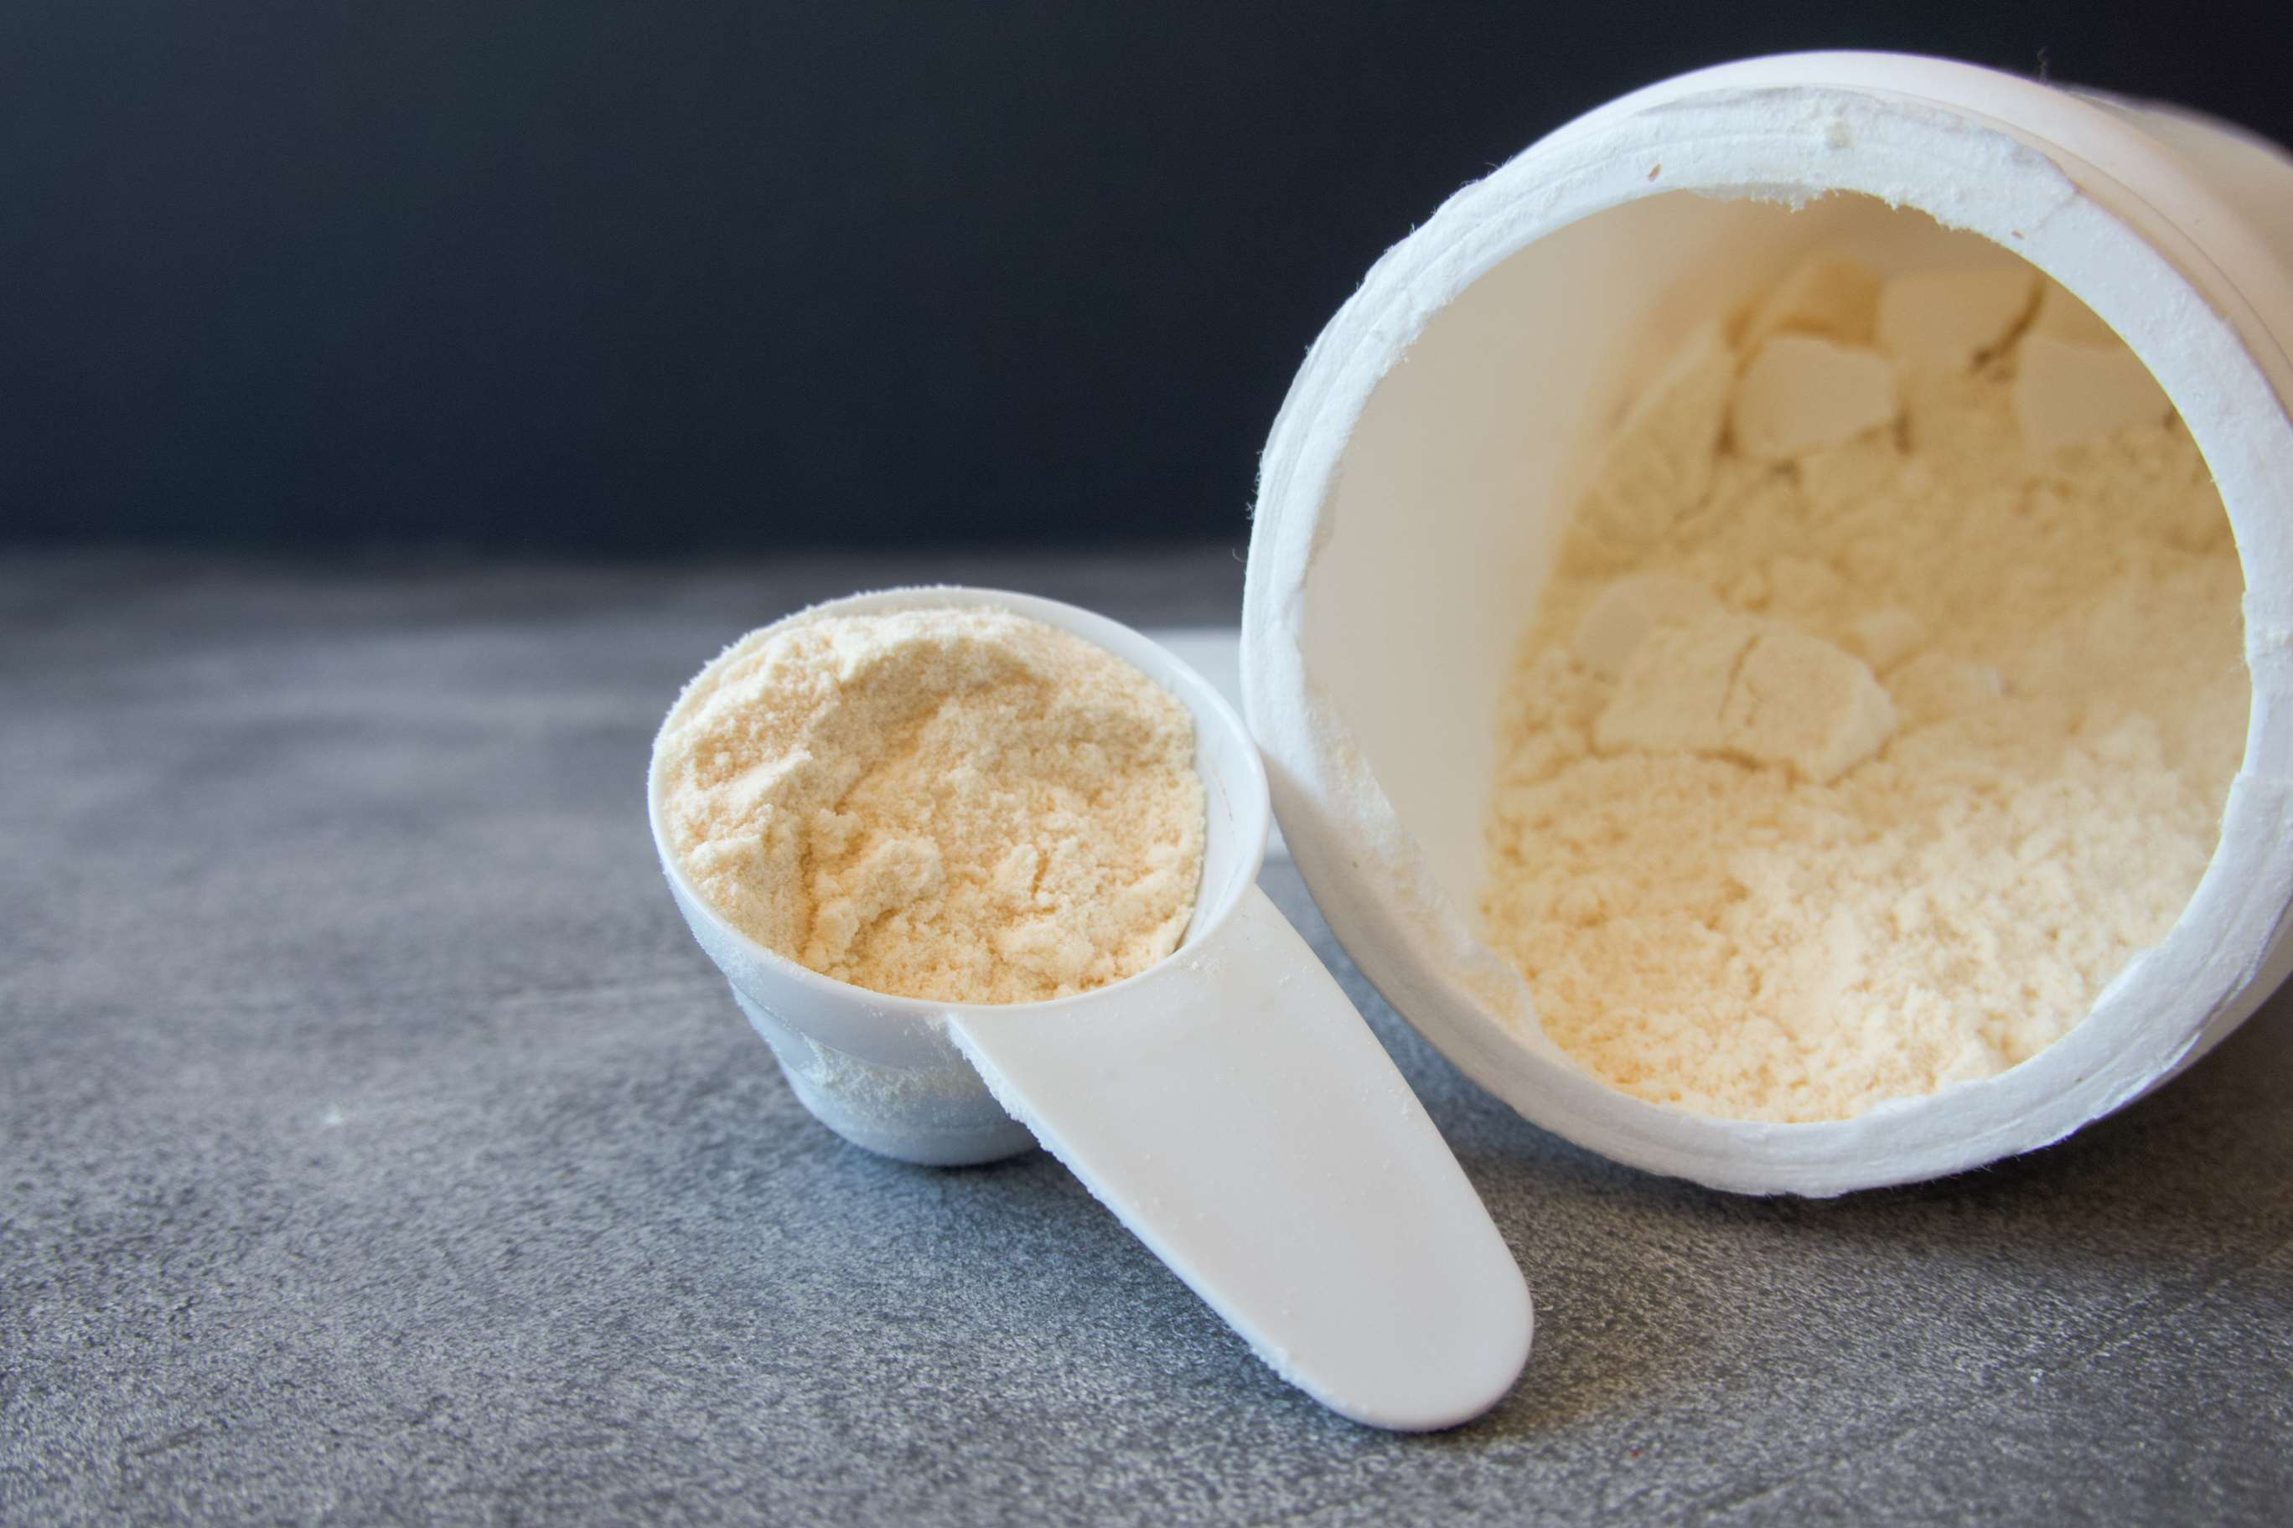
AUTHOR'S PERSPECTIVE
  The global fat filled milk powders market will expand significantly by 6.20% CAGR between 2024 to 2031.
  Sachets are the fastest-growing category over the forecast period owing to their convenience and portion-controlled packaging, catering to on-the-go consumers.
  The sales of fat filled milk powder 28% are expected to increase due to its higher fat content, which enhances creaminess and flavour, making it a preferred choice for various food applications.
  The sales of tin cans are likely to increase due to their durability and suitability for long-term storage, providing convenience and preserving the quality of fat-filled milk powder products.

Slide 8
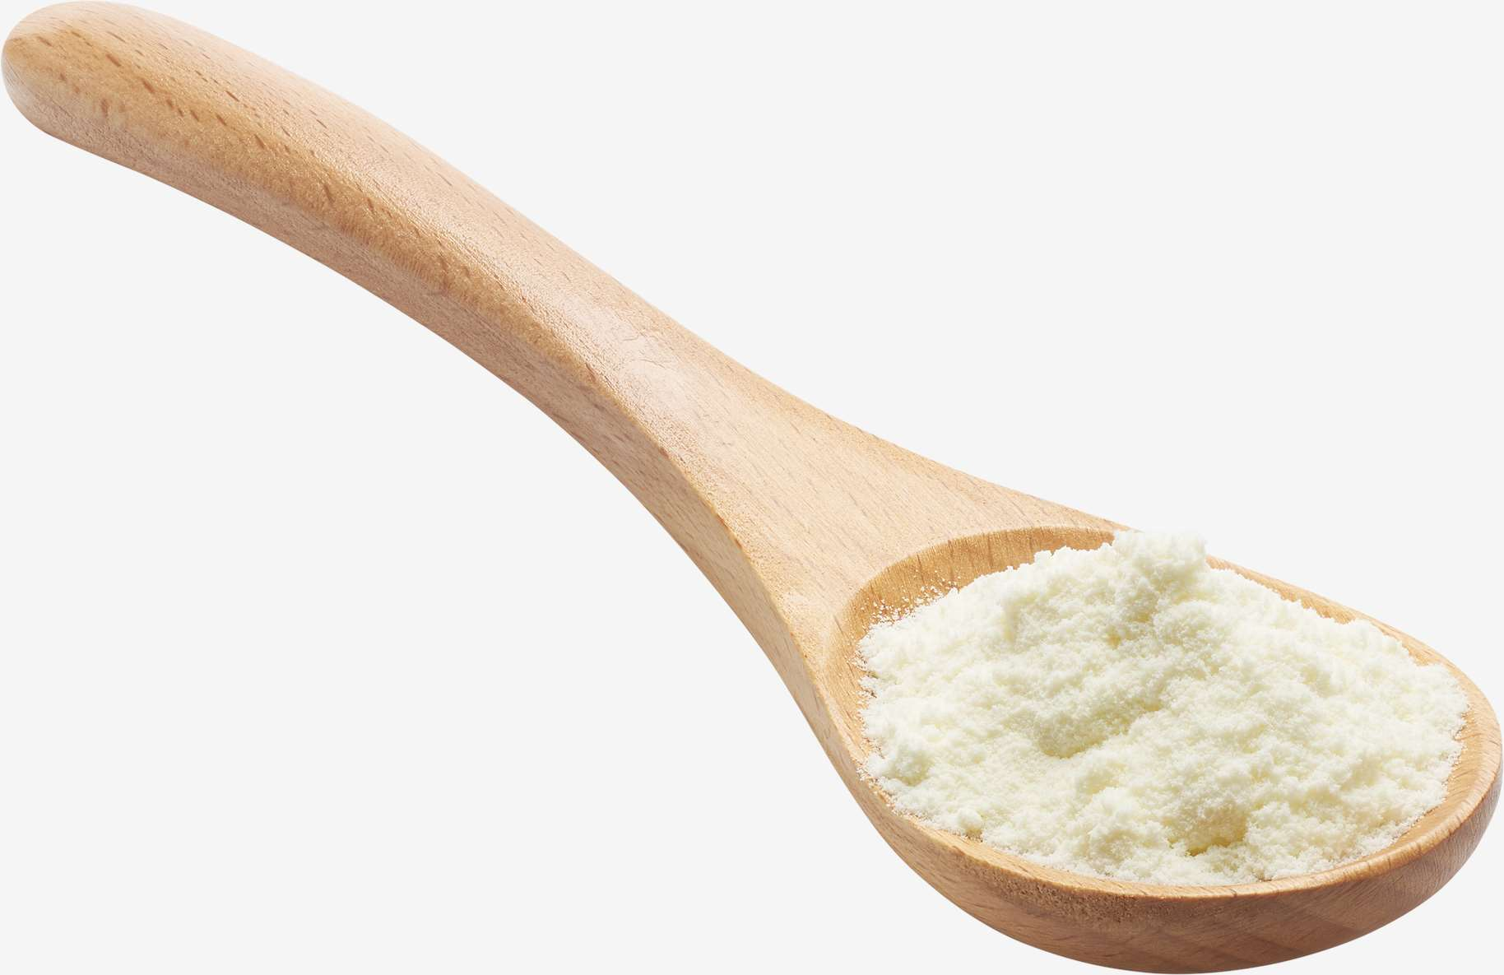
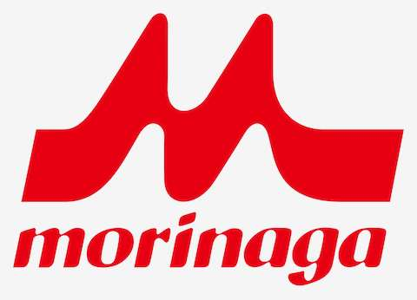









KEY PLAYERS

Slide 9


For Full Report
Contact us
COGNITIVE MARKET RESEARCH
Tel: +1 312-376-8303 | +44 020-8123-0732
India: (+91) 983-496-8611
sales@cognitivemarketresearch.com
Access the Full Report : https://tinyurl.com/bcp7zneb
Please visit our website:
https://www.cognitivemarketresearch.com

