Slide 1



FASHION DESIGN SOFTWARE
MARKET REPORT
2024
Qualitative Analysis + Quantitative Analysis

Slide 2
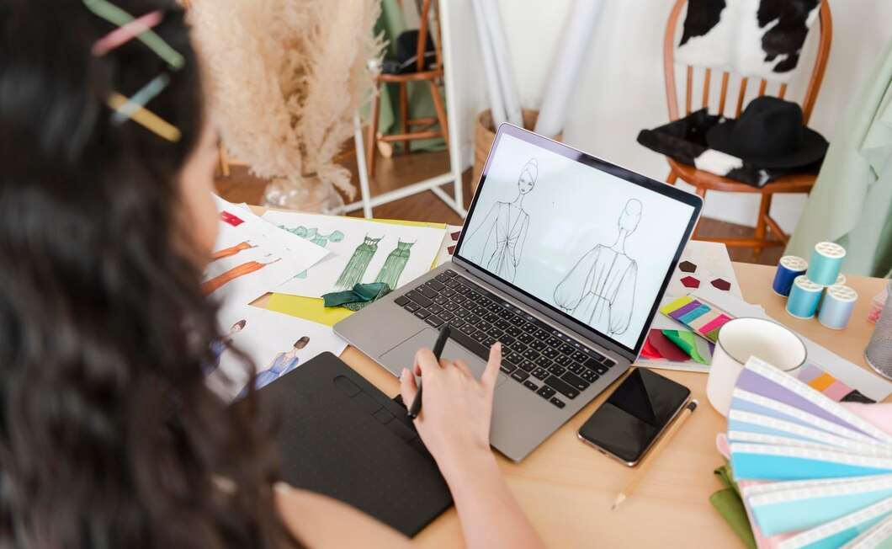
INTRODUCTION
Computer programs or applications created expressly to help fashion designers create, design, and visualize their garment creations are referred to as fashion design software. With the help of these software tools, the design process may be streamlined from the initial concept sketching to the production of comprehensive technical drawings and even the simulation of how clothing would appear when worn. The Fashion Design Software market is being driven by different variables including growing collaboration, technological advancements, growing number of initiatives and programs, rising investment in 3D software and many others.

Slide 3


KEY INSIGHTS
MARKET SIZE
USD 2251.2 million
2024
CAGR
9.00%
2024- 2031

Slide 4

REVENUE MARKET SHARE BY SEGMENTS 2024
  Enterprises
  Individuals
  Institutions
  Subscription
  Licensing
End User Segment
Deployment Model Segment
  Cloud based
  On premise
  Large Enterprise
  SMB
Product Type Segment
Enterprise Size Segment

Slide 5
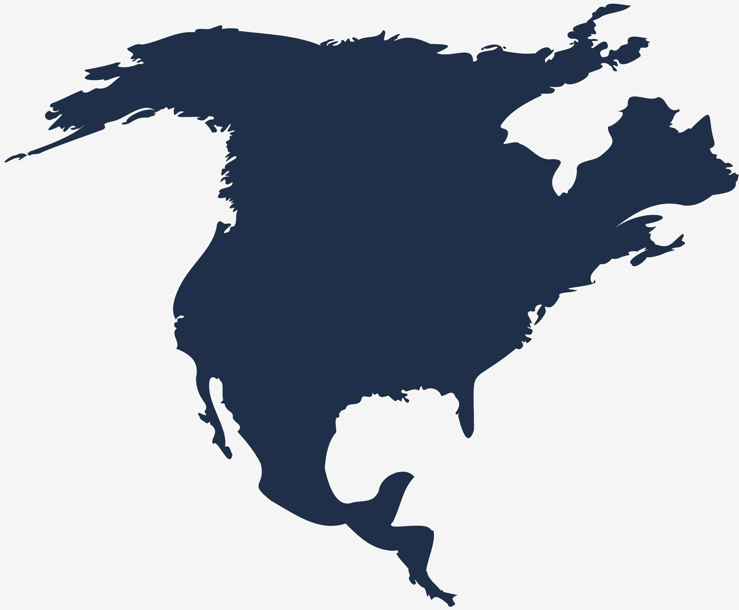
North America
40%
North America Fashion Design Software Market Revenue share for 2024 is 40%

Slide 6

  Rise of 3D Design and Virtual Prototyping to Propel the Market Revenue Growth
  Growing Number of Program and Campaign to Boost Market Growth
Drivers
High Initial Investment to Limit the Market Growth
Restraints

Slide 7

AUTHOR'S PERSPECTIVE
  The global Fashion Design Software market will expand significantly by 9.00% CAGR between 2024 to 2031.
  The dominating category is On premise.
  On premise product type offer more security as compared to its counterpart.
  The dominating category is Large Enterprise.
  To meet their own workflows, procedures, and branding needs, large businesses frequently look for customization possibilities in fashion design software.

Slide 8










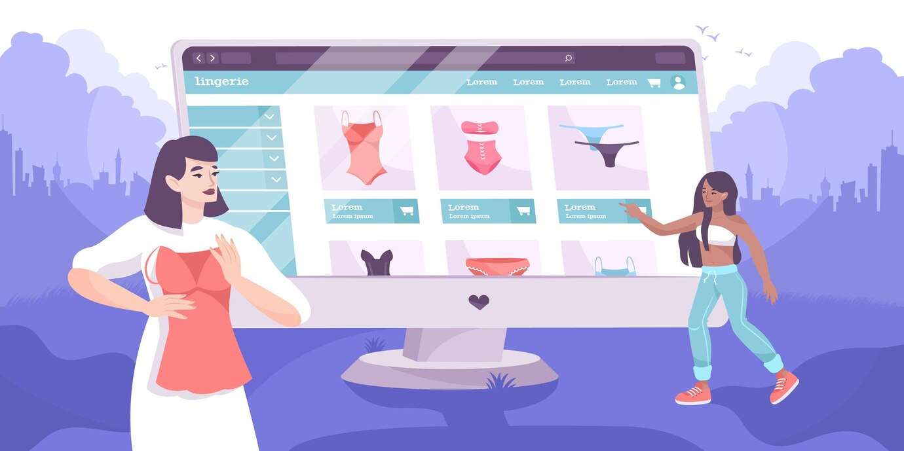
KEY PLAYERS

Slide 9


For Full Report
Contact us
COGNITIVE MARKET RESEARCH
Tel: +1 312-376-8303 | +44 020-8123-0732
India: (+91) 983-496-8611
sales@cognitivemarketresearch.com
Access the Full Report : https://tinyurl.com/mpw6pfe4
Please visit our website:
https://www.cognitivemarketresearch.com

