Slide 1


FACIAL SERUM
MARKET REPORT
2024
Qualitative Analysis + Quantitative Analysis

Slide 2

INTRODUCTION
The facial serum market encompasses quite a number of skin care merchandise formulated with concentrated active components to address unique pores and skin issues. These lightweight, rapid-soaking formulations are designed to penetrate deeper layers of the skin, handing over strong advantages consisting of hydration, brightening, anti-growing old, or pimples remedy. With a focal point on efficacy and precision, facial serums cater to diverse skincare needs, providing solutions for problems like wrinkles, hyperpigmentation, or dryness. The market increase is fueled by way of growing patron cognizance of skincare substances, increasing call for personalized splendor answers, and advancements in the cosmetic era. Key gamers in the industry constantly innovate to fulfill evolving purchaser options, riding product development, and market expansion globally.

Slide 3


KEY INSIGHTS
MARKET SIZE
USD 5691.2 million
2024
CAGR
7.00%
2024- 2031

Slide 4
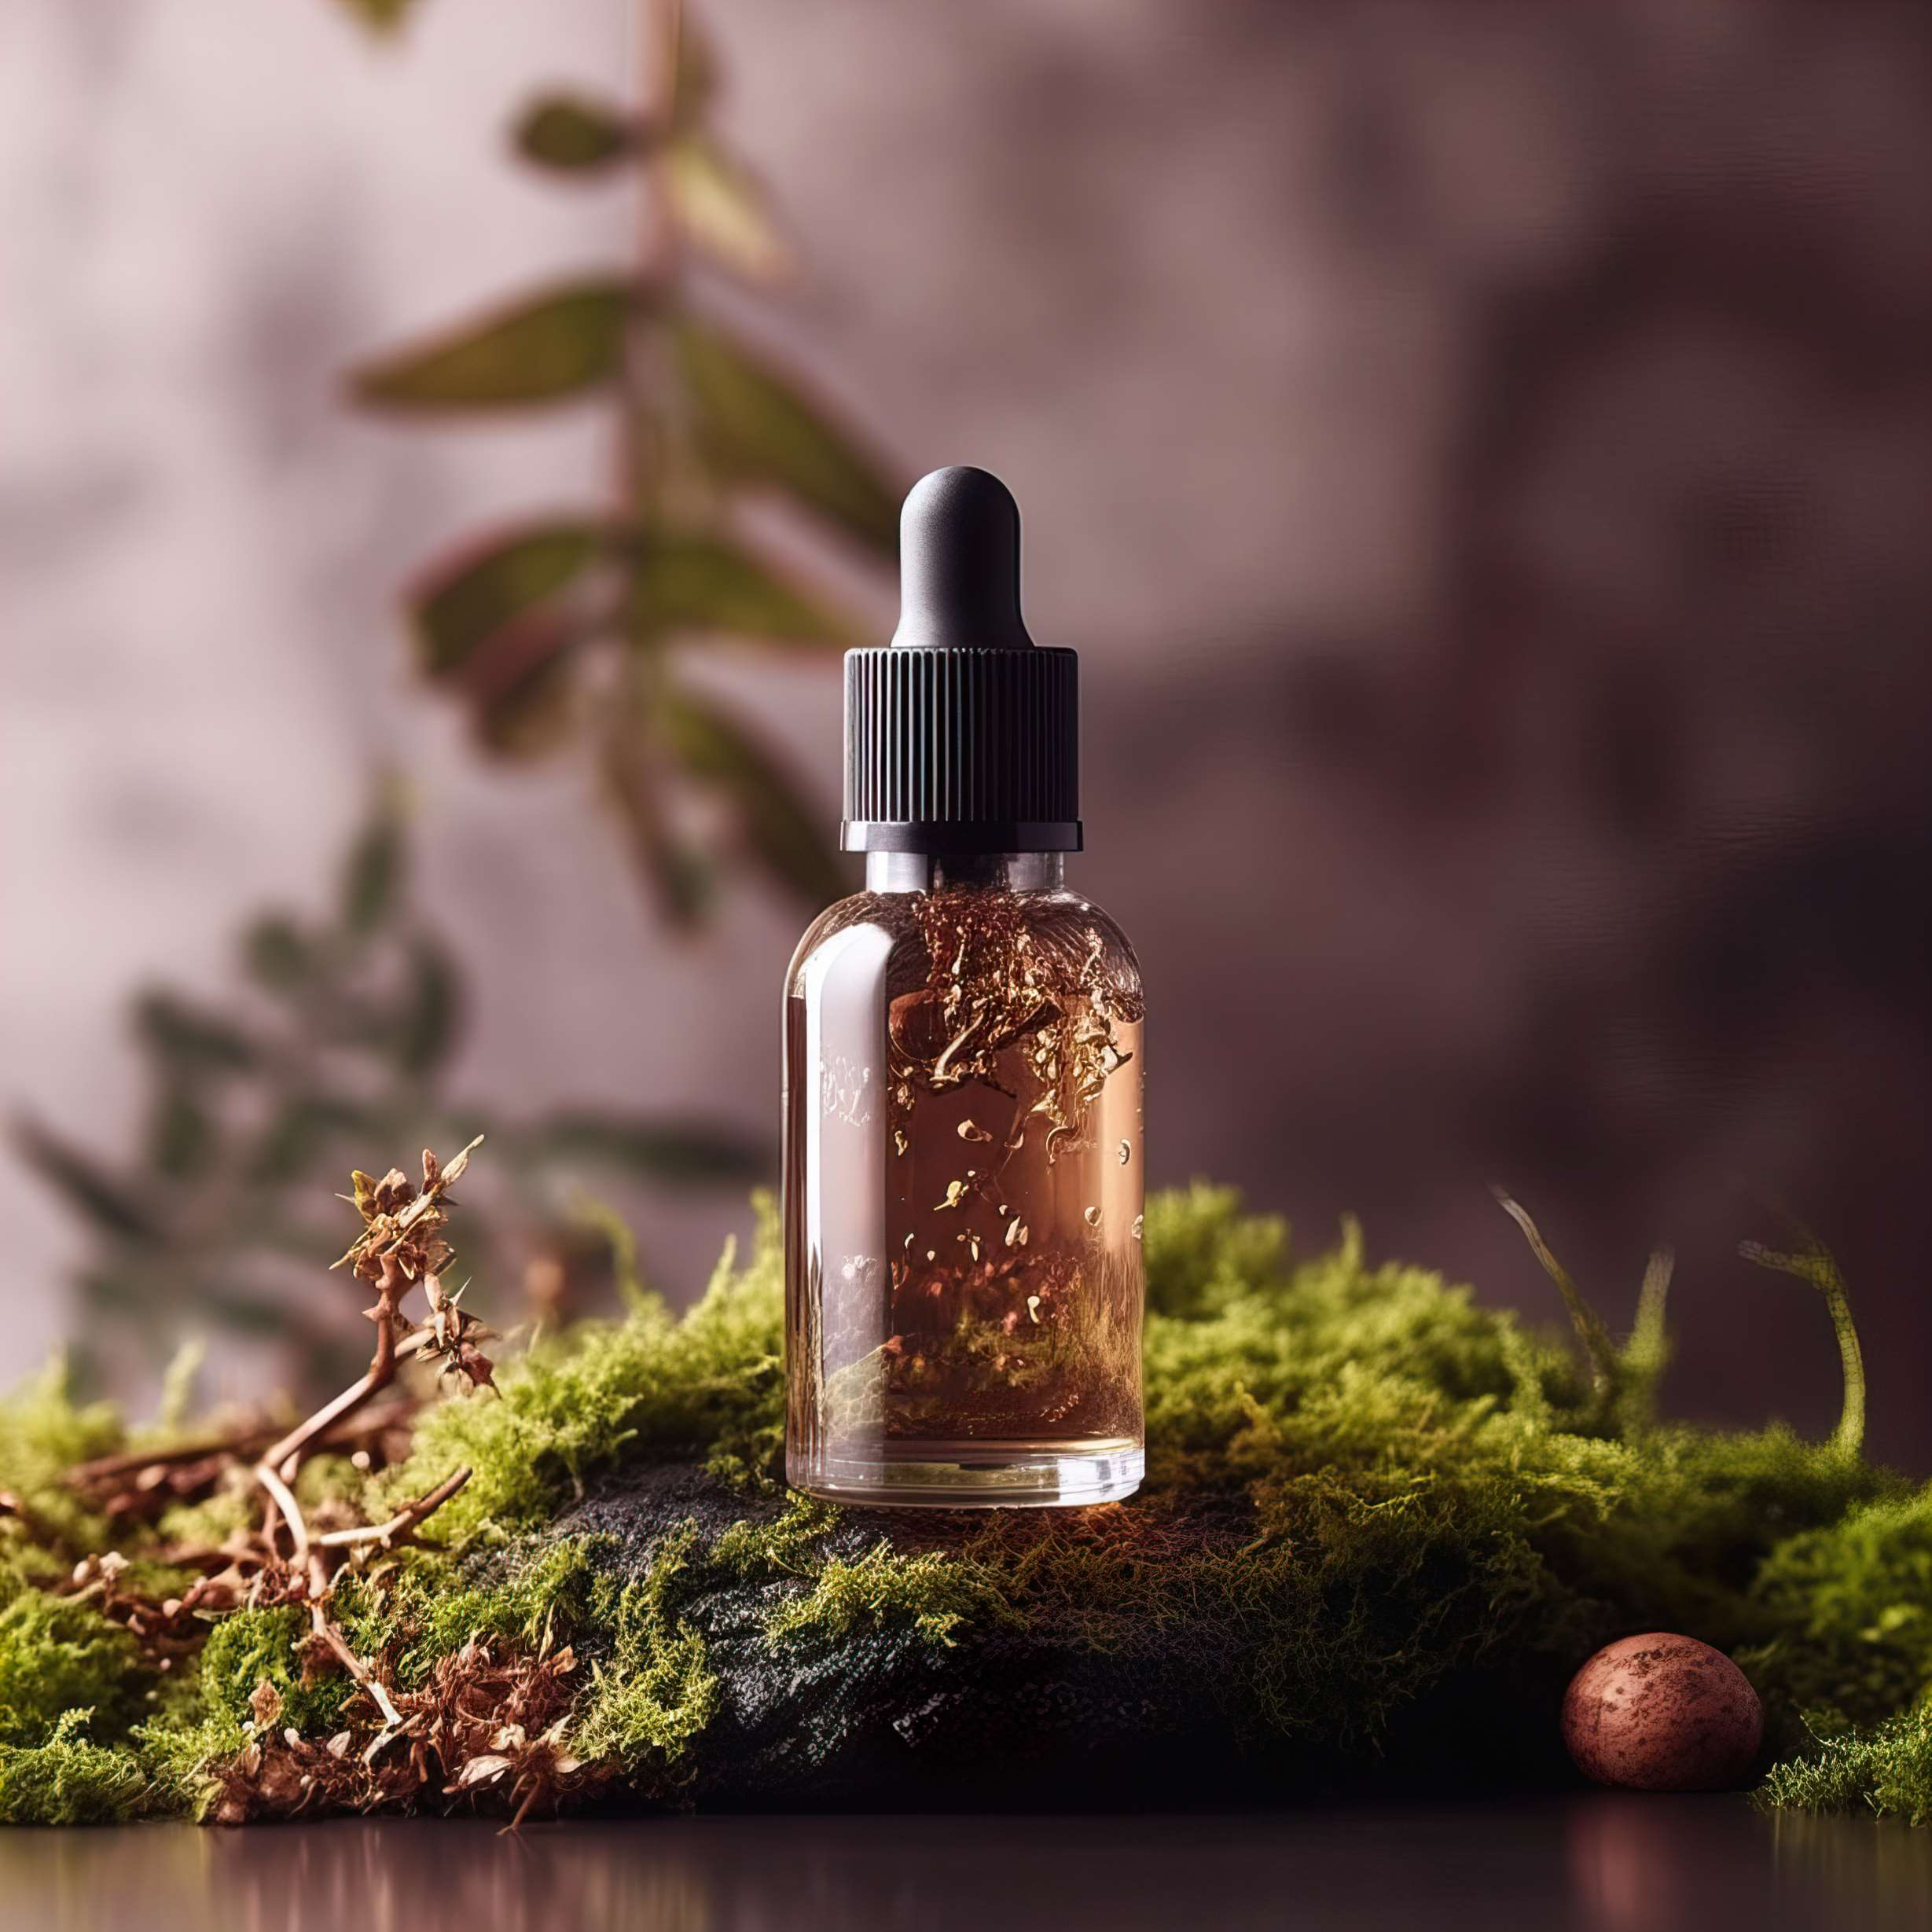
REVENUE MARKET SHARE BY SEGMENTS 2024
  Face Moisturizing Serums stands out as the dominating category. The section of face moisturizing serums is experiencing a robust boom inside the facial serum marketplace.
  Blemish and Acne Treatment Serums emerges as the fastest-growing category in the Facial Serum market.
Type Segment
  The Dominating category is Oil Based. The oil-primarily based facial serum phase is experiencing a super boom inside the marketplace.
  The fastest-growing category in the Facial Serum market is Gel Based. The gel-based facial serum segment is witnessing a large increase in the marketplace.
Form Segment

Slide 5
REVENUE MARKET SHARE BY SEGMENTS 2024
  Mass-Market
  Premium
  Luxury
Price Point Segment
  Supermarkets & Hypermarkets
  Drugstores & Pharmacies
  Specialty Beauty Stores
  Online Retailers
Distributional Channel

Slide 6

REGION ANALYSIS
NORTH AMERICA
Europe
Asia Pacific
Latin America
MIDDLE EAST AFRICA
USD 2276.48 million
USD 1707.36 million
USD 1308.98 million
USD 284.56 million
USD 113.82 million

Slide 7
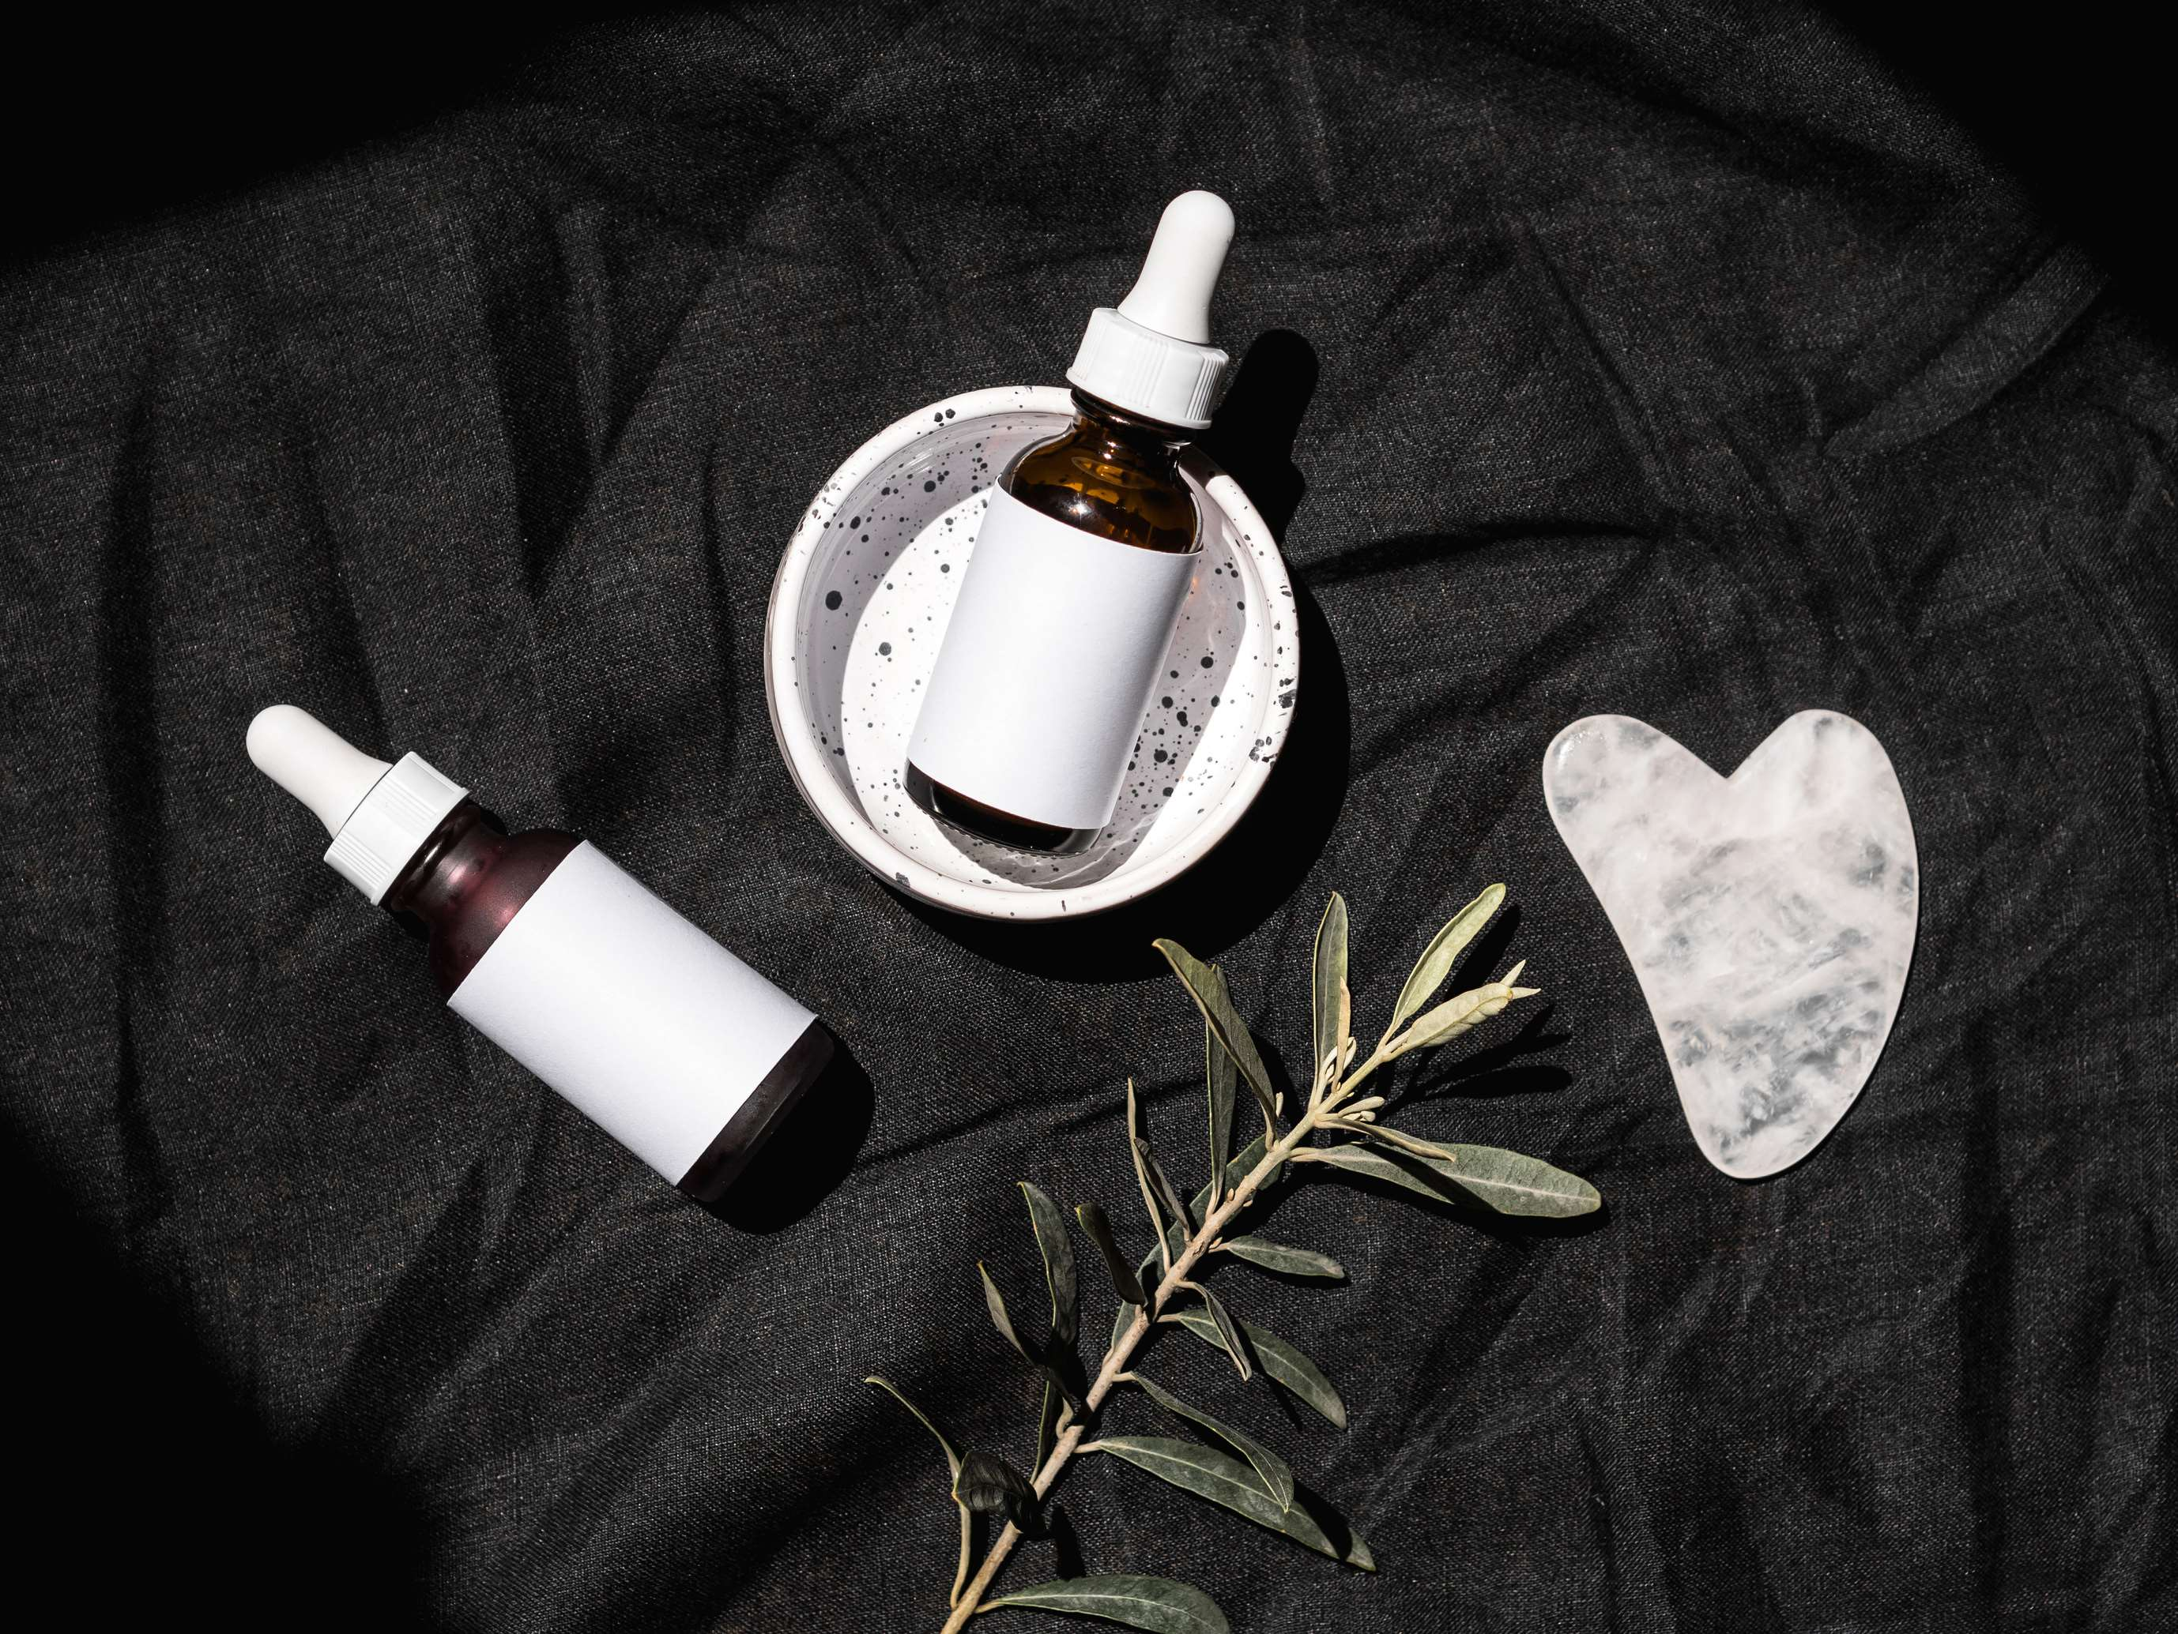
  Rising demand for anti-aging solutions to Increase the Demand Globally
  Growing awareness of skincare ingredients to Propel Market Growth
Drivers
High Initial Investment Cost to Limit the Sales
Restraints

Slide 8
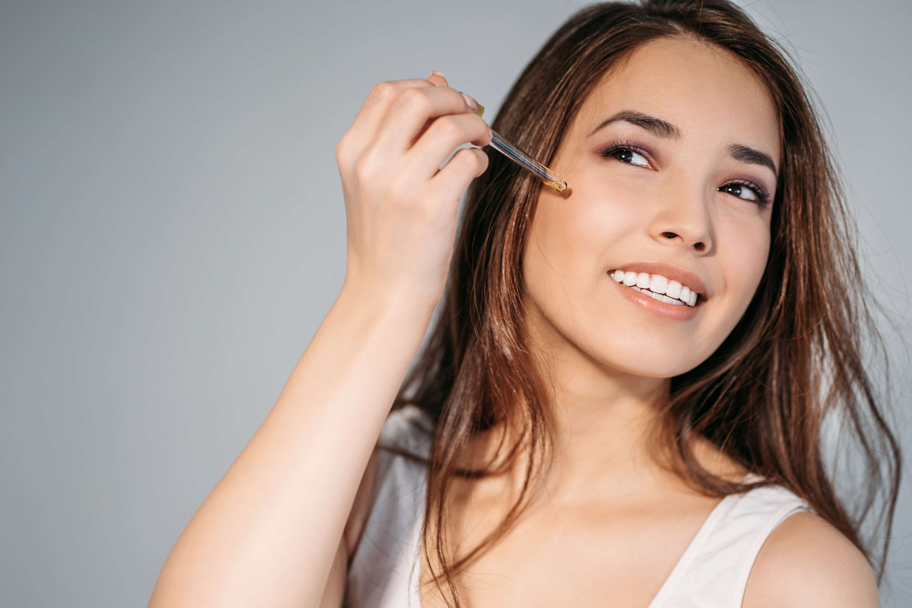
AUTHOR'S PERSPECTIVE
  The global Facial Serum market will expand significantly by 7.00% CAGR between 2024 to 2031.
  There is a shift toward preventative skincare regimes.
  Facial serums, with their light textures and capacity to penetrate deeper layers of the skin, are regarded as useful instruments for maintaining healthy, youthful skin.
  Rising disposable incomes enable customers, particularly in developing nations, to invest in high-end skincare products such as face serums.

Slide 9

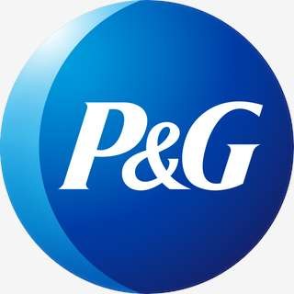
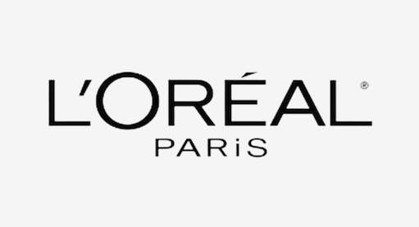

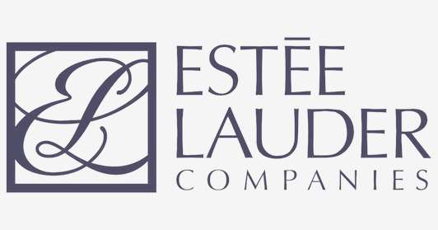

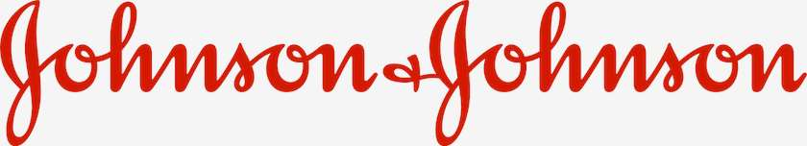


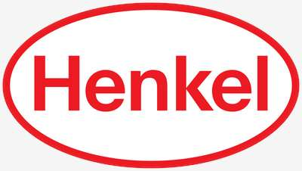

KEY PLAYERS

Slide 10


For Full Report
Contact us
COGNITIVE MARKET RESEARCH
Tel: +1 312-376-8303 | +44 020-8123-0732
India: (+91) 983-496-8611
sales@cognitivemarketresearch.com
Access the Full Report : https://tinyurl.com/48w2ztp5
Please visit our website:
https://www.cognitivemarketresearch.com

