Slide 1





Global,Regional,CountryAnalysis

Slide 2

INTRODUCTION
The expansion of the evening dresses industry's size can be attributed to growing investments in R&D activities, the entry of new players, product innovation, technological advancements, efficient resource allocation, and increasing competition among business rivals to increase their regional as well as customer bases.

Slide 3
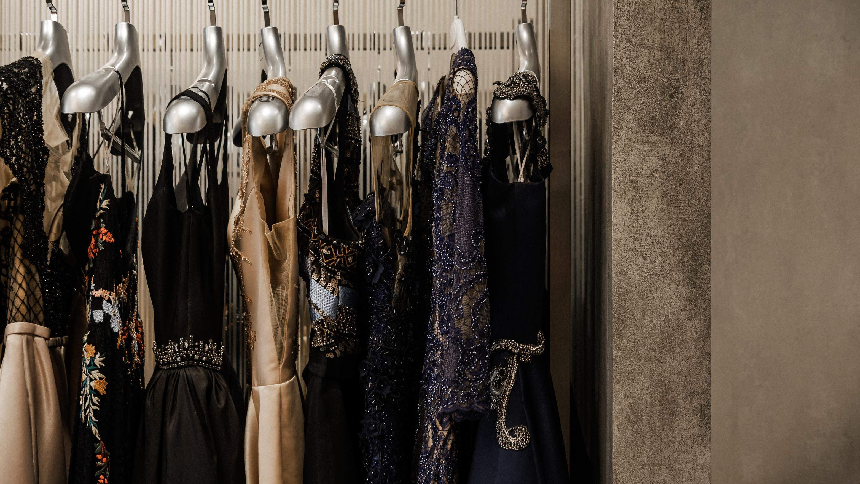

KEY INSIGHTS
MARKET SIZE
USD 1.8 billion
2023
20₋23
CAGR 3.90%
2030

Slide 4
REVENUE MARKET SHARE BY SEGMENTS 2022
Silk Dress
Chiffon Dress
Velvet Dress
Satin Dress
Organza Dress
Type Segment
Application Segment
Wedding
Parties

Slide 5
Global Evening Dress Market Revenue share for 2022
North America 40 %

Slide 6
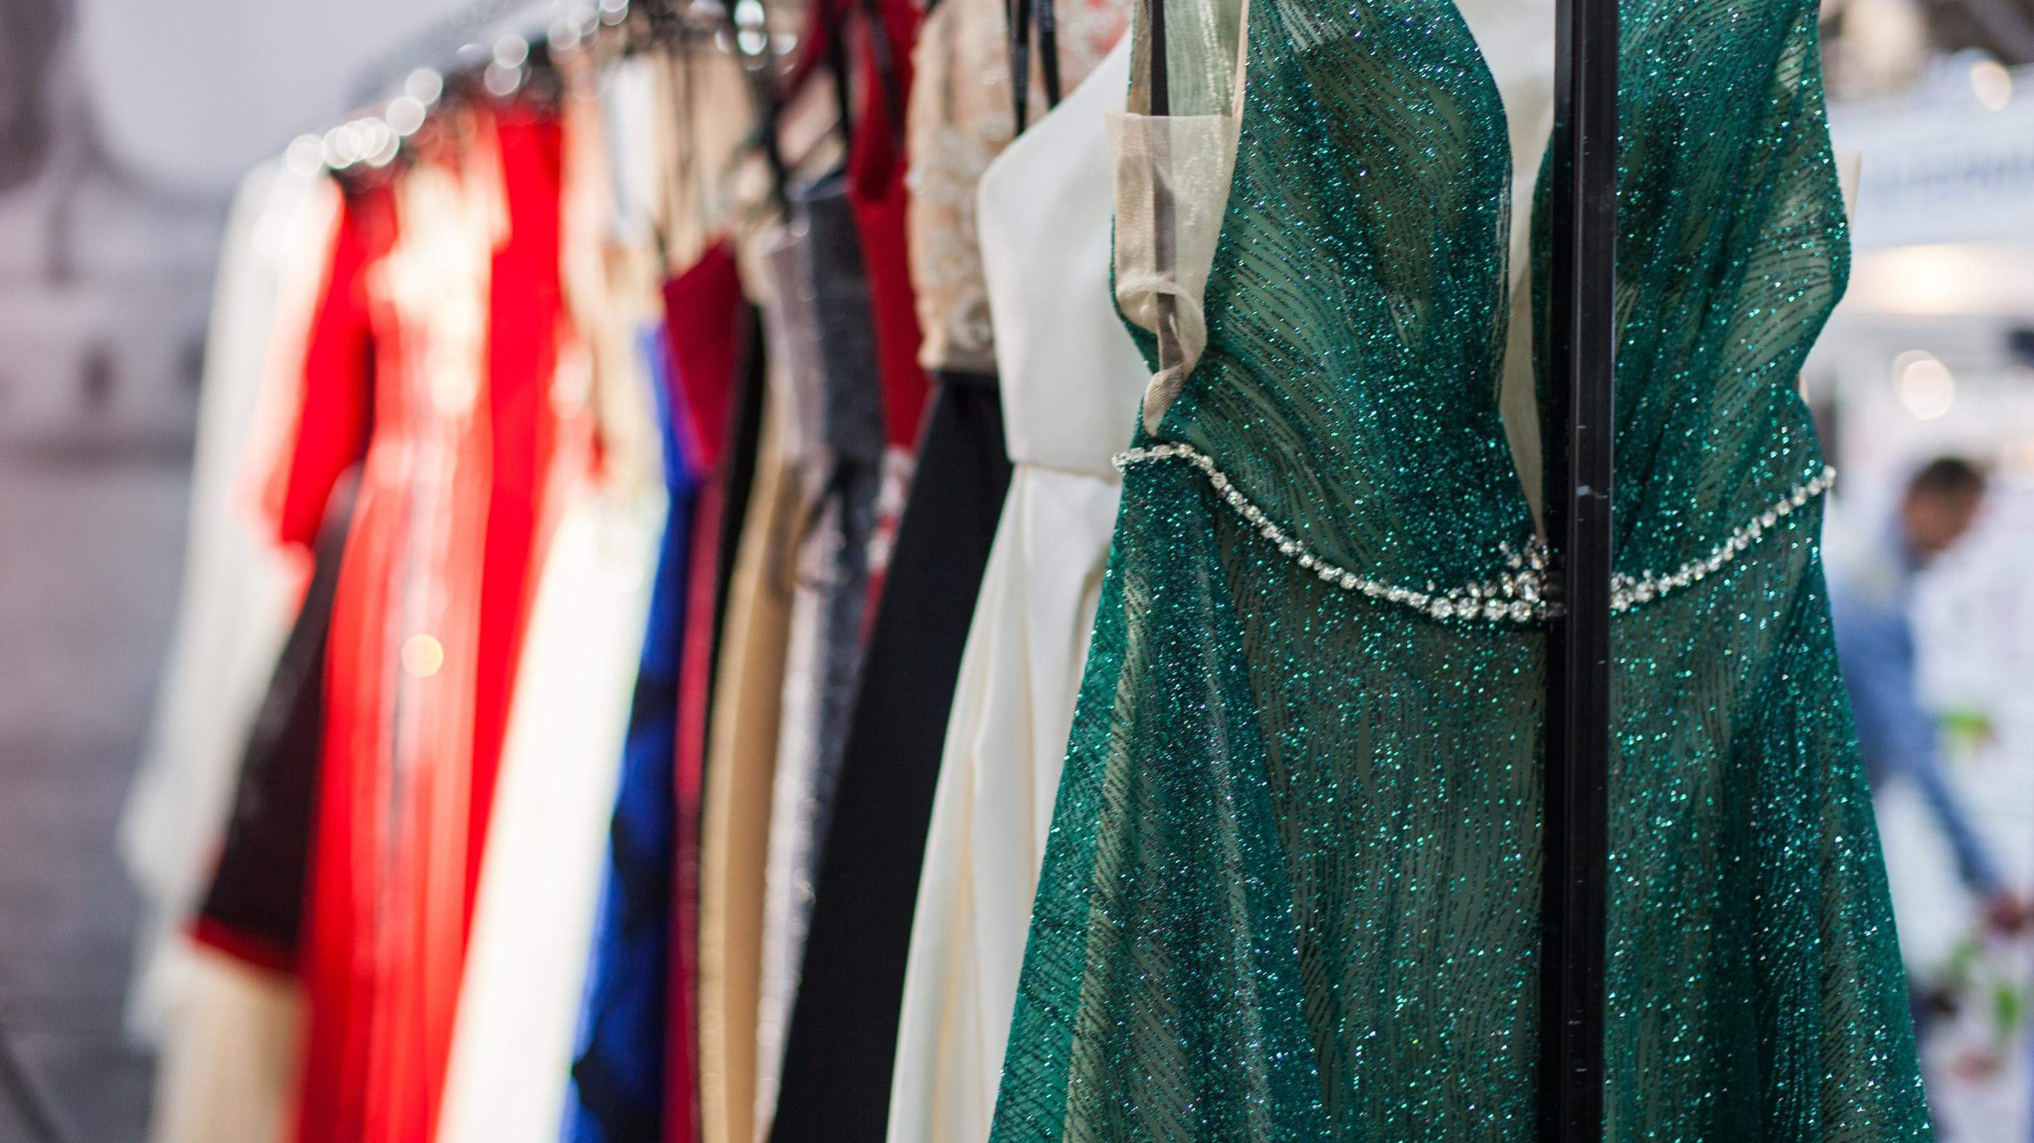



Slide 7


AUTHOR'S PERSPECTIVE
The Global Evening Dress Market is witnessing significant growth in the near future.
The evening dress business, which is continually growing and altering in terms of supply and demand, includes silk as a significant element.
Evening dresses are worn to formal events, including weddings, receptions, and festive gatherings.
The need for speedier surfing has increased connectivity, which has sped up the development of 4G and 5G technology. Additionally, the popularity of smartphones is growing quickly, boosting the customer's exposure to online buying.

Slide 8


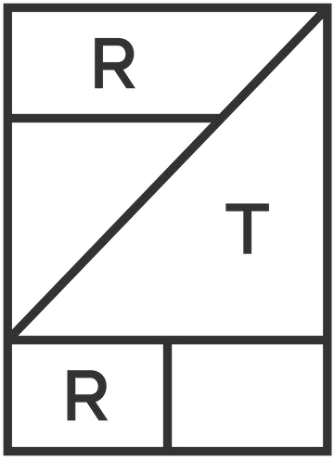










KEY PLAYERS

Slide 9


Contact us
For Full Report
COGNITIVE MARKET RESEARCH
Tel: + 1 312 - 376 - 8303 | + 44 020 - 8123 - 0732
India: ( + 91 ) 983 - 496 - 8611
sales@ cognitivemarketresearch. com
Access the Full Report : http://tinyurl.com/278stc62
Please visit our website:
https://www.cognitivemarketresearch.com

