Slide 1
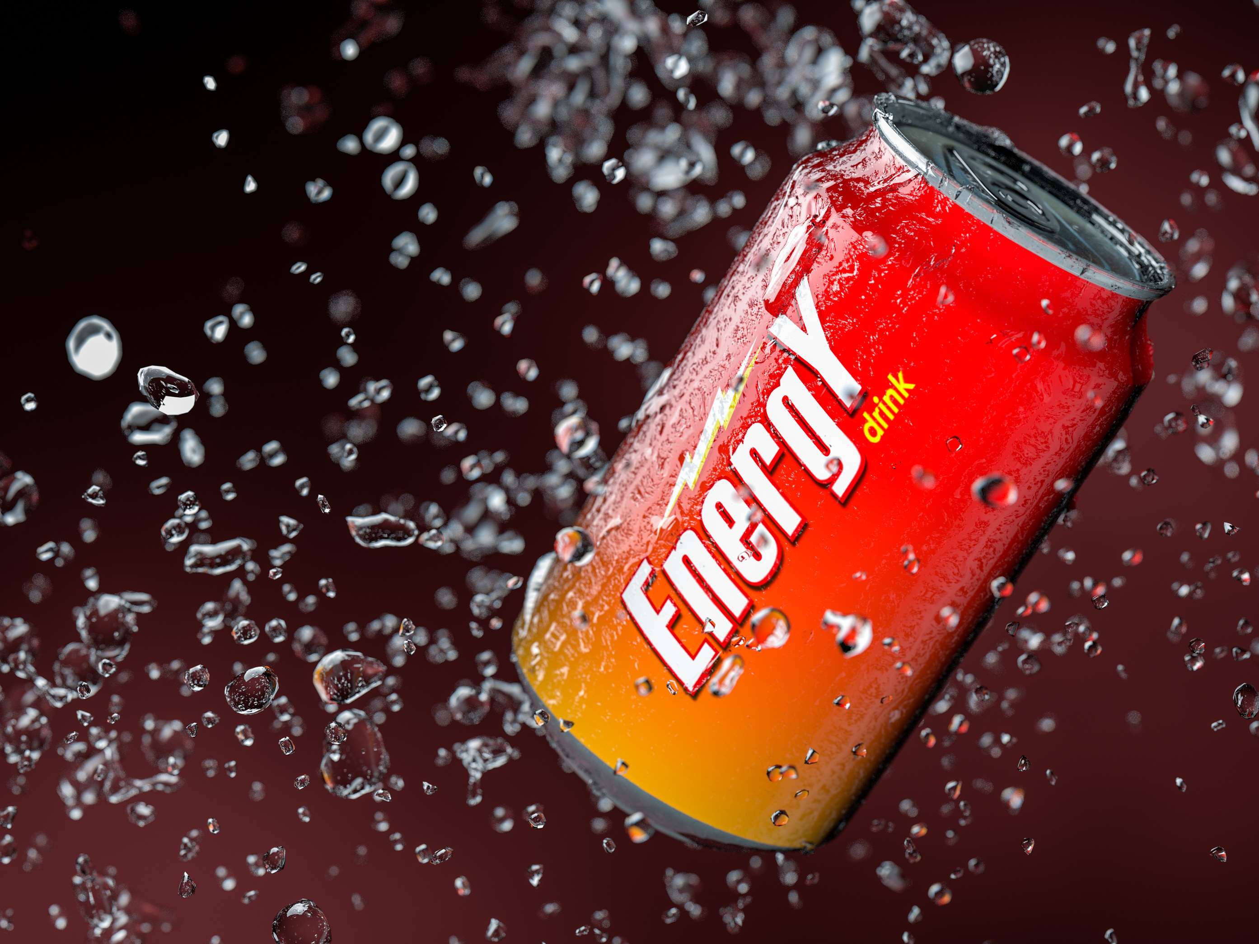
GLOBAL
ENERGY DRINKS
MARKET REPORT
2024
Global,Regional,CountryAnalysis

Slide 2
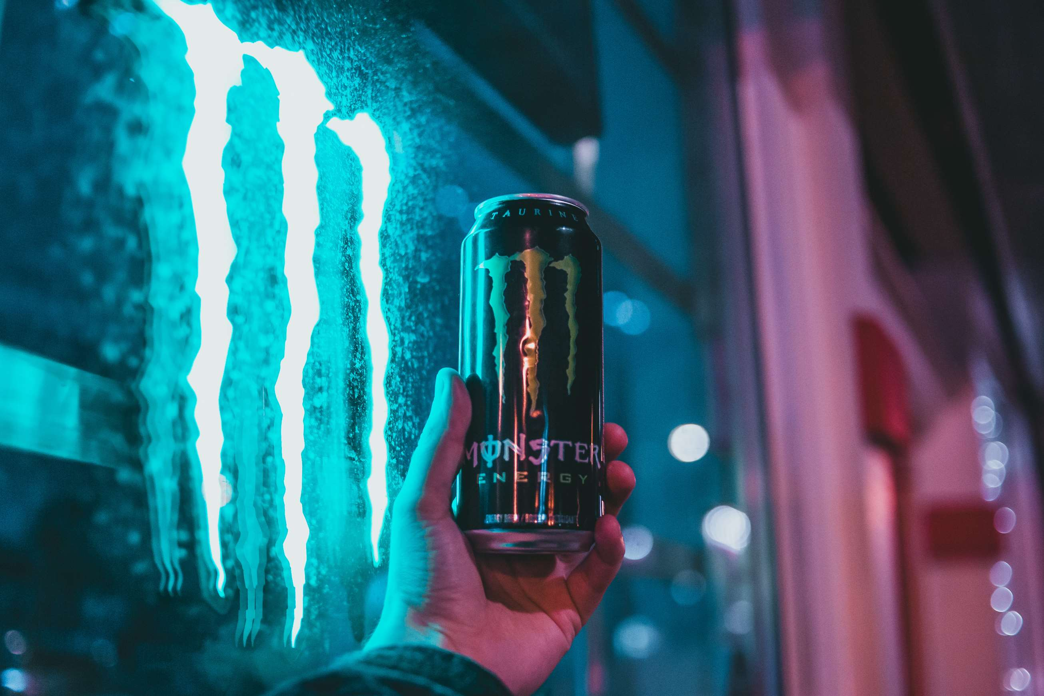
INTRODUCTION
The energy drinks market encompasses beverages designed to provide a quick boost of energy, typically through the inclusion of stimulants such as caffeine, taurine, and B vitamins. These drinks are marketed to consumers seeking enhanced alertness, concentration, and physical performance. Energy drinks often come in various flavours and formulations, including carbonated and non-carbonated options, and are widely available in supermarkets, convenience stores, gyms, and other retail outlets. Two key drivers fueling the growth of the energy drinks market are lifestyle changes and marketing strategies. As consumers lead increasingly hectic lives, there is a growing demand for beverages that offer a quick and convenient energy boost to help them stay alert and focused throughout the day. Additionally, aggressive marketing campaigns by energy drink companies targeting young adults, athletes, and students have contributed to raising awareness and driving consumption.

Slide 3
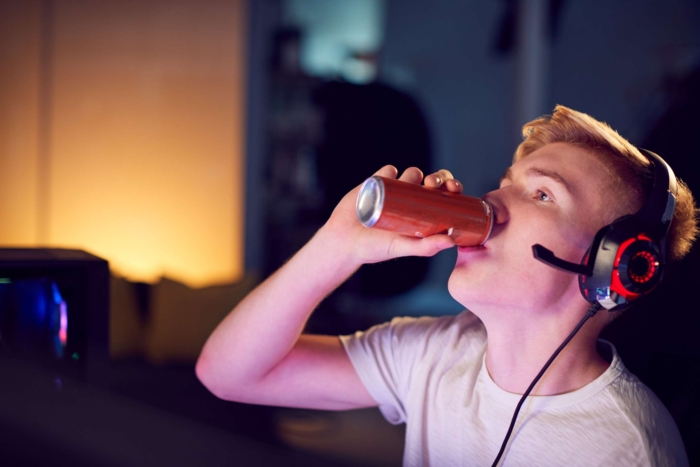

KEY INSIGHTS
MARKET SIZE
USD 61512.2 million
2024
CAGR
8.80%
2024- 2031

Slide 4

REVENUE MARKET SHARE BY SEGMENTS 2022
  Caffeinated Beverage
  De-caffeinated Beverage
  Unflavored
  Flavored
Type Segment
Flavor Segment
  Natural Energy Drink
  Sports Drink
  Non-Alcoholic Beverage
  Functional beverages
  Non-carbonated packaged drinks
  Shots
  powder
  Ready-To-Drink (RTD)
Format Segment
Categories Segment

Slide 5

Global Energy Drinks Market Revenue share for 2024
North America
40%

Slide 6
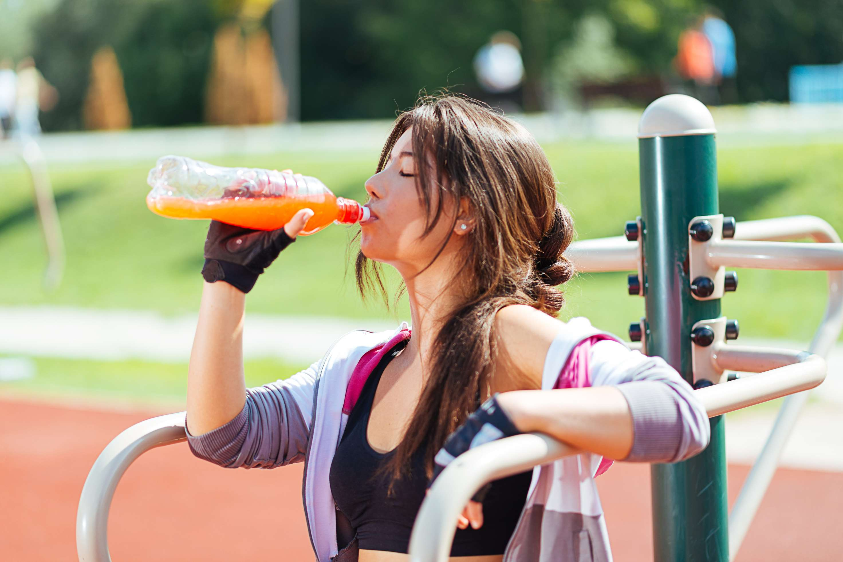
  Rising Health Consciousness and Active Lifestyles to Increase the Demand Globally
  Innovative Product Offerings and Marketing Strategies to Propel Market Growth
Drivers
Health Concerns and Regulatory Scrutiny to Limit the Sales
Restraints

Slide 7

AUTHOR'S PERSPECTIVE
  The global Energy Drinks market will expand significantly by 8.80% CAGR between 2024 to 2031.
  The dominating category is caffeinated beverages. Caffeinated energy drinks contain ingredients like caffeine, taurine, vitamins, and other stimulants that provide consumers with a quick energy boost. These beverages are popular among individuals seeking increased alertness, improved focus, and enhanced physical performance.
  The dominating category is Ready-To-Drink (RTD) beverages. RTD energy drinks are pre-formulated and packaged for immediate consumption, providing convenience and accessibility to consumers on-the-go. These beverages are already mixed and ready to consume, eliminating the need for preparation, thereby appealing to busy individuals seeking a quick energy boost. RTD energy drinks have a strong presence in convenience stores, supermarkets, and vending machines, making them easily accessible to consumers in various locations.

Slide 8
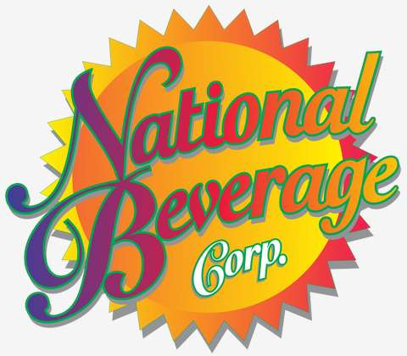

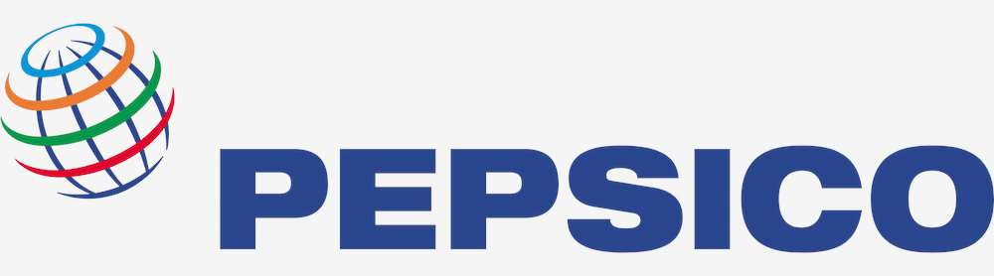

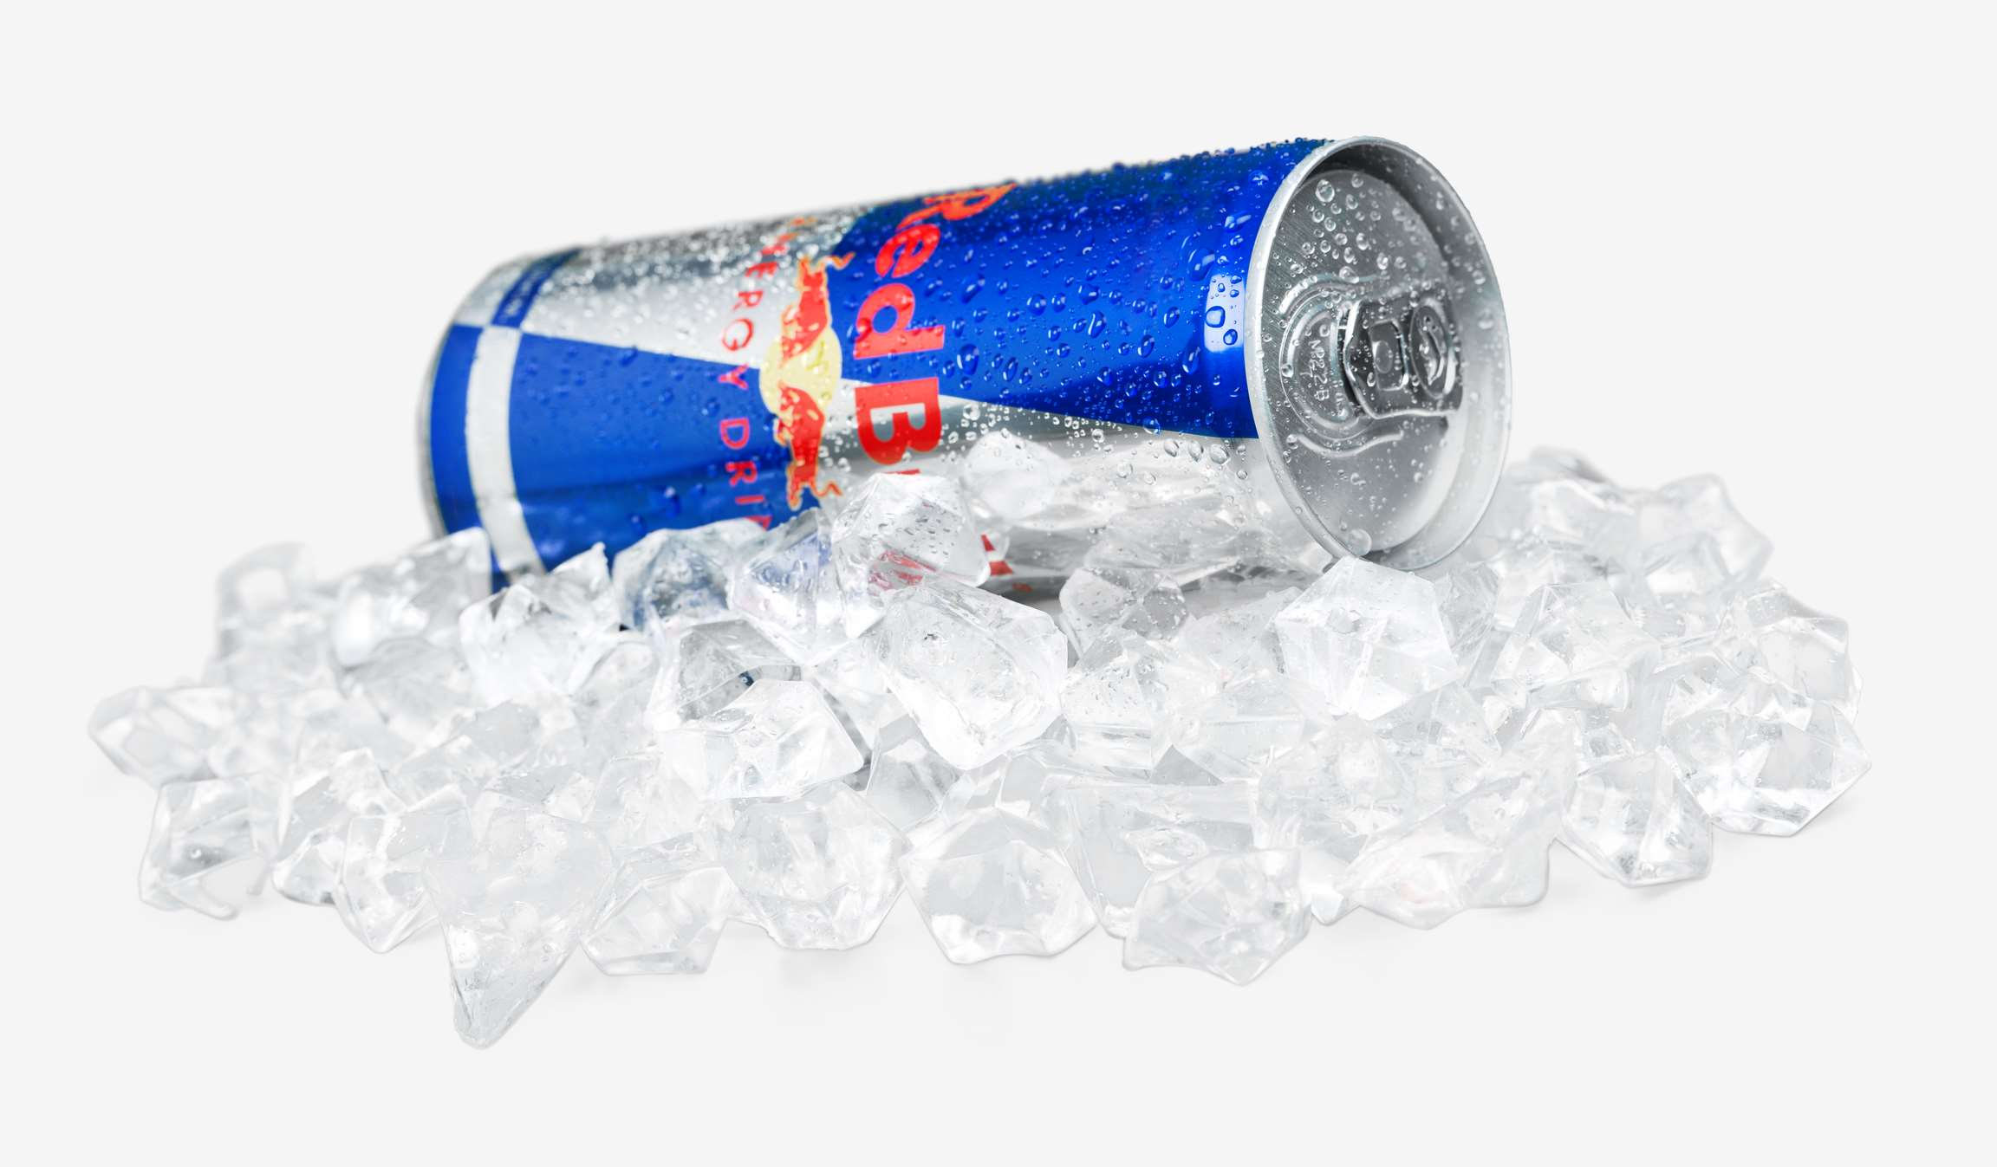



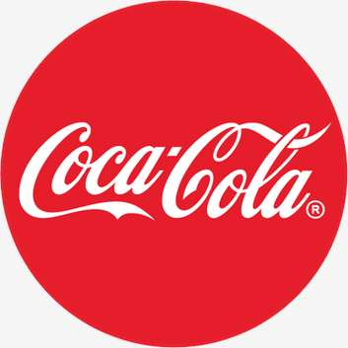
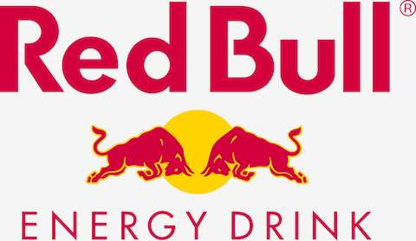
KEY PLAYERS

Slide 9


For Full Report
Contact us
COGNITIVE MARKET RESEARCH
Tel: +1 312-376-8303 | +44 020-8123-0732
India: (+91) 983-496-8611
sales@cognitivemarketresearch.com
Access the Full Report : https://tinyurl.com/yhmtw2um
Please visit our website:
https://www.cognitivemarketresearch.com

