Slide 1
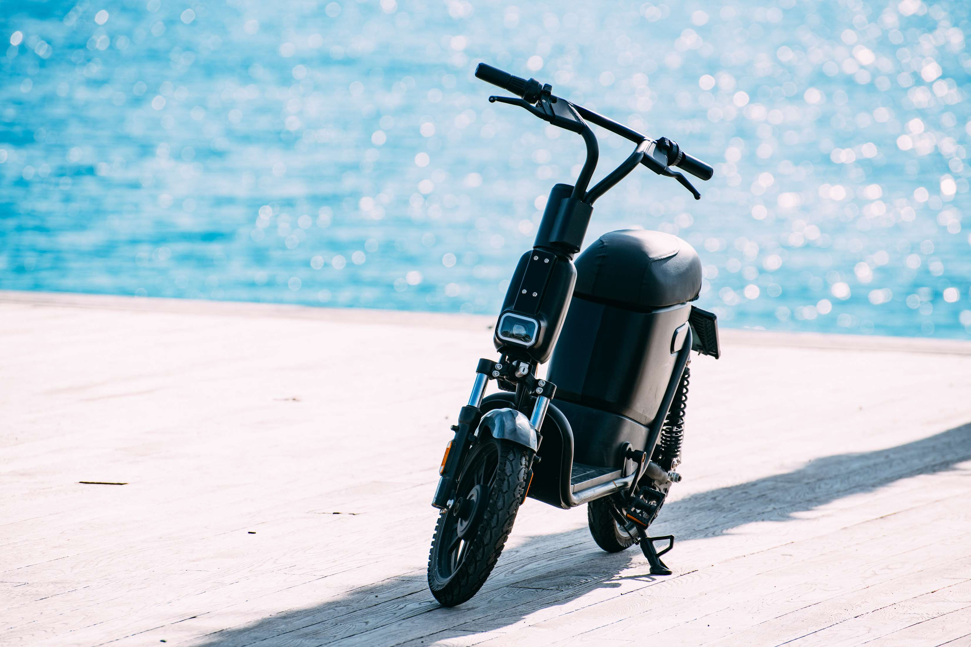

ELECTRIC BIKES
MARKET REPORT
2024
Qualitative Analysis + Quantitative Analysis

Slide 2
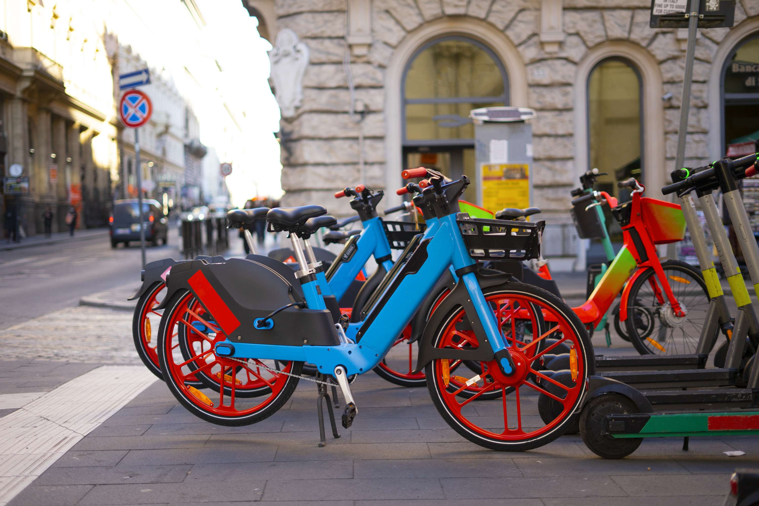
INTRODUCTION
Electric bikes, or e-bikes, are bicycles equipped with electric motors, offering pedal assistance and sometimes throttle control. They amplify human power, enabling easier and faster rides, often with varying levels of assistance. The electric bikes market has experienced a significant expansion in consumer interest, driven by a rising awareness of eco-friendly commute solutions. With concerns about environmental sustainability on the expansion, individuals are increasingly turning to electric bikes as a practical and environmentally intended alternative to traditional transportation methods. These bikes deliver an efficient mode of travel that decreases carbon emissions and delivers healthier lifestyles. As a result, more people are embracing electric bikes as a convenient and eco-conscious way to commute, contributing to the rapid expansion of this market.

Slide 3


KEY INSIGHTS
MARKET SIZE
USD 49581.2 million
2024
CAGR
5.20%
2024- 2031

Slide 4

REVENUE MARKET SHARE BY SEGMENTS 2024
  Class-l
  Class-II
  Class-IIl
  Pedal Assist
  Throttle
Class Segment
Mode Segment
  Batteries
  Electric Motors
  Frames with Forks
  Motor Controllers
  Brake System
  Up to 25 Km/h
  25-45 Km/h
Component Segment
Speed Segment
  Mountain/Trekking
  City/Urban
  Cargo
Motor Type Segment
  Mid
  Hub
Usage Segment

Slide 5

REGION ANALYSIS
NORTH AMERICA
Europe
Asia Pacific
Latin America
MIDDLE EAST AFRICA
USD 19832.48 million
USD 14874.36 million
USD 11403.68 million
USD 2479.06 million
USD 991.62 million
North America held the major market of more than 40% of the global revenue with a market size of USD 19832.48 million in 2024 and will grow at a CAGR of 3.4% from 2024 to 2031.

Slide 6
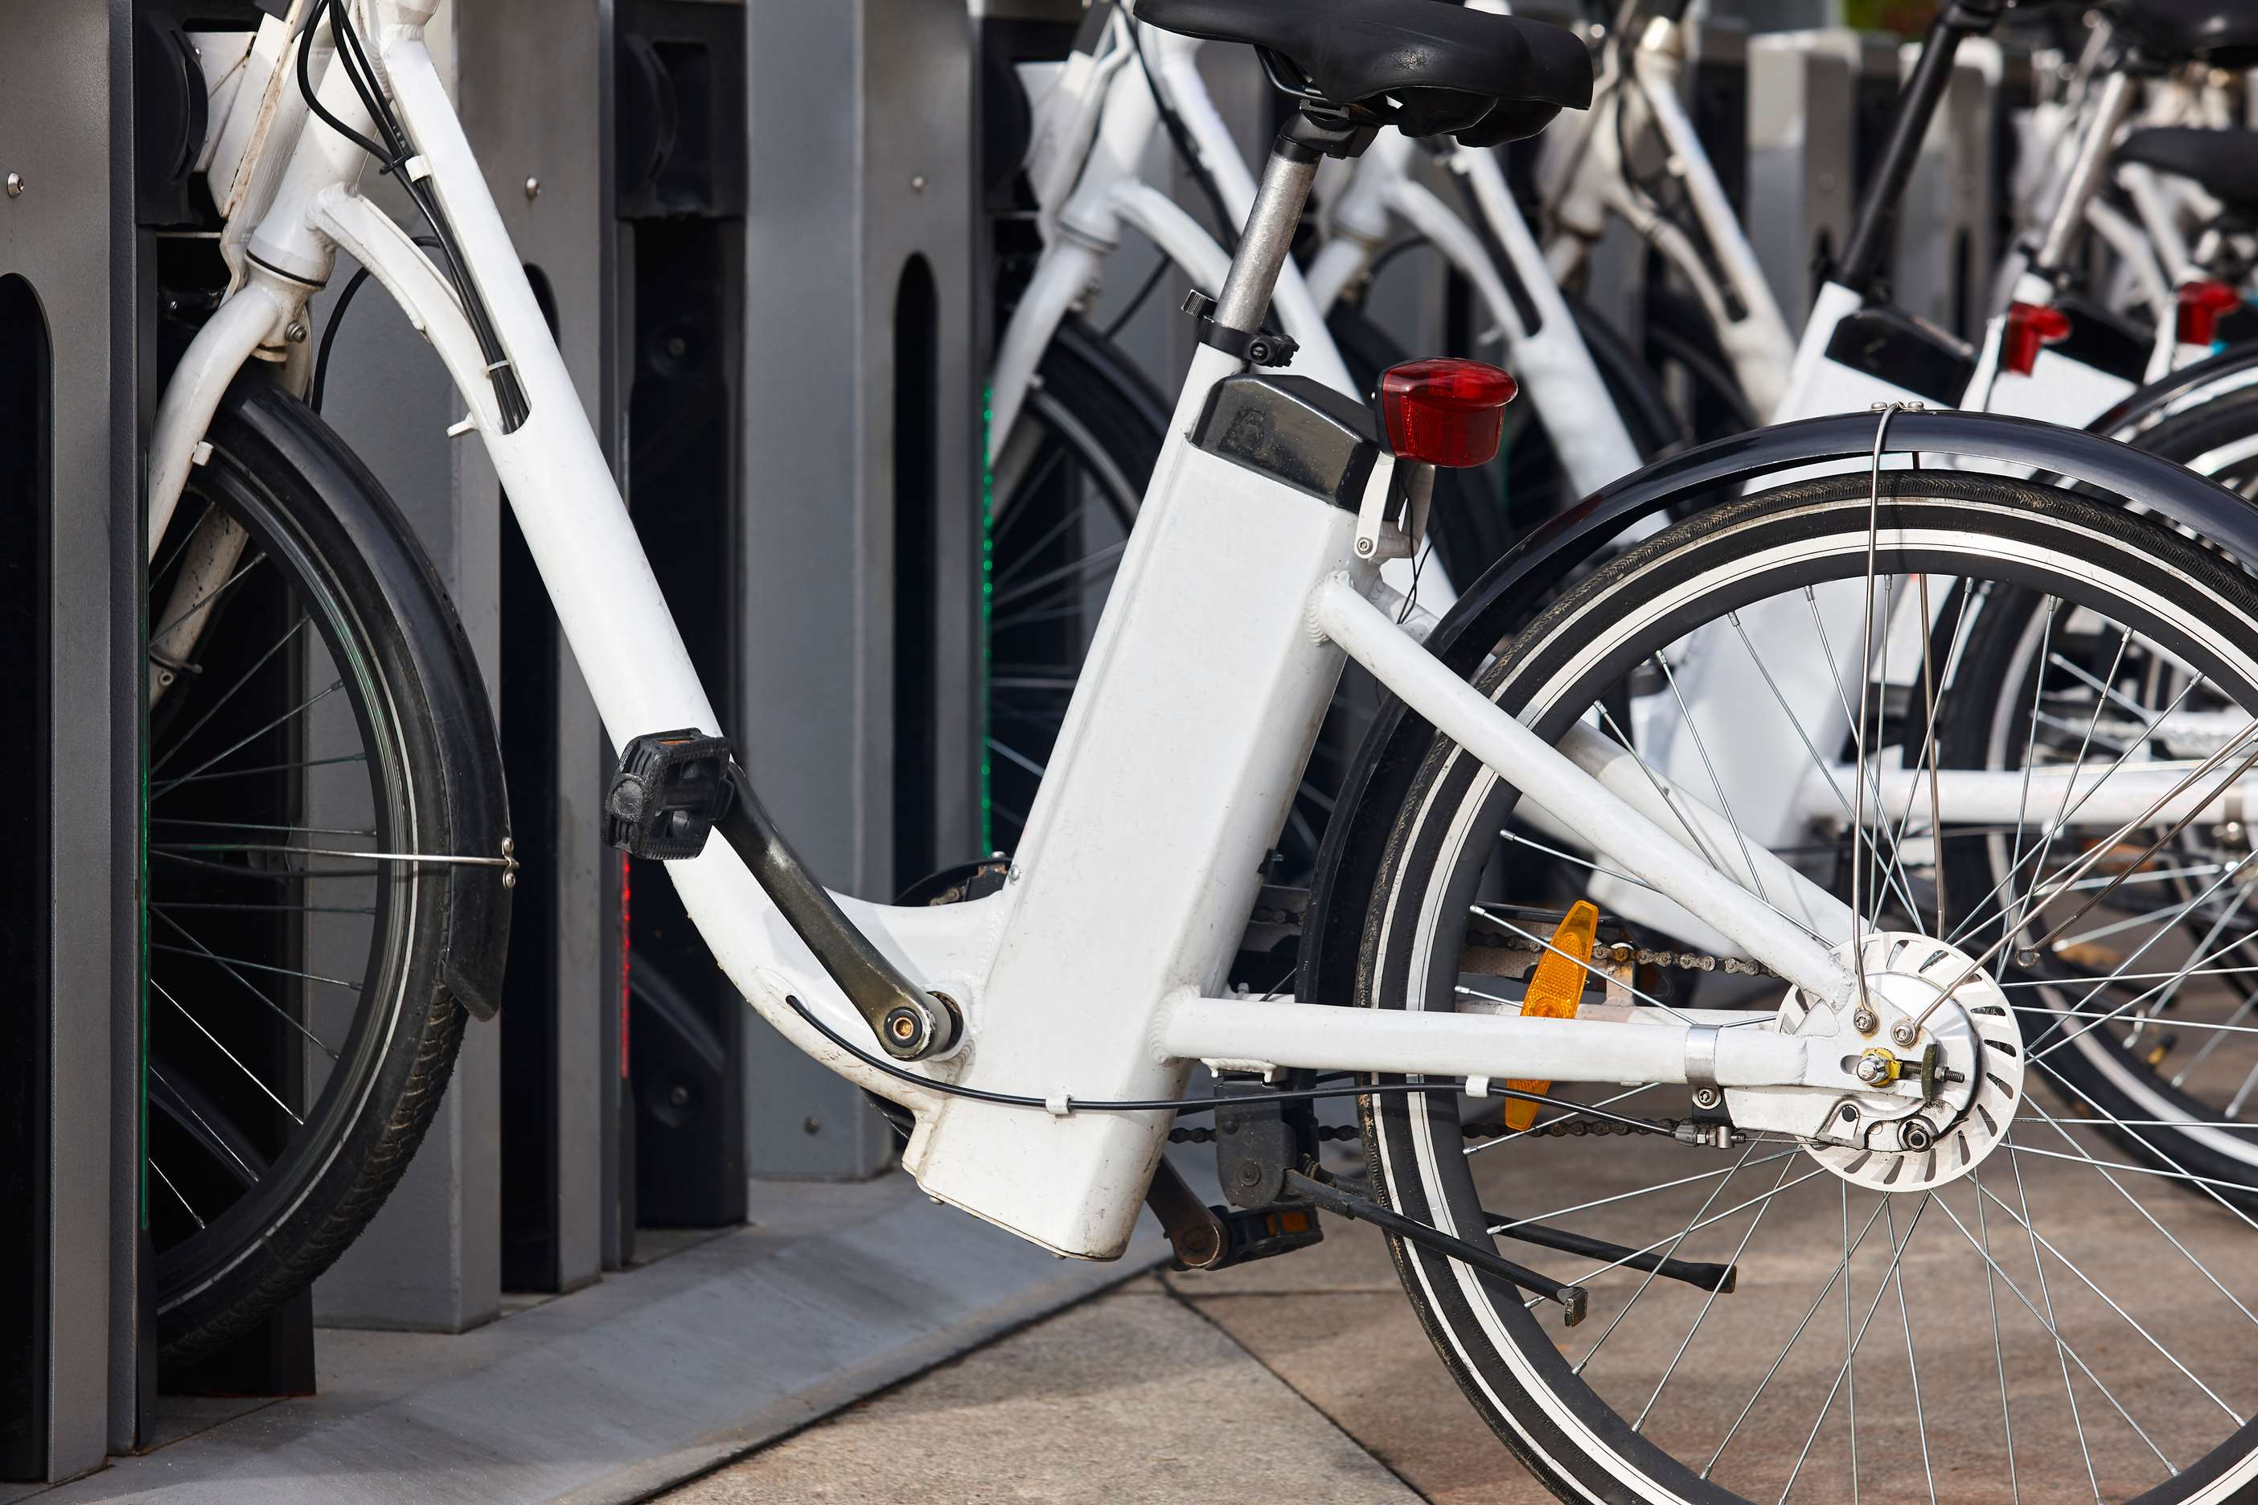
  Rising Trend toward Connected Electric Bikes to Increase the Demand Globally
  Government Support to Increase Electric Bike Sales to Propel Market Growth
Drivers
Restraints
High Manufacturing Costs to Limit Market

Slide 7
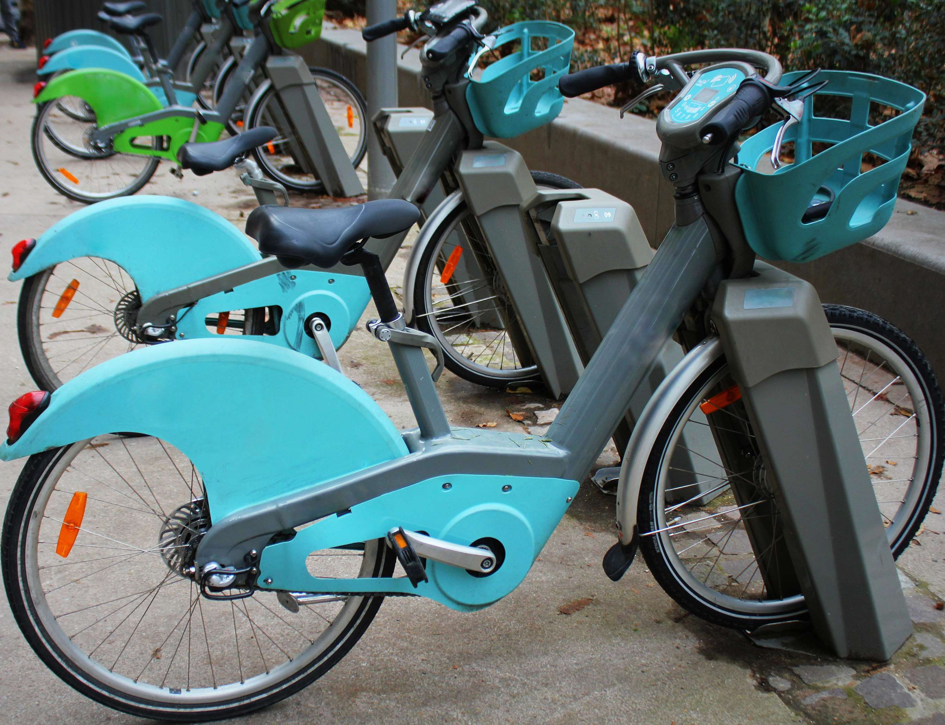
AUTHOR'S PERSPECTIVE
  The dominating category is 2 kg due to a surge in demand as eco-conscious consumers embrace sustainable transportation.
  With a 2 kg weight reduction, drivers enjoy enhanced maneuverability and efficiency, propelling the industry towards a greener, lighter future.
  The fastest-growing category in the electric bikes market is >2.4 kg due to a surge in demand for eco-friendly transportation.
  In 2023, sales reached 2.4 kg, driven by a rising awareness of sustainability and a desire for efficient urban mobility solutions.
  This trend is expected to continue as cities prioritize green initiatives.

Slide 8
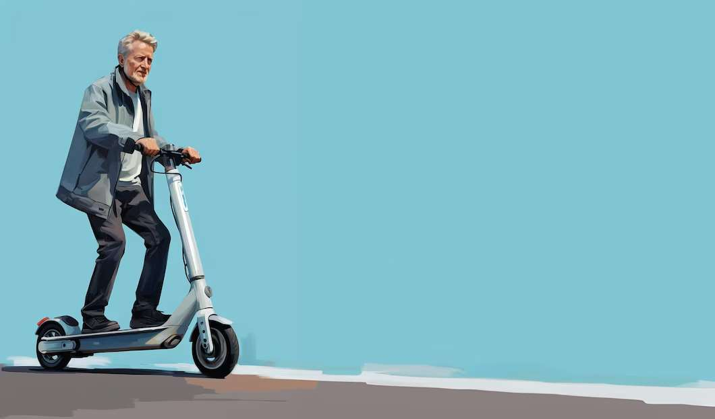









KEY PLAYERS

Slide 9


For Full Report
Contact us
COGNITIVE MARKET RESEARCH
Tel: +1 312-376-8303 | +44 020-8123-0732
India: (+91) 983-496-8611
sales@cognitivemarketresearch.com
Access the Full Report : https://tinyurl.com/55x29m9f
Please visit our website:
https://www.cognitivemarketresearch.com

