Slide 1
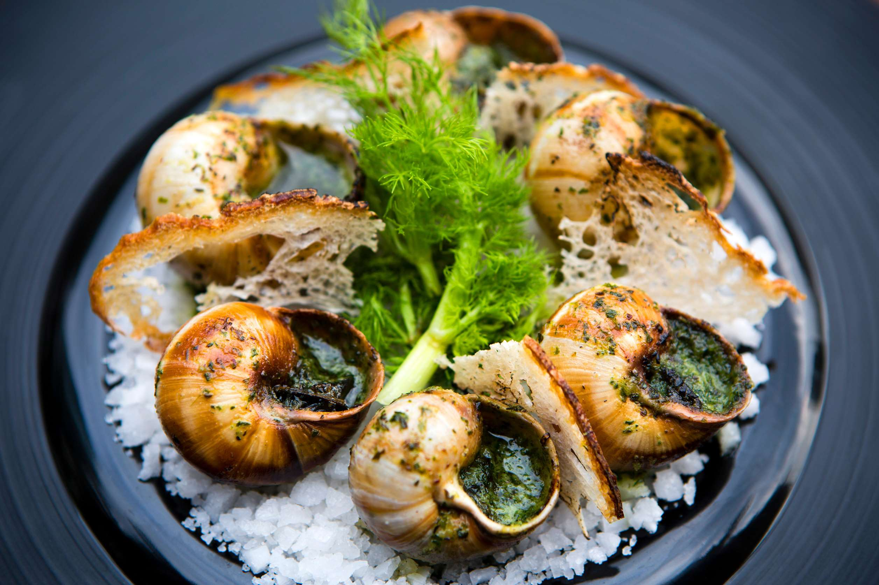
GLOBAL
EDIBLE SNAIL
MARKET REPORT 2024
Global,Regional,CountryAnalysis

Slide 2
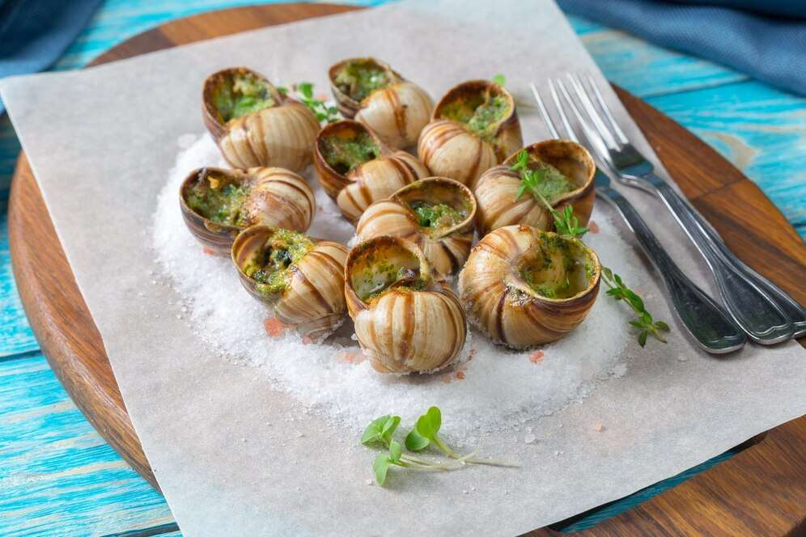
INTRODUCTION
Snails which are able to breath and adapted to the life away from water, on land are referred as the land or terrestrial snail. These snails live on or near to ground and it feed on the decaying plant matter and are hatch from the eggs laid in the soil. Most of the commonly found land snail occurs in cold regions, where they hibernate.

Slide 3
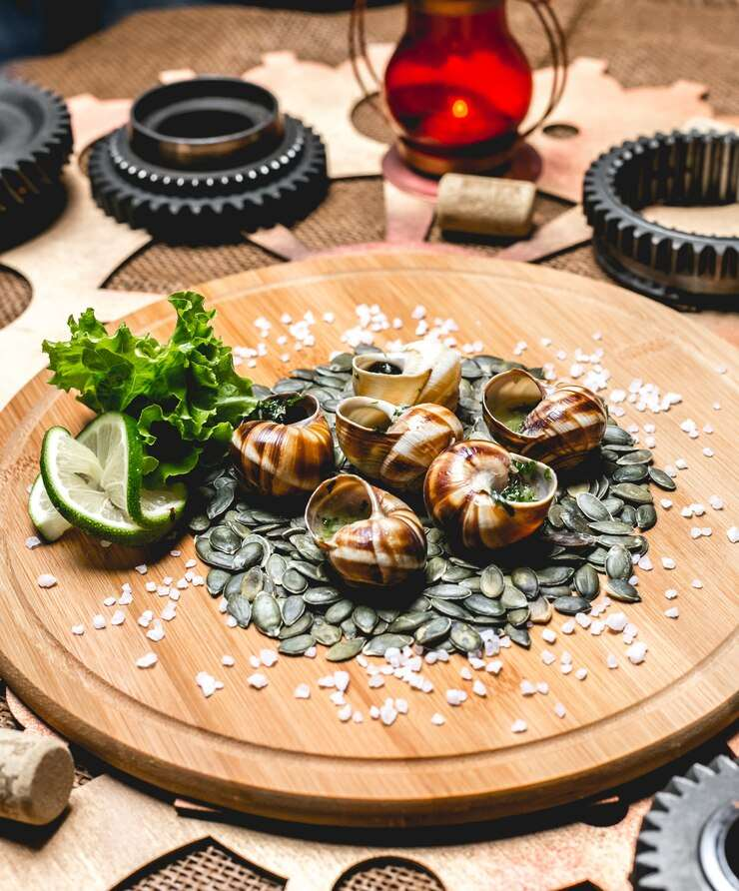

KEY INSIGHTS
MARKET SIZE
$699.72 Million
2028
CAGR
5.92%
2023- 2030

Slide 4
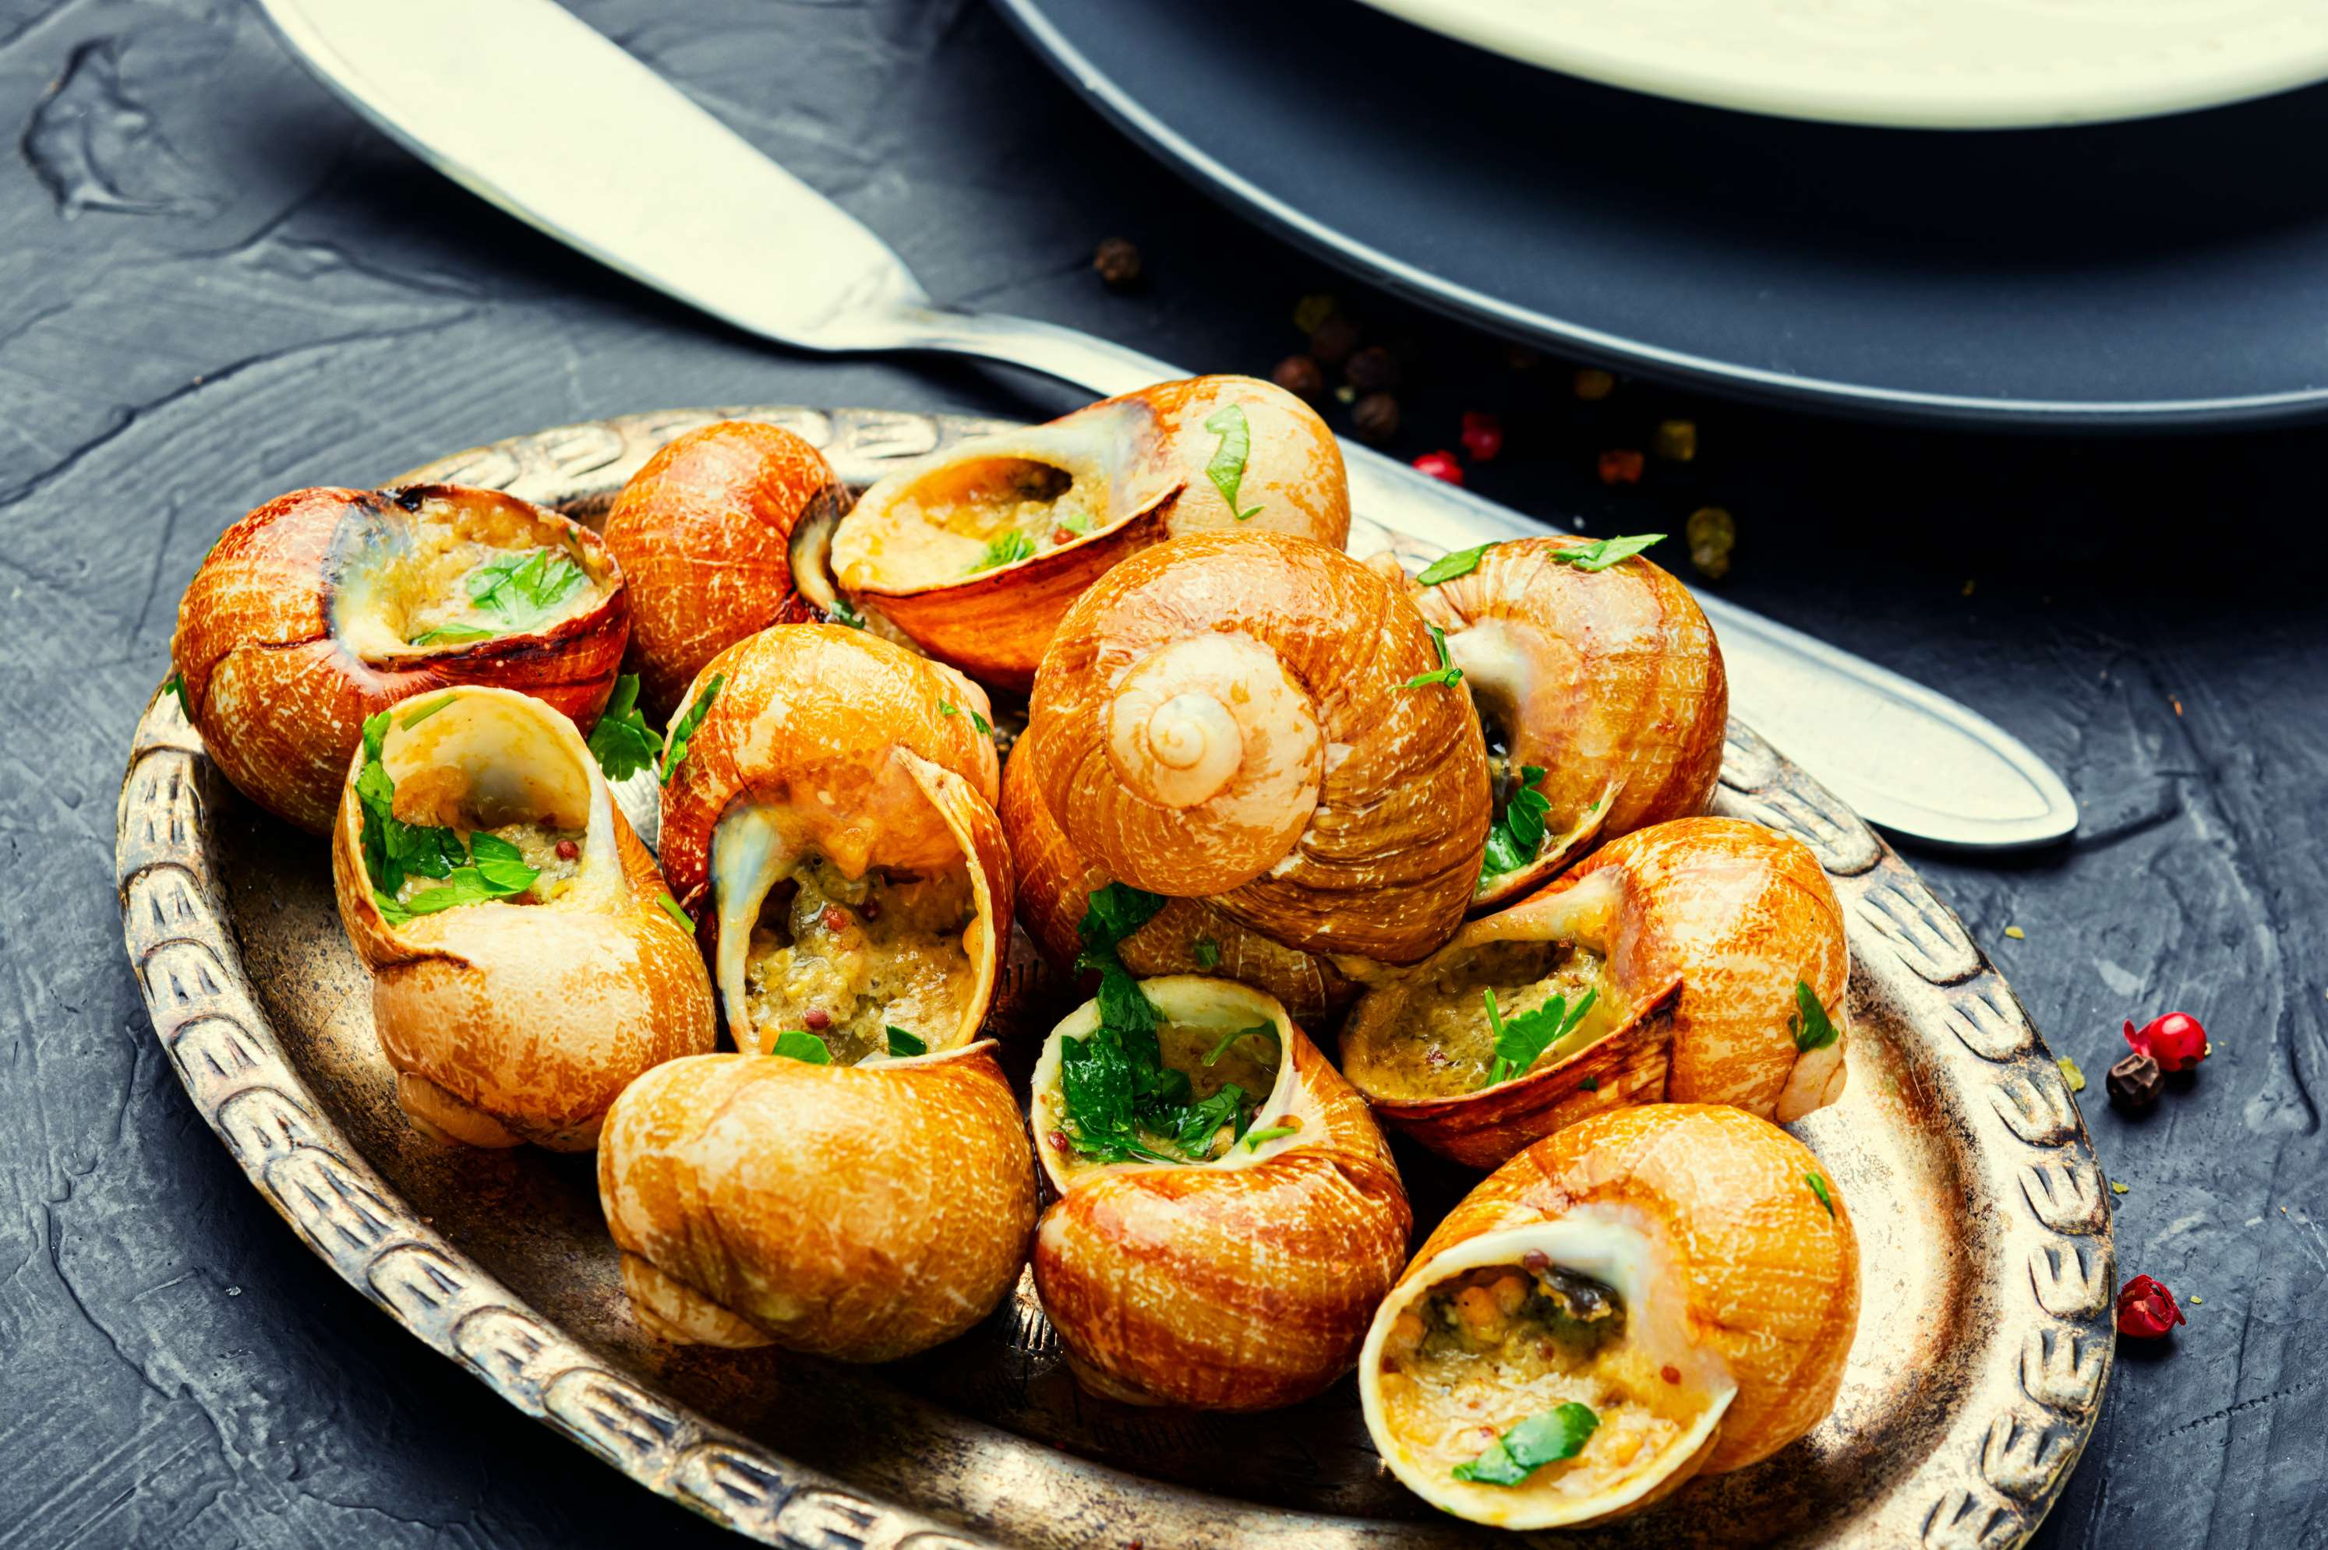
REVENUE MARKET SHARE BY SEGMENTS 2022
  Raw-live
  Processed products
By Product
Application segment
  Restaurant
  Retail
  Canned Snails
  Frozen Snails
Product Segment

Slide 5

Europe
Global Edible Snail Market Revenue share for 2022

Slide 6
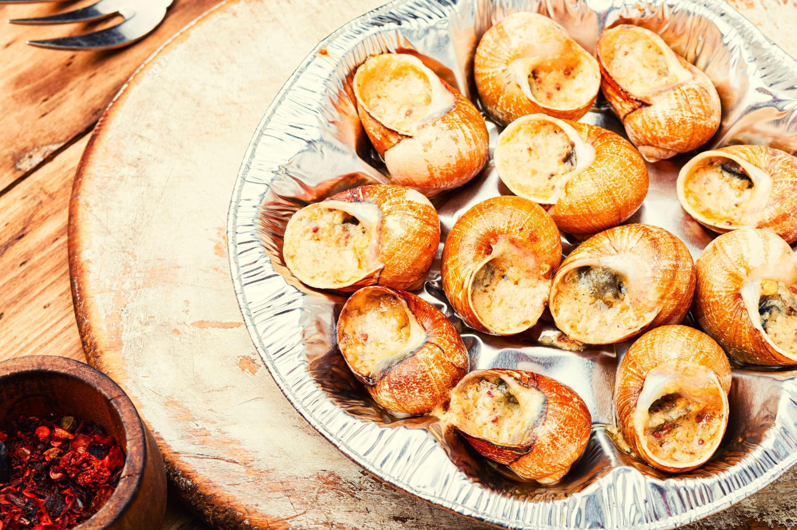
Rising demand for food & beverages industry
Drivers
Supply chain challenges faced by farmers
Restraints

Slide 7
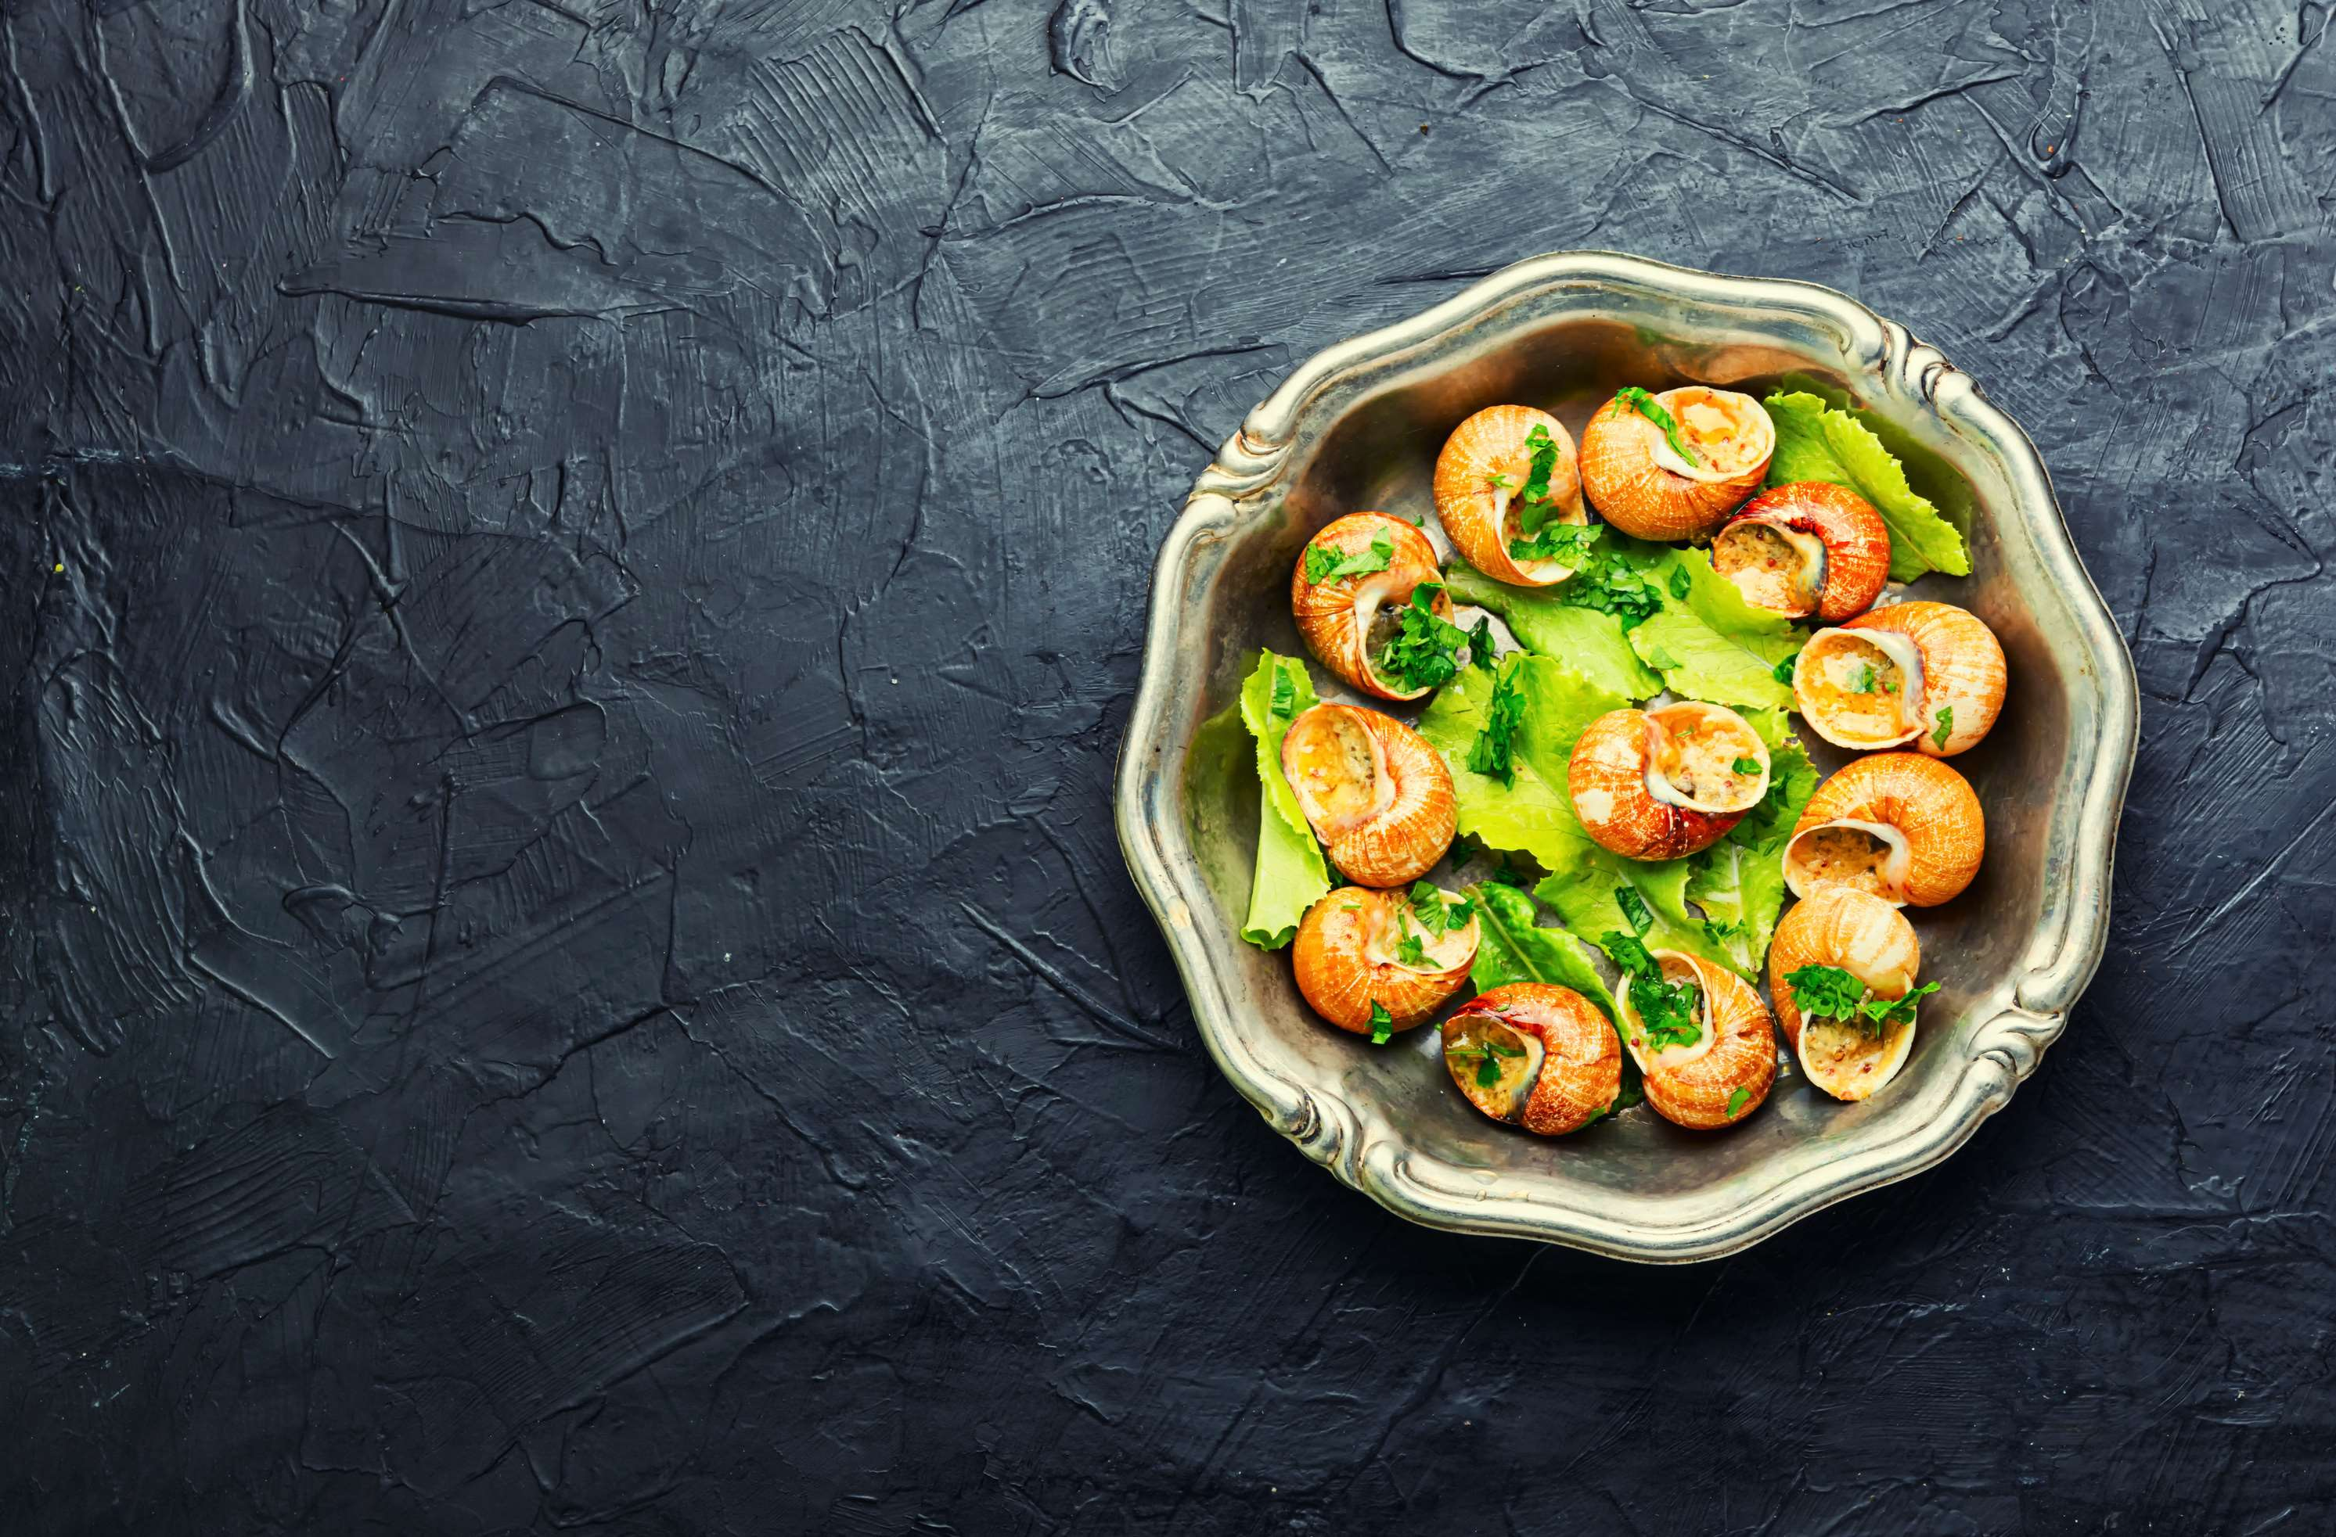
AUTHOR'S PERSPECTIVE
  The Global Edible Snail Market is witnessing significant growth in the near future.
  Raw or live snails generally refers to the alive snail which are used by various restaurant to serve their customer with the dishes made of the fresh flesh of snail.
  The processed snail products are widely consumed by the people at home and in restaurant which are easily available on online shop platforms and also offline in retail shops, supermarkets etc.
  The Escargot are available in many forms such as canned snails, frozen snail, marinated, buttered etc. in retails such as supermarket, grocery shop and more.
  The Restaurant segment is expected to expand at the significant CAGR retaining position throughout the forecast period.

Slide 8

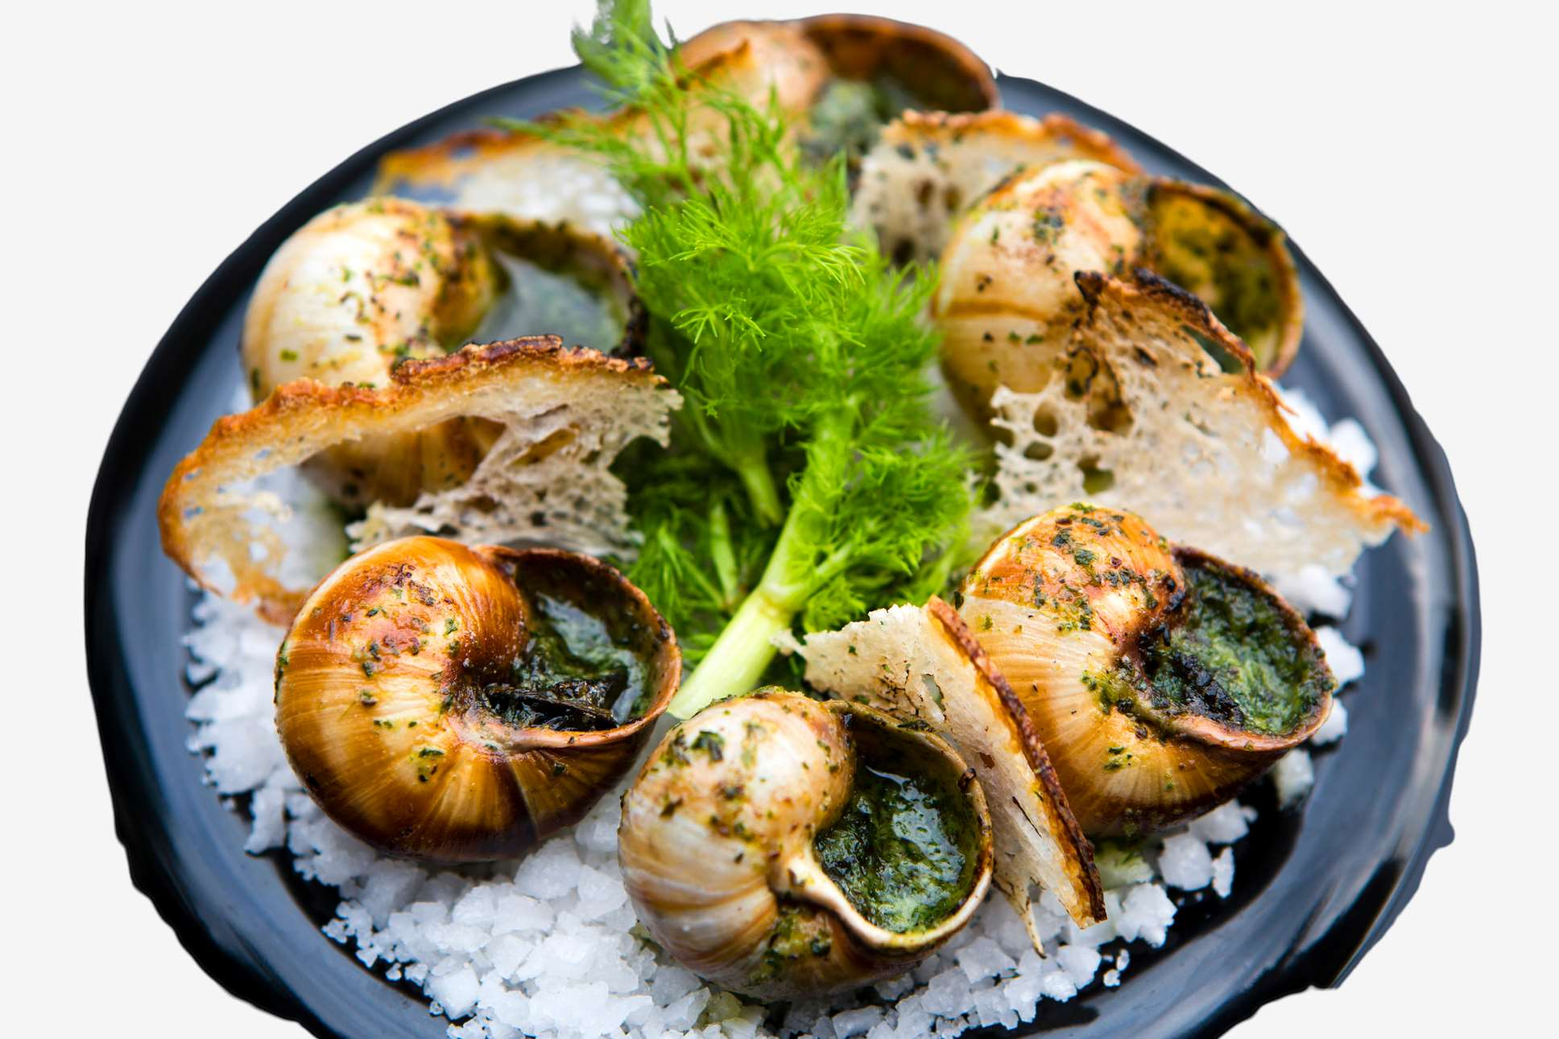









KEY PLAYERS

Slide 9


For Full Report
Contact us
COGNITIVE MARKET RESEARCH
Tel: +1 312-376-8303 | +44 020-8123-0732
India: (+91) 983-496-8611
sales@cognitivemarketresearch.com
Access the Full Report : https://tinyurl.com/3ncuwh6s
Please visit our website:
https://www.cognitivemarketresearch.com

