Slide 1





E GROCERY
MARKET REPORT
2024
Qualitative Analysis + Quantitative Analysis

Slide 2

INTRODUCTION
The E grocery market encompasses digital platforms where consumers can conveniently purchase a variety of food and household items via the Internet. This digital marketplace offers a plethora of benefits, including convenience, extensive product choices, and timesaving features. From fresh produce to pantry staples, snacks, and beverages, e-grocery platforms offer an extensive selection tailored to diverse preferences. Leveraging advanced technologies and efficient logistics networks, e-grocers ensure prompt delivery, enhancing the overall shopping experience. One of the key drivers propelling the growth of the E grocery market is the increase in internet penetration.

Slide 3



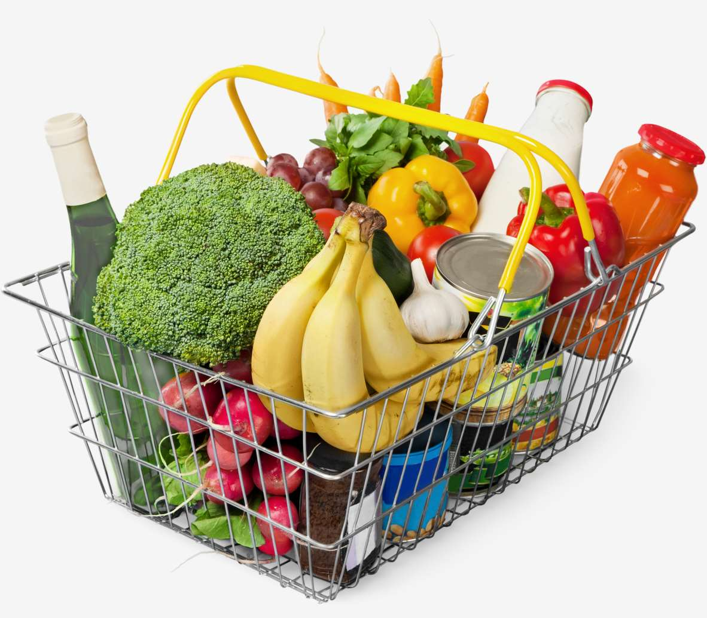
KEY INSIGHTS
MARKET SIZE
USD 51254.2 million
2024
CAGR
27.00%
2024- 2031

Slide 4
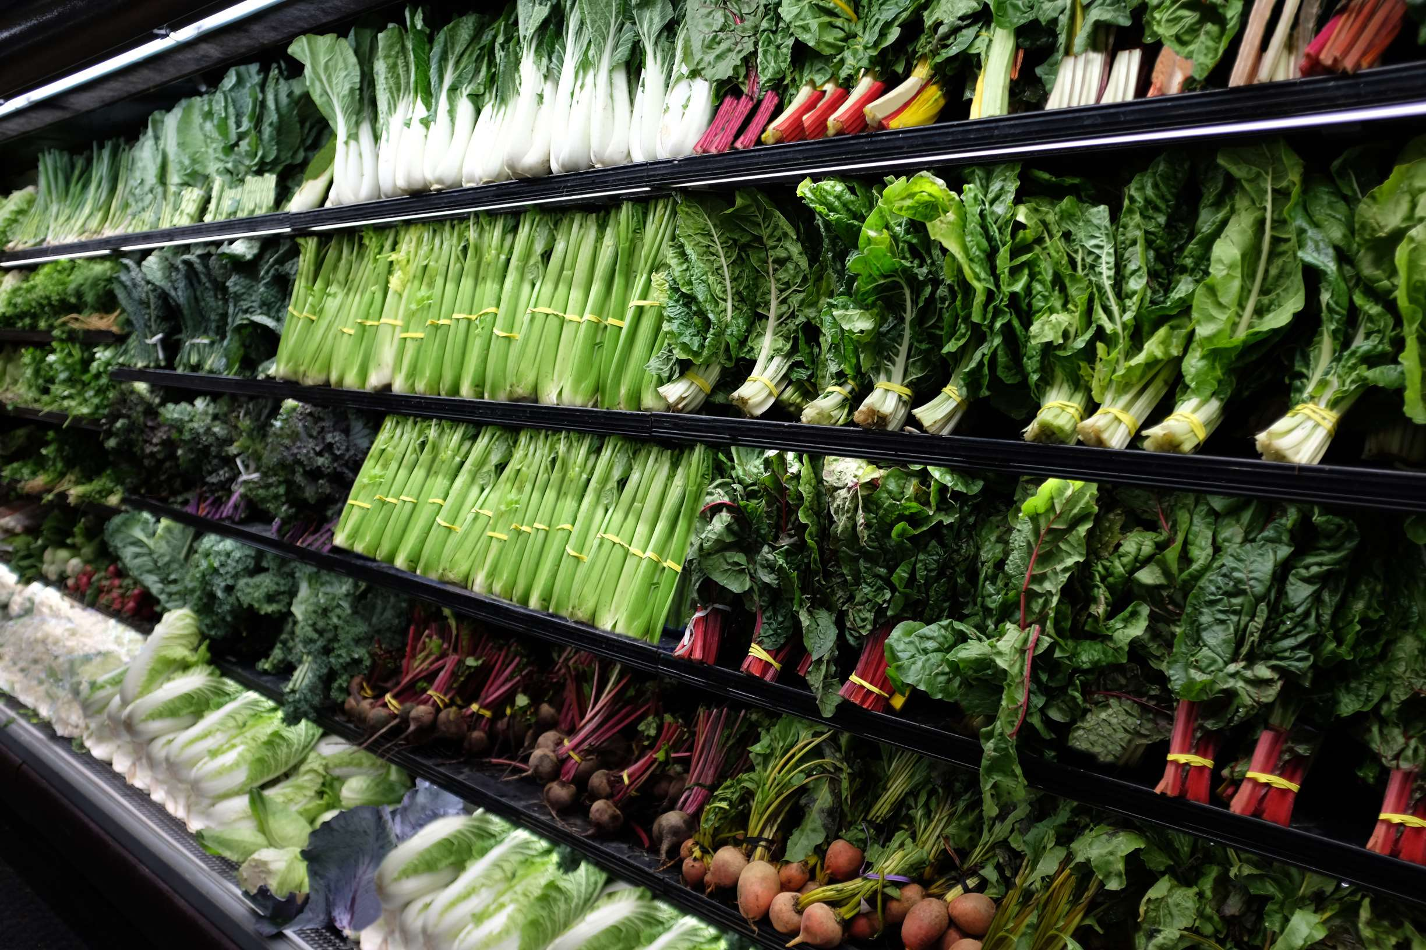
REVENUE MARKET SHARE BY SEGMENTS 2024
Staple and Cooking Essentials stands out as the dominating category. It encompasses grains, flour, oils, spices, and other indispensable cooking ingredients, enjoying widespread popularity due to their essential role in everyday culinary preparation
Product Type Segment
E-grocers are increasingly investing in infrastructure and technology to enhance scheduling capabilities and ensure timely deliveries.
Delivery Type Segment

Slide 5



North America
40%
North America E grocery
Market Revenue share for 2024 is 40%

Slide 6
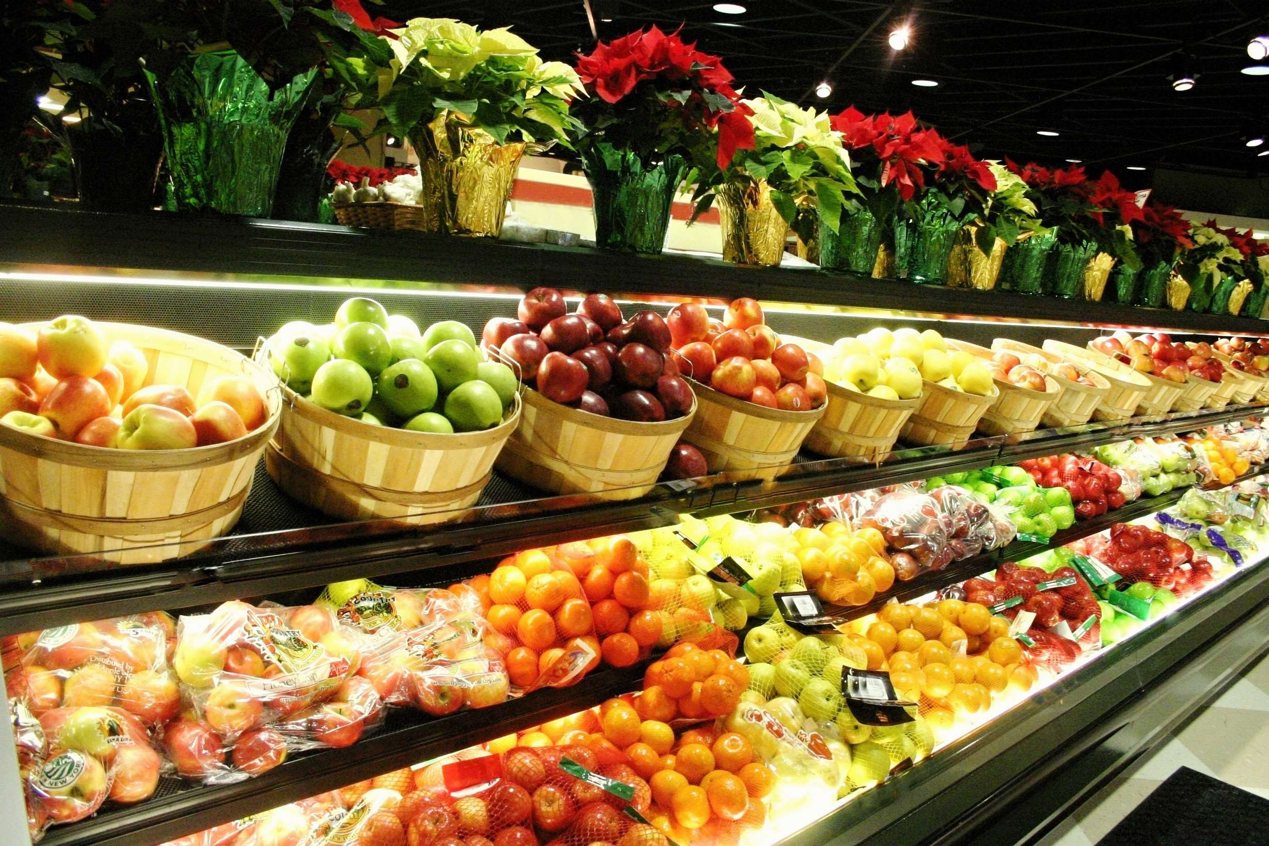
Convenience and Timesaving Benefits to Increase the Demand Globally
Drivers
Quality Concerns to Impede the Growth
Restraints

Slide 7

AUTHOR'S PERSPECTIVE
  The global E grocery market will expand significantly by 27.00% CAGR from 2024 to 2031.
  Staple and Cooking Essentials stand out as the dominating category.
  These encompass grains, flour, oils, spices, and other indispensable cooking ingredients, which enjoy widespread popularity due to their essential role in everyday culinary preparation.
  The dominating category is scheduled delivery.
  This delivery mode, prioritizing customer convenience and adaptability, is set to maintain its upward momentum, exerting significant influence on the evolution of e-grocery services.

Slide 8













KEY PLAYERS

Slide 9


For Full Report
Contact us
COGNITIVE MARKET RESEARCH
Tel: +1 312-376-8303 | +44 020-8123-0732
India: (+91) 983-496-8611
sales@cognitivemarketresearch.com
Access the Full Report : https://tinyurl.com/mpnkjyw5
Please visit our website:
https://www.cognitivemarketresearch.com

