Slide 1


E COMMERCE LOGISTICS
MARKET REPORT

Slide 2

E-commerce logistics is well-defined as the supply chain through which a company's online customer orders are fulfilled. This is the process from the point of manufacture until the product is delivered to the consumer-commerce logistics include providing warehousing, transportation, value-added services, packaging, and other services.
Introduction

Slide 3


KEY INSIGHTS
MARKET SIZE
$27.20 Bn
2022
FORECAST
$55.48 Bn
2030
CAGR
9.3%
2030

Slide 4

REVENUE MARKET SHARE BY SEGMENTS 2022
Type
Forward logistics: 69.4%
Model
3PL:
71.2%
Service Transportation: 71.2%
Operations
Domestic:
75.1%
Industry Vertical Apparels:
32.2%

Slide 5

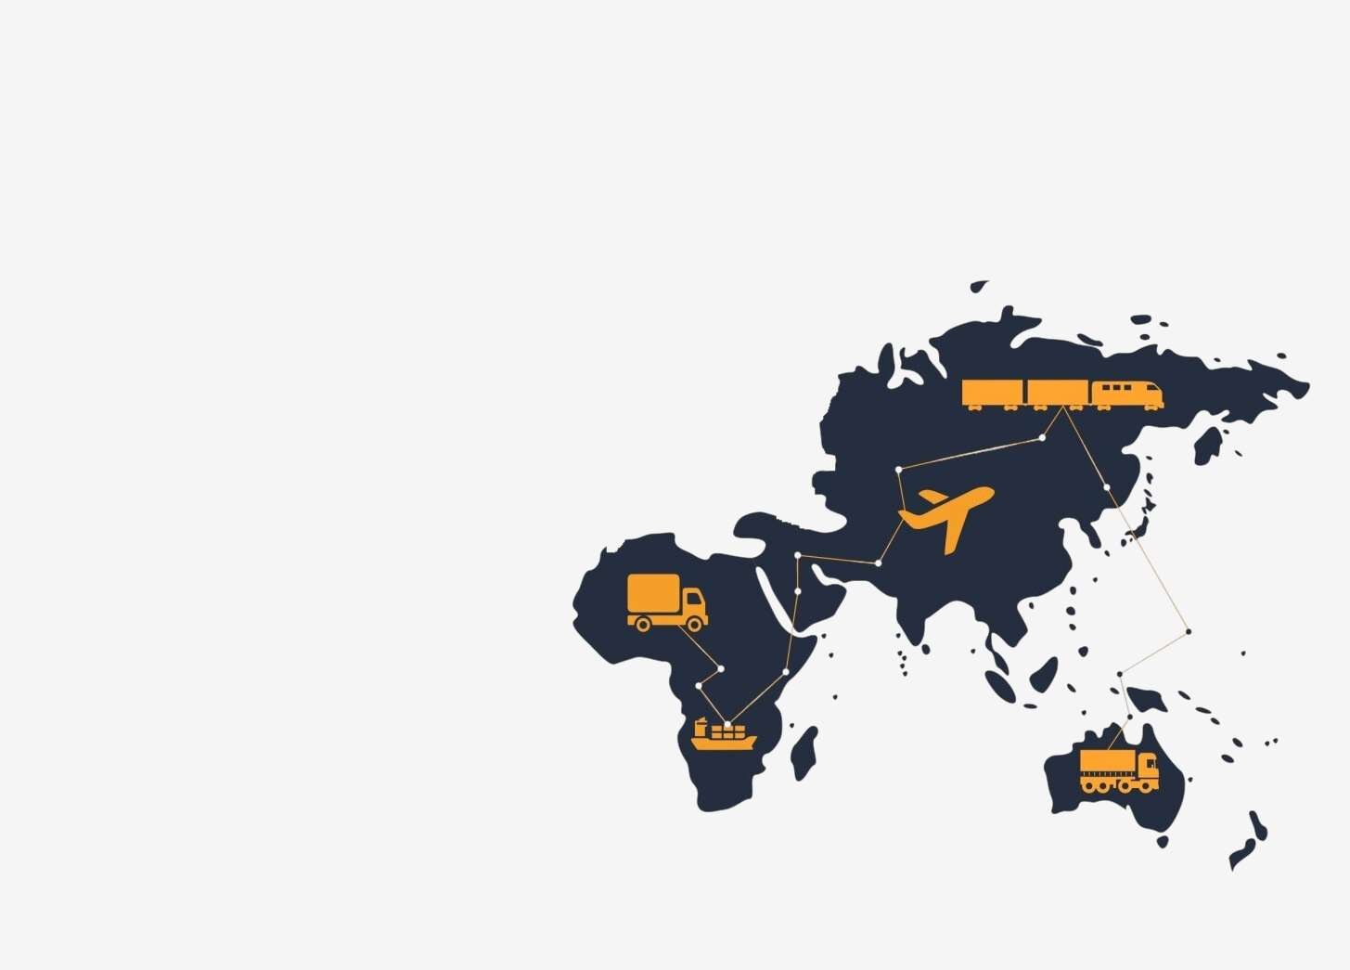
Global E Commerce Logistics Market Revenue share for 2022
Asia Pacific
38.4%

Slide 6
  Growing cross-border e-commerce activities, due to increasing per capita income
  The adoption of technologies such as barcode technology, blockchain, electronic data interchange (EDI) and others
Drivers
Numerous returns due to product defects and delivery failures increase logistics costs
Restraints

Slide 7

Author's Perspective
  As a result of growing smartphone adoption, drone delivery, digitalization, and digital payments, the e-commerce logistics industry is predicted to grow significantly over the course of the forecast period.
  The industry's expansion is further fueled by the growing use of hardware technologies including the Internet of Things (IoT), barcodes, portable data terminals, GIS, and GPS.

Slide 8







KEY PLAYERS

Slide 9
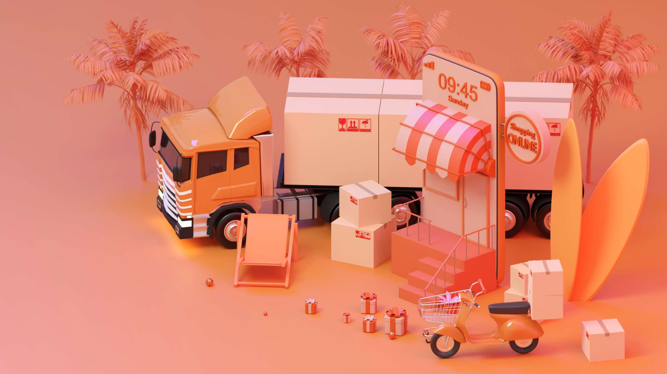

For Full Report
Contact us
COGNITIVE MARKET RESEARCH
Tel: +1 312-376-8303 | +44 020-8123-0732
India: (+91) 983-496-8611
sales@cognitivemarketresearch.com
Access the Full Report : https://tinyurl.com/tdccr4ye
Please visit our website:
https://www.cognitivemarketresearch.com

