Slide 1


DRY SHAMPOO POWDER
MARKET REPORT
2024
Qualitative Analysis + Quantitative Analysis

Slide 2

INTRODUCTION
The market for dry shampoo powder includes goods made to clean and revitalize hair without using water. Customers looking for quick fixes for hair care, particularly those with hectic schedules or situations where traditional washing isn't practical, will find it convenient. In order to revitalize and add volume between washes, dry shampoo powders usually contain chemicals like starches, clays, or powders that absorb excess oil and pollutants from the scalp and hair. Factors like growing urbanization, busy schedules, and growing awareness of water- and sustainable-saving measures are what propel the market's expansion. Market growth is also aided by formulas that address particular hair types and concerns as well as technology improvements.

Slide 3


KEY INSIGHTS
MARKET SIZE
USD 3152.2 million
2024
CAGR
6.00%
2024- 2031

Slide 4

REVENUE MARKET SHARE BY SEGMENTS 2024
  Anti-Dandruff
  Color Protection
  Hair Loss Protection
  Daily Care
  Multifunction
Function Segment
  Supermarket
  Hypermarket
  Convenience Stores
  Online
  Specialty Stores
  Drug Stores
Distribution Channel
  Men
  Women
  Children
End-User Segment

Slide 5

North America
40%
North America Dry Shampoo Powder Market Revenue share for 2024 is 40%

Slide 6
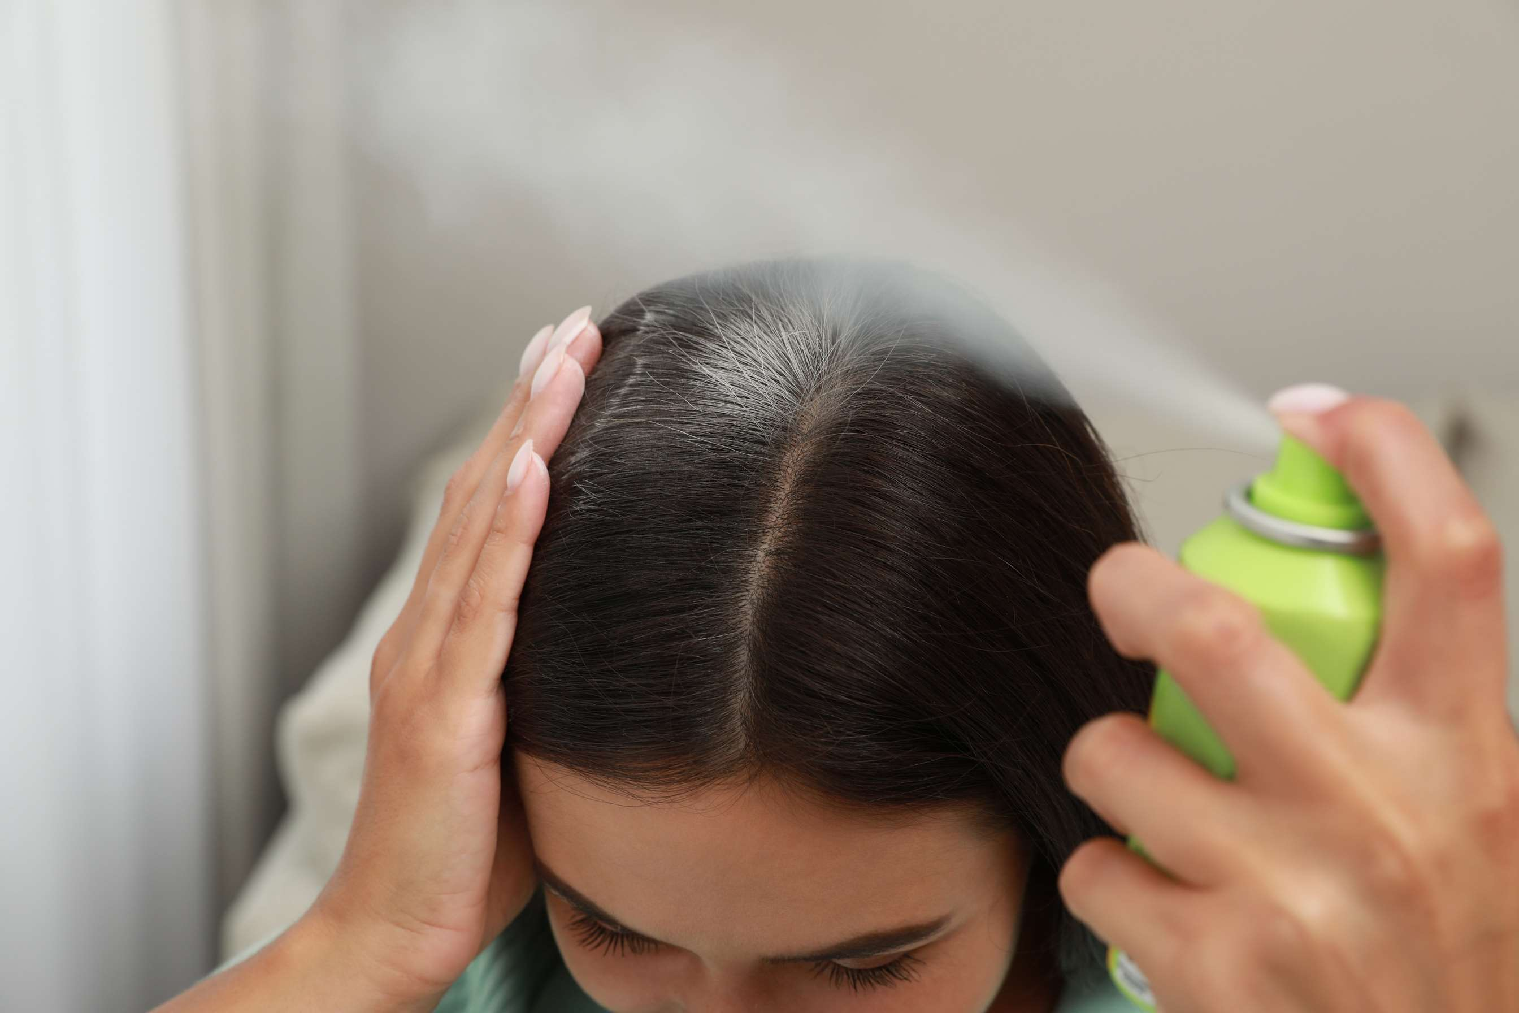
  Convenience and Time-saving to Increase the Demand Globally
  Fashion trends to Propel Market Growth
Drivers
Health Concerns to Limit the Sales
Restraints

Slide 7
AUTHOR'S PERSPECTIVE
  The global Dry Shampoo Powder market will expand significantly by 6.00% CAGR between 2024 to 2031.
  Producers are always creating new recipes with more advantages. These can be color-protecting dry shampoos, ones that fight dandruff, or even ones that come in colored variants to hide hair roots.
  Dry shampoo powder is being successfully promoted by social media influencers and focused marketing initiatives, which are reaching a larger audience and piqueing customer interest.

Slide 8










KEY PLAYERS

Slide 9


For Full Report
Contact us
COGNITIVE MARKET RESEARCH
Tel: +1 312-376-8303 | +44 020-8123-0732
India: (+91) 983-496-8611
sales@cognitivemarketresearch.com
Access the Full Report : https://tinyurl.com/yk8waap9
Please visit our website:
https://www.cognitivemarketresearch.com

