Slide 1
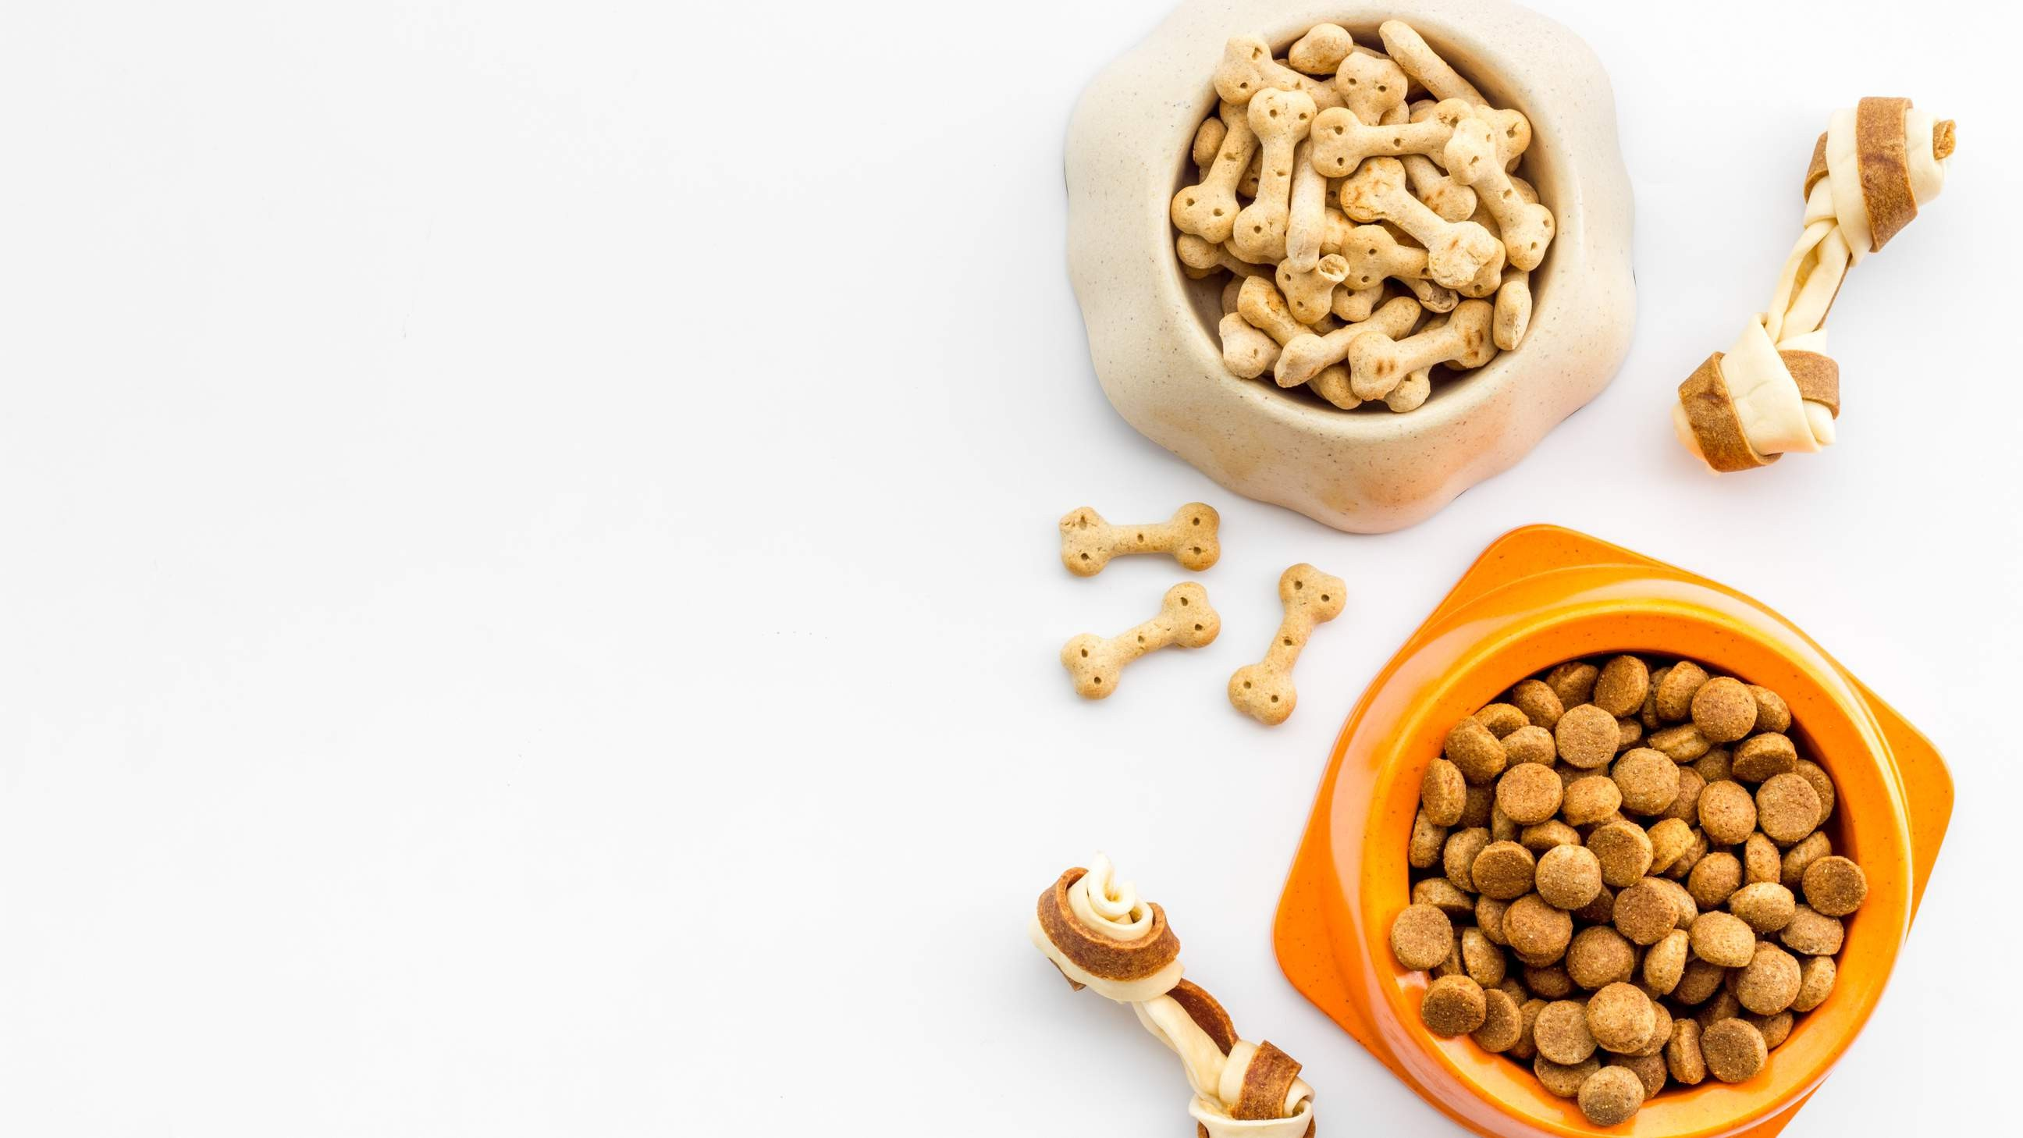
GLOBAL
DRY PET FOOD
MARKET REPORT 2024
Global,Regional,CountryAnalysis

Slide 2
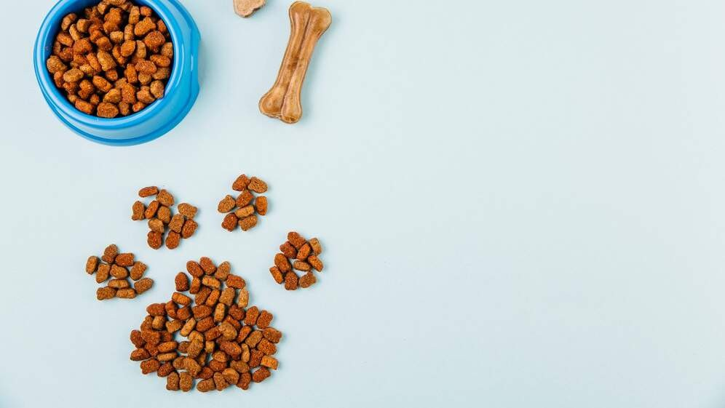
INTRODUCTION
While most pet feeds are utilised as utilitarian goods, they are often designed to give pets a comprehensive and balanced diet. A processed pet food diet is a dry diet, a biscuit diet, or a kibble diet. Compared to other pet food products, the demand for dry meals is significantly higher since pet owners view them as an accessible and simple diet option without sacrificing nutritional content. Dry pet food is in greater demand globally among young, employed urban pet owners due to how simple it is to store and feed pets.
Furthermore, growing adoption of pets and increasing public awareness of their health needs are expected to drive sales in the market. Pet owners have become more conscious of the benefits and requirements of providing nutrient-rich food to their pets due to pet humanization.

Slide 3
KEY INSIGHTS
CAGR 5.50%
20₋23
2030

Slide 4
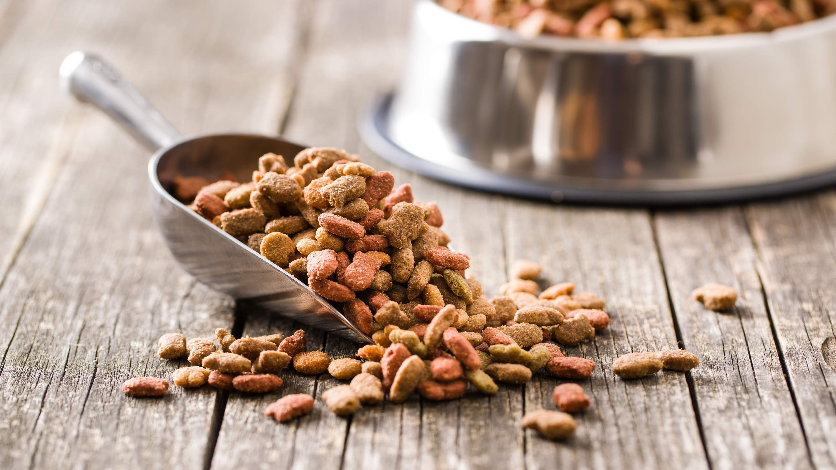
REVENUE MARKET SHARE BY SEGMENTS 2022
Kibble
Other Product Types
Product Type Segment
Specialized Pet Shops Online Channels Supermarkets/Hyper markets
Protein
Animal-derived Plant-derived Cereals and Cereals Derivatives
Distribution Channel
Ingredient Type

Slide 5

Global Dry Pet Food Market Revenue share for 2022
North America

Slide 6
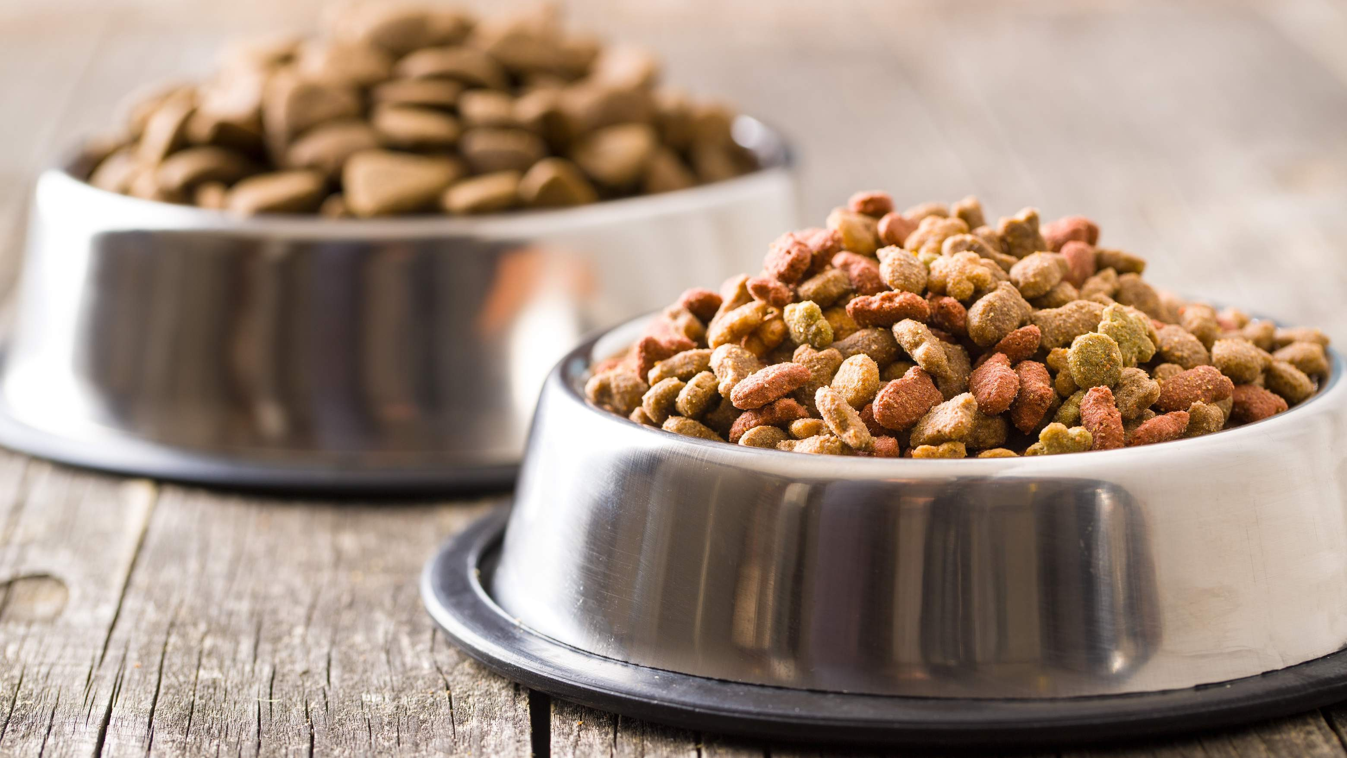
Drivers
The introduction of Tastefuls, a new line of cat food, was announced by General Mills, Inc. The item is specifically made to support with cognitive growth
Stringent Regulations Associate with Pet Food to Obstruct Market Growth
Restraints

Slide 7

AUTHOR'S PERSPECTIVE
The Global Dry Pet Food Market is witnessing significant growth in the near future.
Kibble is known for its convenience, long shelf life, and affordability. It is available in various shapes, sizes, and flavors to cater to pet preferences and dietary needs.
Other product types category encompass various dry pet food alternatives to kibble, including freeze-dried, dehydrated, air-dried, and freeze-dried raw pet foods.
Premium and natural ingredient-based products are gaining traction in both categories, reflecting the evolving preferences of pet owners.
Plant-derived proteins, such as soy, peas, and lentils, have gained popularity recently as more pet owners seek vegetarian or vegan options.
High-quality animal proteins are often the primary ingredient in premium pet foods, offering essential amino acids and fats that support pets' growth and energy needs.

Slide 8
KEY PLAYERS

Slide 9


Contact us
For Full Report
COGNITIVE MARKET RESEARCH
Tel: + 1 312 - 376 - 8303 | + 44 020 - 8123 - 0732
India: ( + 91 ) 983 - 496 - 8611
sales@ cognitivemarketresearch. com
Access the Full Report : http://tinyurl.com/4ntsuf3s
Please visit our website:
https://www.cognitivemarketresearch.com

