Slide 1

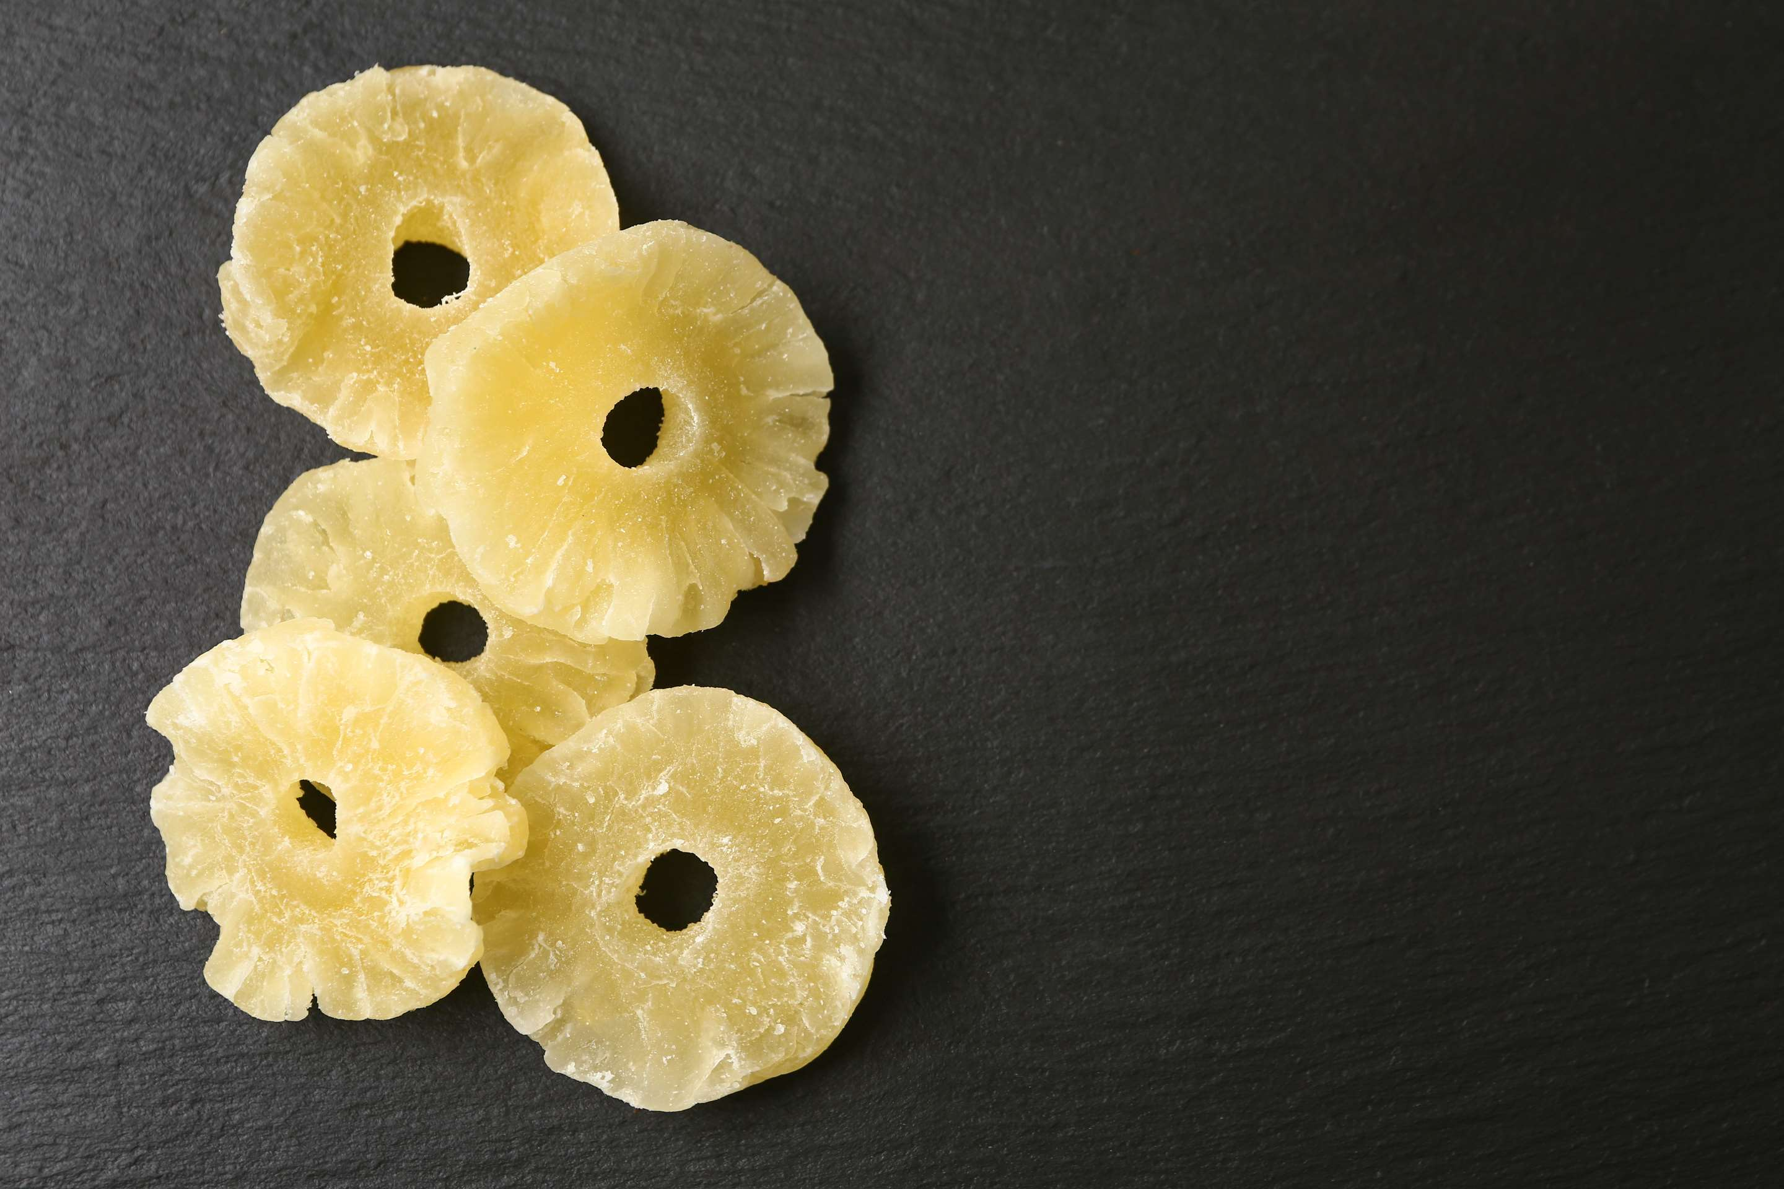
DRIED PINEAPPLE
MARKET REPORT
2024
Qualitative Analysis + Quantitative Analysis

Slide 2
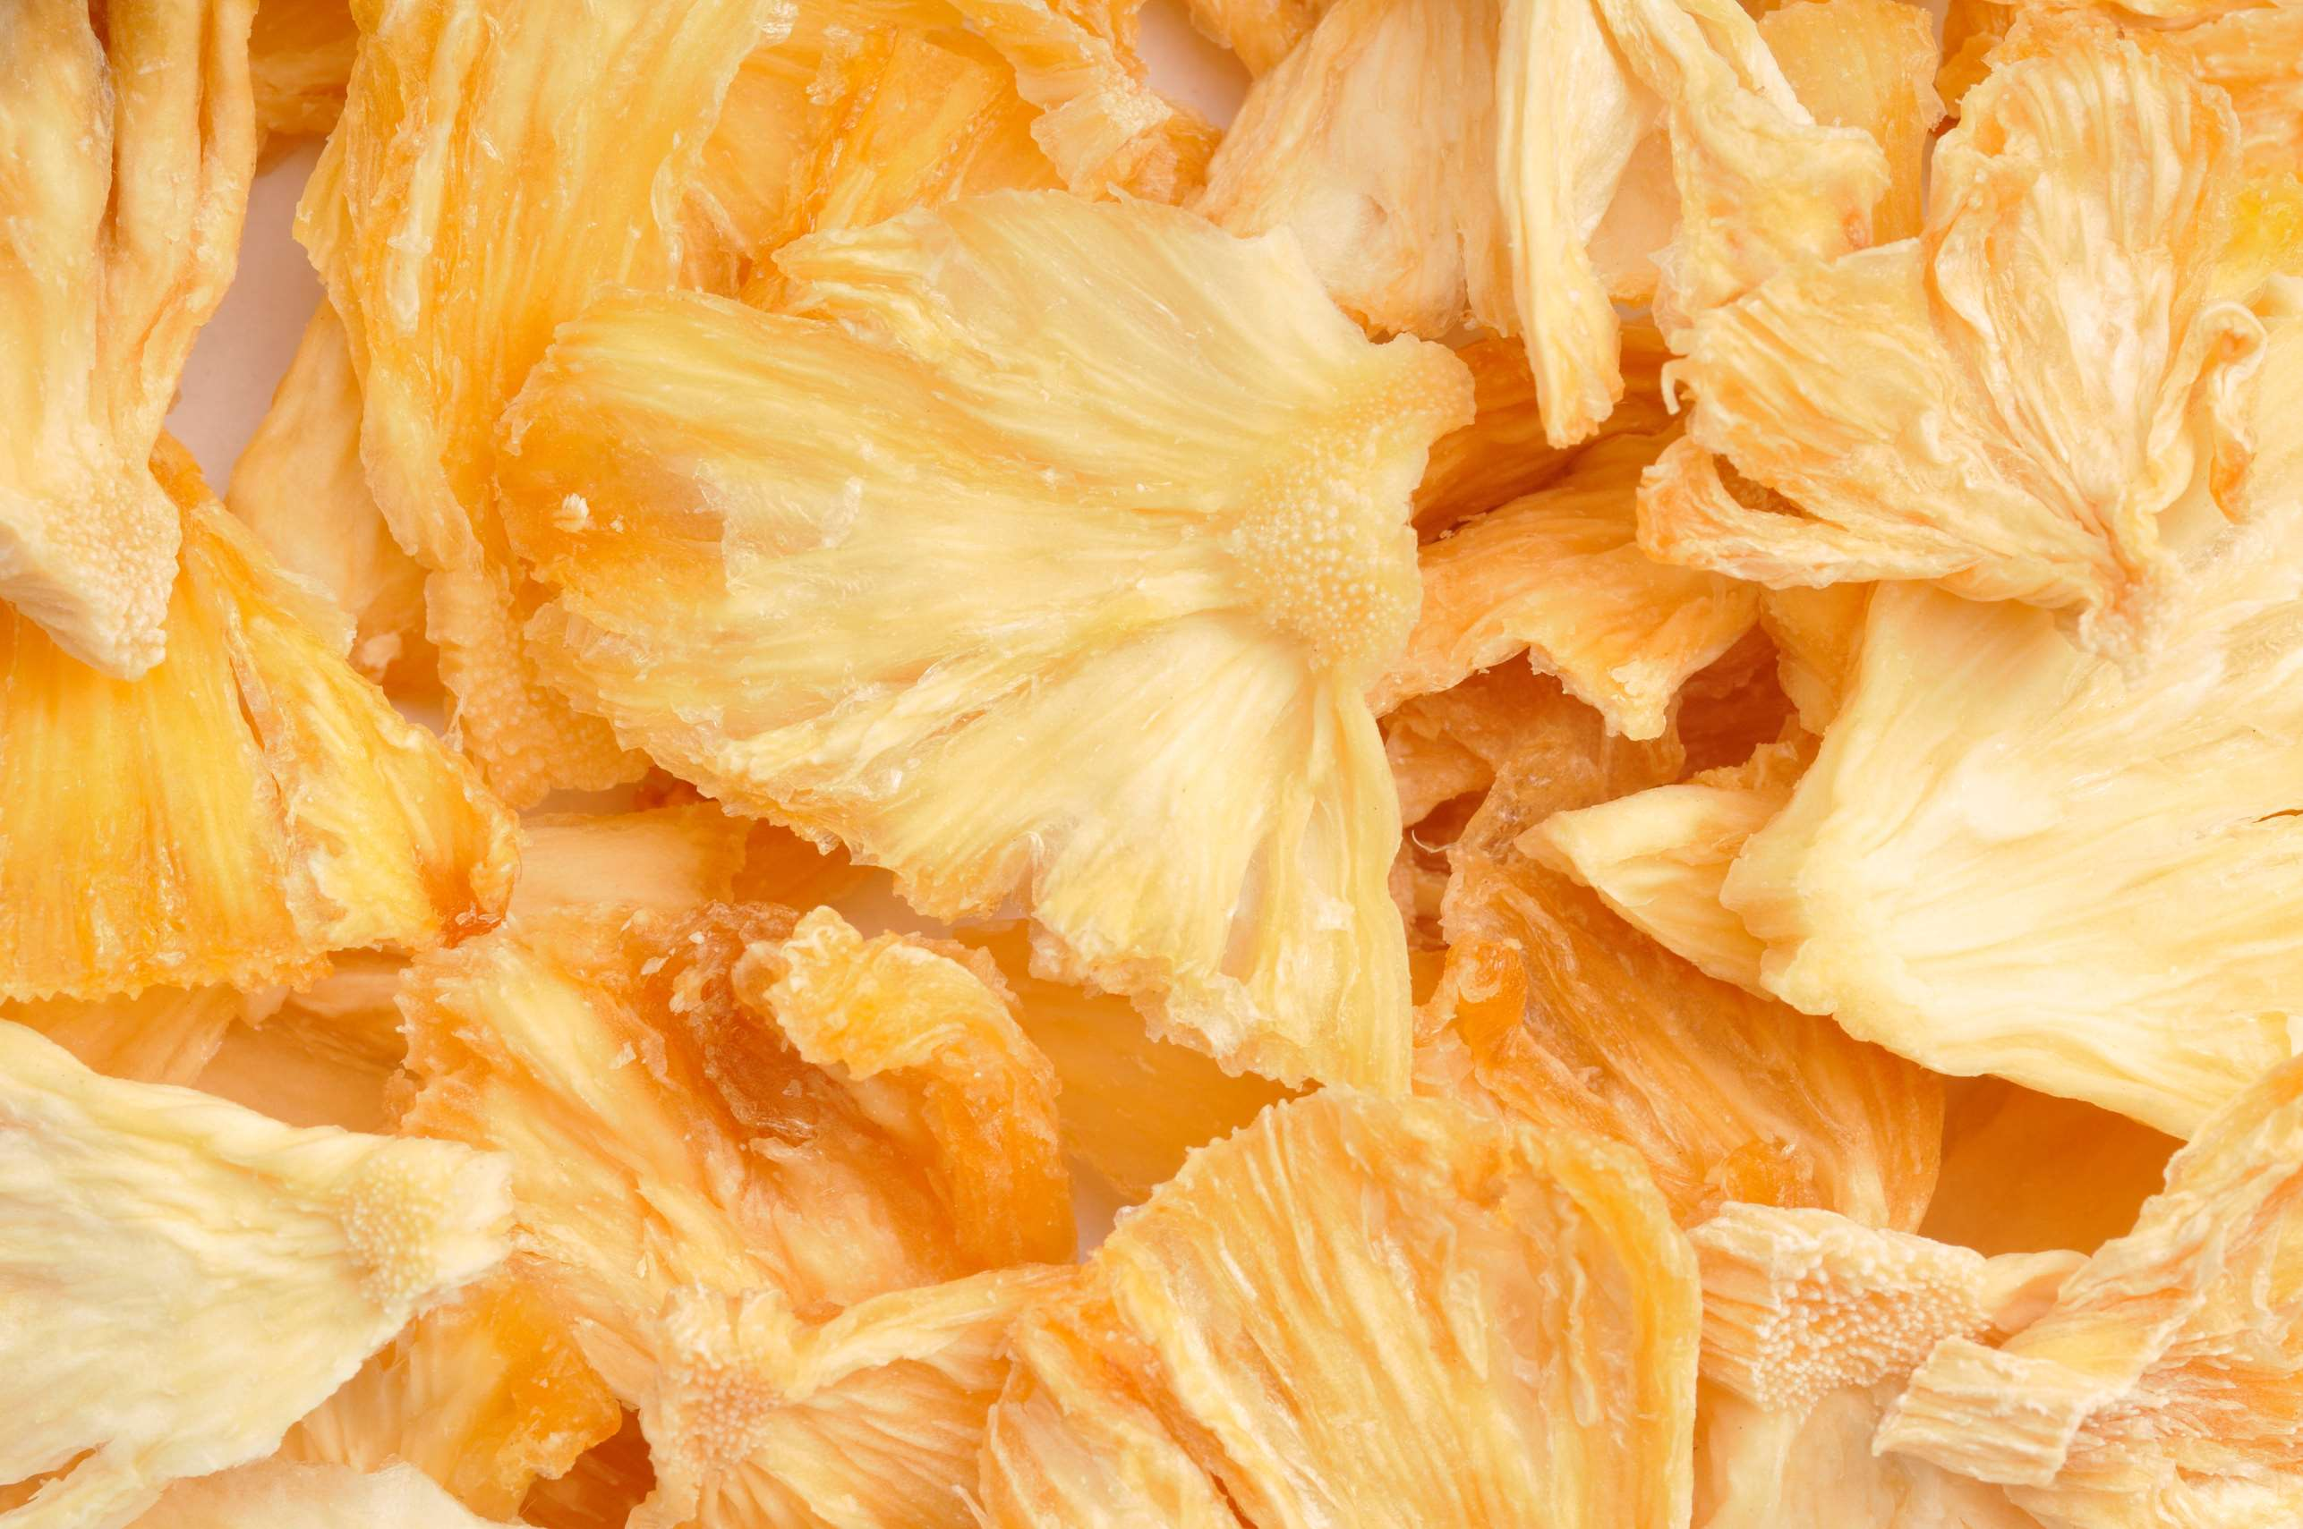
INTRODUCTION
The production, transport, and consumption of pineapple that has been dehydrated to eliminate moisture and increase shelf life are all included in the dry pineapple market. This market provides a flexible ingredient for a range of culinary products as well as a stand-alone snack choice, catering to both the retail and industrial sectors. The natural sweetness, flavor, and nutritional advantages of pineapple, such as fiber, vitamins, and minerals, are mostly preserved when it is dried. Customers looking for handy and healthful snack options like it because of its mobility, lengthy shelf life, and ease of use. A number of variables, including agricultural methods, weather patterns, processing technology developments, and changing customer tastes for natural and healthier foods, have an impact on the market.

Slide 3
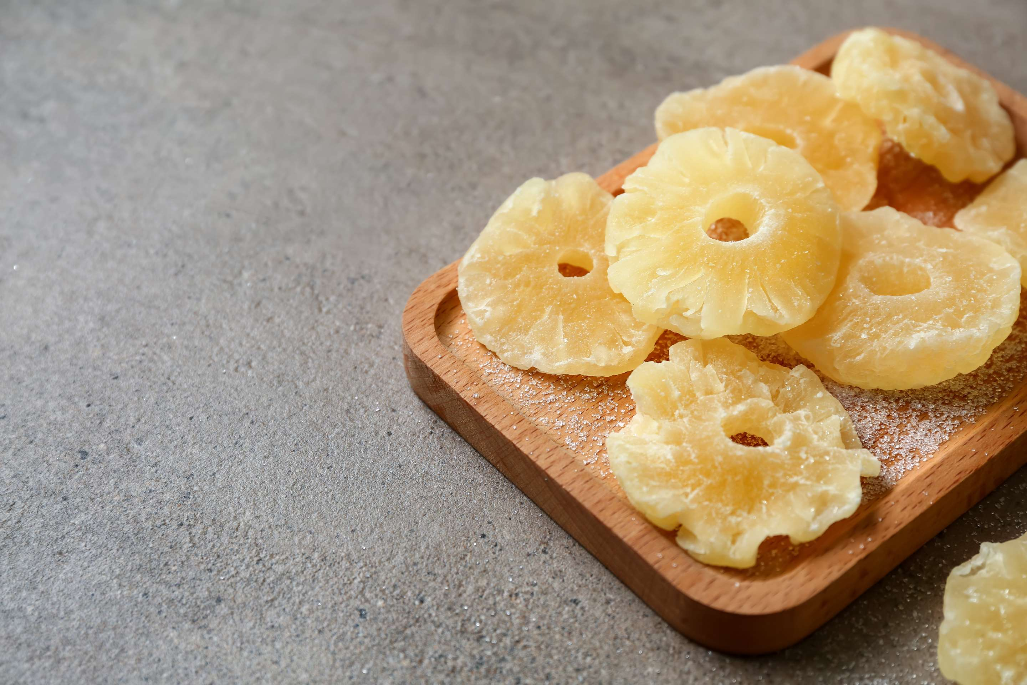

KEY INSIGHTS
CAGR
5.00%
2024- 2031

Slide 4
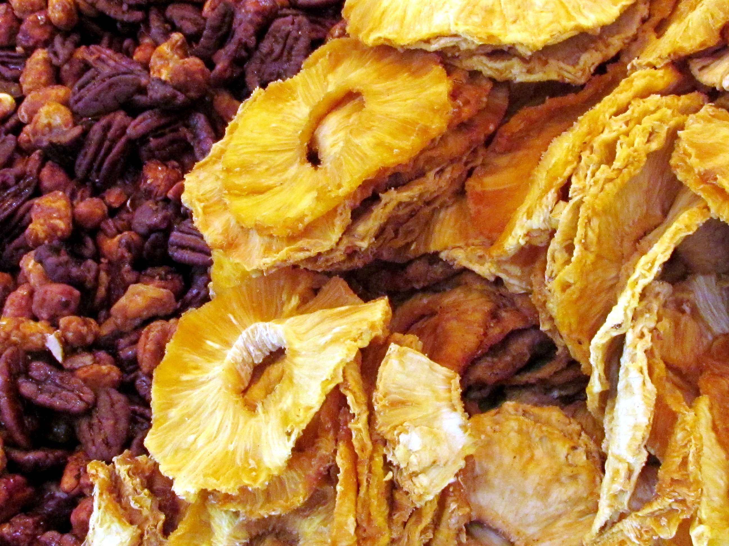
REVENUE MARKET SHARE BY SEGMENTS 2024
  No Sugar
  Traditional Sugar
Type Segment
  Dried Pineapple Piece
  Dried Pineapple Slice
Shape Segment
  Direct Consumption
  Candy and Snacks
  Food Industry
  Beverages
Application Segment
  Pouches
  Jars
  Containers
  Bulk
Packaging Segment
  Supermarkets & Hypermarkets
  Convenience Stores
  Online
Distribution Channel

Slide 5
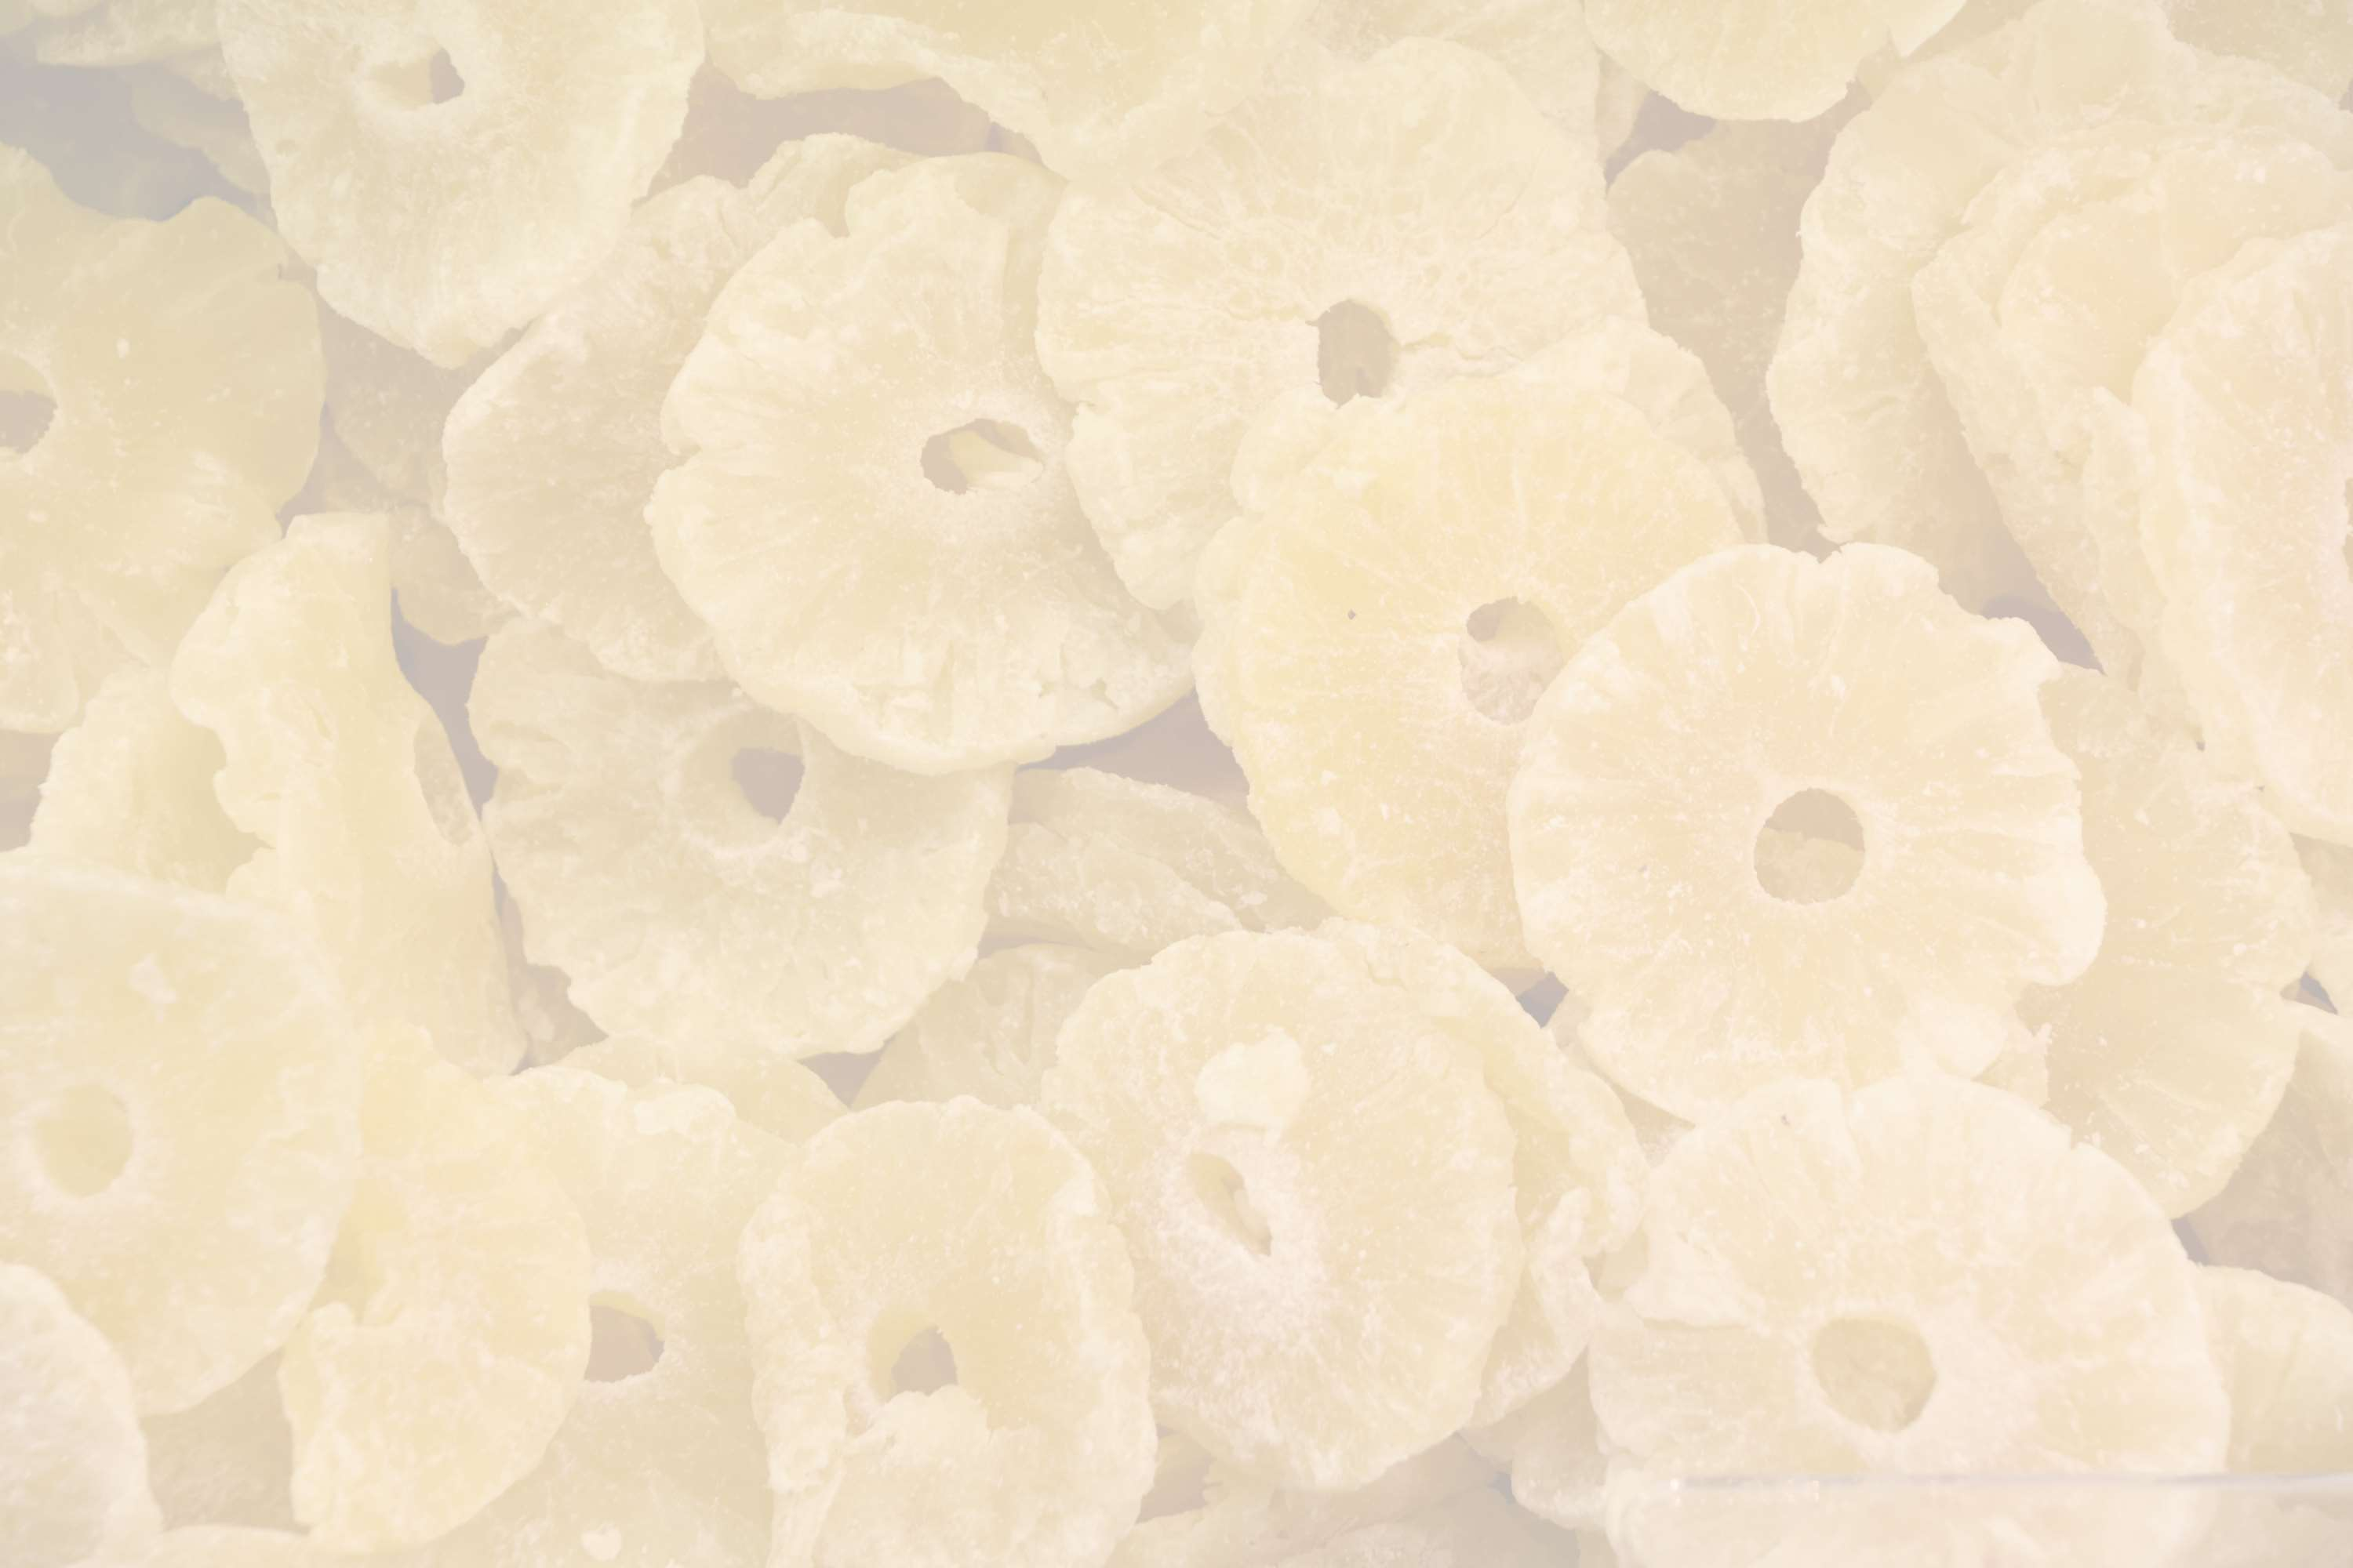
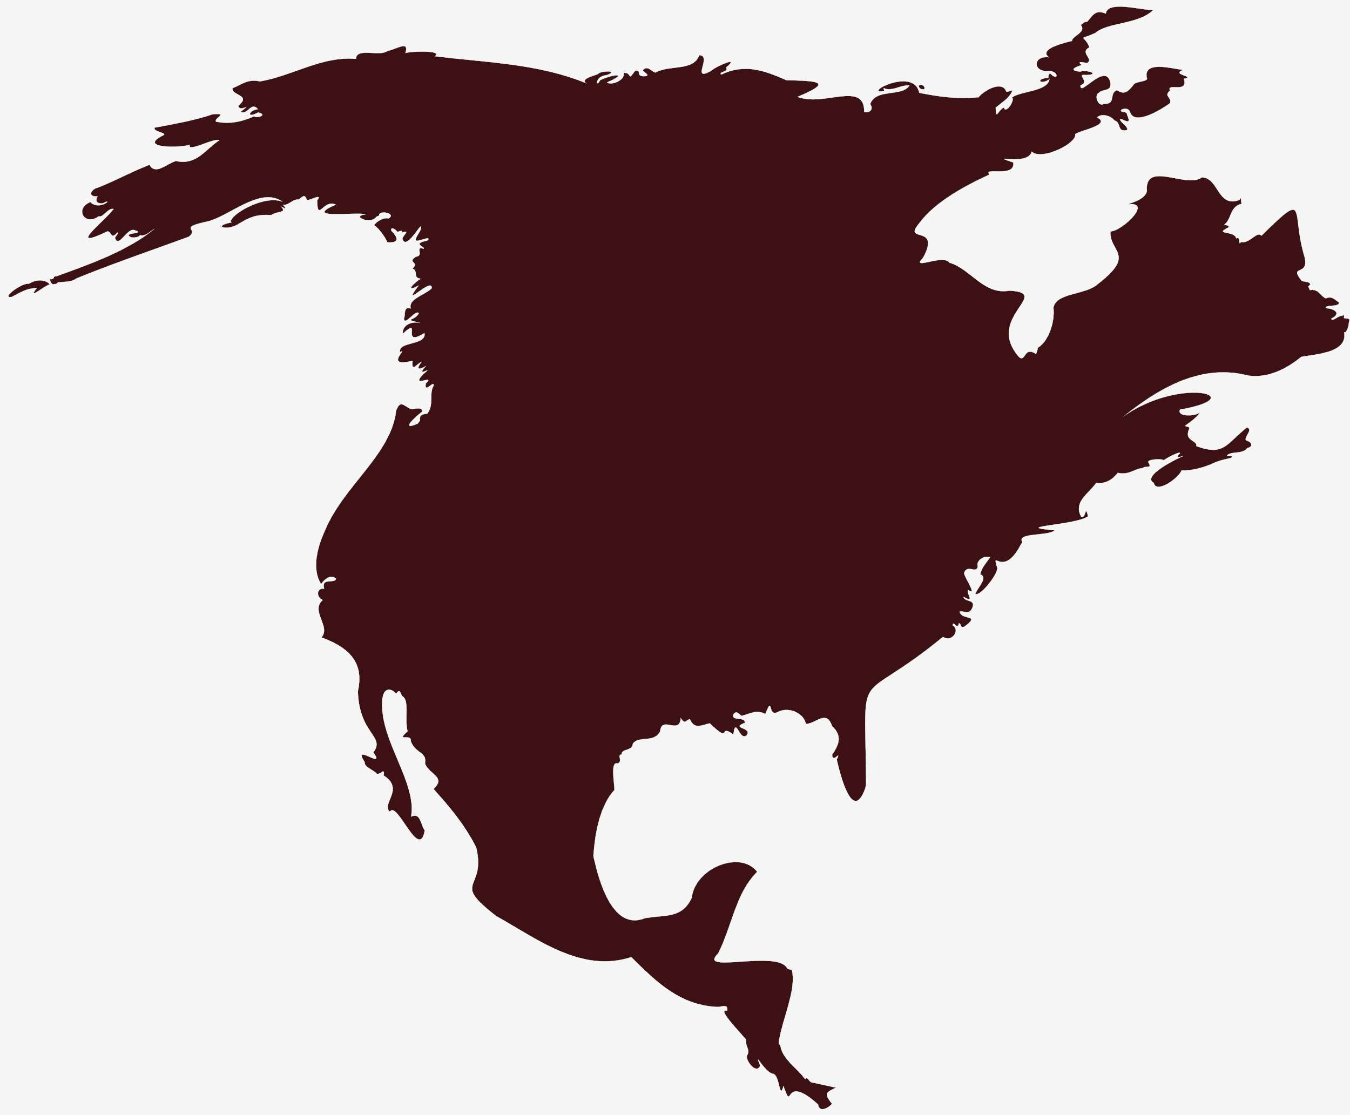
North America
40%
North America Dried Pineapple Market Revenue share for 2024 is 40%

Slide 6
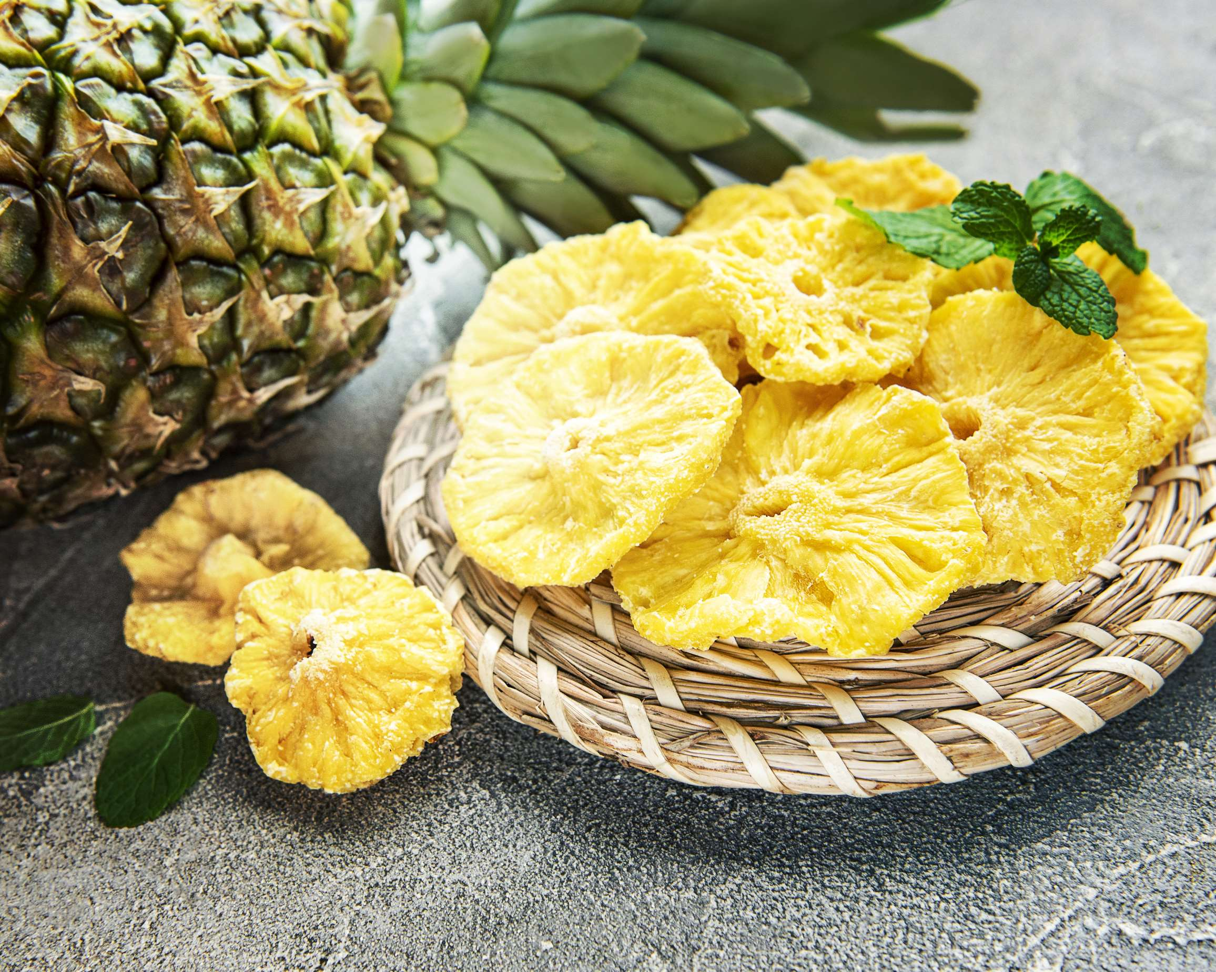
  Health-conscious consumers to Increase the Demand Globally
  Rising awareness of pineapple's benefits to Propel Market Growth
Drivers
Transportation and storage challenges to Limit the Sales
Restraints

Slide 7
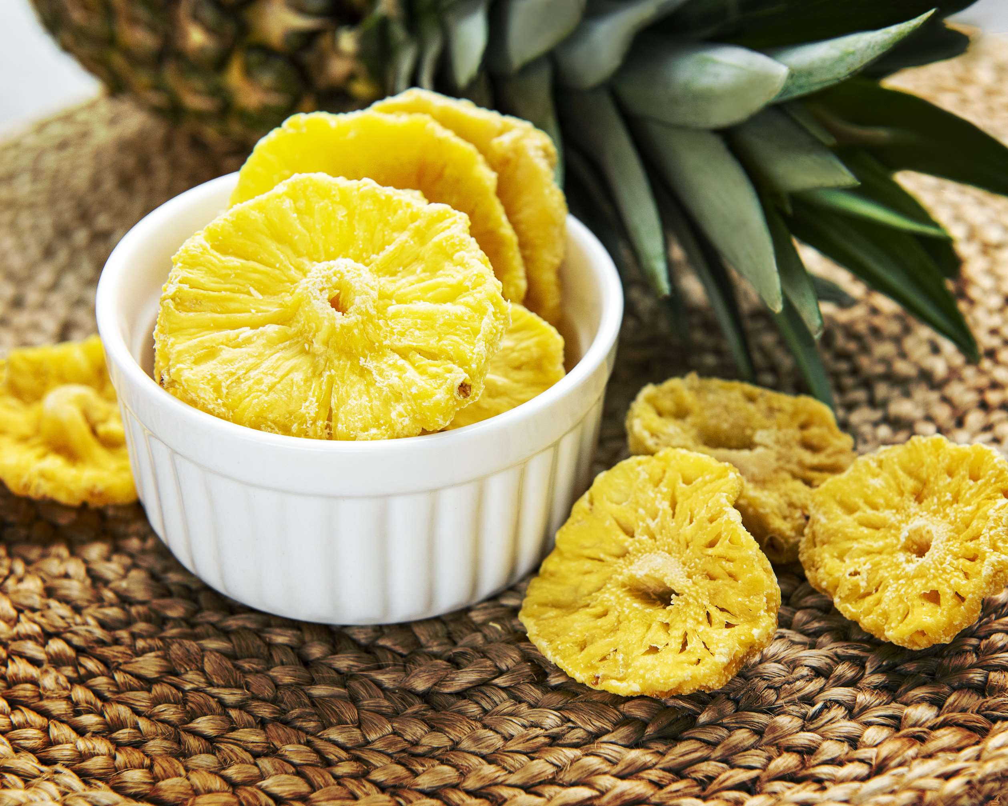
AUTHOR'S PERSPECTIVE
  The global Dried Pineapple market will expand significantly by 5.00% CAGR between 2024 to 2031.
  The dried pineapple market is expanding due to the rise of the candy and snacks industry, which is taking advantage of the fruit's inherent sweetness and health advantages to cater to changing customer tastes.
  Discovering novel and unusual flavors is becoming more and more popular.
  A year-round taste of the tropics is provided by dried pineapple.

Slide 8
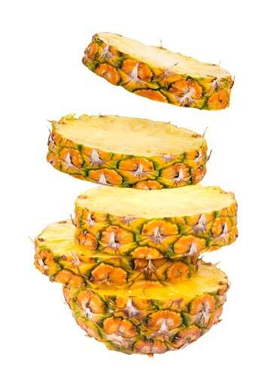










KEY PLAYERS

Slide 9


For Full Report
Contact us
COGNITIVE MARKET RESEARCH
Tel: +1 312-376-8303 | +44 020-8123-0732
India: (+91) 983-496-8611
sales@cognitivemarketresearch.com
Access the Full Report : https://tinyurl.com/mvmna2r4
Please visit our website:
https://www.cognitivemarketresearch.com

